Slide 1
Inner Product

Slide 2
Frobenius Norm

Slide 3
Matrix Multiplication

Slide 4
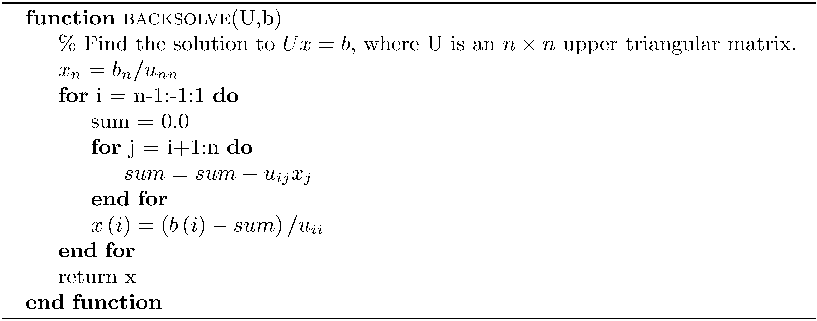
Back Substitution

Slide 5
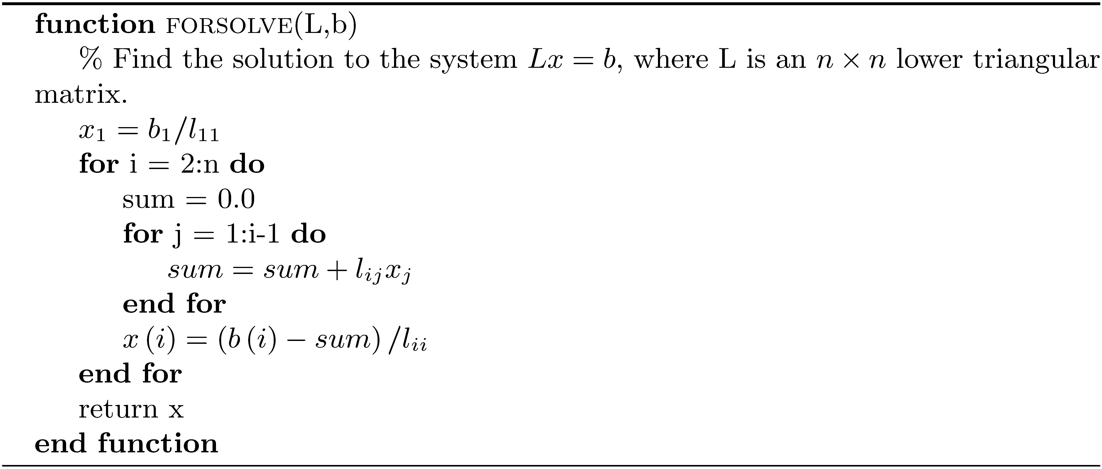
Forward Substitution

Slide 6
Thomas Algorithm

