Slide 1
LU Decomposition without Pivoting

Slide 2
LU Decomposition without Pivoting (concluded)

Slide 3
Gaussian Elimination with Partial Pivoting

Slide 4
Gaussian Elimination with Partial Pivoting (continued)

Slide 5
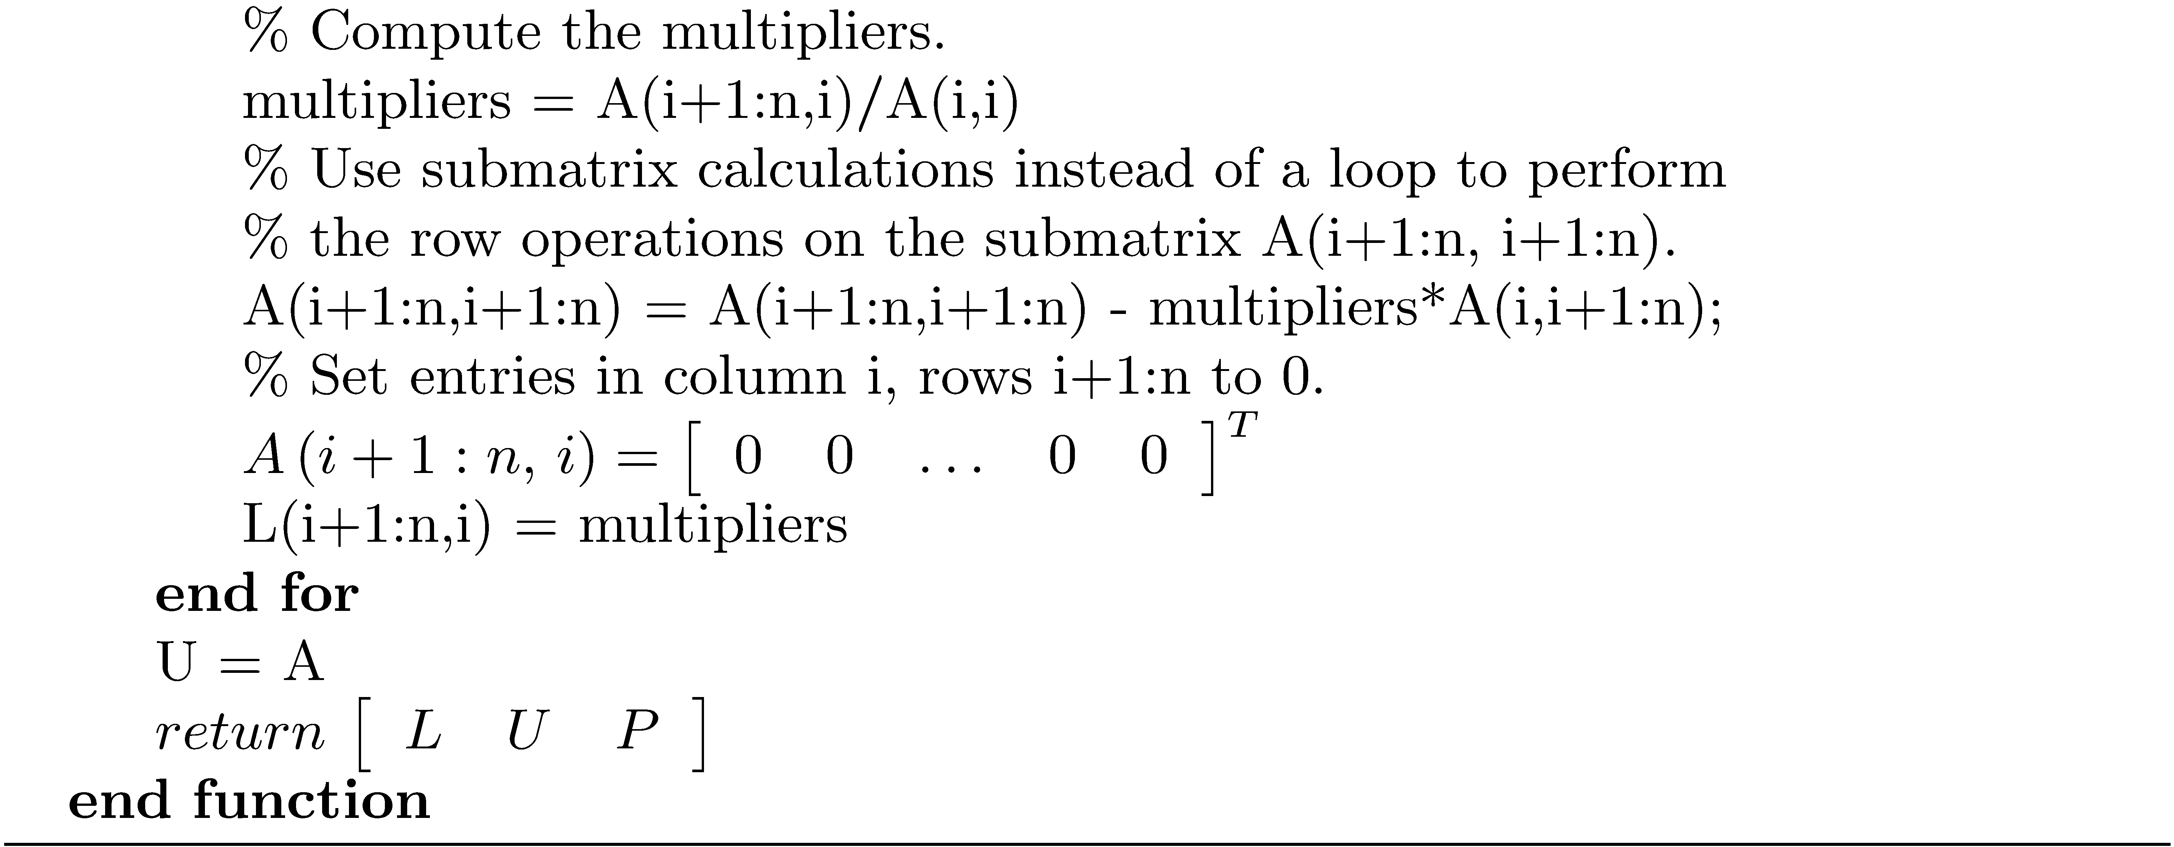
Gaussian Elimination with Partial Pivoting (concluded)

Slide 6
Solve an LU Factored System

Slide 7
Iterative Improvement

