Slide 1
LU Decomposition of a Tridiagonal Matrix

Slide 2
Solve a Factored Tridiagonal System

Slide 3
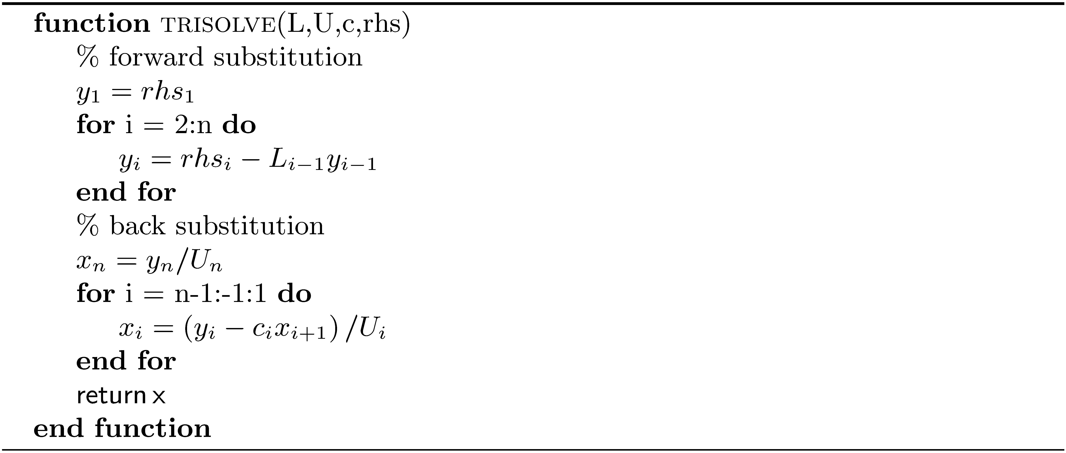
Solve a Factored Tridiagonal System (concluded)

Slide 4
Cholesky Decomposition

