Slide 1
Least-Squares Solution using the Normal Equations

Slide 2
Solving the Least-Squares Problem using the QR decomposition

Slide 3
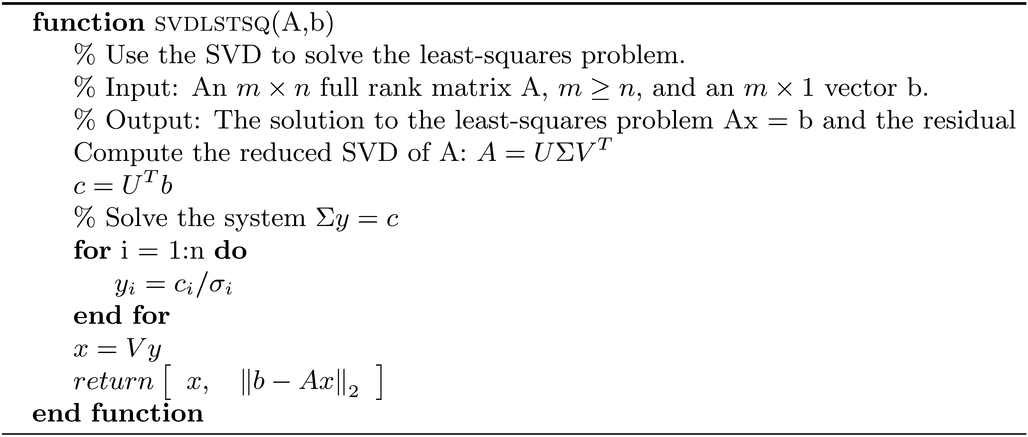
Solving the Least-Squares Problem using the SVD

Slide 4
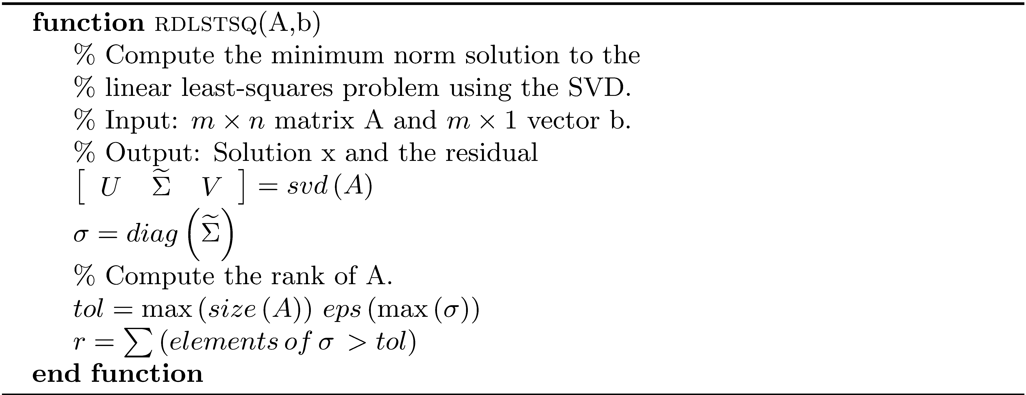
Minimum Norm Solution to the Least-Squares Problem

Slide 5
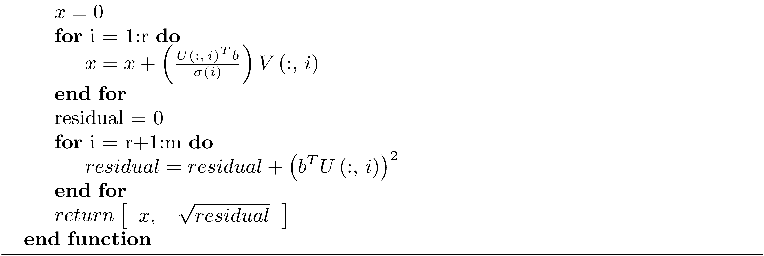
Minimum Norm Solution to the Least-Squares Problem (concluded)

Slide 6
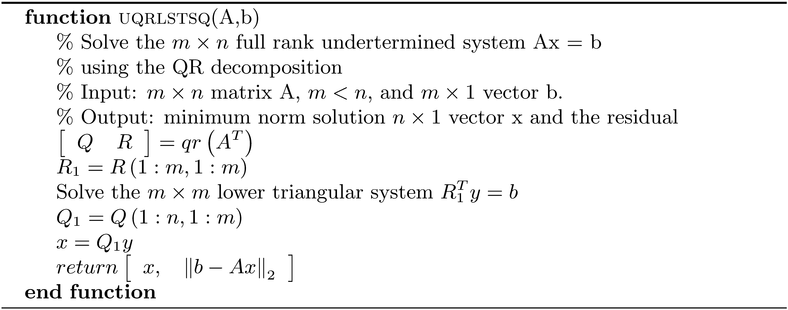
Solution of a Full Rank Underdetermined System using the QR Decomposition

