Slide 1
Product of a Givens Matrix J with a General Matrix A

Slide 2
Computing the Givens Parameters

Slide 3
Givens QR Decomposition

Slide 4
Zero Out 1st Column Matrix Entries using a Householder Reflection

Slide 5
Zero Out 1st Column Matrix Entries using a Householder Reflection (concluded)

Slide 6
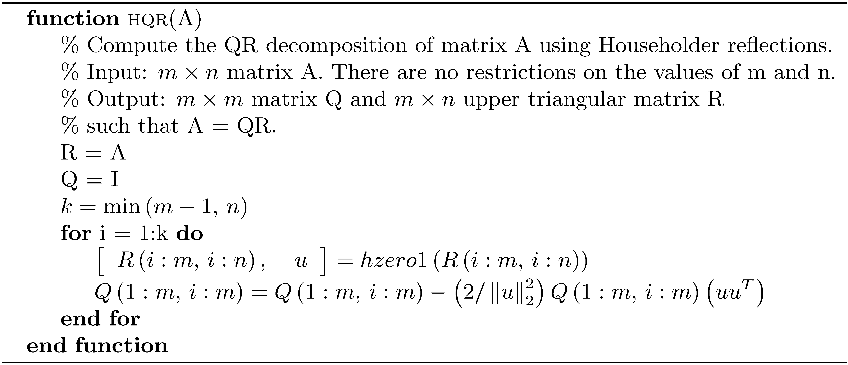
Computation of QR decomposition using Householder Reflections

