Slide 1
The Power Method

Slide 2
The Power Method (concluded)

Slide 3
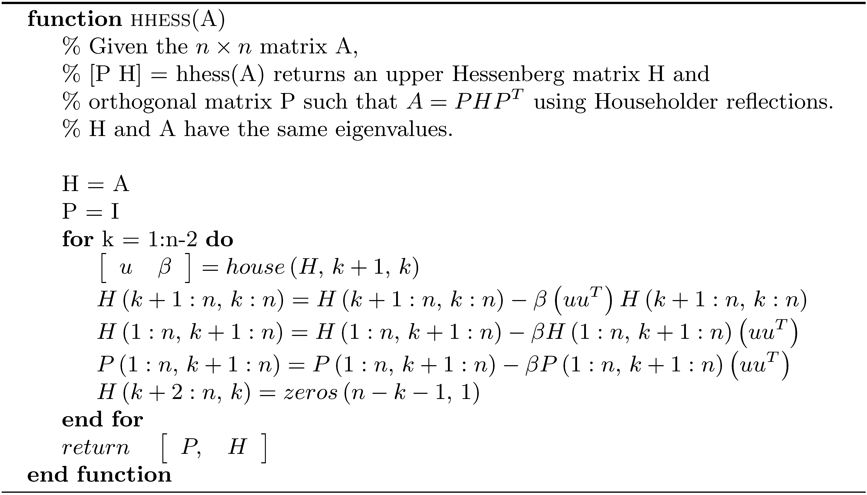
Transformation to Upper Hessenberg Form

Slide 4
Unshifted Hessenberg QR iteration

Slide 5
Unshifted Hessenberg QR iteration (concluded)

Slide 6
Single shift using the Francis Iteration of Degree One

Slide 7
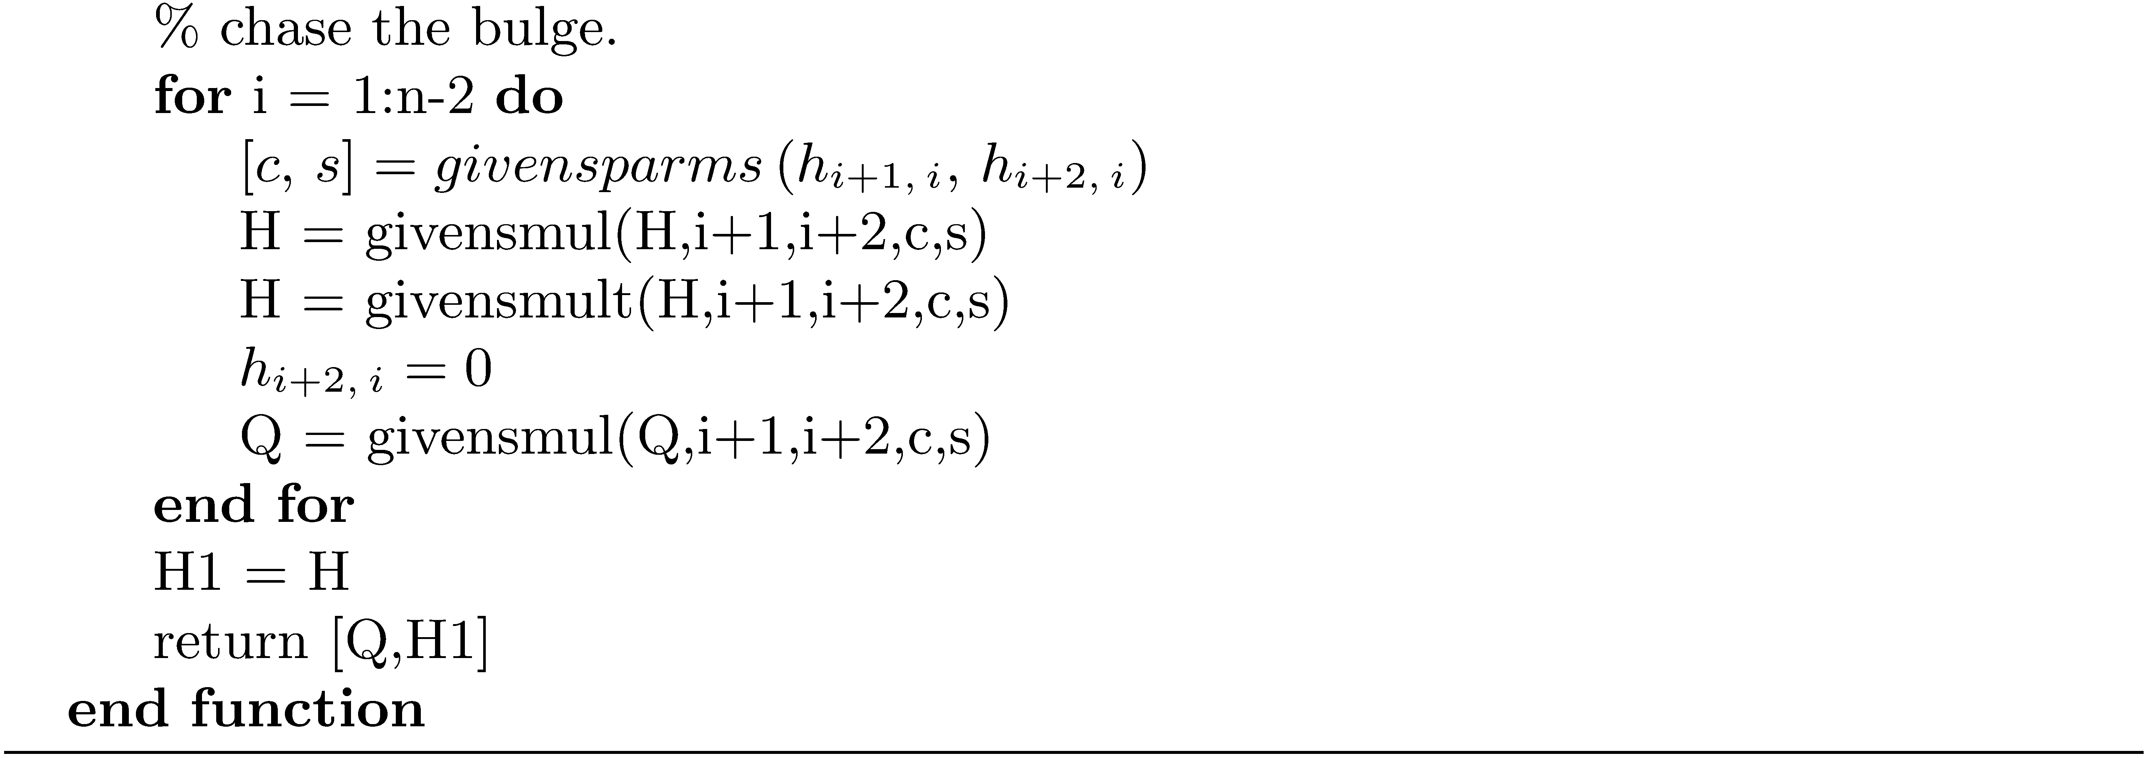
Single Shift using the Francis Iteration of Degree One (concluded)

Slide 8
Implicit Double Shift QR

Slide 9
Implicit Double Shift QR (continued)

Slide 10
Implicit Double Shift QR (concluded)

Slide 11
Inverse Iteration to Find Eigenvector of an Upper Hessenberg Matrix

Slide 12
Inverse Iteration to Find Eigenvector of an Upper Hessenberg Matrix (concluded)

Slide 13
Compute Eigenvalue Condition Numbers

