Slide 1
Jacobi Method for the Real Symmetric Matrix Eigenproblem

Slide 2
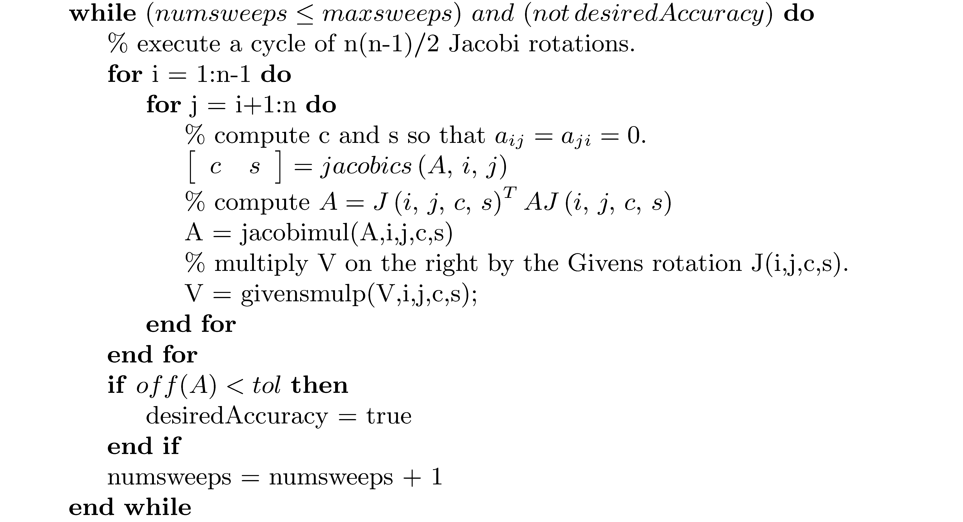
Jacobi Method for the Real Symmetric Matrix Eigenproblem (continued)

Slide 3
Jacobi Method for the real Symmetric Matrix Eigenproblem(concluded)

Slide 4
Orthogonal Reduction of a Symmetric Matrix to Tridiagonal Form

Slide 5
Orthogonal Reduction of a Symmetric Matrix to Tridiagonal Form (concluded)

