Slide 1
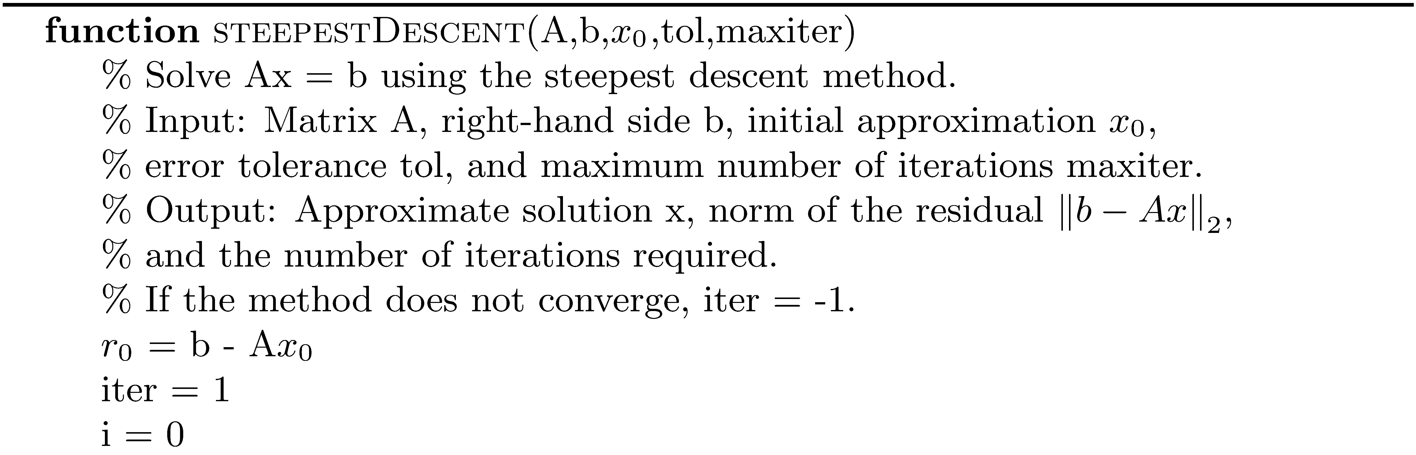
Steepest Descent

Slide 2
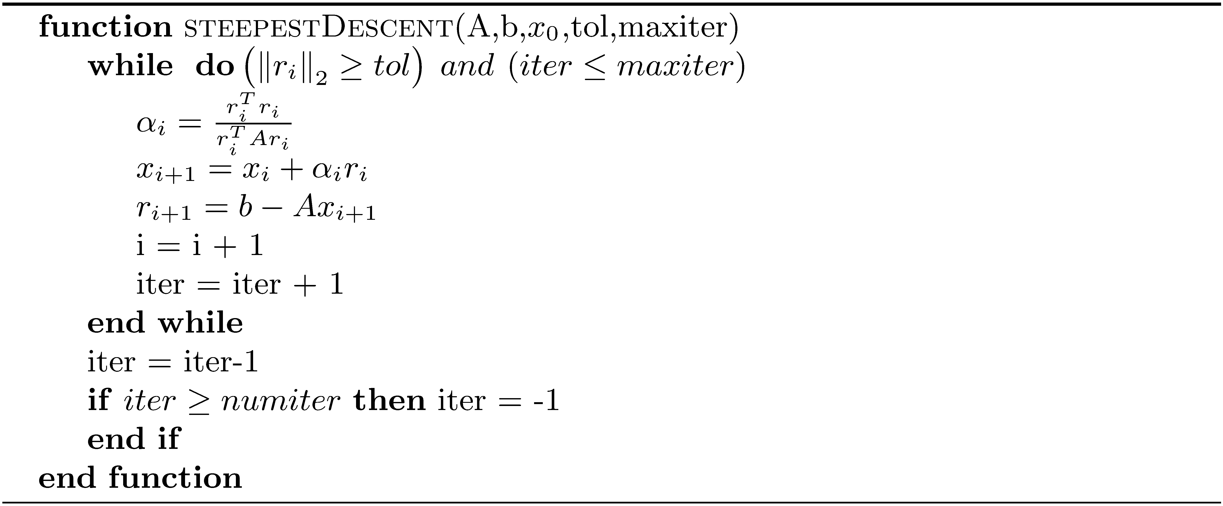
Steepest Descent (concluded)

Slide 3
Conjugate Gradient

Slide 4
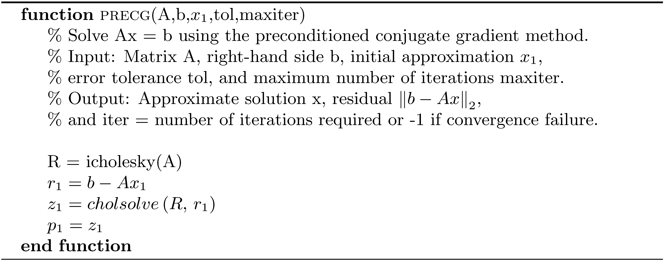
Preconditioned Conjugate Gradient

Slide 5
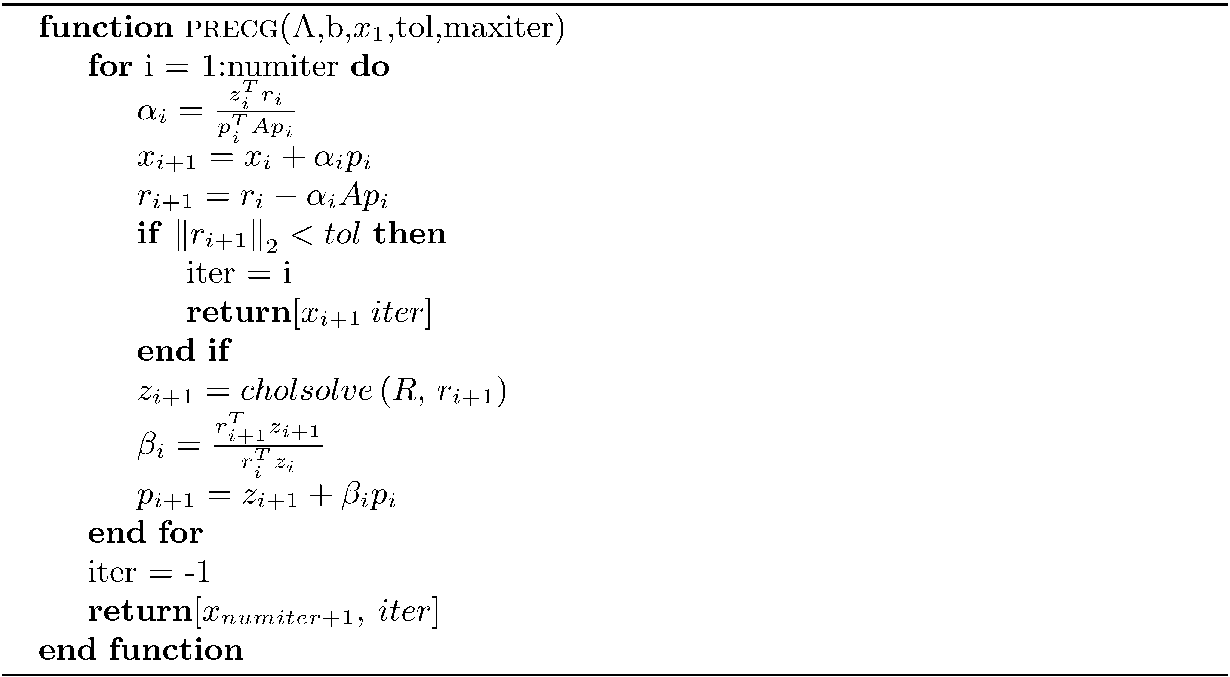
Preconditioned Conjugate Gradient (concluded)

Slide 6
Arnoldi Process

Slide 7
GMRES

Slide 8
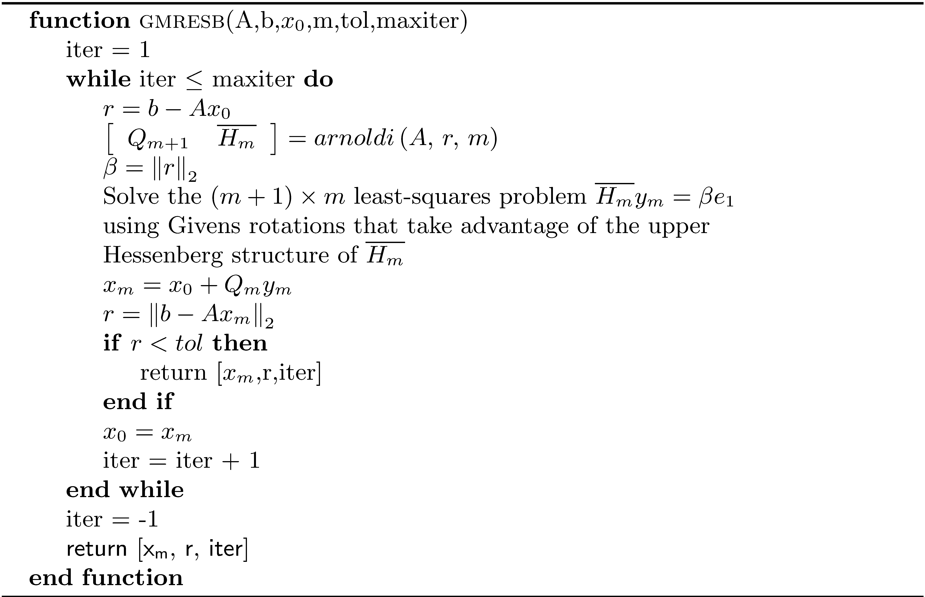
GMRES (concluded)

Slide 9
Incomplete LU Decomposition

Slide 10
Incomplete LU Decomposition (concluded)

Slide 11
Lanczos Process

Slide 12
MINRES

Slide 13
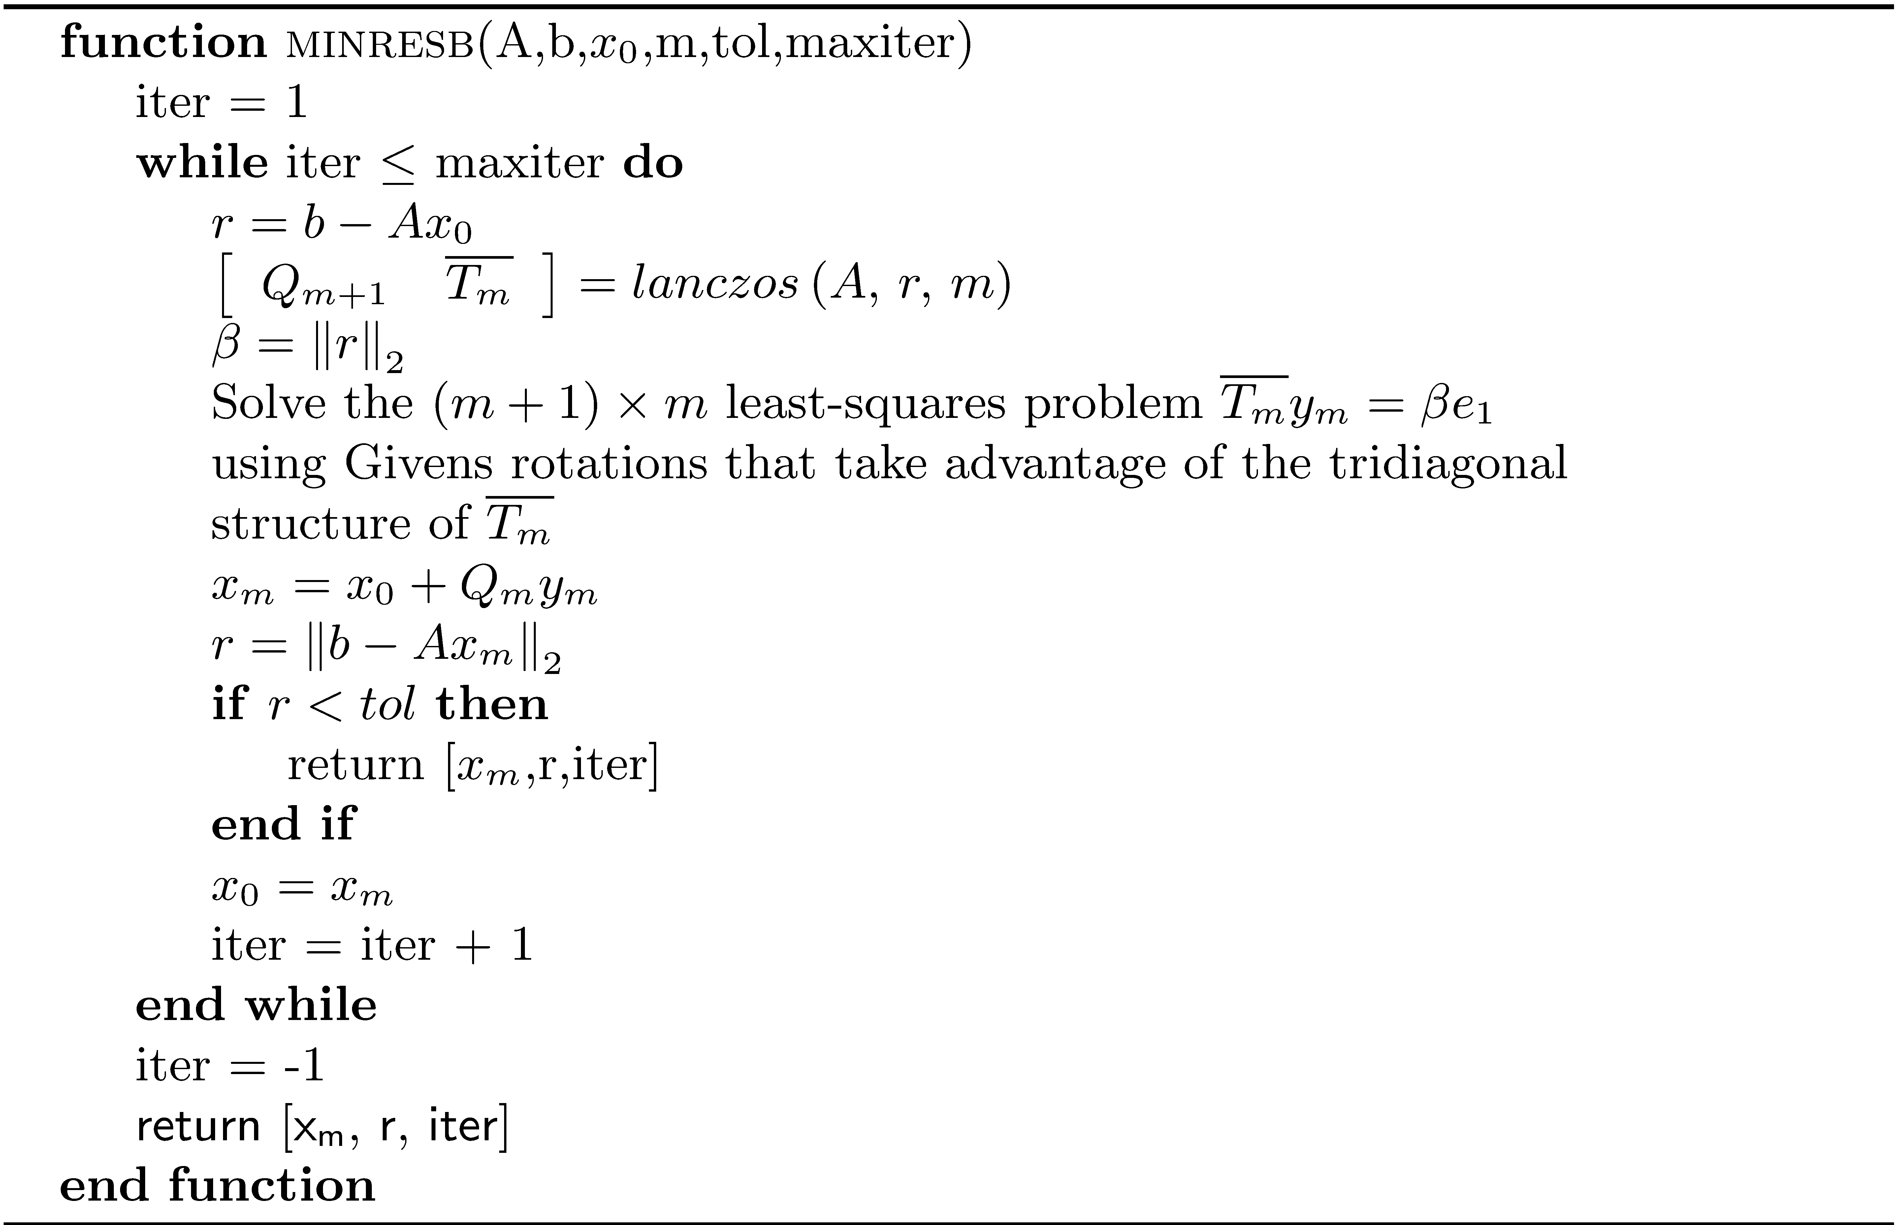
MINRES (concluded)

