Slide 1
The Implicitly Restarted Arnoldi Method

Slide 2
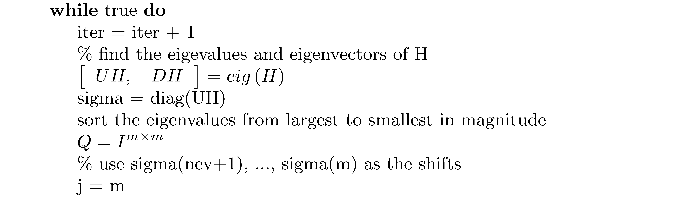
The Implicitly Restarted Arnoldi Method (continued)

Slide 3
The Implicitly Restarted Arnoldi Method (continued)

Slide 4
The Implicitly Restarted Arnoldi Method (continued)

Slide 5
The Implicitly Restarted Arnoldi Method (concluded)

