Slide 1
One-Sided Jacobi

Slide 2
One-Sided Jacobi (continued)

Slide 3
One-Sided Jacobi (continued)

Slide 4
One-Sided Jacobi (continued)

Slide 5
One-Sided Jacobi (continued)

Slide 6
One-Sided Jacobi (concluded)

Slide 7
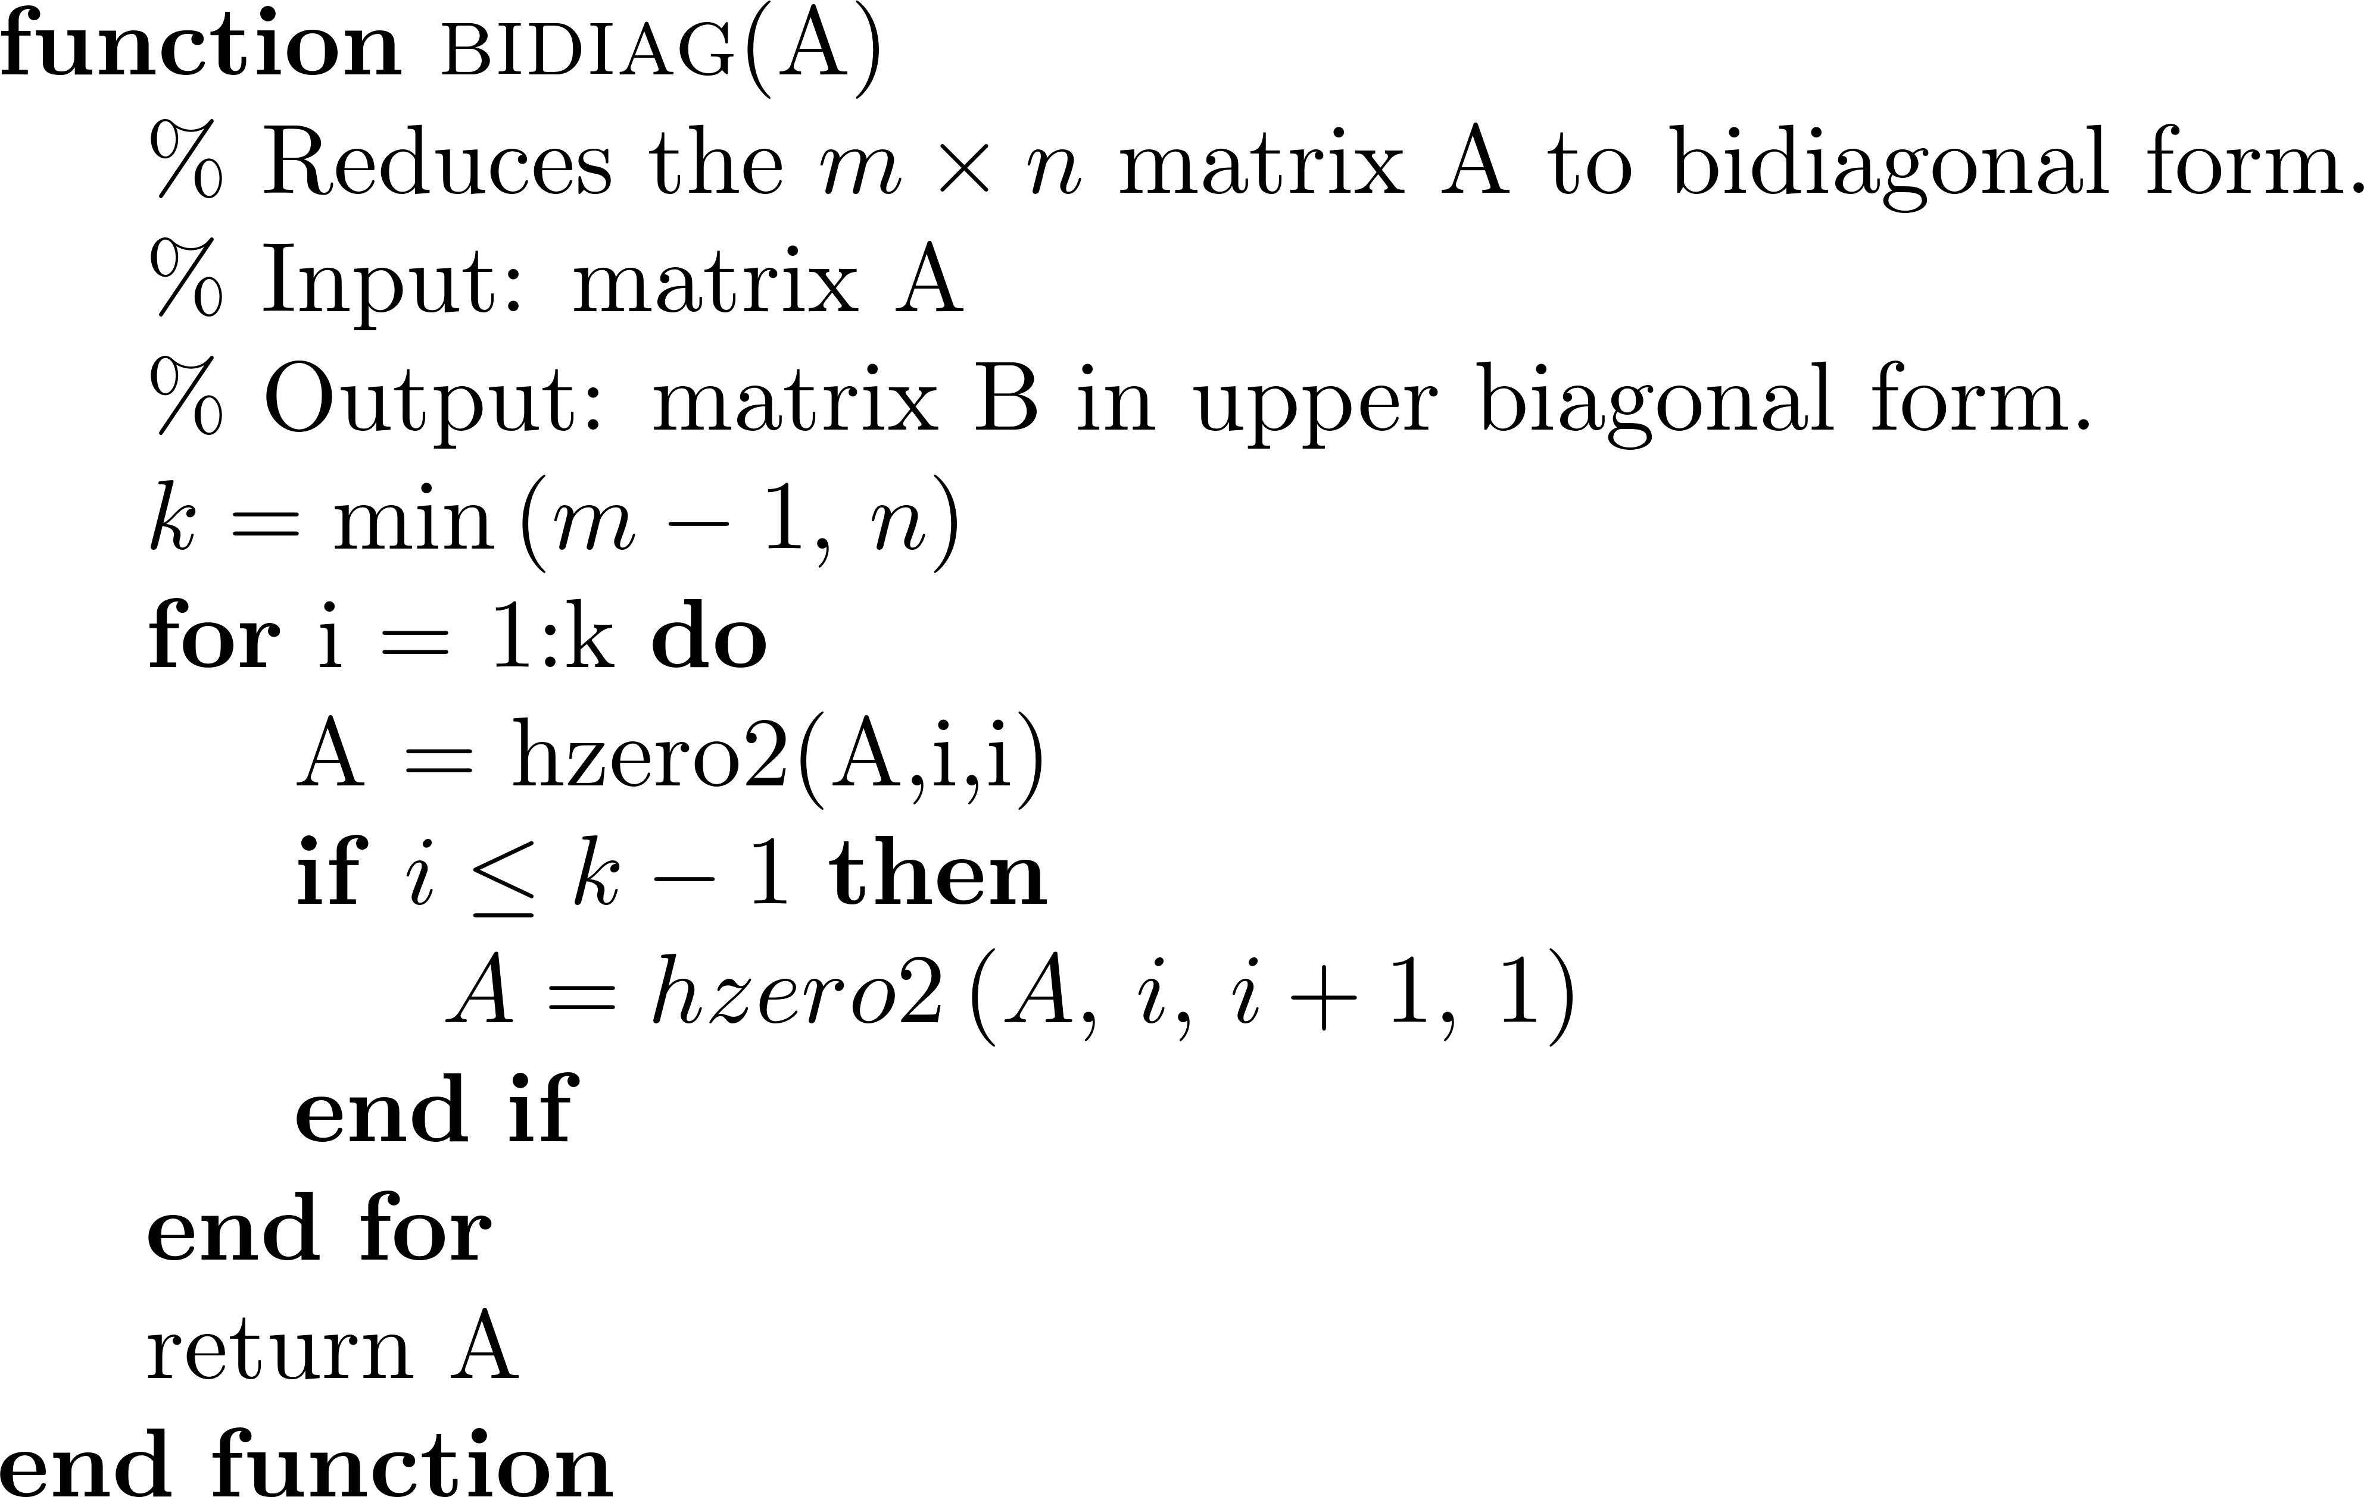
Reduction of a Matrix to Upper Bidiagonal Form

Slide 8
Demmel and Kahan Zero-shift QR Downward Sweep

Slide 9
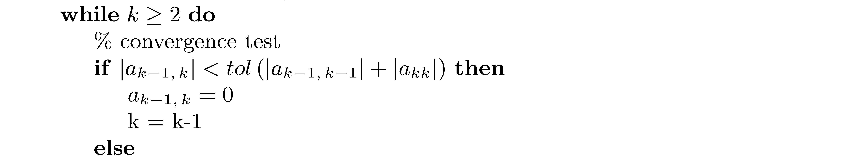
Demmel and Kahan Zero-shift QR Downward Sweep (continued)

Slide 10
Demmel and Kahan Zero-shift QR Downward Sweep (concluded)

