Slide 1
Chapter 10
Regulation of Cell Proliferation by Receptor Tyrosine Protein Kinases

Slide 2
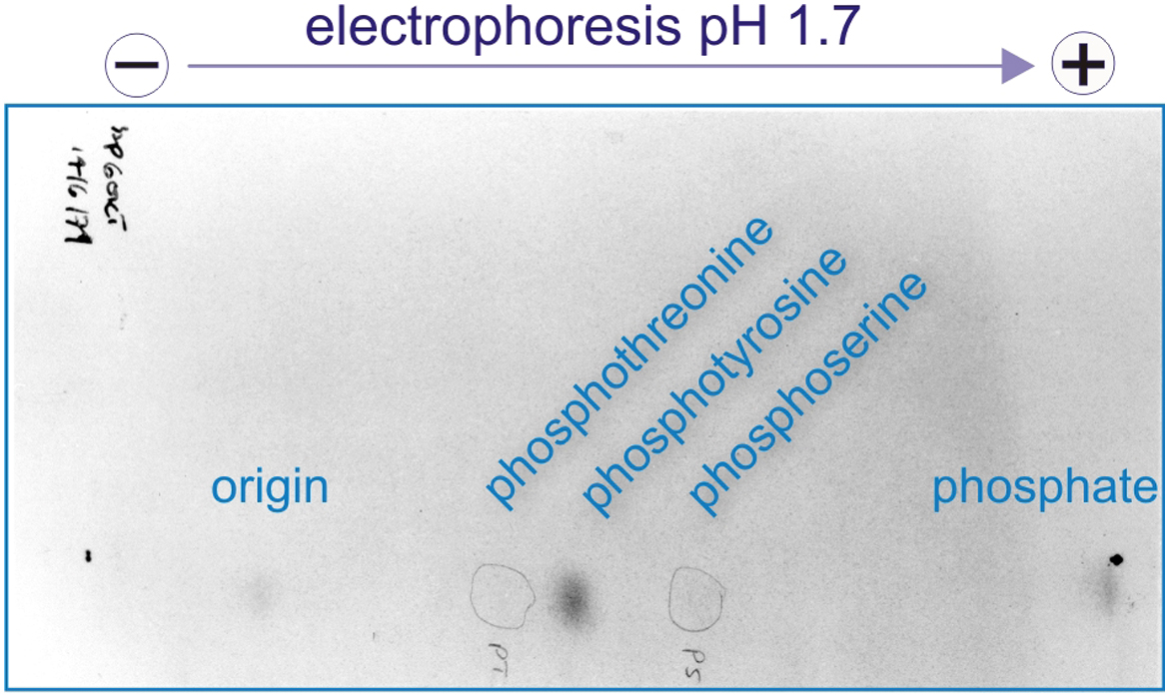
Figure 10.01

Slide 3
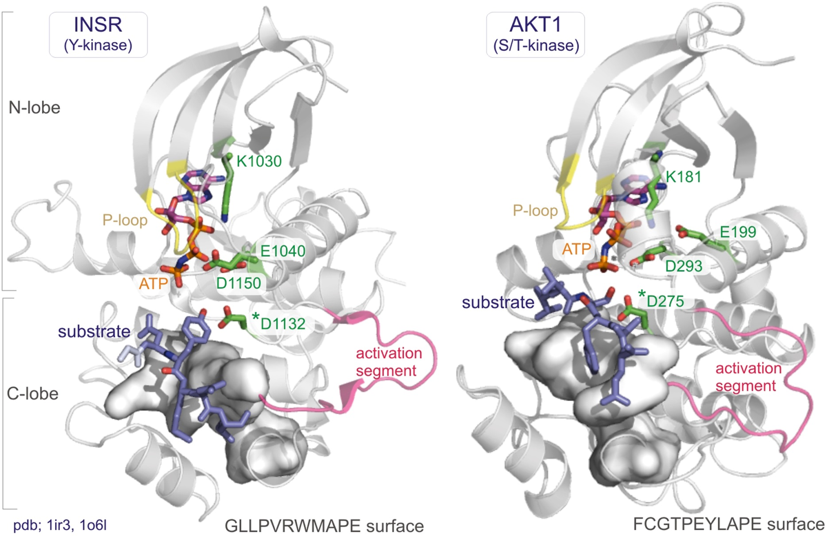
Figure 10.02

Slide 4
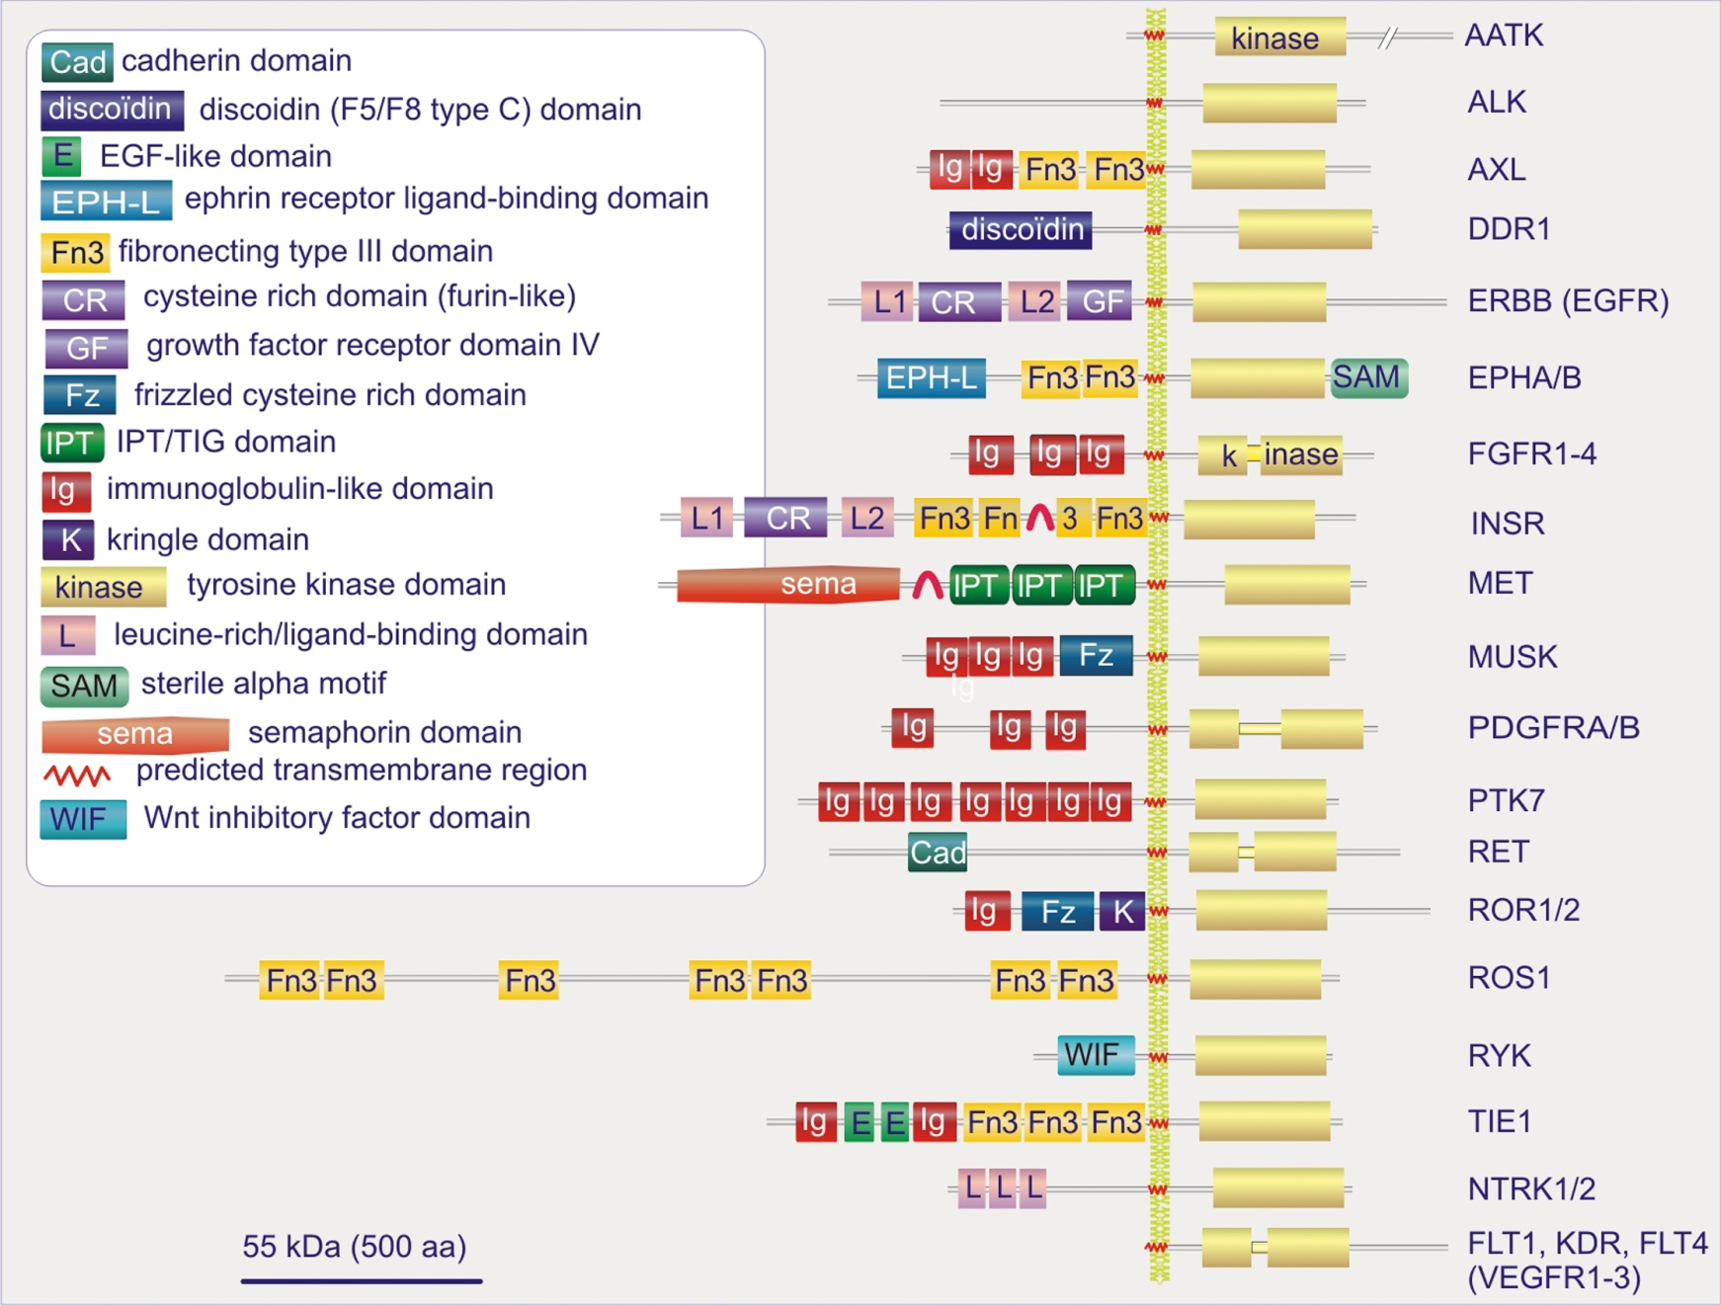
Figure 10.03

Slide 5
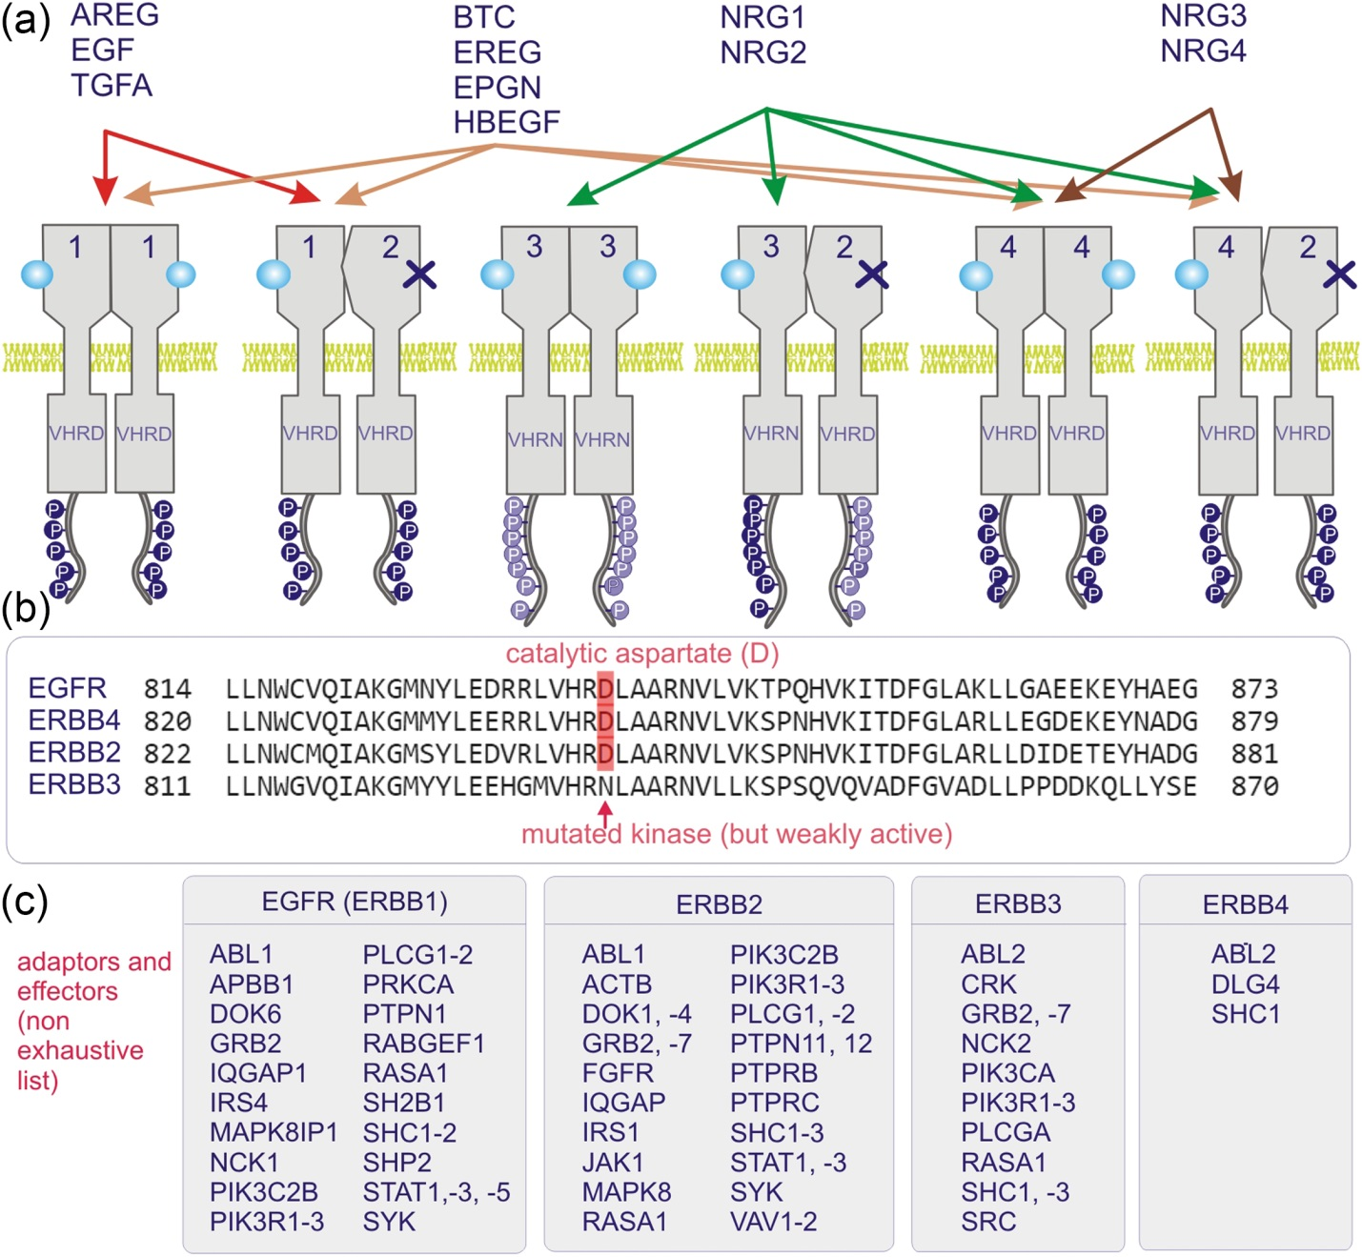
Figure 10.04

Slide 6
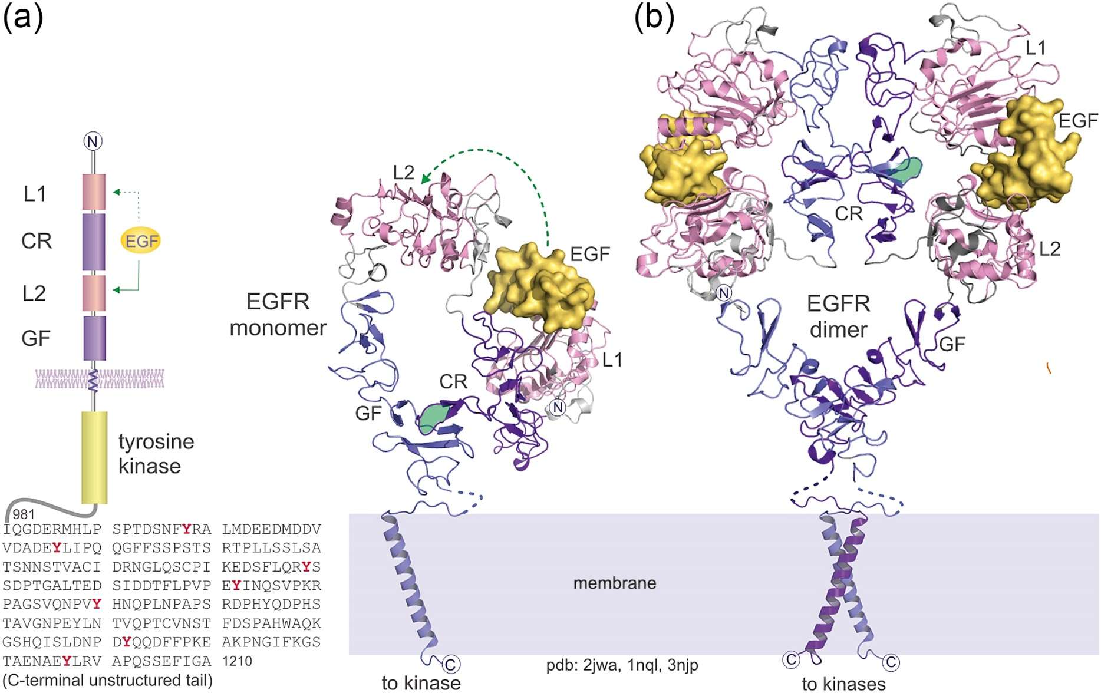
Figure 10.05

Slide 7
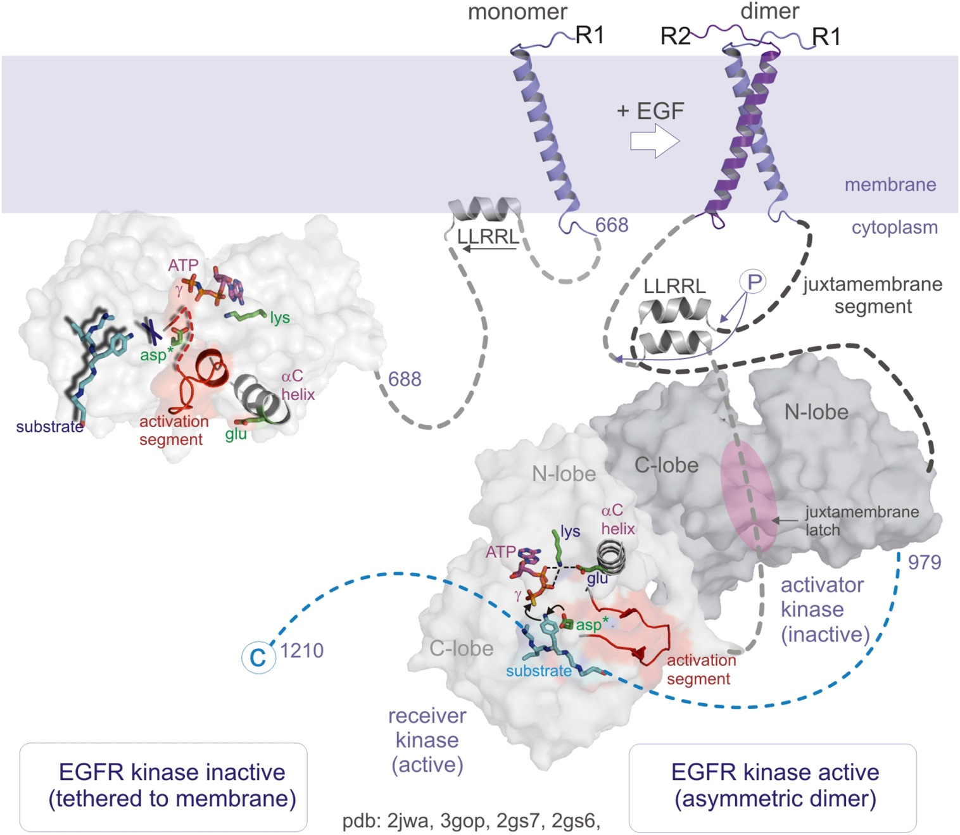
Figure 10.06

Slide 8
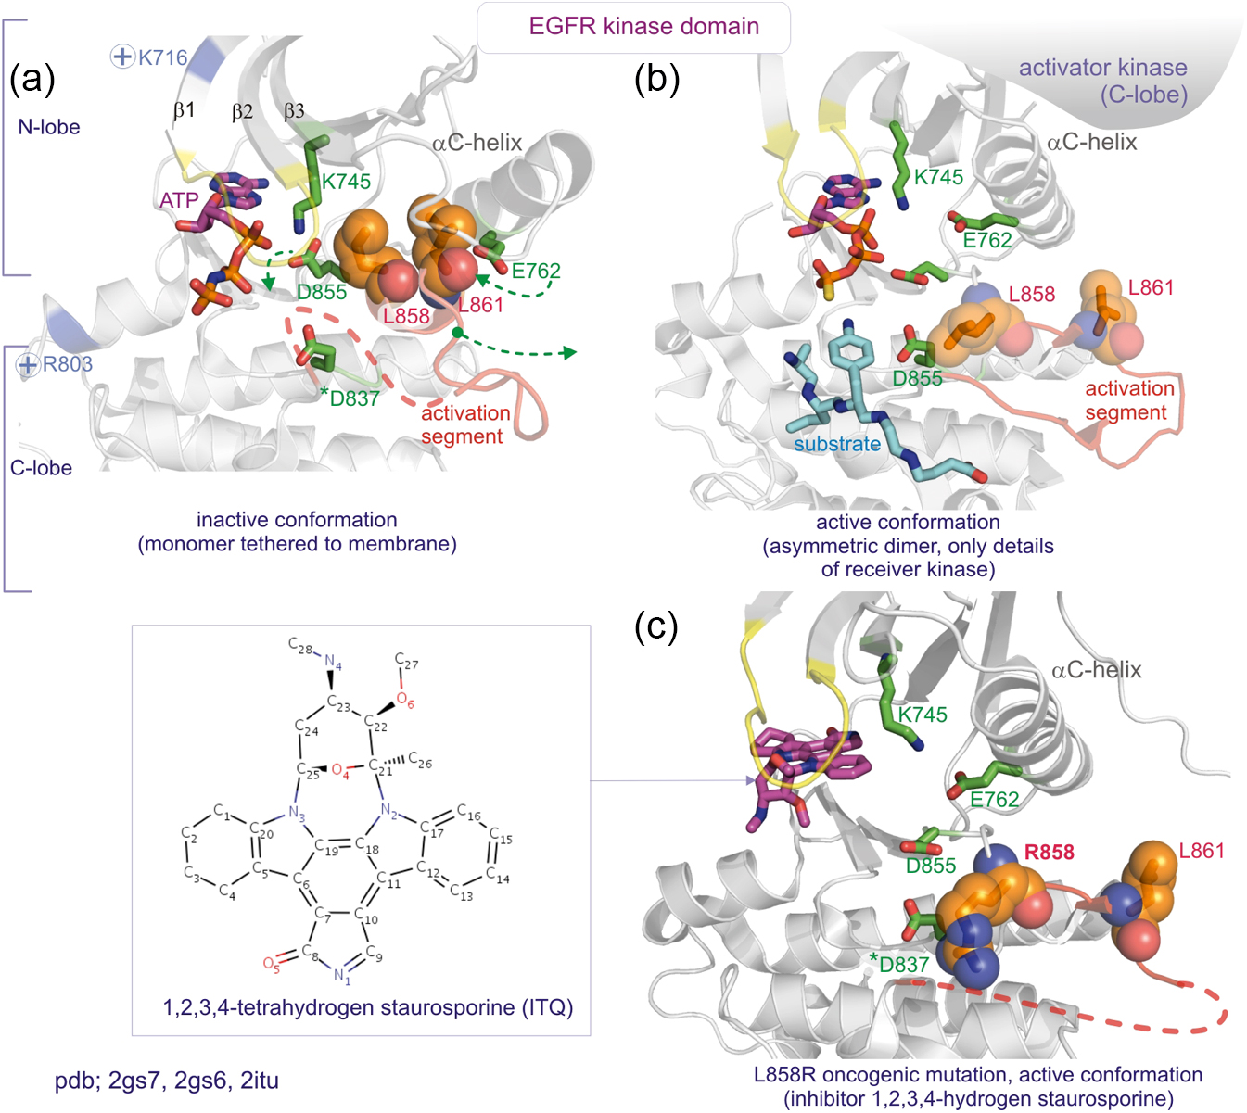
Figure 10.07

Slide 9
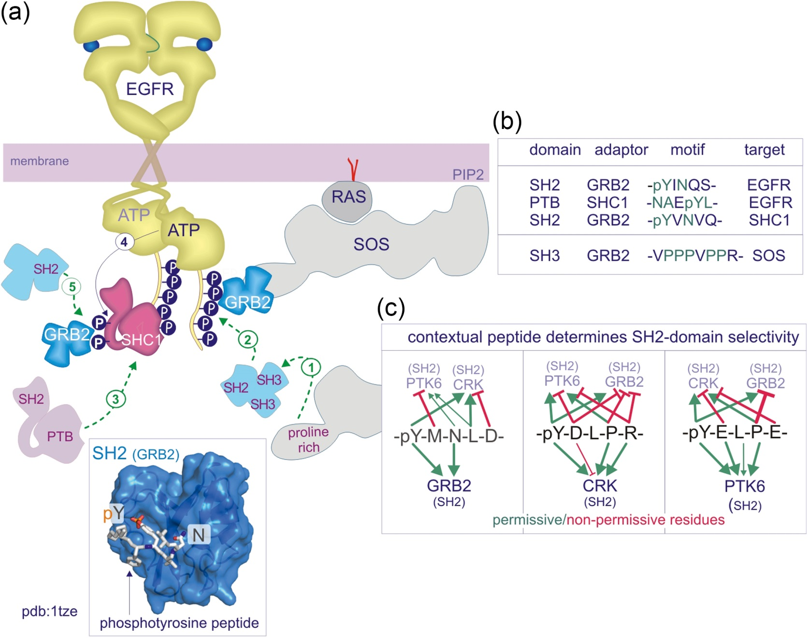
Figure 10.08

Slide 10
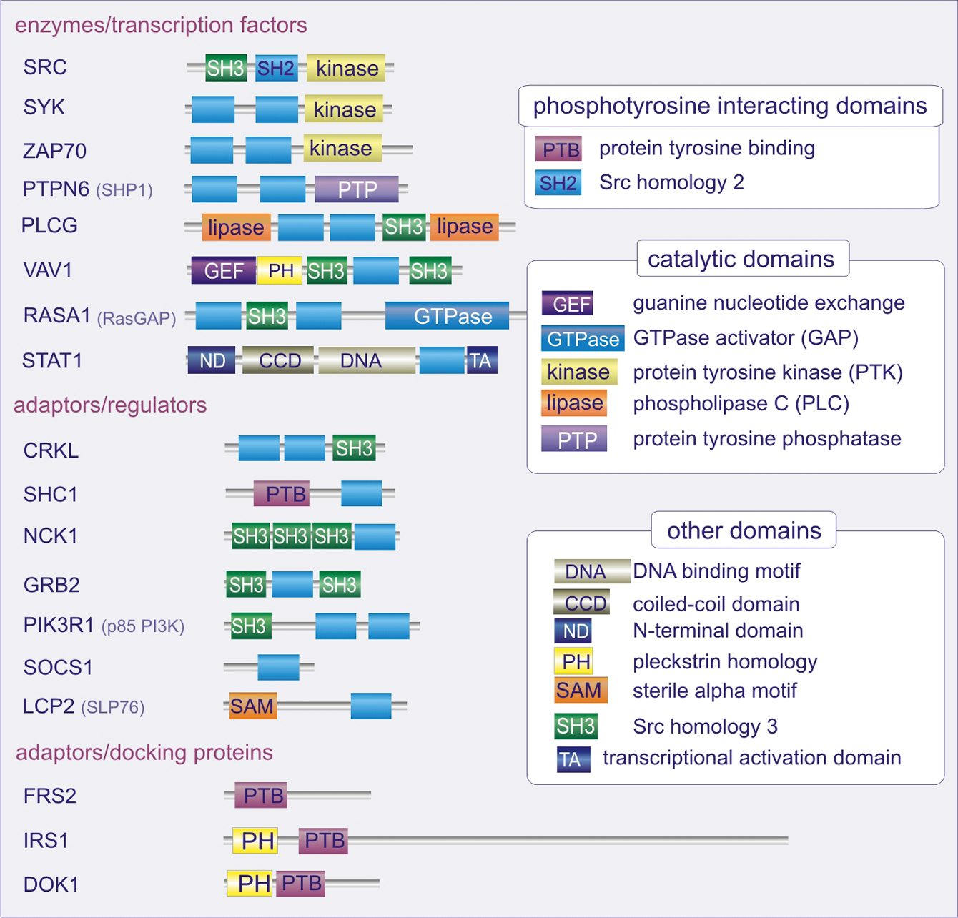
Figure 10.09

Slide 11
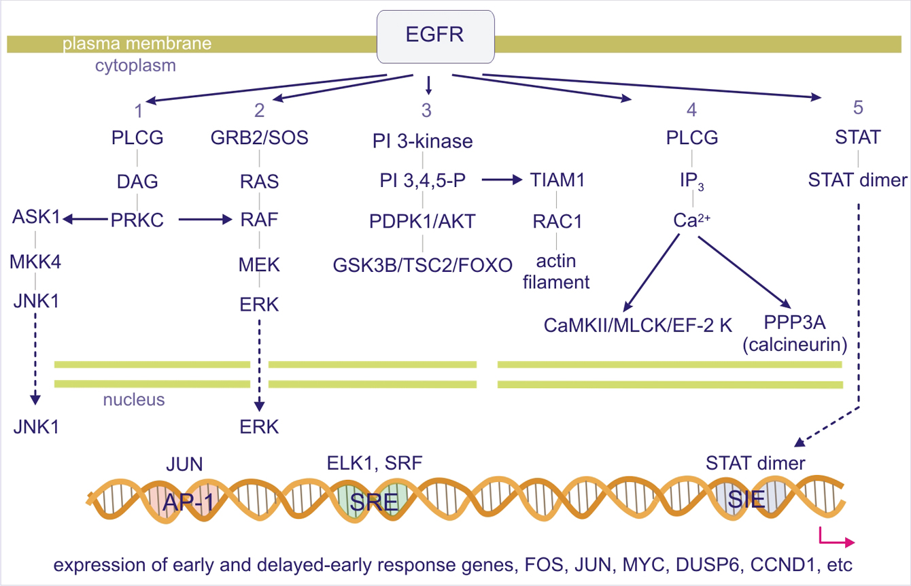
Figure 10.10

Slide 12
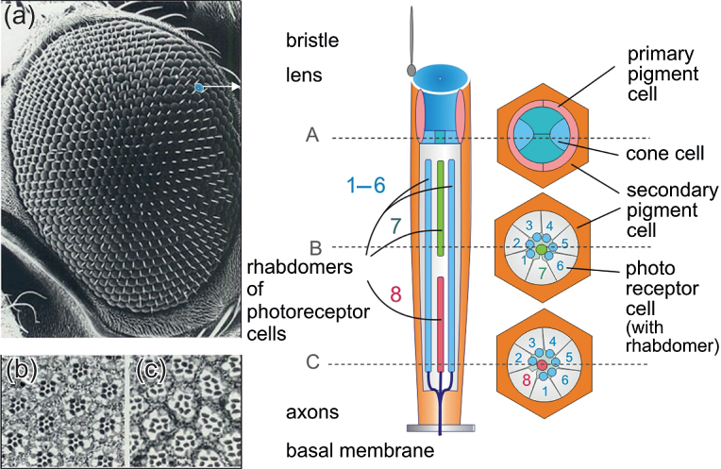
Figure 10.11

Slide 13
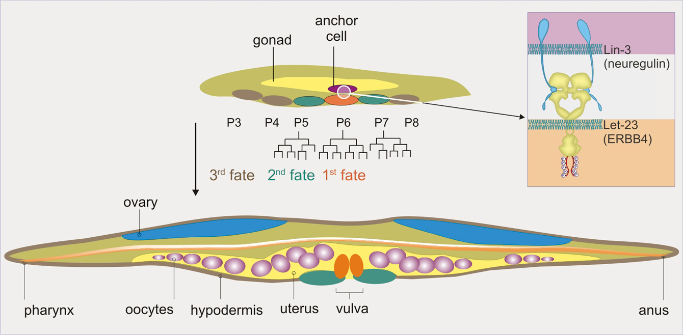
Figure 10.12

Slide 14
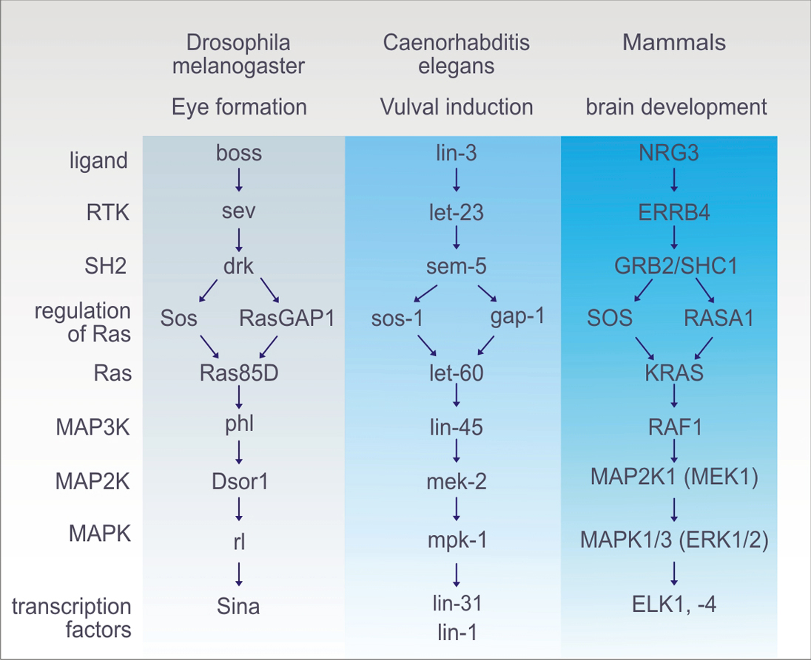
Figure 10.13

Slide 15
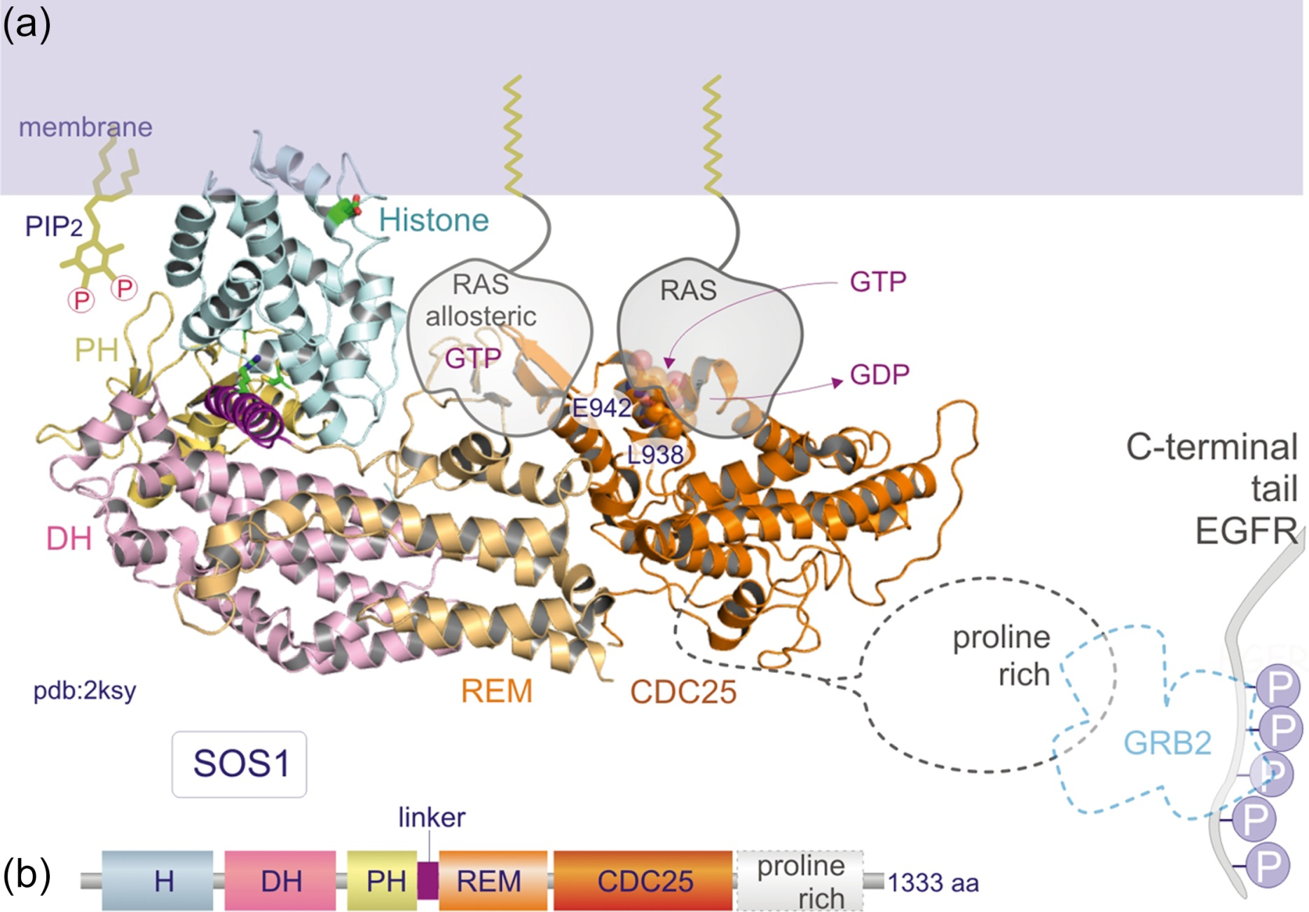
Figure 10.14

Slide 16
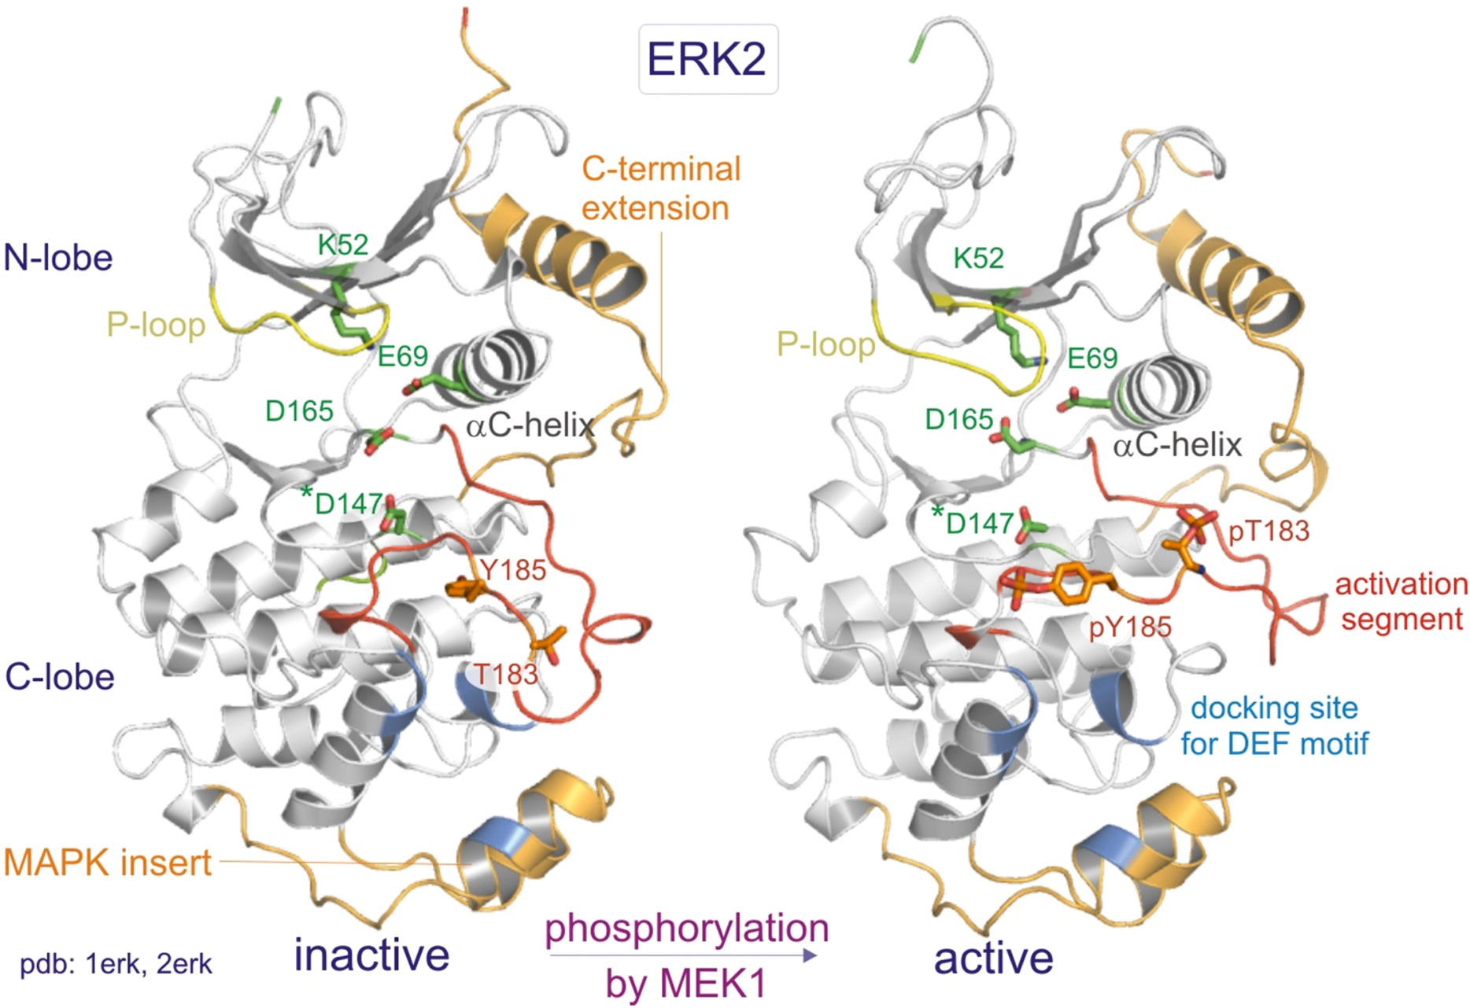
Figure 10.15

Slide 17
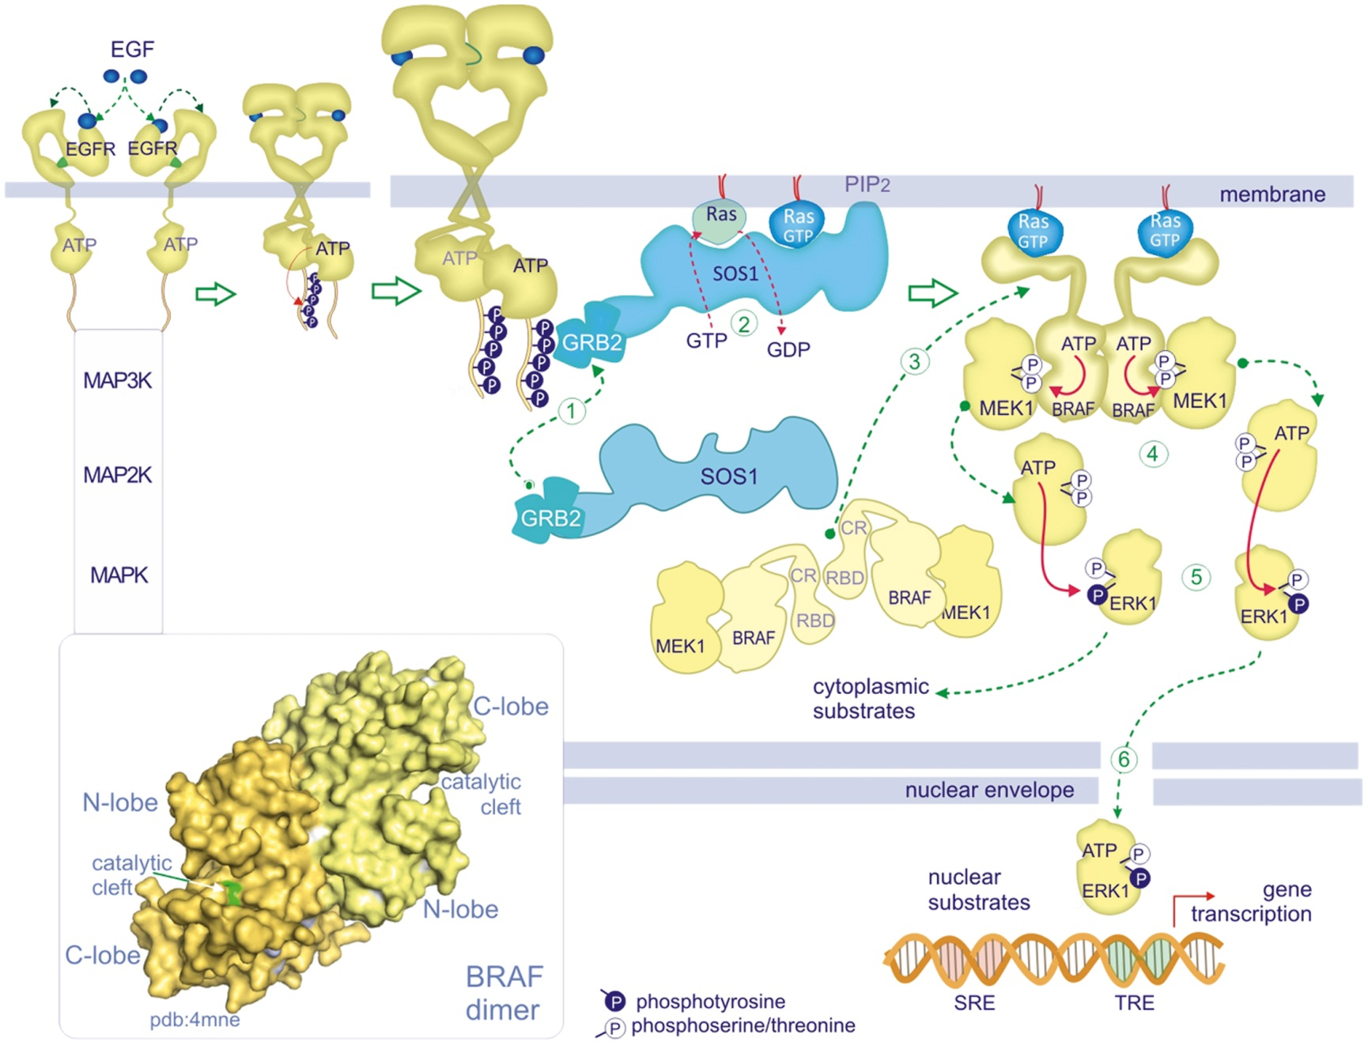
Figure 10.16

Slide 18
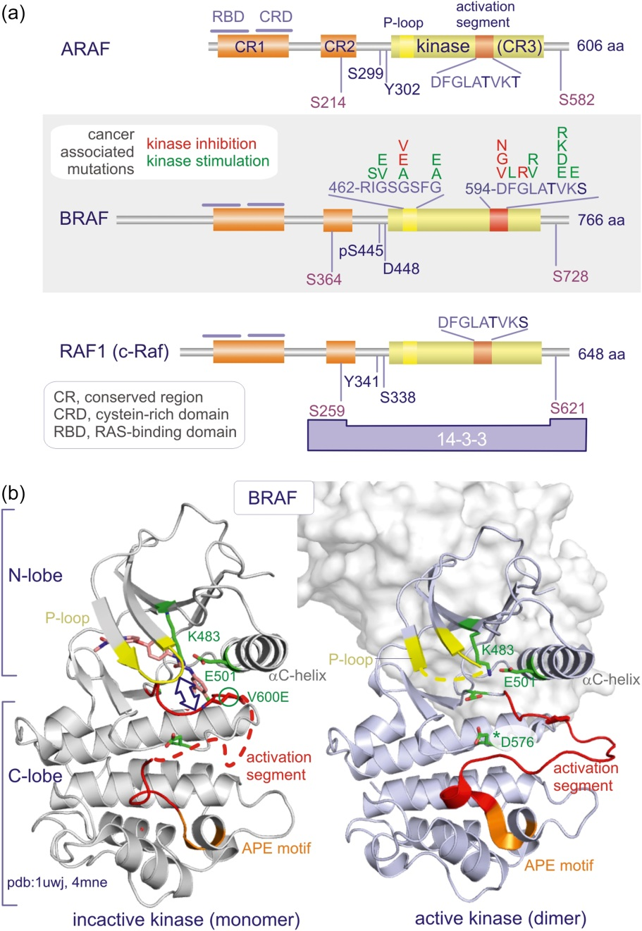
Figure 10.17

Slide 19
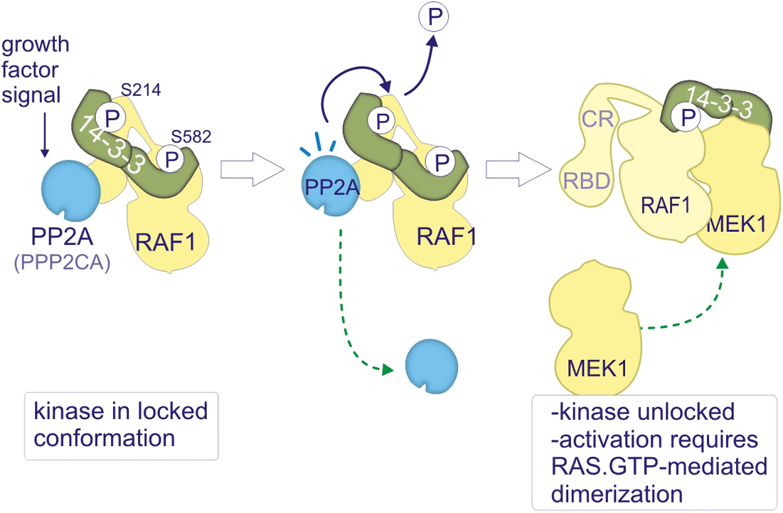
Figure 10.18

Slide 20
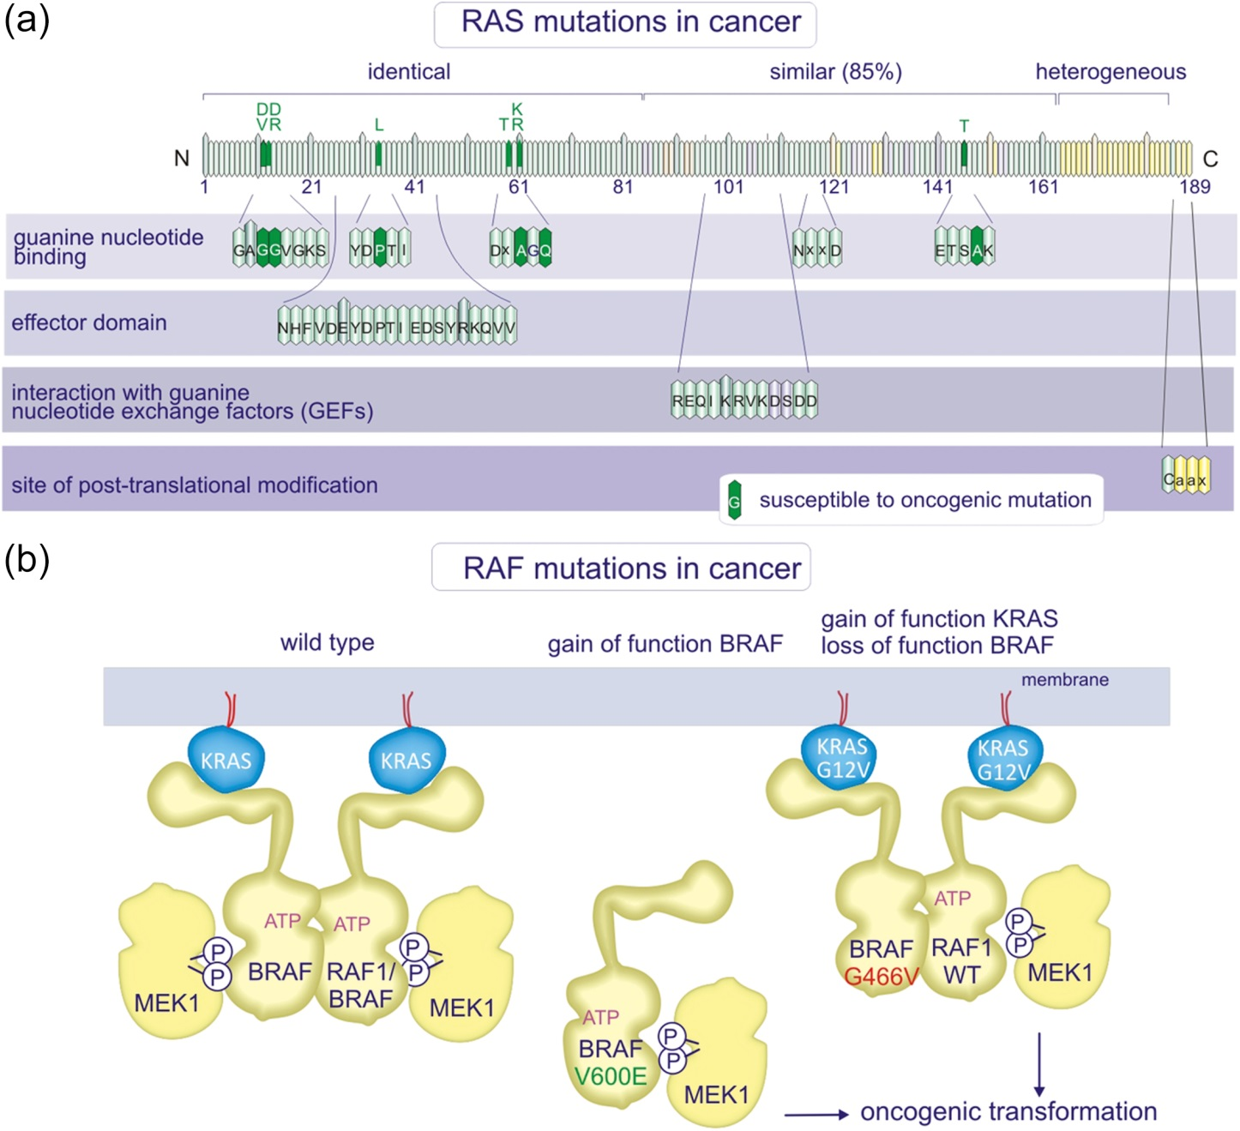
Figure 10.19

Slide 21
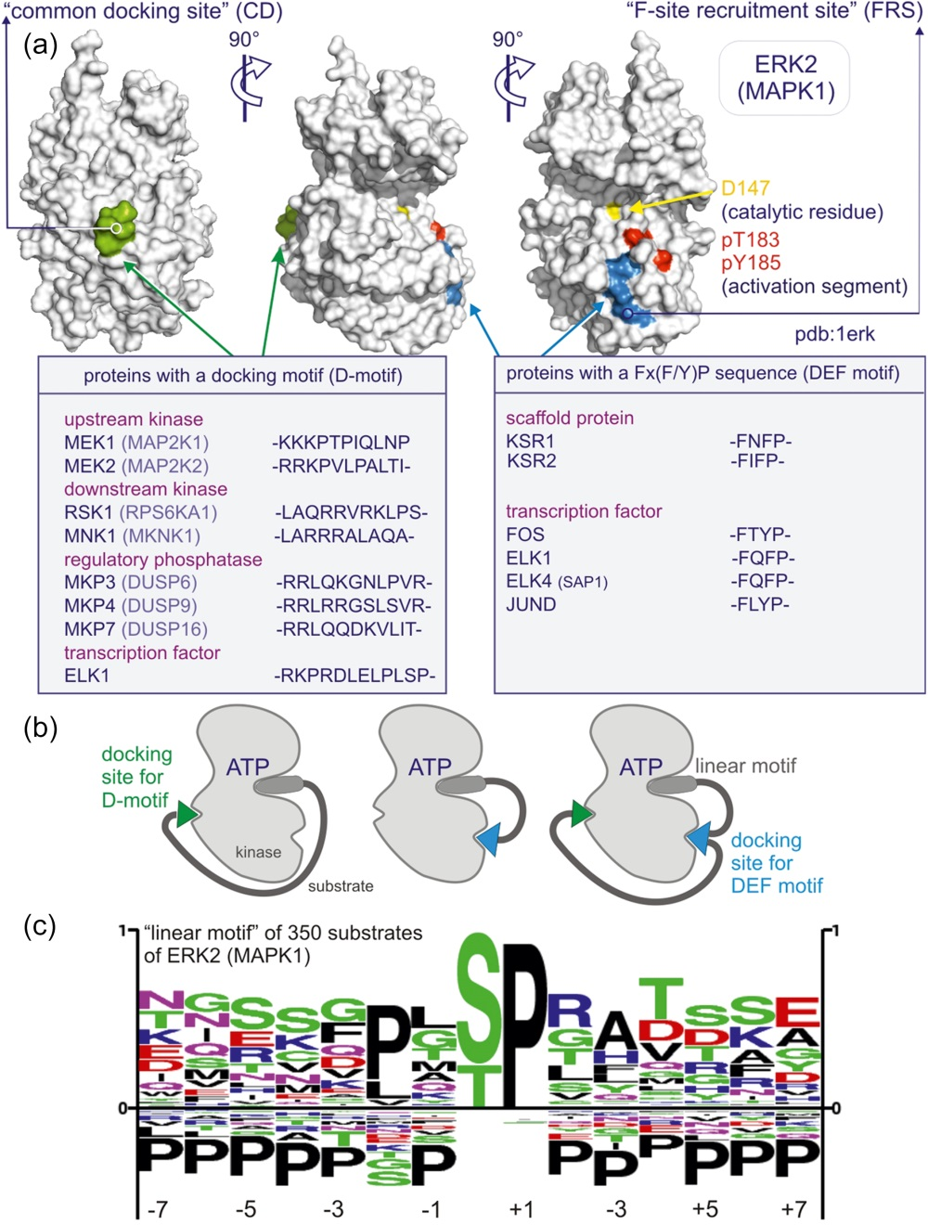
Figure 10.20

Slide 22
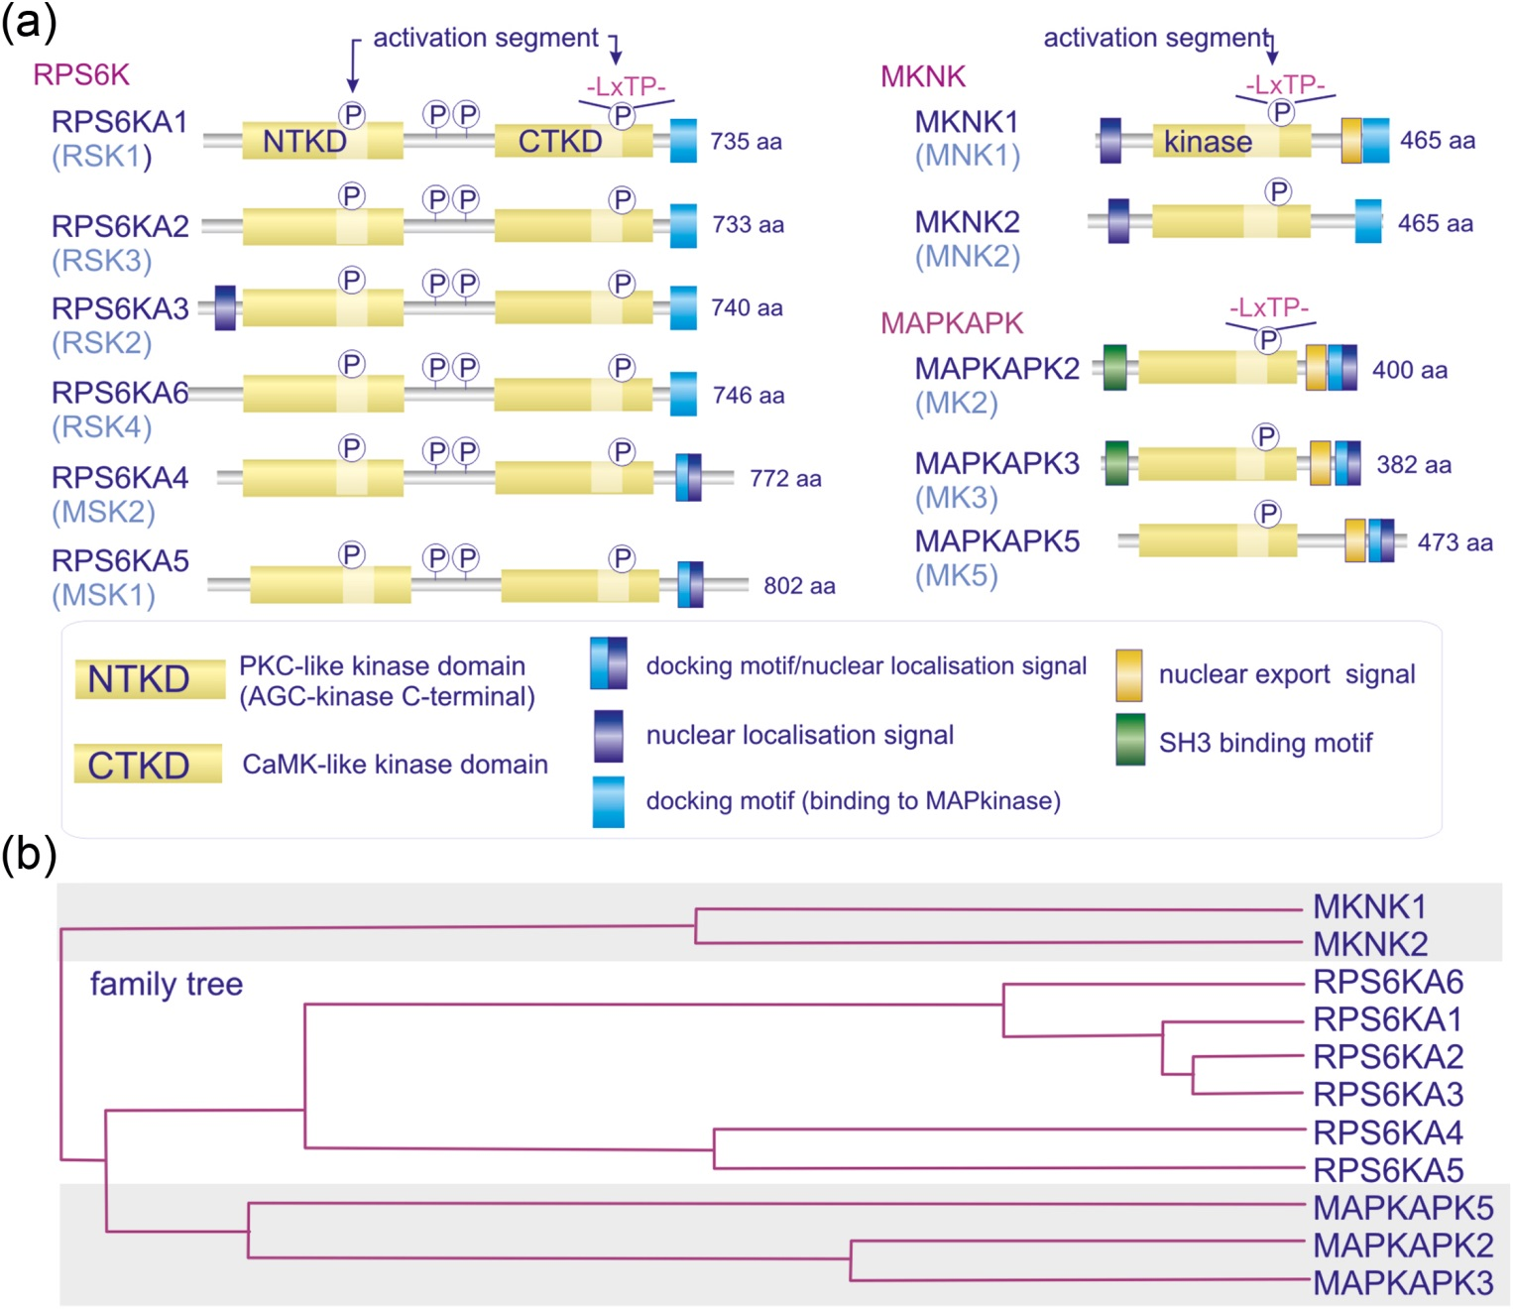
Figure 10.21

Slide 23
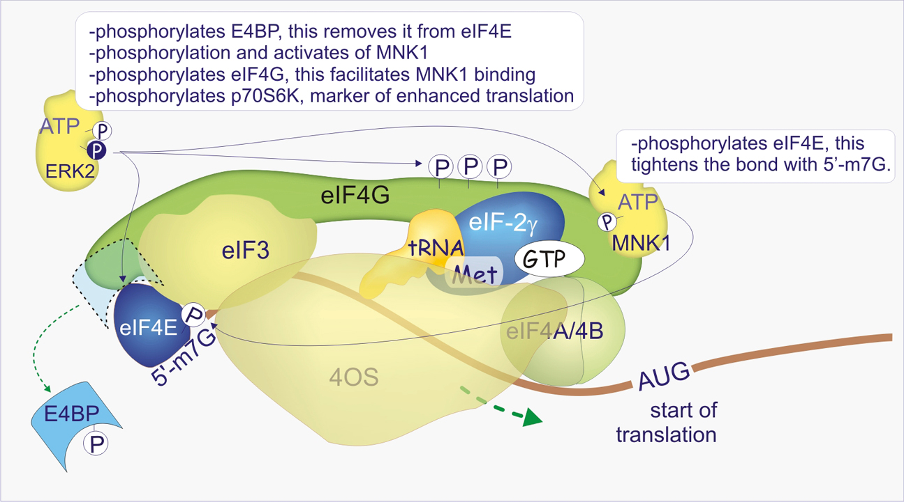
Figure 10.22

Slide 24
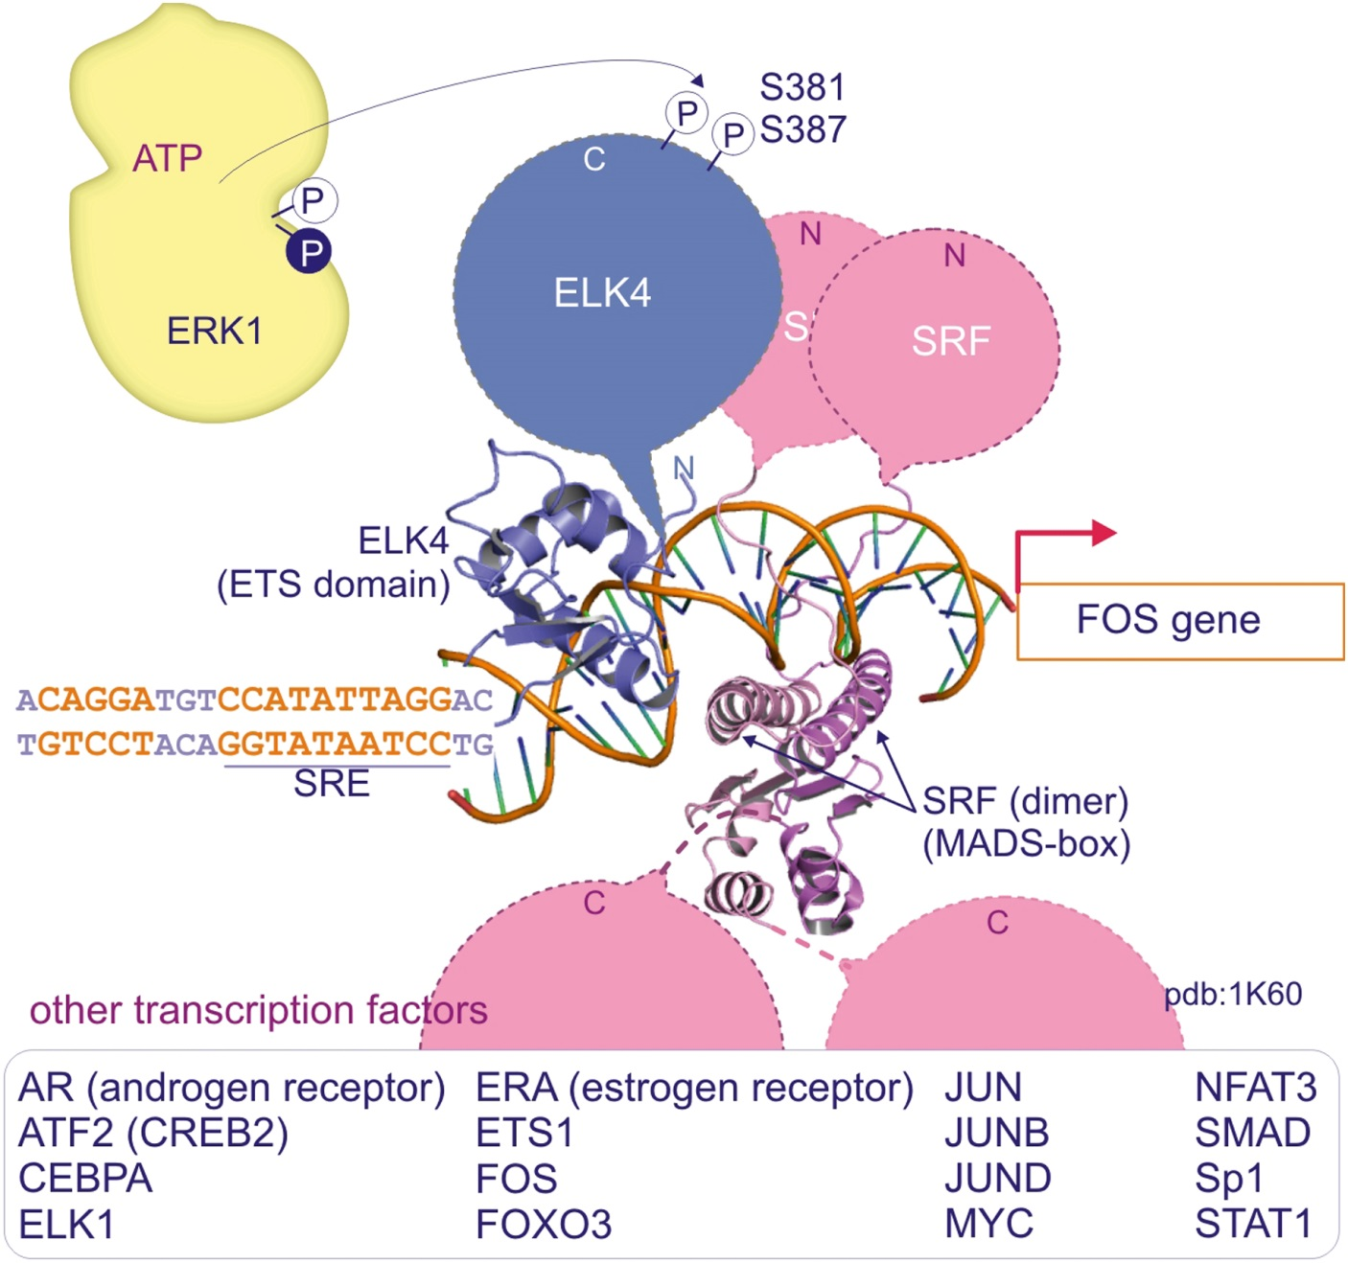
Figure 10.23

Slide 25
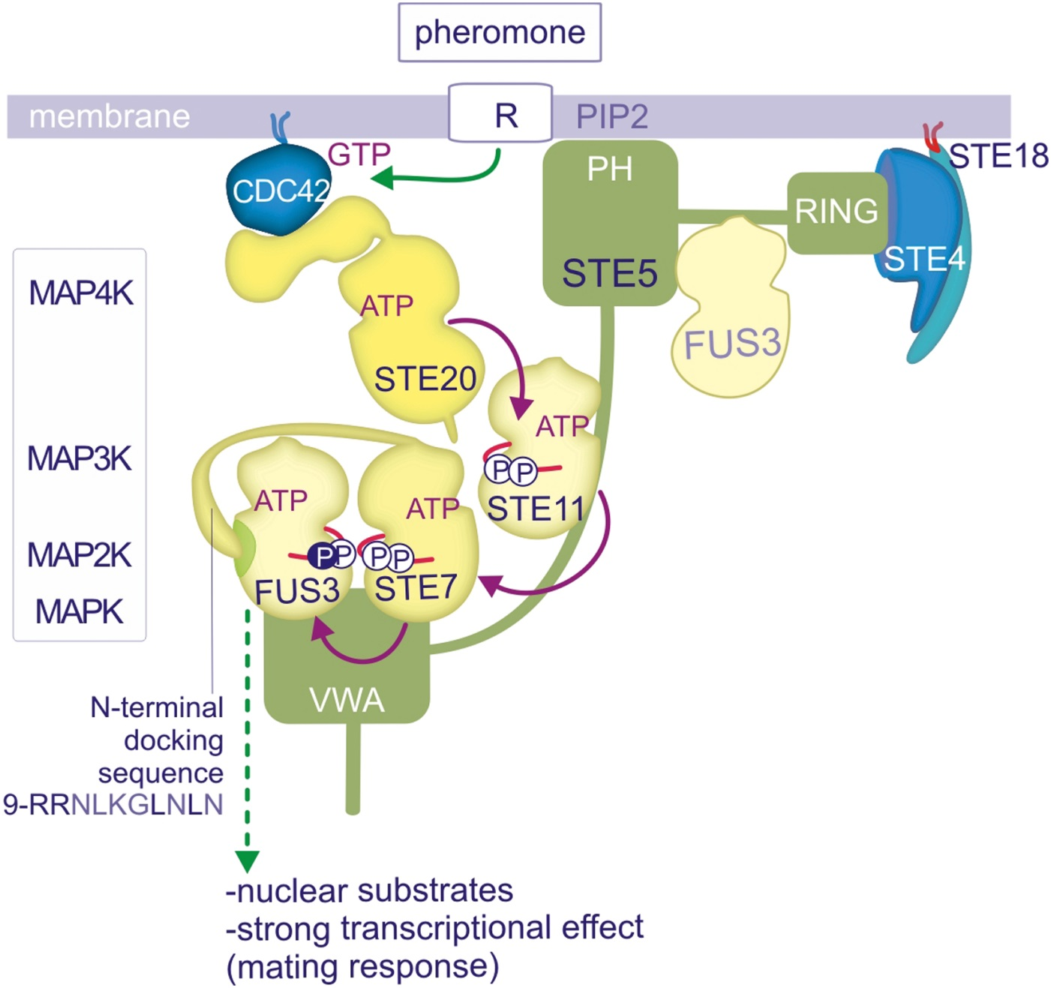
Figure 10.24

Slide 26
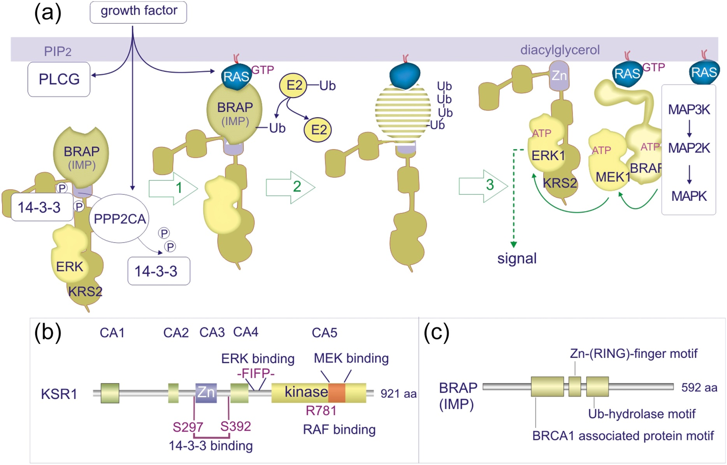
Figure 10.25

Slide 27
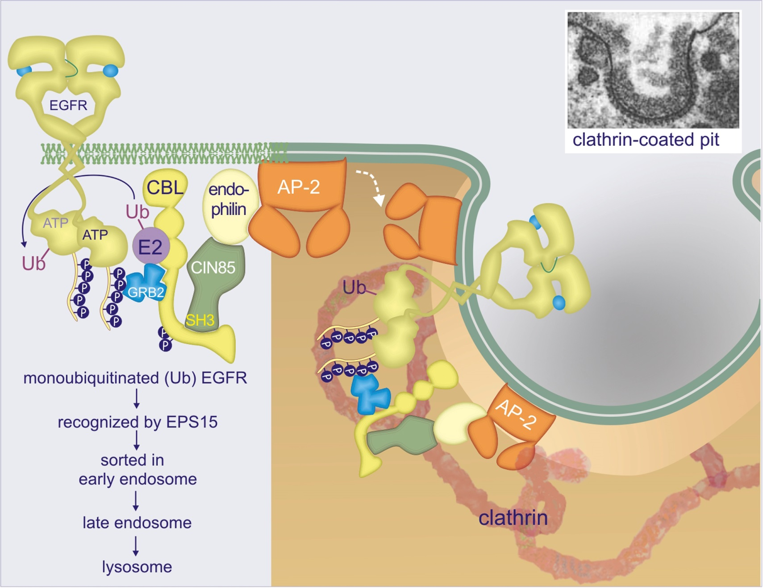
Figure 10.26

Slide 28
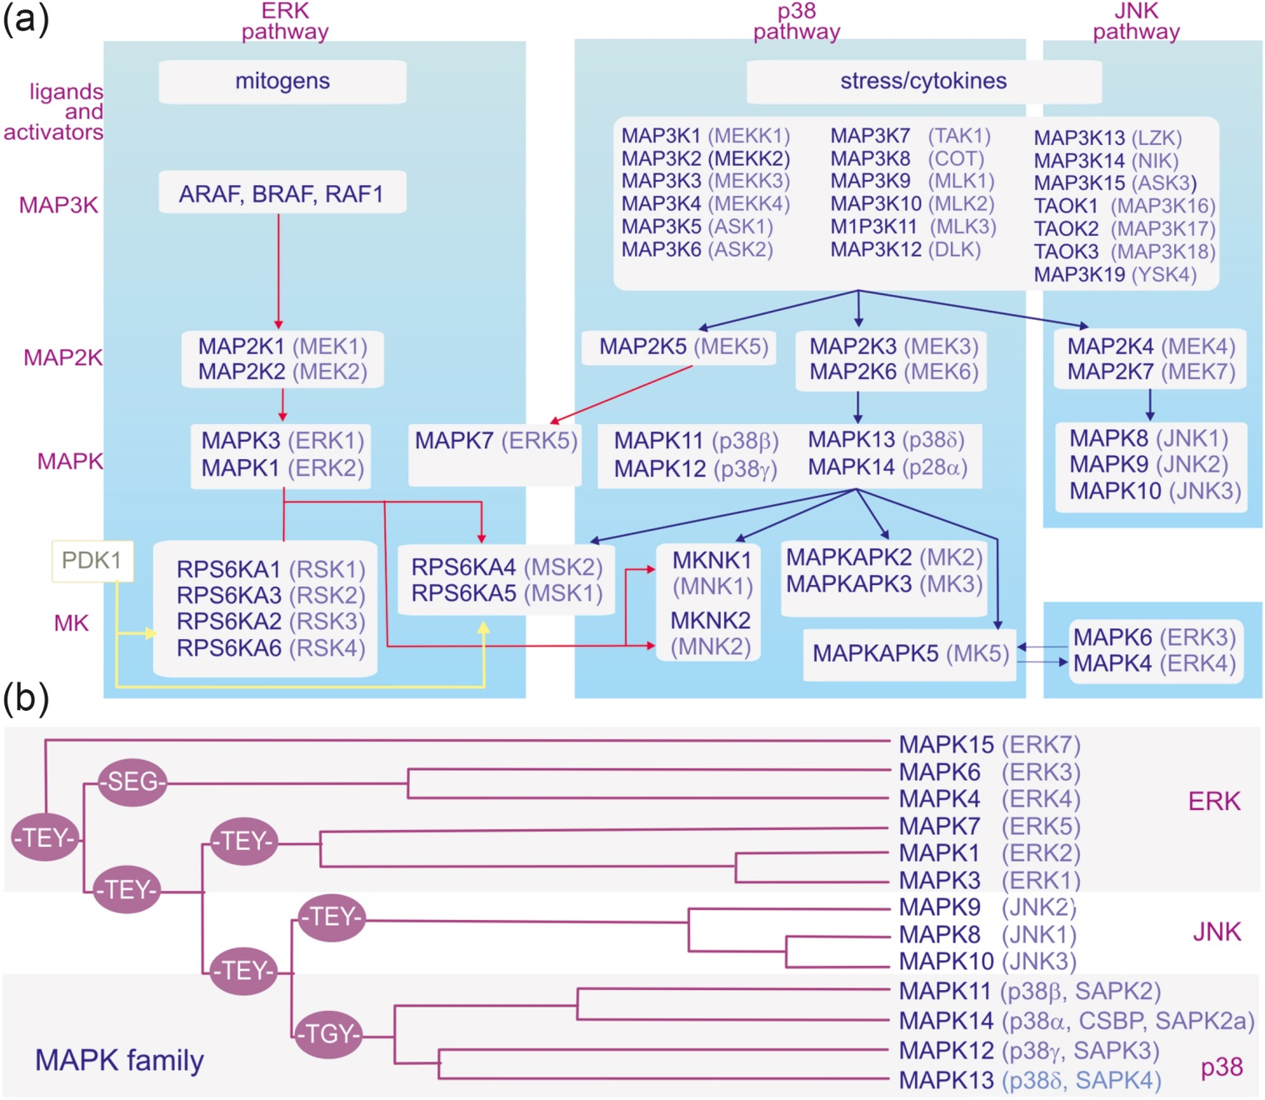
Figure 10.27

Slide 29
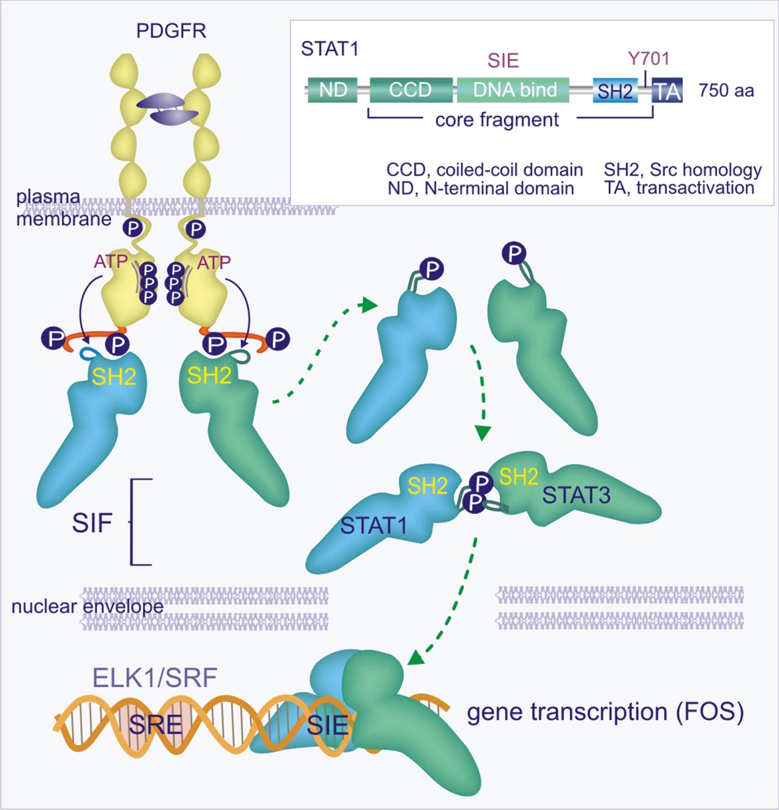
Figure 10.28

Slide 30
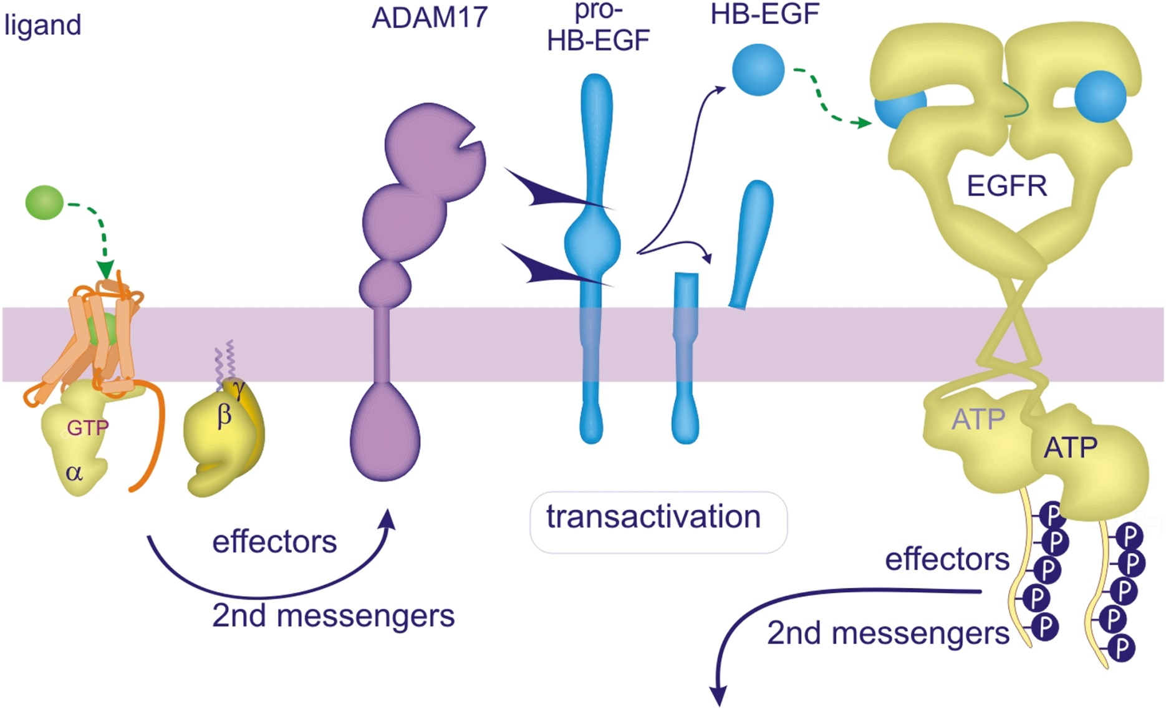
Figure 10.29

