Slide 1
Chapter 14
Chemokines and Traffic of White Blood Cells

Slide 2
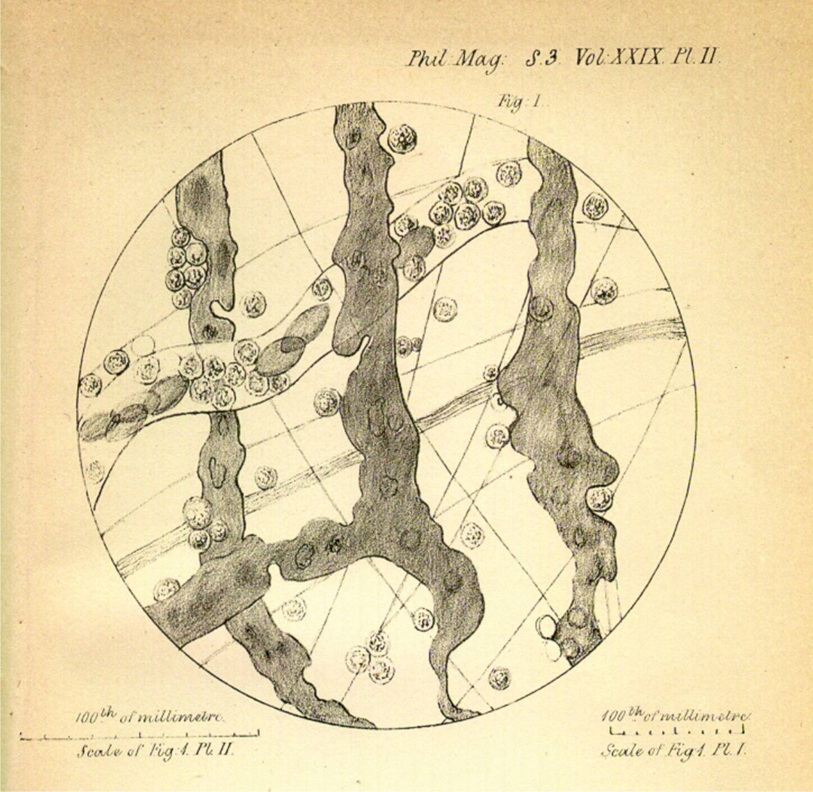
Figure 14.01

Slide 3
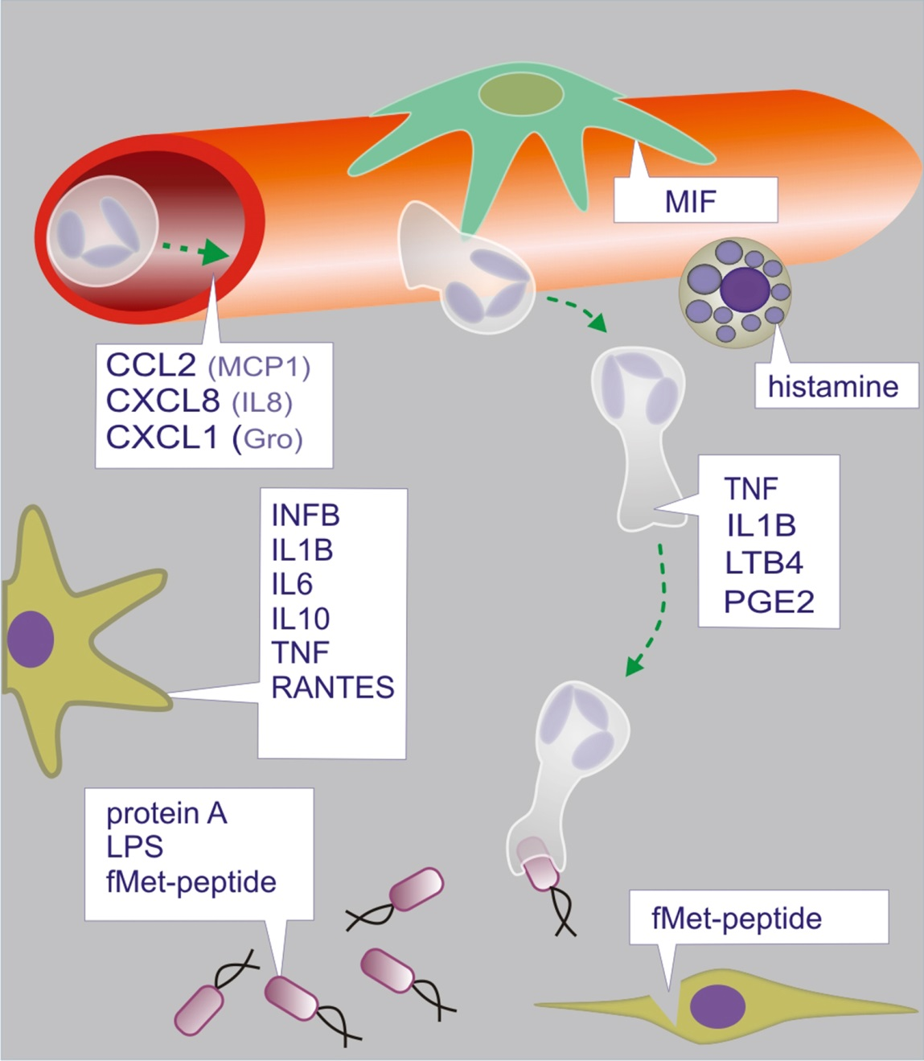
Figure 14.02

Slide 4
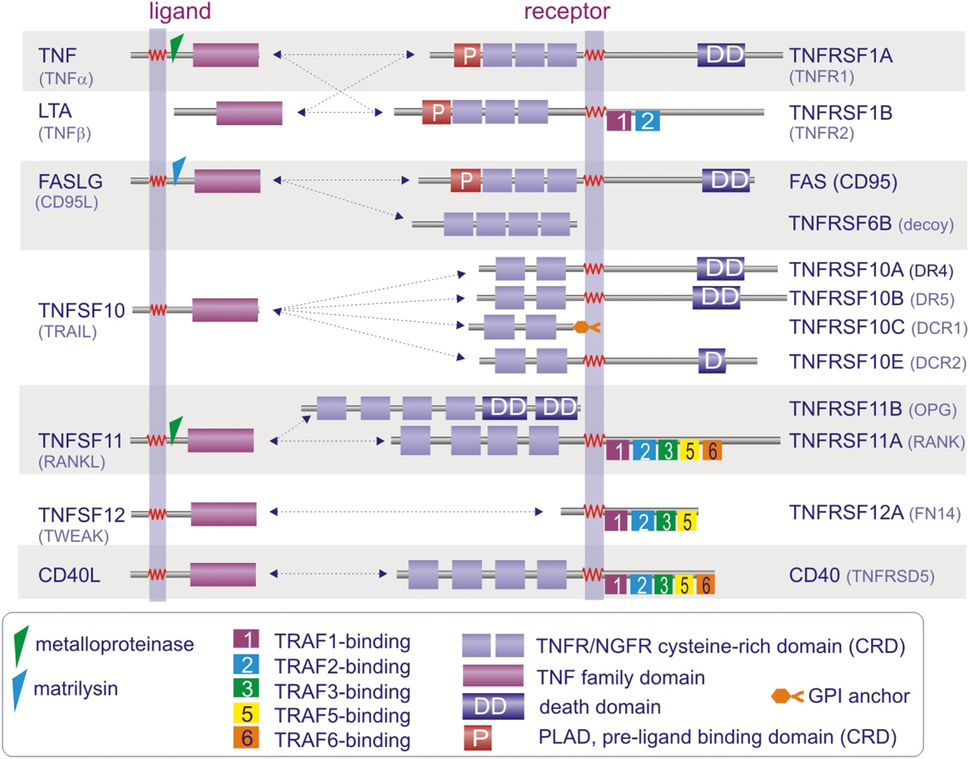
Figure 14.03

Slide 5
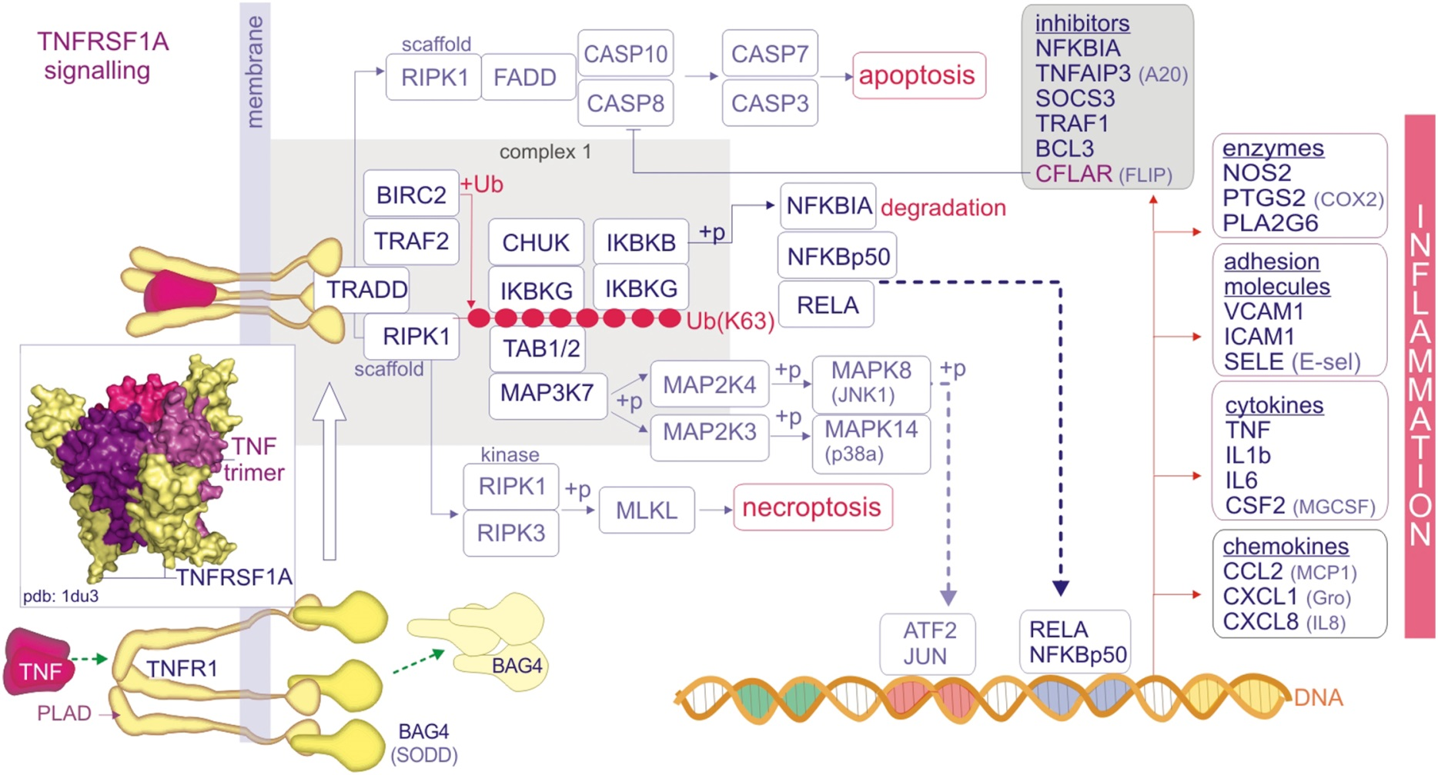
Figure 14.04

Slide 6
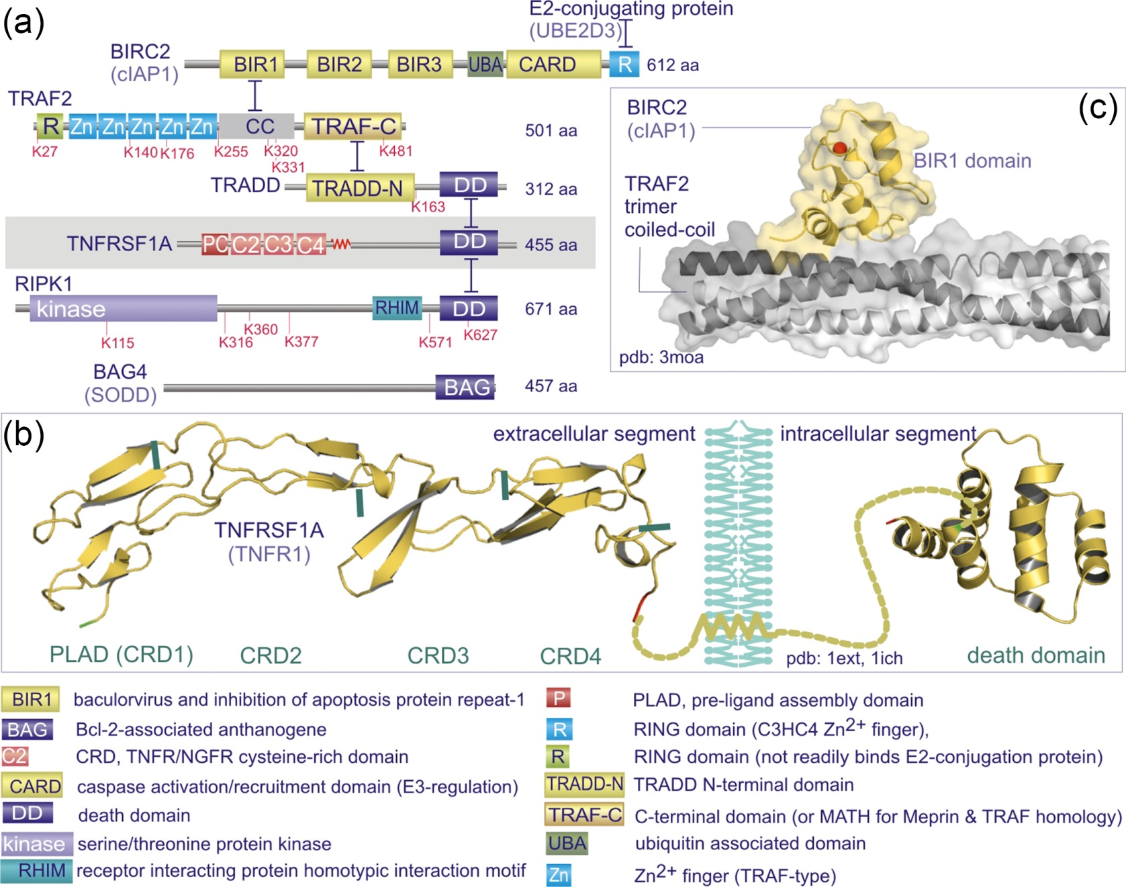
Figure 14.05

Slide 7
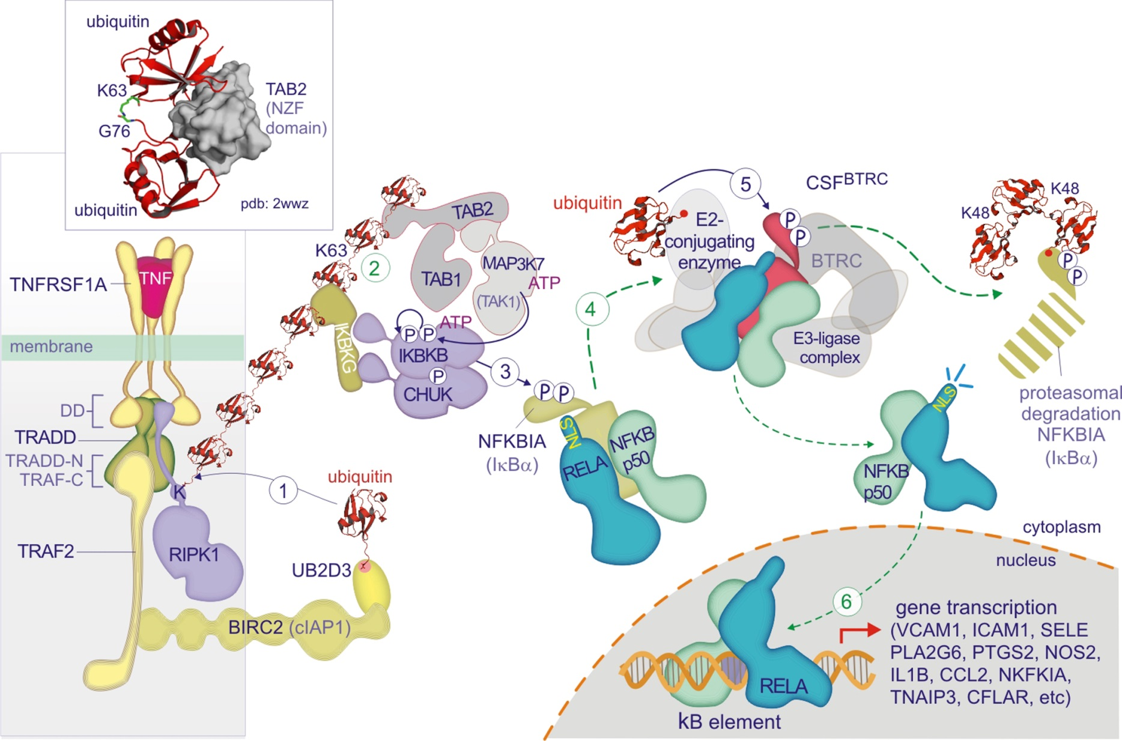
Figure 14.06

Slide 8
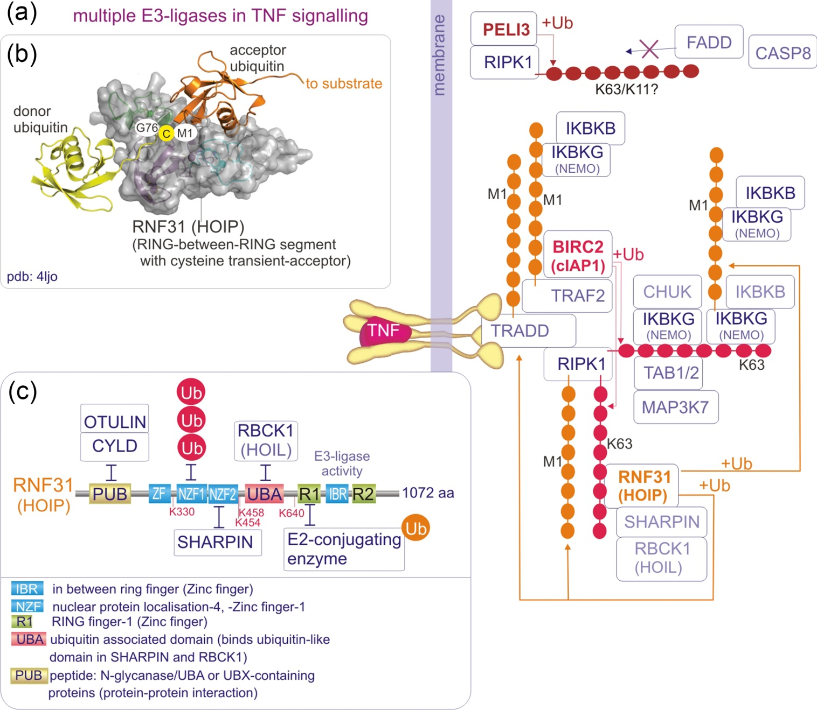
Figure 14.07

Slide 9
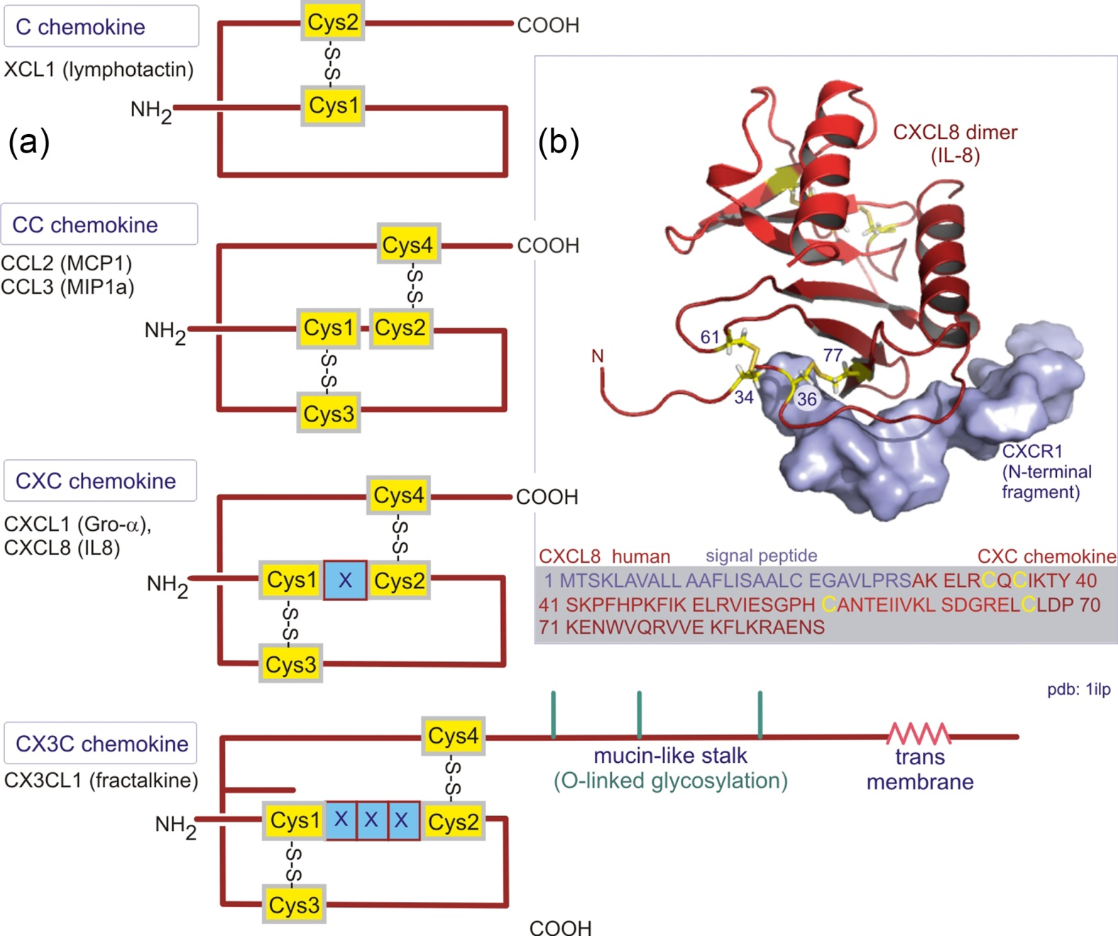
Figure 14.08

Slide 10
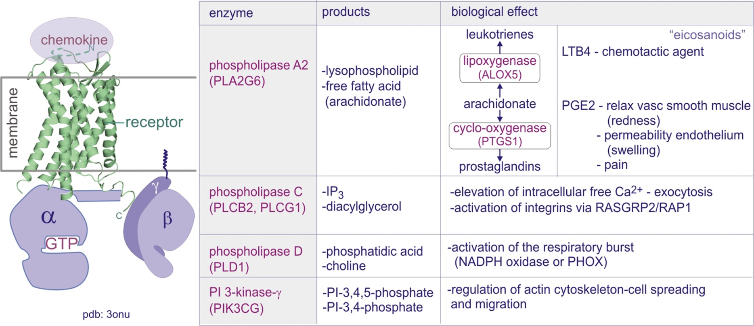
Figure 14.09

Slide 11
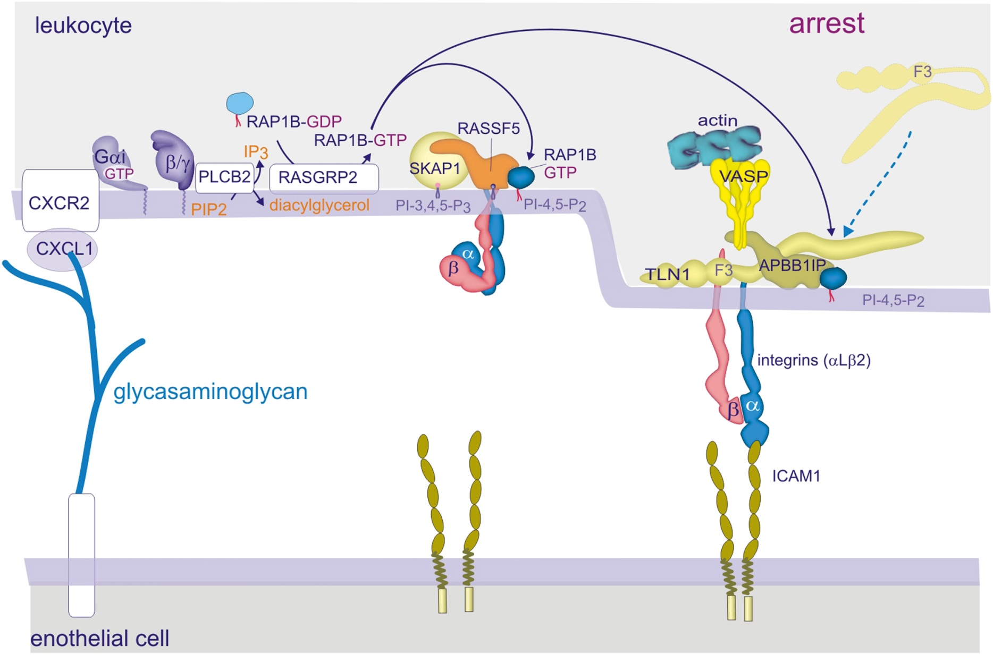
Figure 14.10

Slide 12
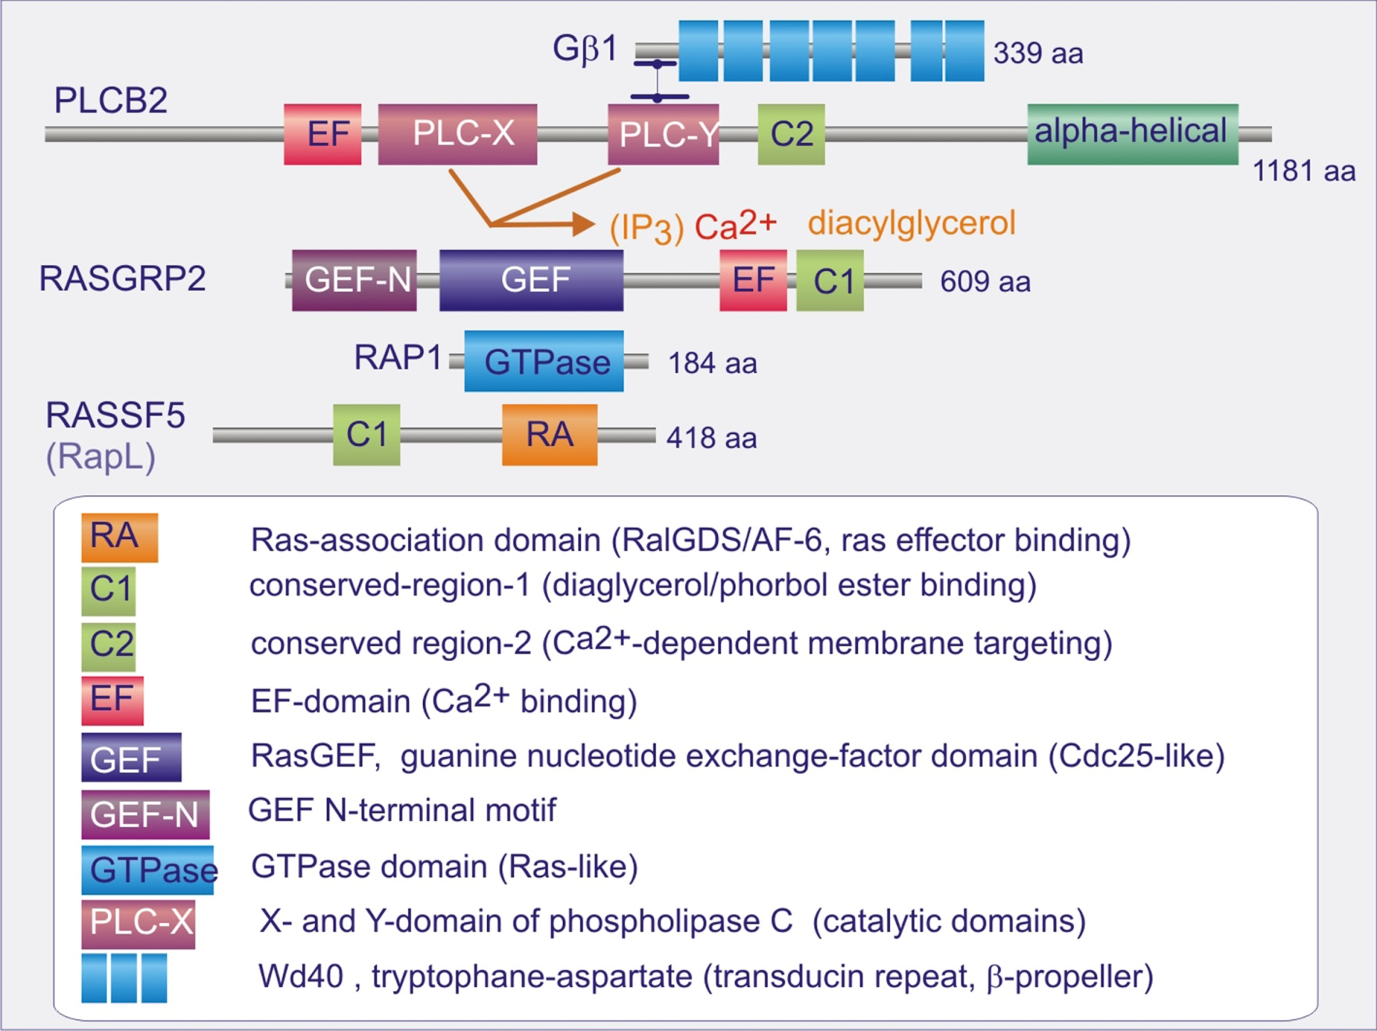
Figure 14.11

Slide 13
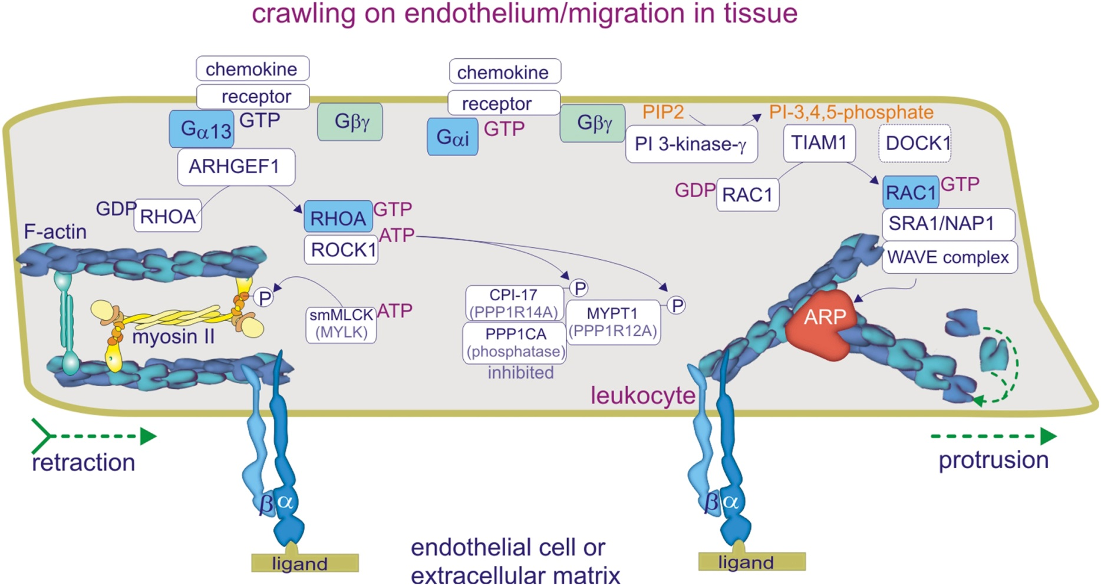
Figure 14.12

Slide 14
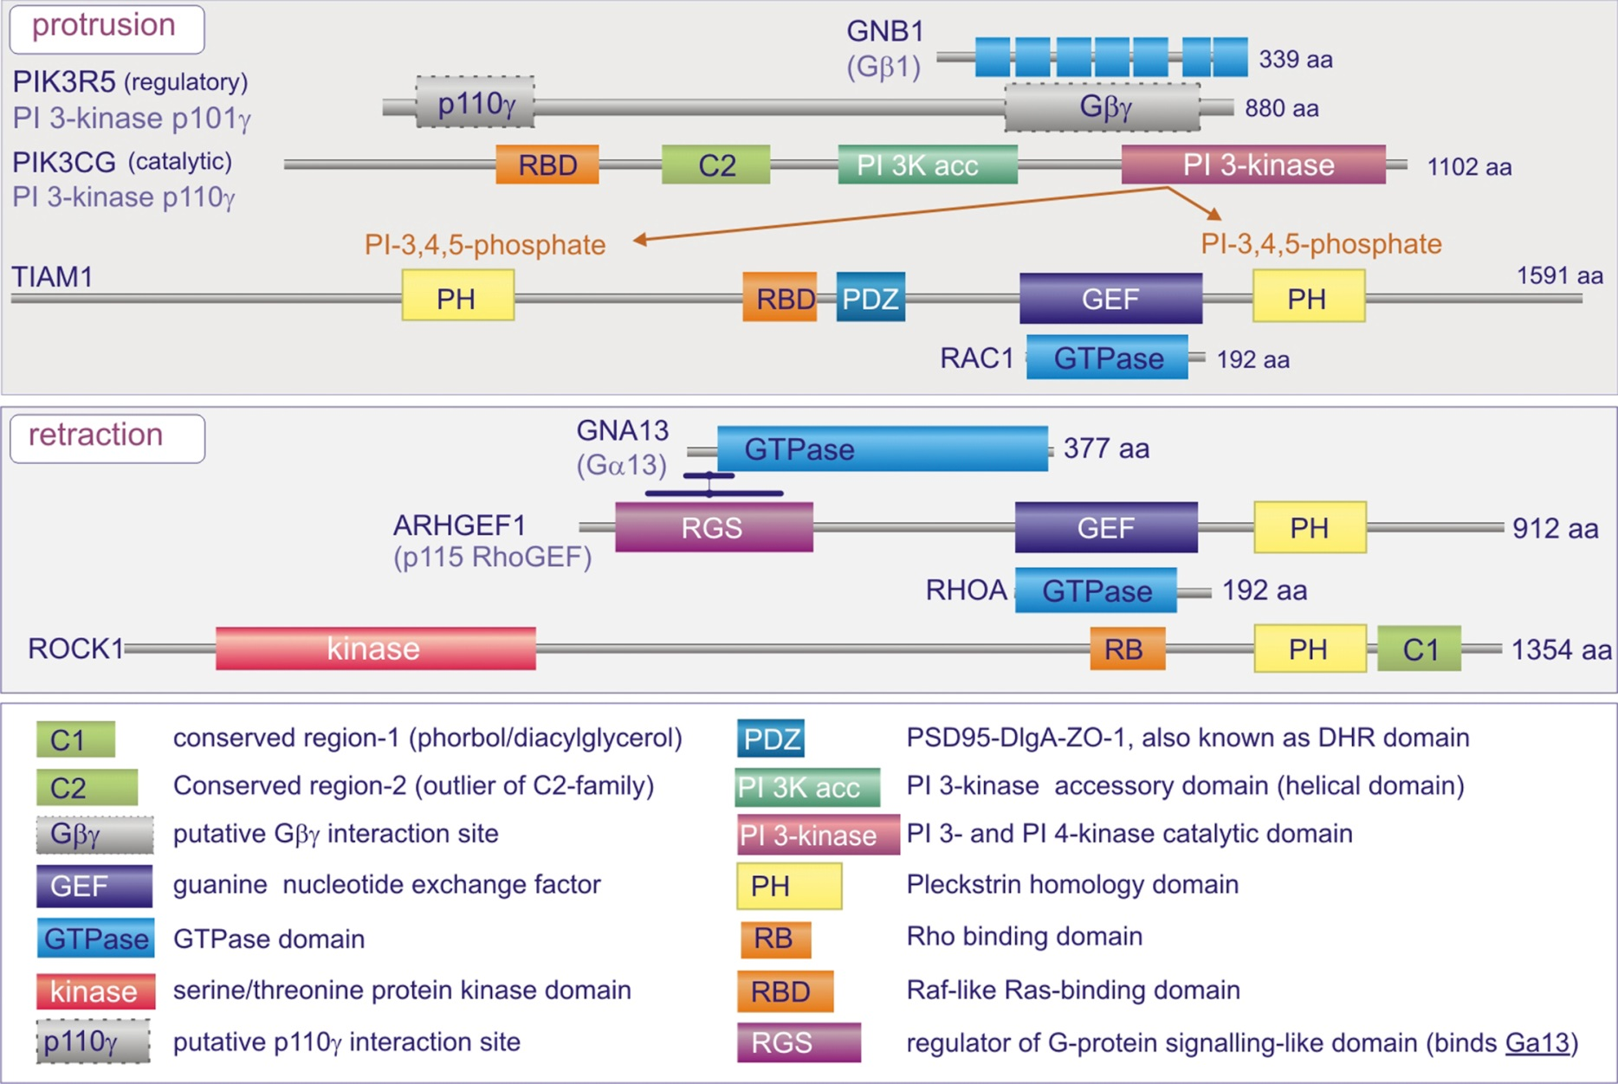
Figure 14.13

Slide 15
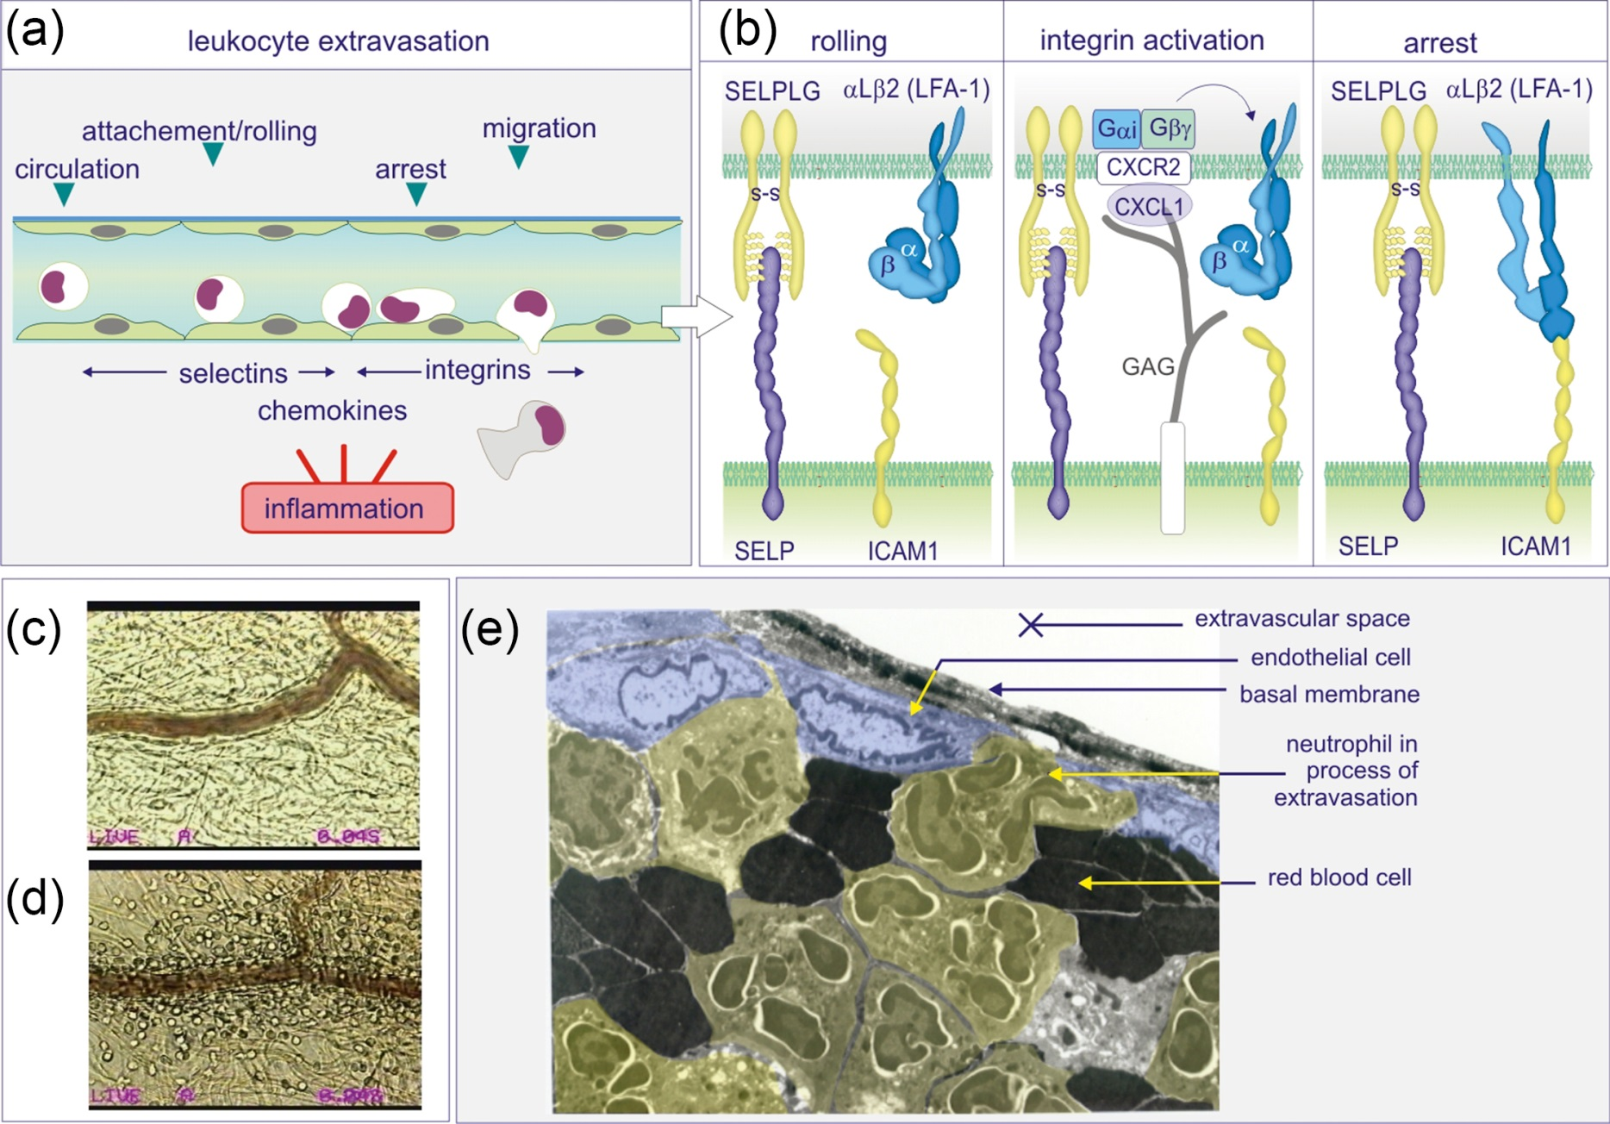
Figure 14.14

