Slide 1
Chapter 15
Activating the Adaptive Immune System: Role of Non-receptor Tyrosine Kinases

Slide 2
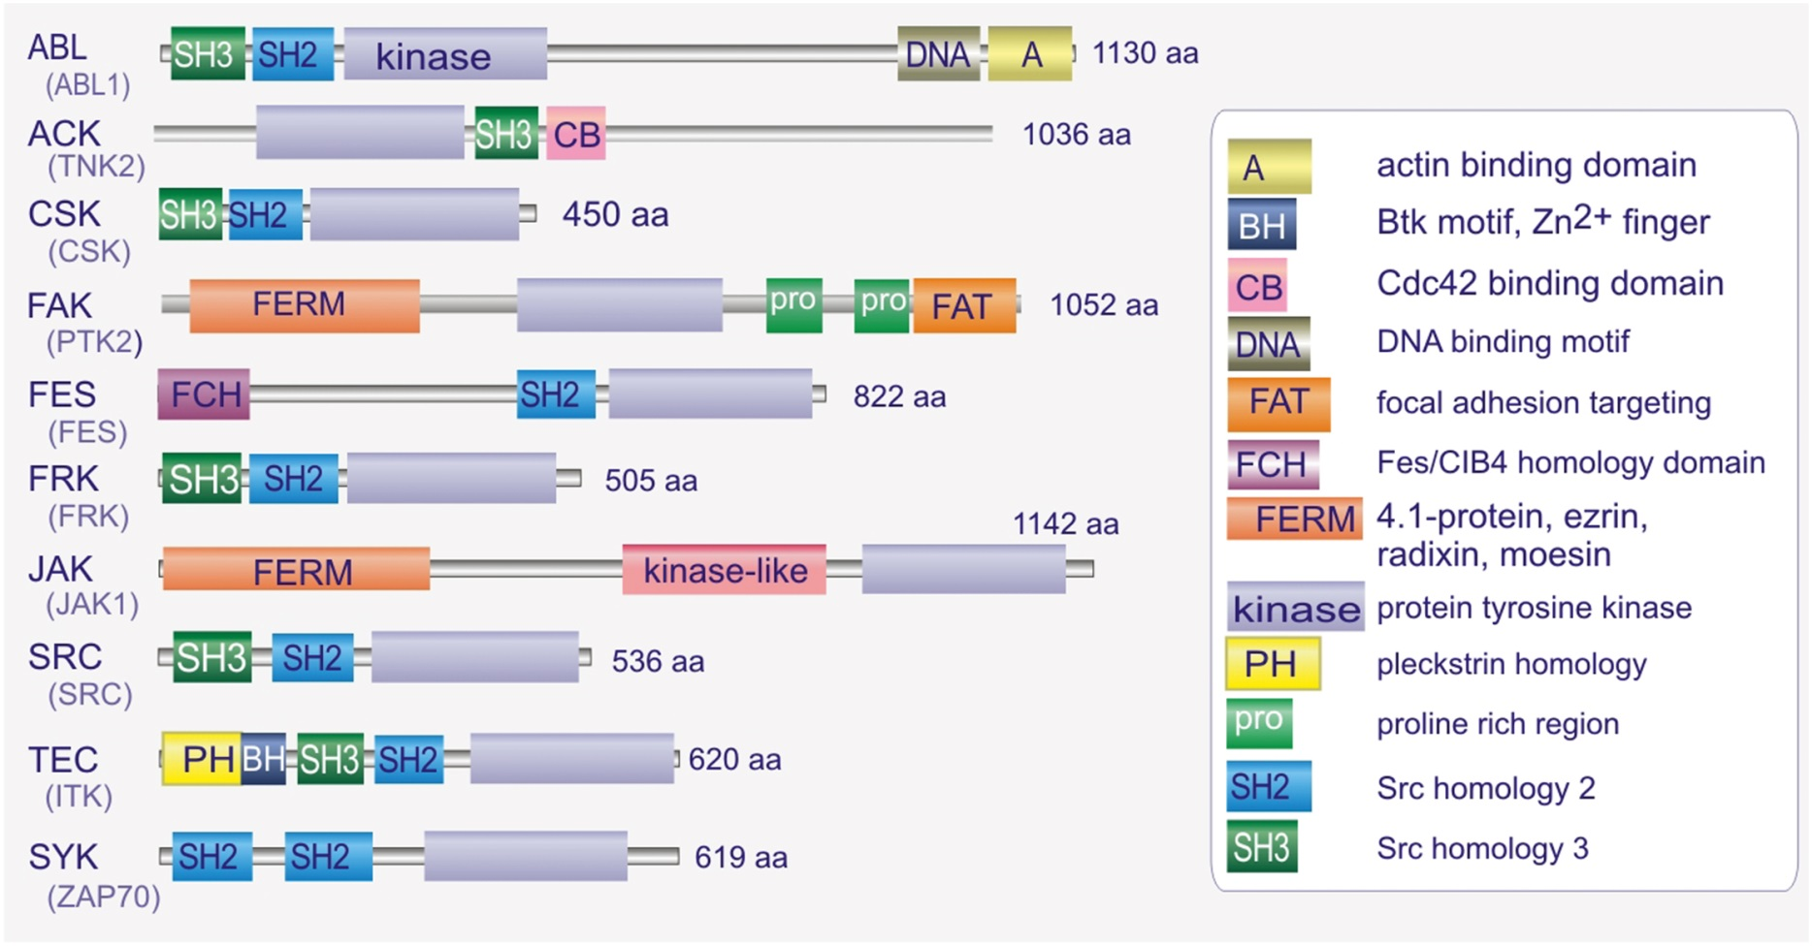
Figure 15.01

Slide 3
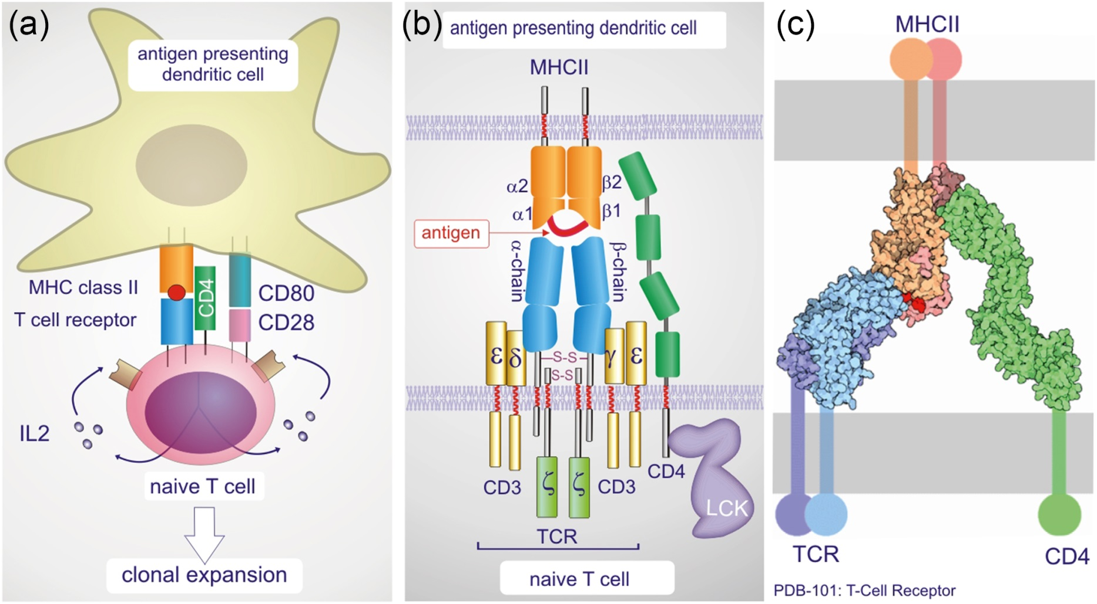
Figure 15.02

Slide 4
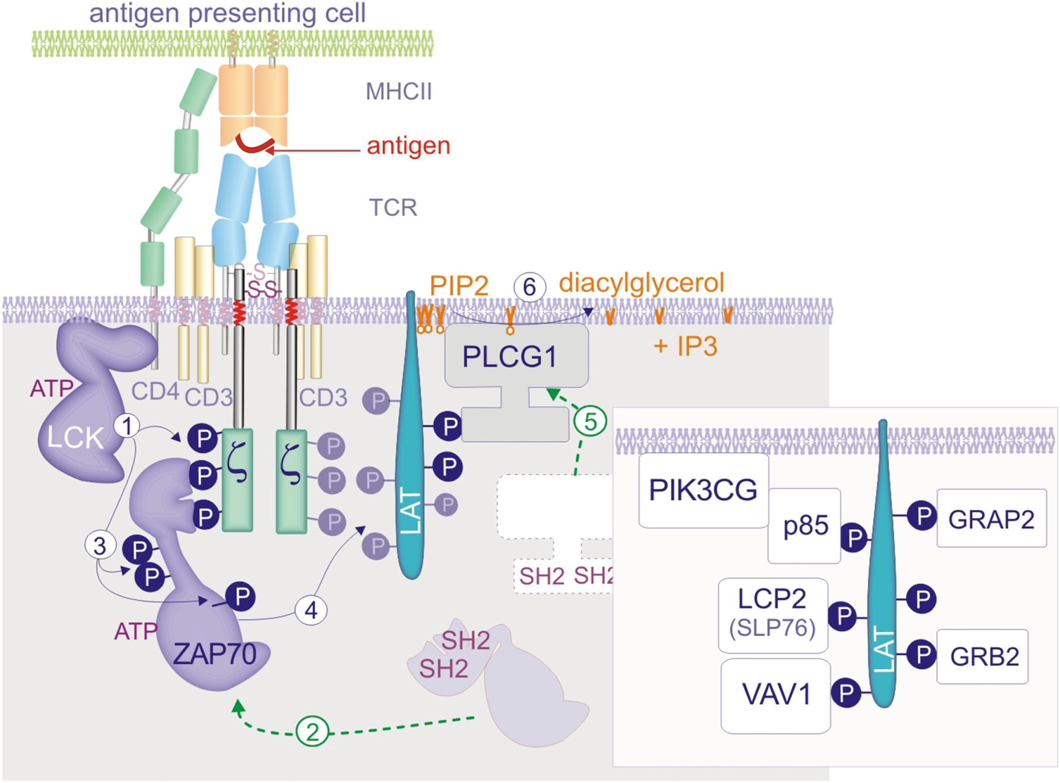
Figure 15.03

Slide 5
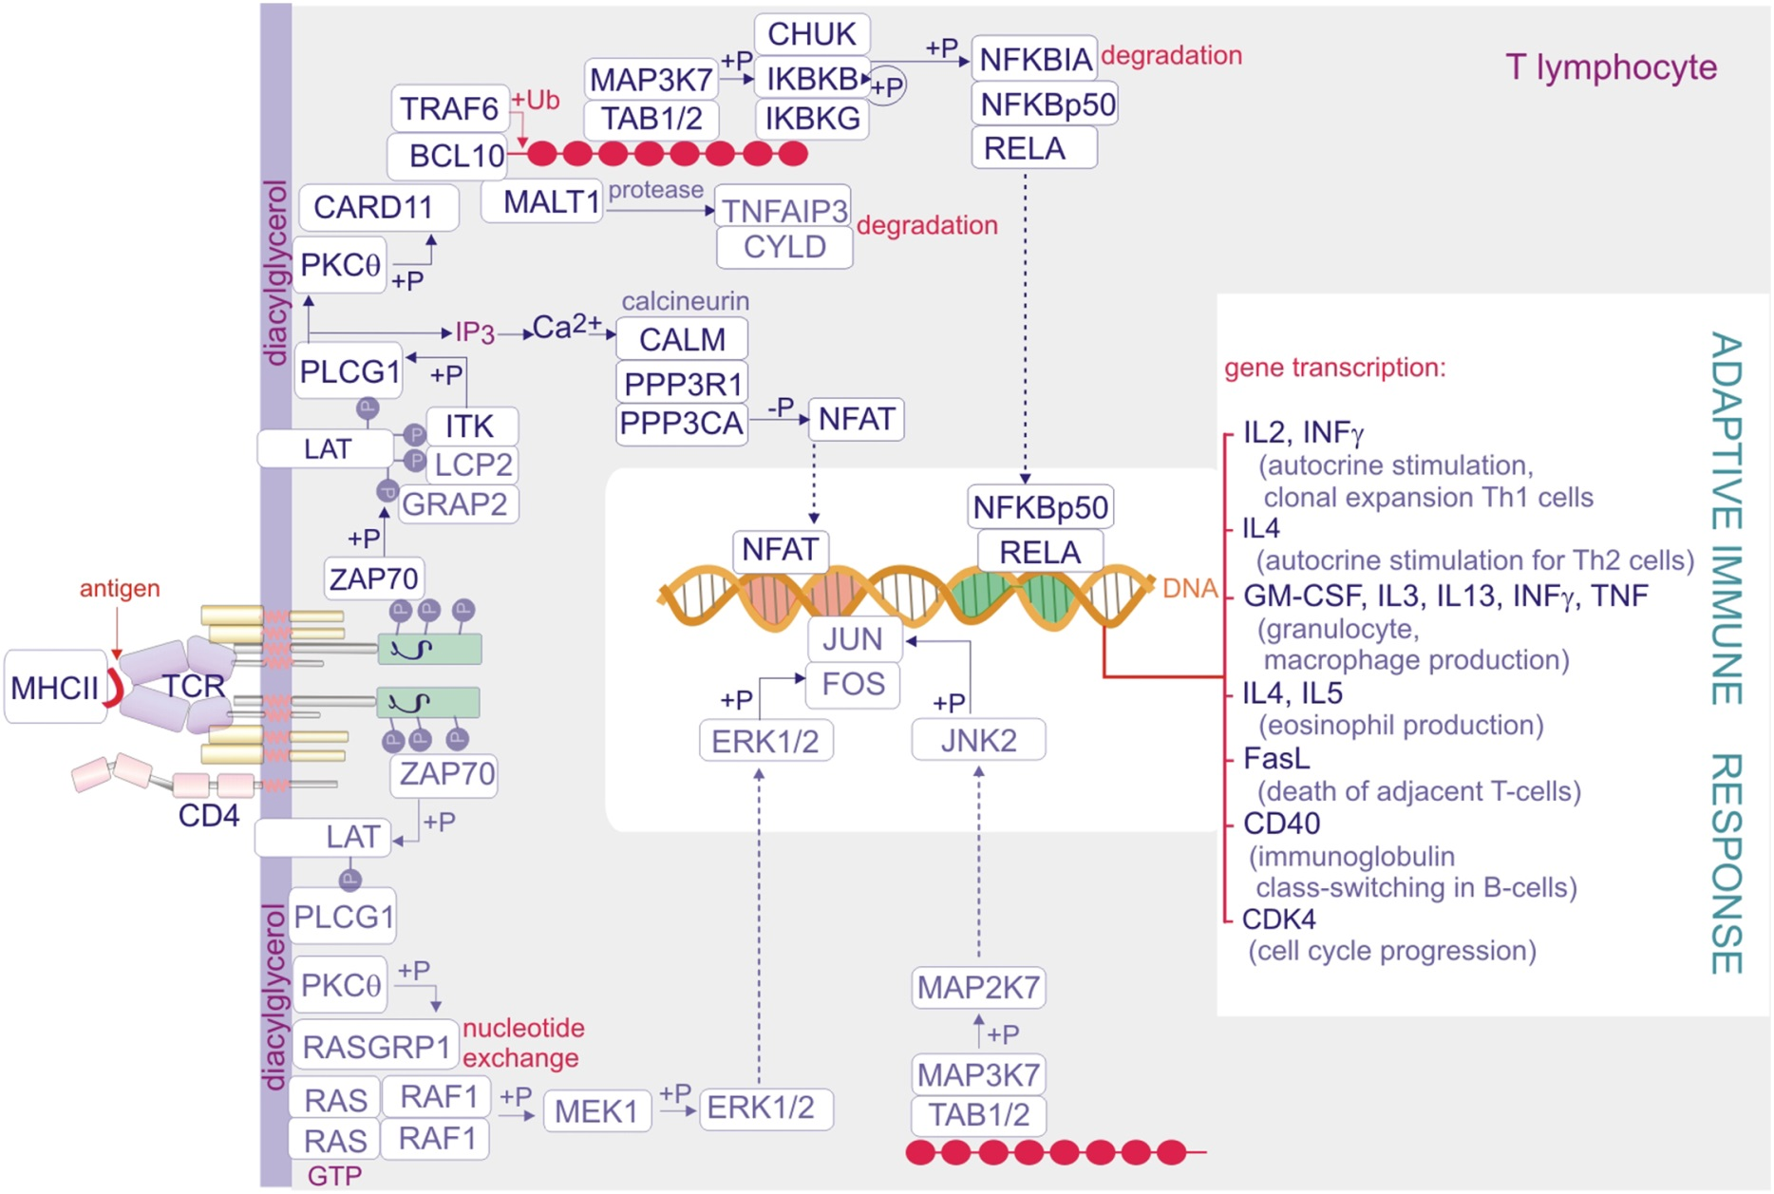
Figure 15.04

Slide 6
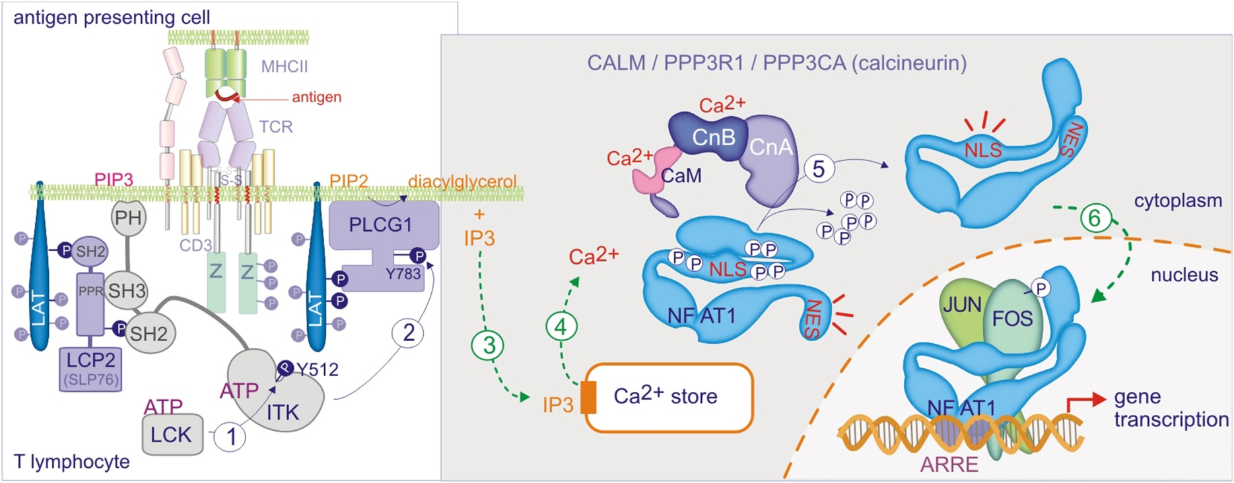
Figure 15.05

Slide 7
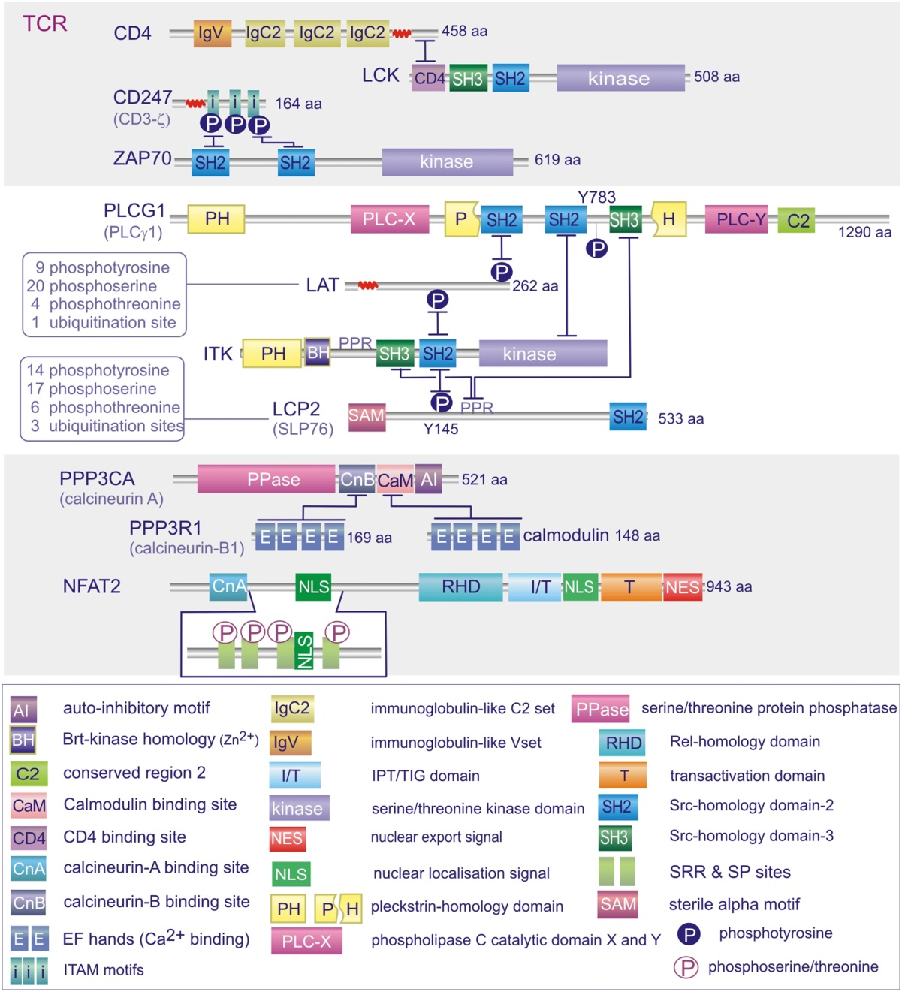
Figure 15.06

Slide 8
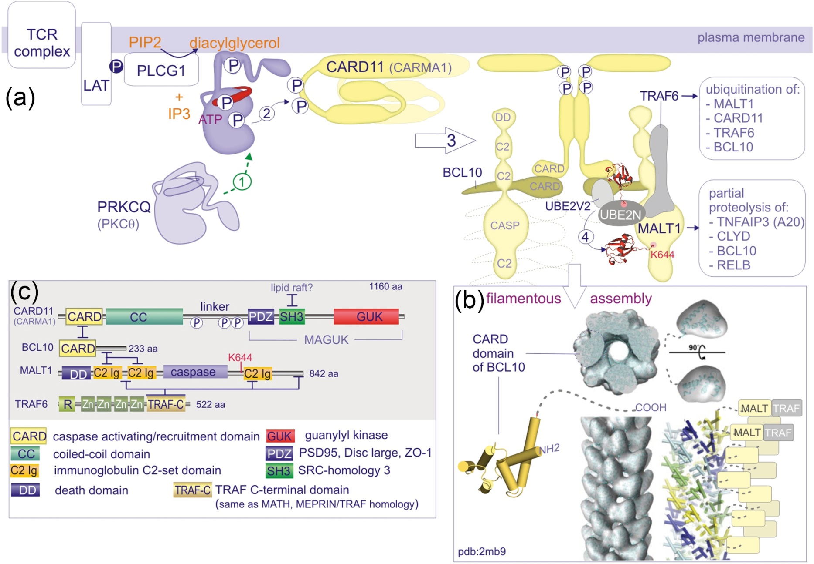
Figure 15.07

Slide 9
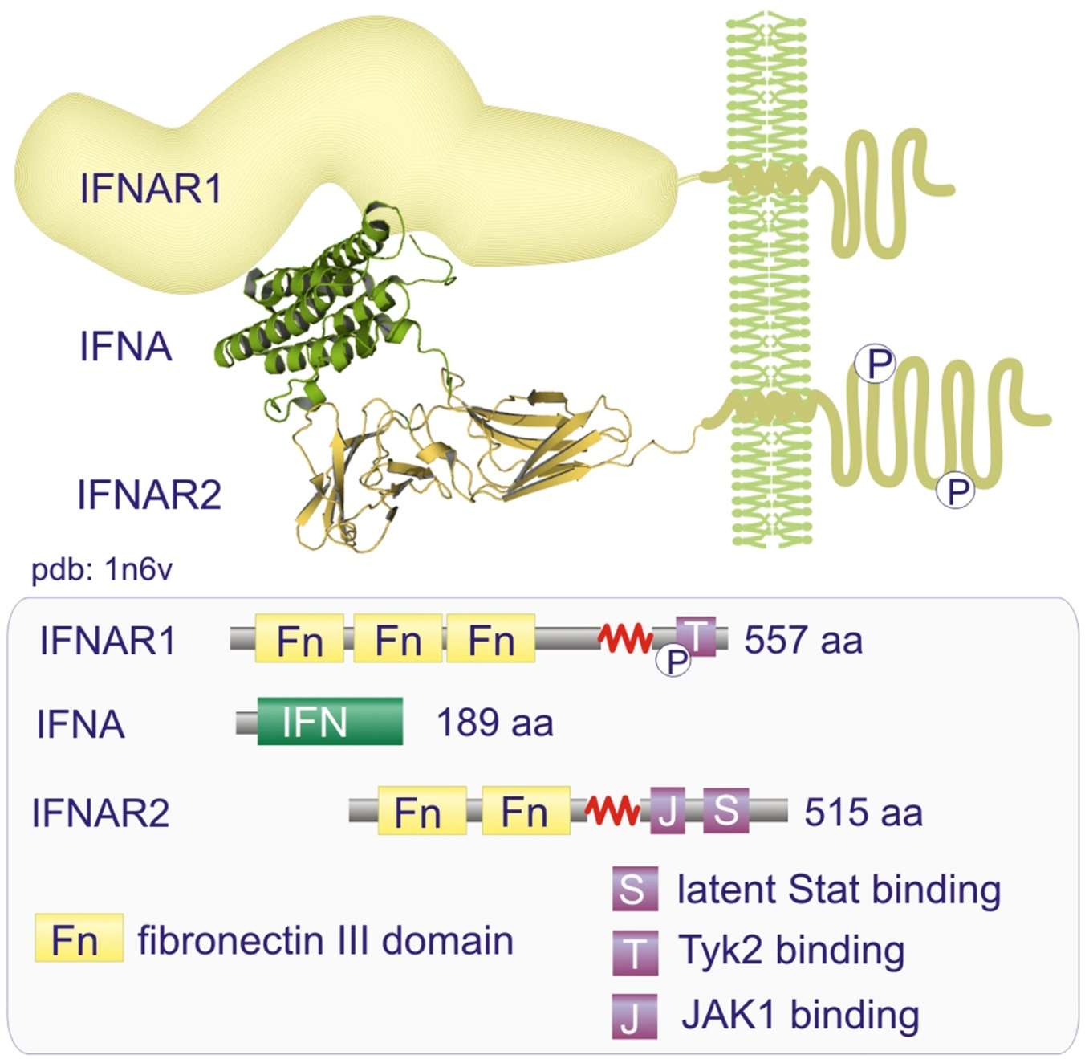
Figure 15.08

Slide 10
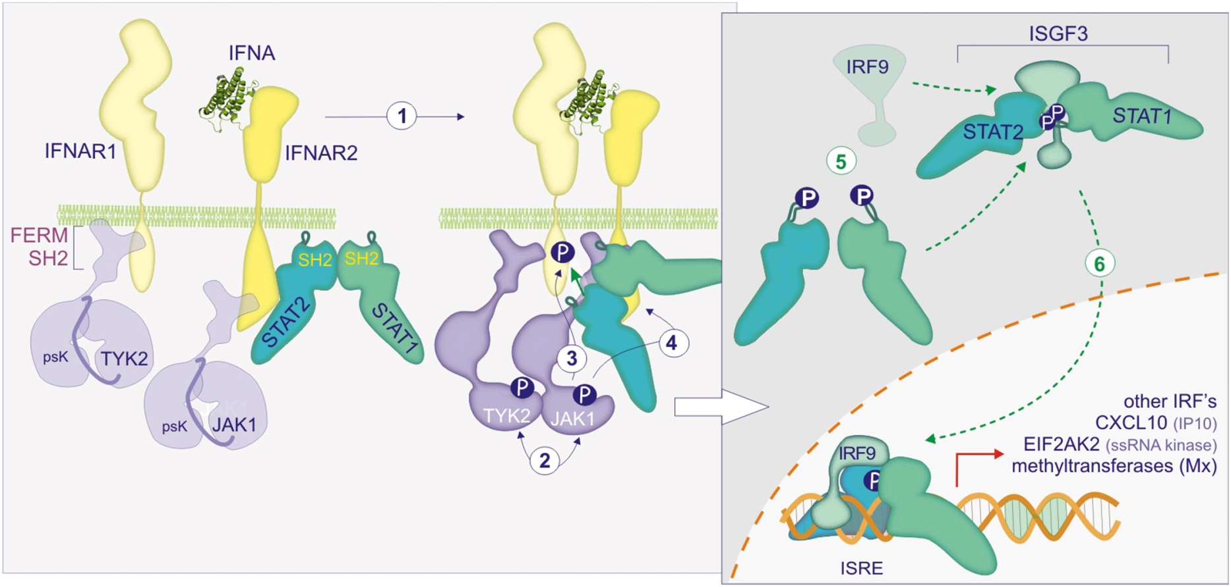
Figure 15.09

Slide 11
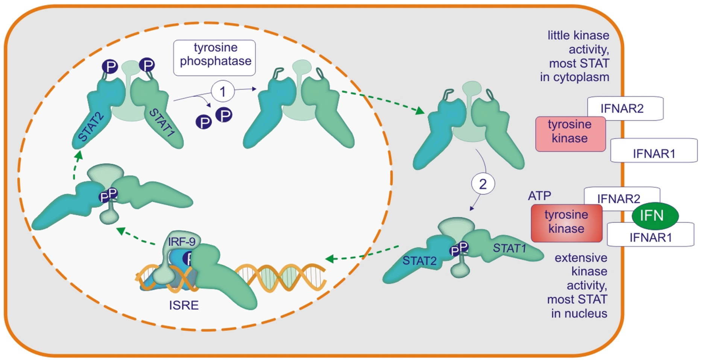
Figure 15.10

Slide 12
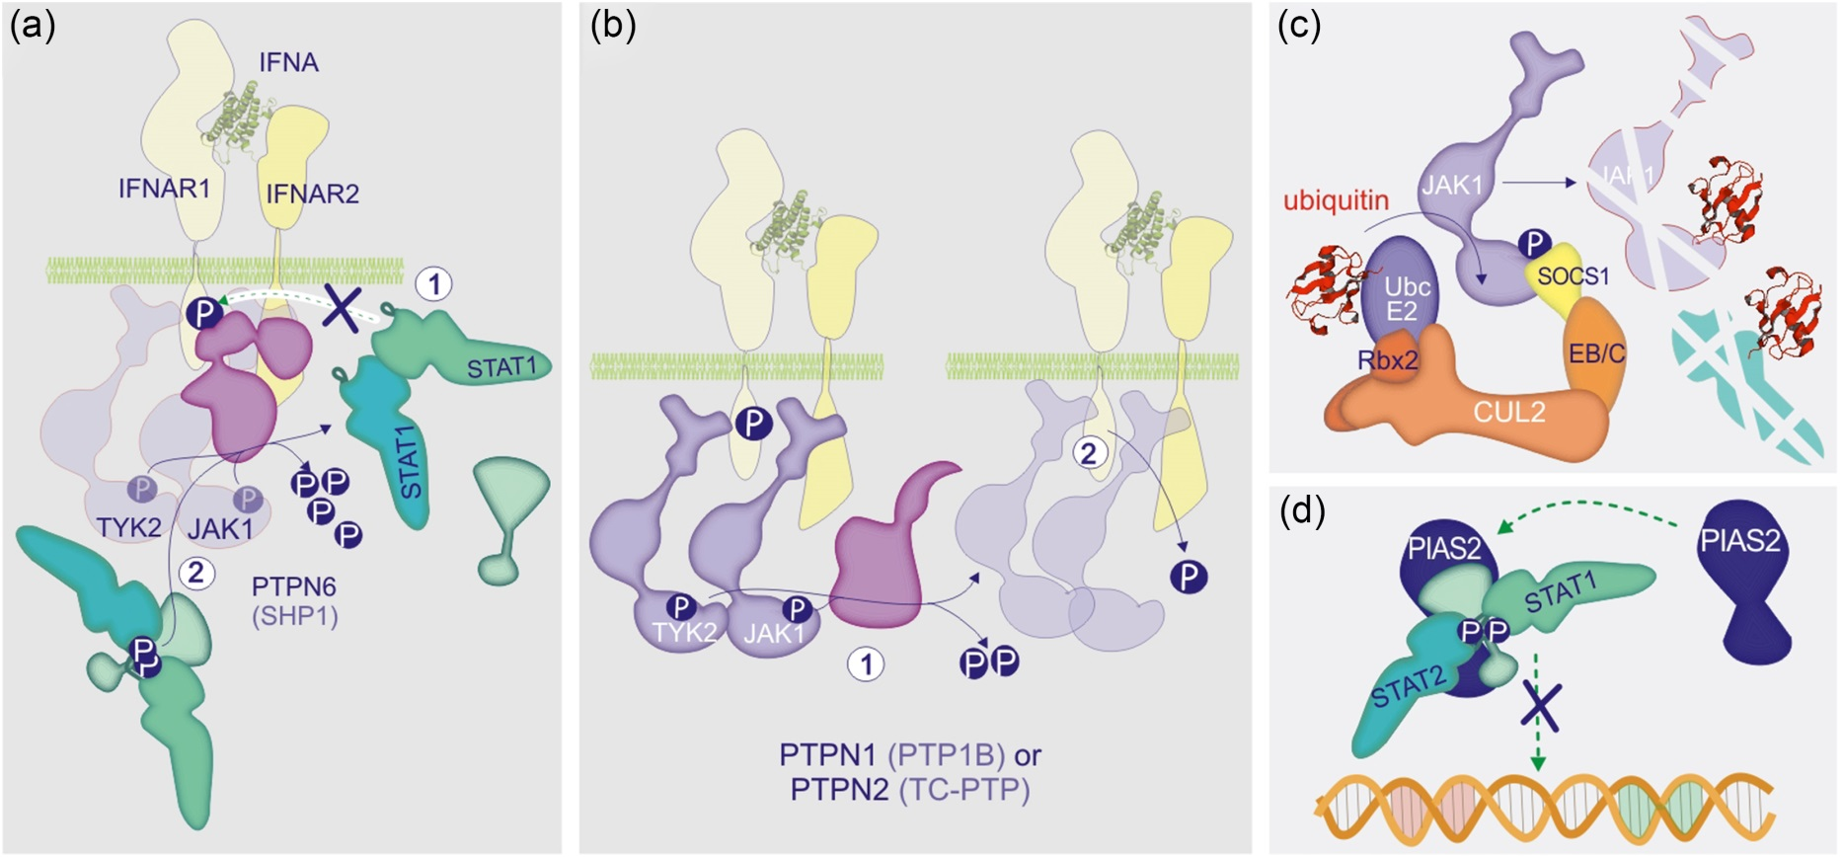
Figure 15.11

Slide 13
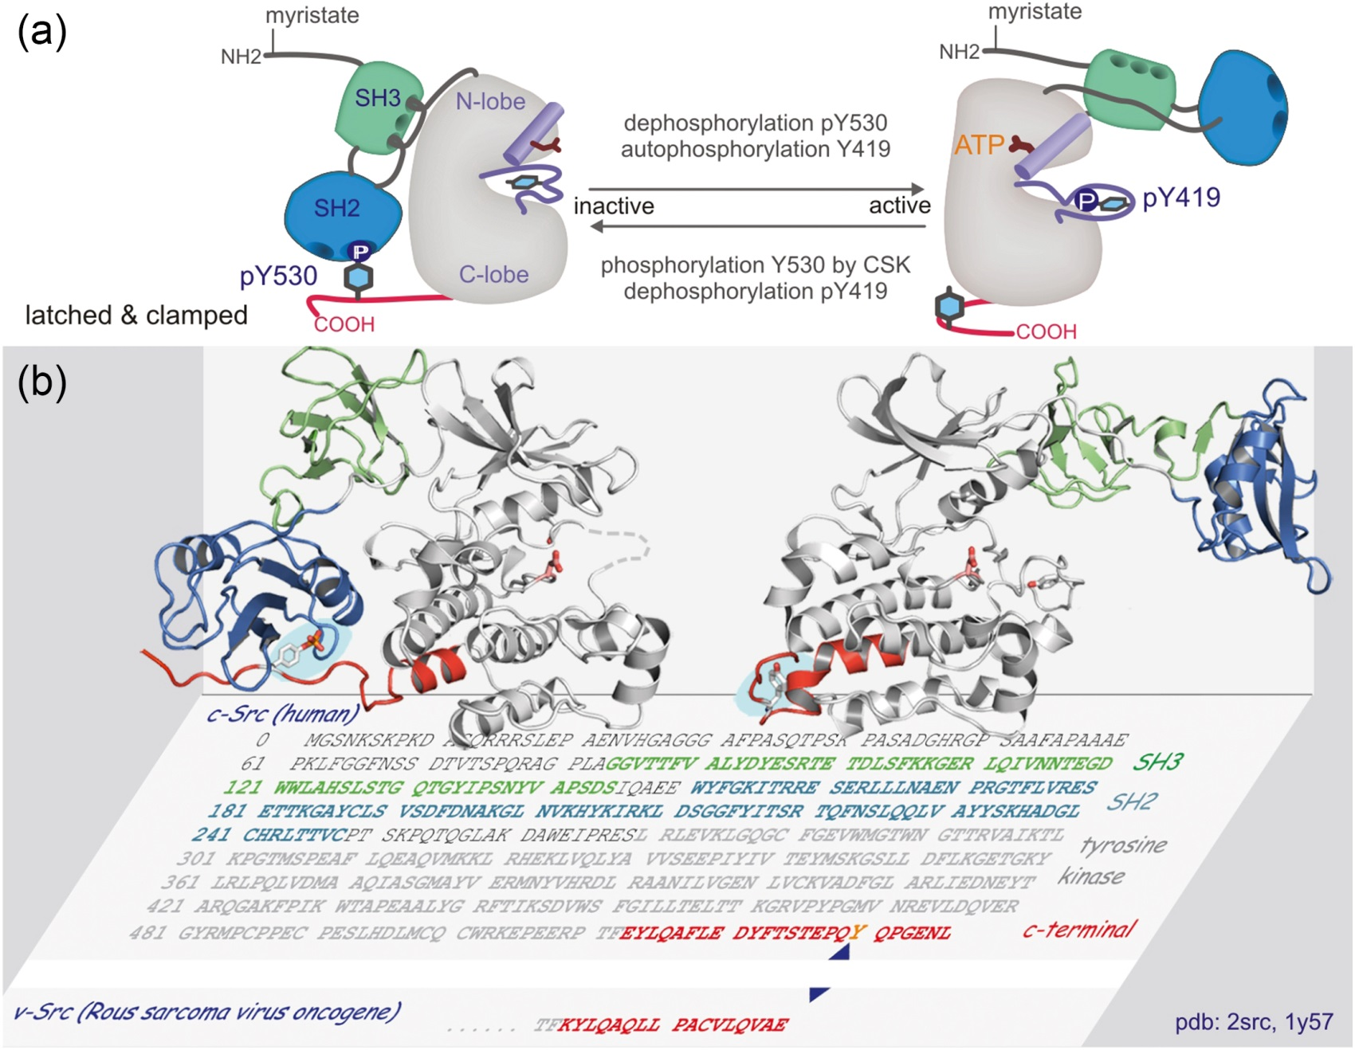
Figure 15.12

Slide 14
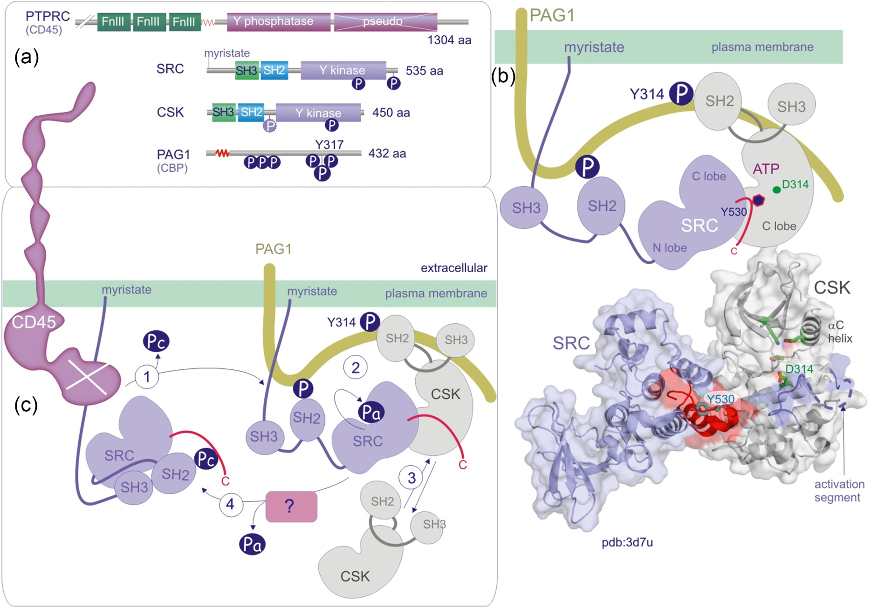
Figure 15.13

Slide 15
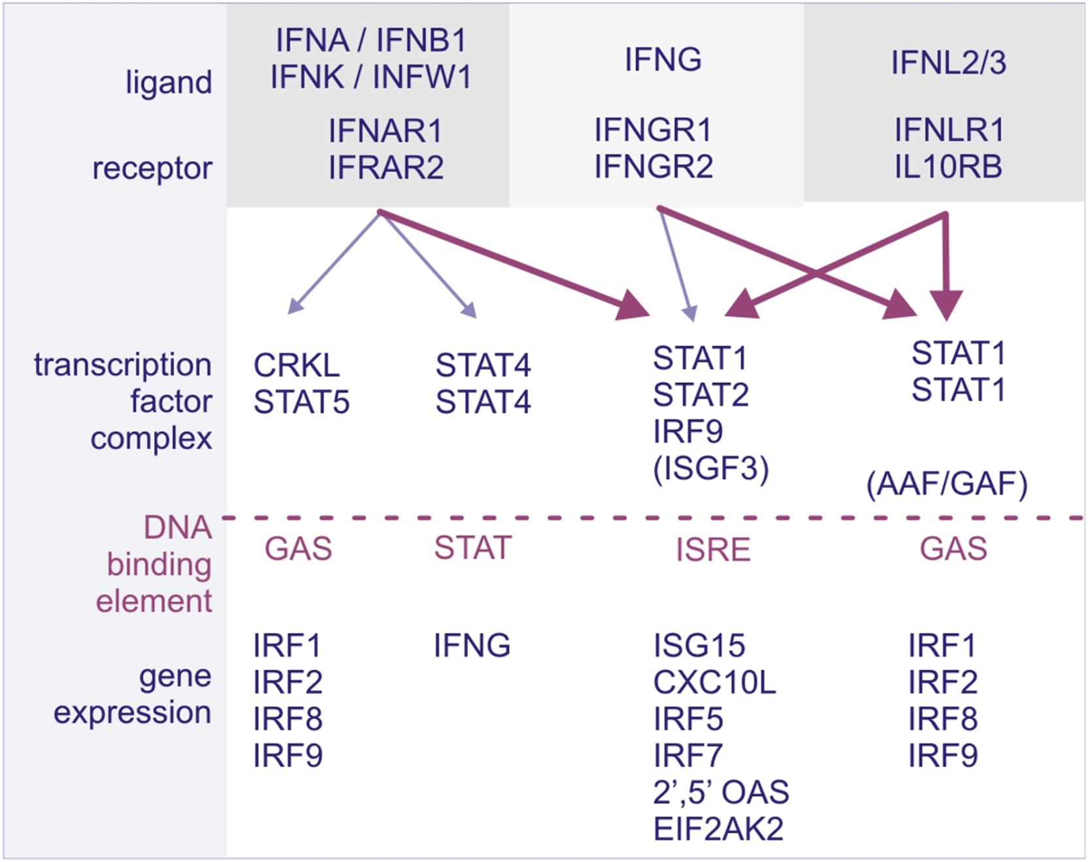
UnnFigure 15.01

