Slide 1
Chapter 19
Cell Fate Determination by Notch

Slide 2
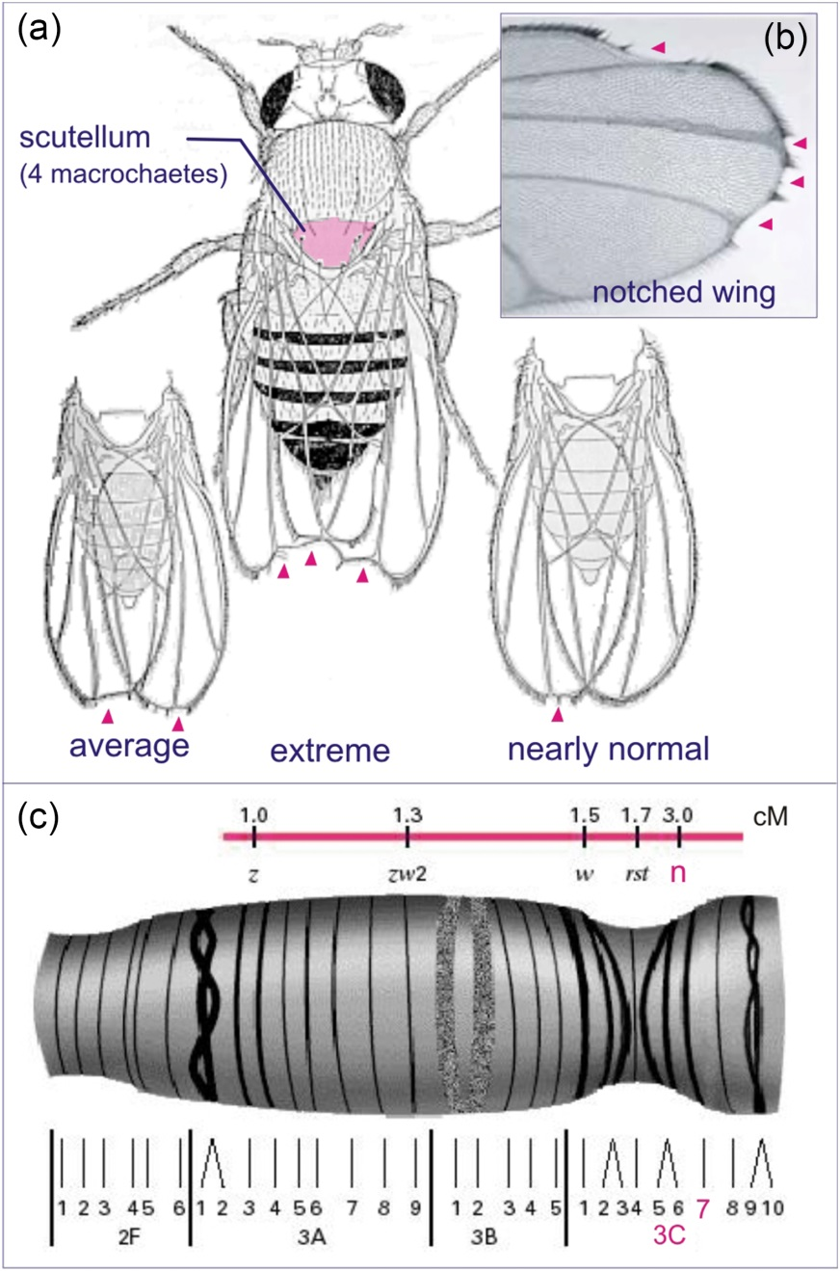
Figure 19.01

Slide 3
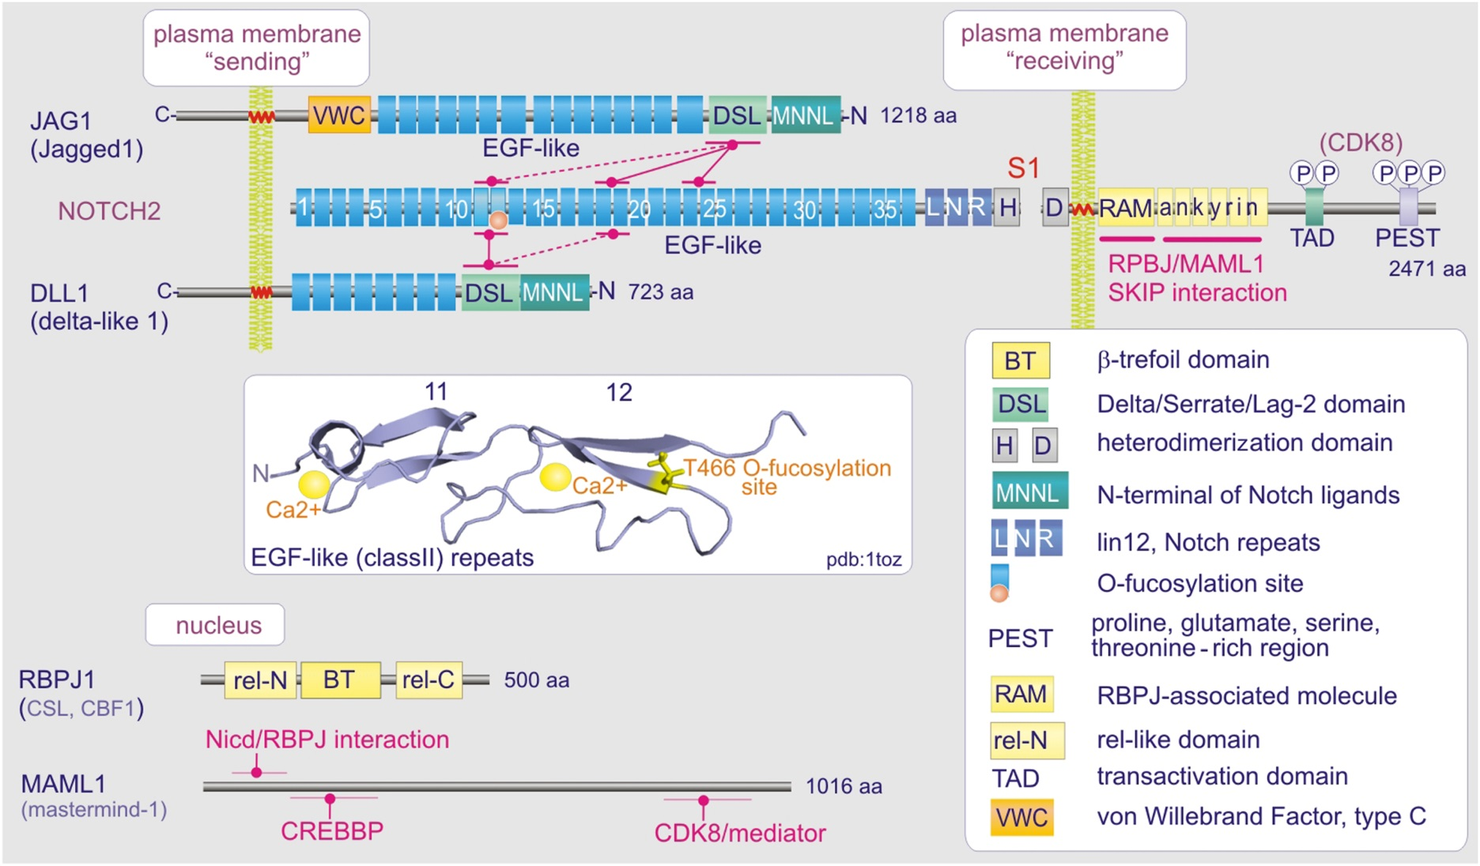
Figure 19.02

Slide 4
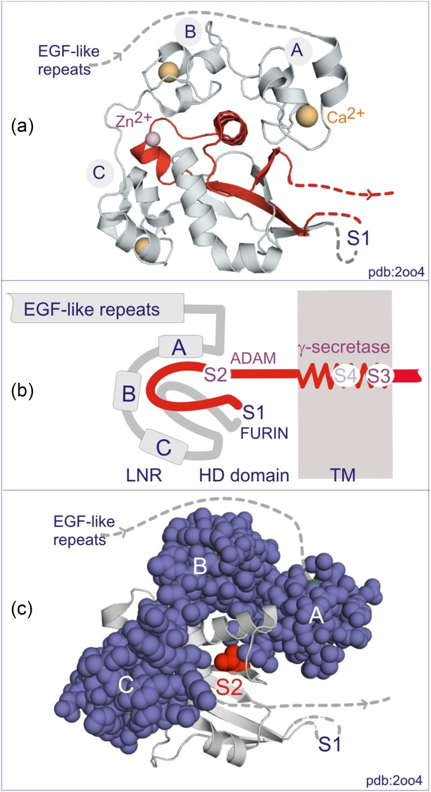
Figure 19.03

Slide 5
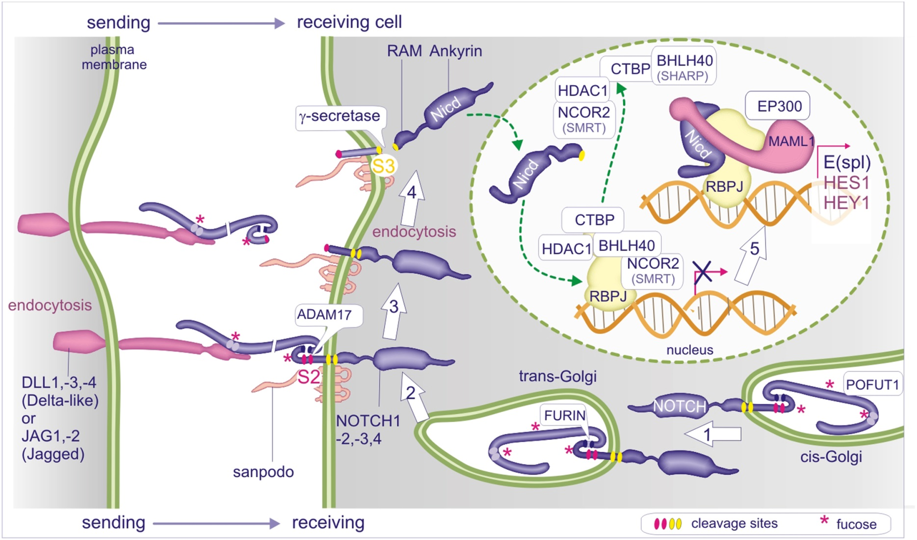
Figure 19.04

Slide 6
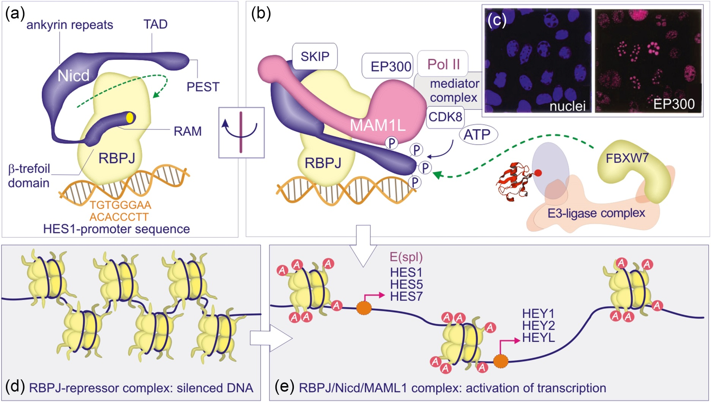
Figure 19.05

Slide 7
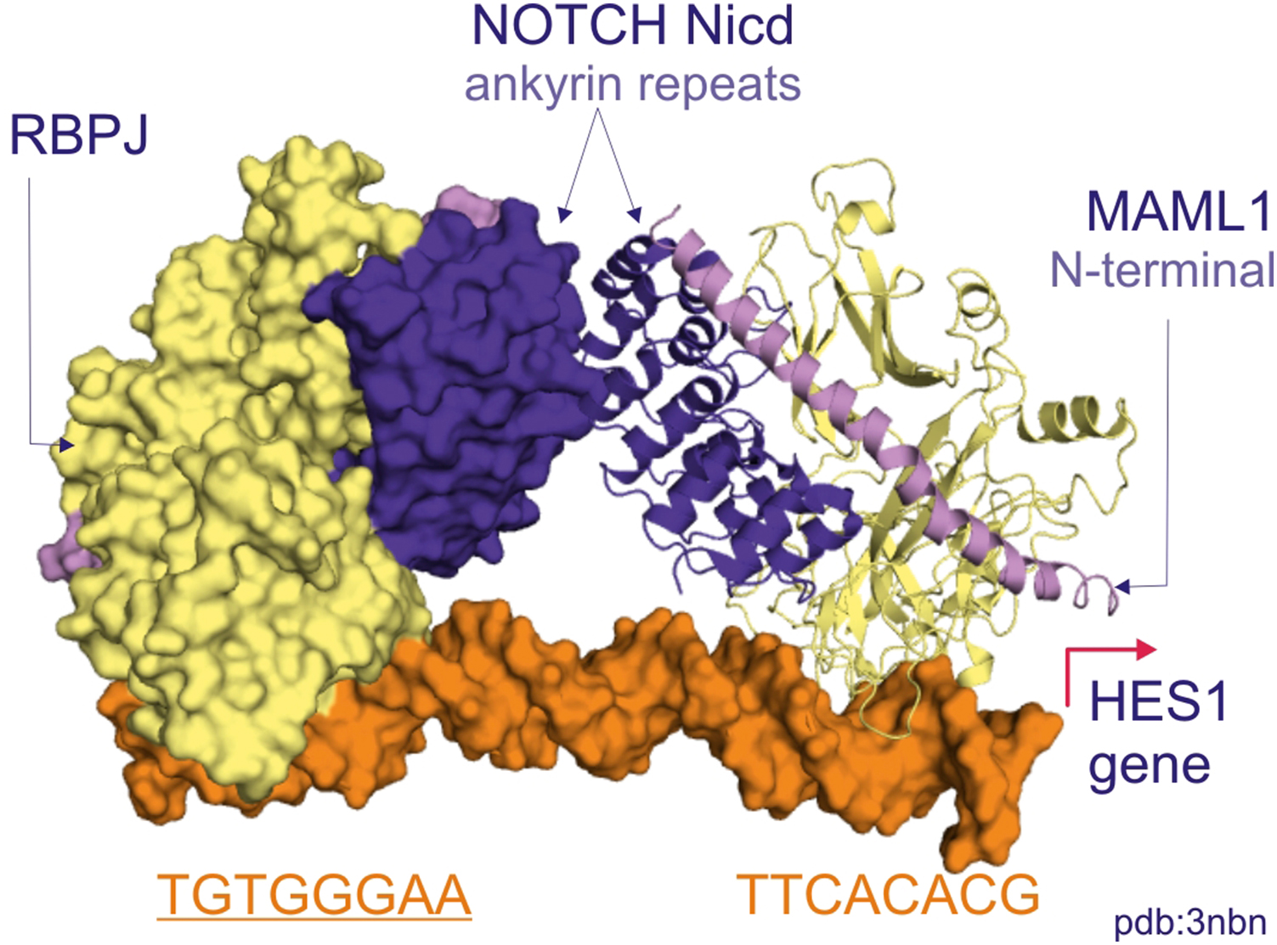
Figure 19.06

Slide 8
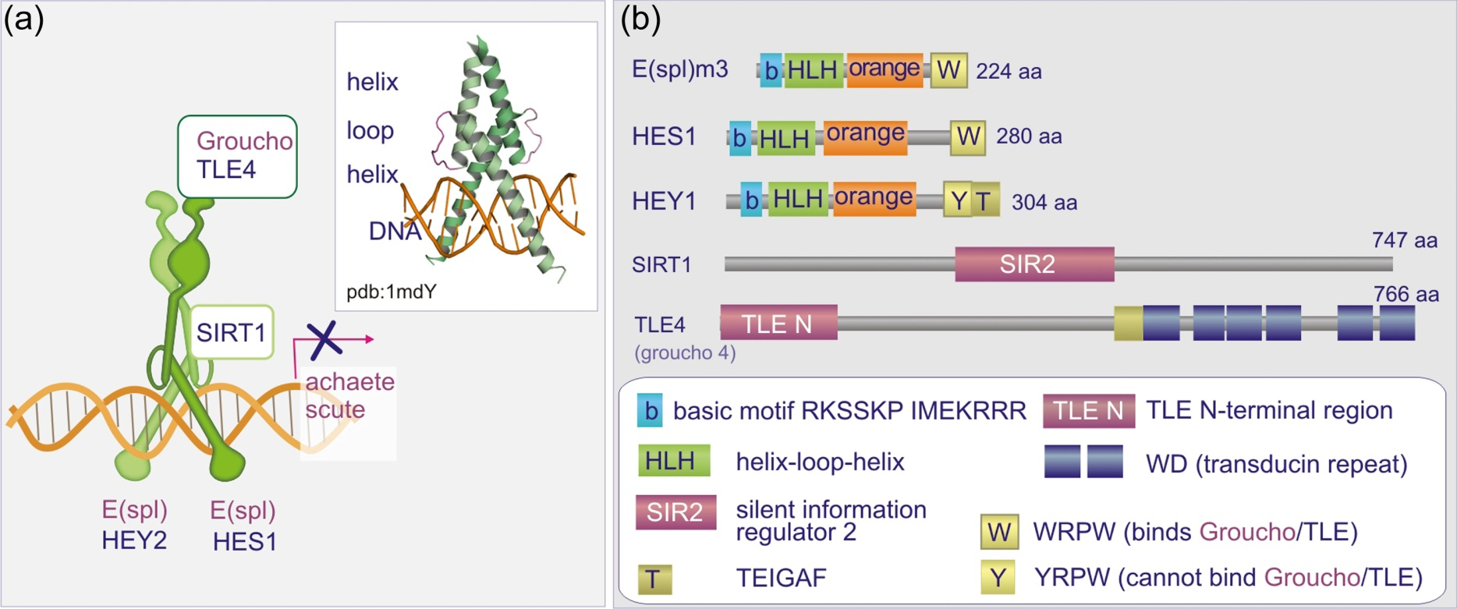
Figure 19.07

Slide 9
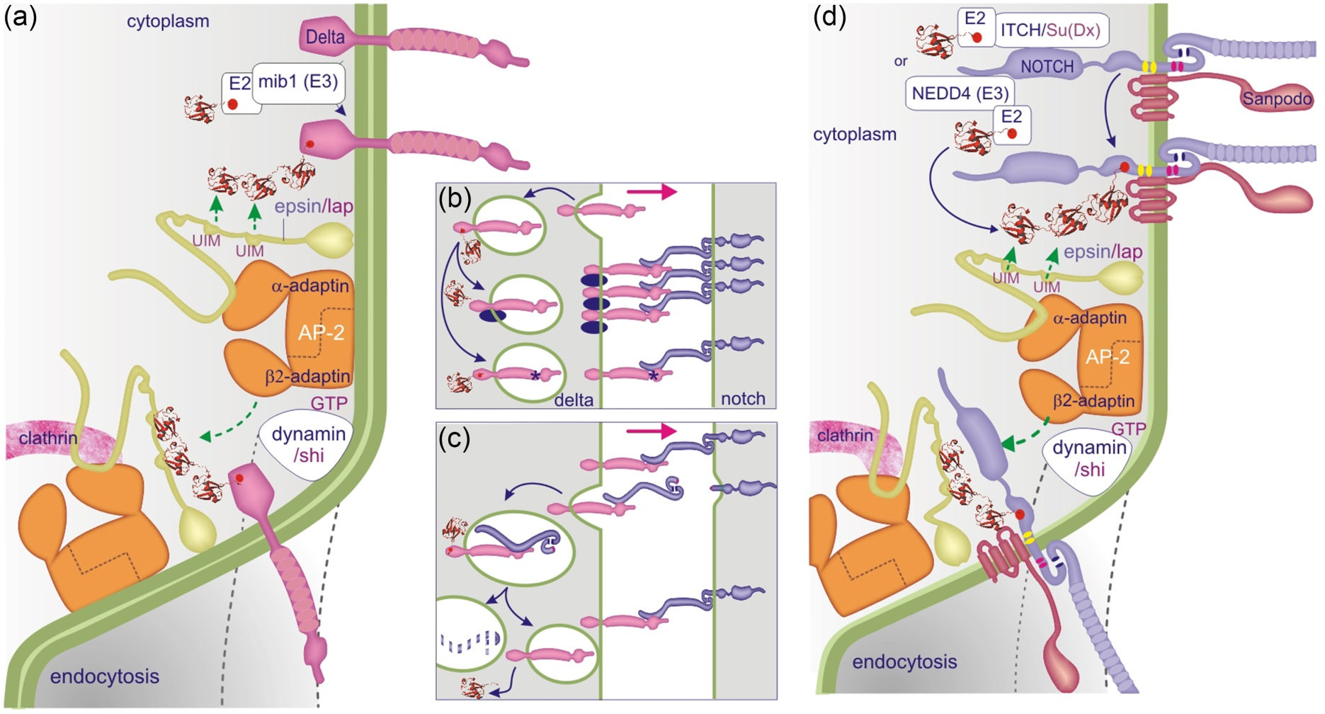
Figure 19.08

Slide 10
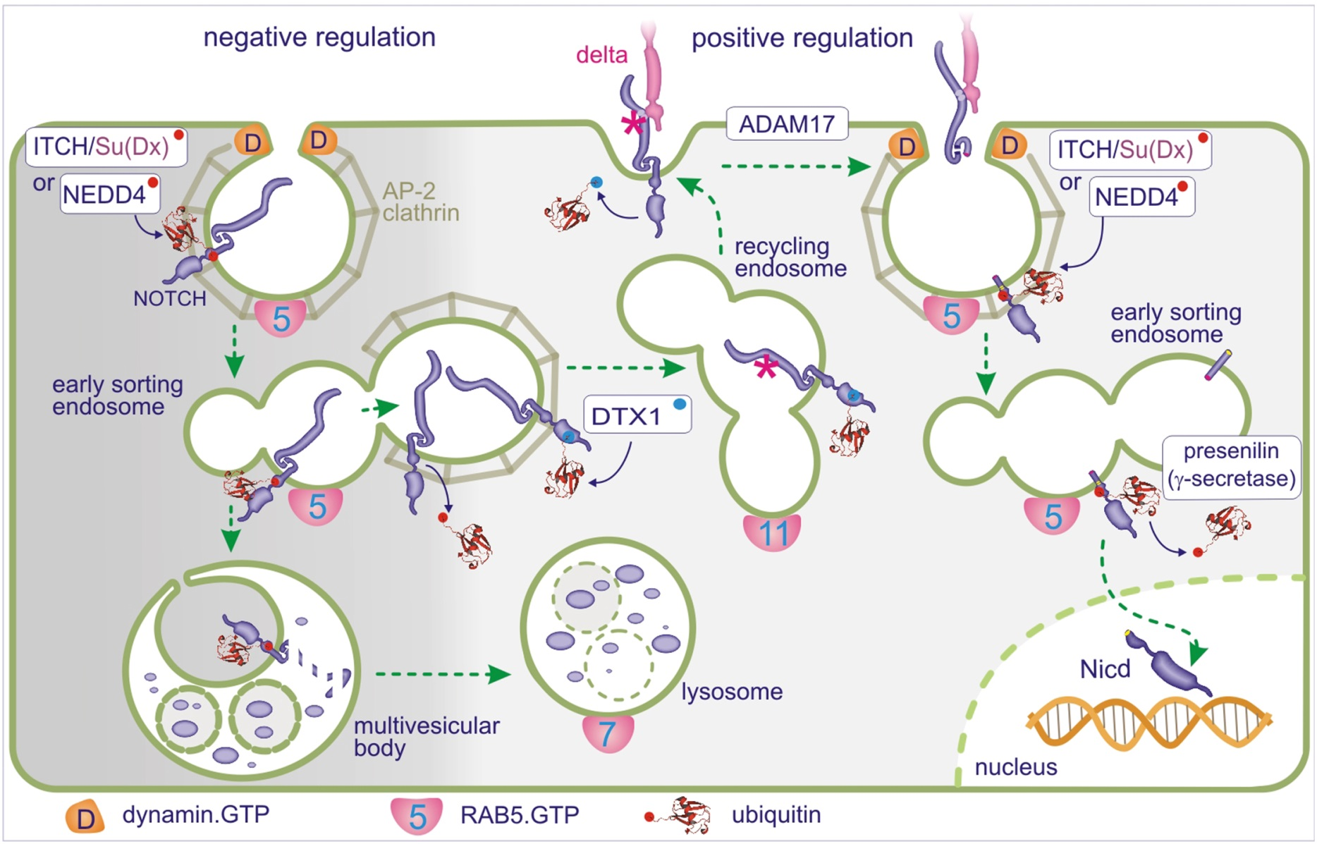
Figure 19.09

Slide 11
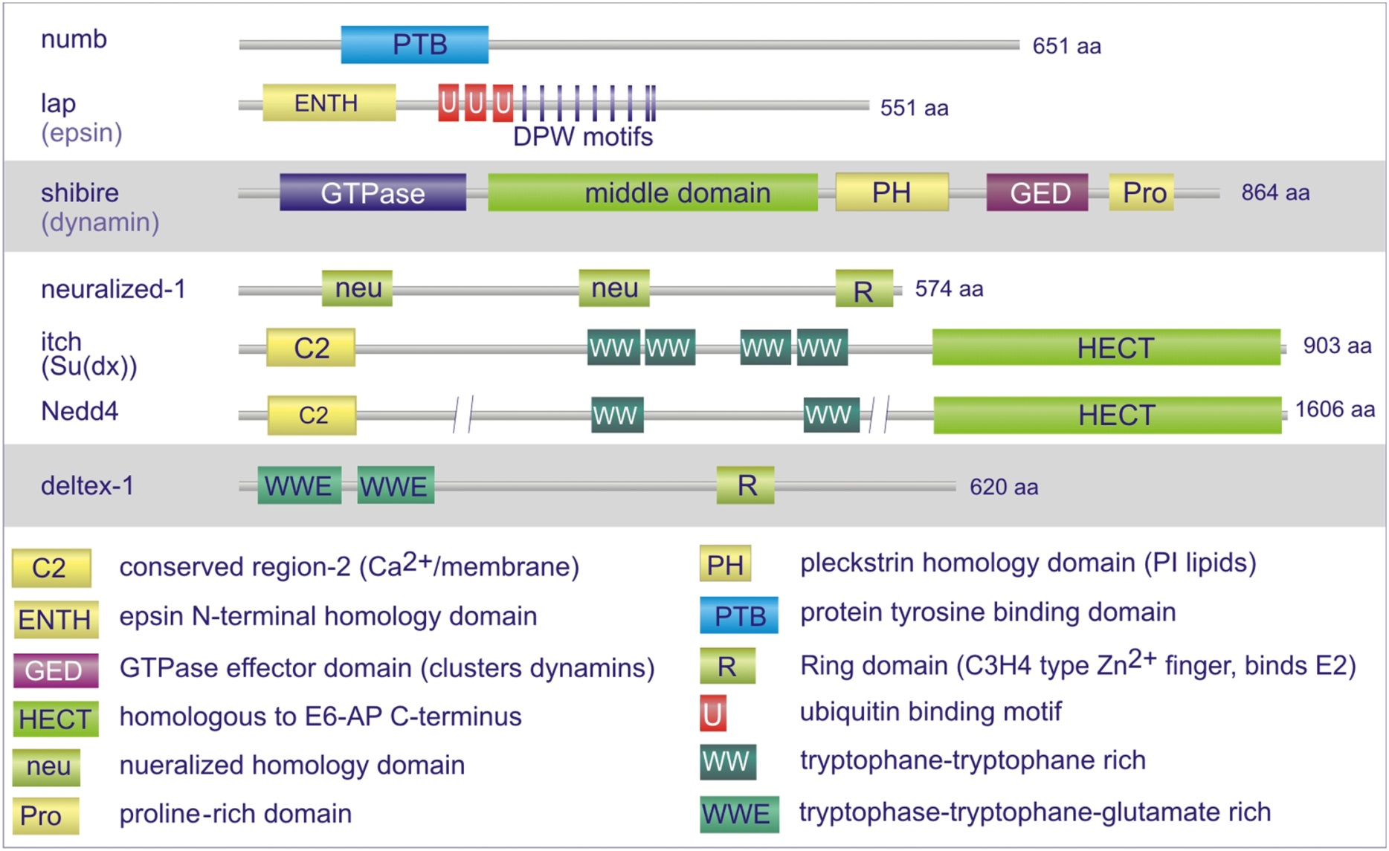
Figure 19.10

Slide 12
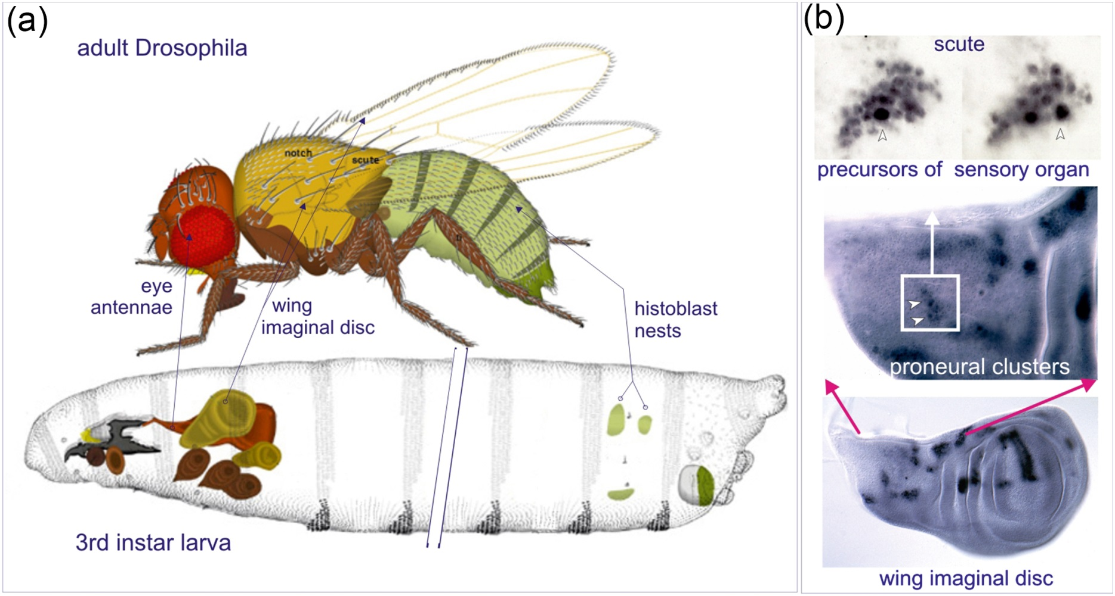
Figure 19.11

Slide 13
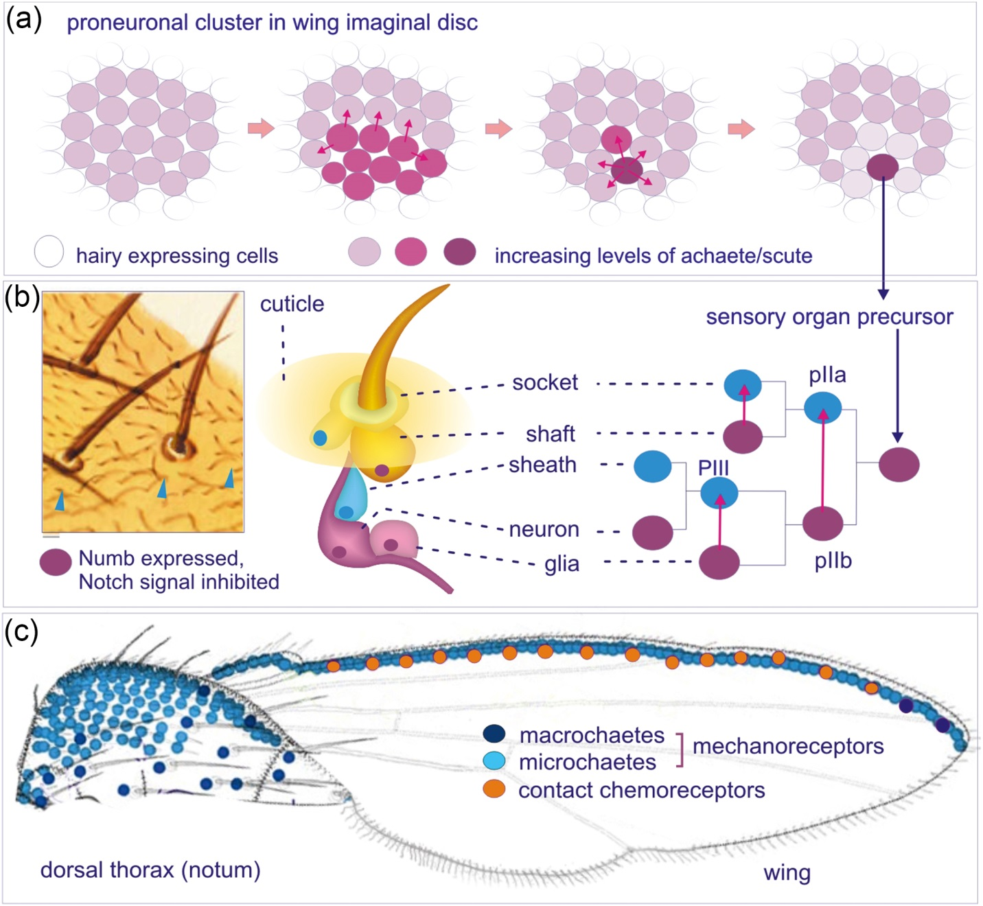
Figure 19.12

Slide 14
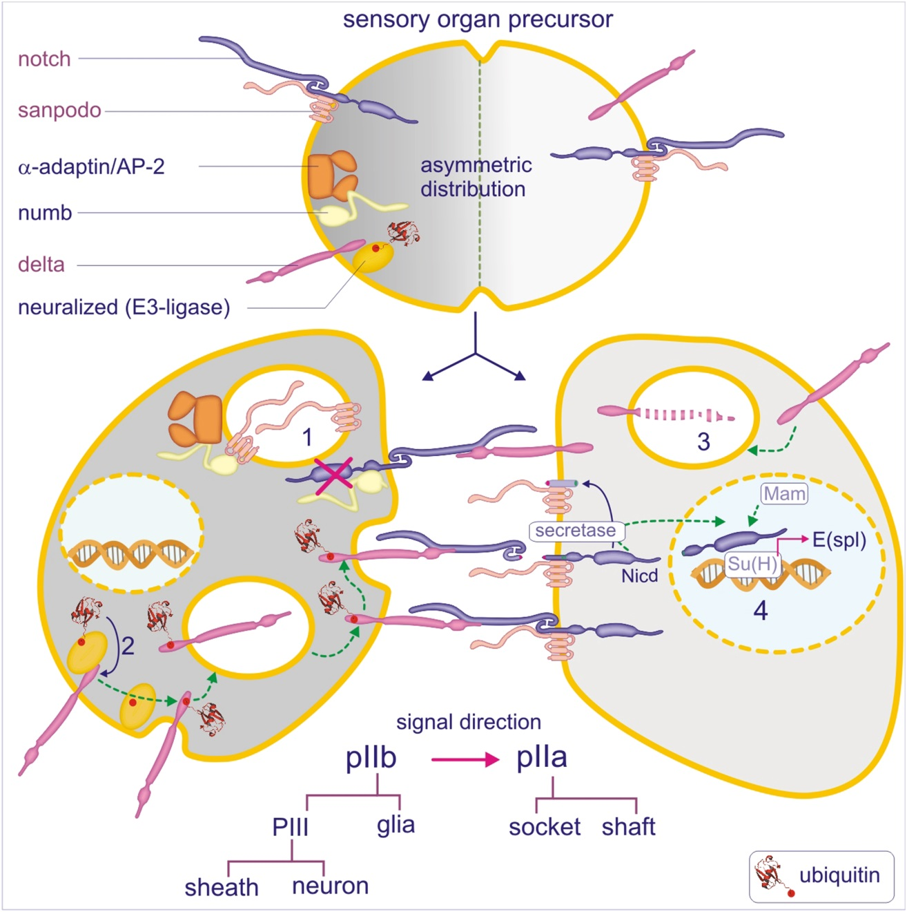
Figure 19.13

Slide 15
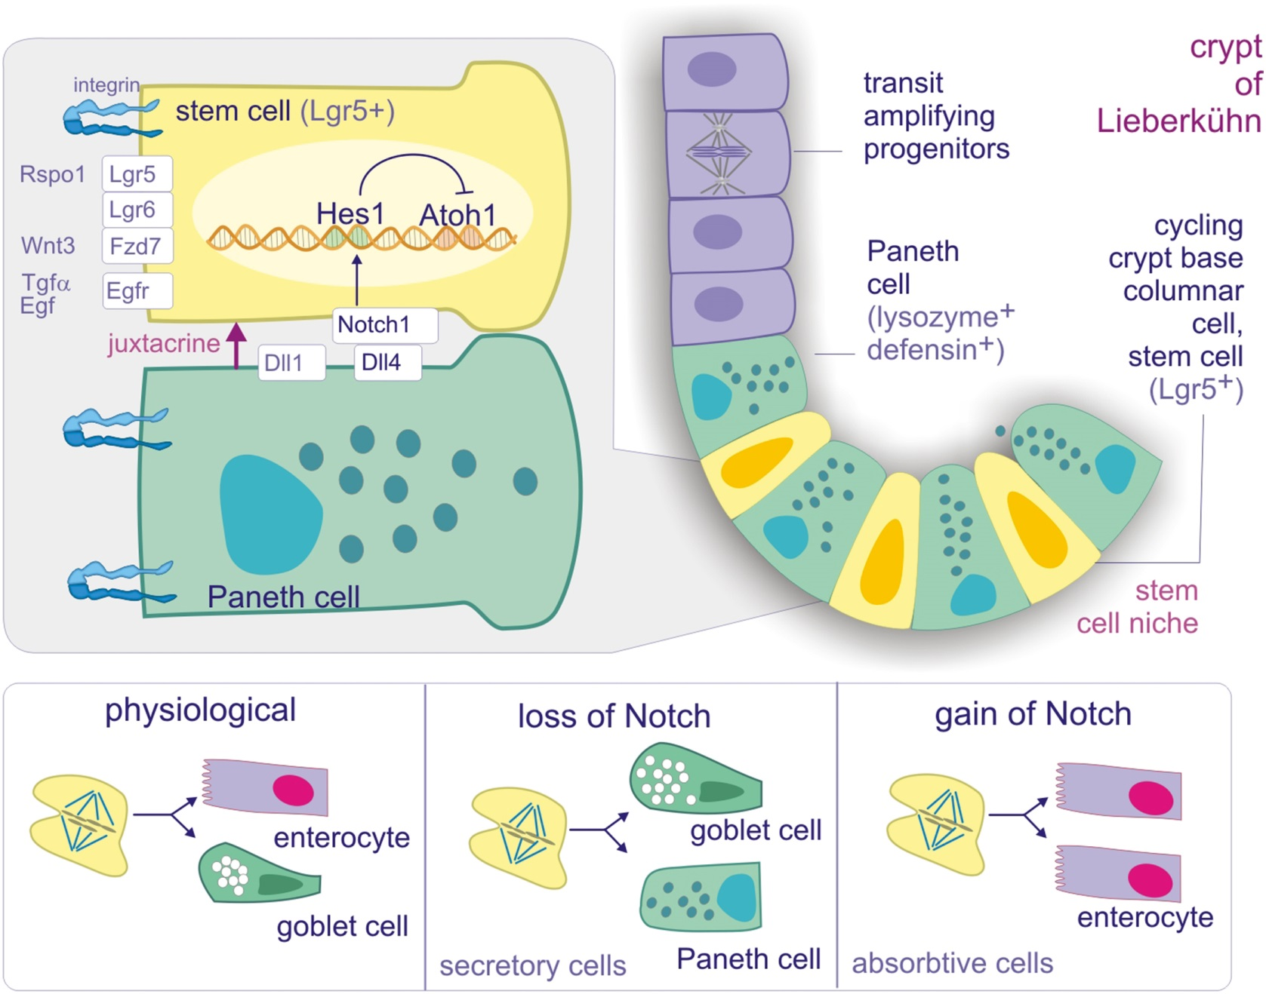
Figure 19.14

Slide 16
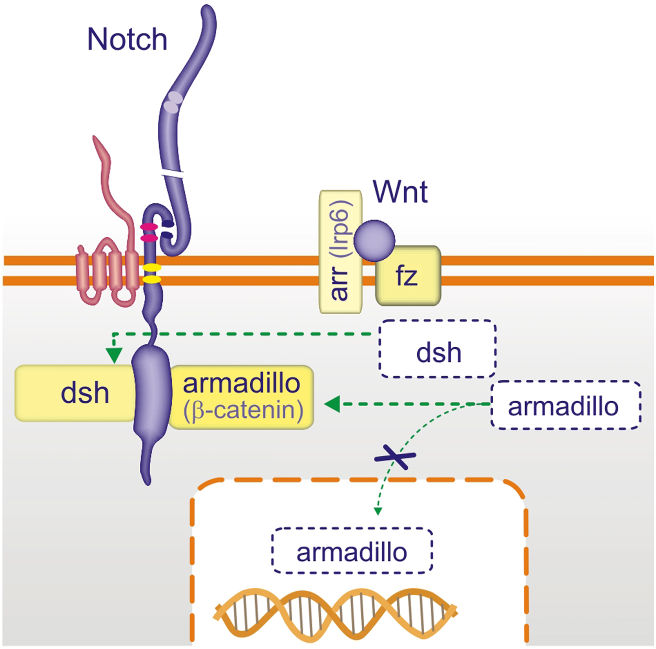
Figure 19.15

Slide 17
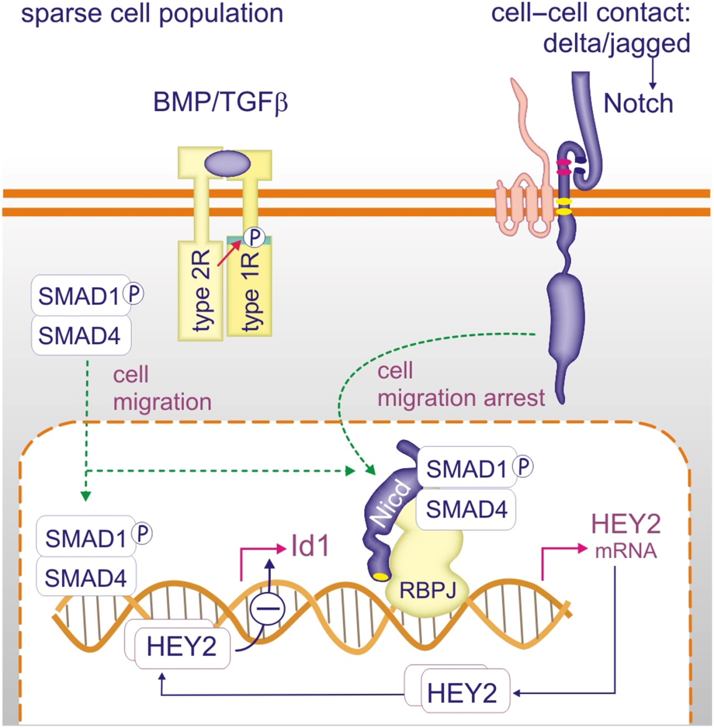
Figure 19.16

Slide 18
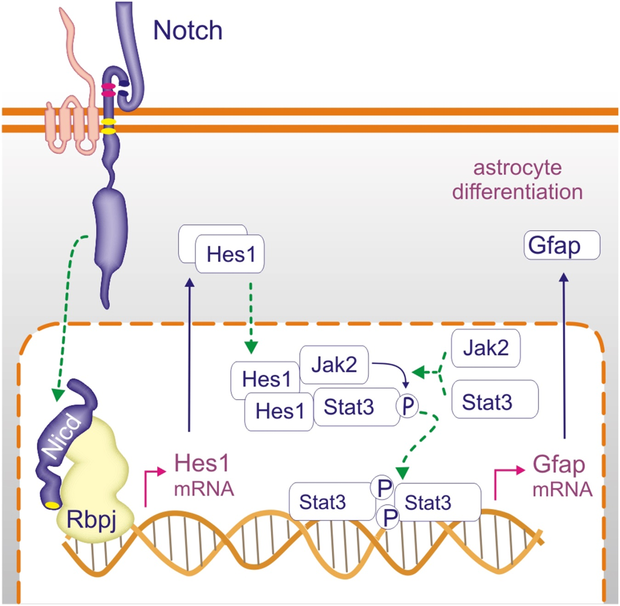
Figure 19.17

Slide 19
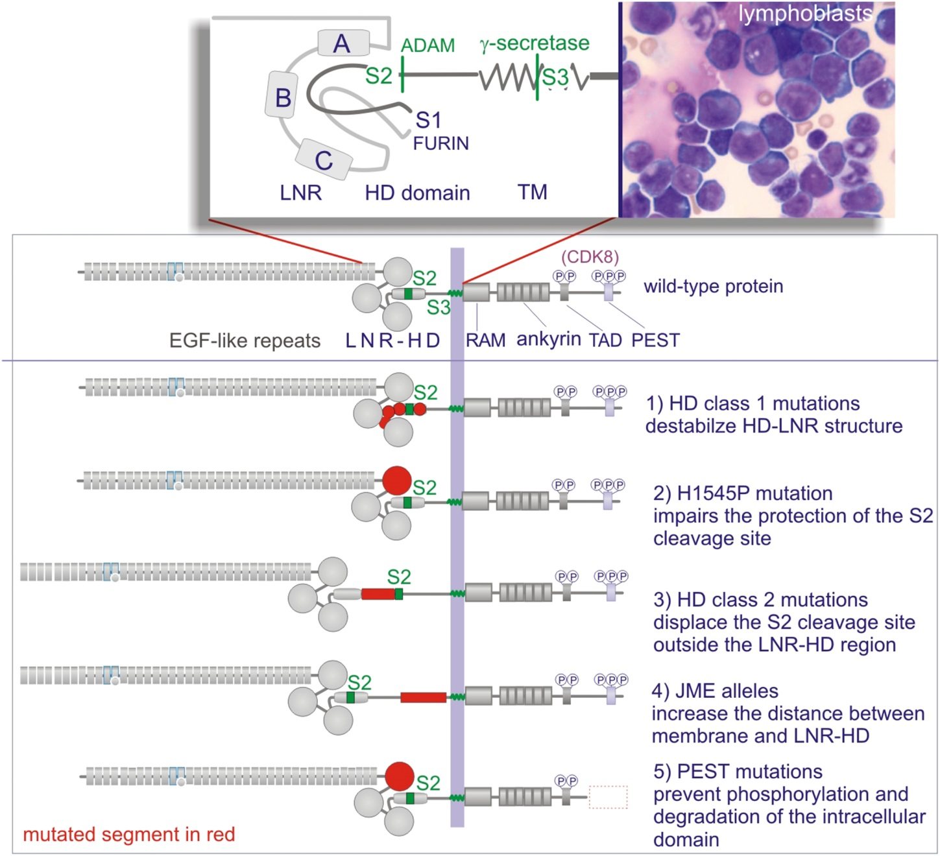
Figure 19.18

