Slide 1
Chapter 02
Water, Acids, Bases, and Buffers

Slide 2
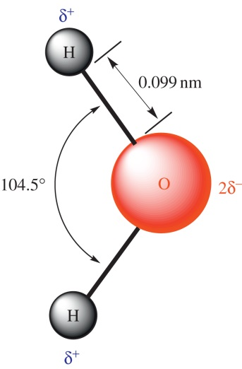
Figure 2.1

Slide 3
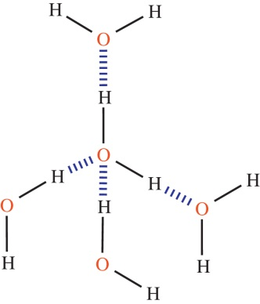
Figure 2.2

Slide 4
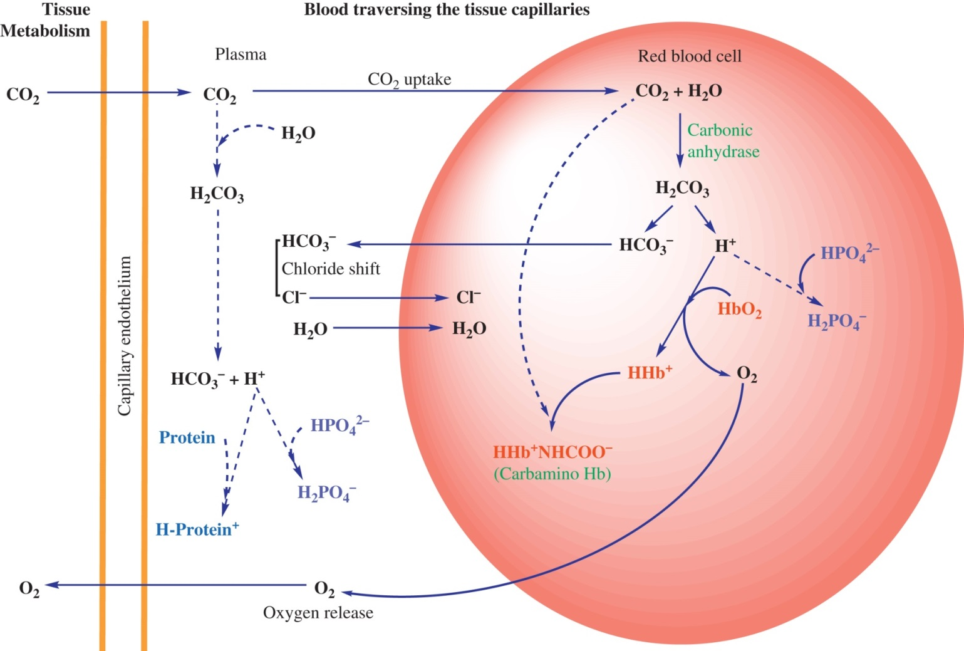
Figure 2.3

Slide 5
Figure 2.4

Slide 6
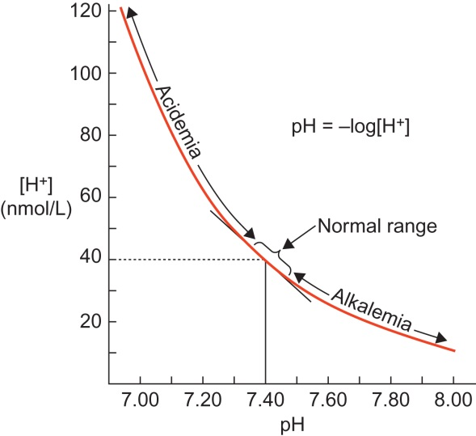
Figure 2.5

Slide 7
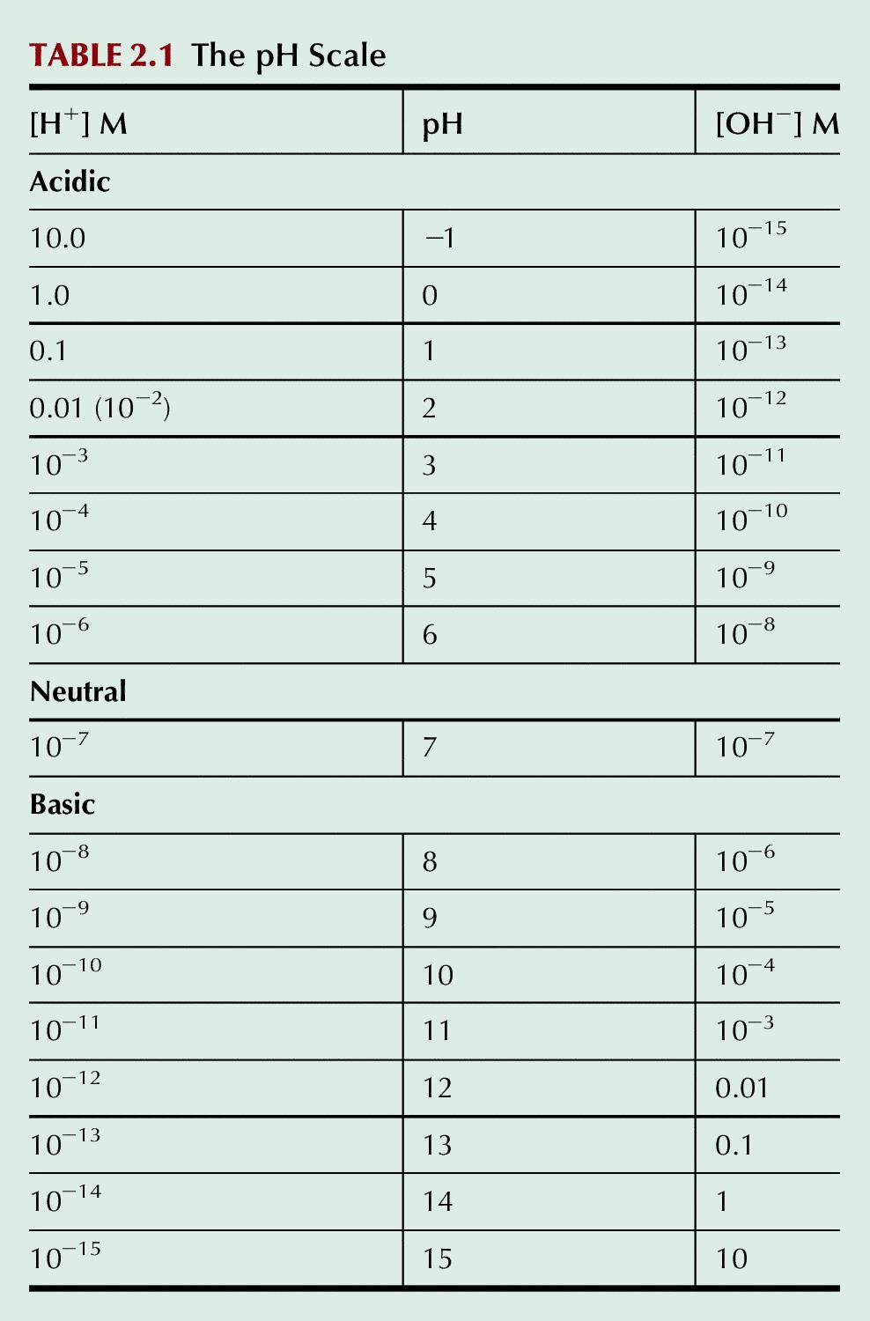
Table 2.1

Slide 8
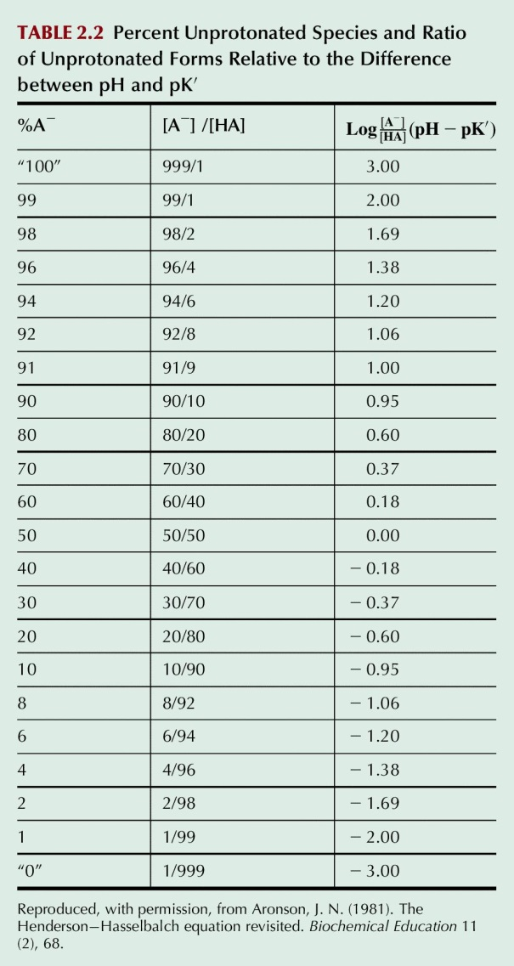
Table 2.2

Slide 9
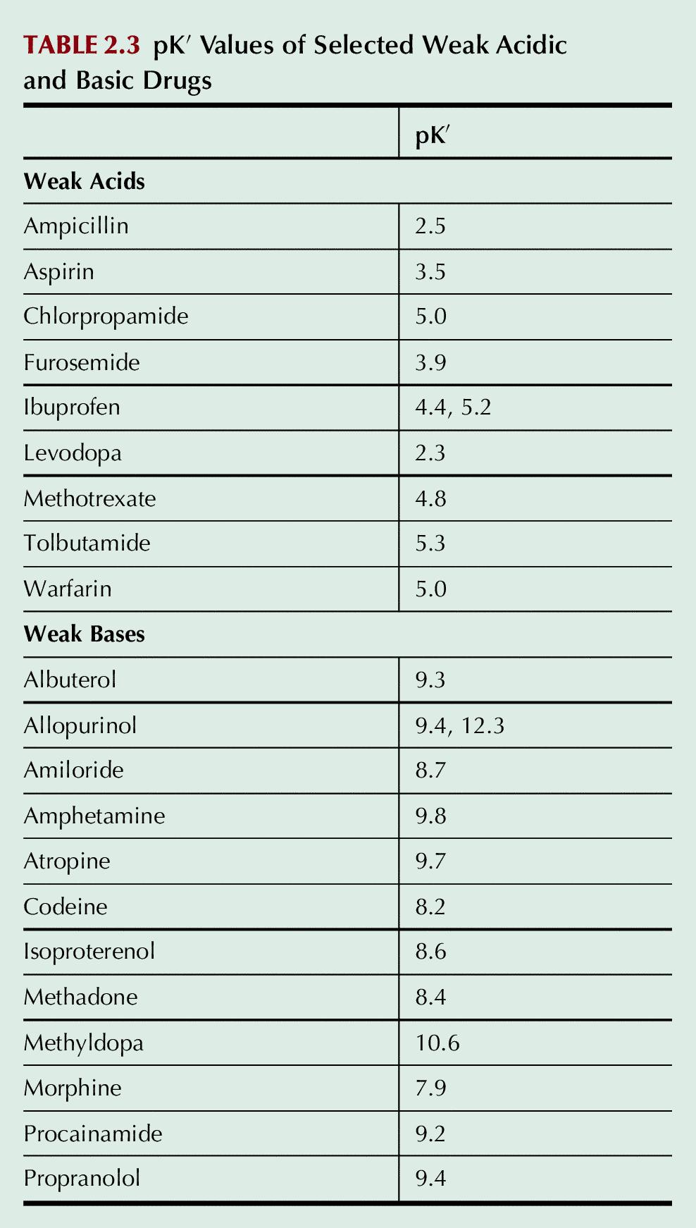
Table 2.3

Slide 10
UnFig 2.1

