Slide 1
Chapter 04
Three-Dimensional Structure of Proteins

Slide 2
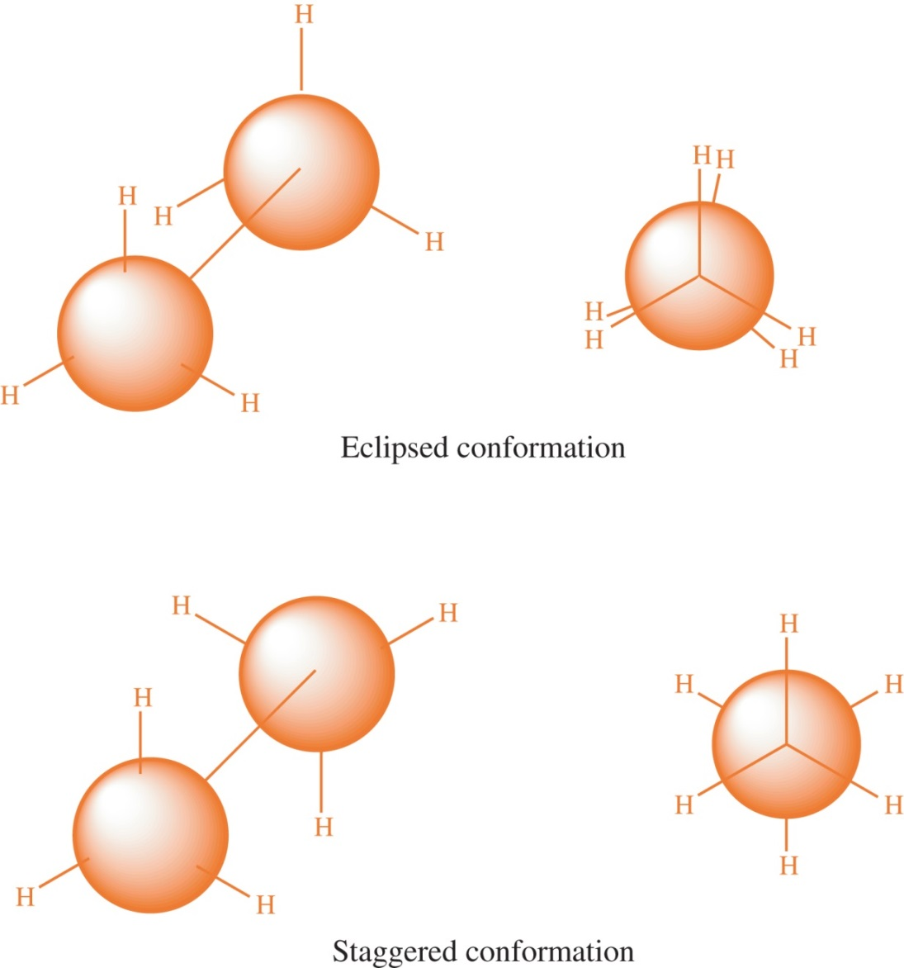
Figure 4.1

Slide 3
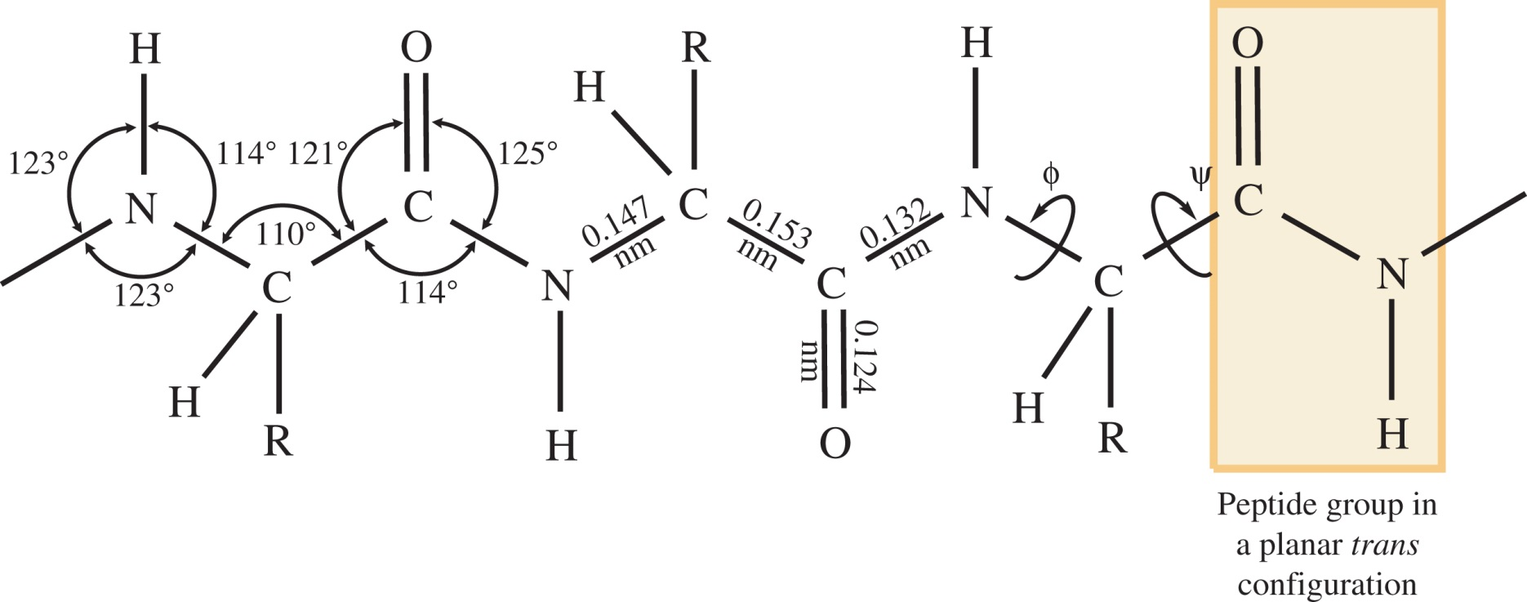
Figure 4.2

Slide 4
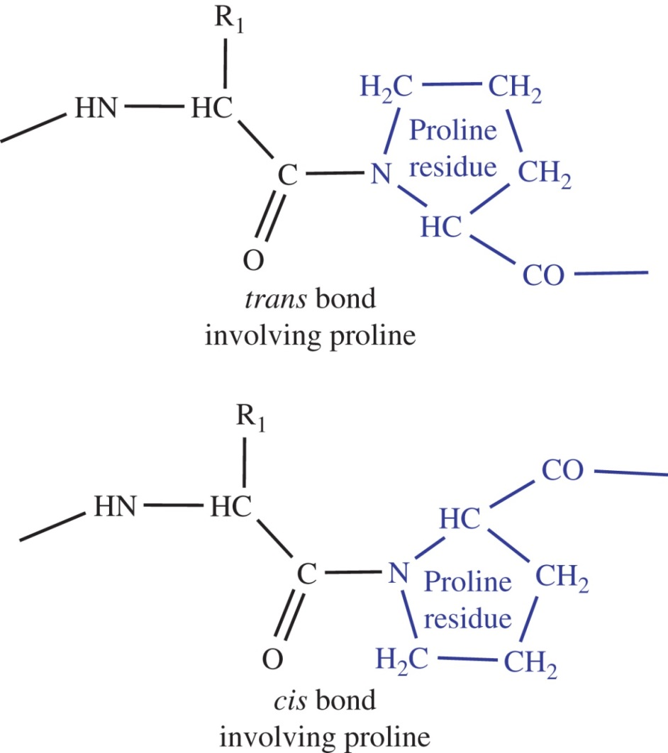
Figure 4.3

Slide 5
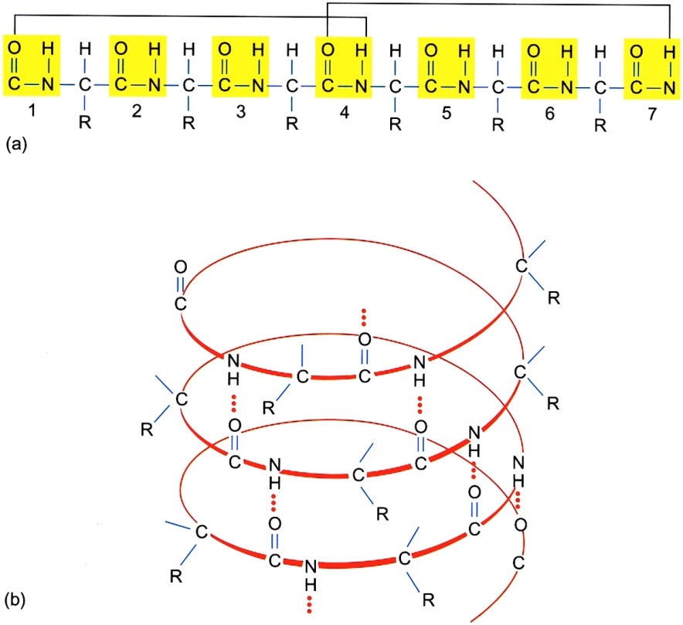
Figure 4.4

Slide 6
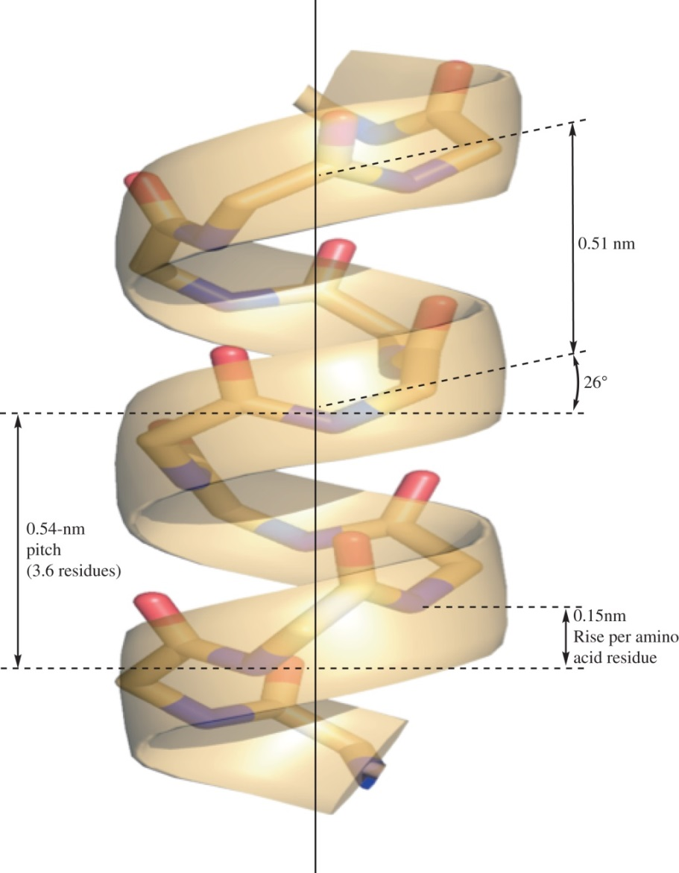
Figure 4.5

Slide 7
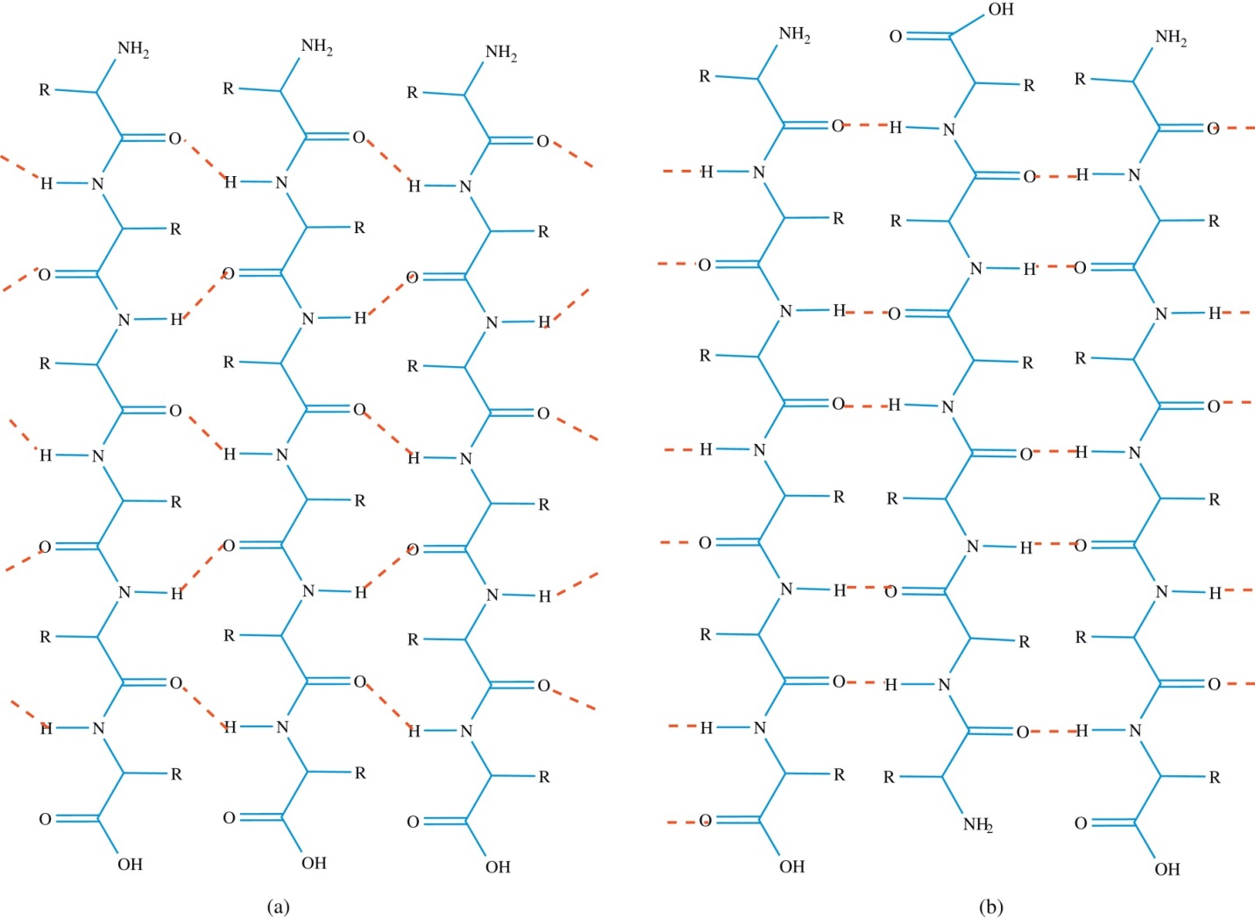
Figure 4.6

Slide 8
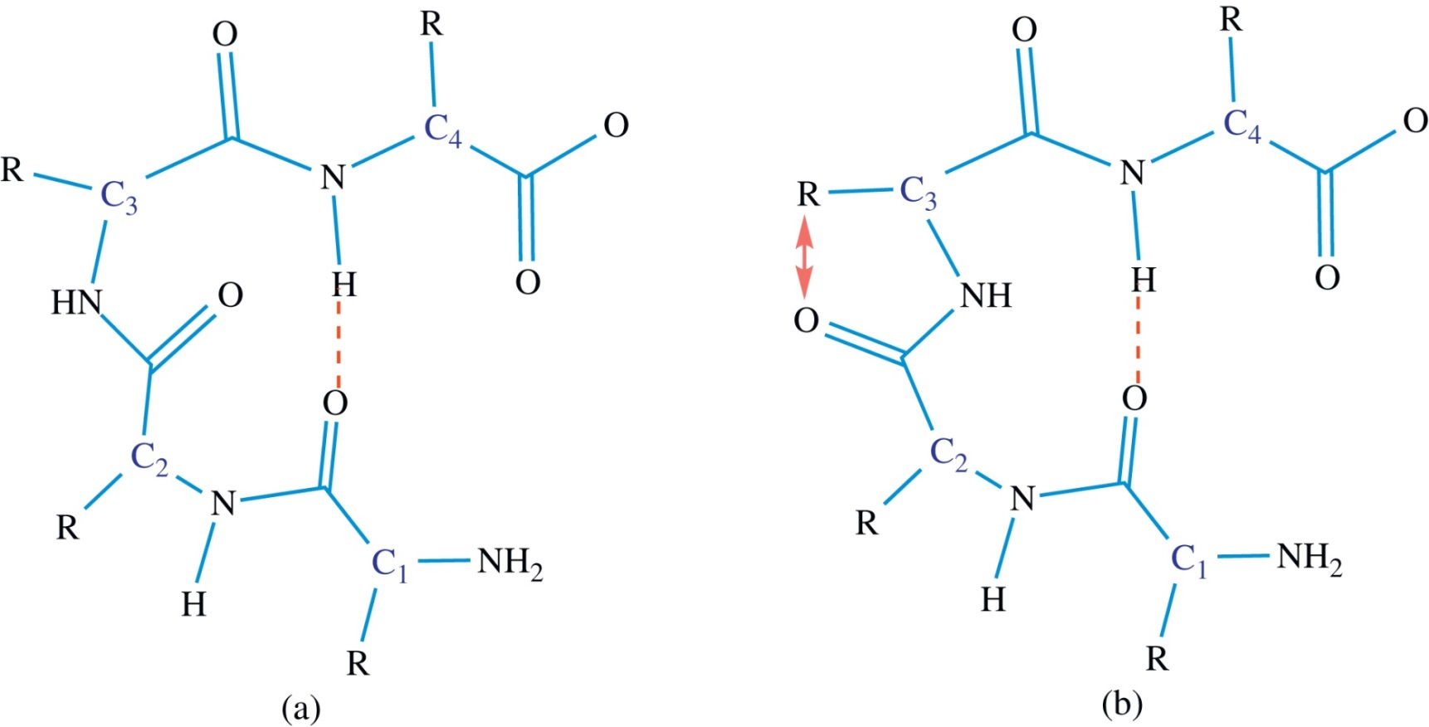
Figure 4.7

Slide 9
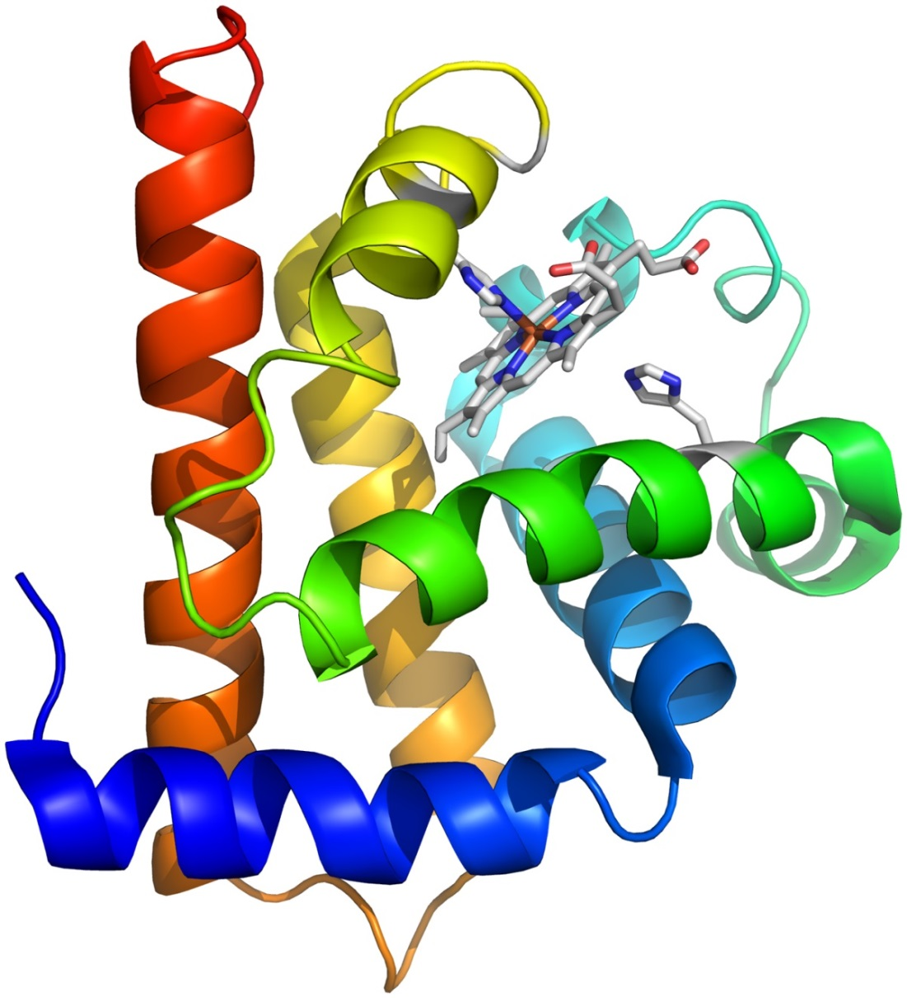
Figure 4.8

Slide 10
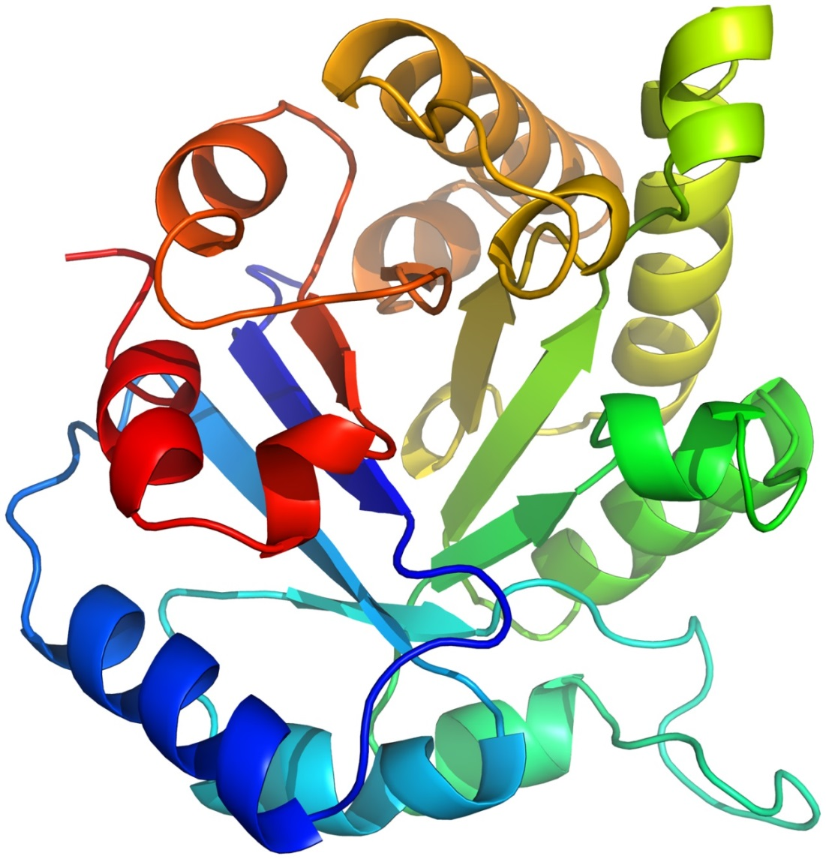
Figure 4.9

Slide 11
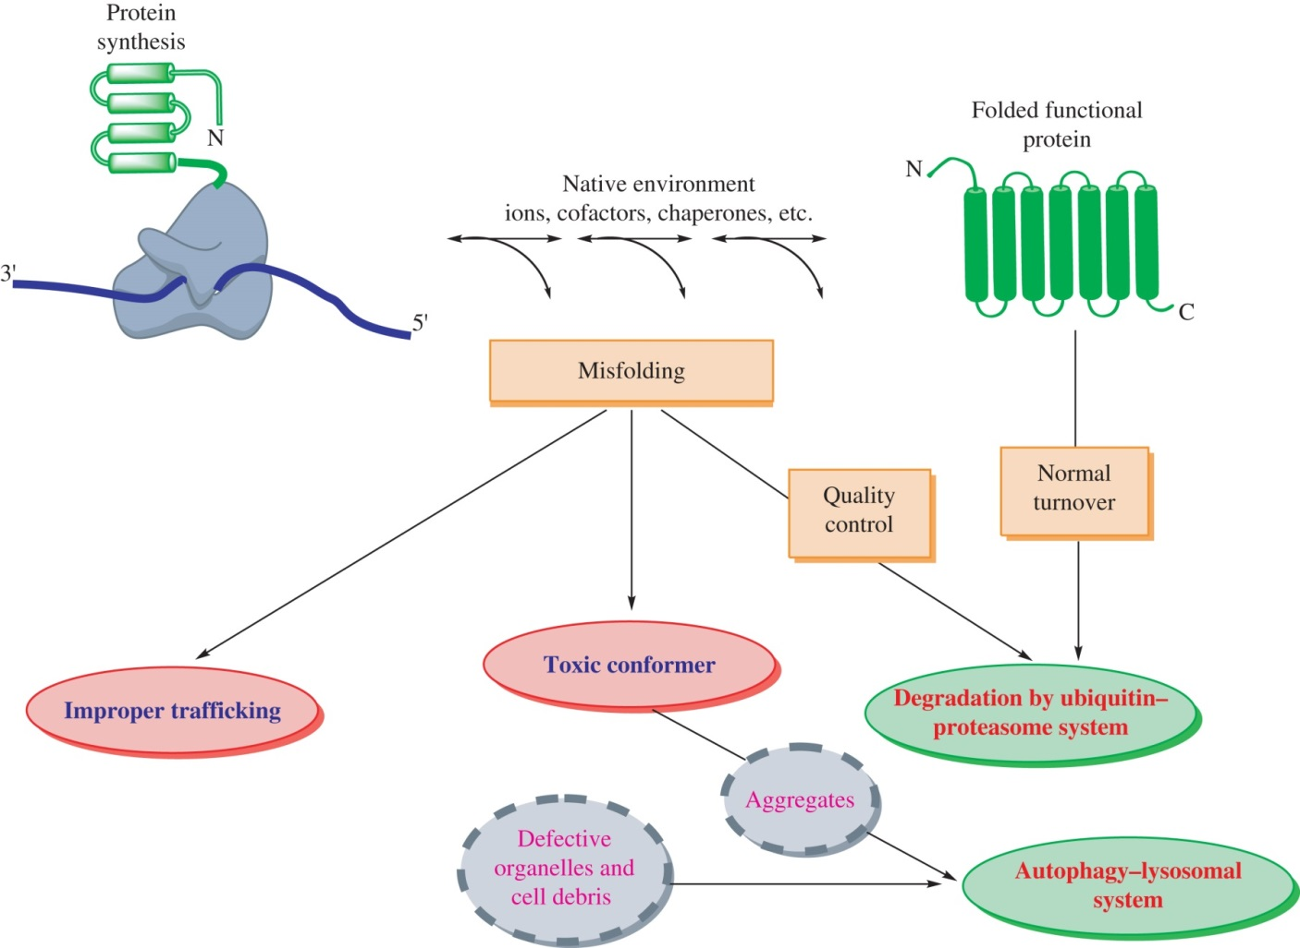
Figure 4.10

Slide 12
Figure 4.11

Slide 13
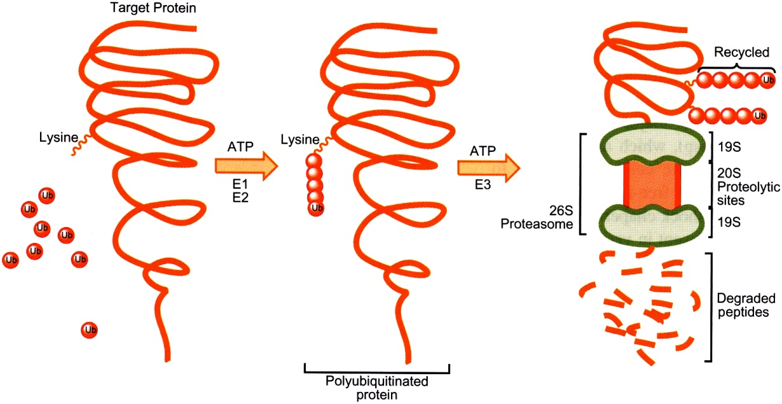
Figure 4.12

Slide 14
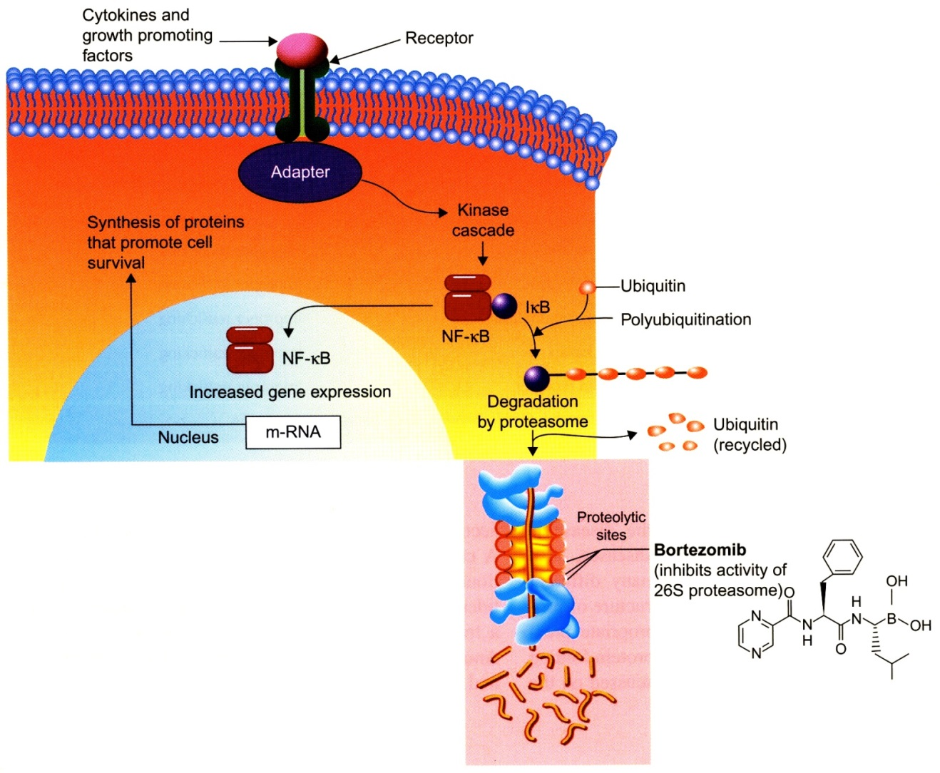
Figure 4.13

Slide 15
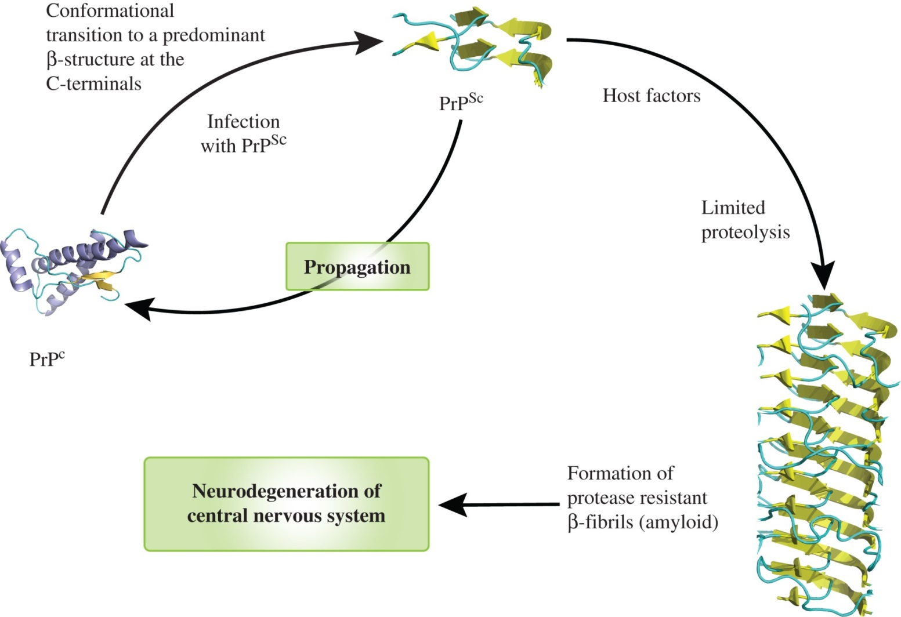
Figure 4.14

Slide 16
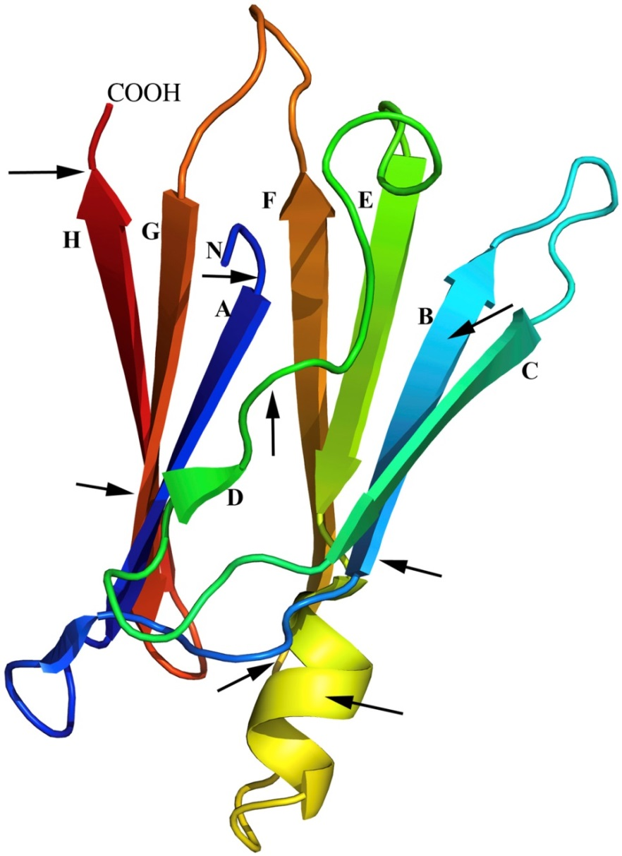
Figure 4.15

Slide 17
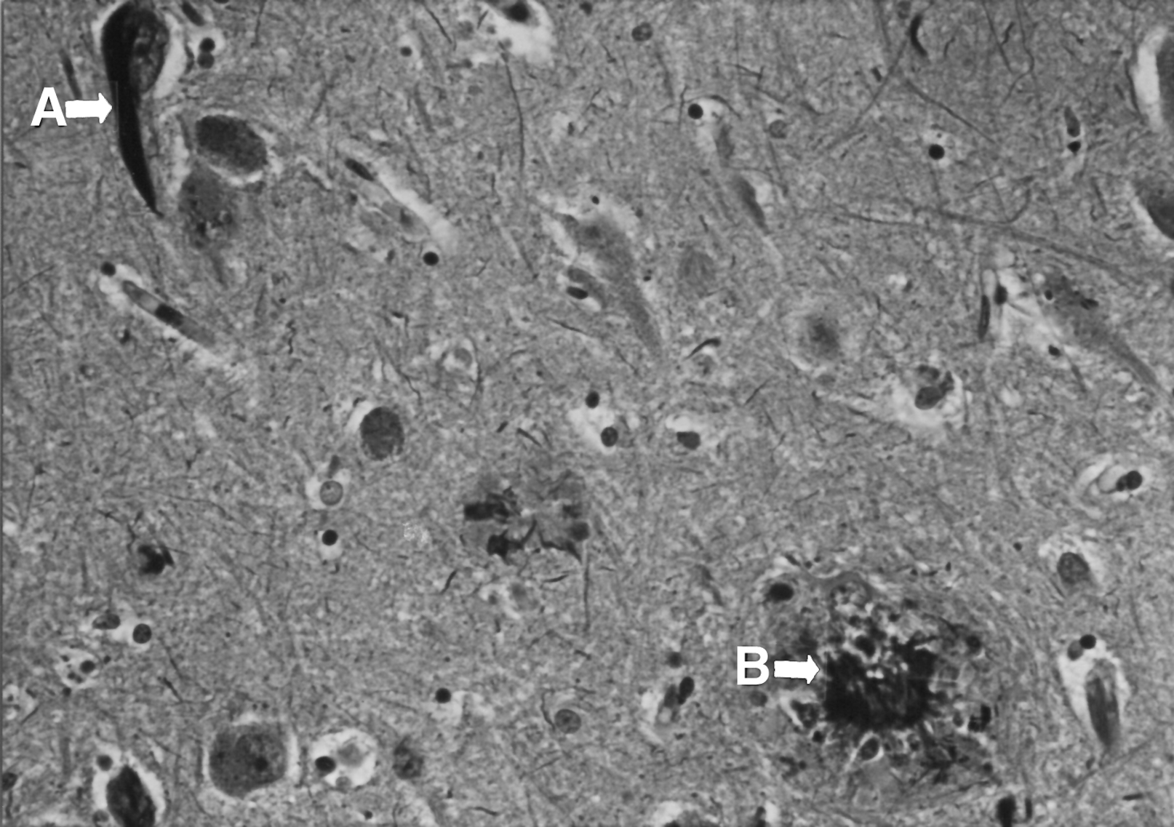
Figure 4.16

Slide 18
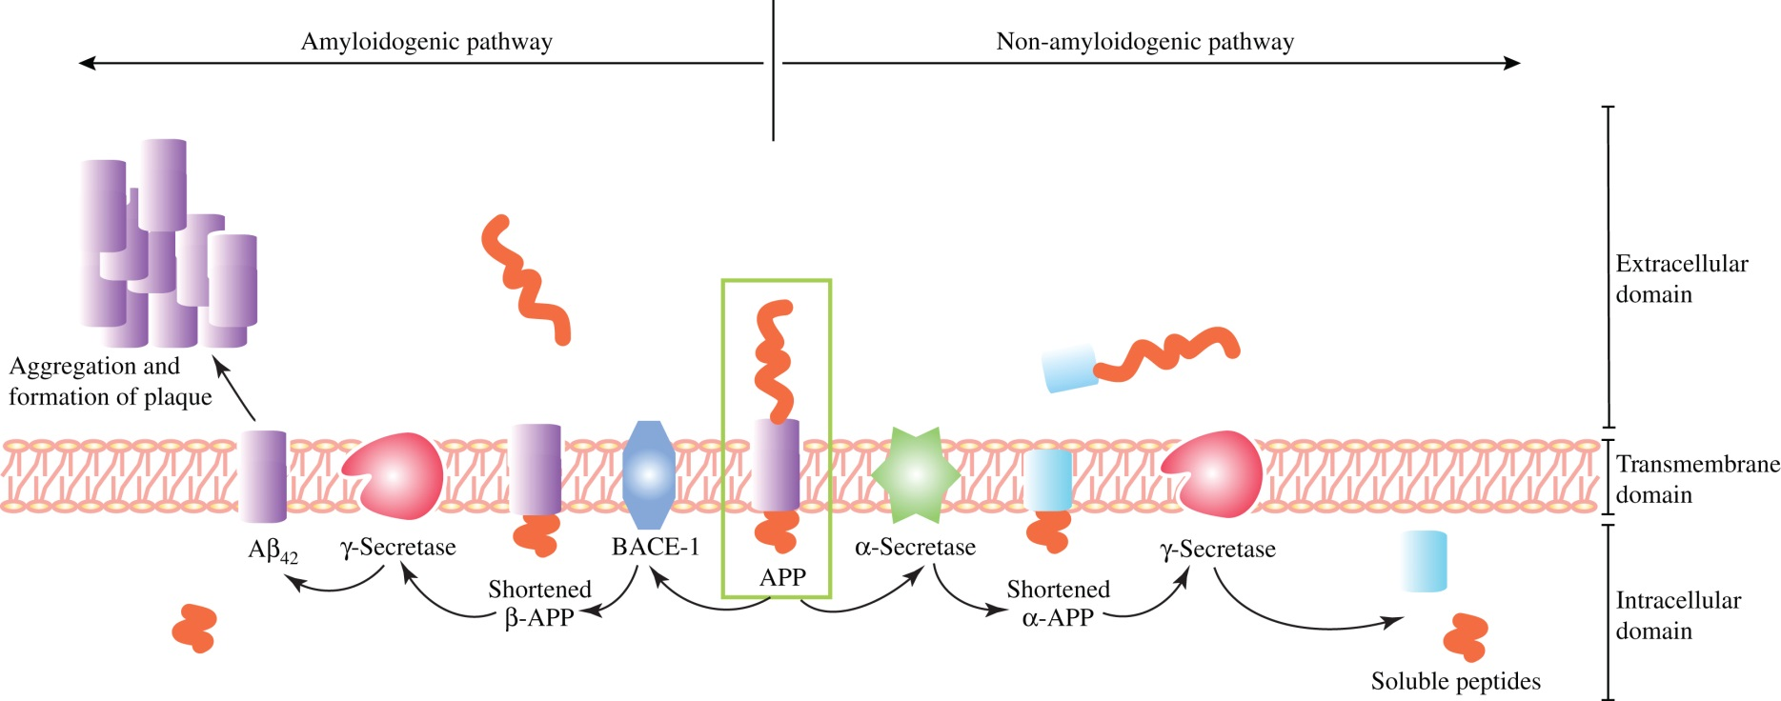
Figure 4.17

Slide 19
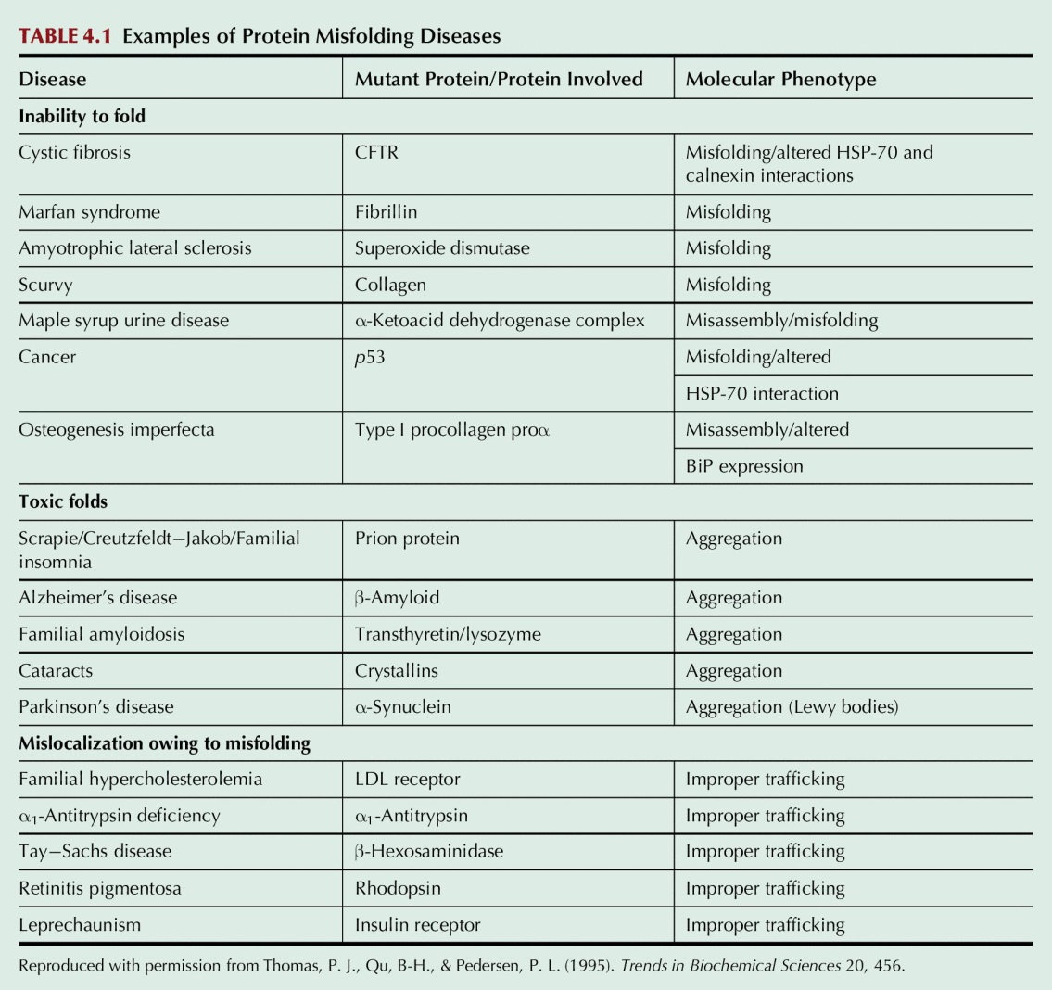
Table 4.1

