Slide 1
Chapter 05
Energetics of Biological Systems

Slide 2
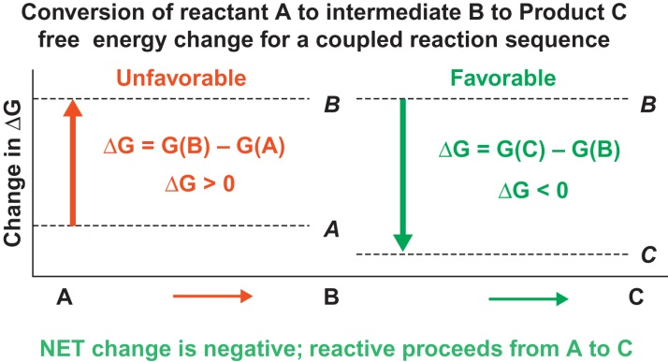
Figure 5.1

Slide 3
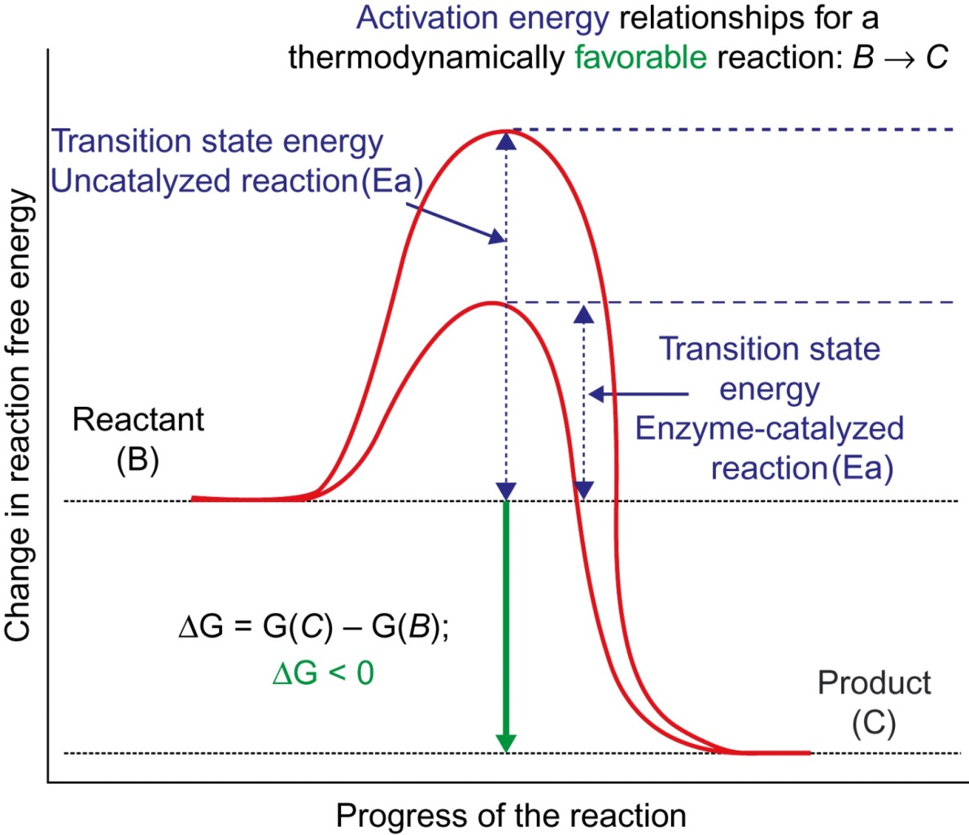
Figure 5.2

Slide 4
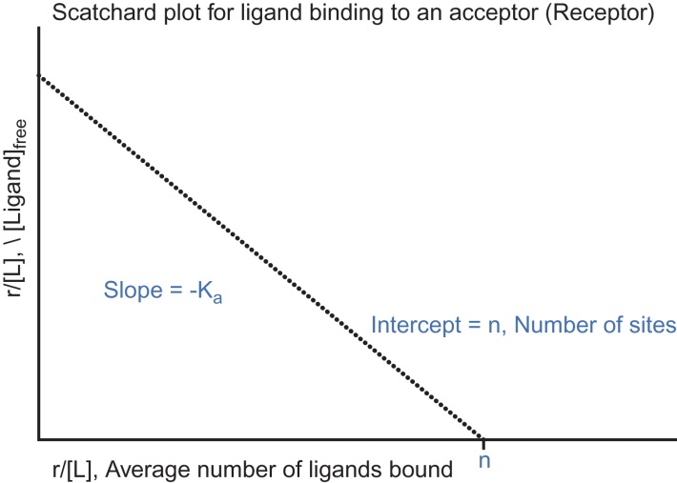
Figure 5.3

Slide 5
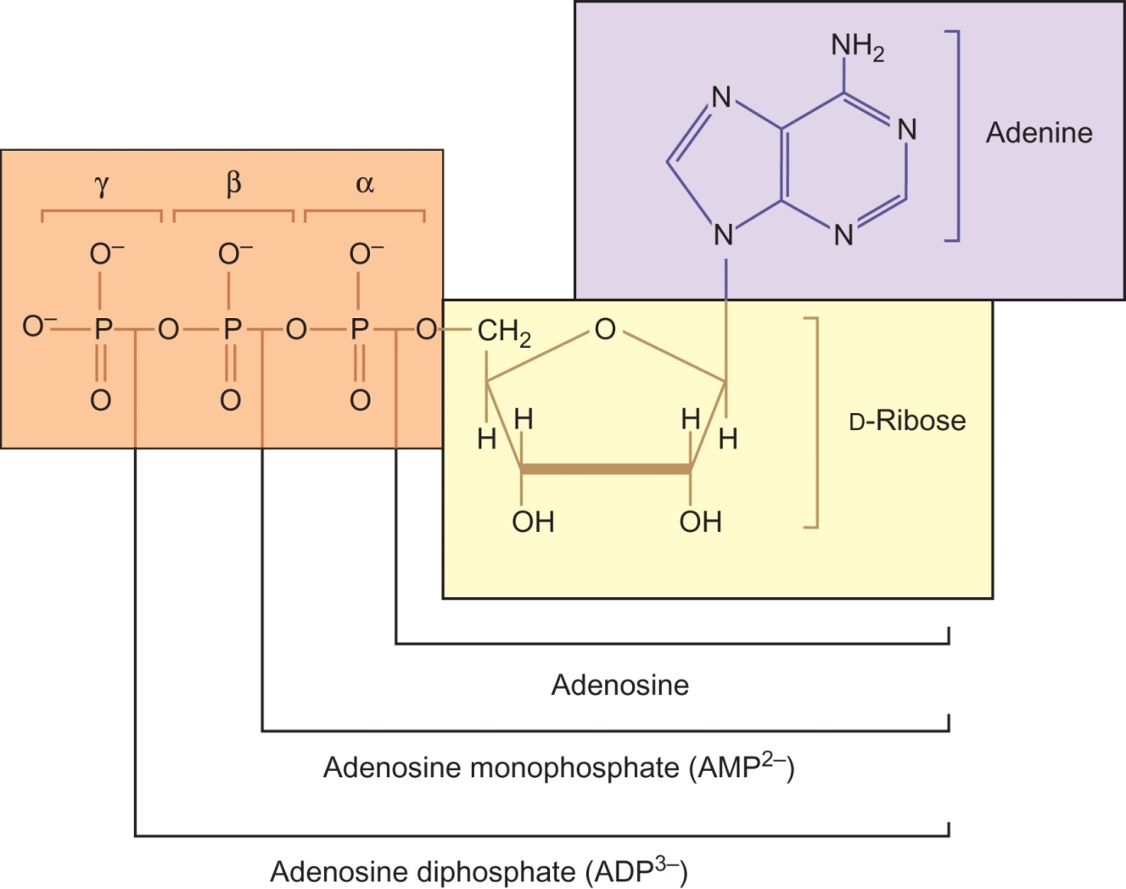
Figure 5.4

Slide 6
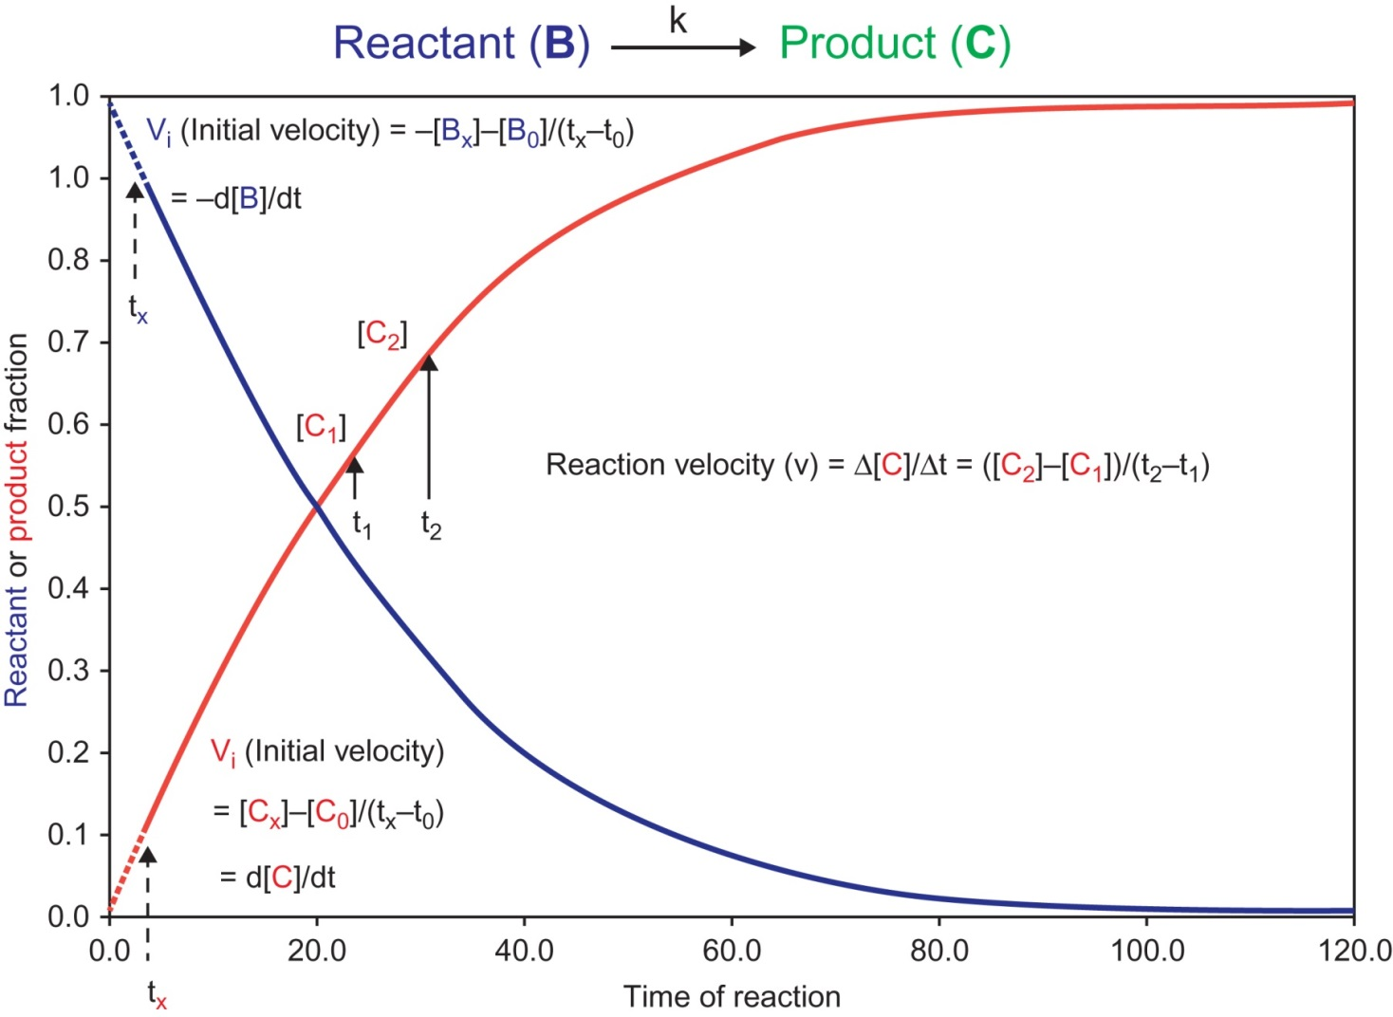
Figure 5.5

