Slide 1
Chapter 09
Heteropolysaccharides I: Glycoconjugates, Glycoproteins, and Glycolipids

Slide 2
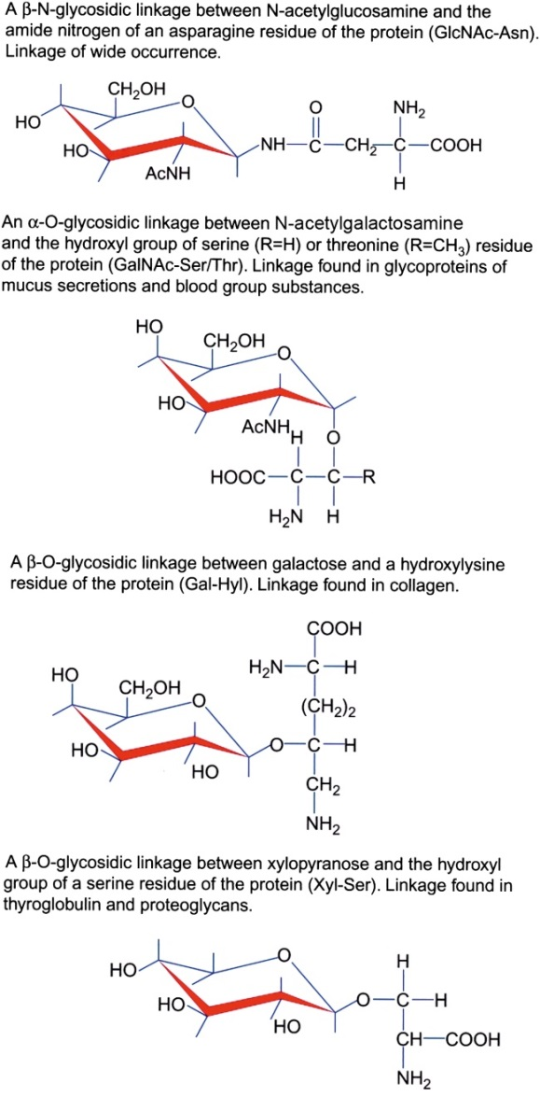
Figure 9.1

Slide 3
Figure 9.2

Slide 4
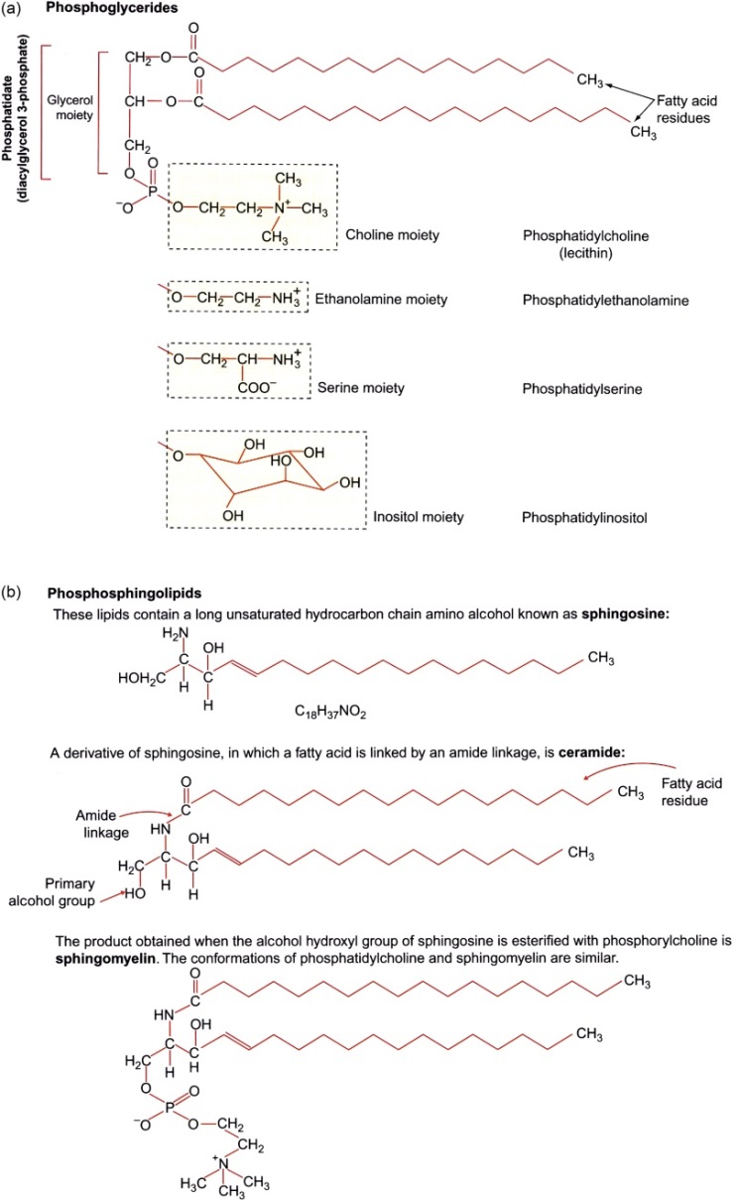
Figure 9.3

Slide 5
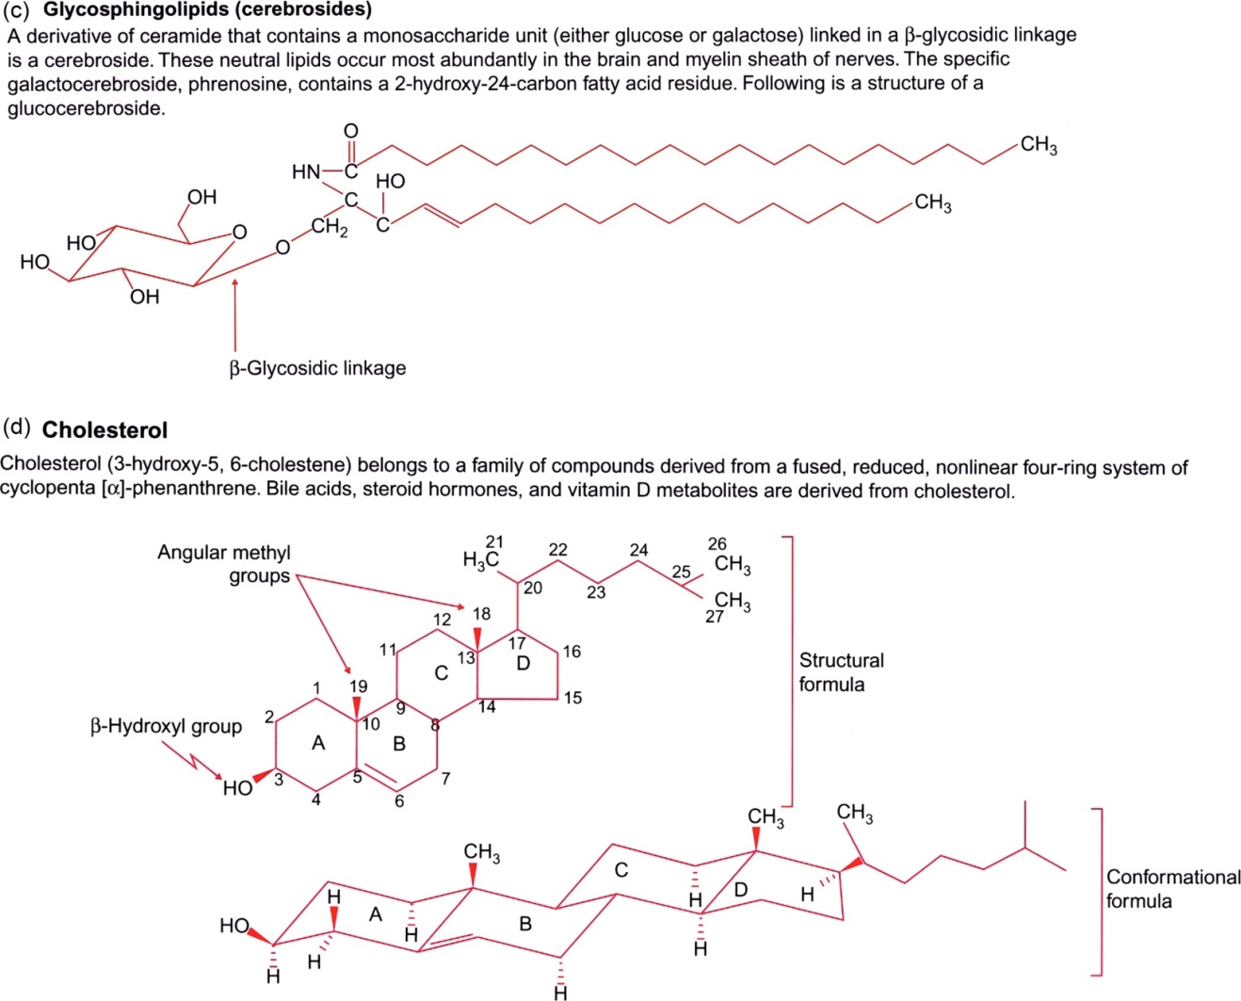
Figure 9.4

Slide 6
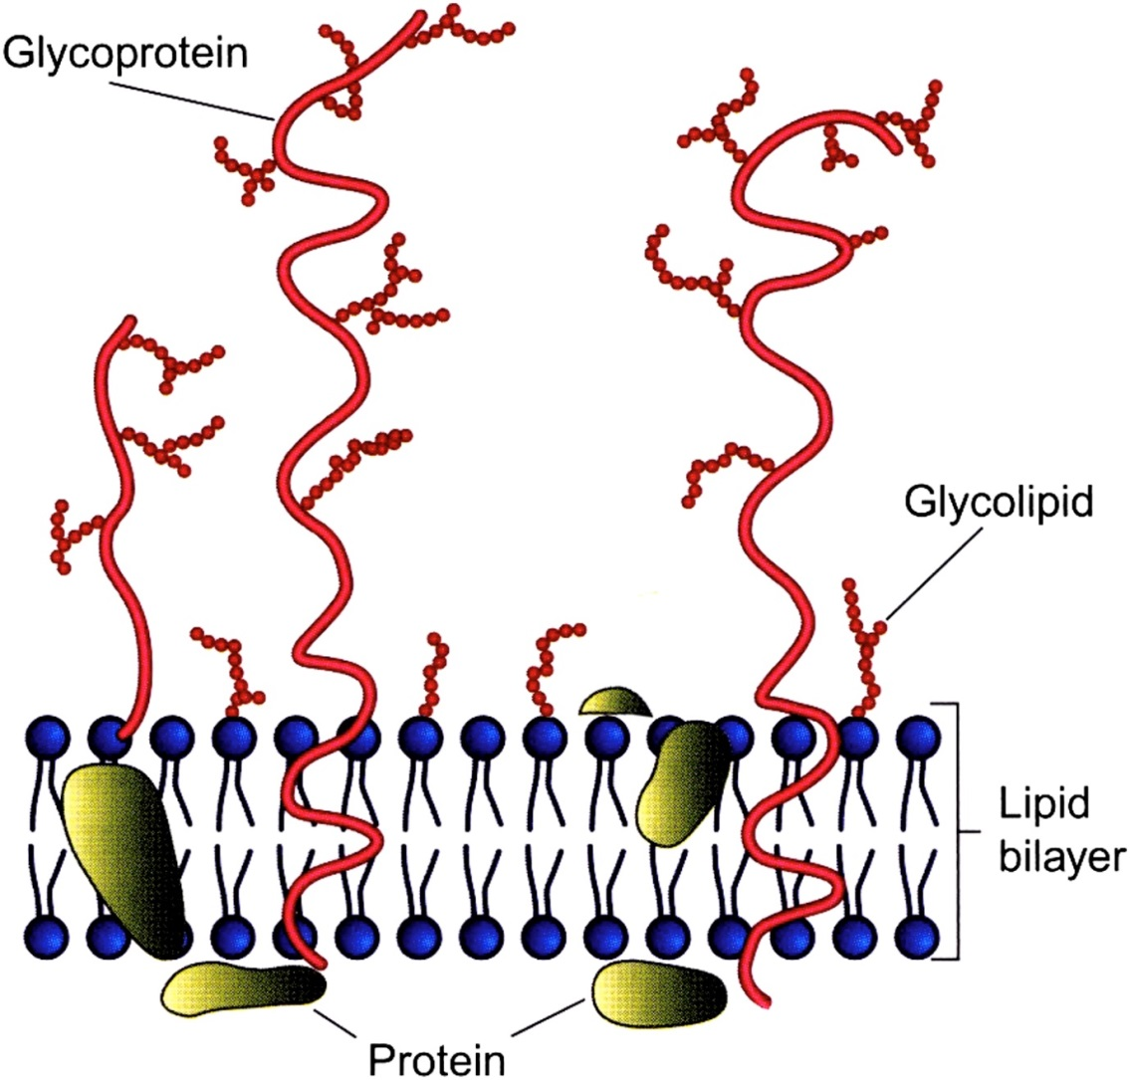
Figure 9.5

Slide 7
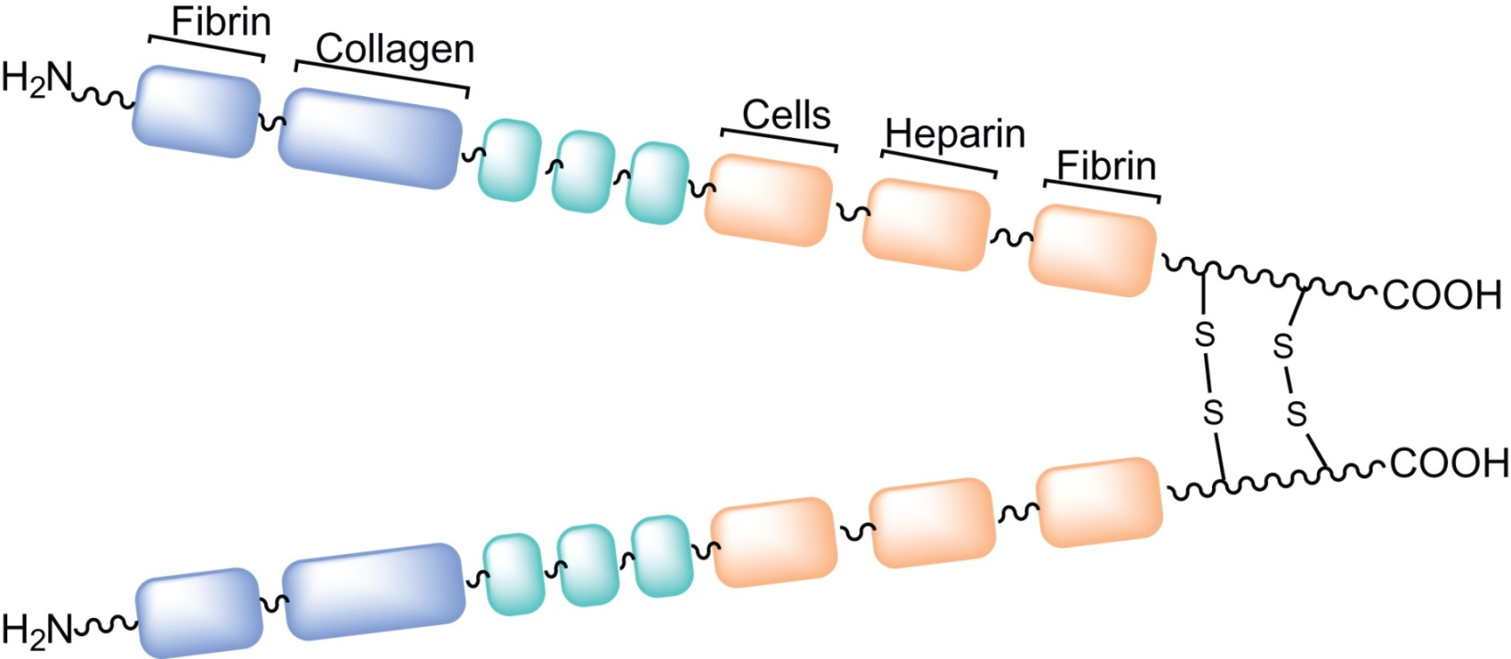
Figure 9.6

Slide 8
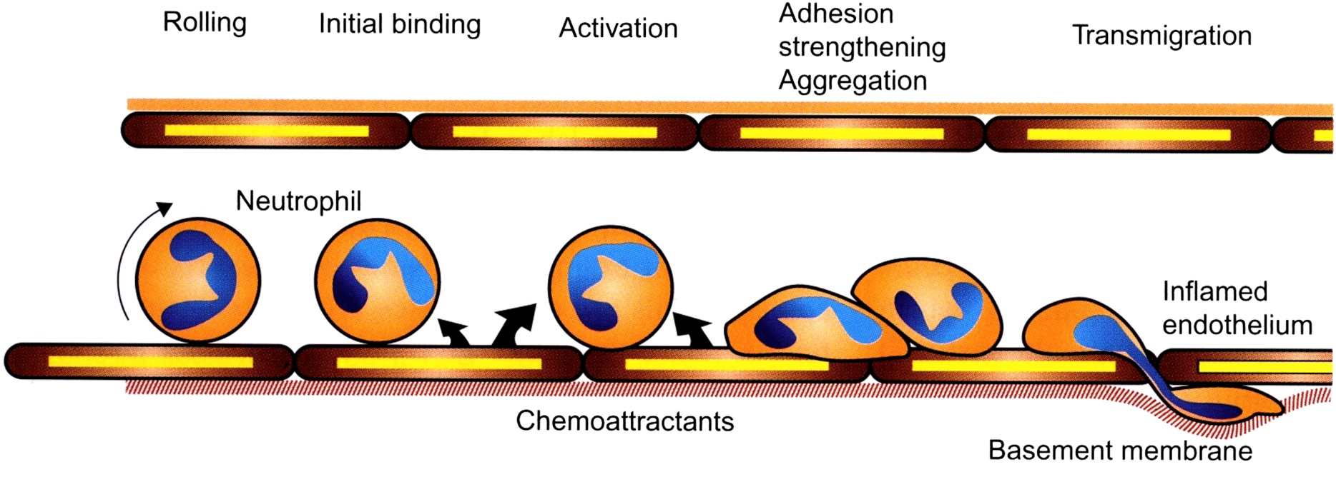
Figure 9.7

Slide 9
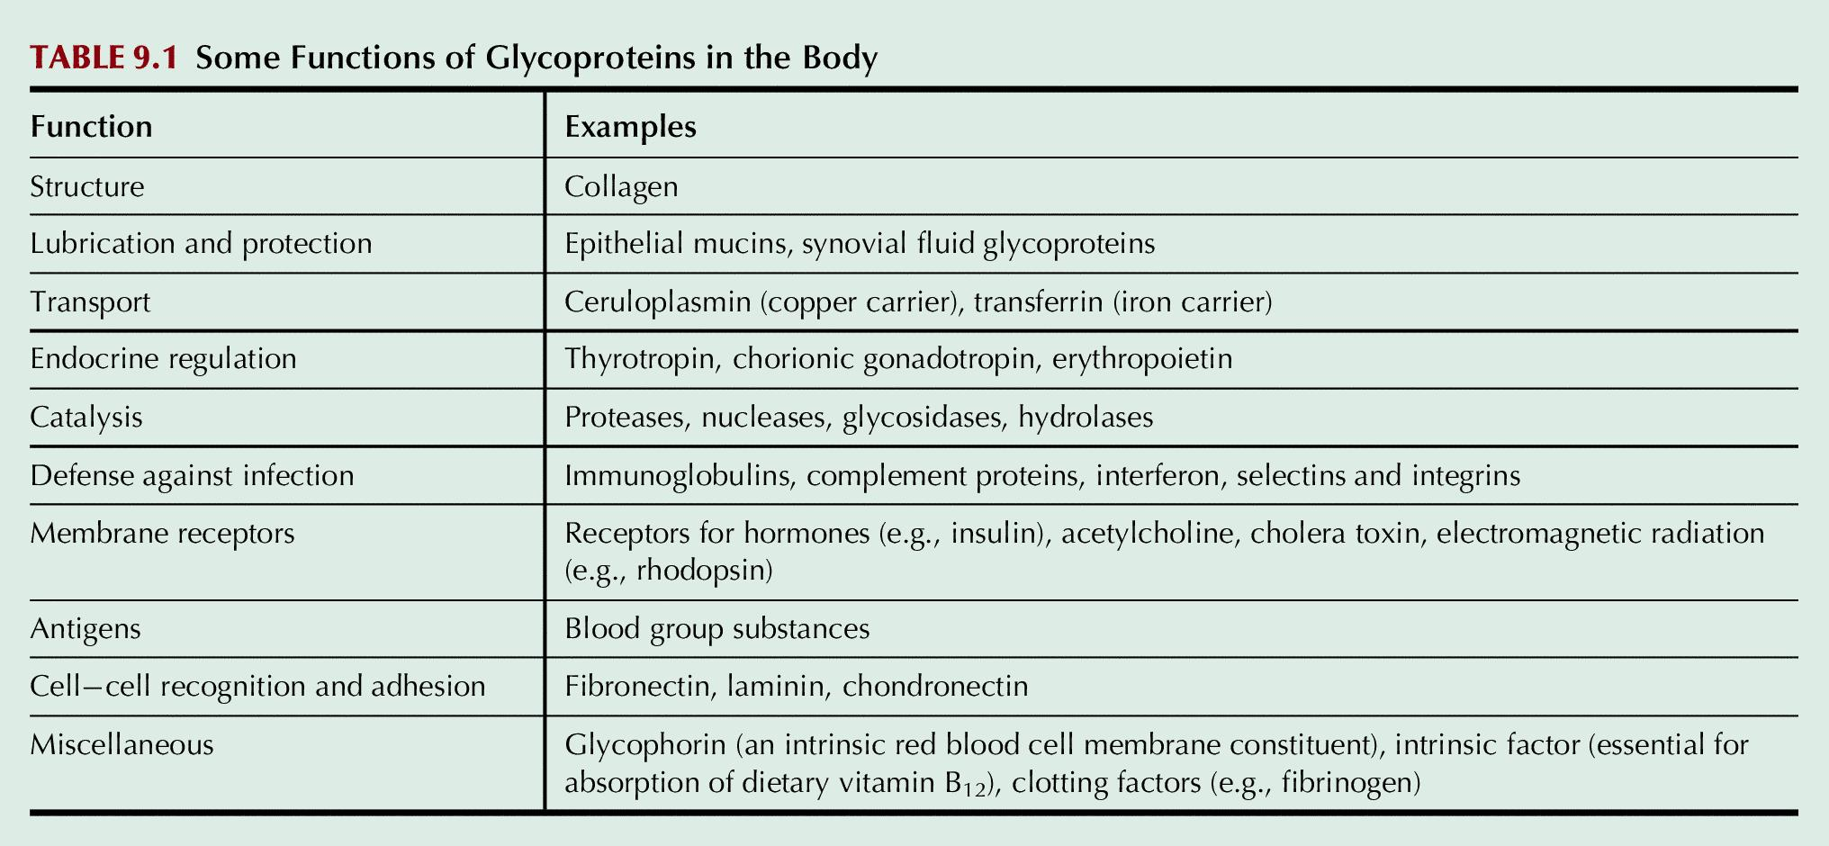
Table 9.1

