Slide 1
Chapter 10
Connective Tissue: Fibrous and
Non Fibrous Proteins
and Proteoglycans

Slide 2
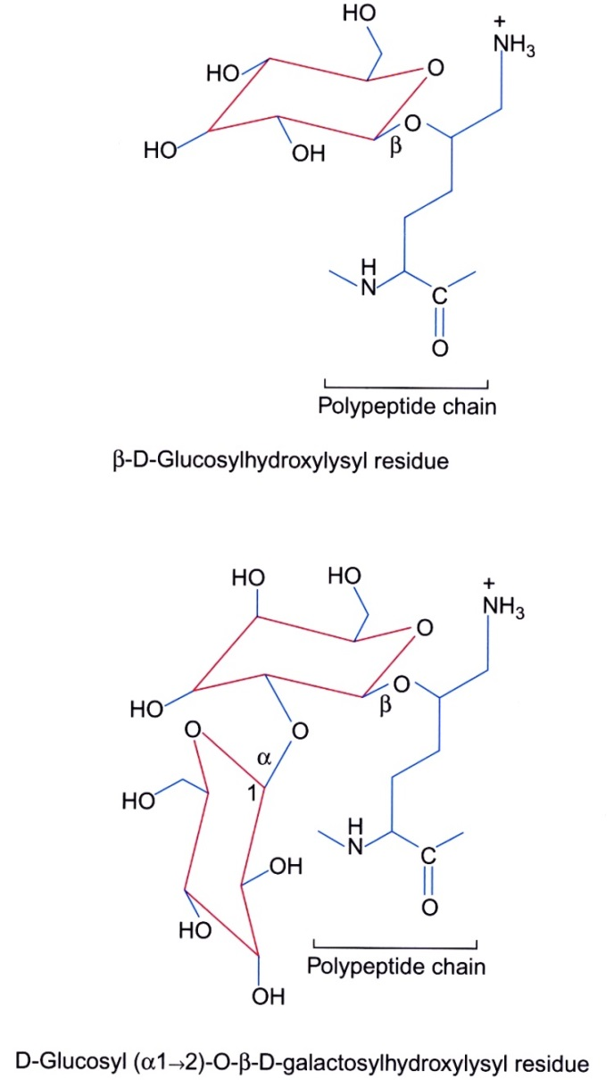
Figure 10.1

Slide 3
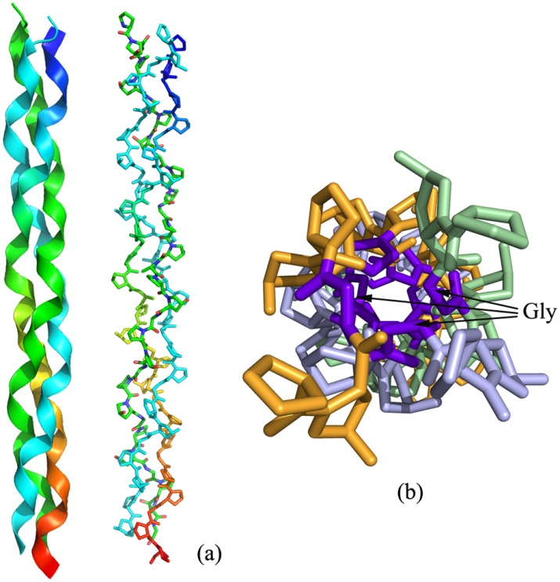
Figure 10.2

Slide 4
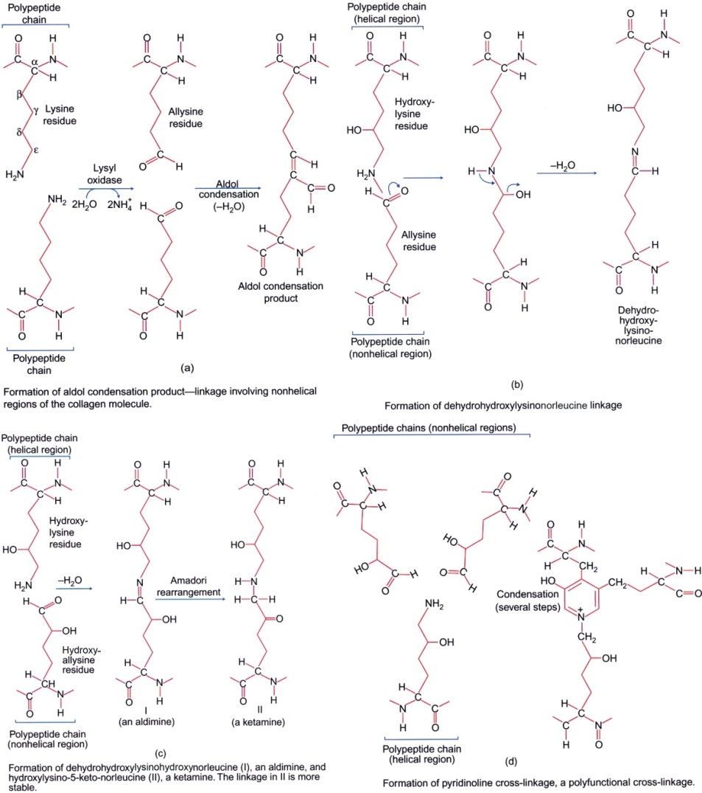
Figure 10.3

Slide 5
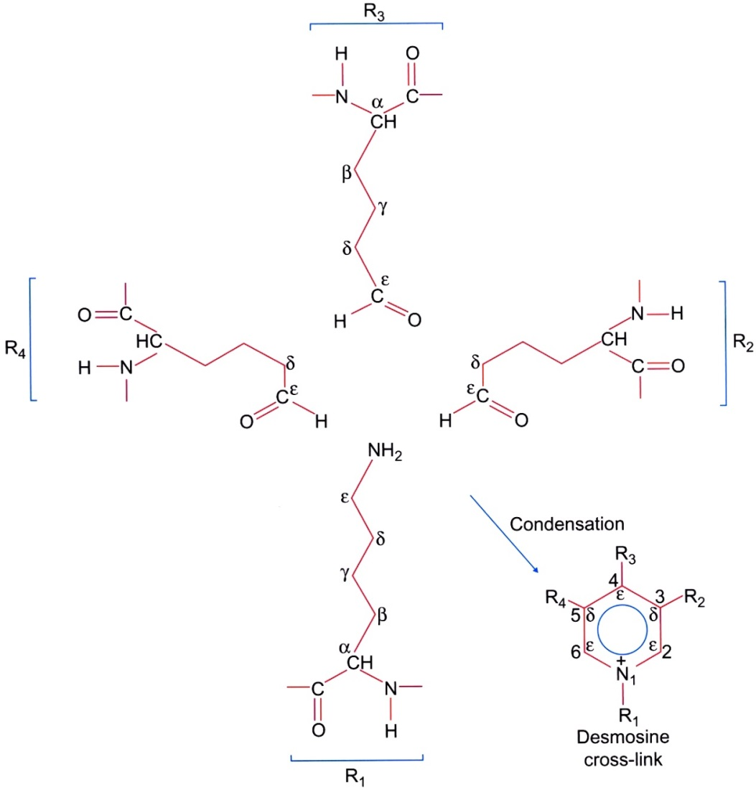
Figure 10.4

Slide 6
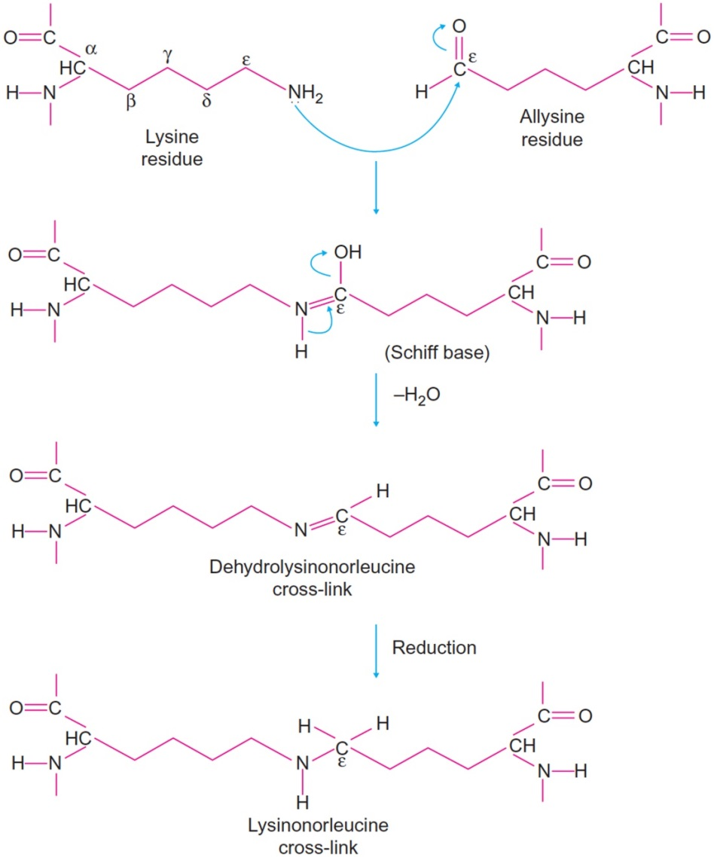
Figure 10.5

Slide 7
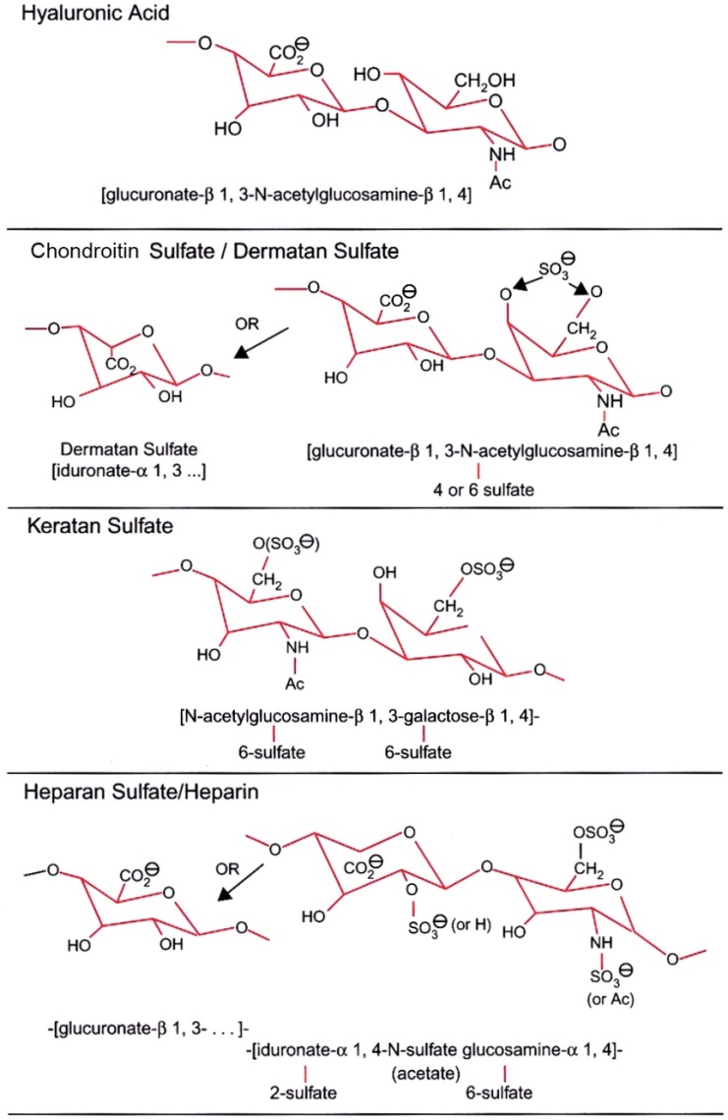
Figure 10.6

Slide 8
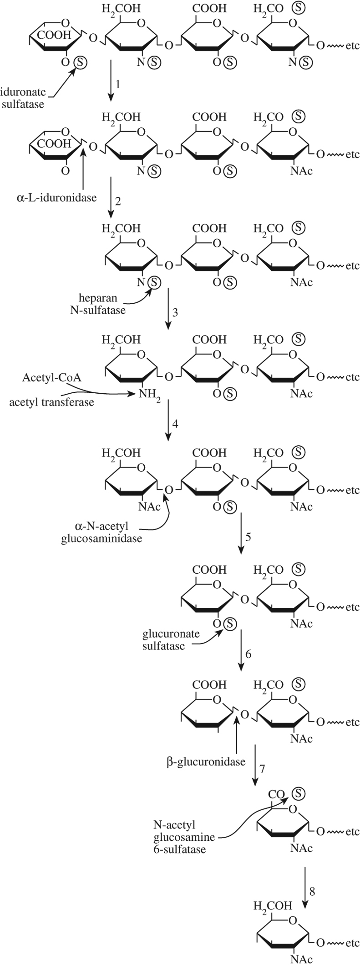
Figure 10.7

Slide 9
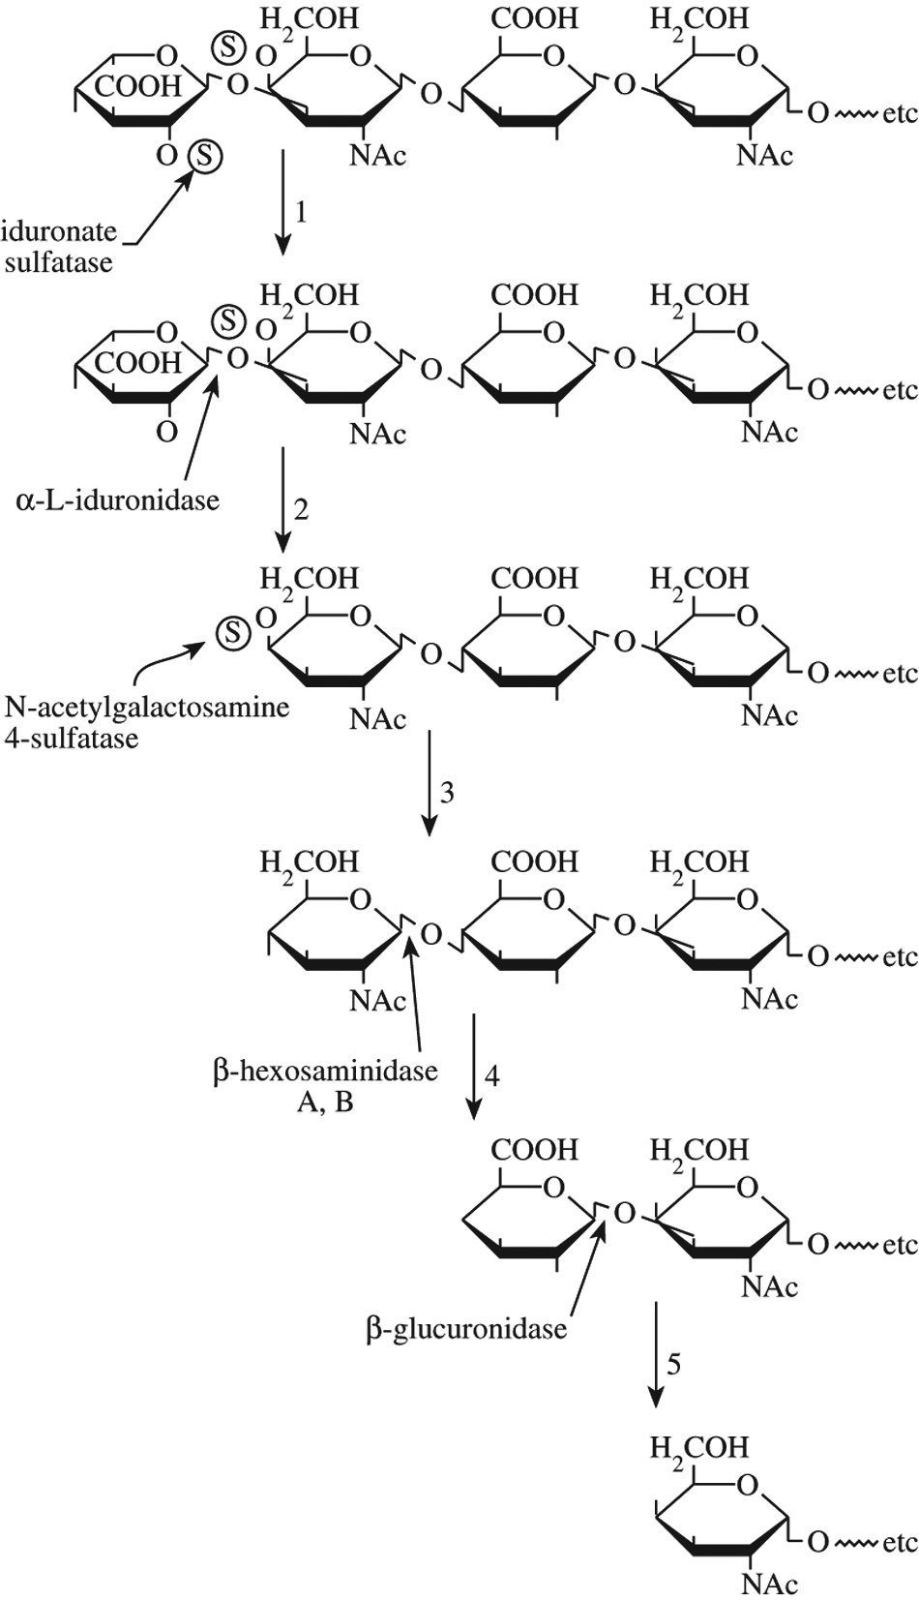
Figure 10.8

Slide 10
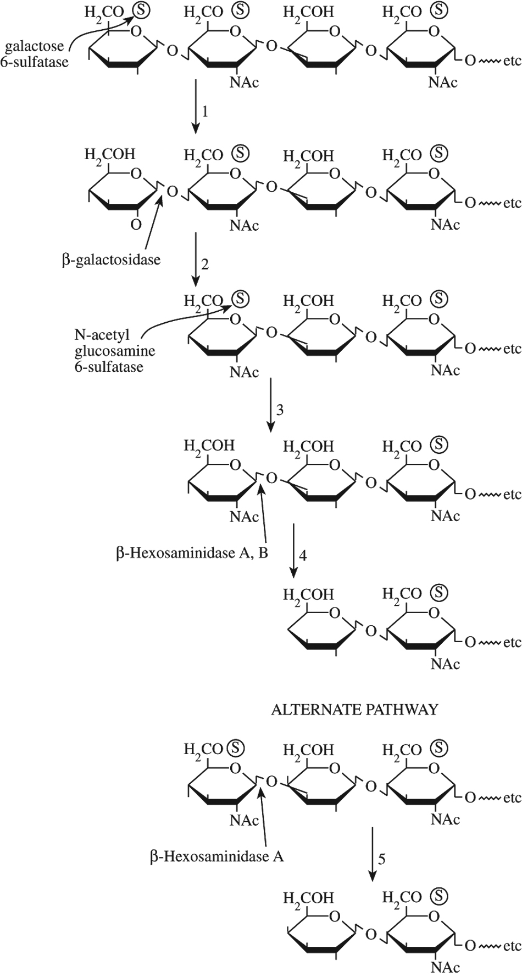
Figure 10.9

Slide 11
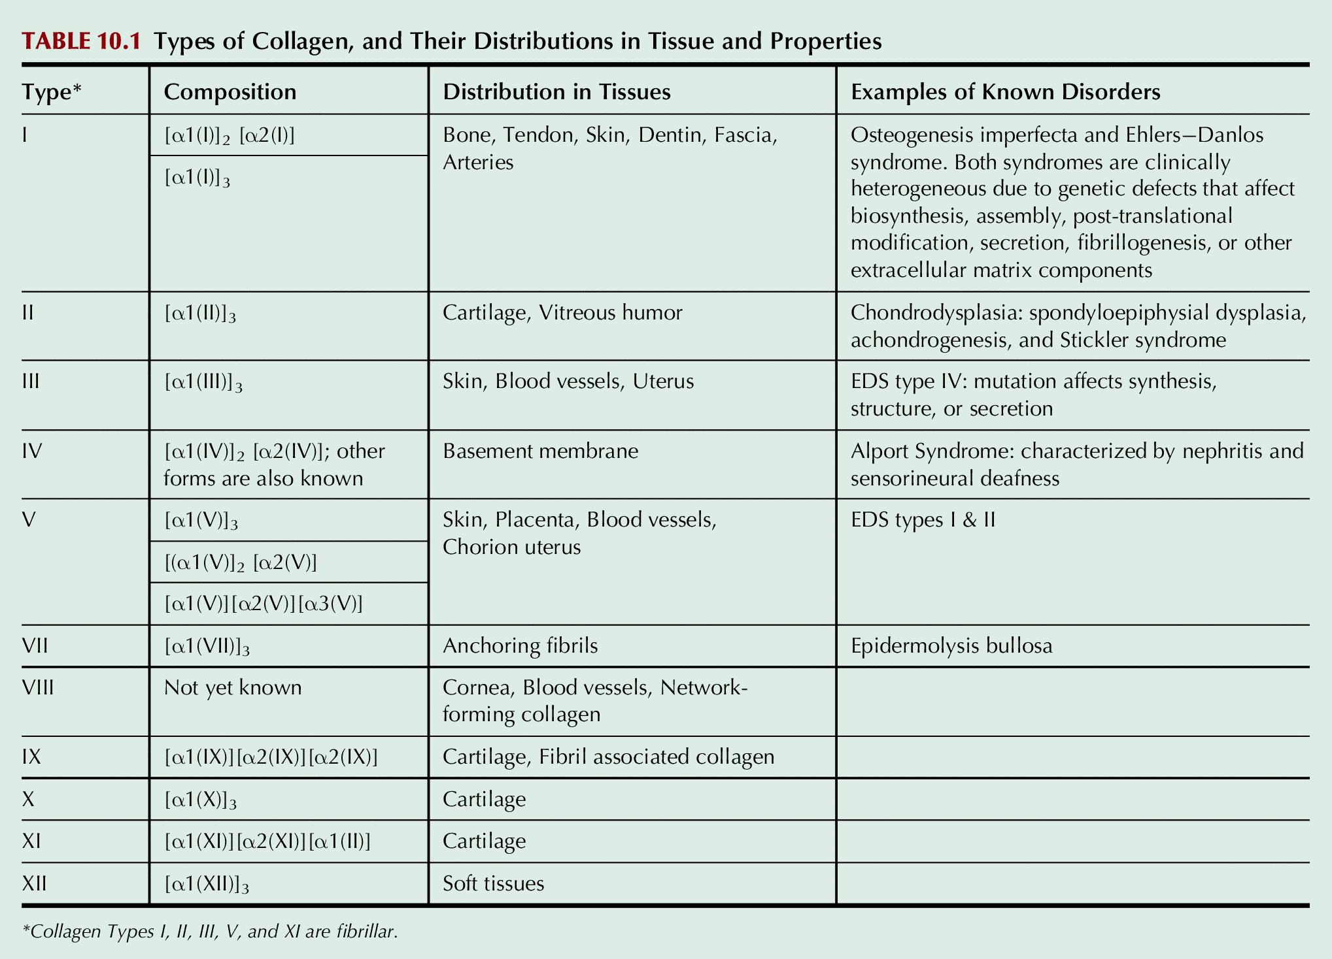
Table 10.1

Slide 12
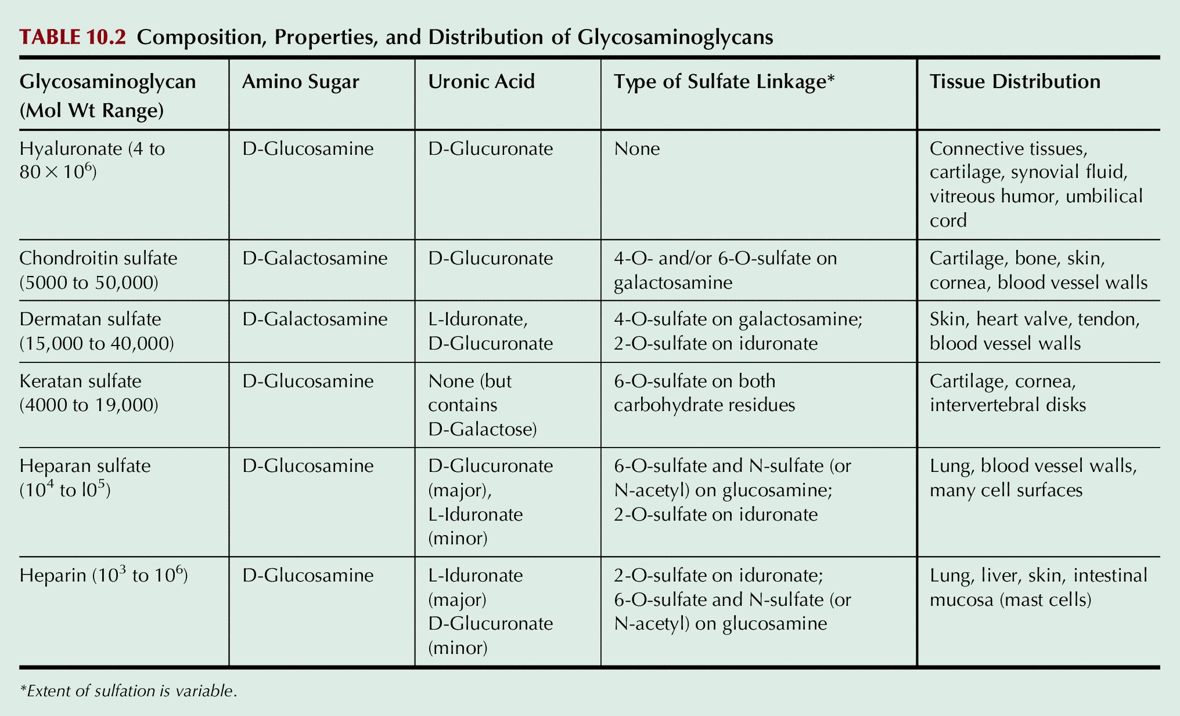
Table 10.2

Slide 13
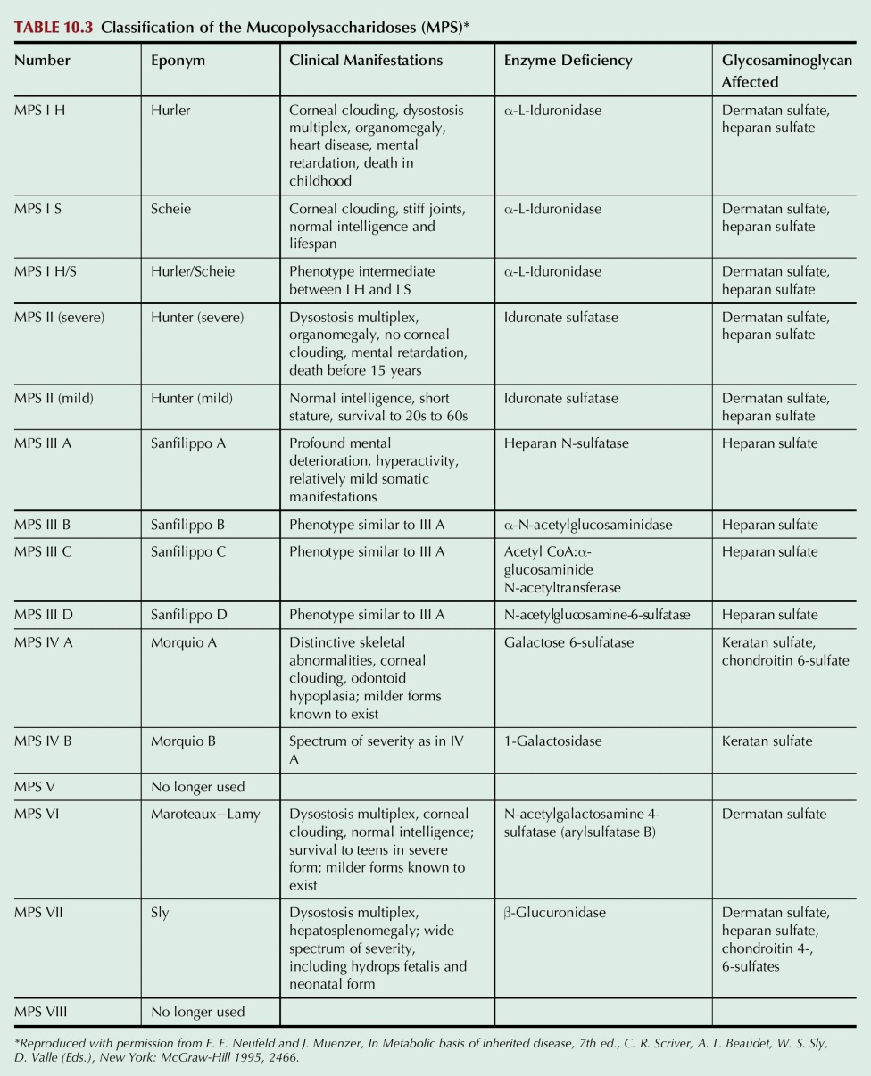
Table 10.3

