Slide 1
Chapter 11
Gastrointestinal Digestion and
Absorption

Slide 2
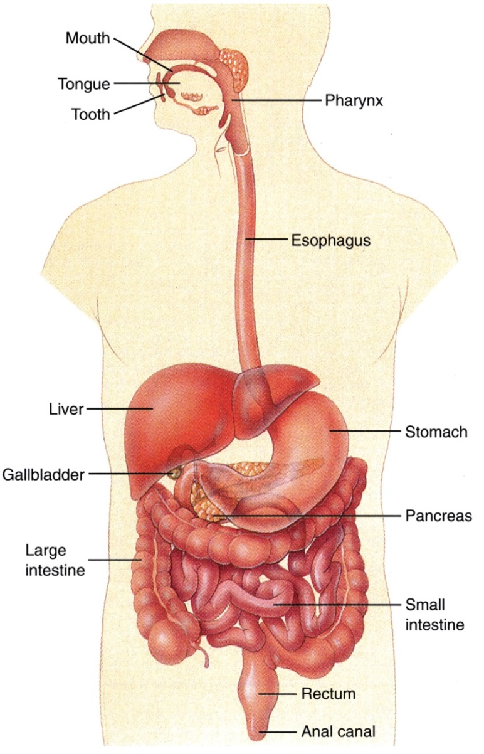
Figure 11.1

Slide 3
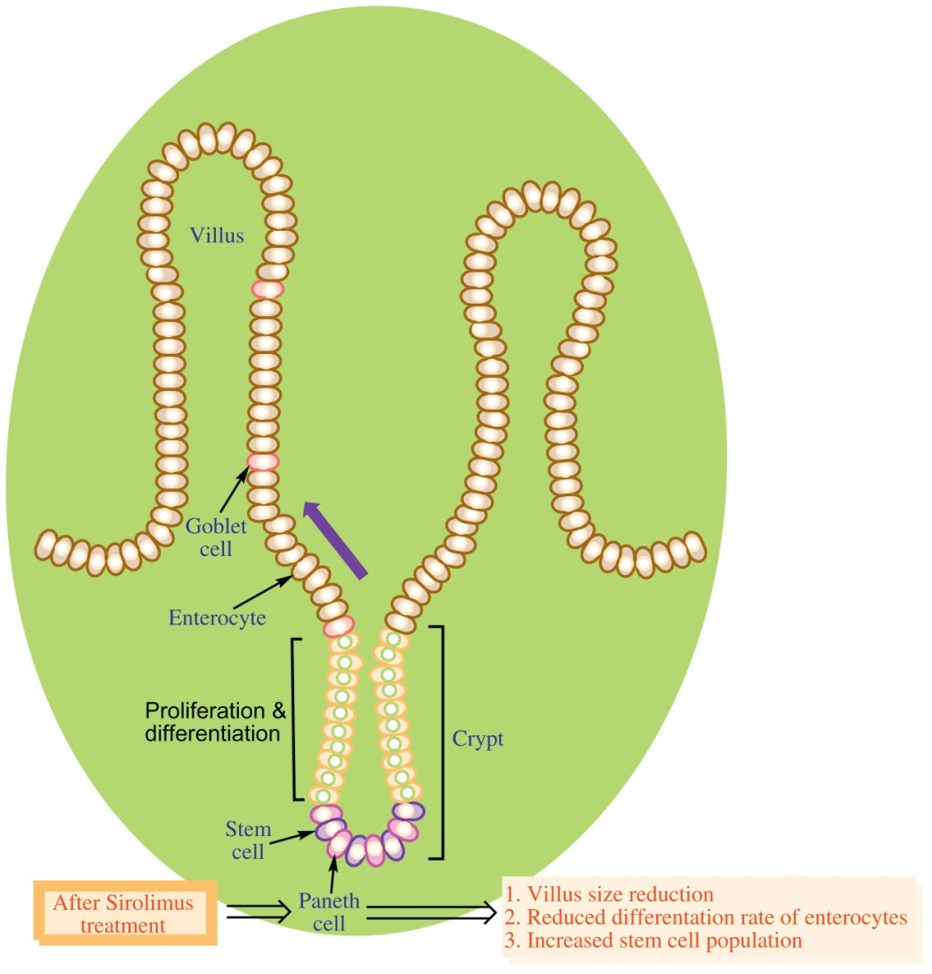
Figure 11.2

Slide 4
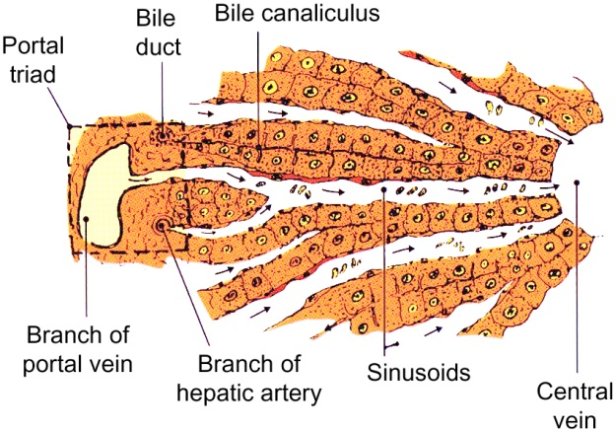
Figure 11.3

Slide 5
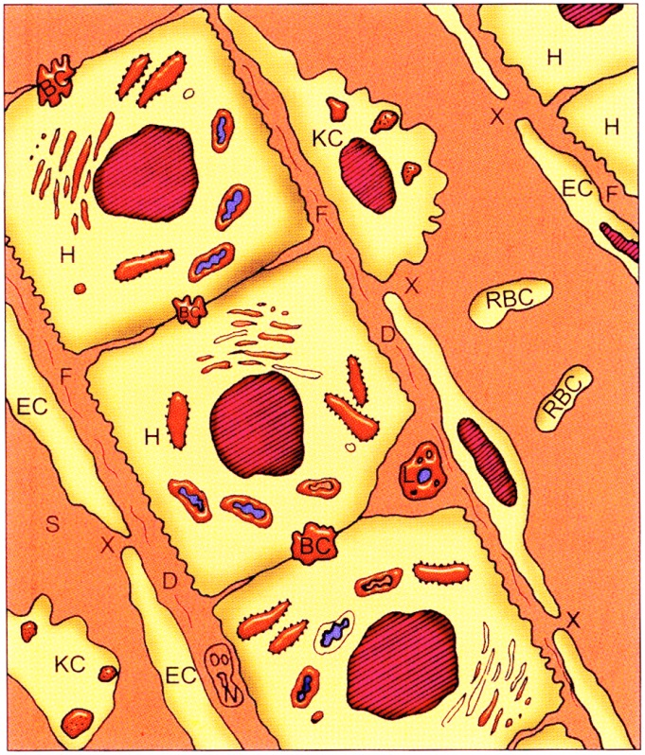
Figure 11.4

Slide 6
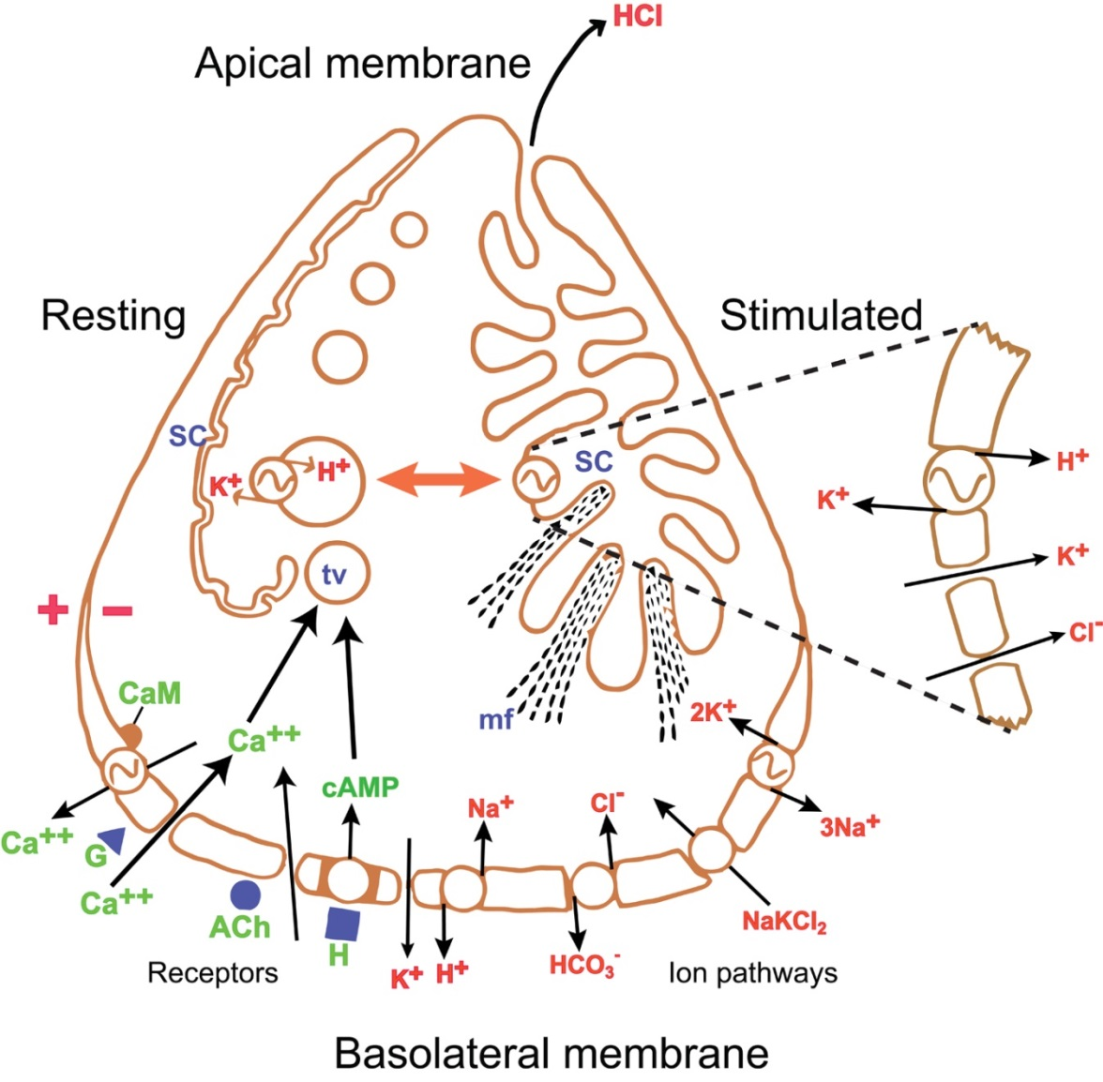
Figure 11.5

Slide 7
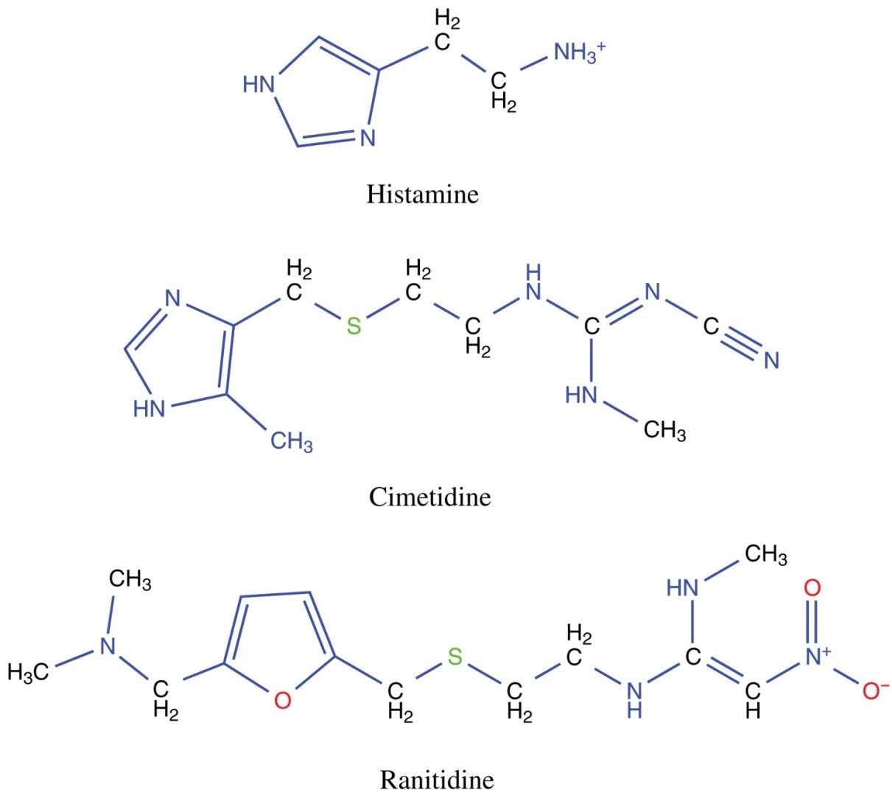
Figure 11.6

Slide 8
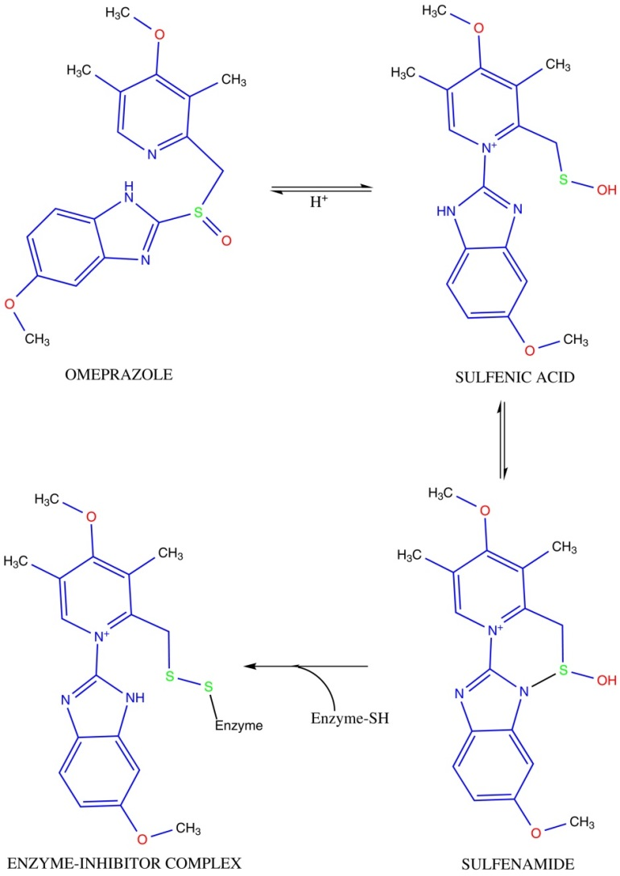
Figure 11.7

Slide 9
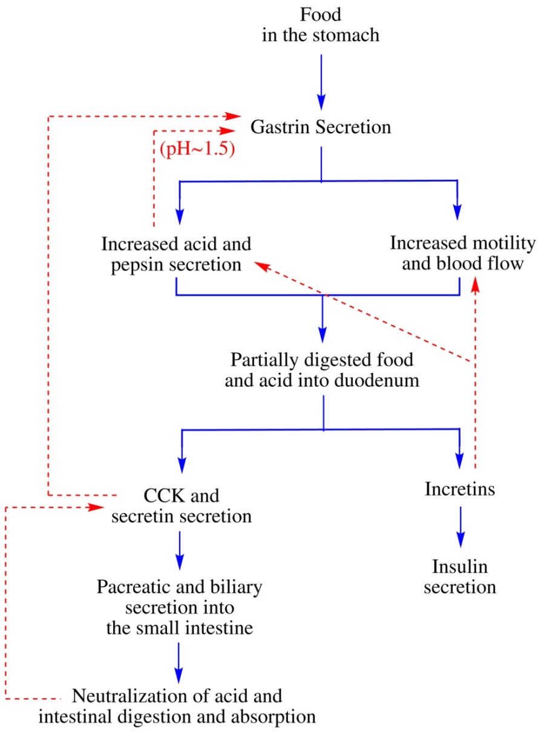
Figure 11.8

Slide 10
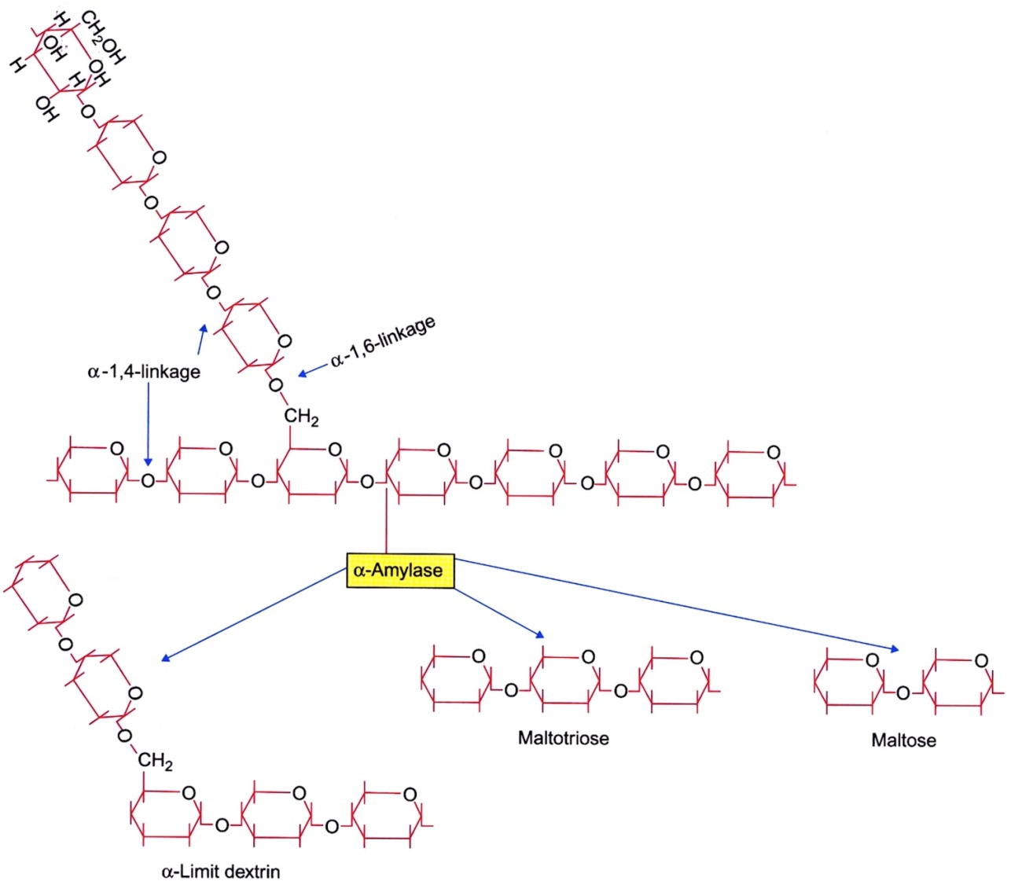
Figure 11.9

Slide 11
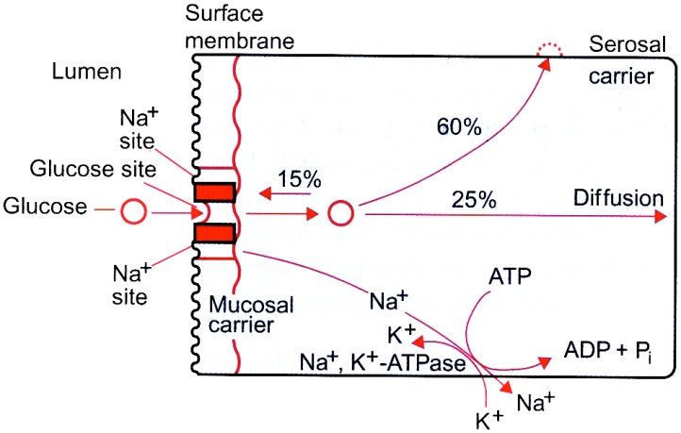
Figure 11.10

Slide 12
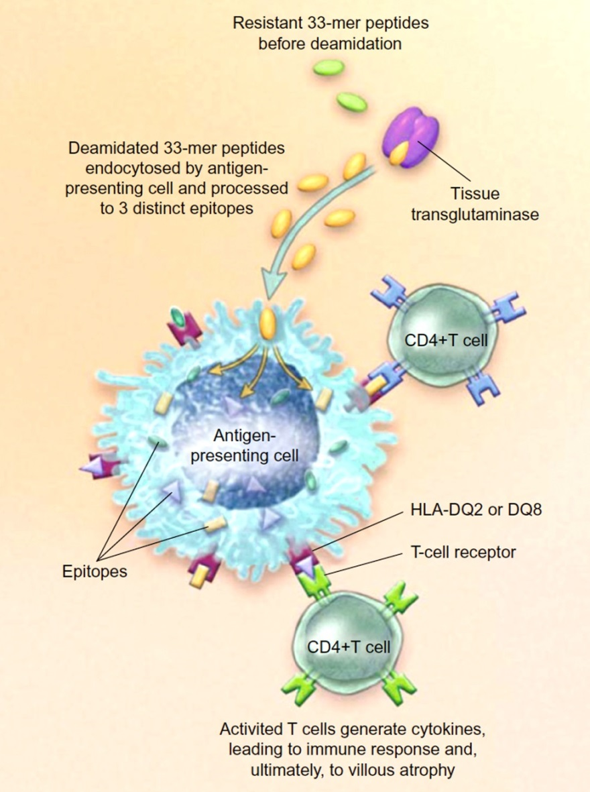
Figure 11.11

Slide 13
Figure 11.12

Slide 14
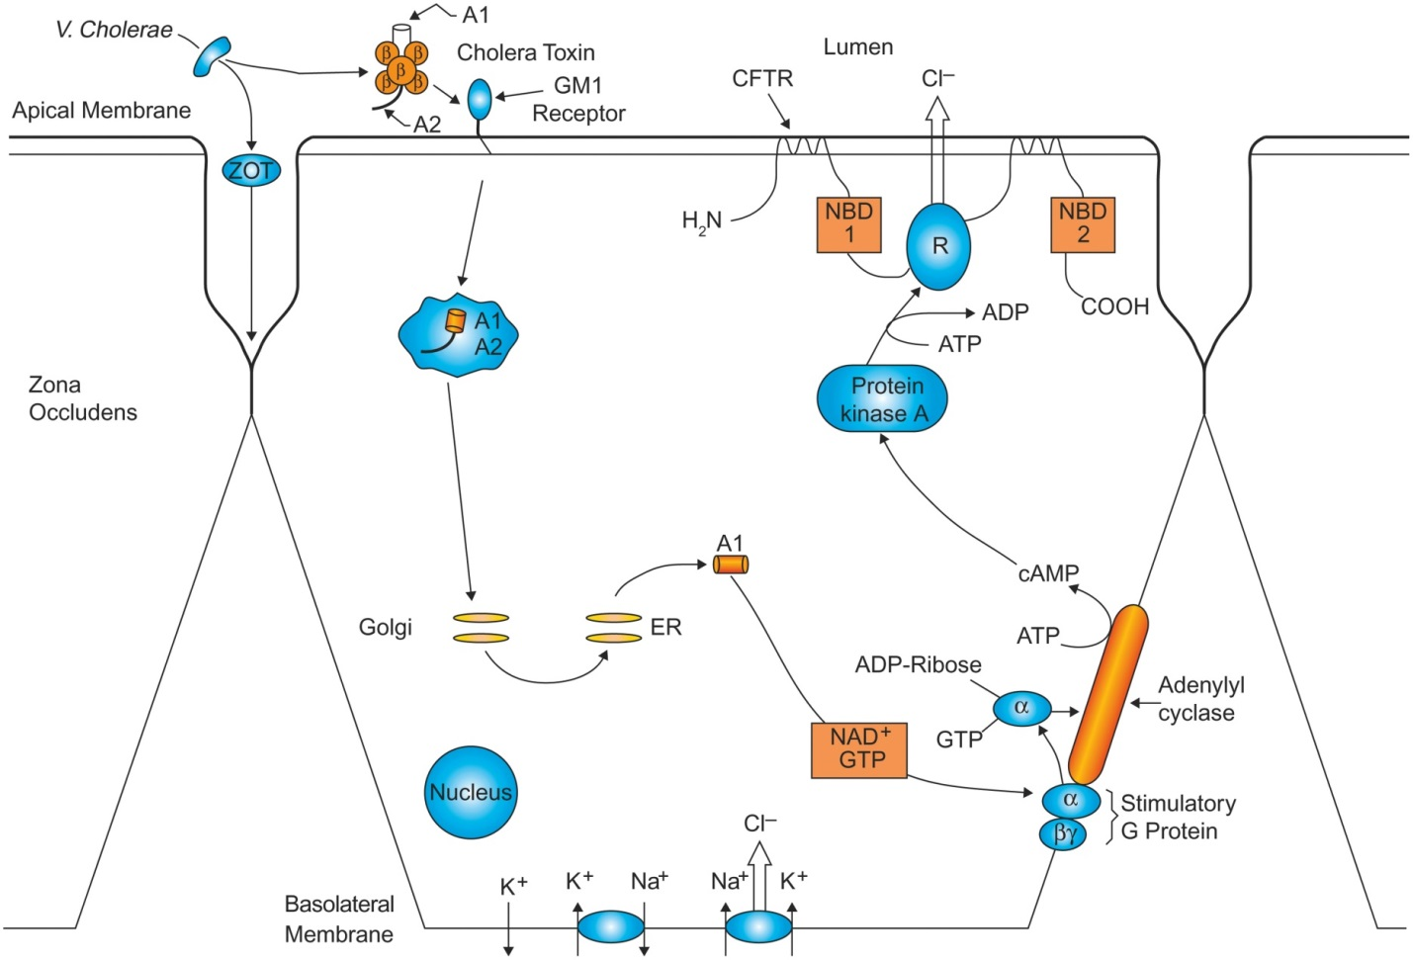
Figure 11.13

Slide 15
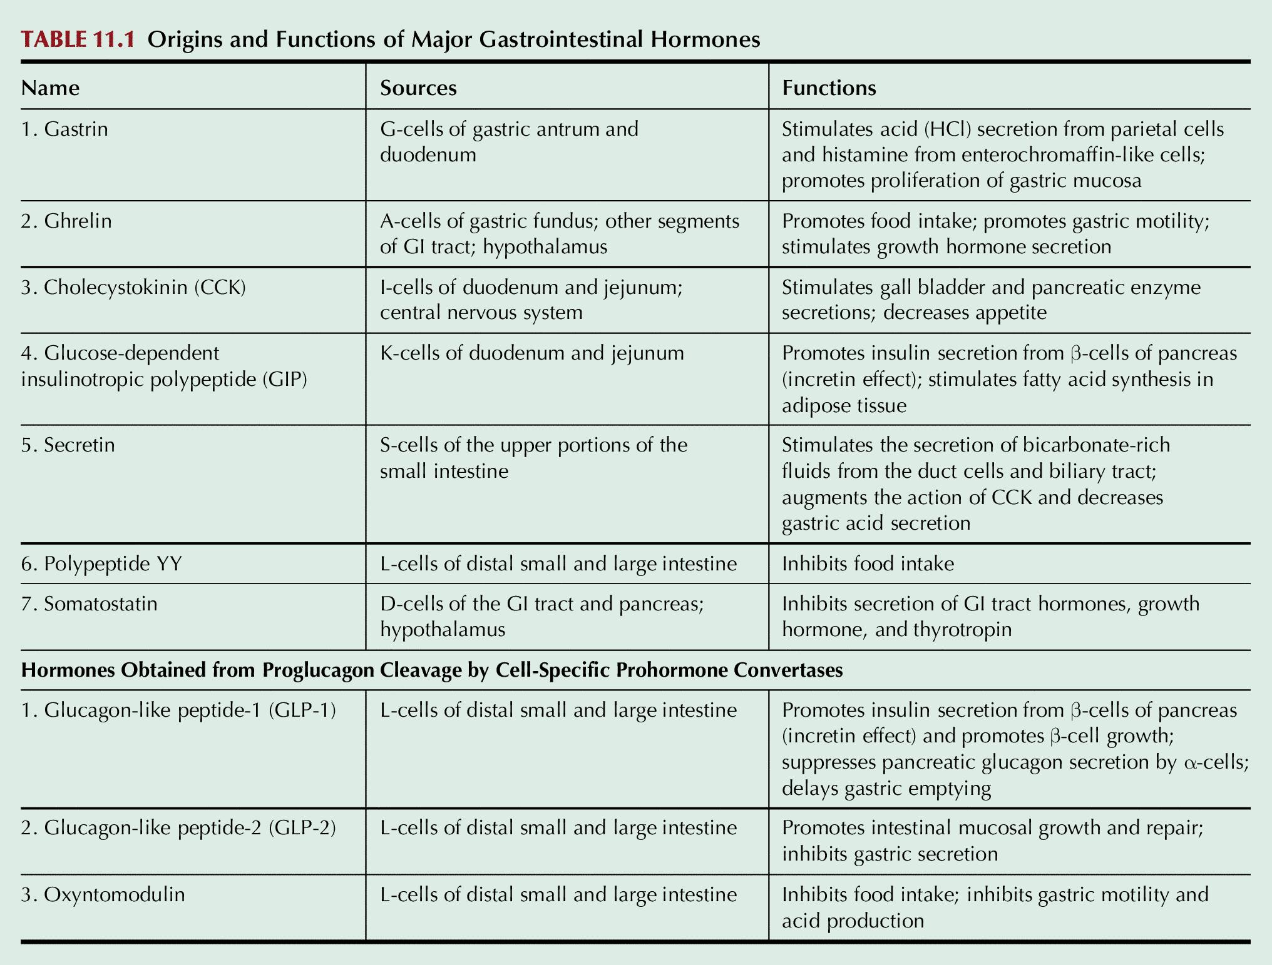
Table 11.1

Slide 16
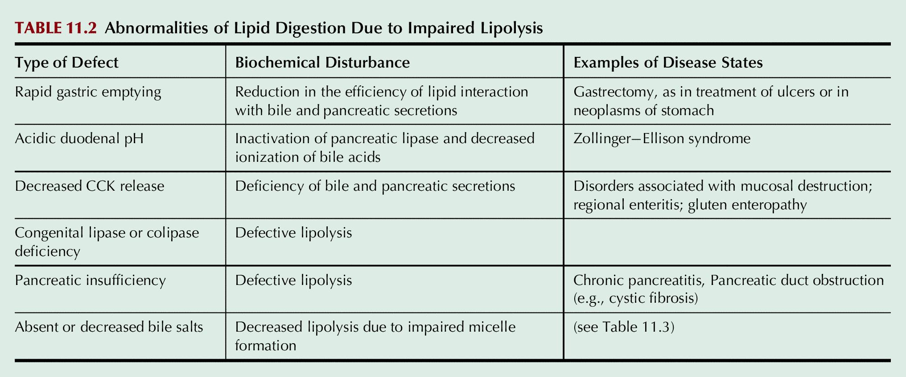
Table 11.2

Slide 17
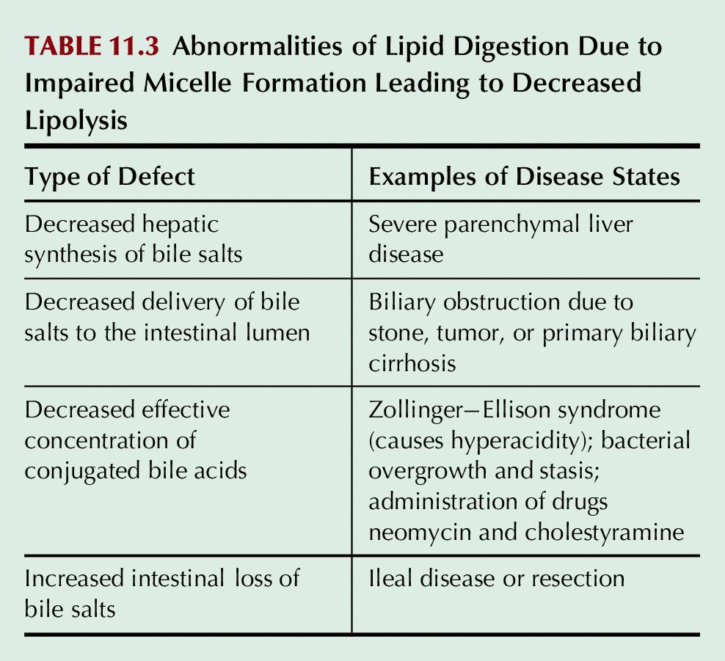
Table 11.3

Slide 18
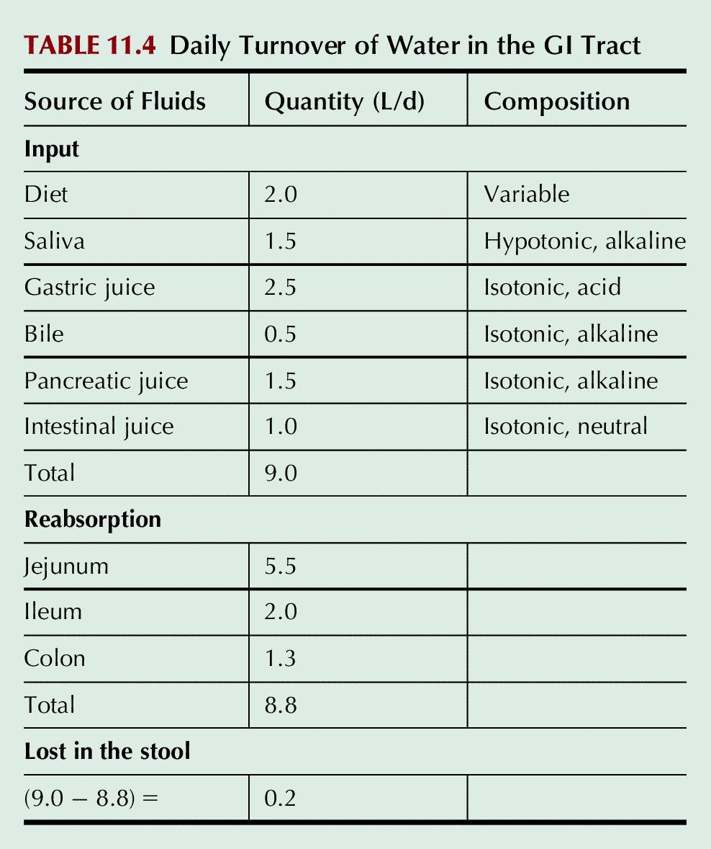
Table 11.4

Slide 19
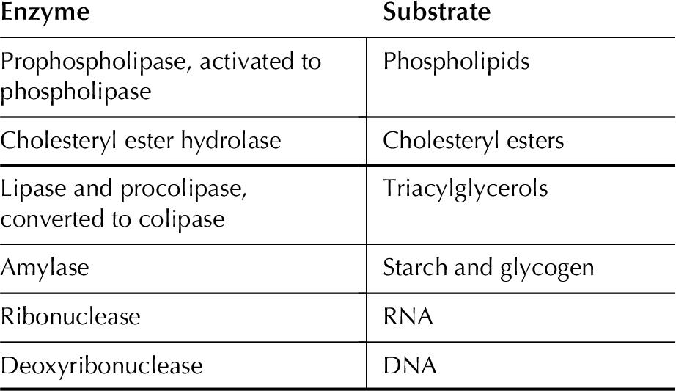
Table 11.5

Slide 20
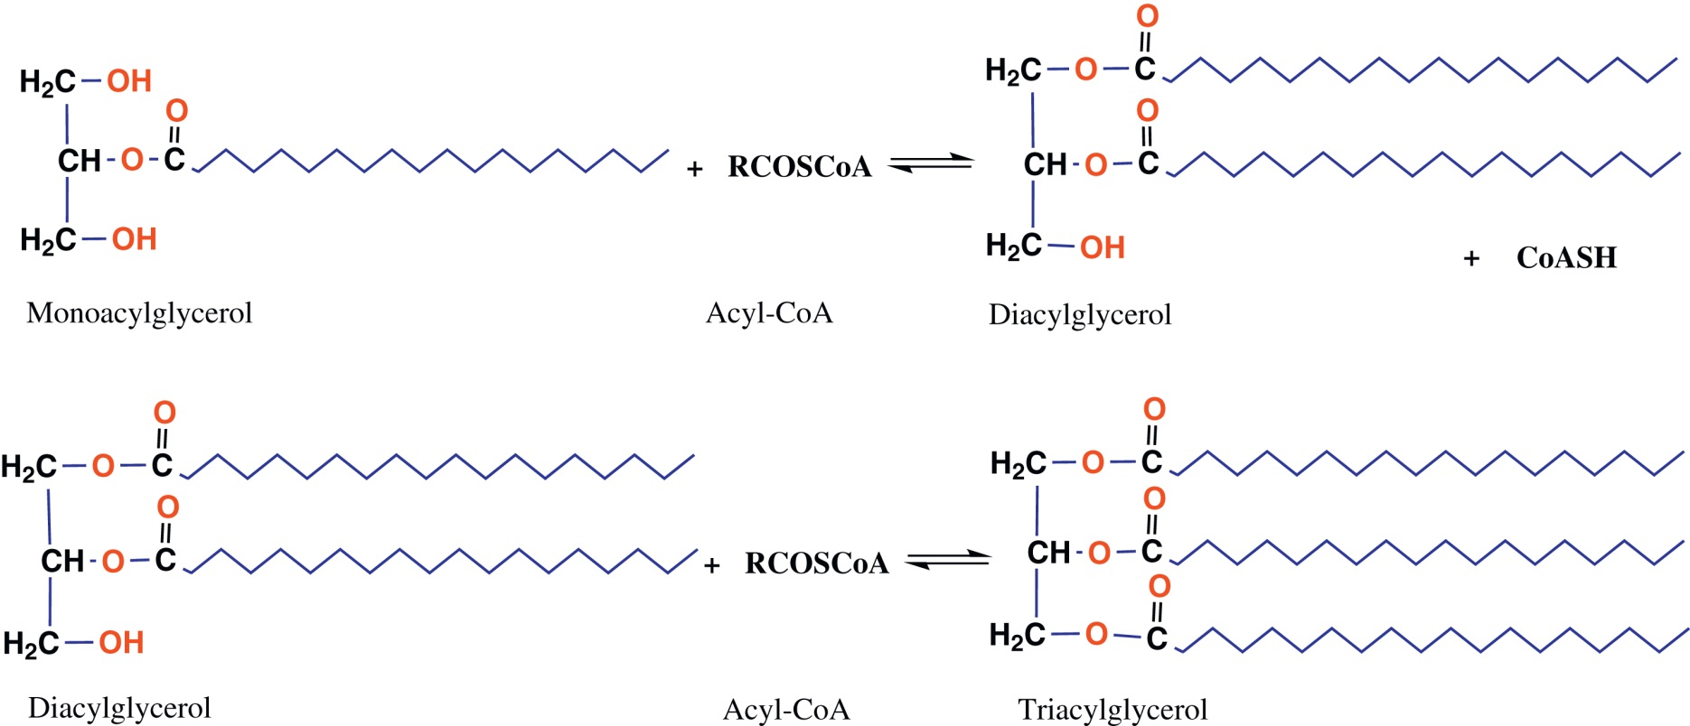
UnFig 11.1

