Slide 1
Chapter 14
Carbohydrate Metabolism II: Gluconeogenesis, Glycogen Synthesis and Breakdown, and Alternative Pathways

Slide 2
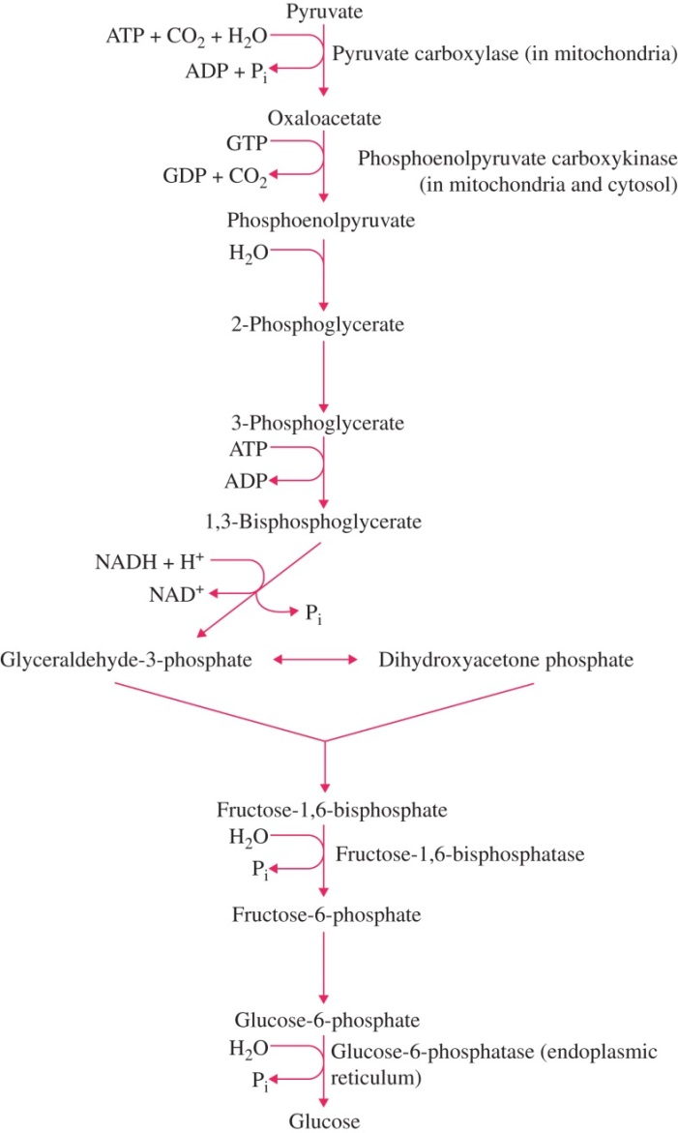
Figure 14.1

Slide 3
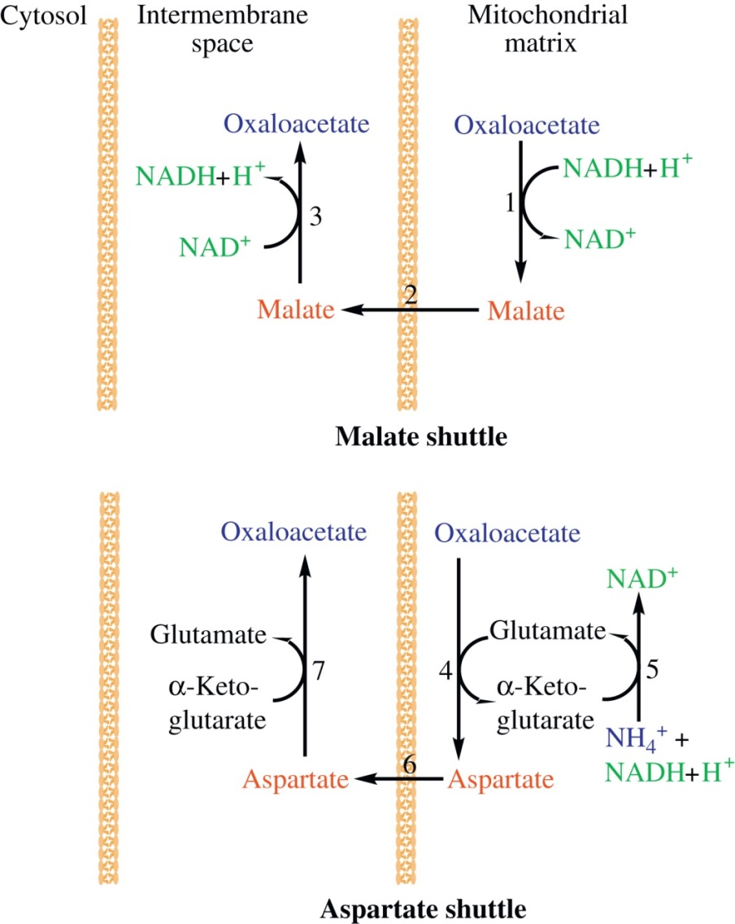
Figure 14.2

Slide 4
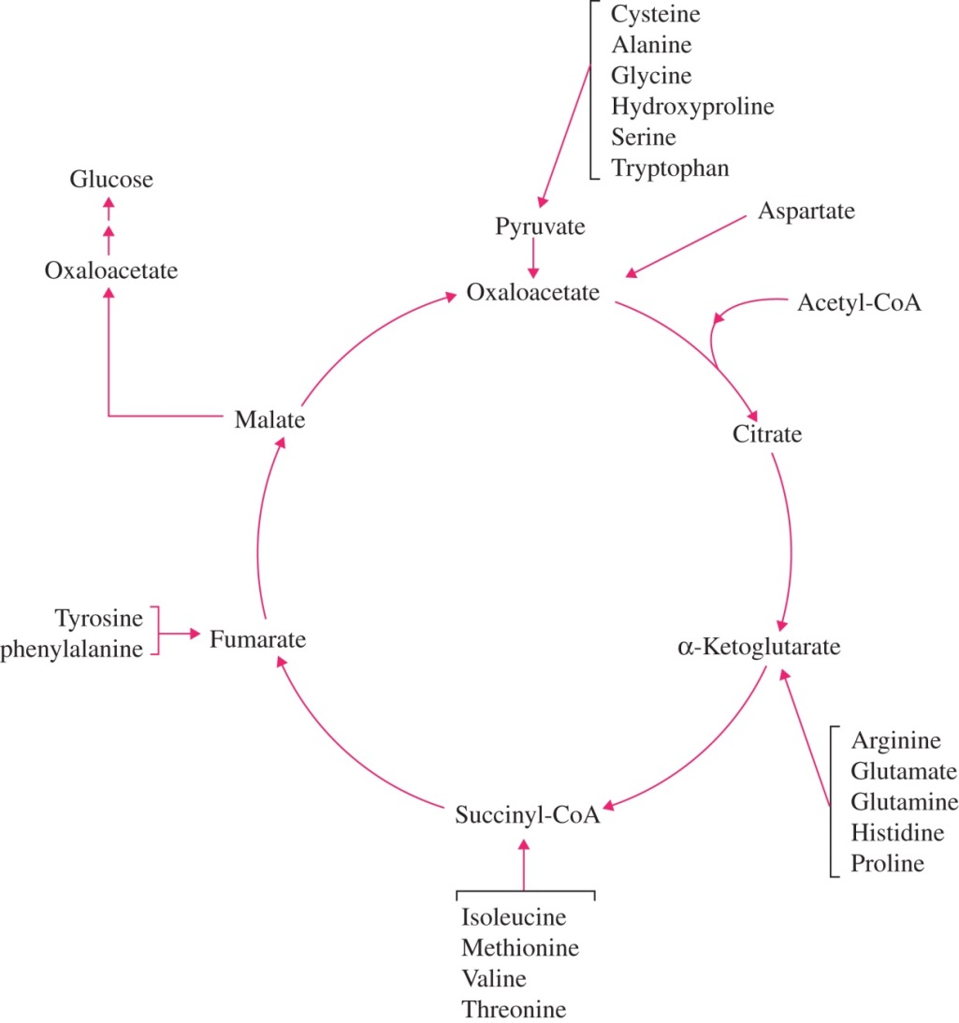
Figure 14.3

Slide 5
Figure 14.4

Slide 6
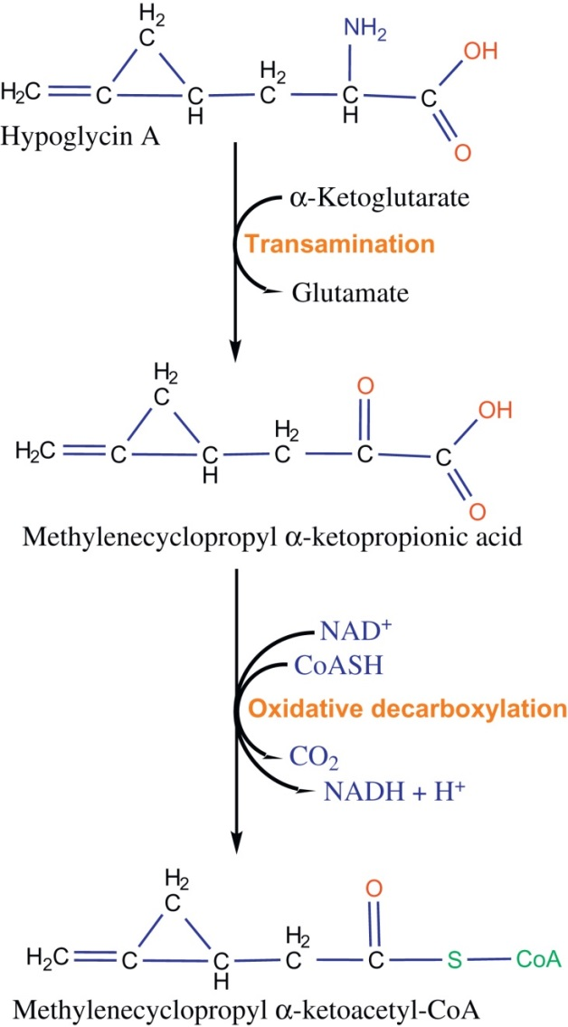
Figure 14.5

Slide 7
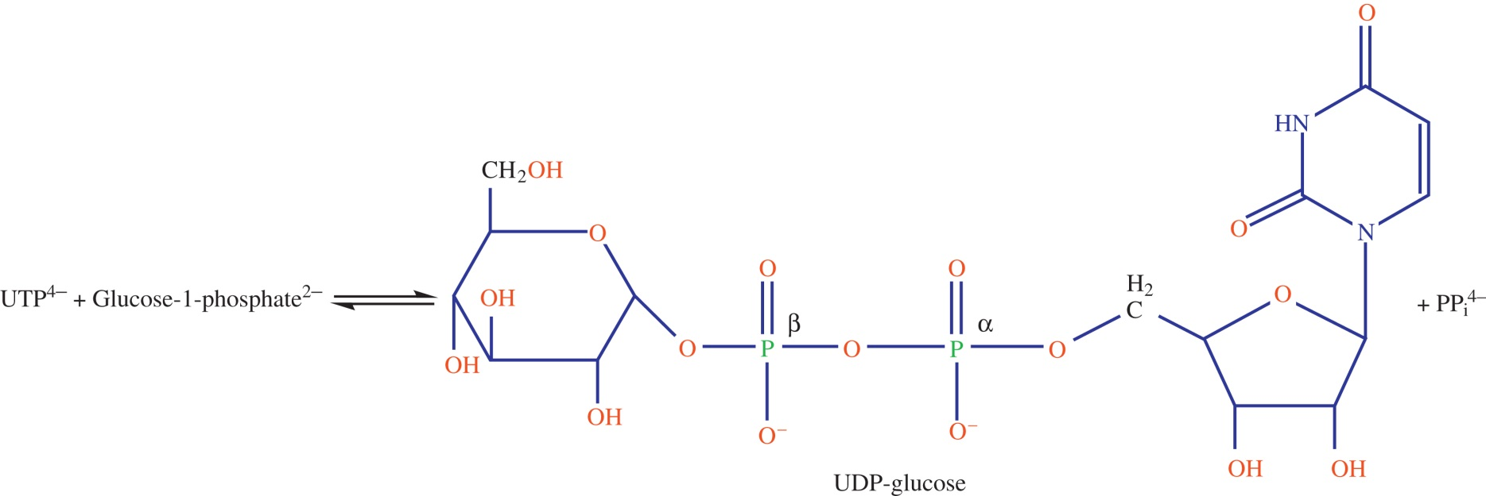
Figure 14.6

Slide 8
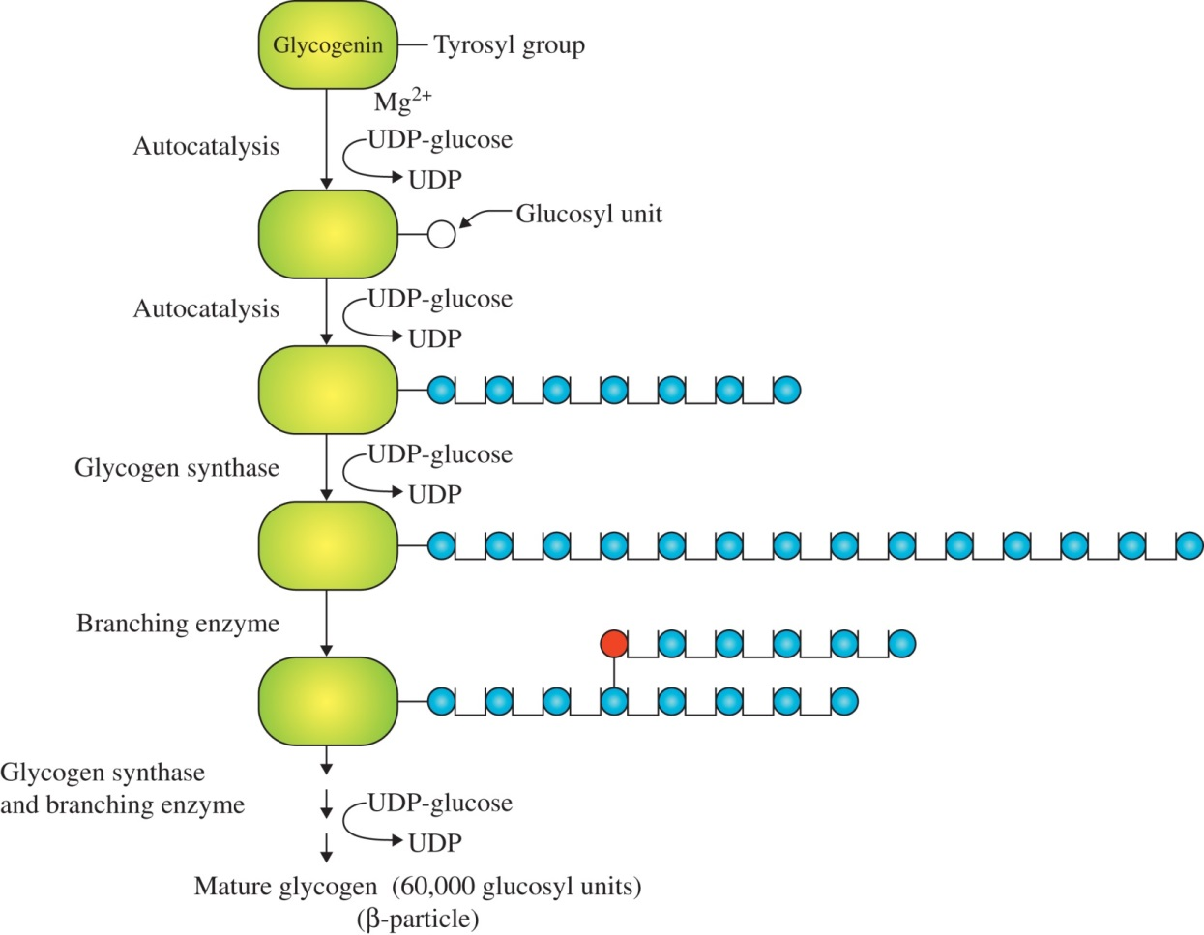
Figure 14.7

Slide 9
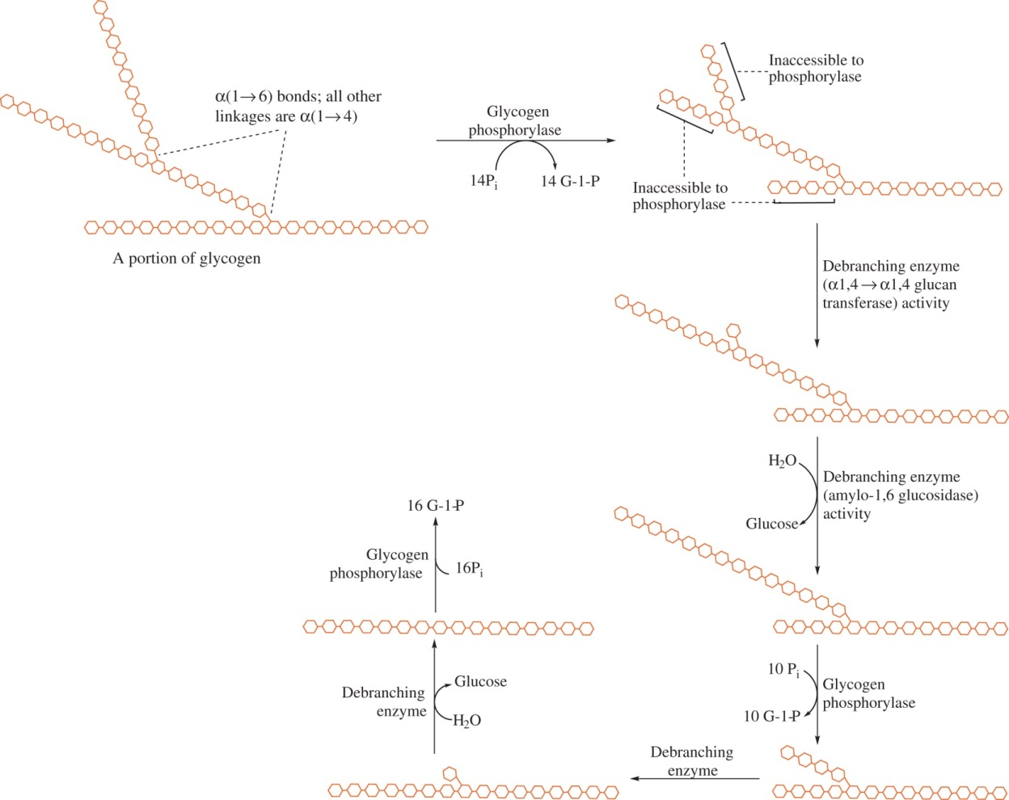
Figure 14.8

Slide 10
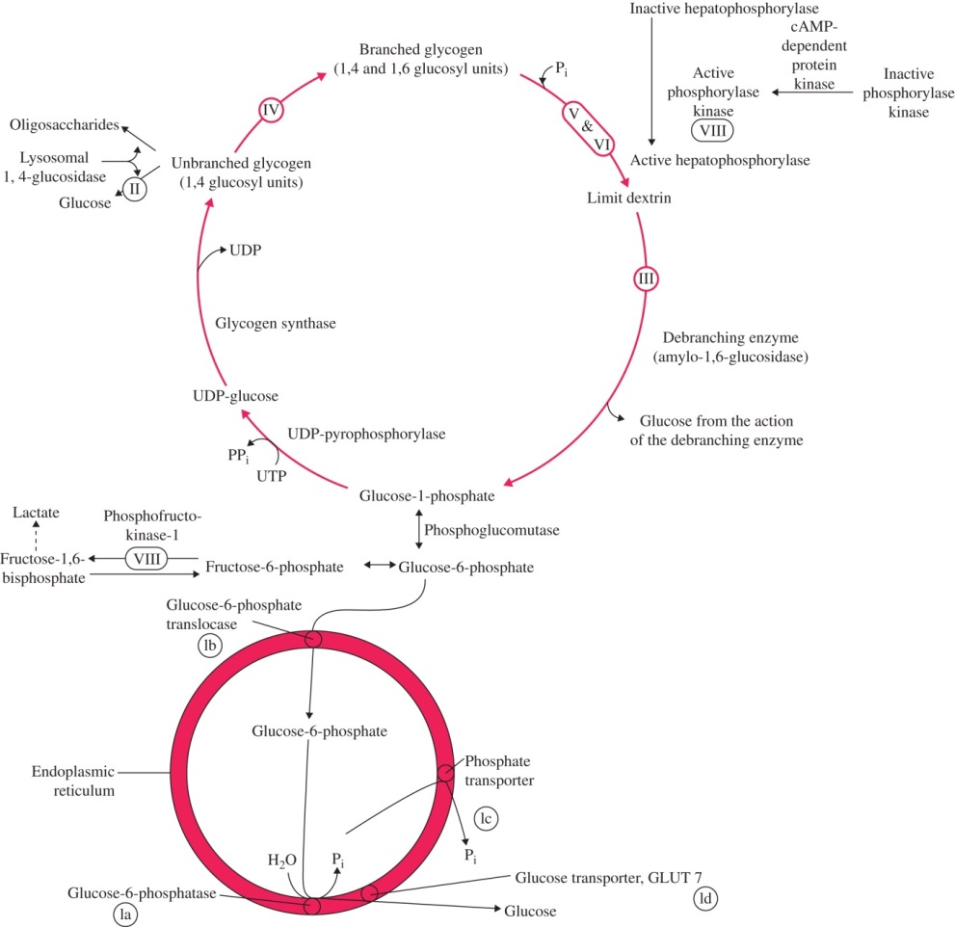
Figure 14.9

Slide 11
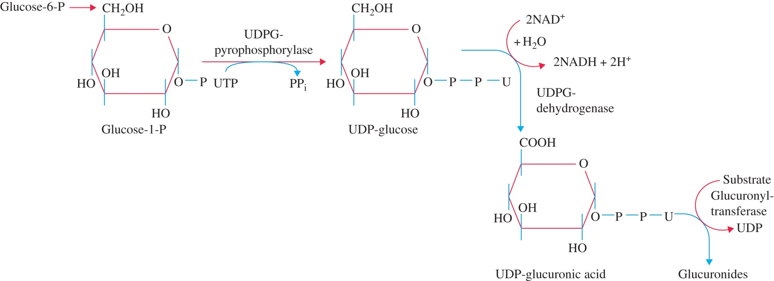
Figure 14.10

Slide 12
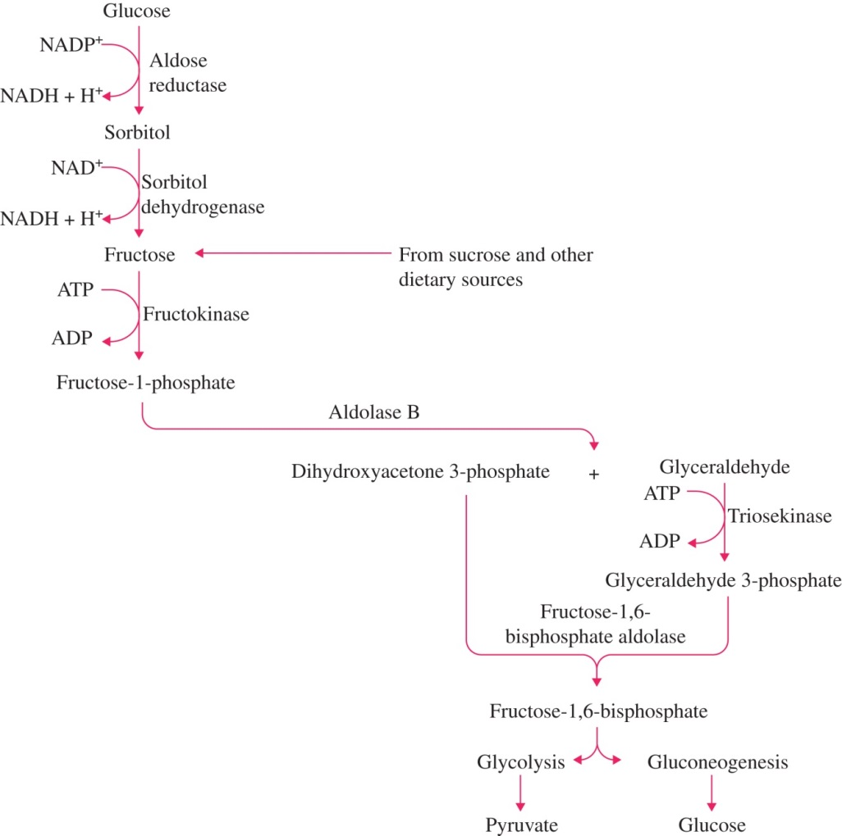
Figure 14.11

Slide 13
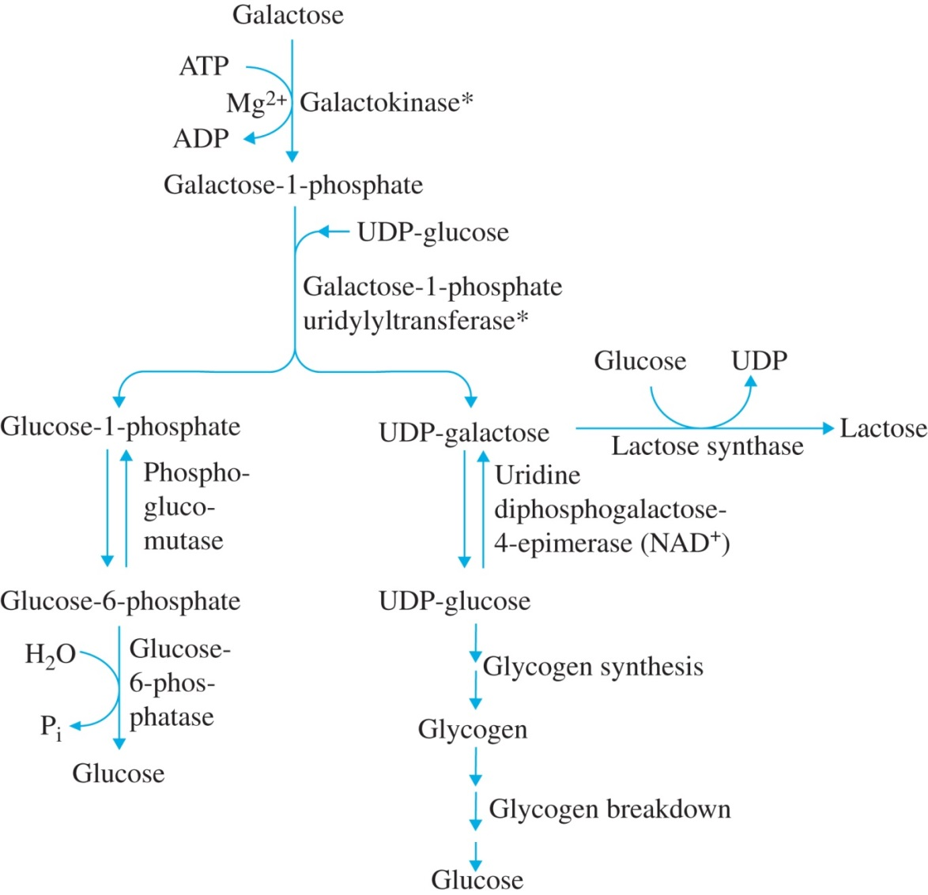
Figure 14.12

Slide 14
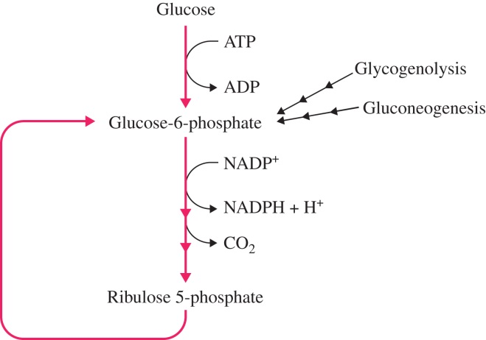
Figure 14.13

Slide 15
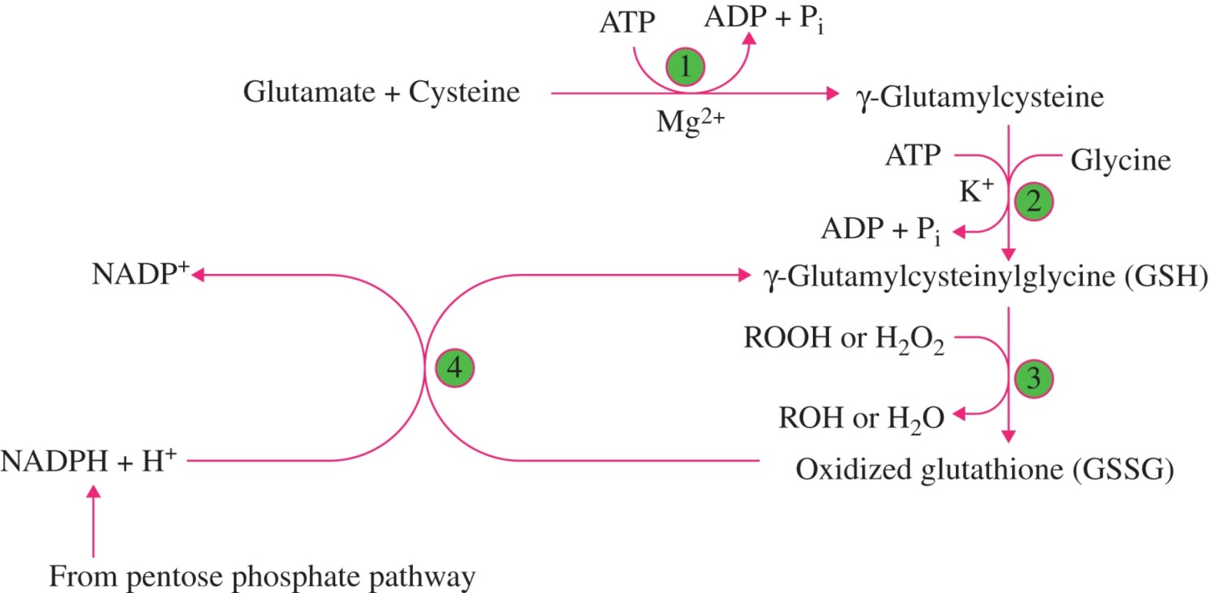
Figure 14.14

Slide 16
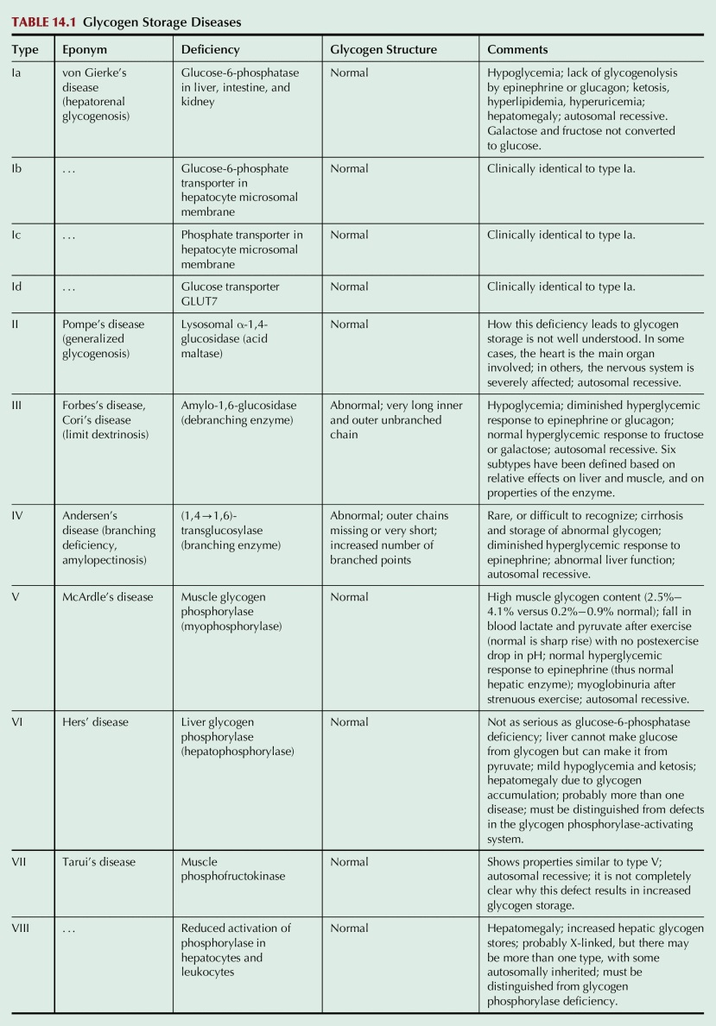
Table 14.1

Slide 17
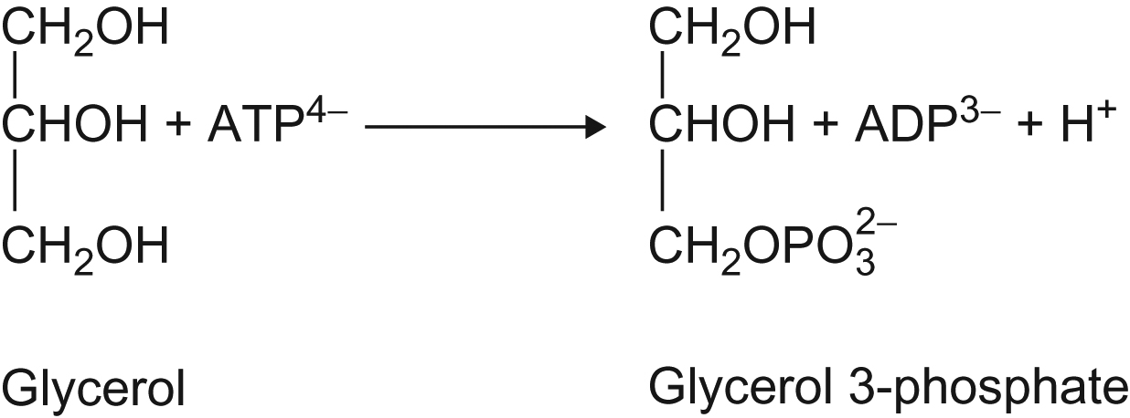
UnnFigure 14.1

Slide 18
UnFig 14.2

Slide 19
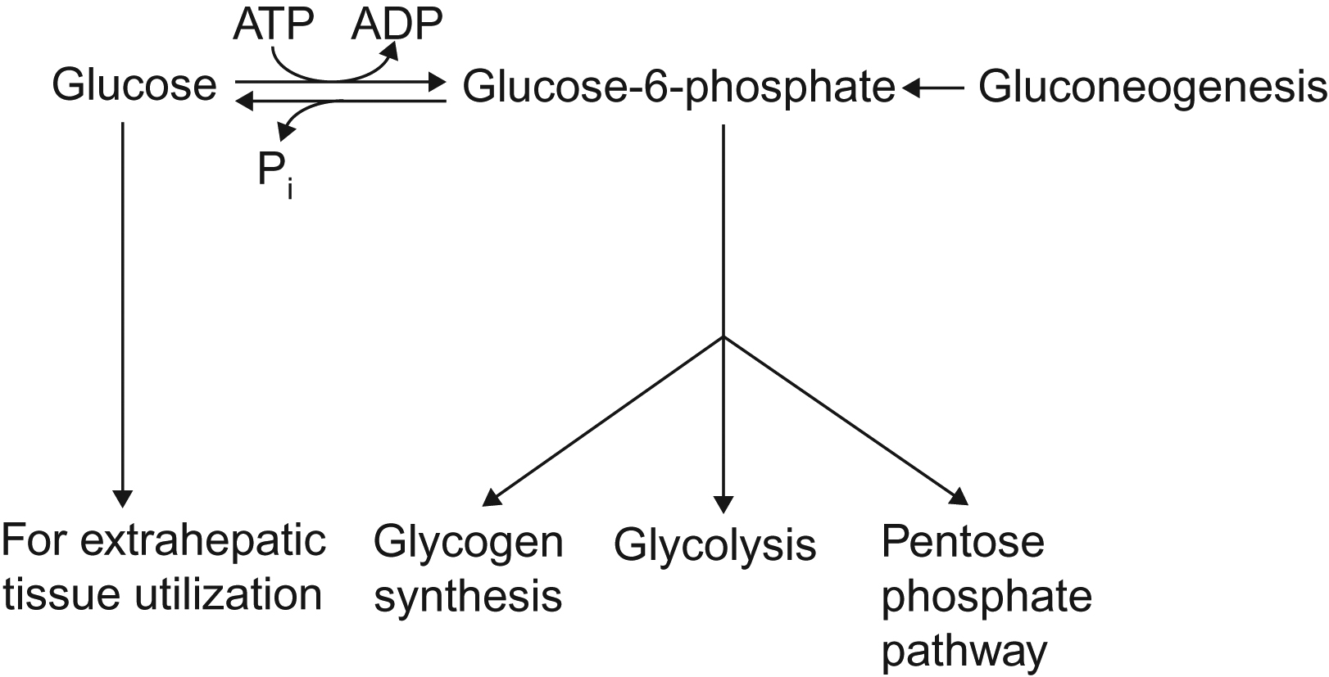
UnFig 14.3

Slide 20
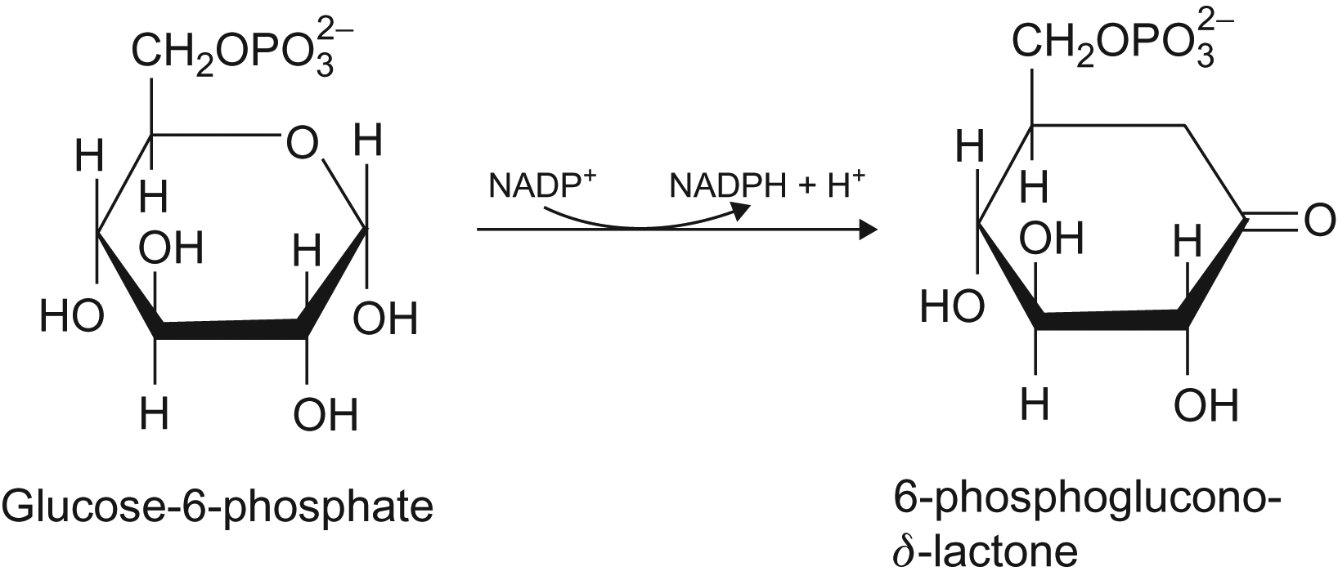
UnFig 14.4

Slide 21
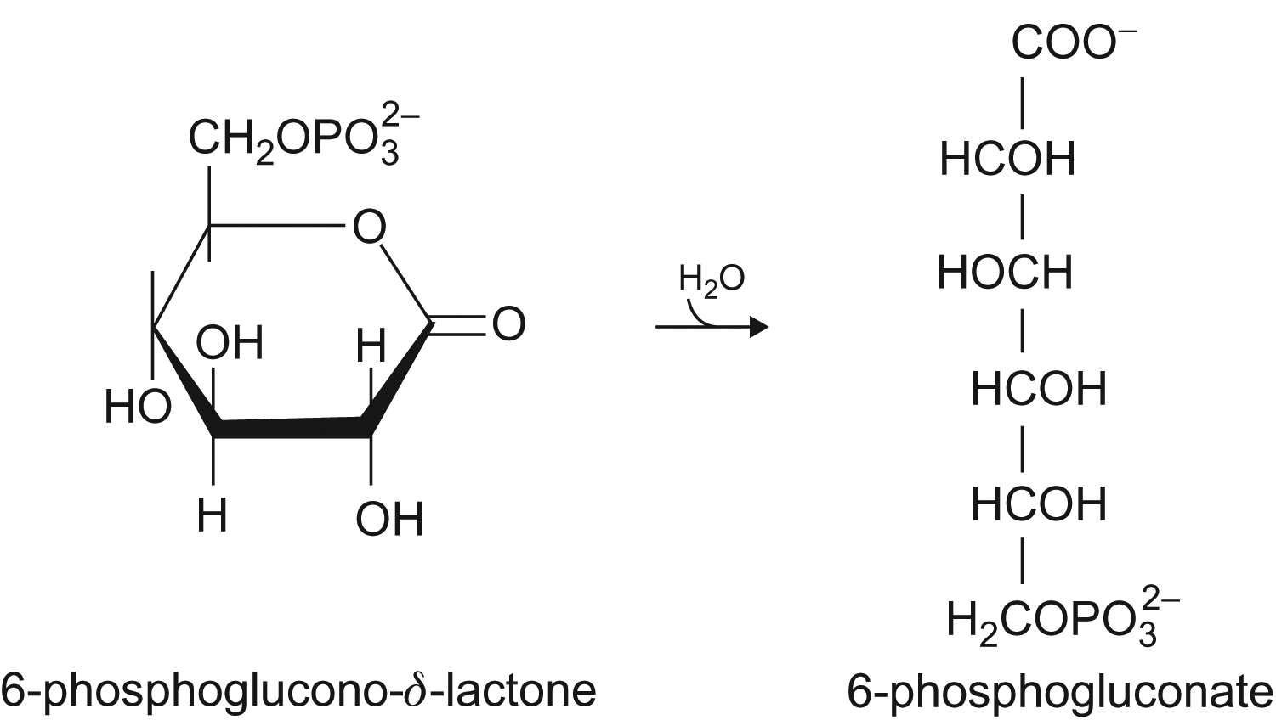
UnFig 14.5

Slide 22
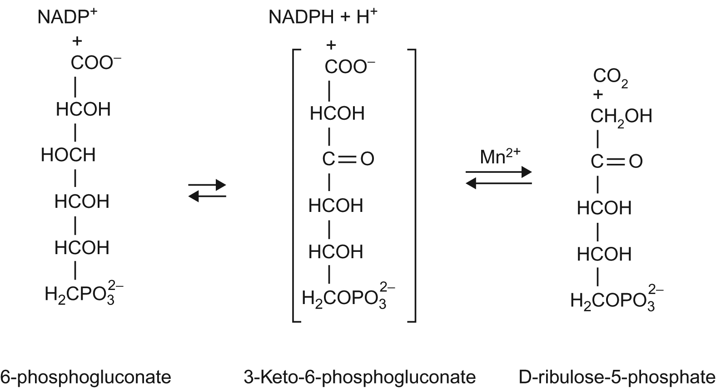
UnFig 14.6

Slide 23
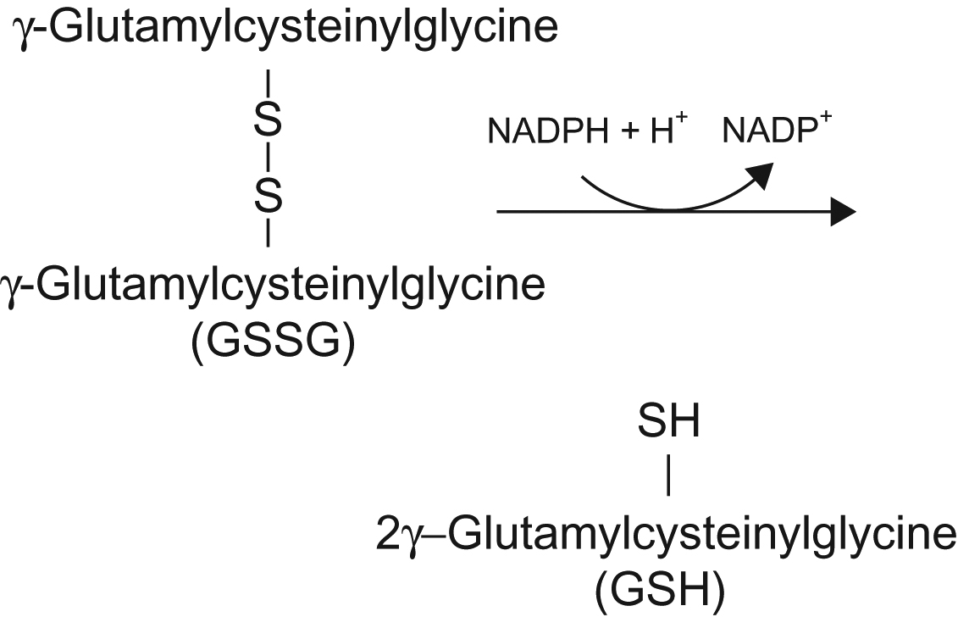
UnFig 14.7

Slide 24
UnFig 14.8

