Slide 1
Chapter 15
Protein and Amino Acid Metabolism

Slide 2
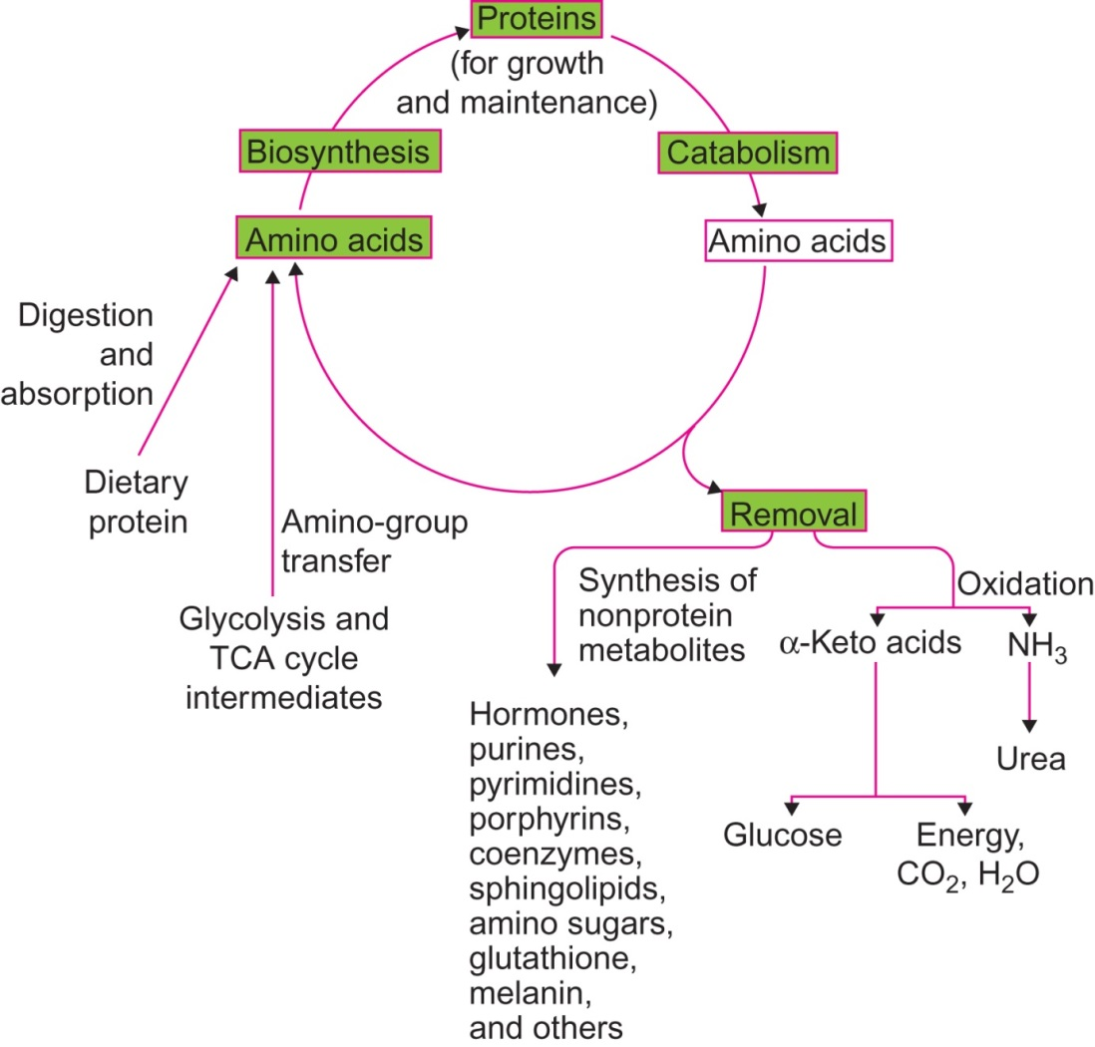
Figure 15.1

Slide 3
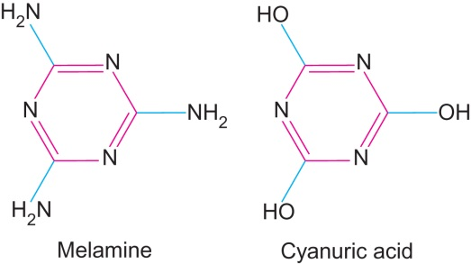
Figure 15.2

Slide 4
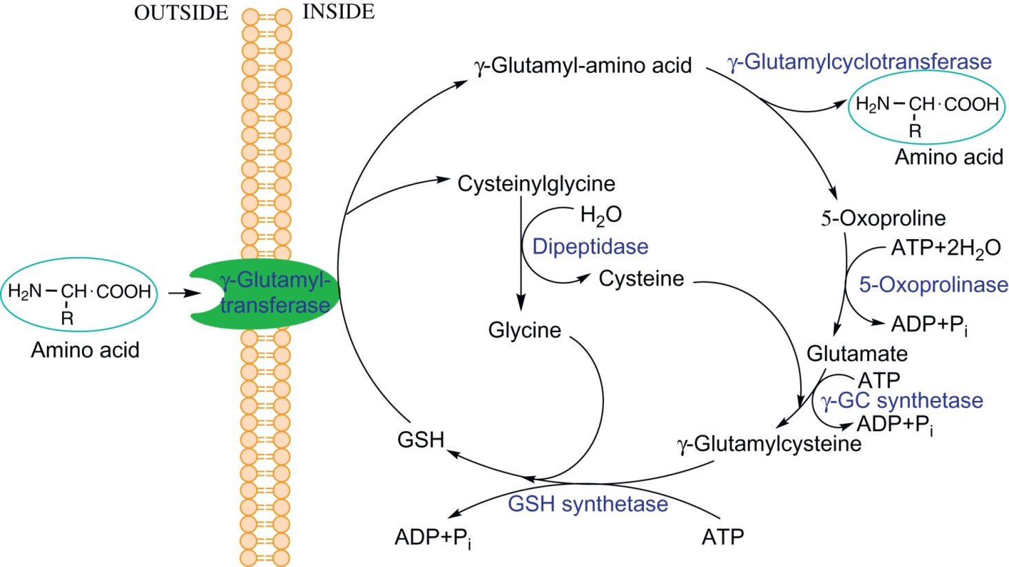
Figure 15.3

Slide 5
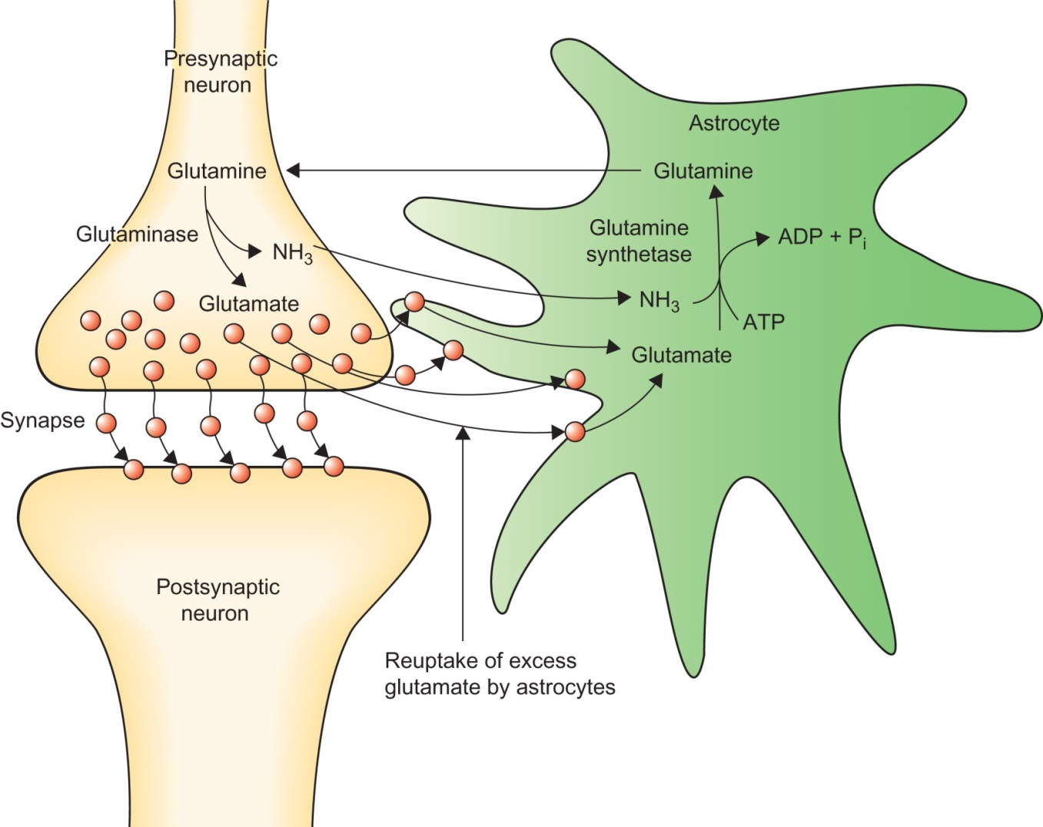
Figure 15.4

Slide 6
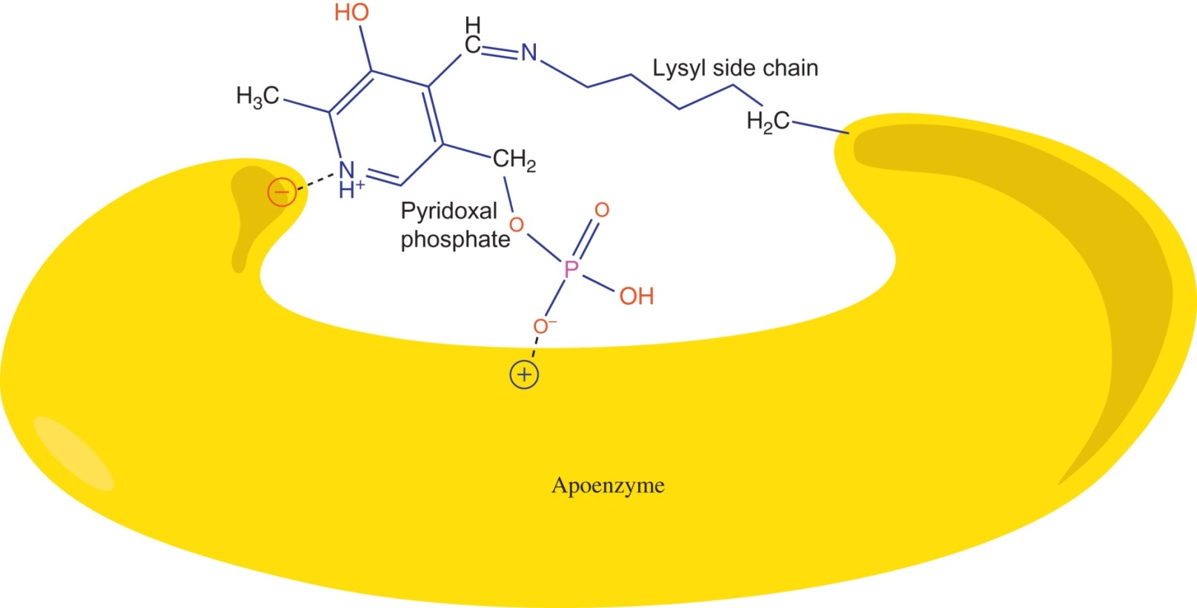
Figure 15.5

Slide 7
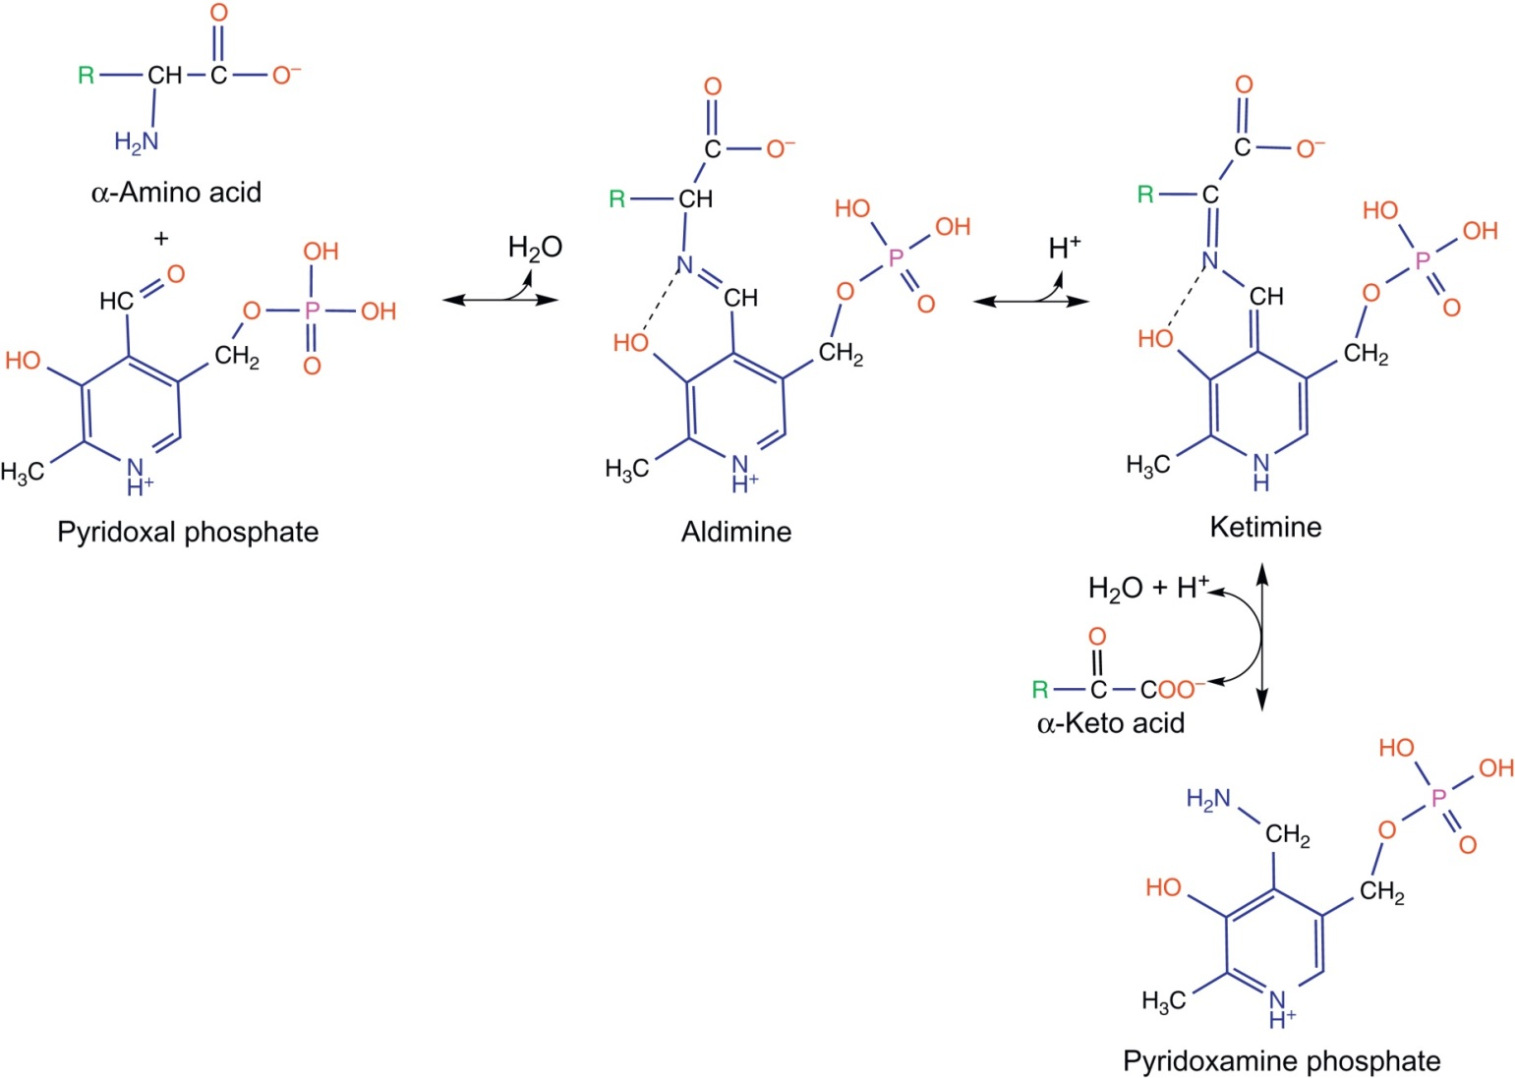
Figure 15.6

Slide 8
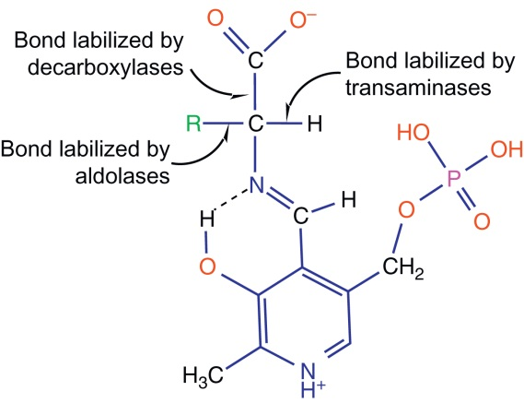
Figure 15.7

Slide 9
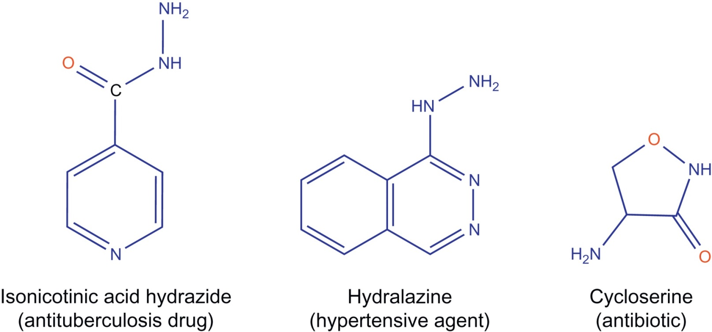
Figure 15.8

Slide 10
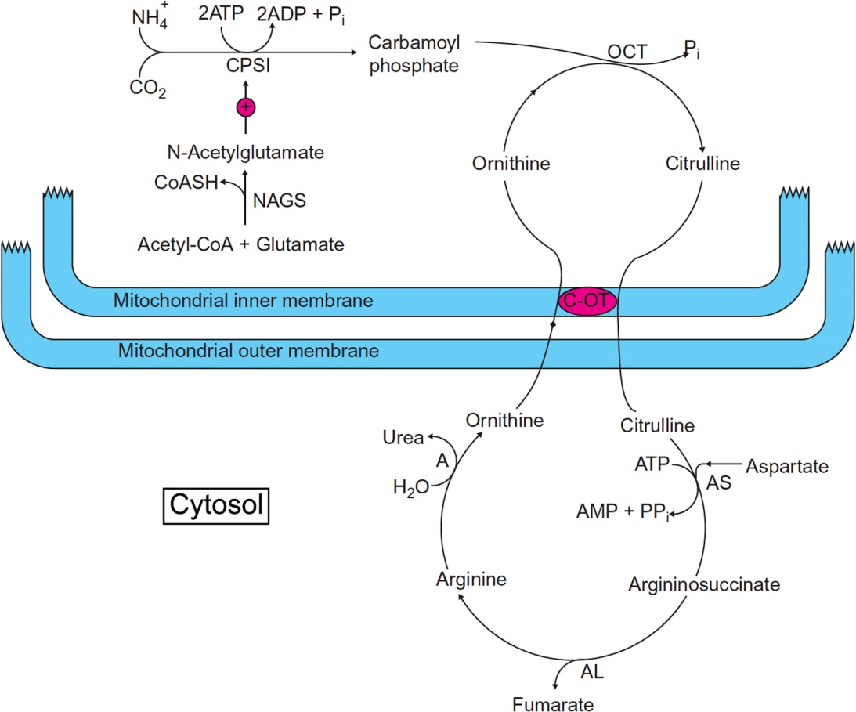
Figure 15.9

Slide 11
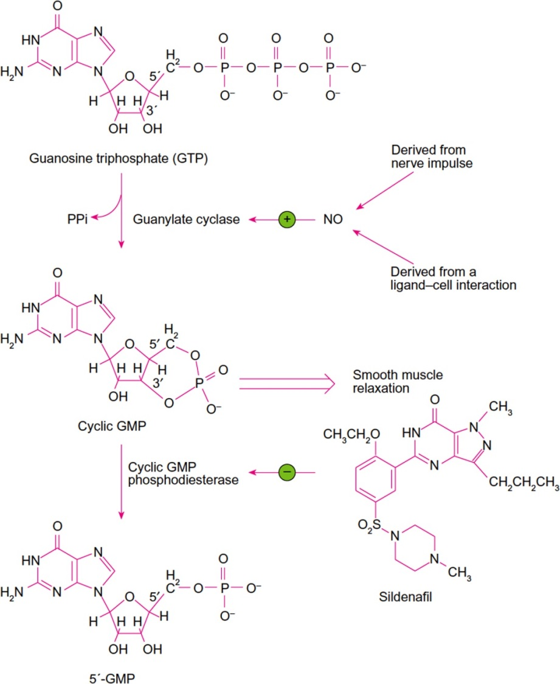
Figure 15.10

Slide 12
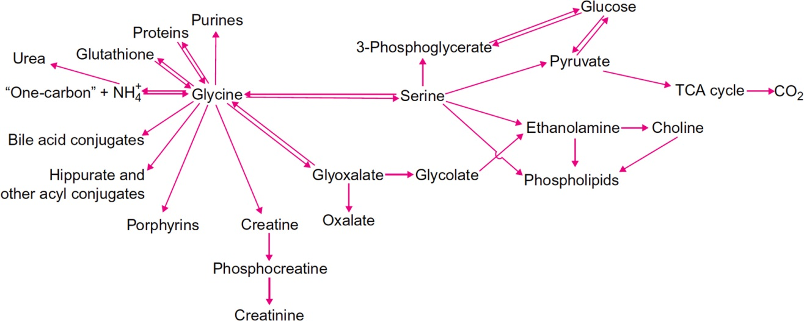
Figure 15.11

Slide 13
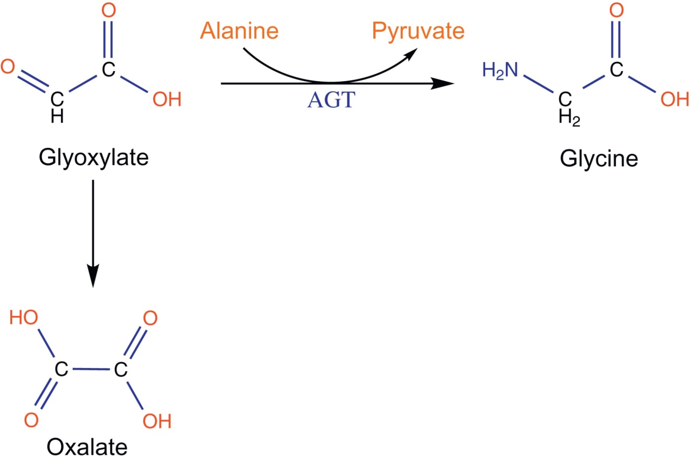
Figure 15.12

Slide 14
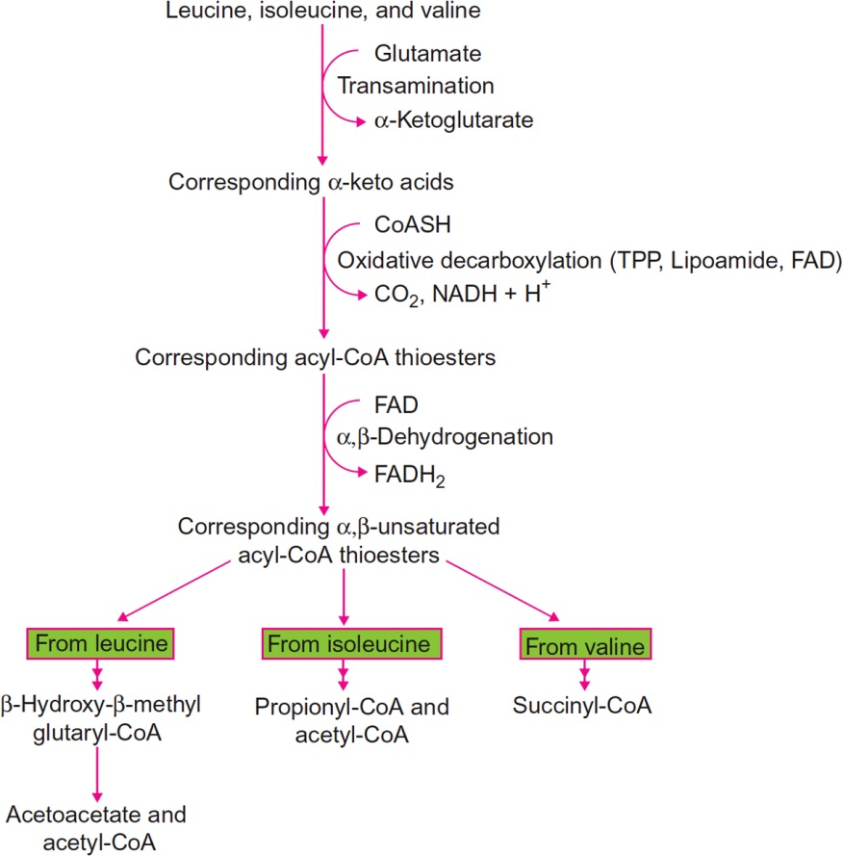
Figure 15.13

Slide 15
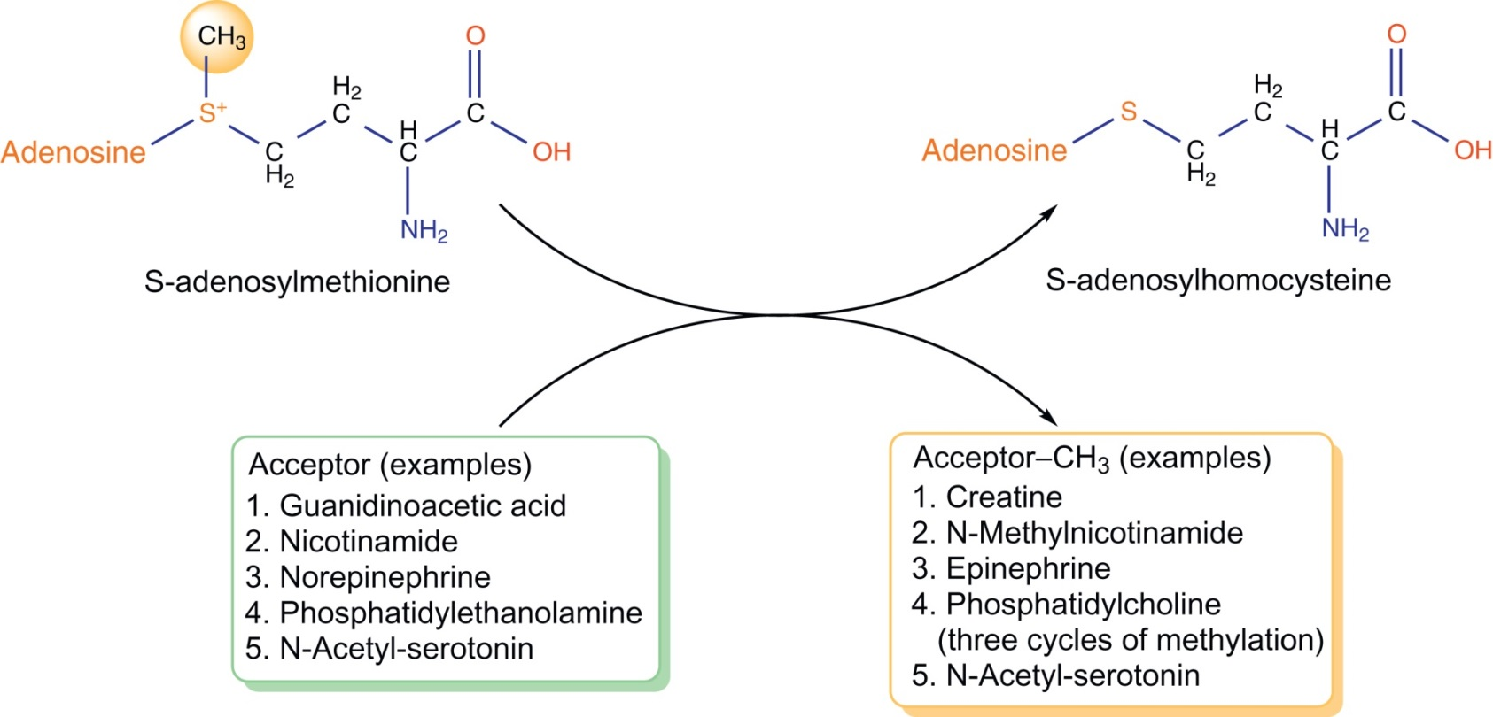
Figure 15.14

Slide 16
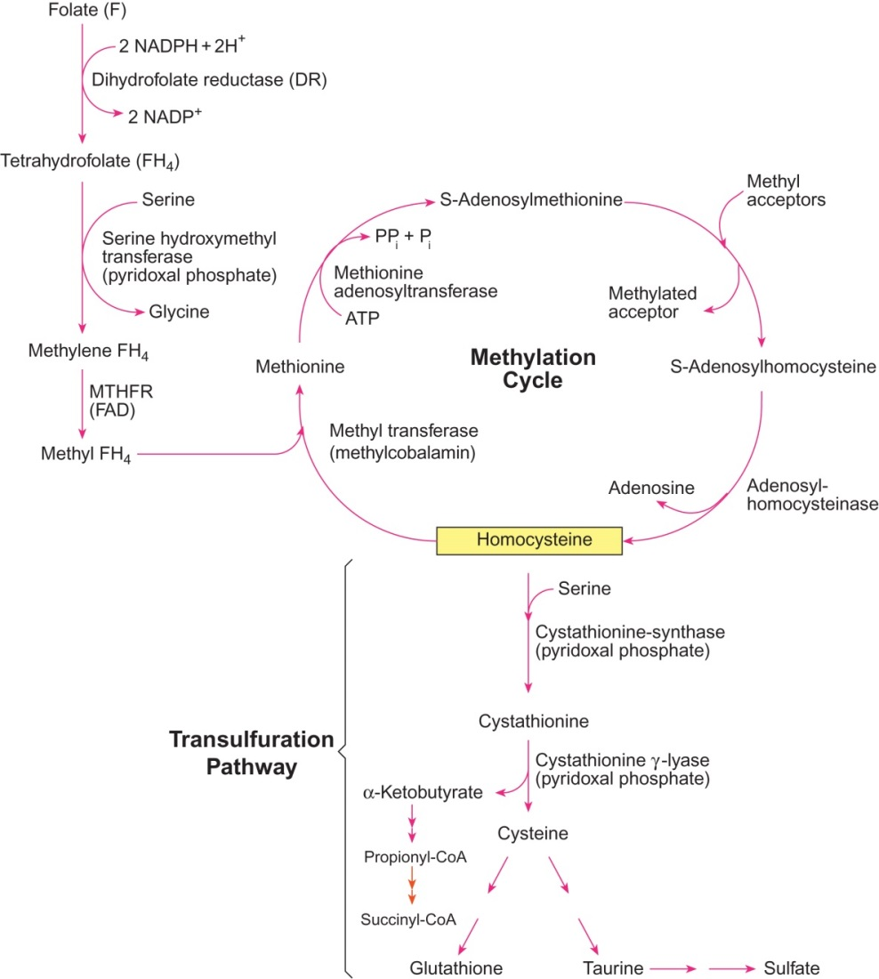
Figure 14.15

Slide 17
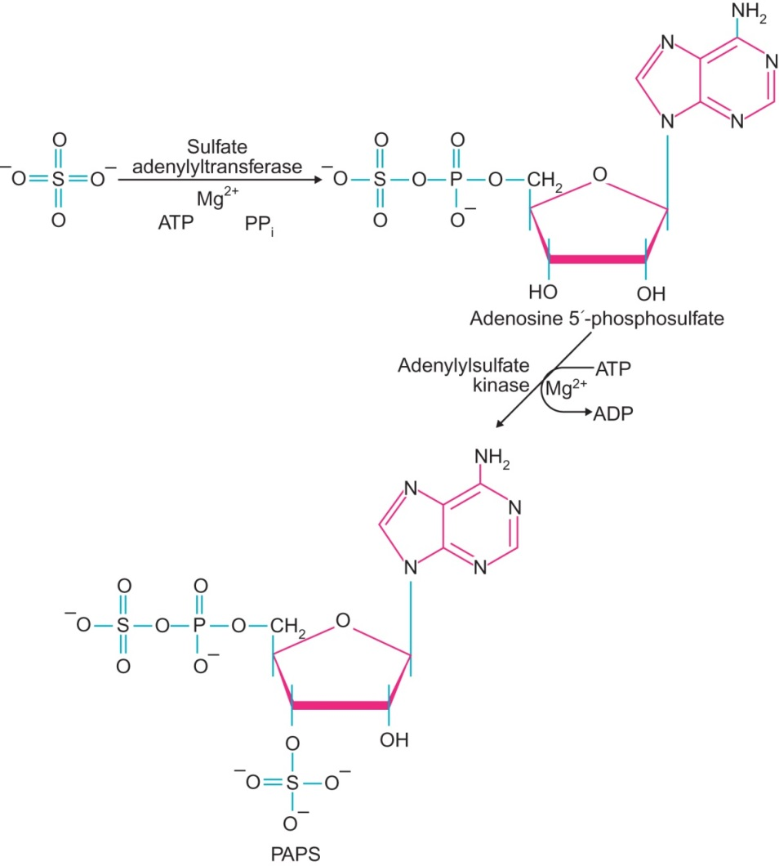
Figure 15.16

Slide 18
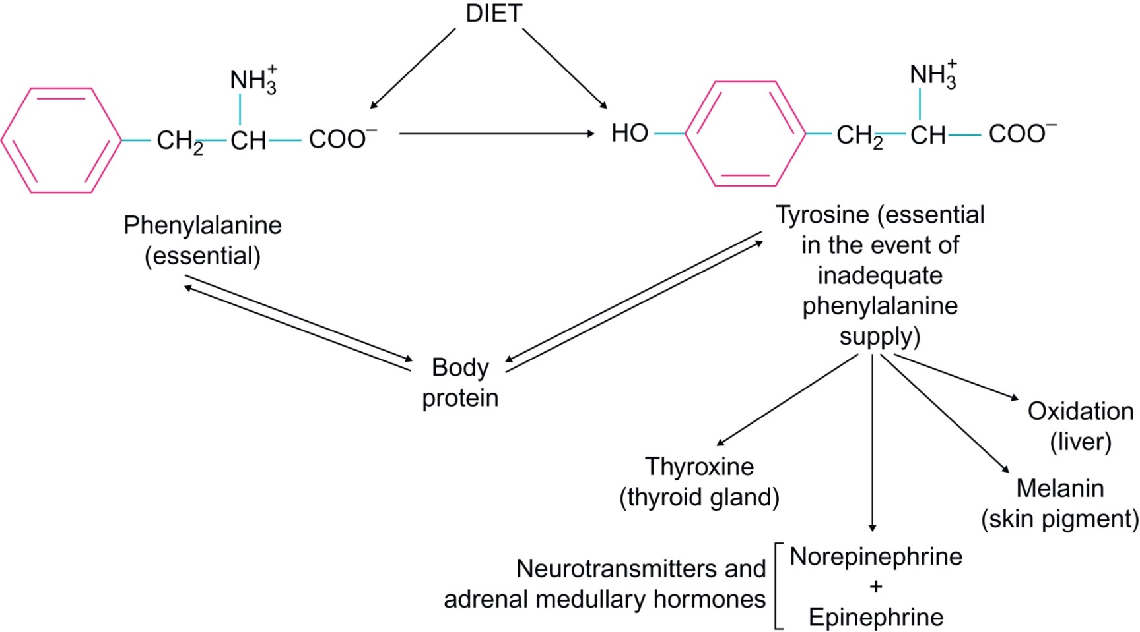
Figure 15.17

Slide 19
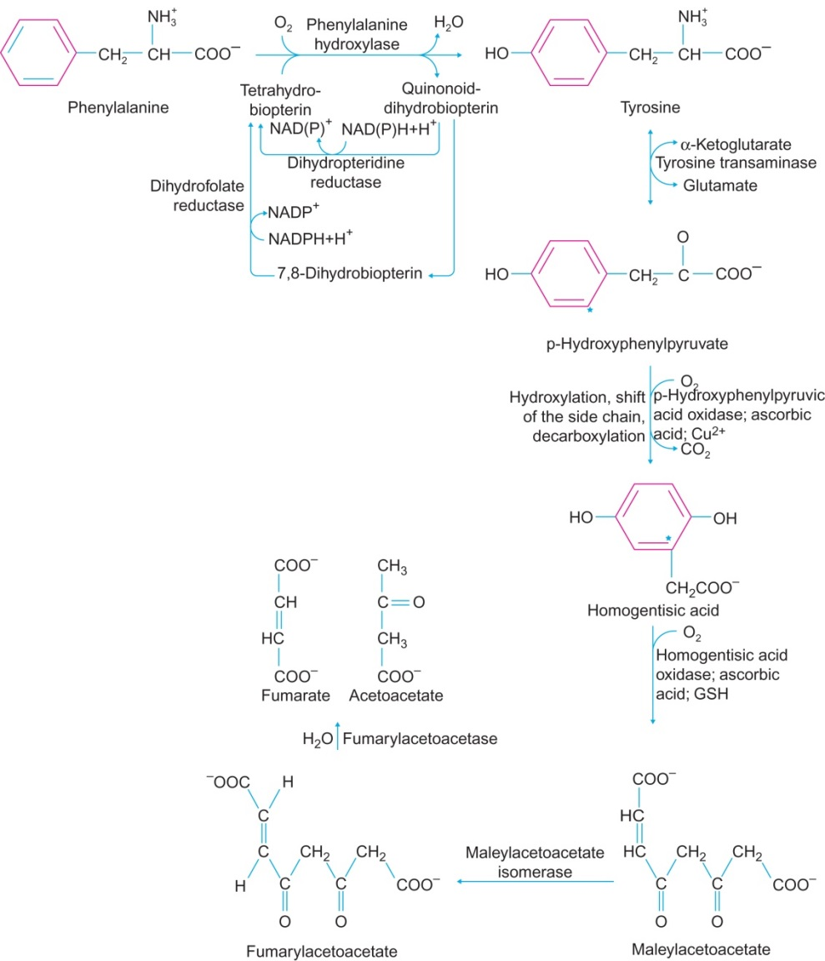
Figure 15.18

Slide 20
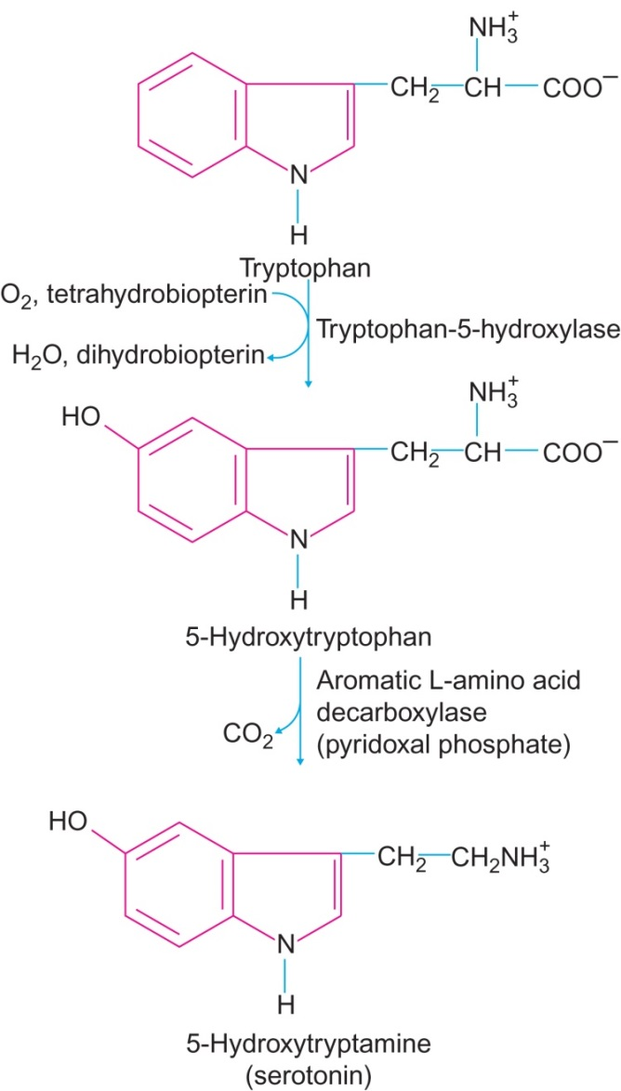
Figure 15.19

Slide 21
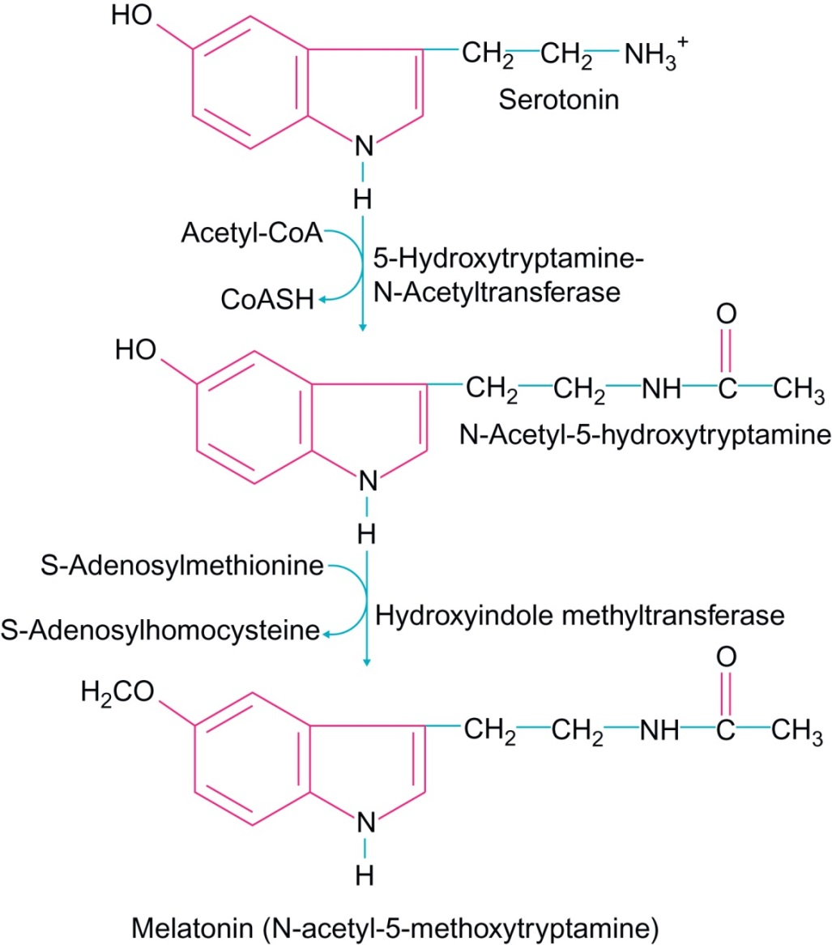
Figure 15.20

Slide 22
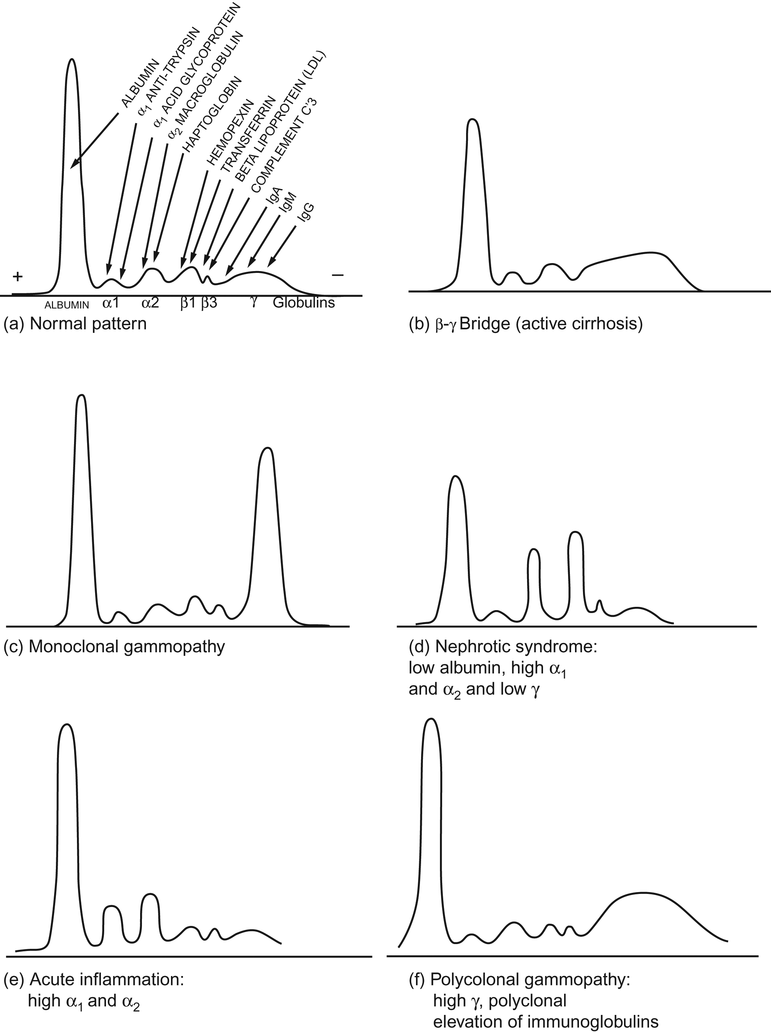
Figure 15.21

Slide 23
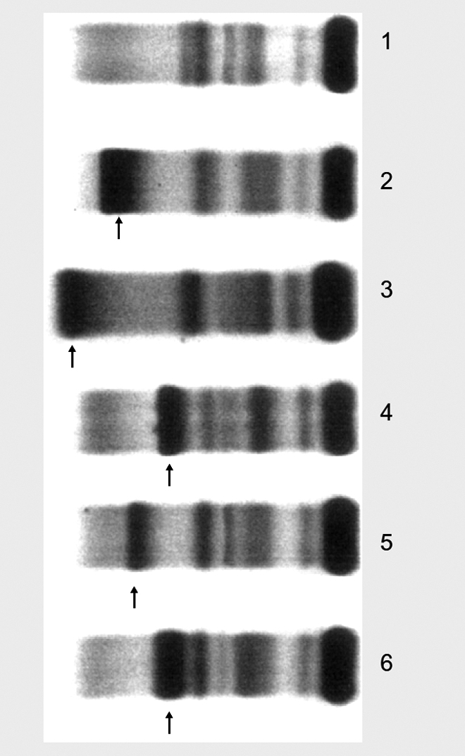
Figure 15.22

Slide 24
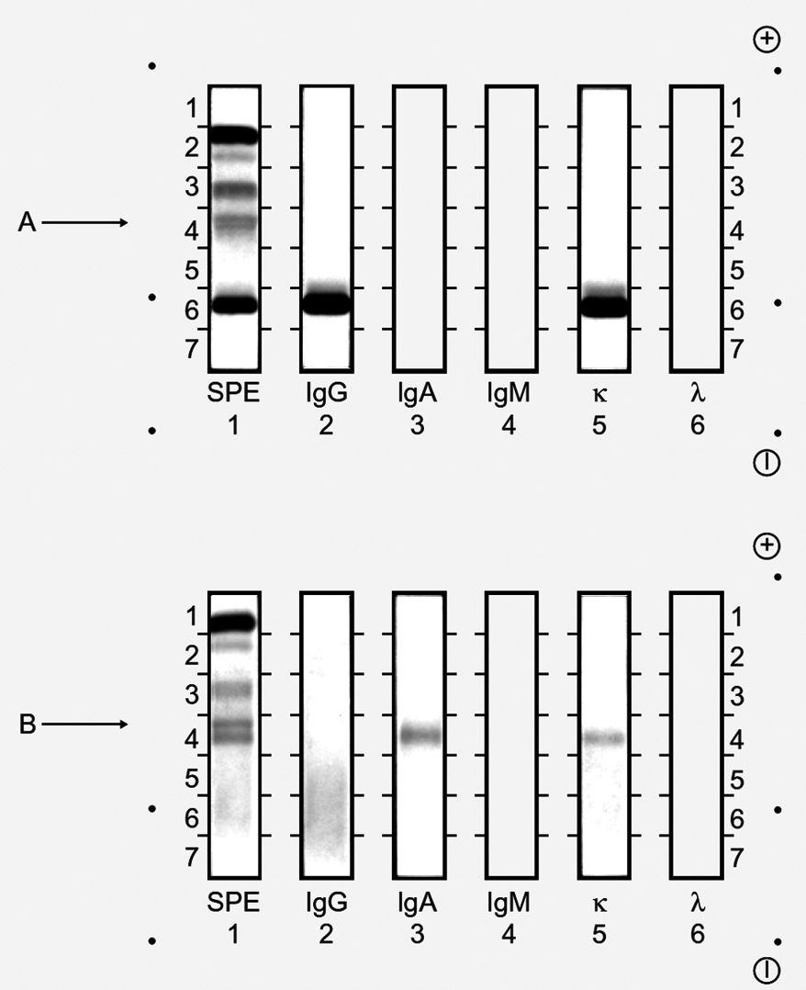
Figure 15.23

Slide 25
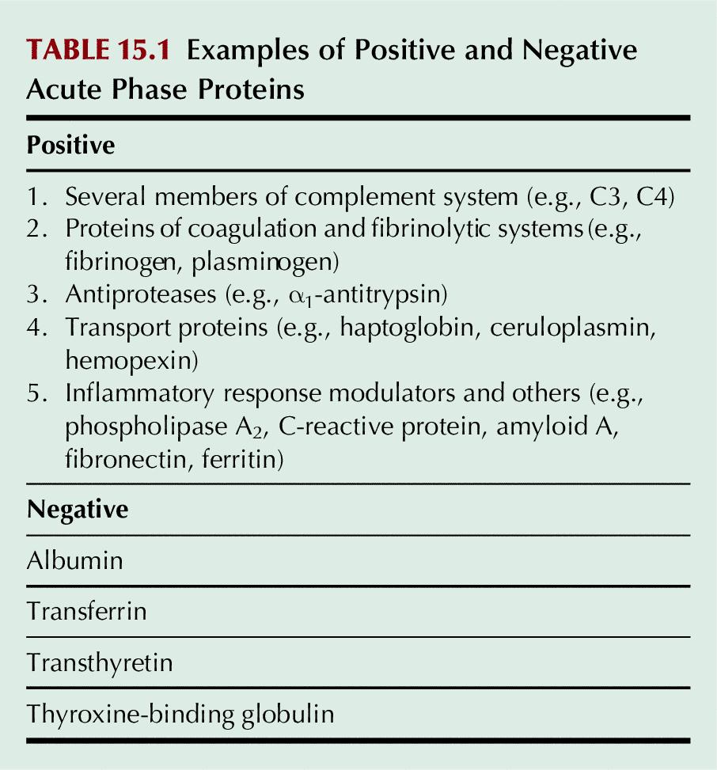
Table 15.1

Slide 26
UnFig 15.1

Slide 27
UnFig 15.2

Slide 28
UnFig 15.3

Slide 29
UnFig 15.4

Slide 30
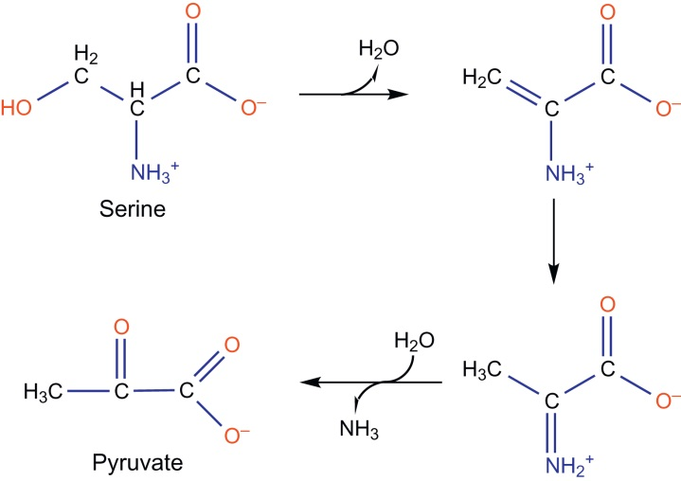
UnFig 15.5

Slide 31
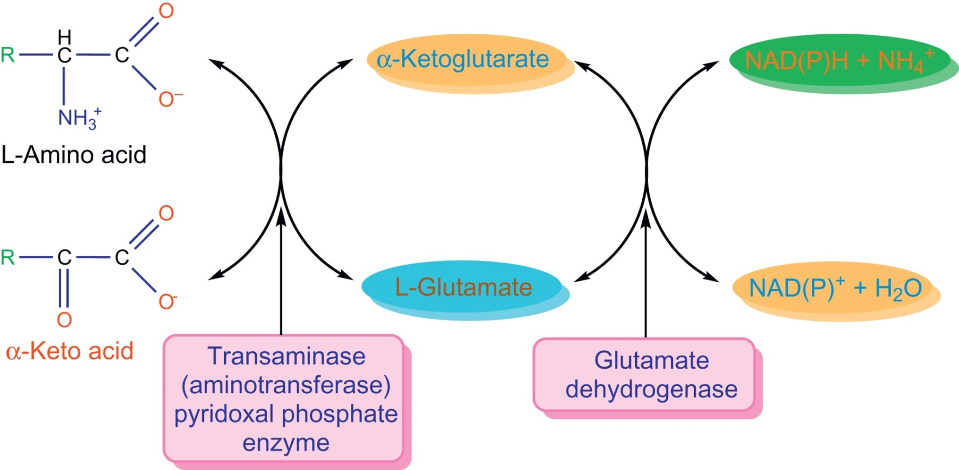
UnFig 15.6

Slide 32
UnFig 15.7

Slide 33
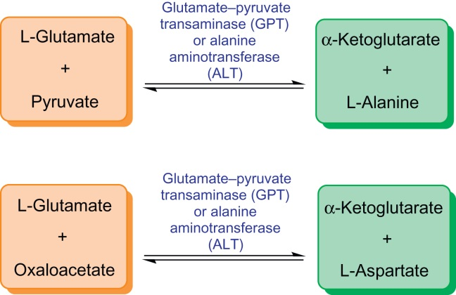
UnFig 15.8

Slide 34
UnFig 15.9

Slide 35
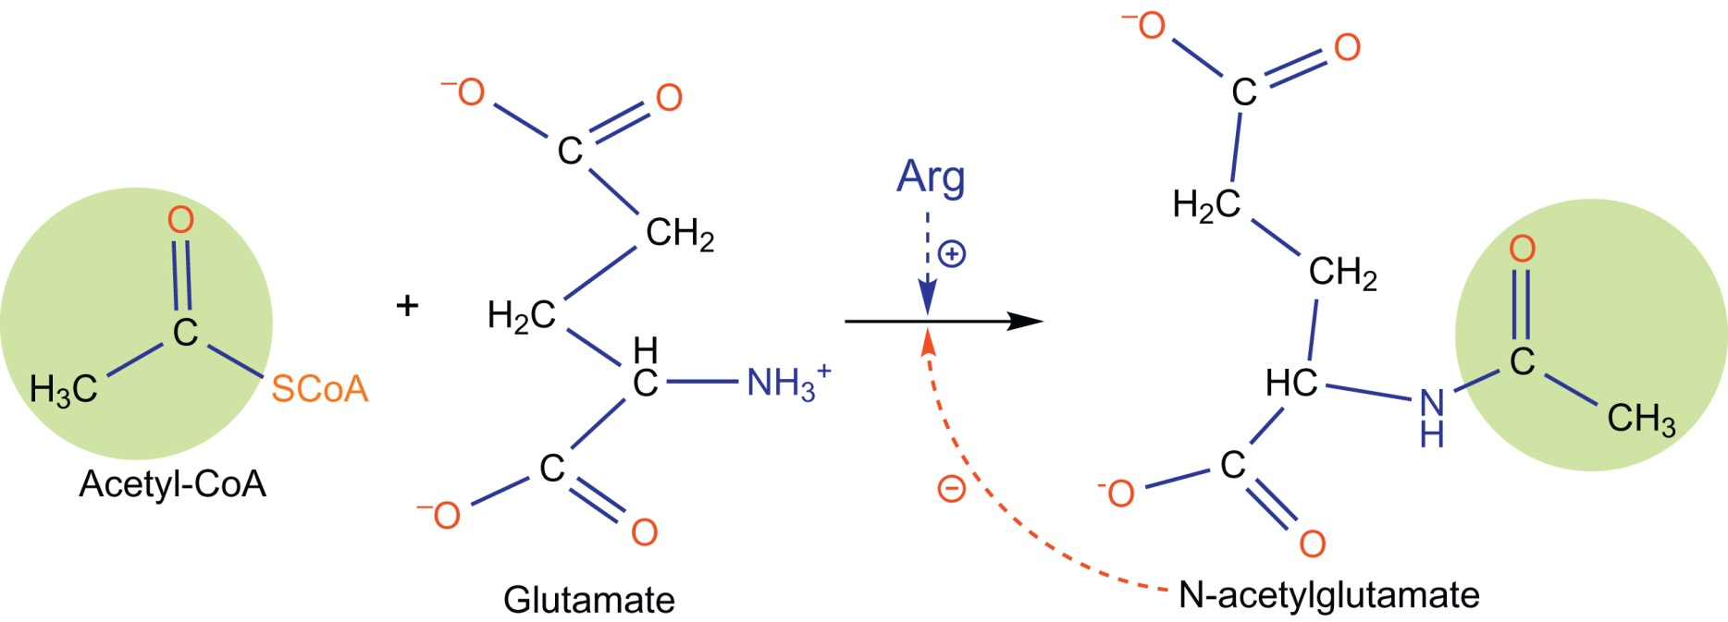
UnFig 15.10

Slide 36
UnFig 15.11

Slide 37
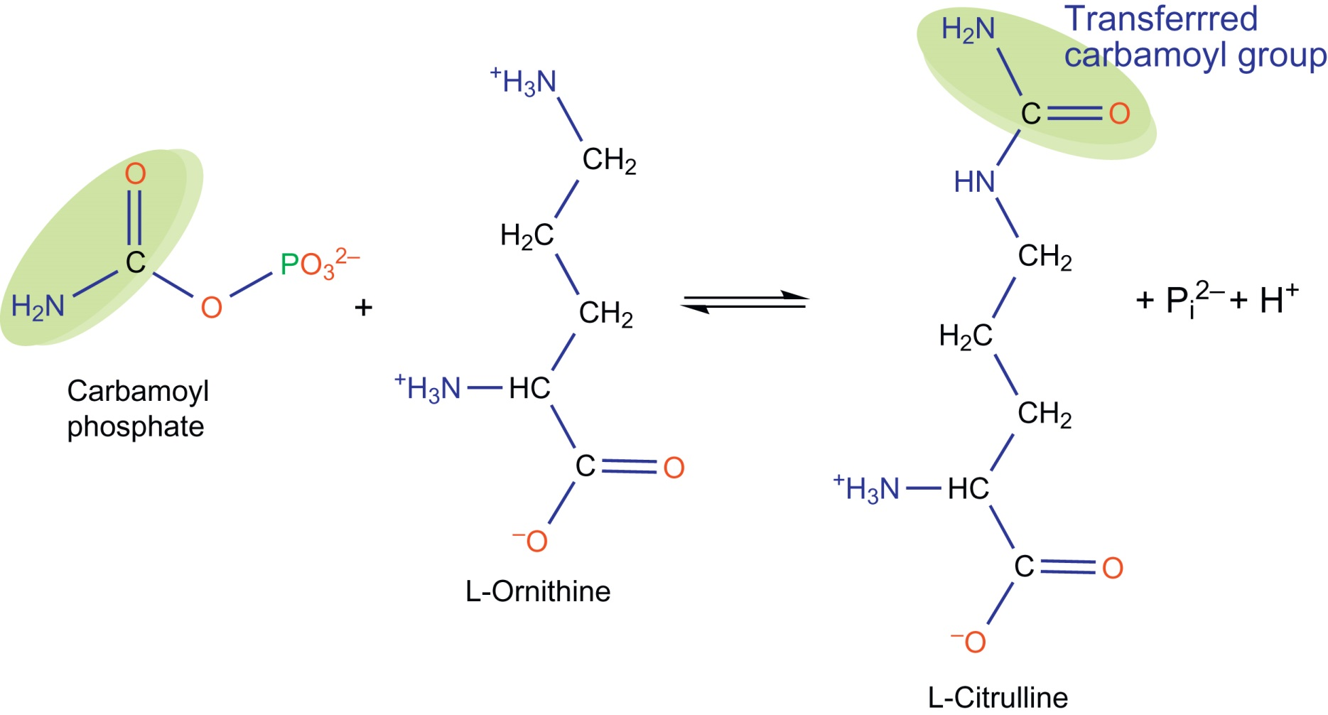
UnFig 15.12

Slide 38
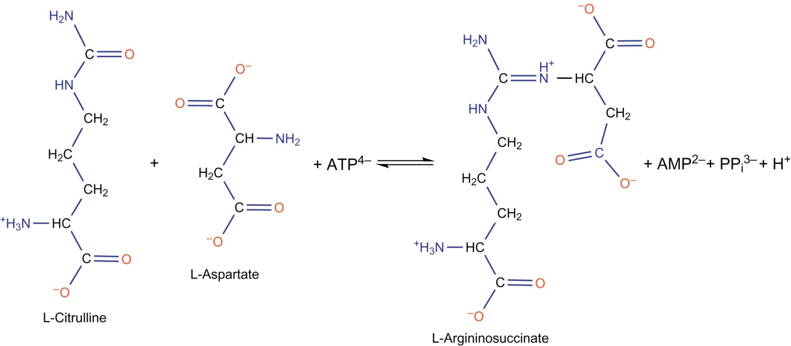
UnFig 15.13

Slide 39
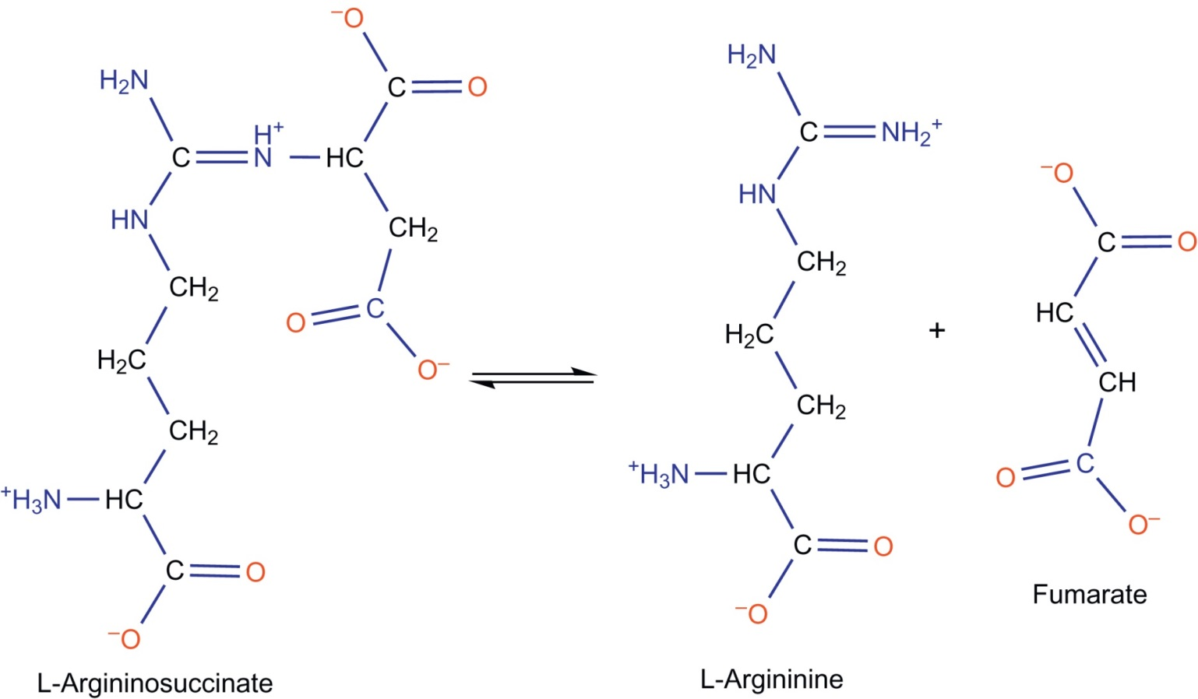
UnFig 15.14

Slide 40
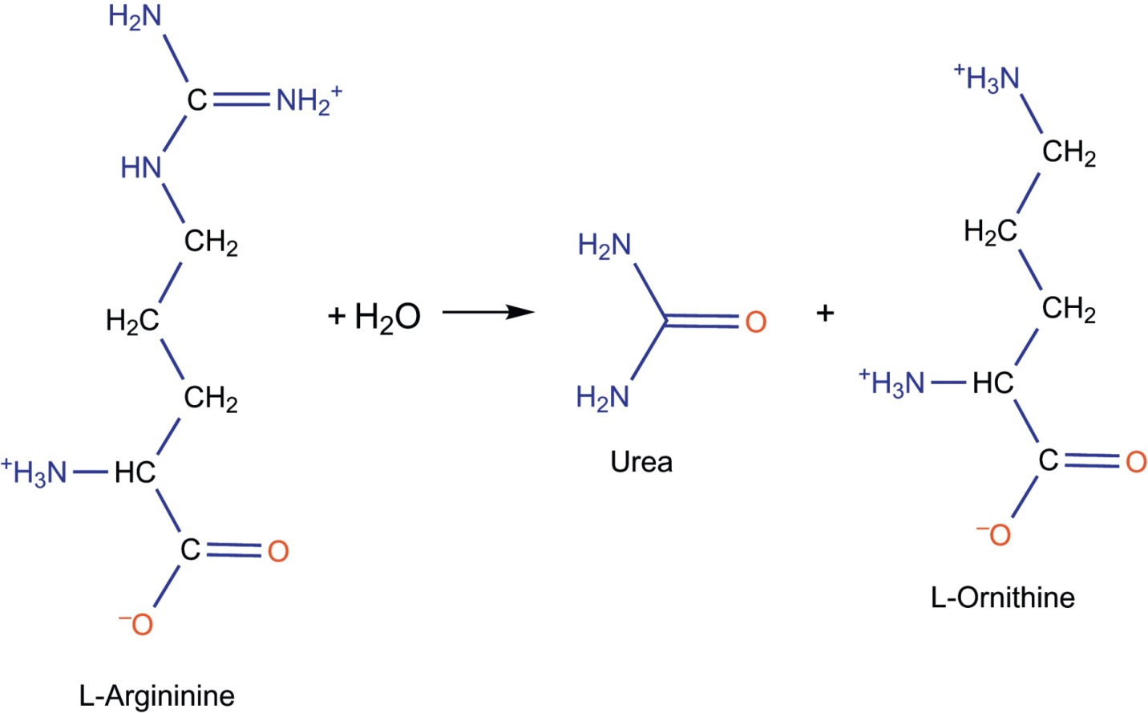
UnFig 15.15

Slide 41
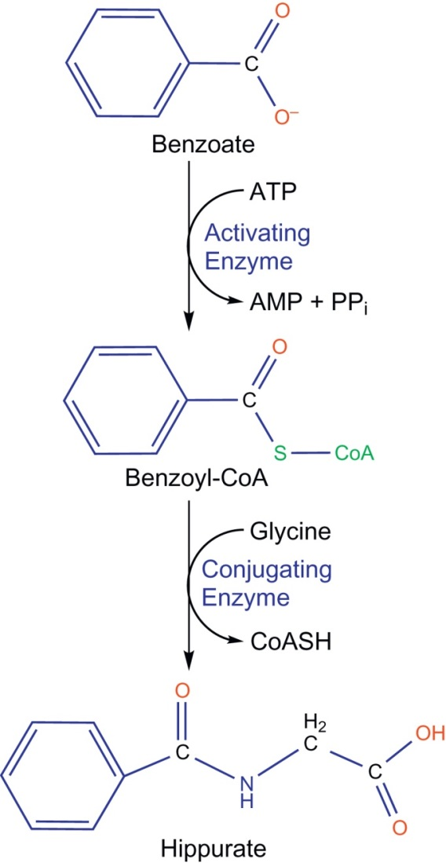
UnFig 15.16

Slide 42
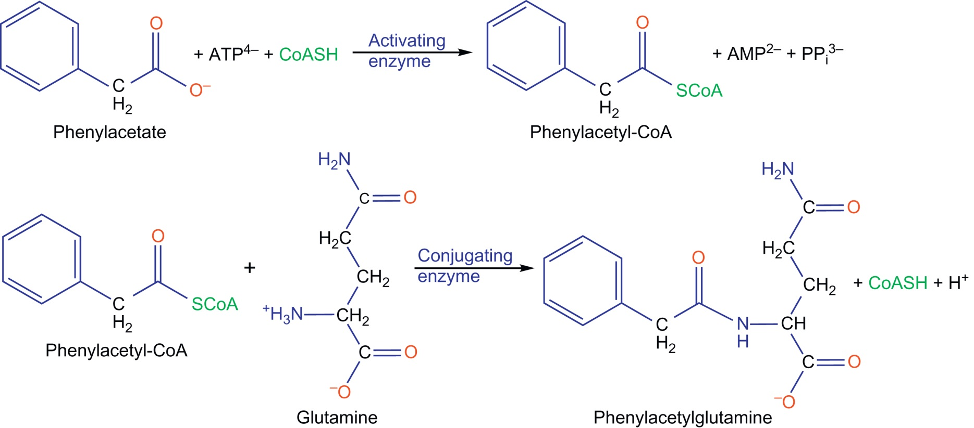
UnFig 15.17

Slide 43
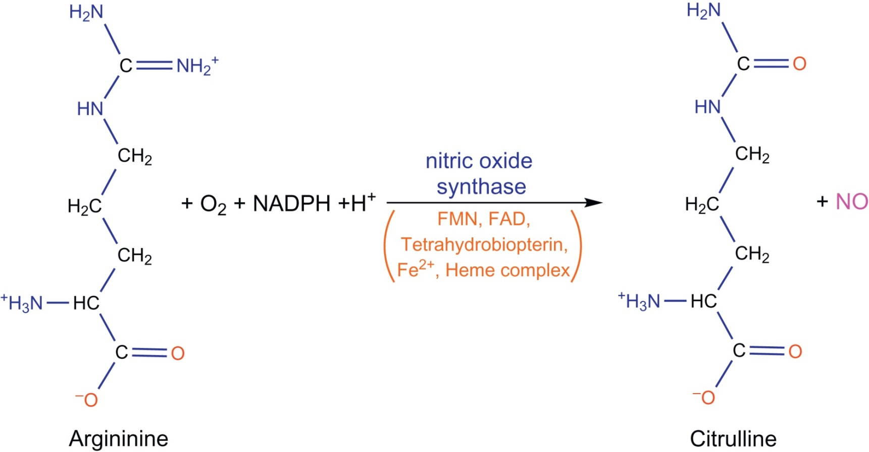
UnFig 15.18

Slide 44
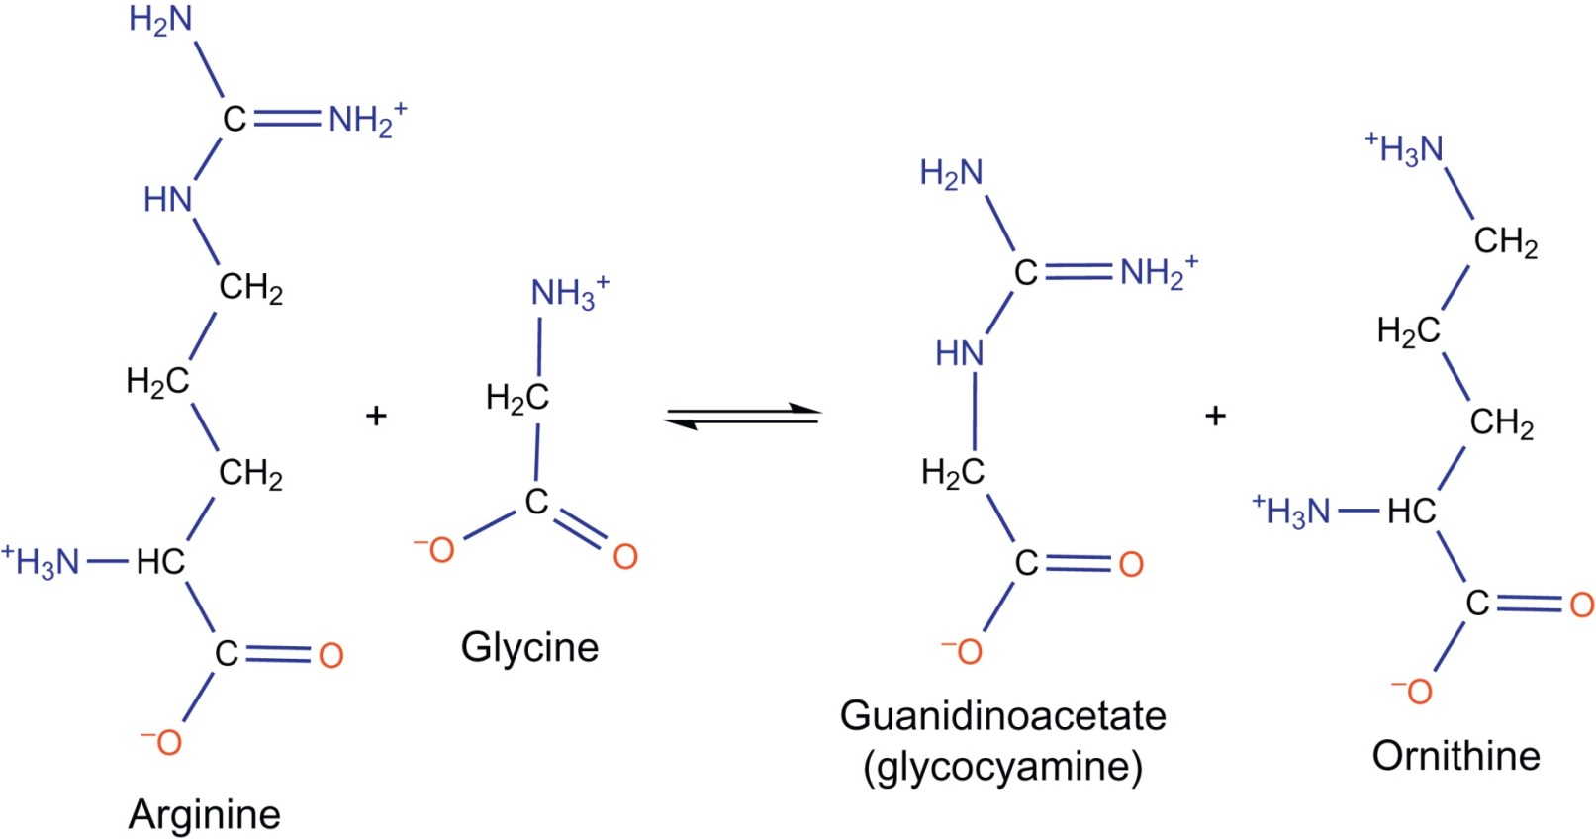
UnFig 15.19

Slide 45
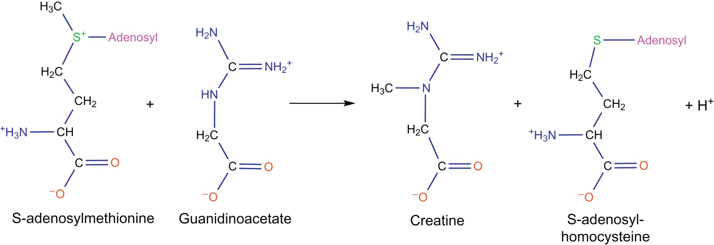
UnFig 15.20

Slide 46
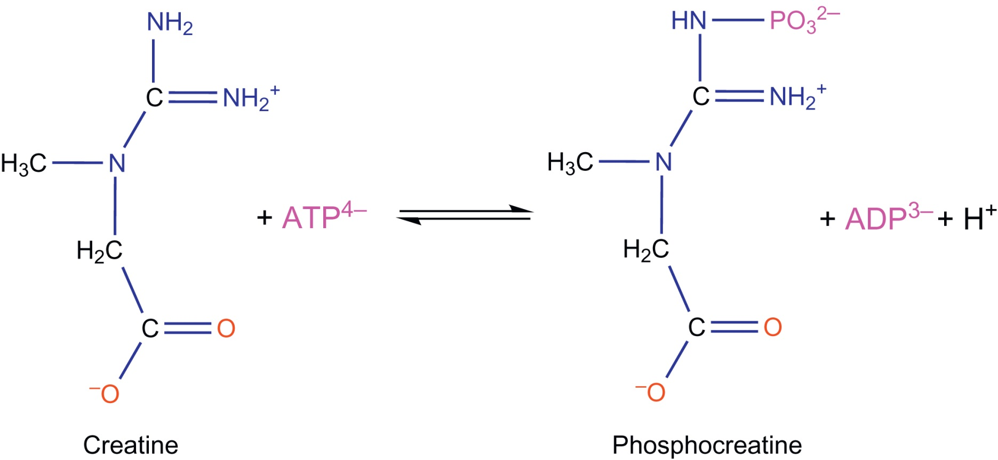
UnFig 15.21

Slide 47
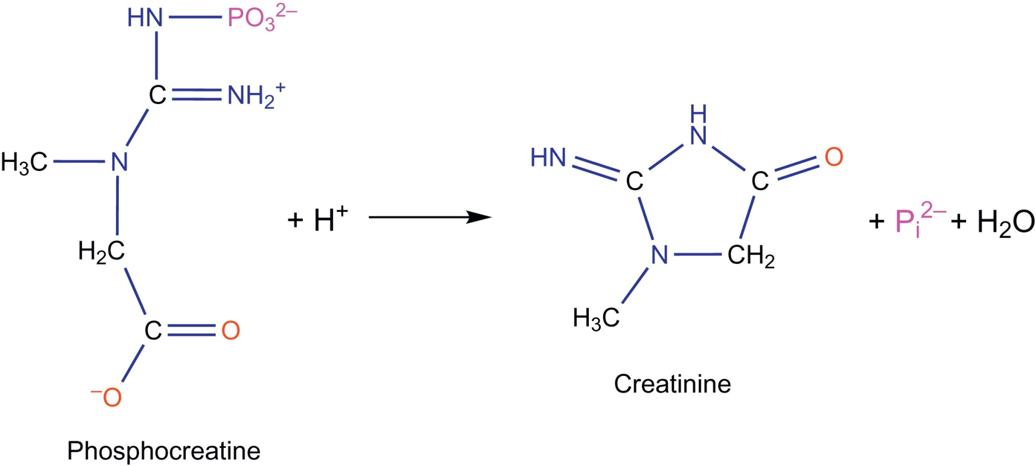
UnFig 15.22

Slide 48
UnFig 15.23

Slide 49
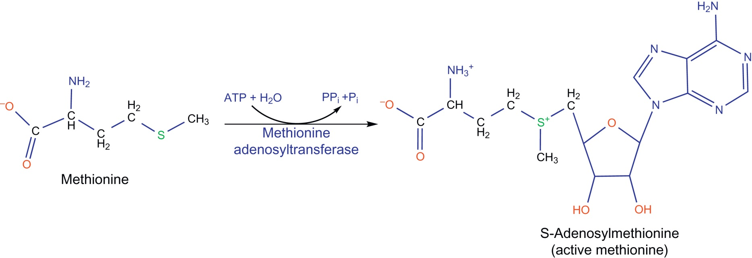
UnFig 15.24

Slide 50
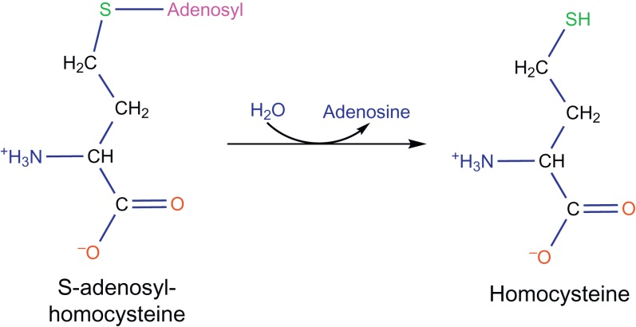
UnFig 15.25

Slide 51
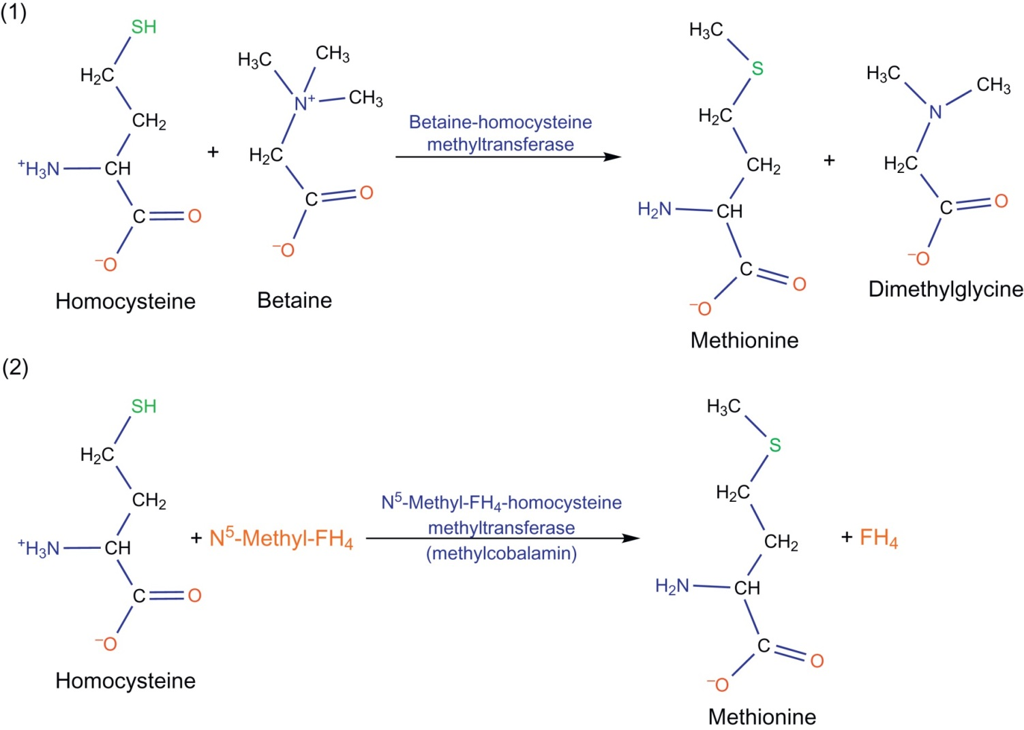
UnFig 15.26

Slide 52
UnFig 15.27

