Slide 1
Chapter 16
Lipids I: Fatty Acids and Eicosanoids

Slide 2
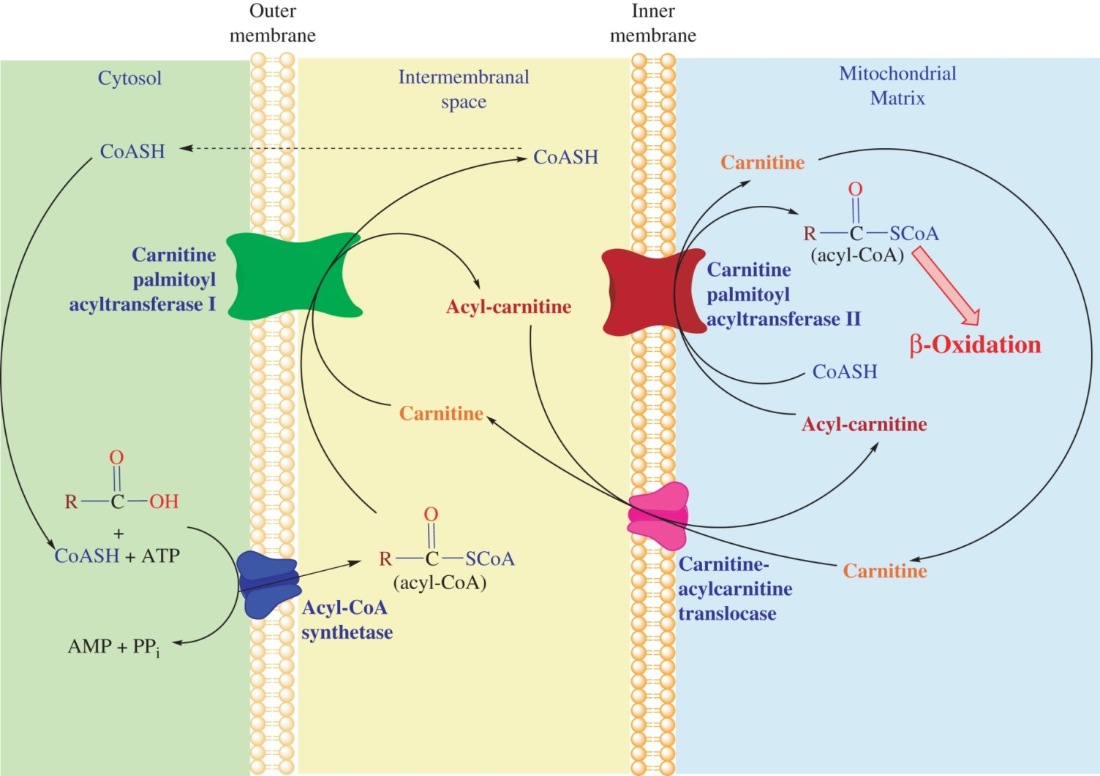
Figure 16.1

Slide 3
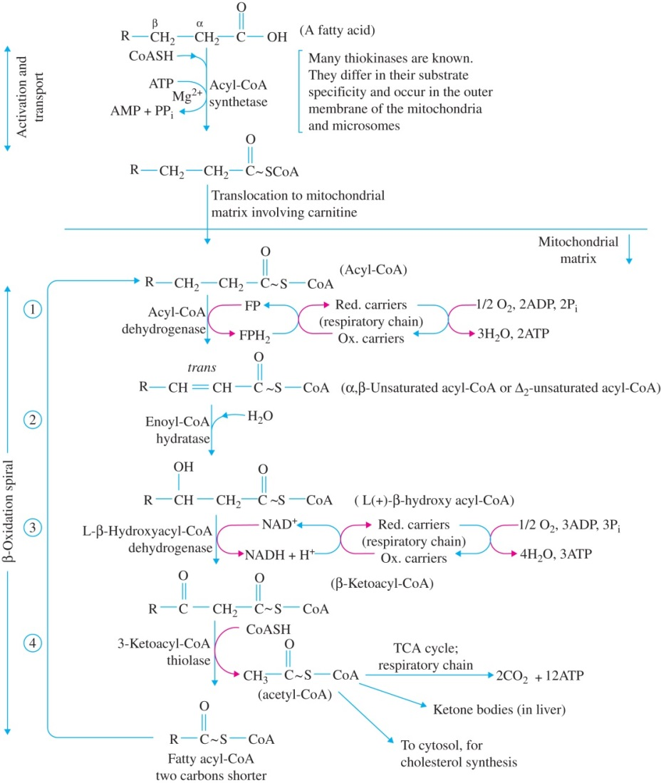
Figure 16.2

Slide 4
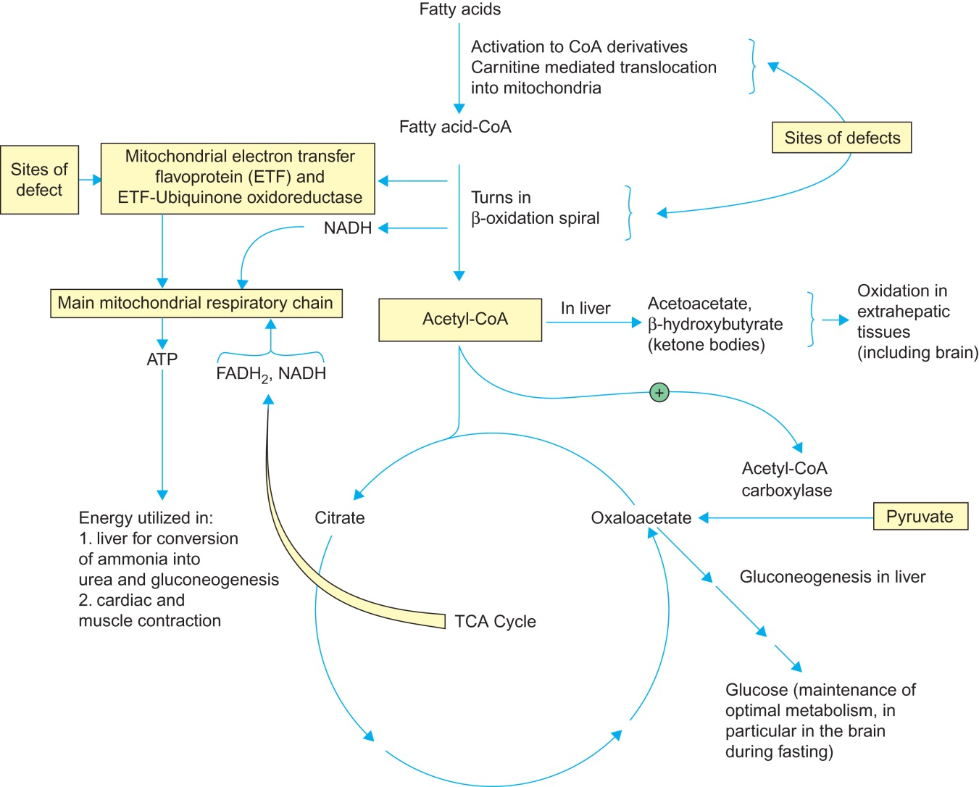
Figure 16.3
From Essentials of Medical Biochemistry: With Clinical Cases, Second Edition. Copyright © 2015 Elsevier Inc. All rights reserved.
4

Slide 5
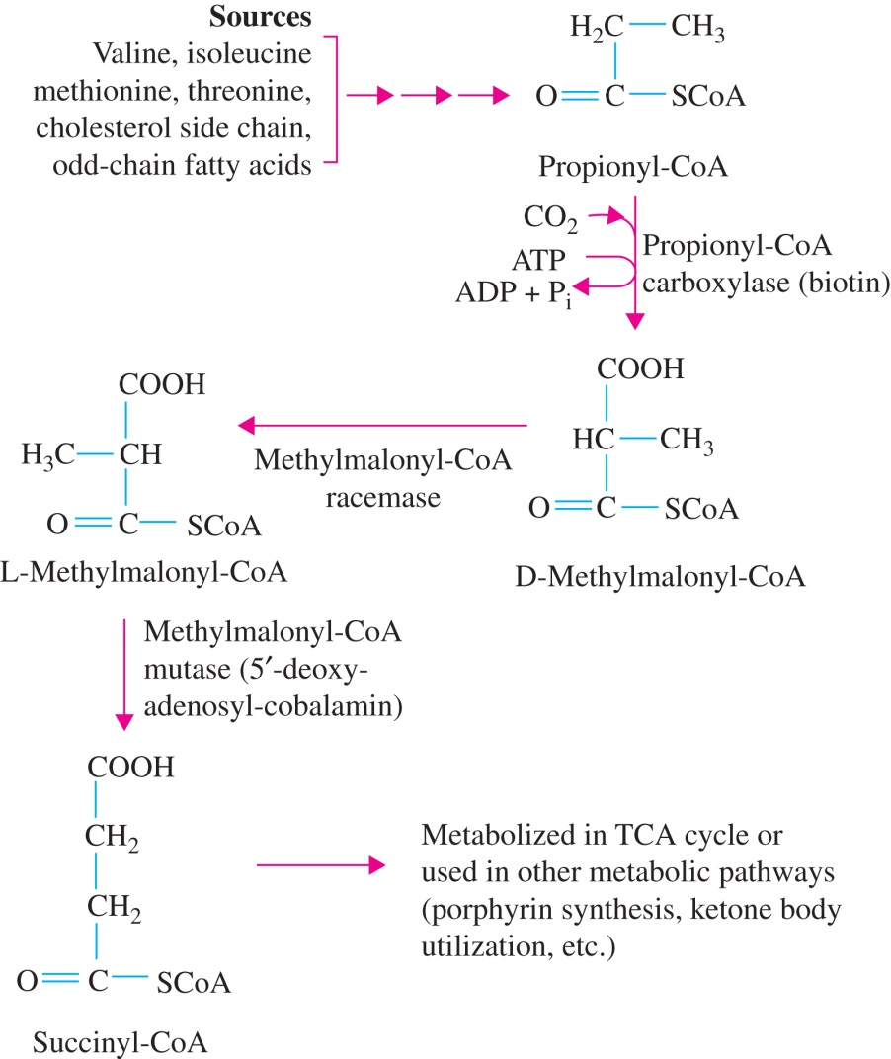
Figure 16.4

Slide 6
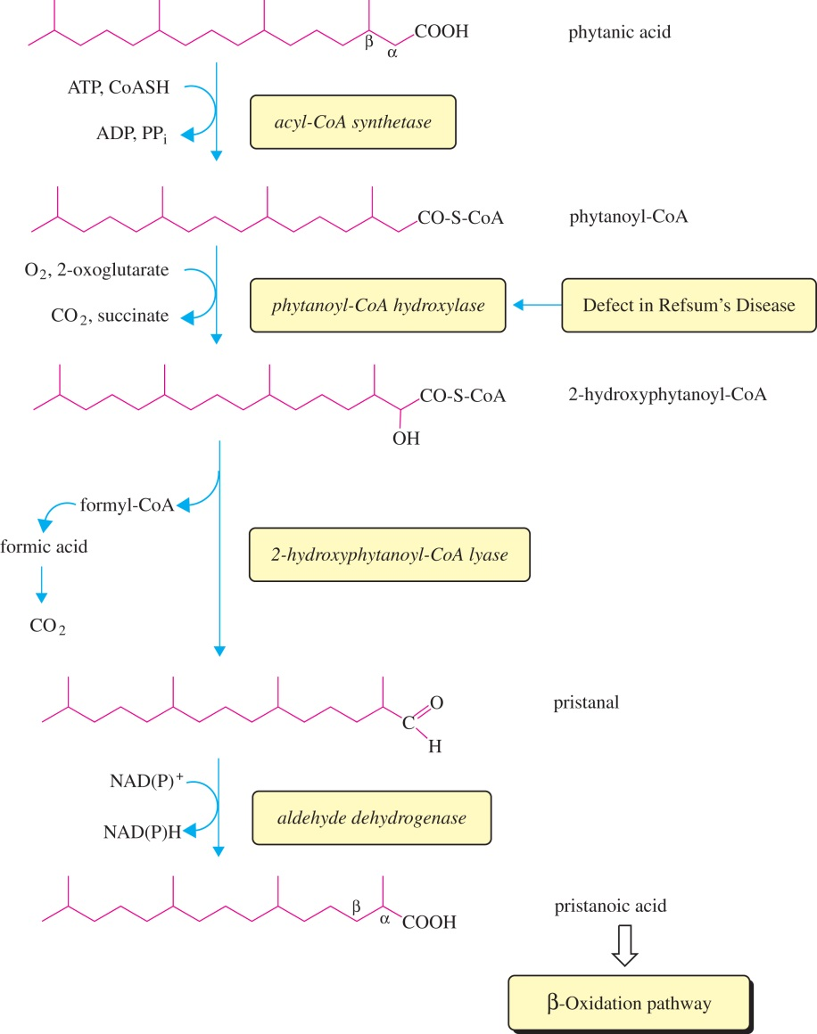
Figure 16.5

Slide 7
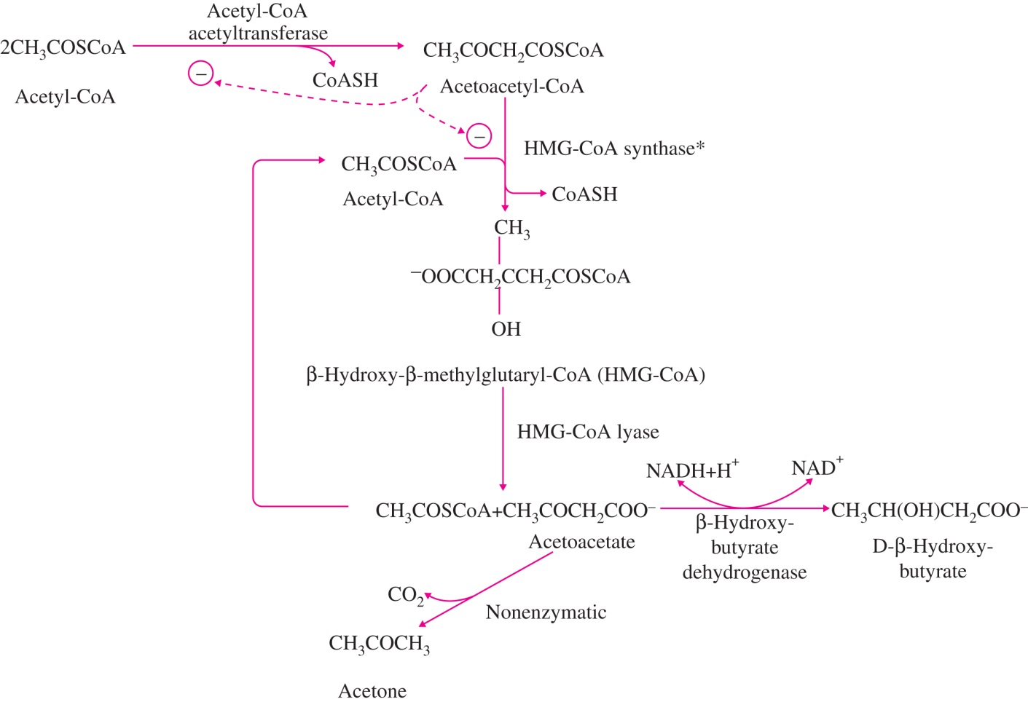
Figure 16.6

Slide 8
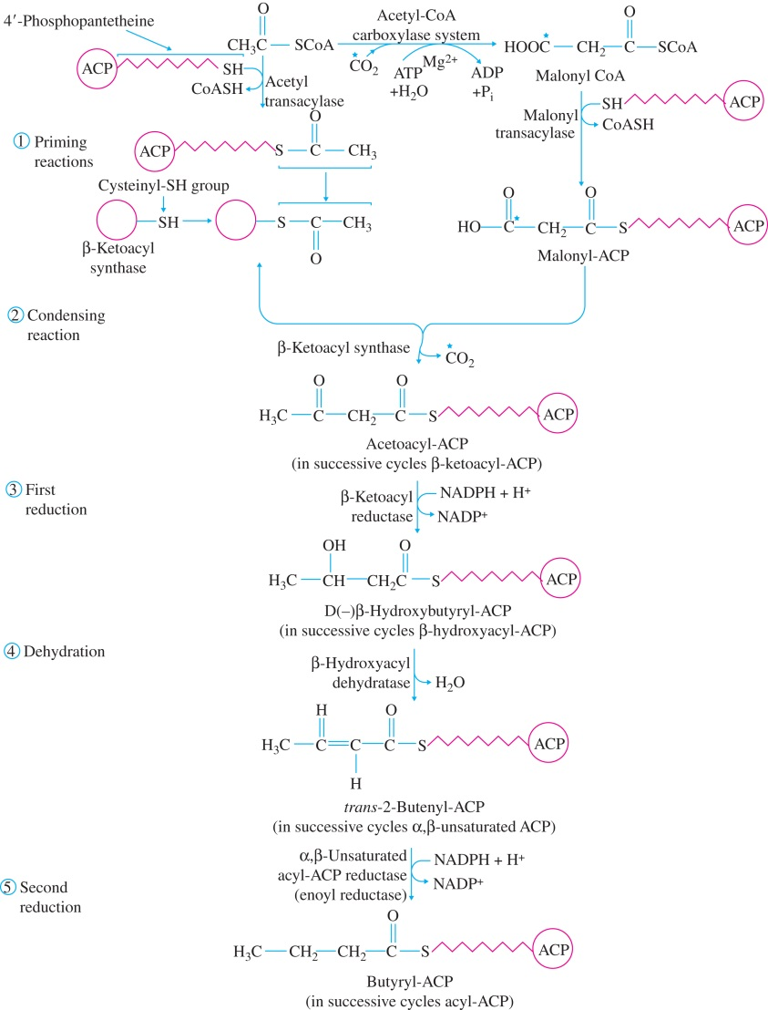
Figure 16.7a

Slide 9
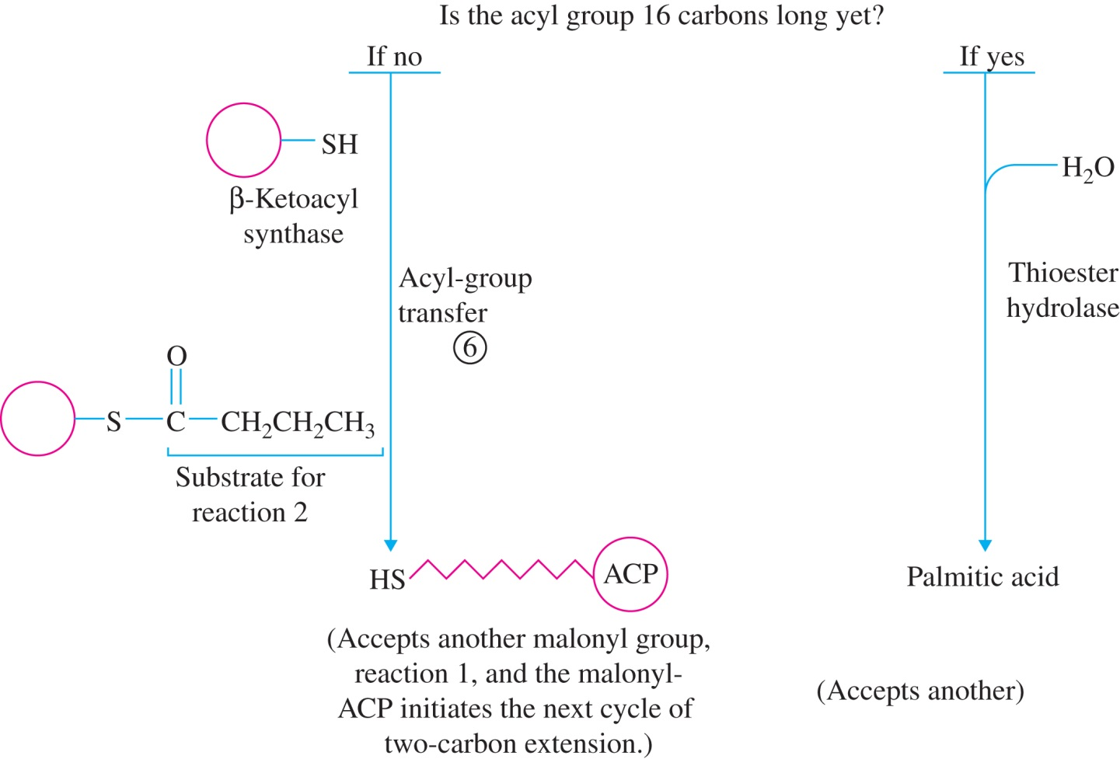
Figure 16.7b

Slide 10
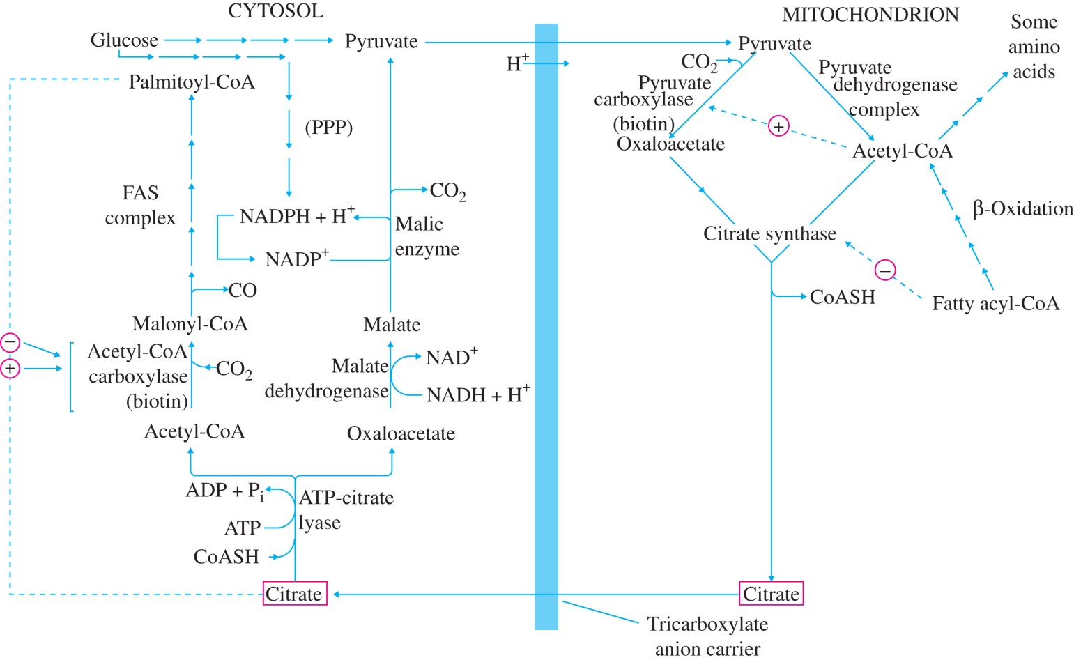
Figure 16.8

Slide 11
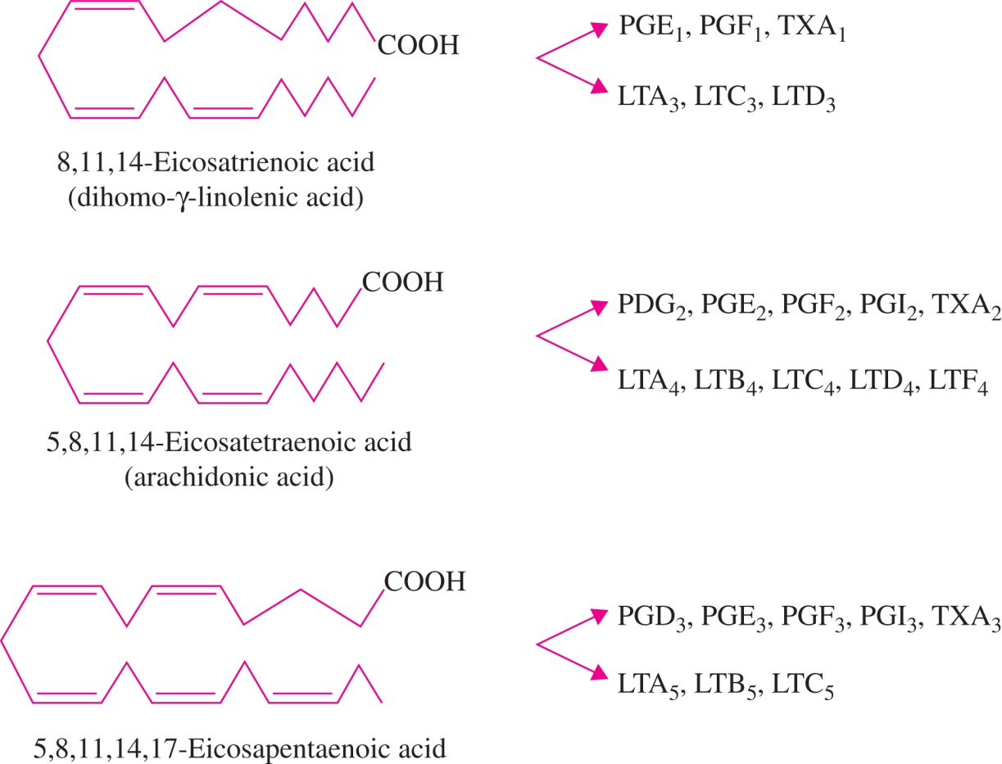
Figure 16.9

Slide 12
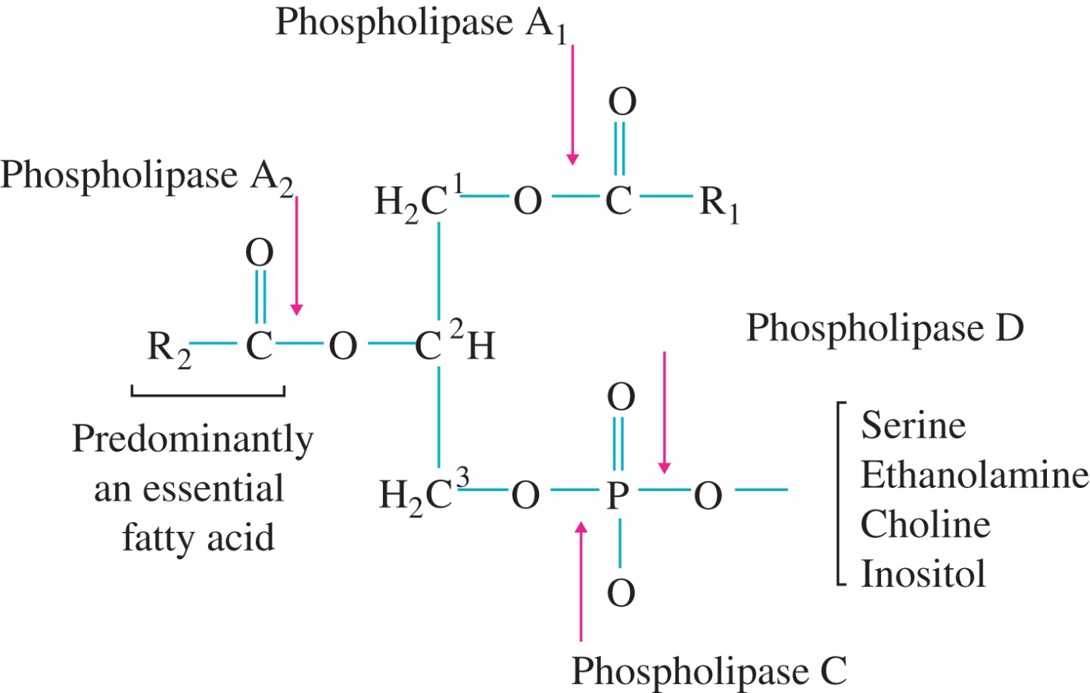
Figure 16.10

Slide 13
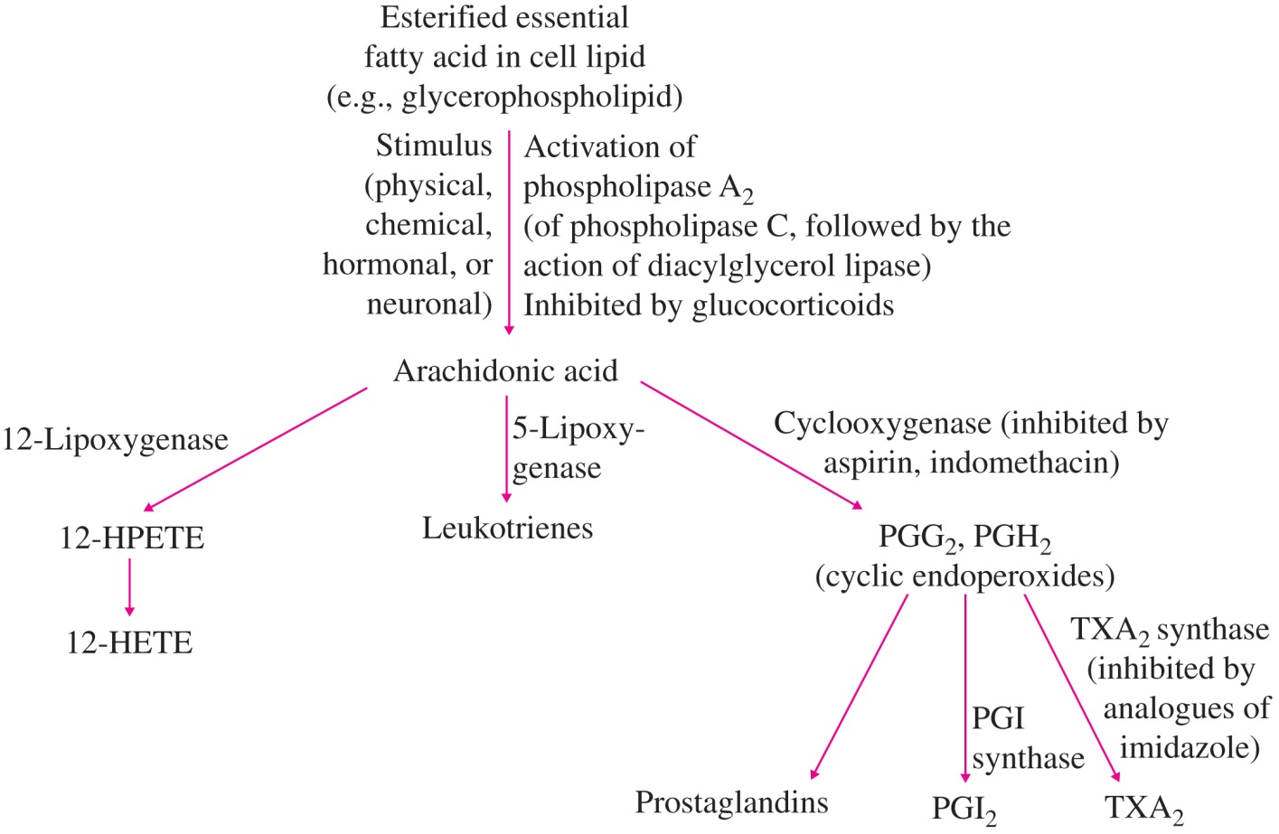
Figure 16.11

Slide 14
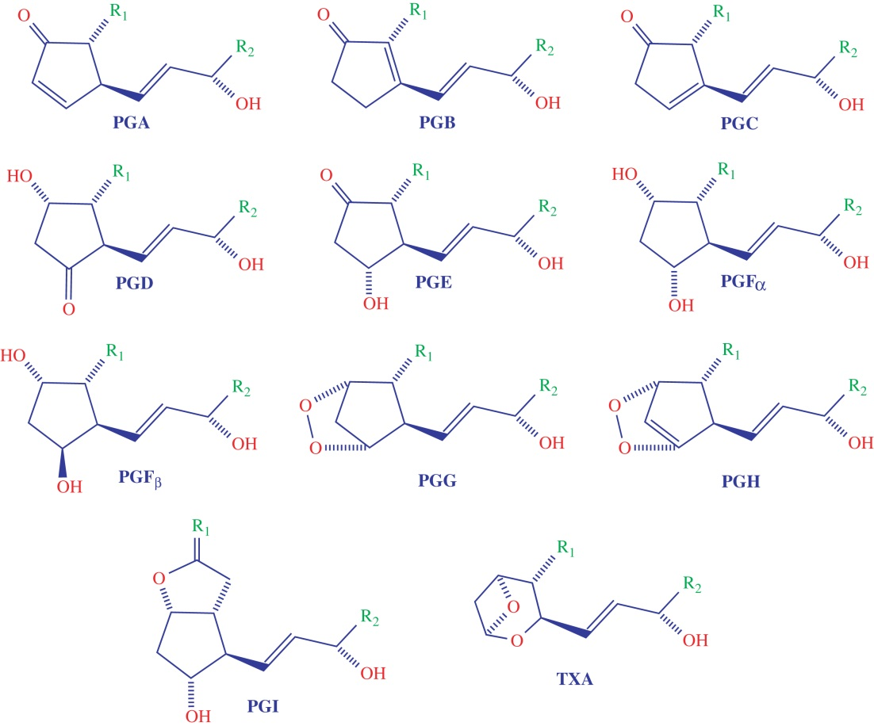
Figure 16.12

Slide 15
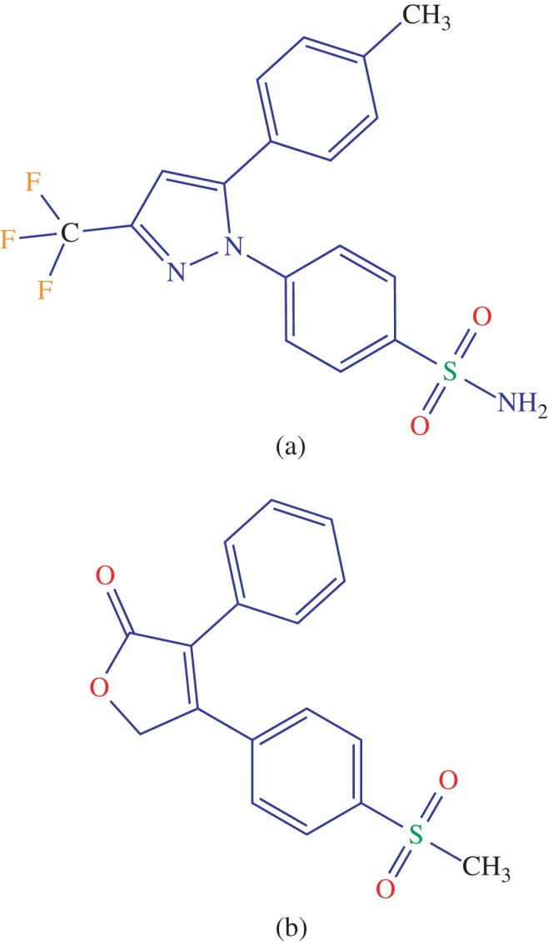
Figure 16.13

Slide 16
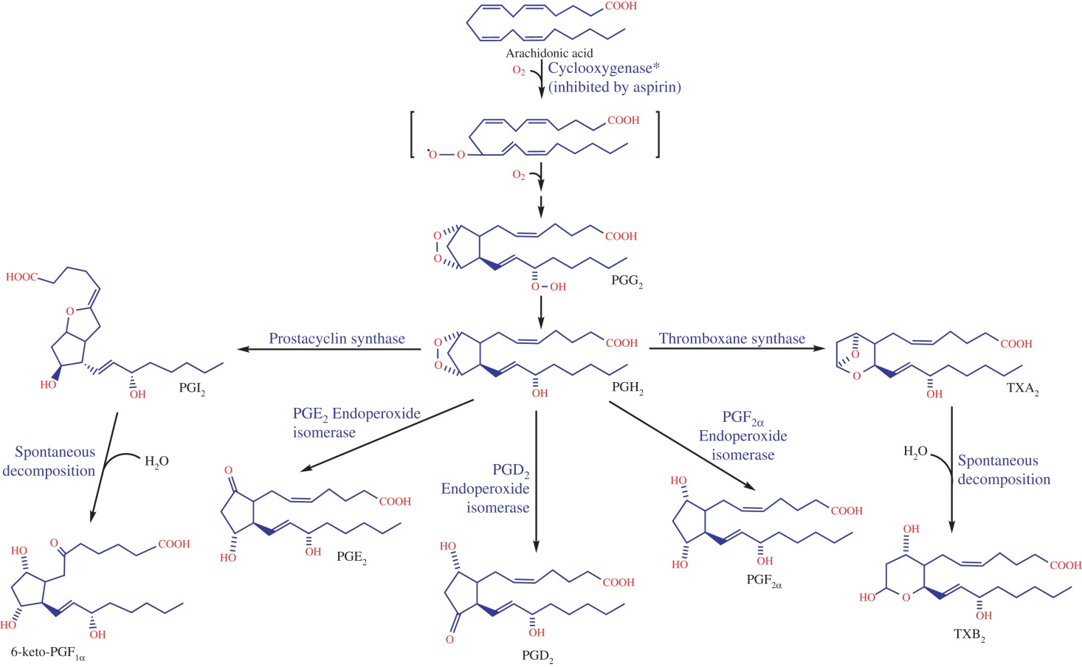
Figure 16.14

Slide 17
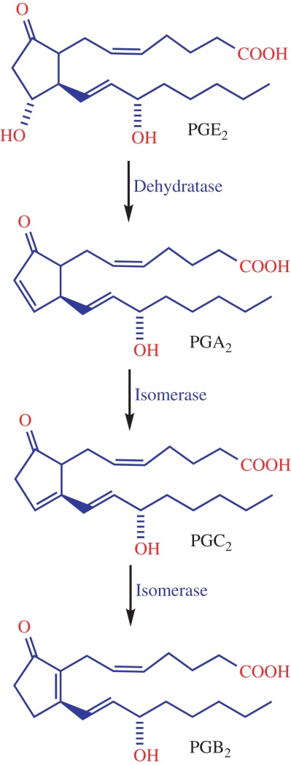
Figure 16.15

Slide 18
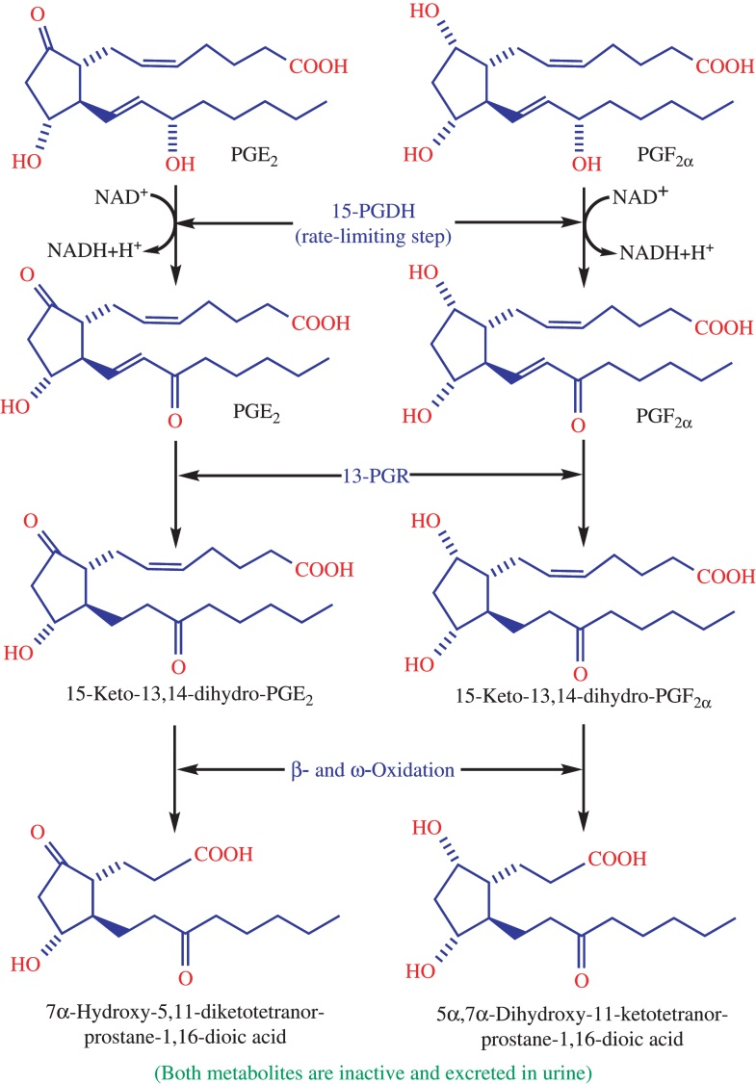
Figure 16.16

Slide 19
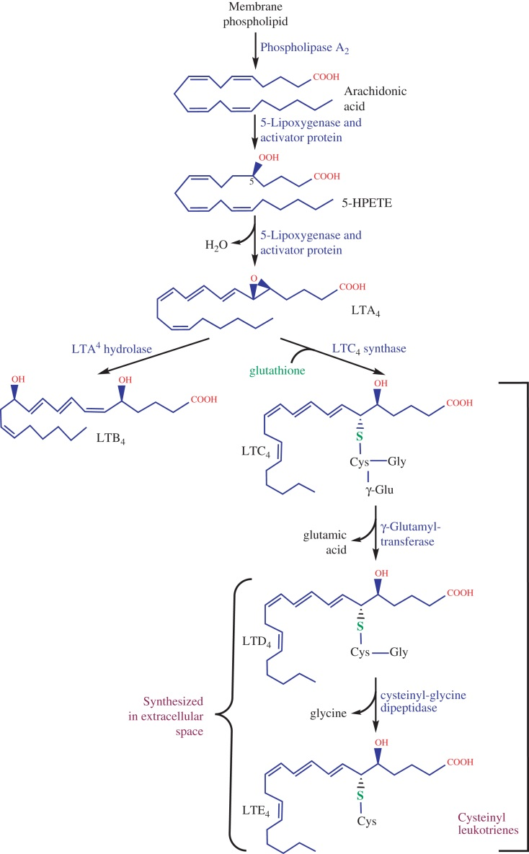
Figure 16.17

Slide 20
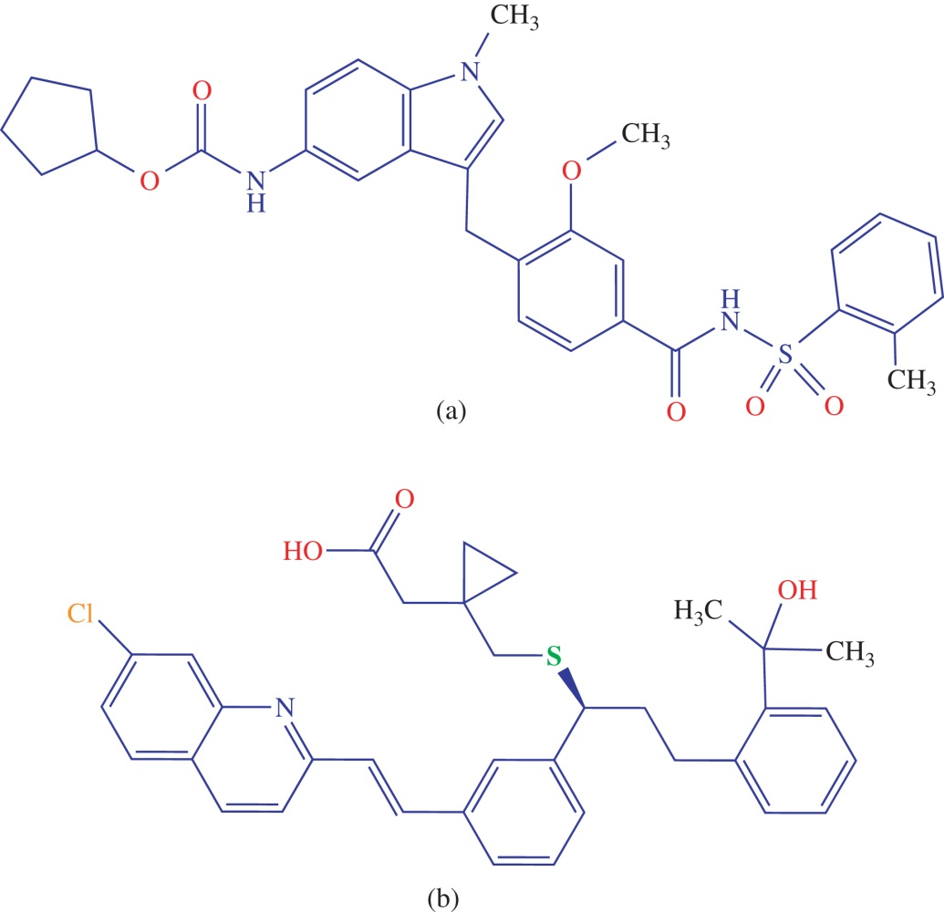
Figure 16.18

Slide 21
UnFig 16.1
21

Slide 22
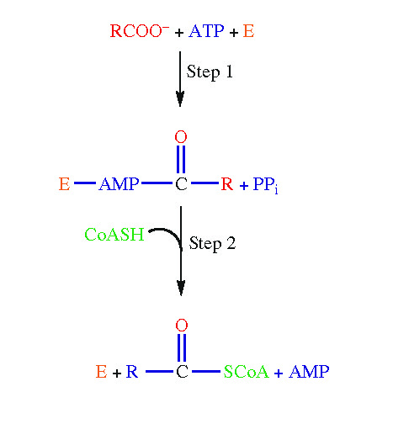
UnFig 16.2

Slide 23
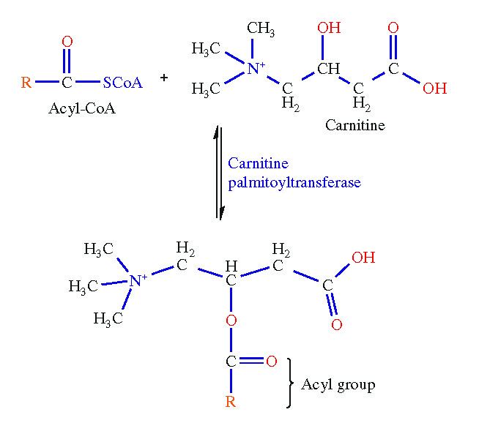
UnFig 16.3

Slide 24
UnFig 16.4

Slide 25
UnFig 16.5

Slide 26
UnFig 16.6

Slide 27
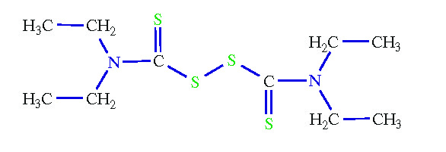
UnFig 16.7

Slide 28
UnFig 16.8

Slide 29
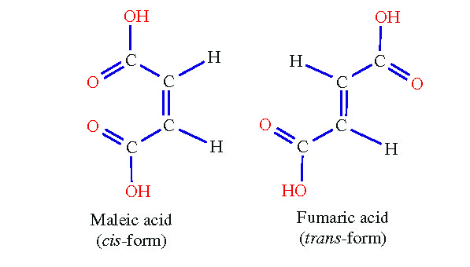
UnFig 16.9

Slide 30
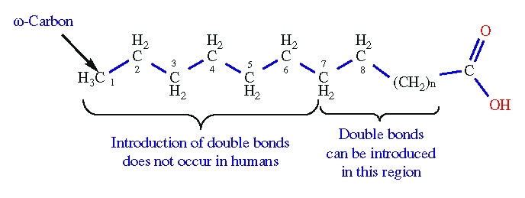
UnFig 16.10

Slide 31
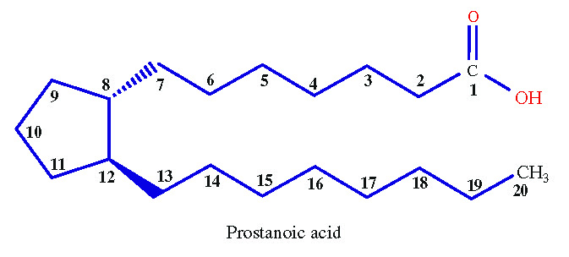
UnFig 16.11

Slide 32
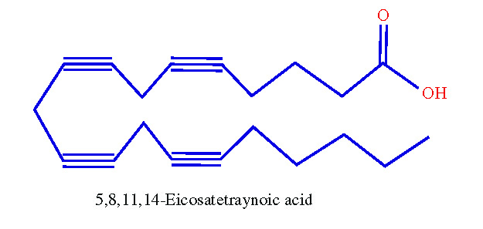
UnFig 16.12

Slide 33
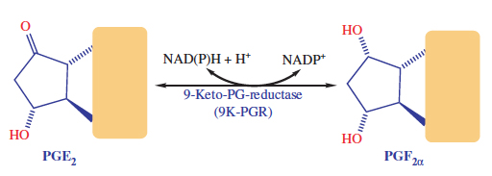
UnFig 16.13

Slide 34
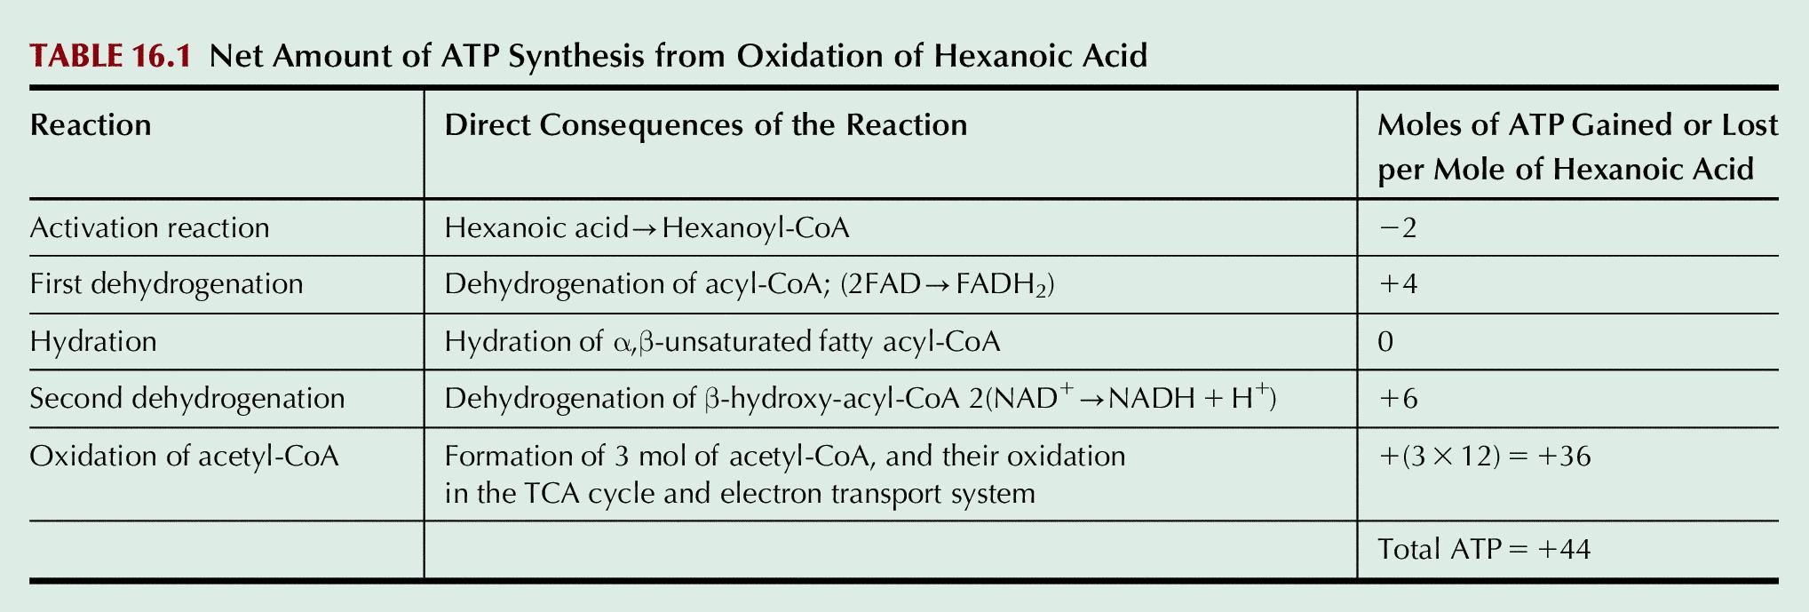
Table 16.1

Slide 35
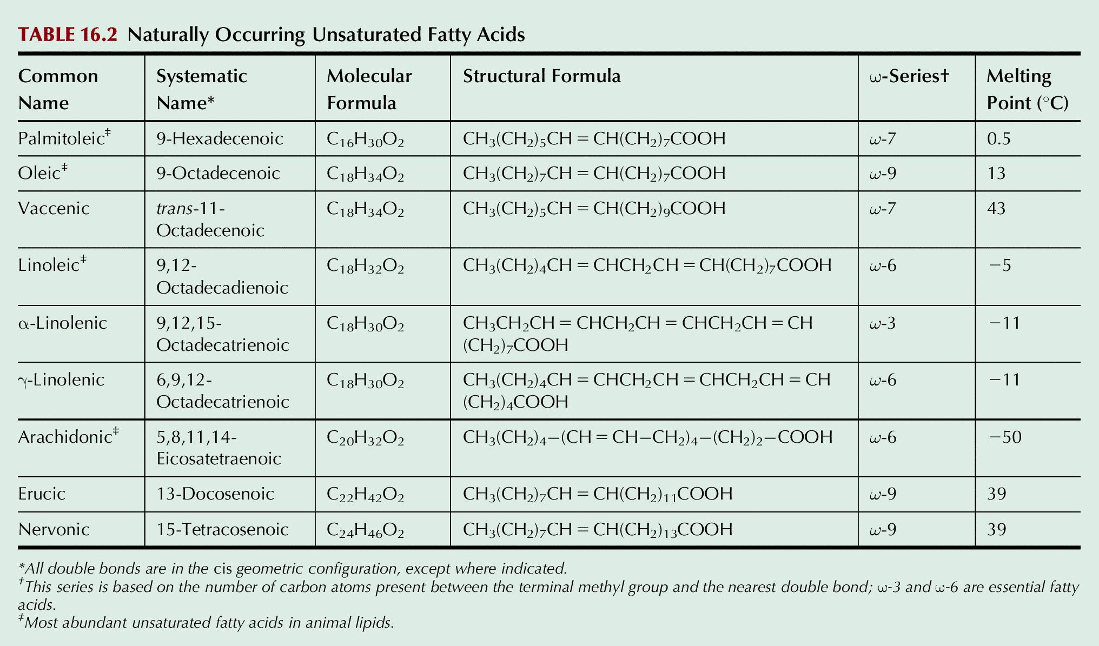
Table 16.2

