Slide 1
Chapter 18
Lipids III: Plasma Lipoproteins

Slide 2
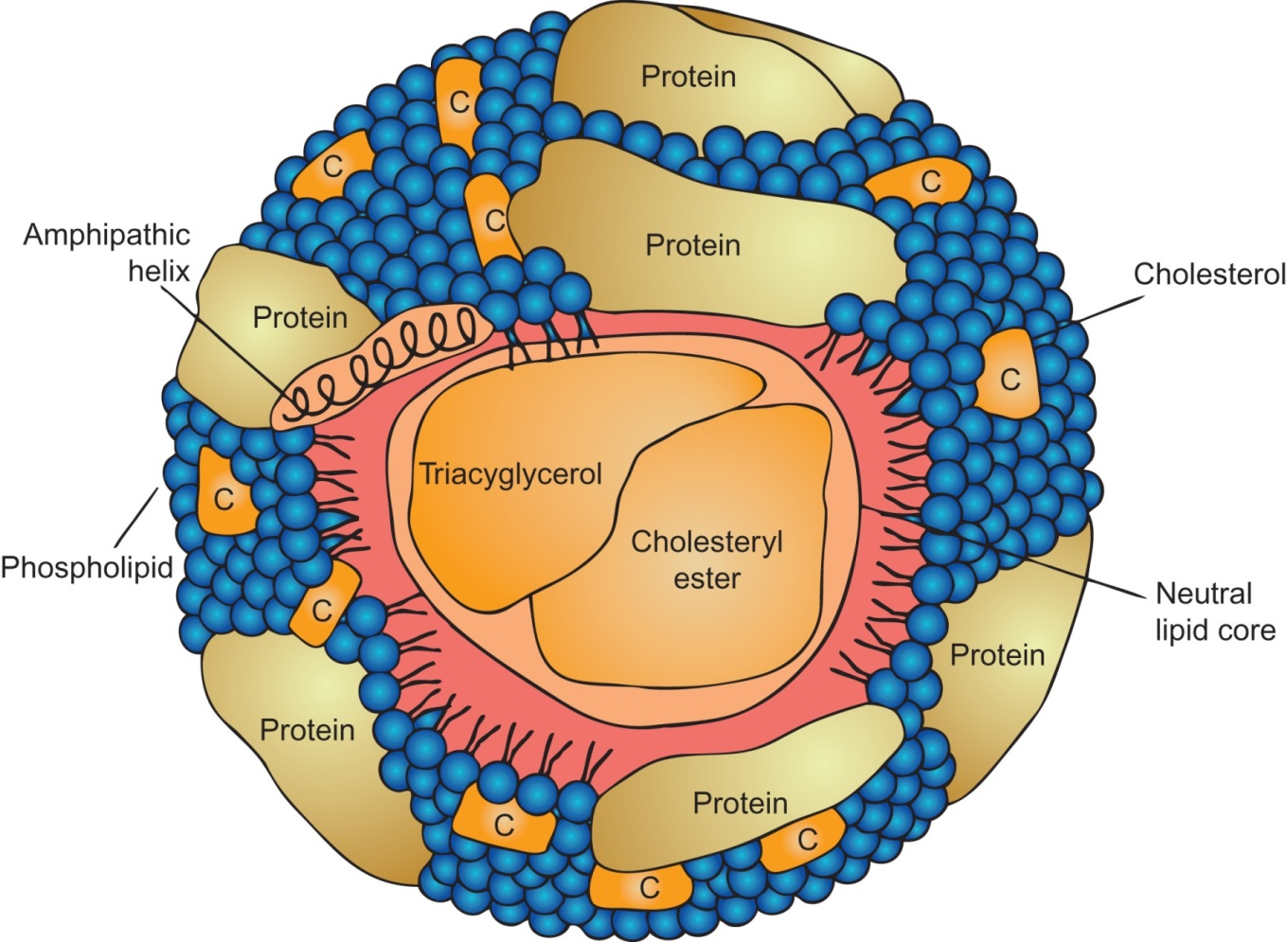
Figure 18.1

Slide 3
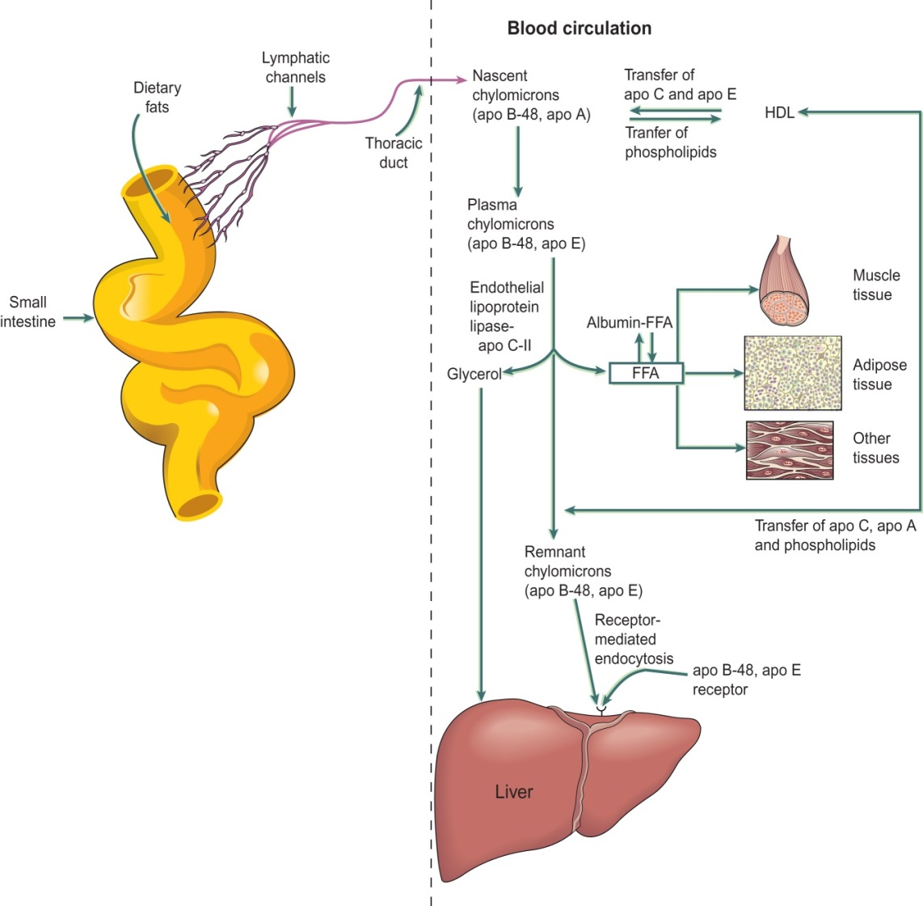
Figure 18.2

Slide 4
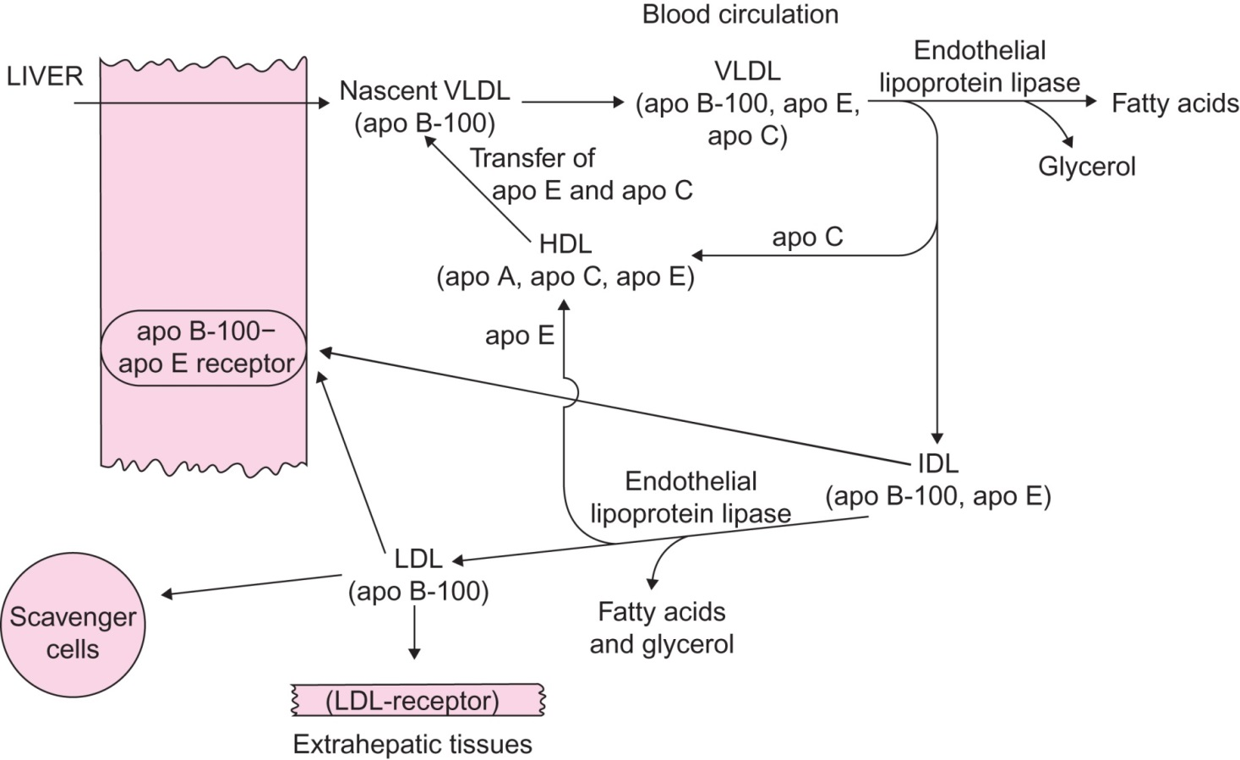
Figure 18.3

Slide 5
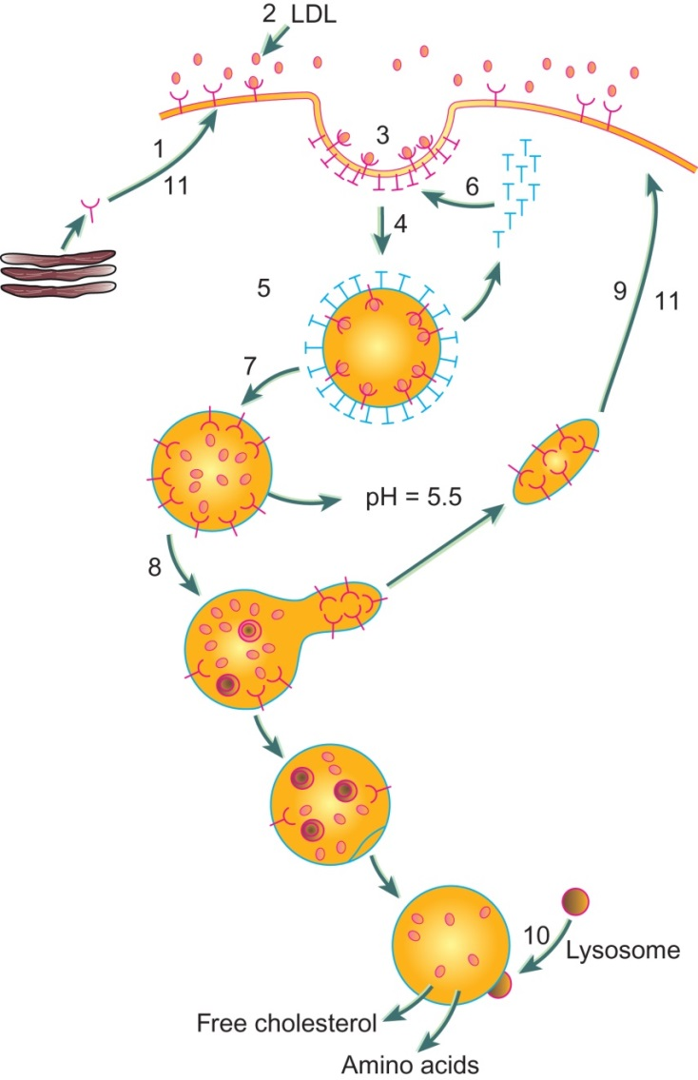
Figure 18.4

Slide 6
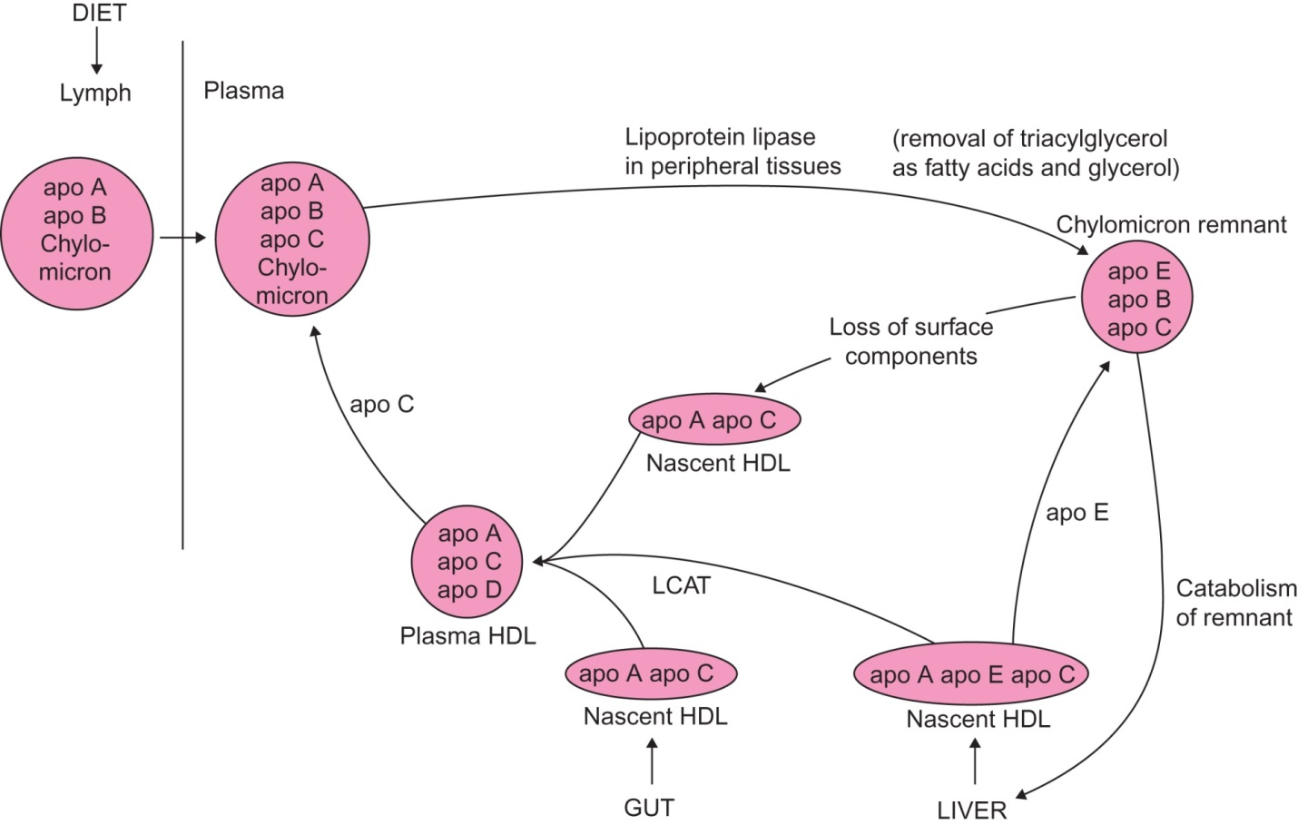
Figure 18.5

Slide 7
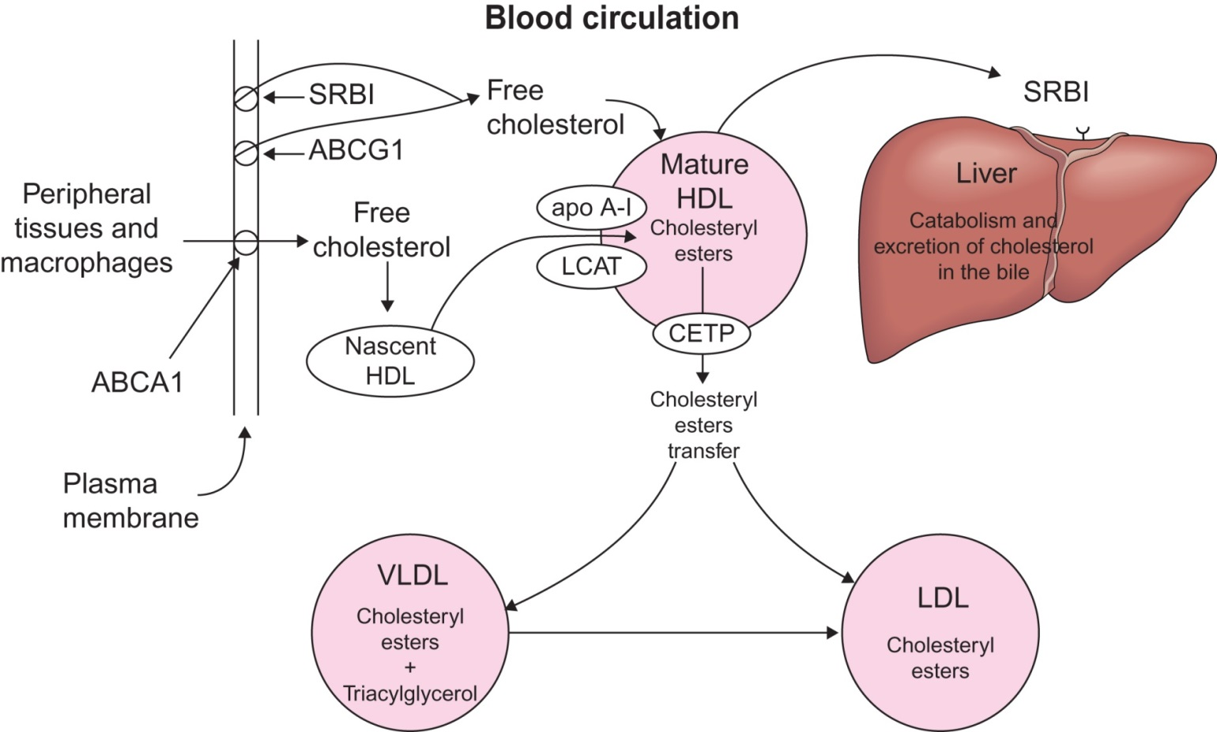
Figure 18.6

Slide 8
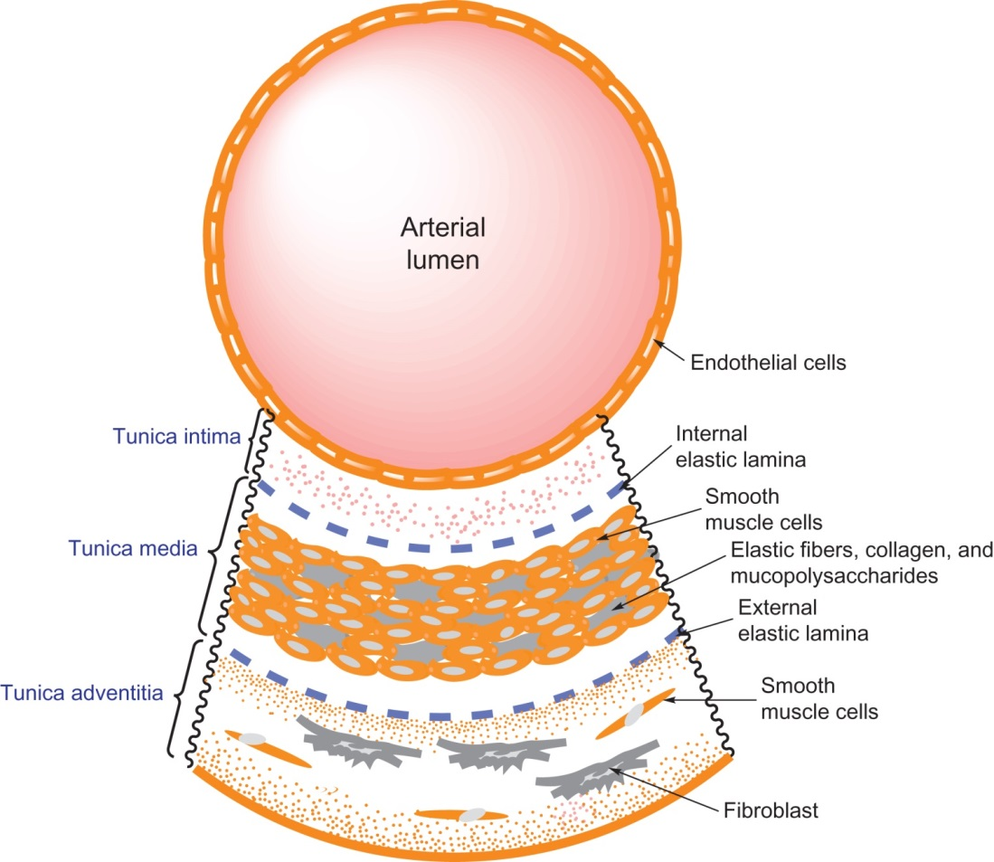
Figure 18.7

Slide 9
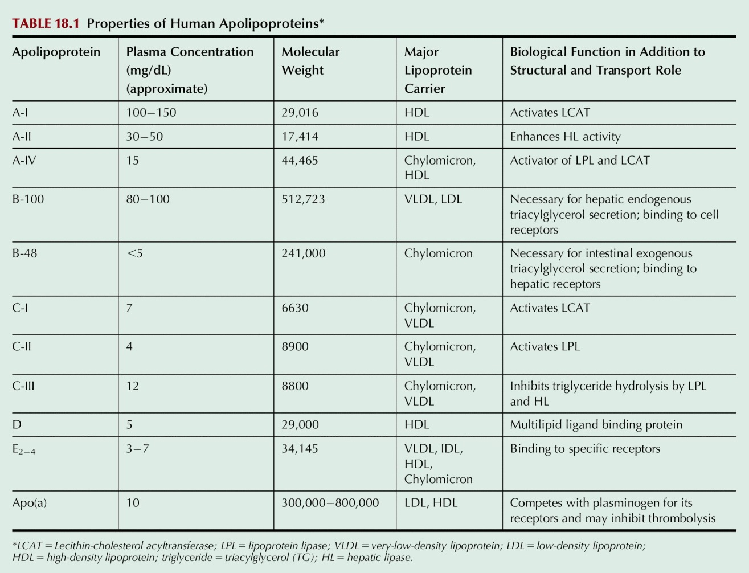
Table 18.1

Slide 10
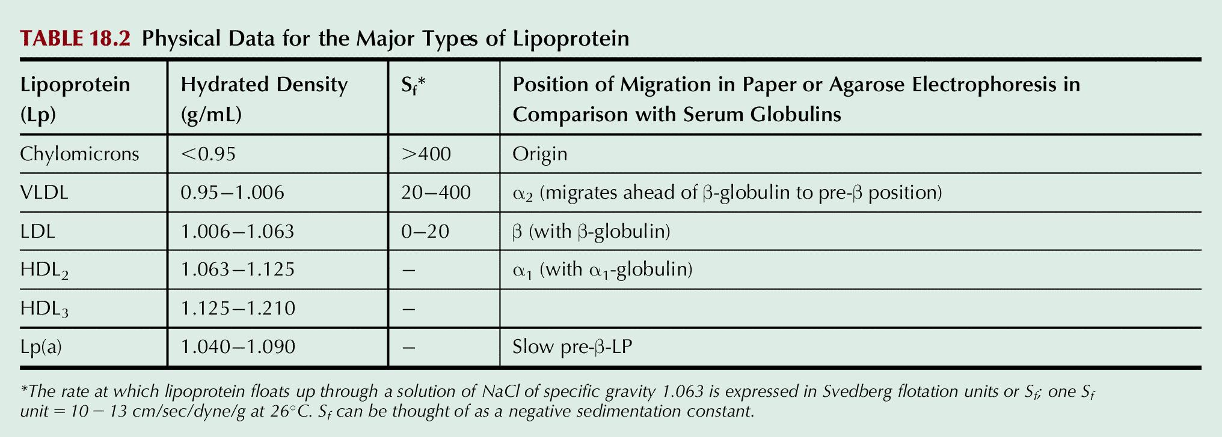
Table 18.2

Slide 11
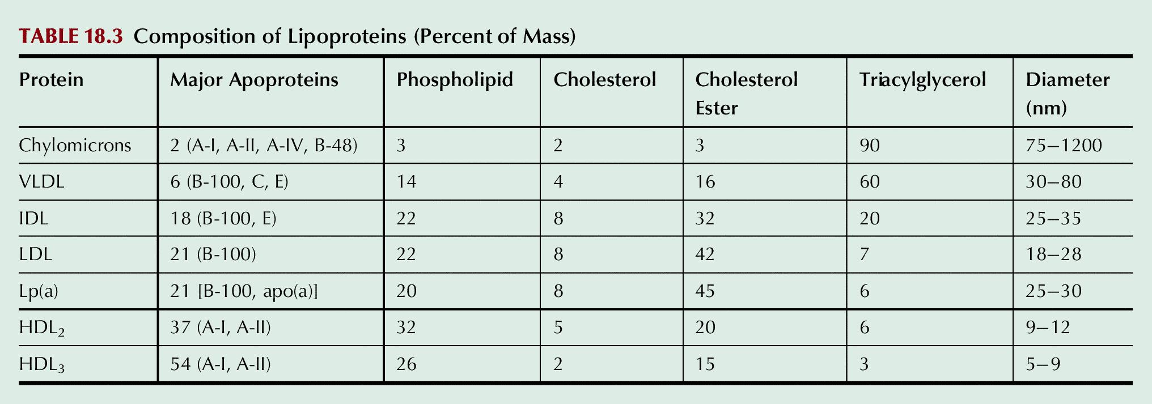
Table 18.3

Slide 12
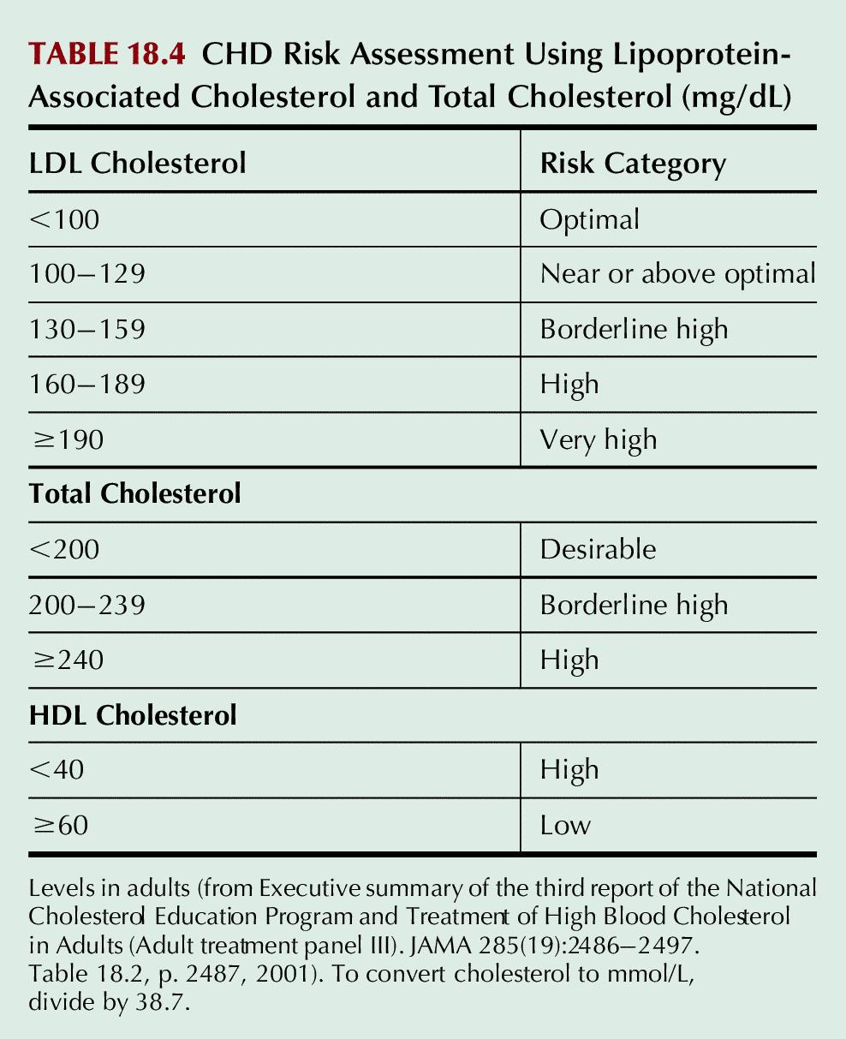
Table 18.4

Slide 13
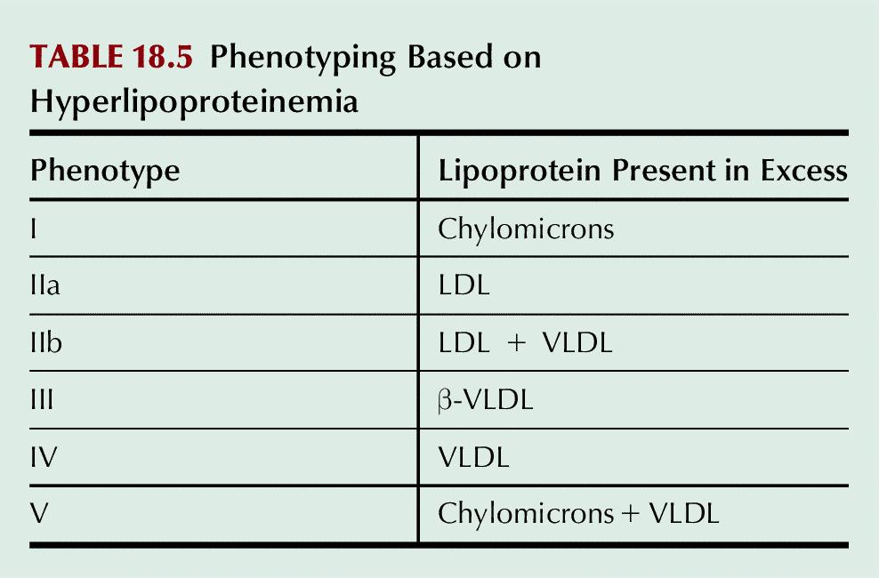
Table 18.5

Slide 14
Table 18.6

Slide 15
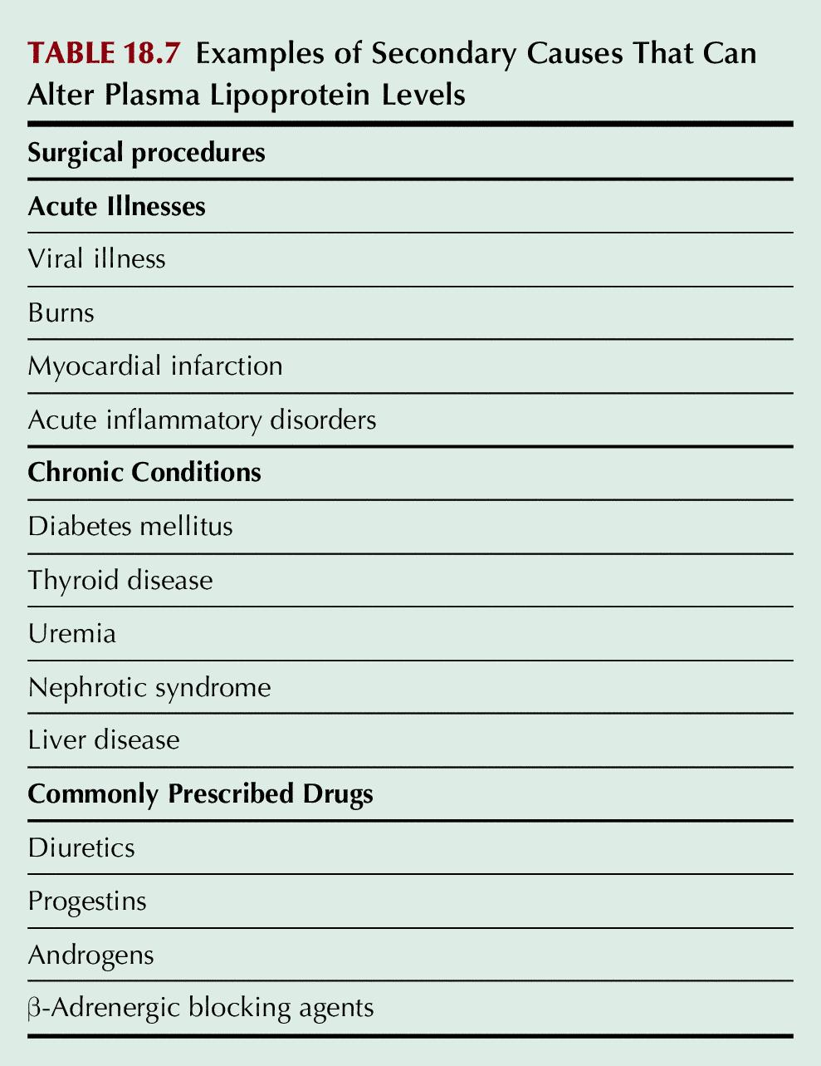
Table 18.7

