Slide 1
Chapter 20
Perturbations of Energy Metabolism: Obesity and Diabetes Mellitus

Slide 2
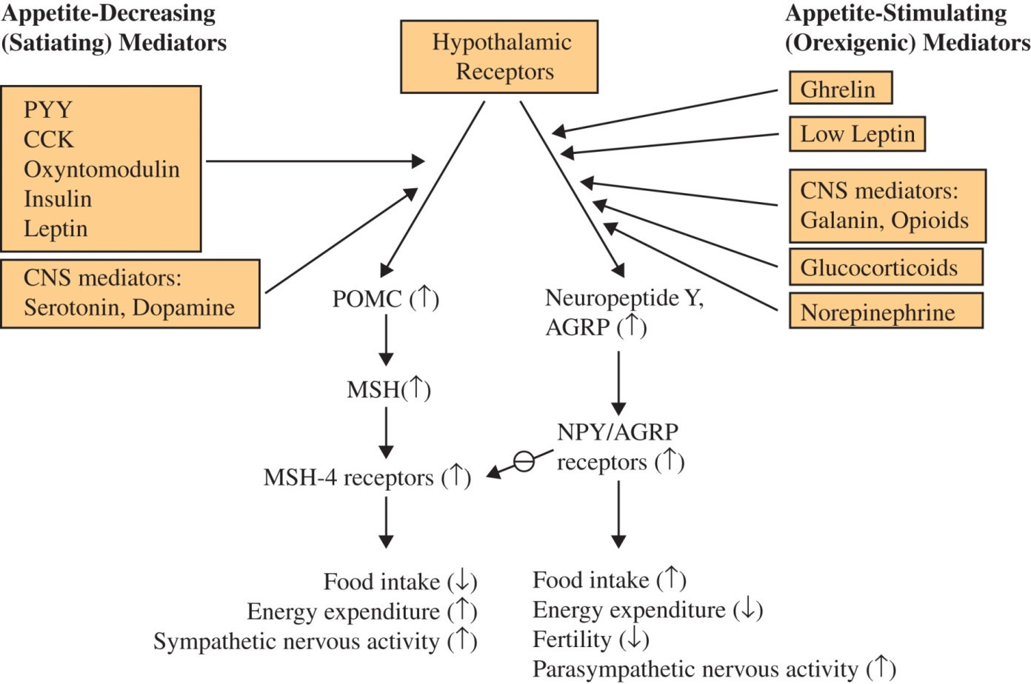
Figure 20.1

Slide 3
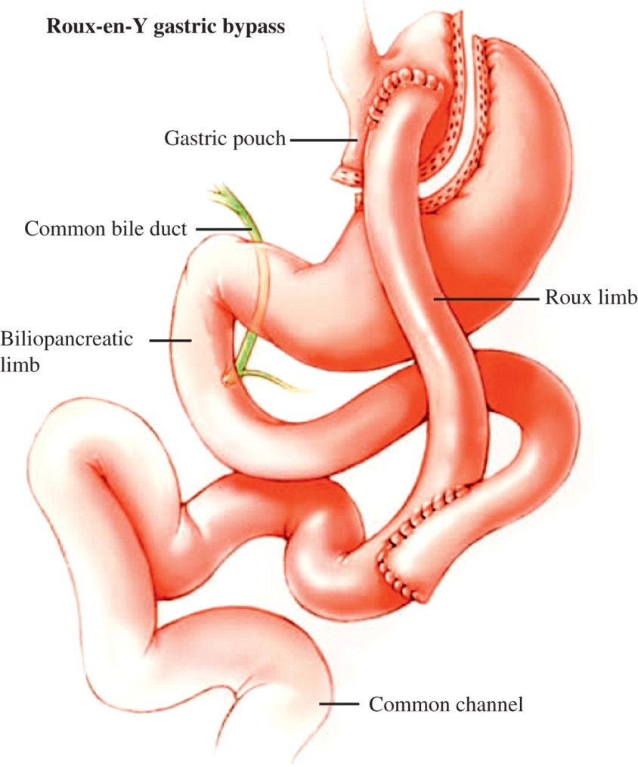
Figure 20.2

Slide 4
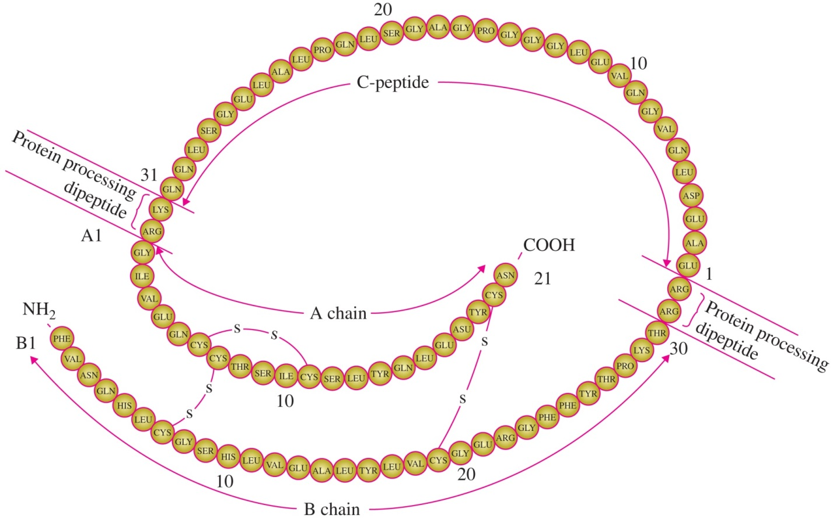
Figure 20.3

Slide 5
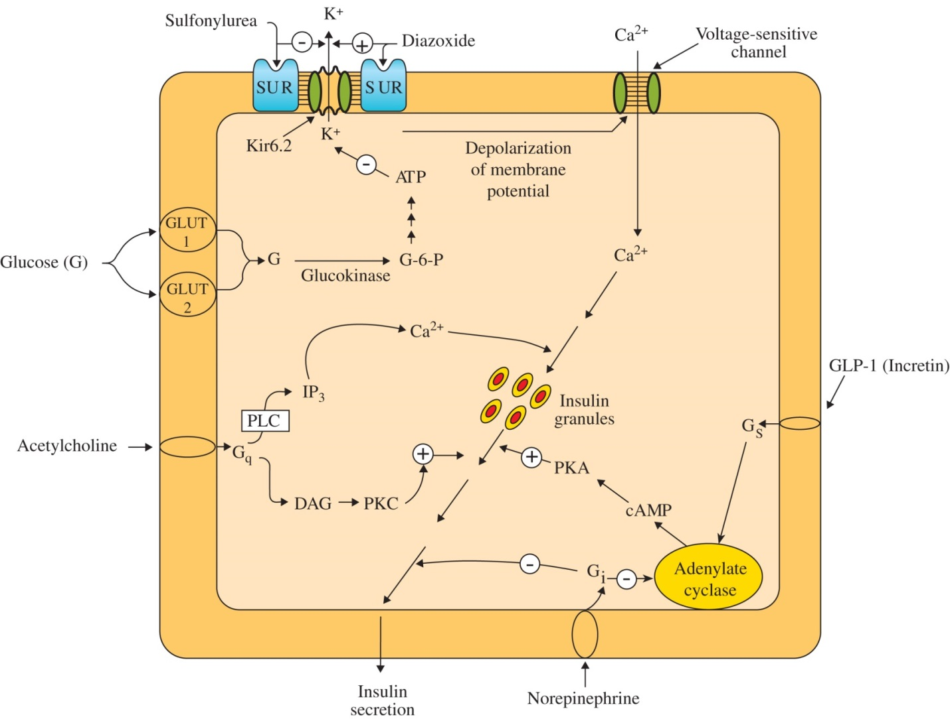
Figure 20.4

Slide 6
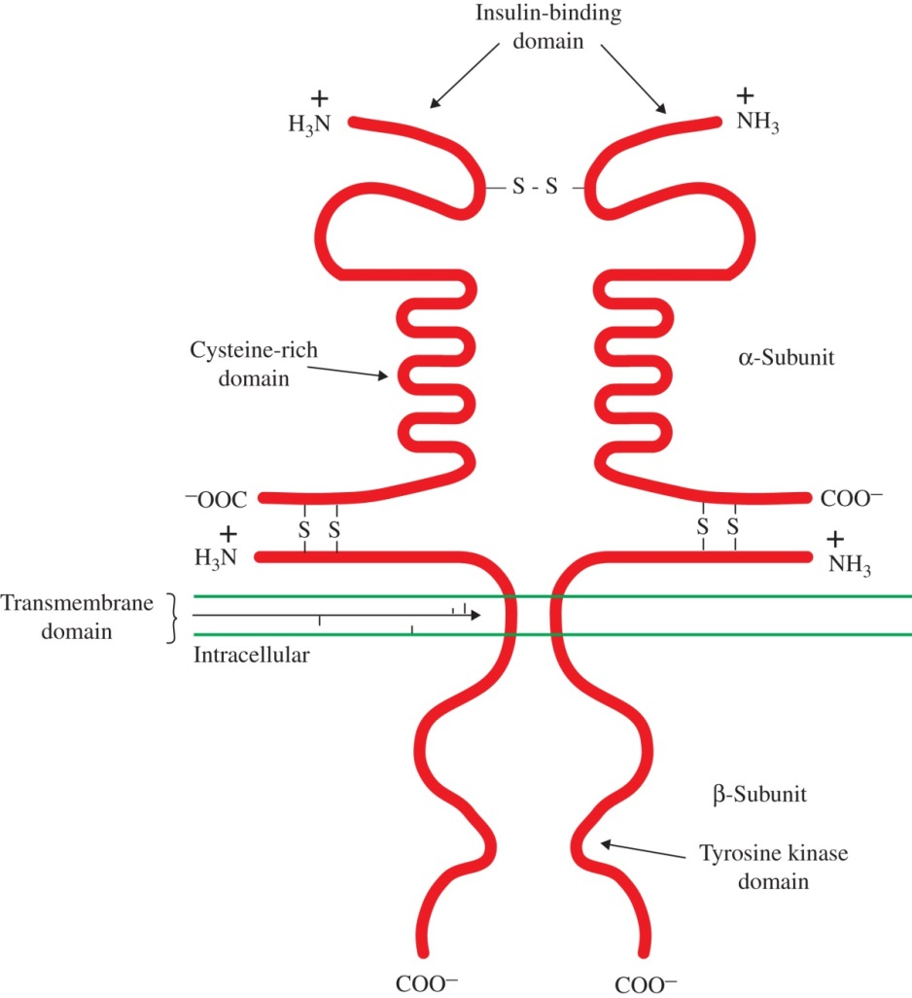
Figure 20.5

Slide 7
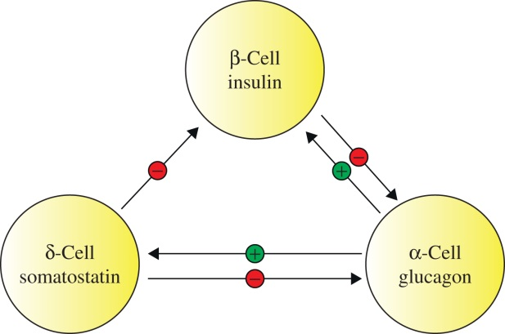
Figure 20.6

Slide 8
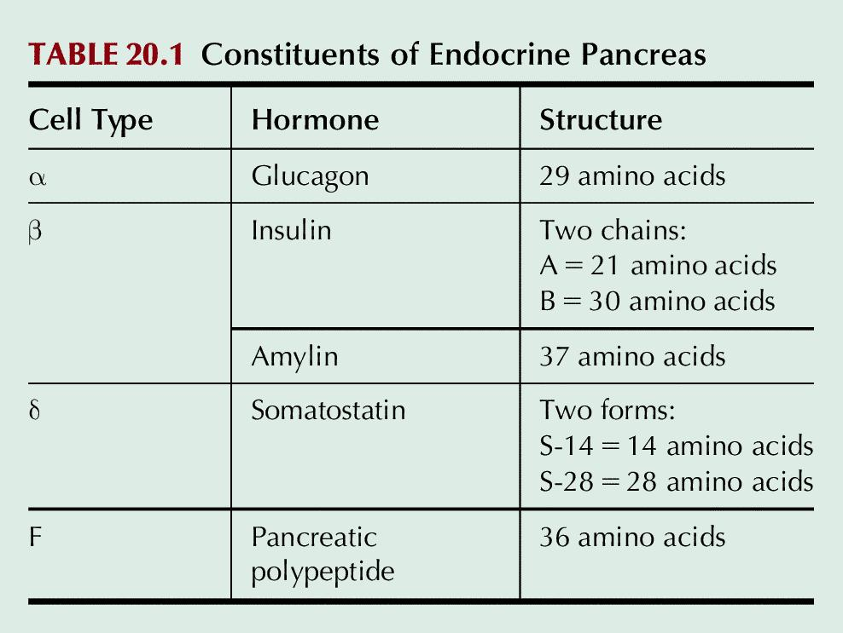
Table 20.1

Slide 9
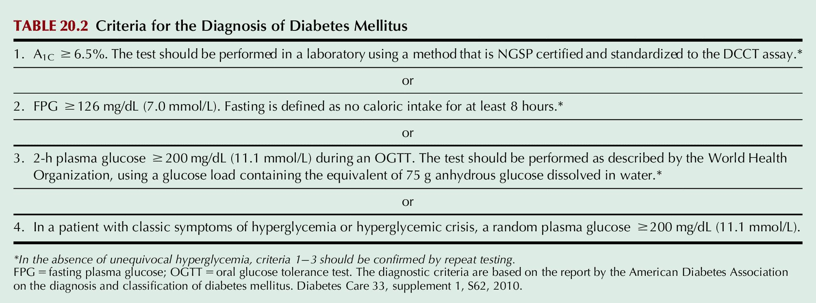
Table 20.2

Slide 10
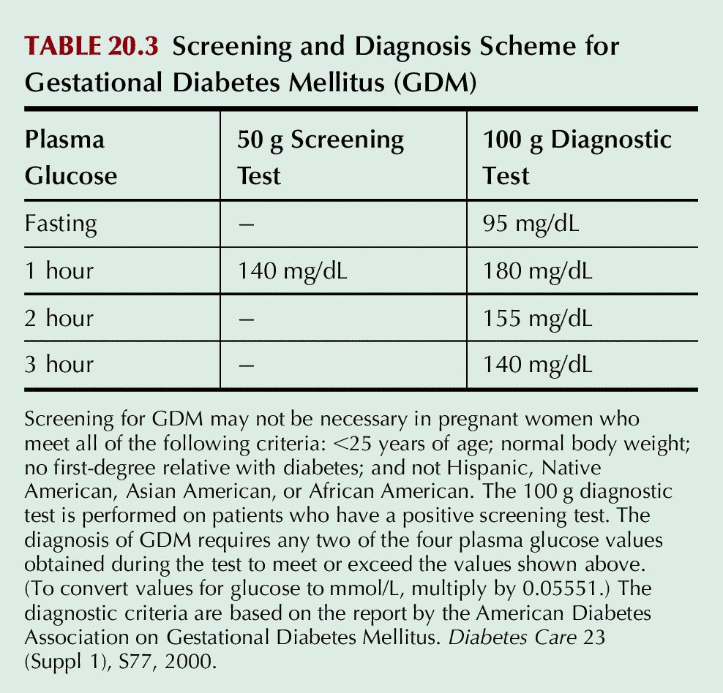
Figure 20.3

Slide 11
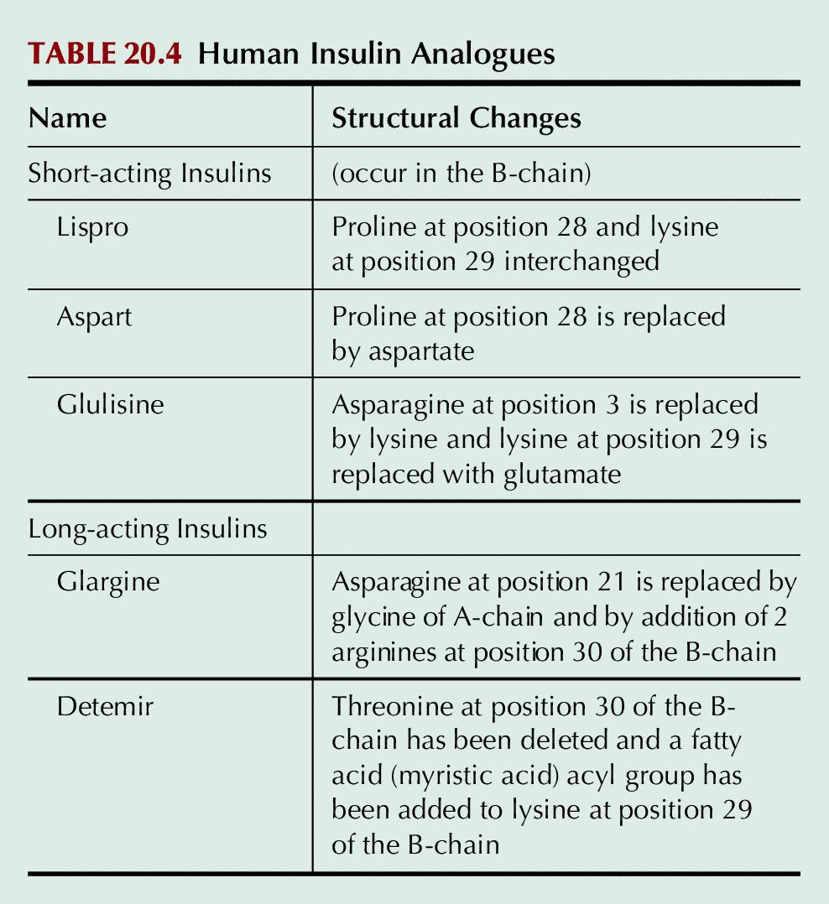
Figure 20.3

Slide 12
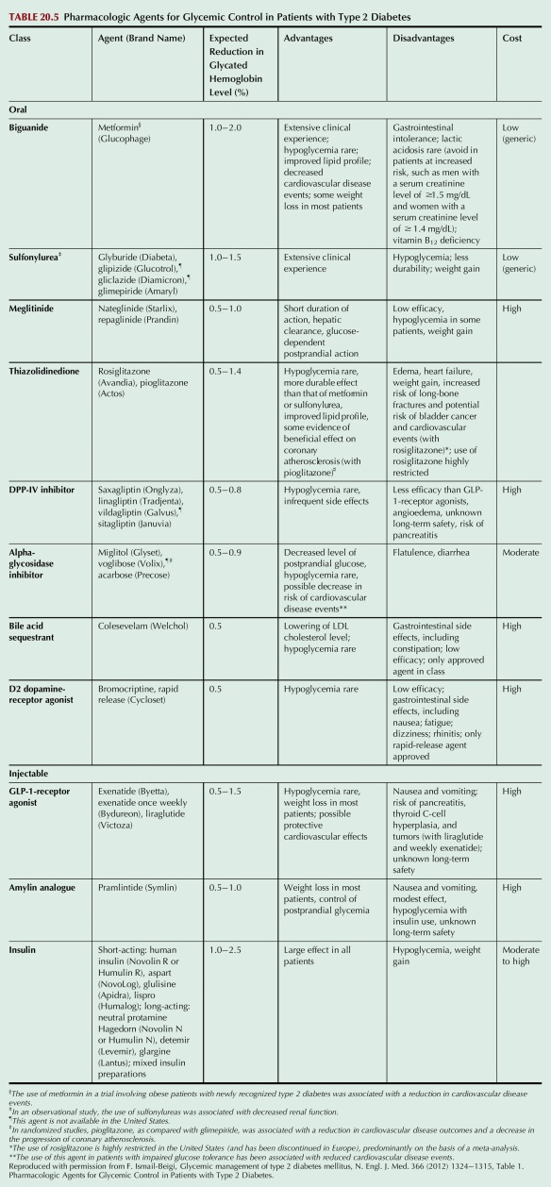
Figure 20.4

