Slide 1
Chapter 21
Structure and Properties of DNA

Slide 2
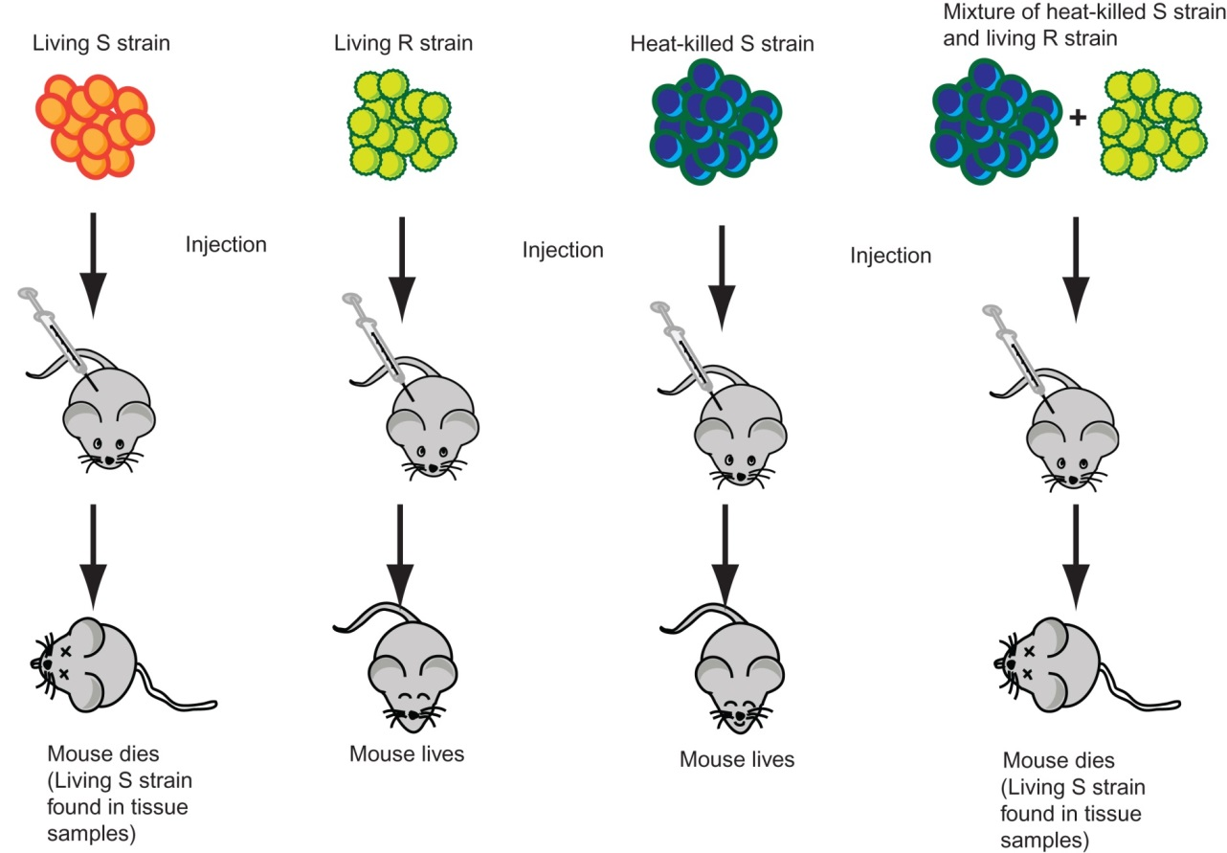
Figure 21.1

Slide 3
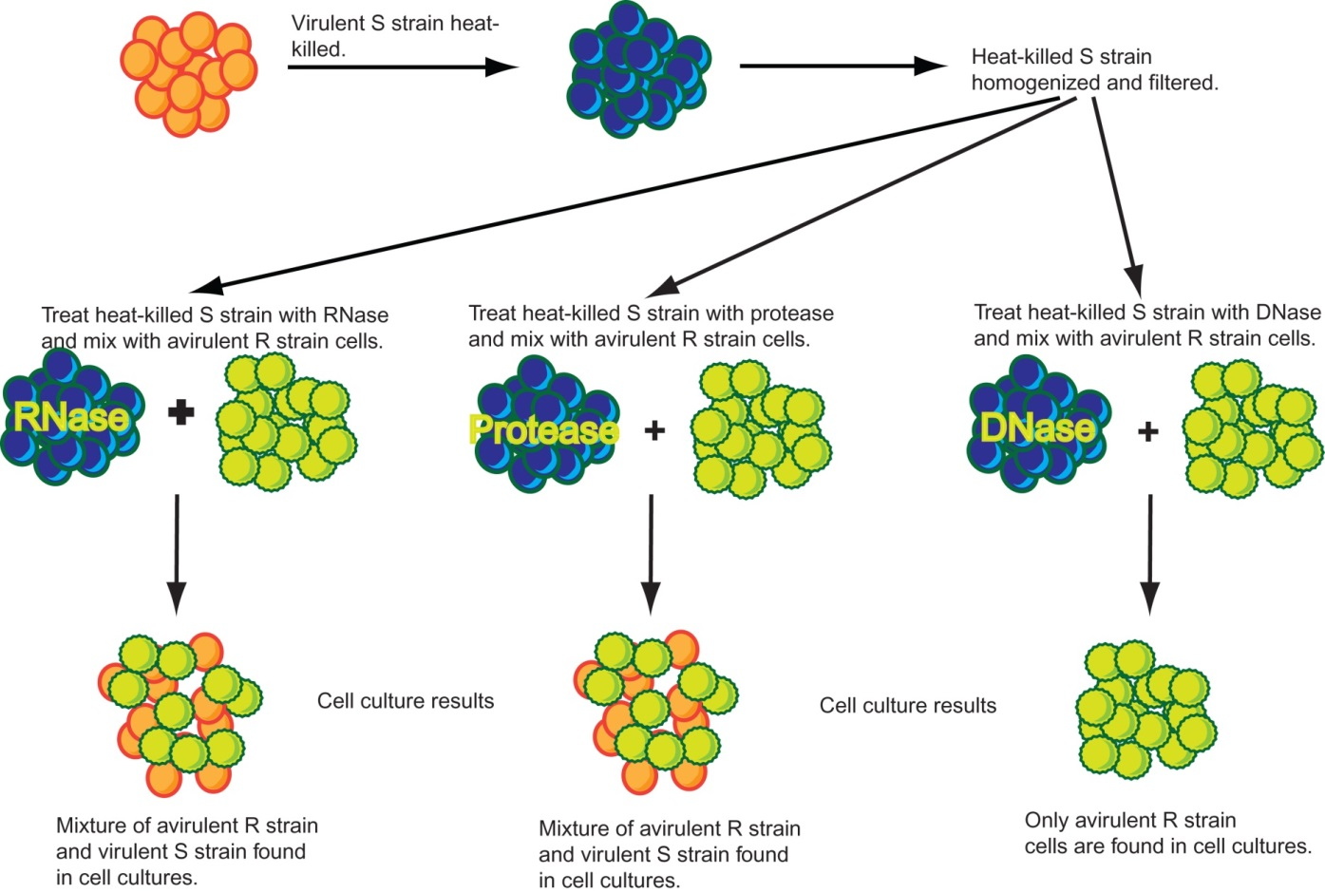
Figure 21.2

Slide 4
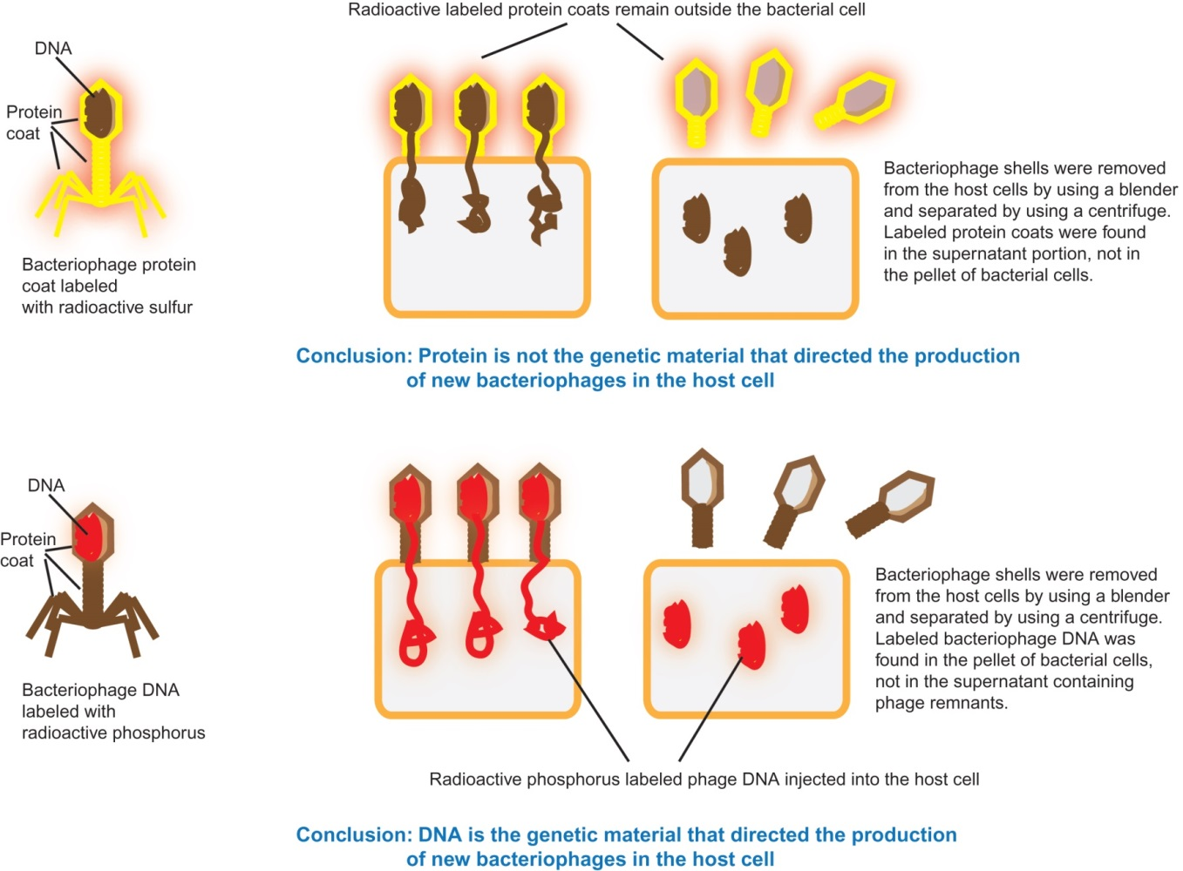
Figure 21.3

Slide 5
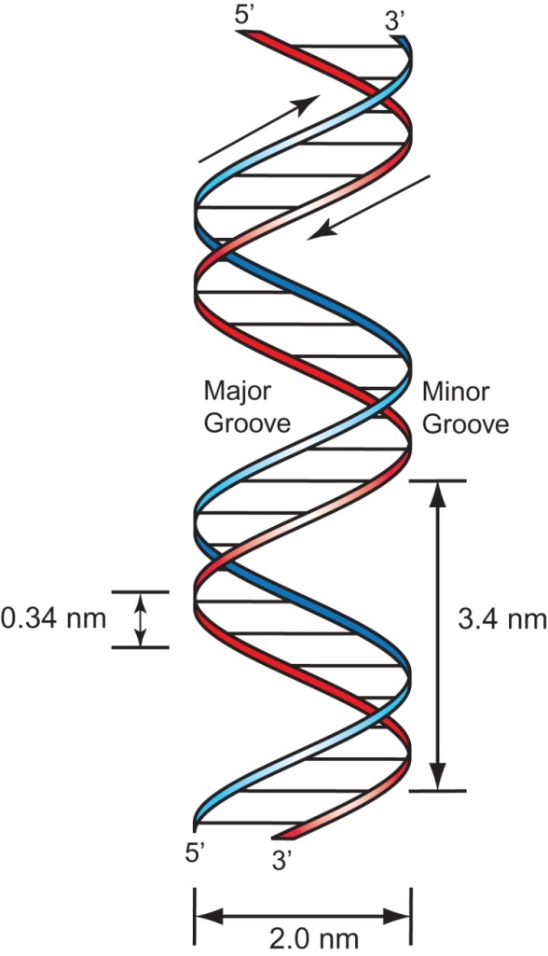
Figure 21.4

Slide 6
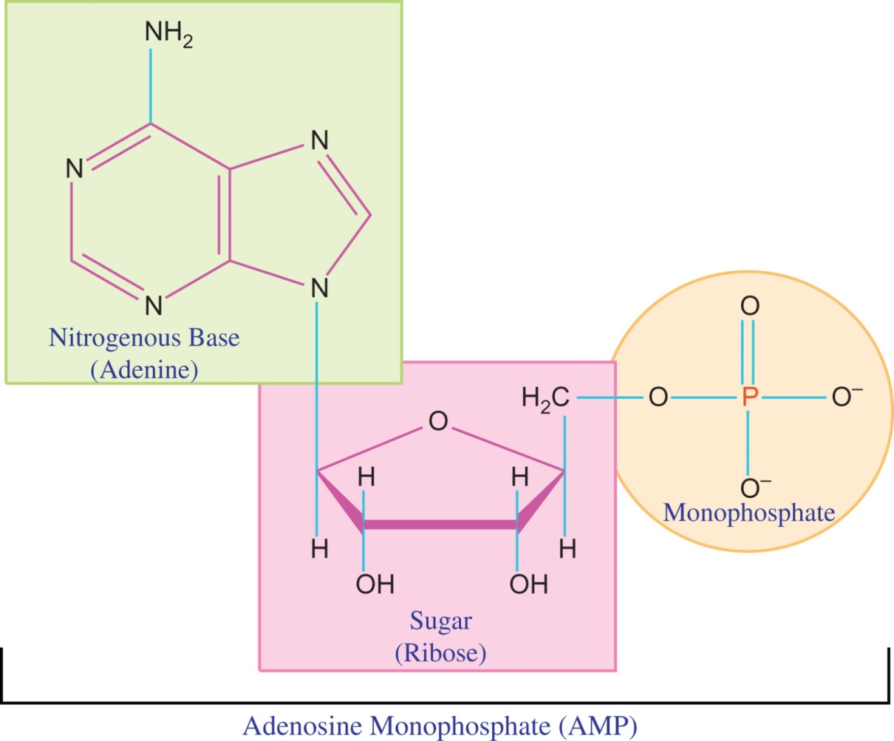
Figure 21.5

Slide 7
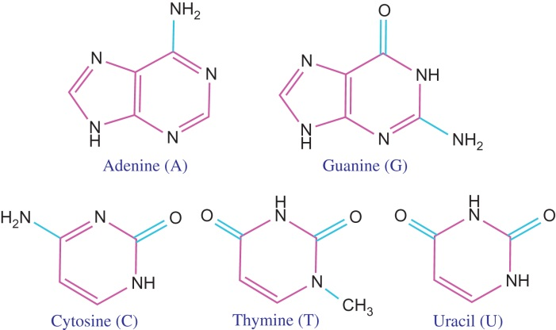
Figure 21.6

Slide 8
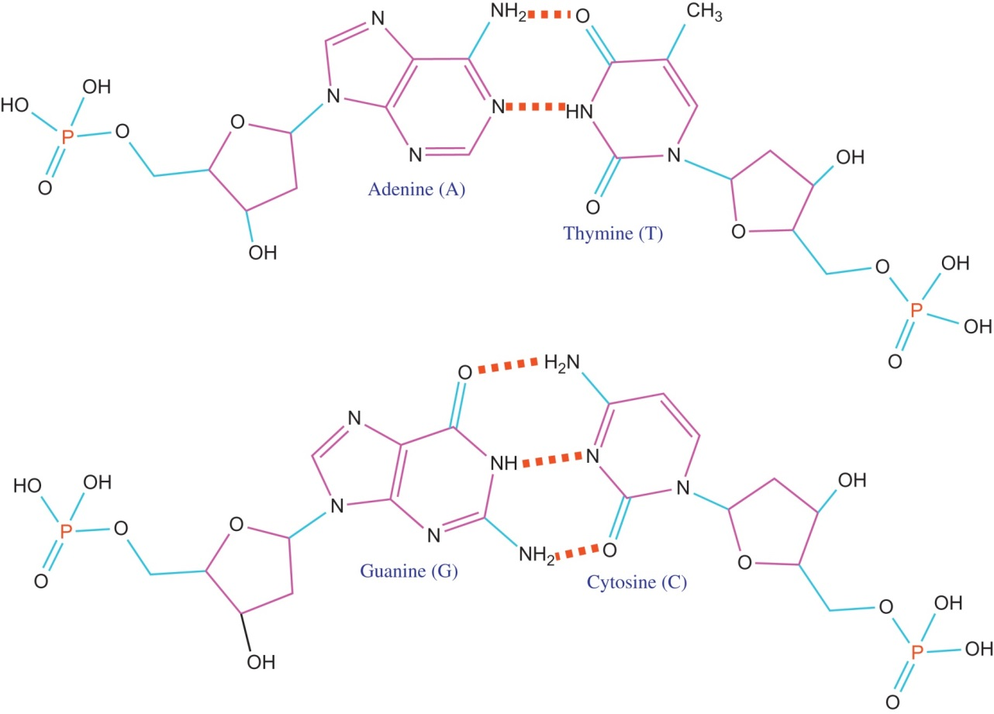
Figure 21.7

Slide 9
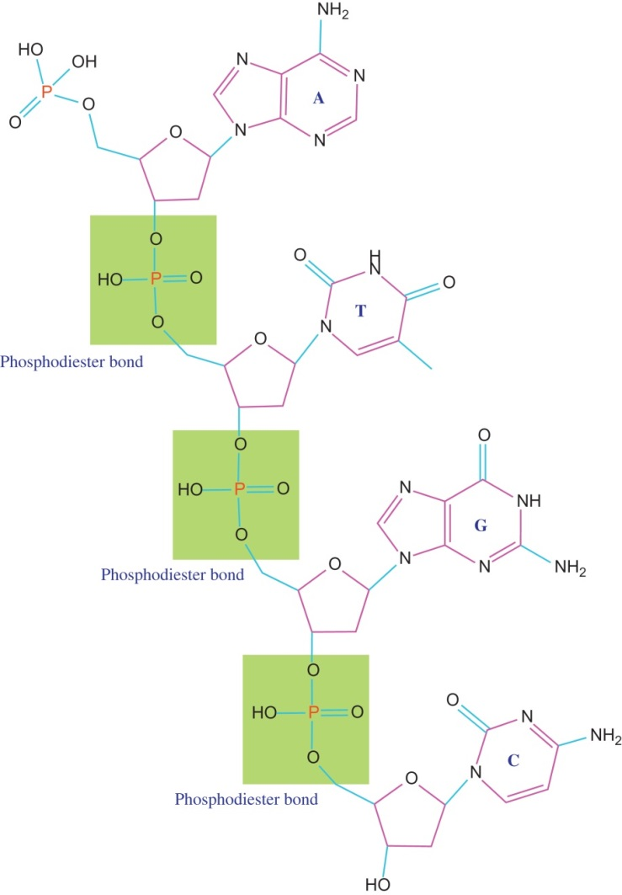
Figure 21.8

Slide 10
Figure 21.9

Slide 11
Figure 21.10

Slide 12
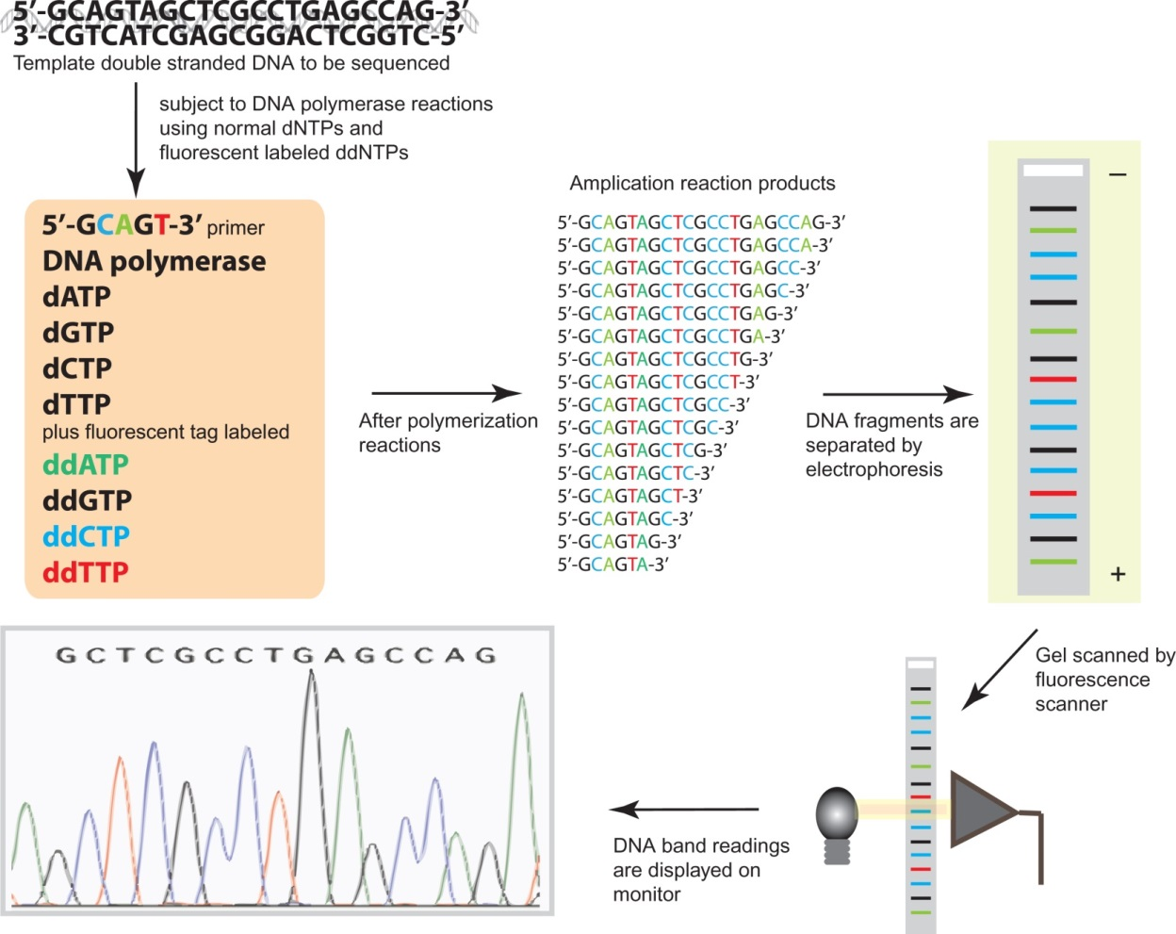
Figure 21.11

Slide 13
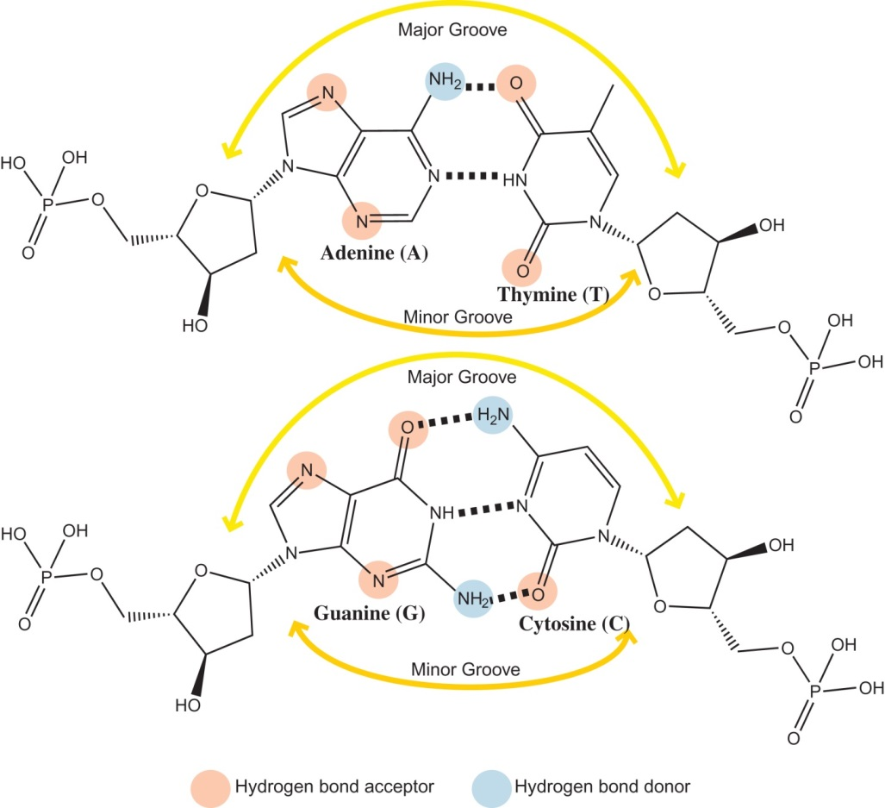
Figure 21.12

Slide 14
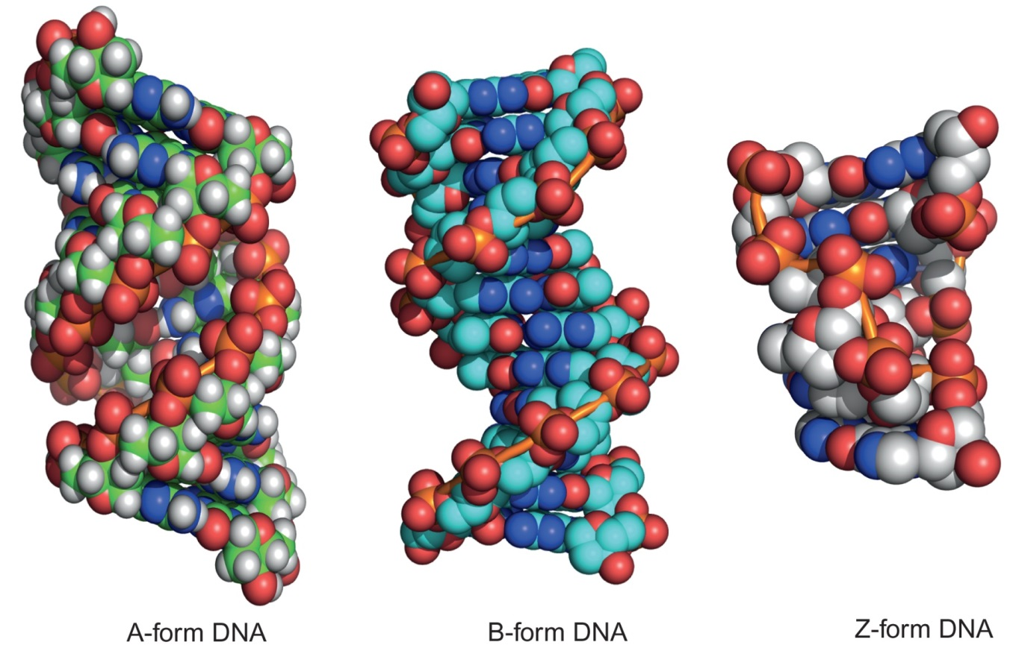
Figure 21.13

Slide 15
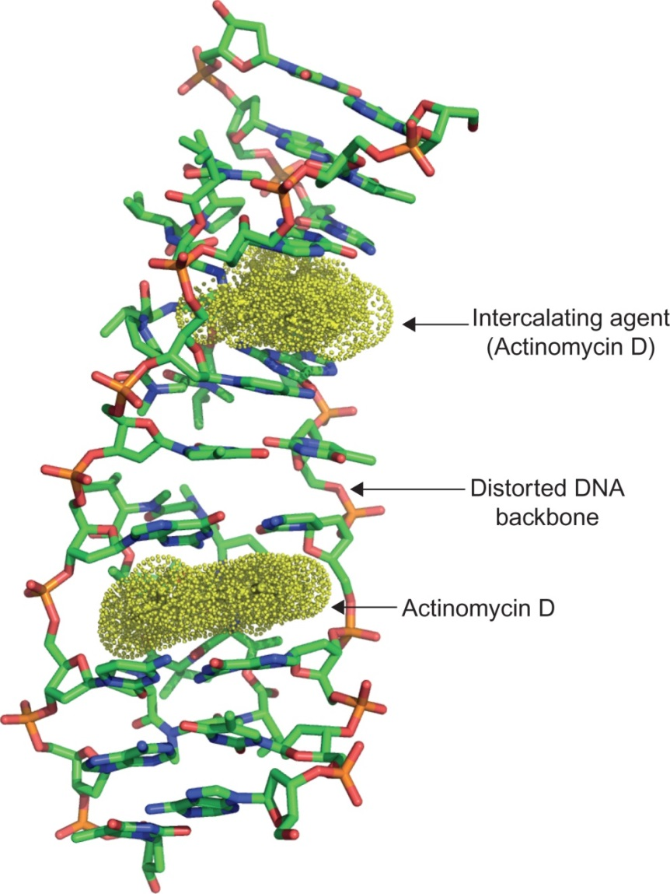
Figure 21.14

Slide 16
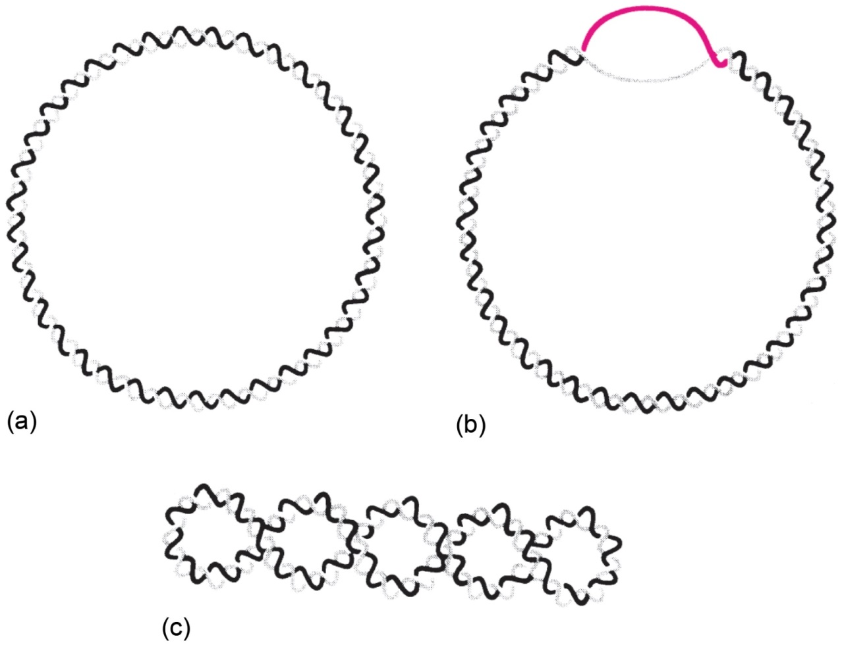
Figure 21.15

Slide 17
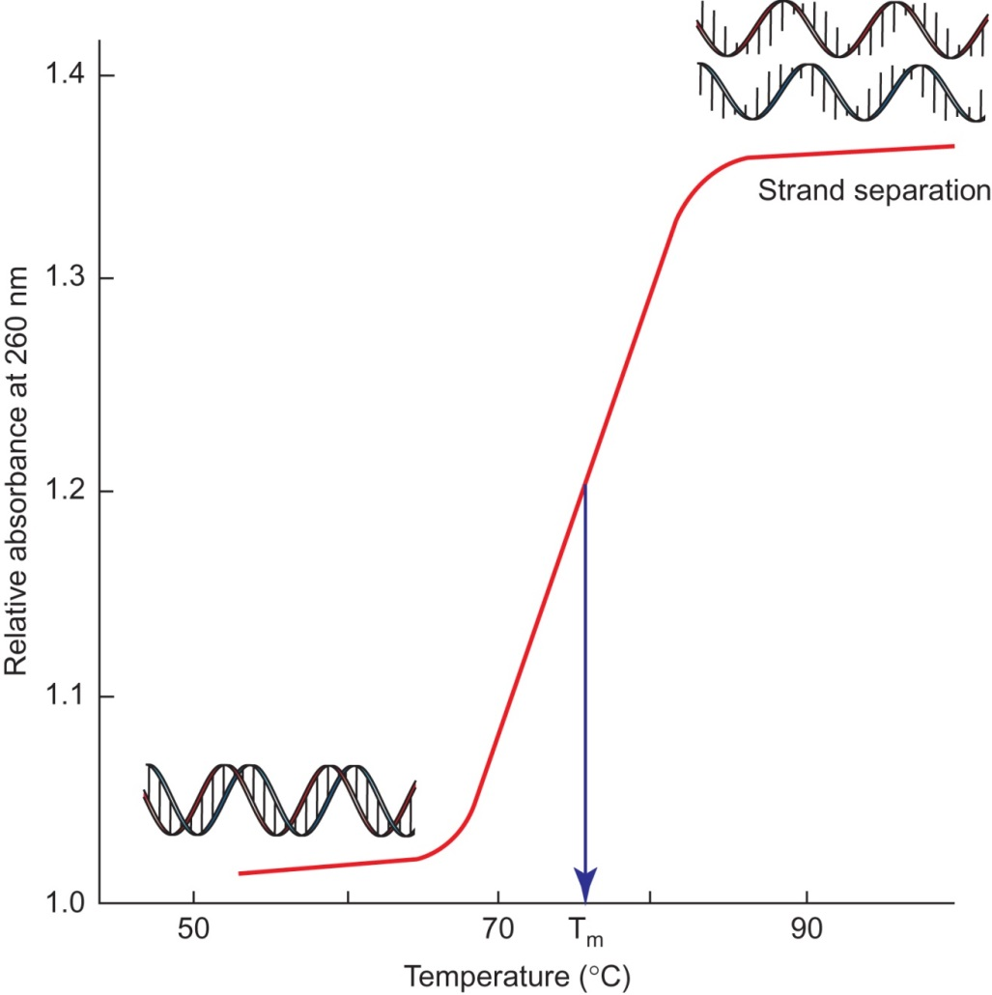
Figure 21.16

Slide 18
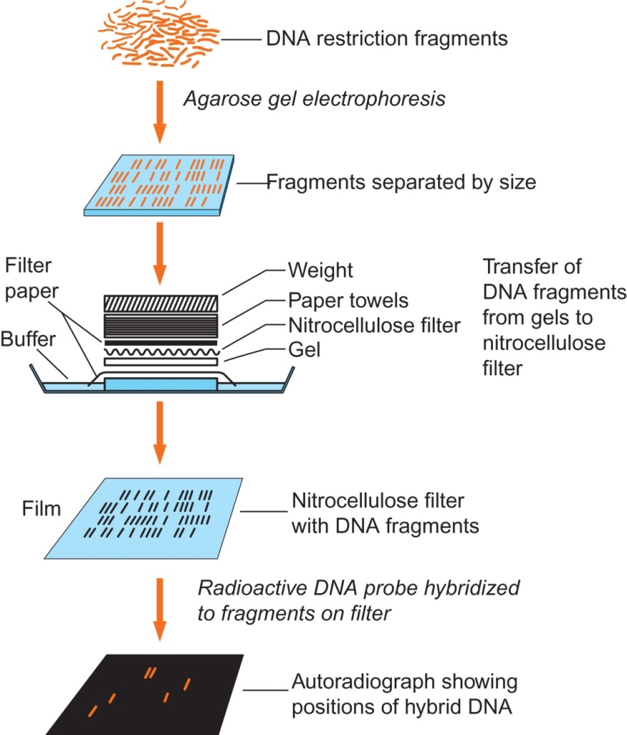
Figure 21.17

Slide 19
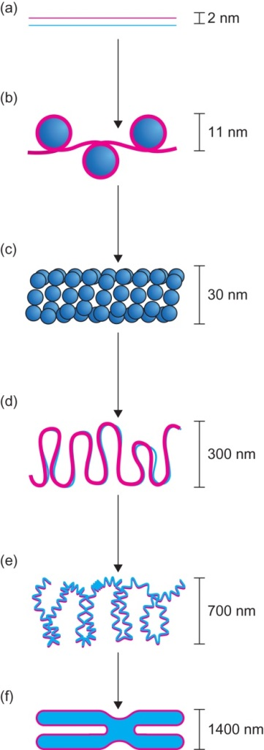
Figure 21.18

Slide 20
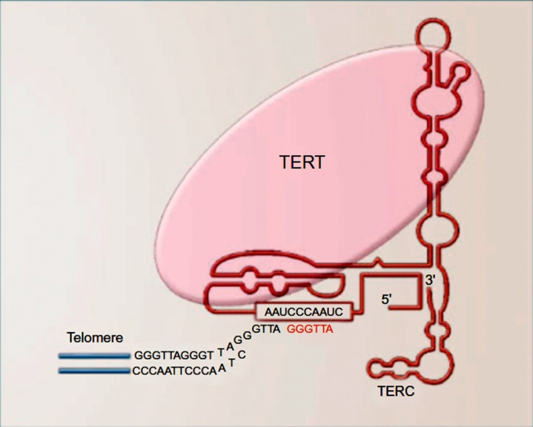
Figure 21.19

Slide 21
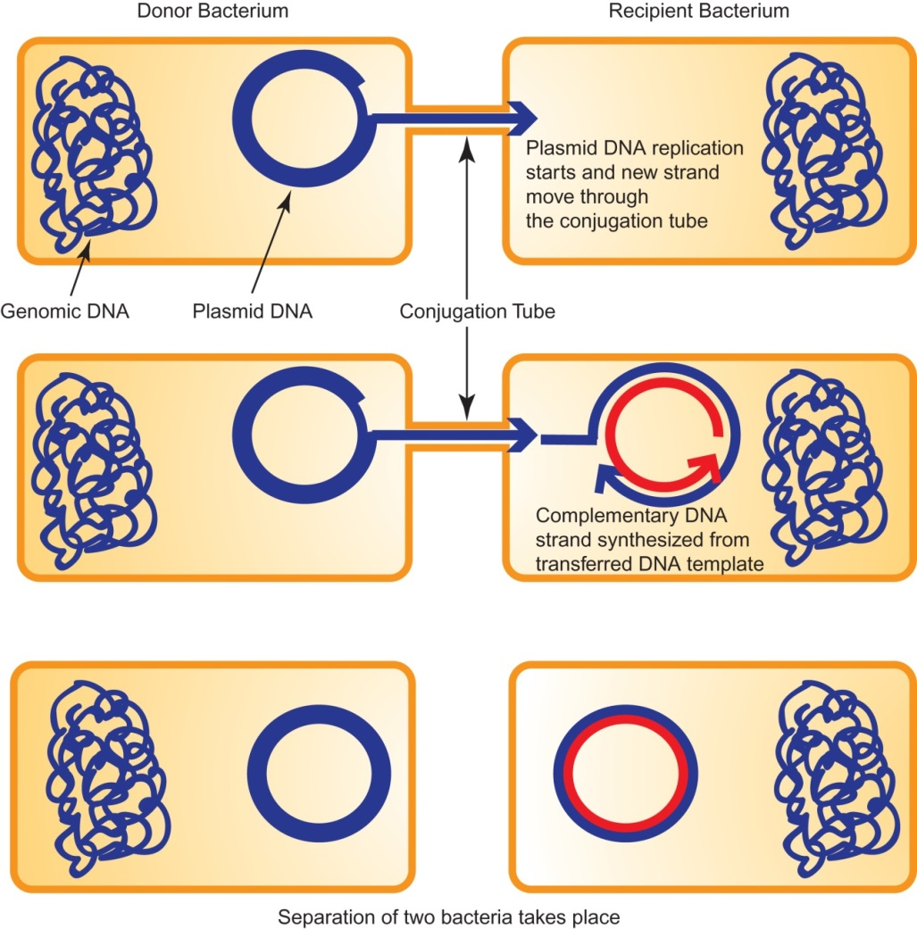
Figure 21.20

Slide 22
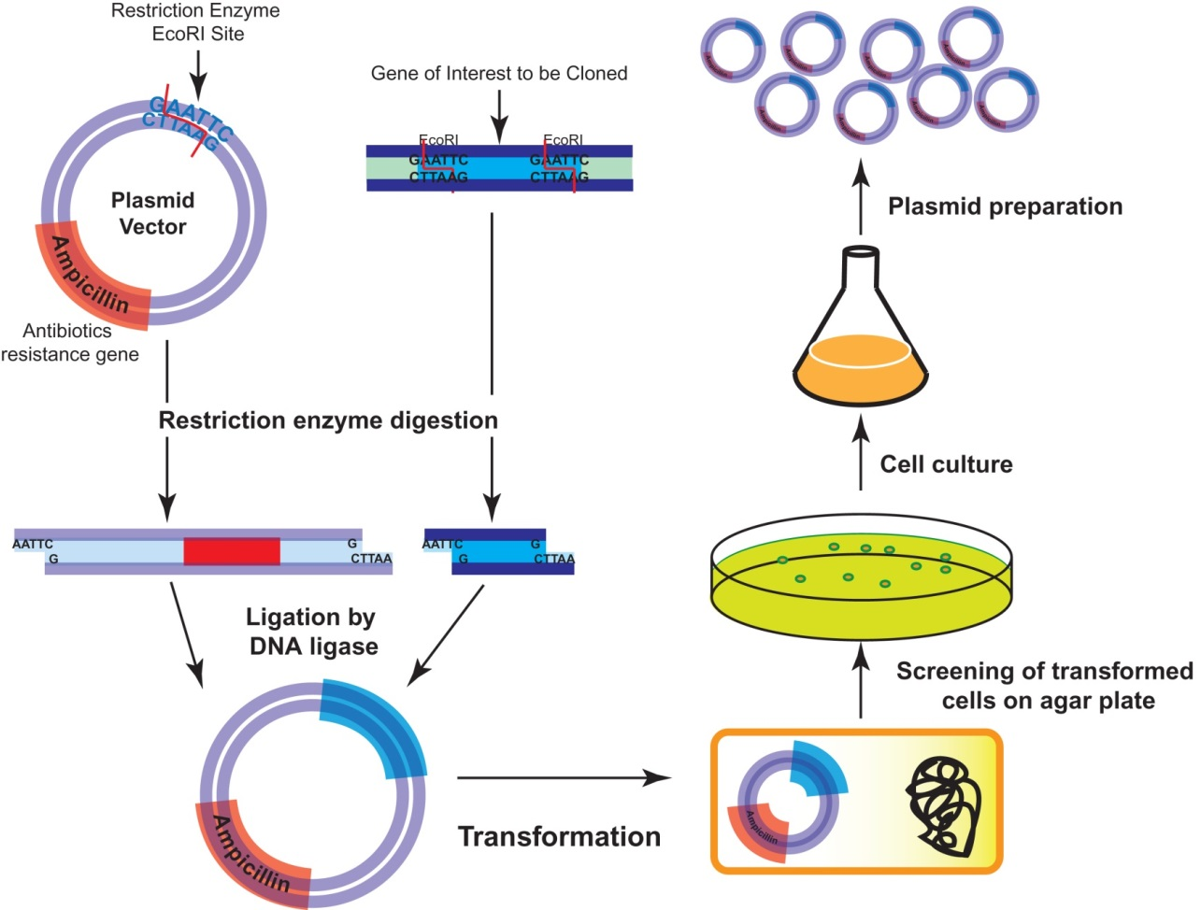
Figure 21.21

Slide 23
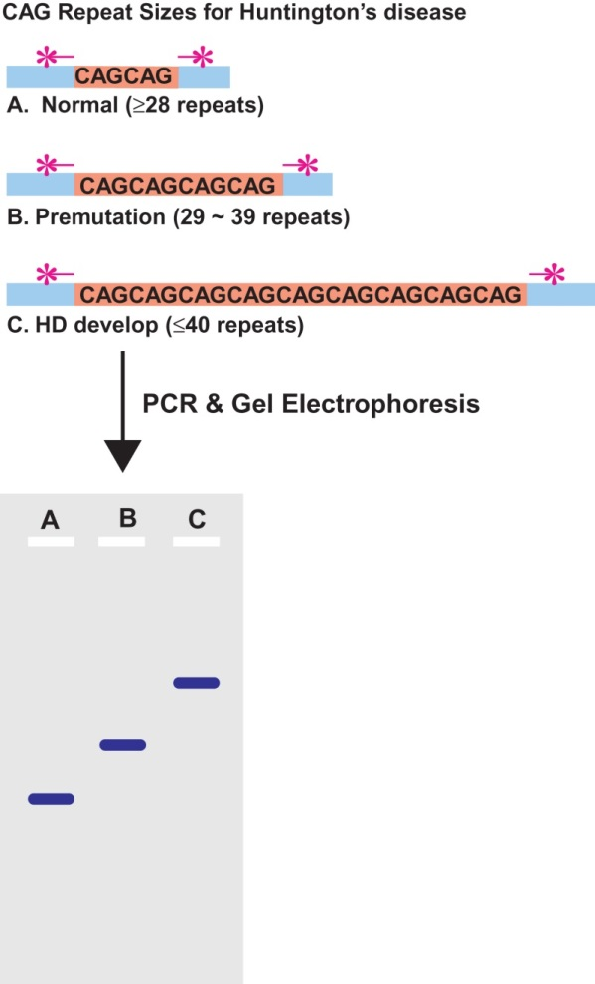
Figure 21.22

Slide 24
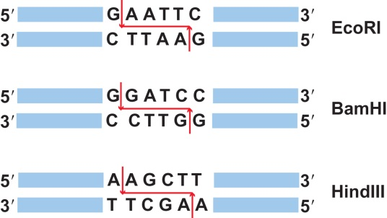
Figure 21.23

Slide 25
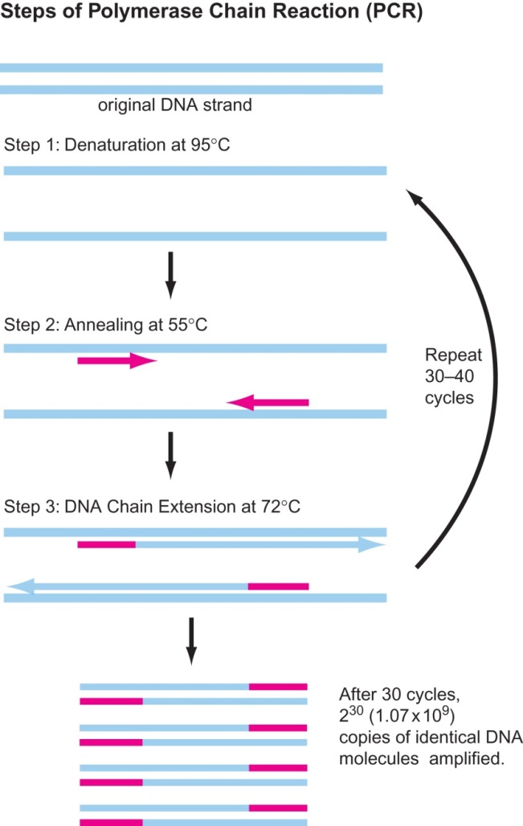
Figure 21.24

Slide 26
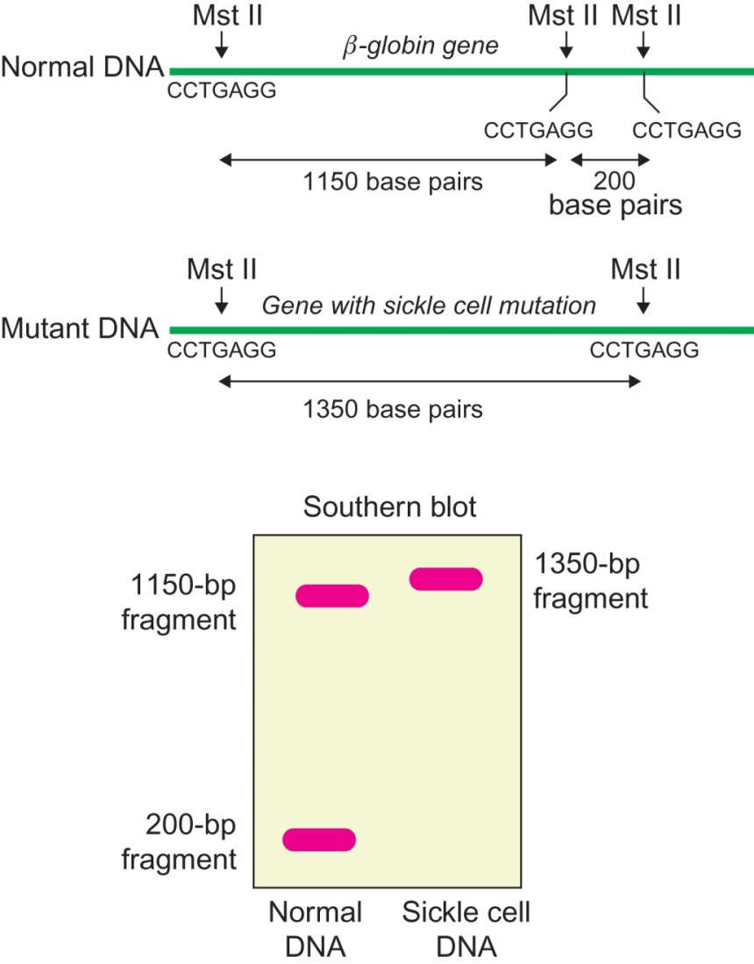
Figure 21.25

Slide 27
Figure 21.26

Slide 28
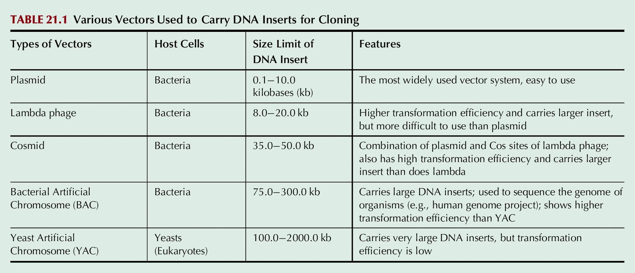
Table 21.1

