Slide 1
Chapter 26
Hemoglobin

Slide 2
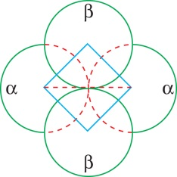
Figure 26.1

Slide 3
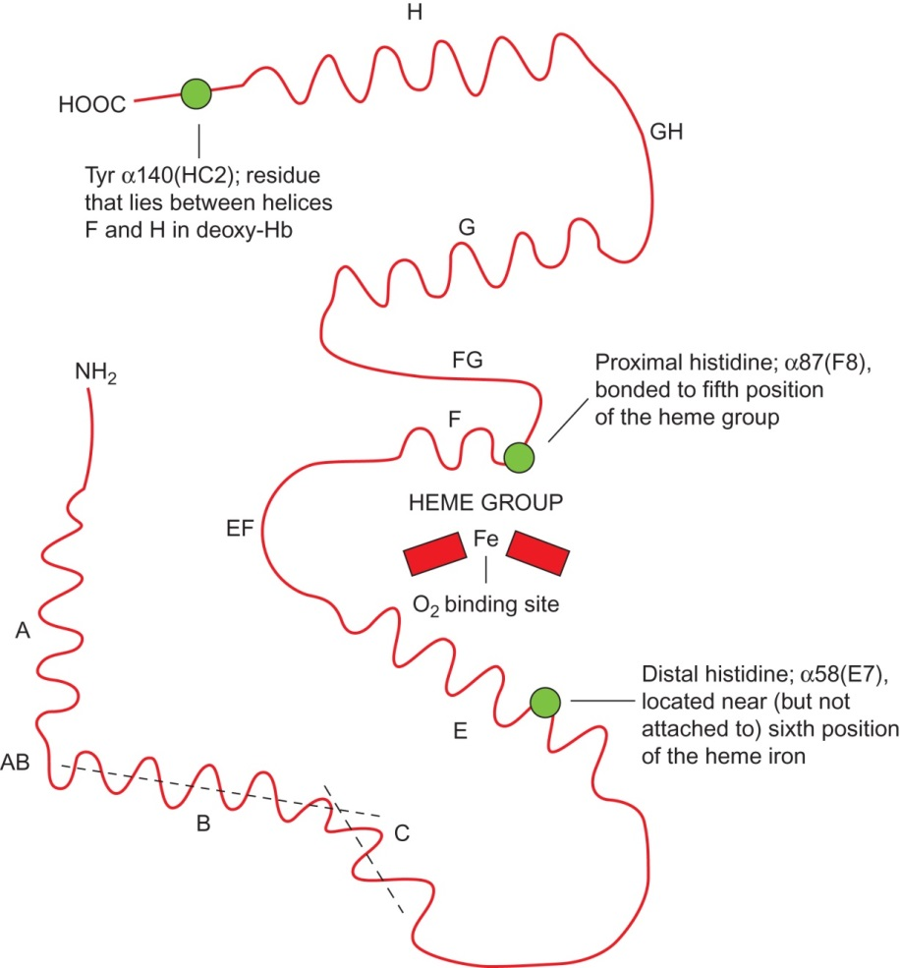
Figure 26.2

Slide 4
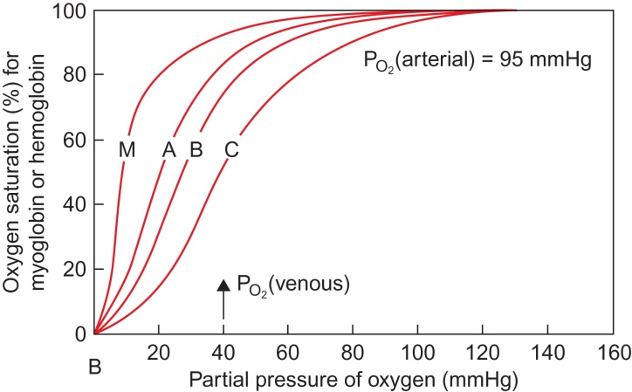
Figure 26 .3

Slide 5
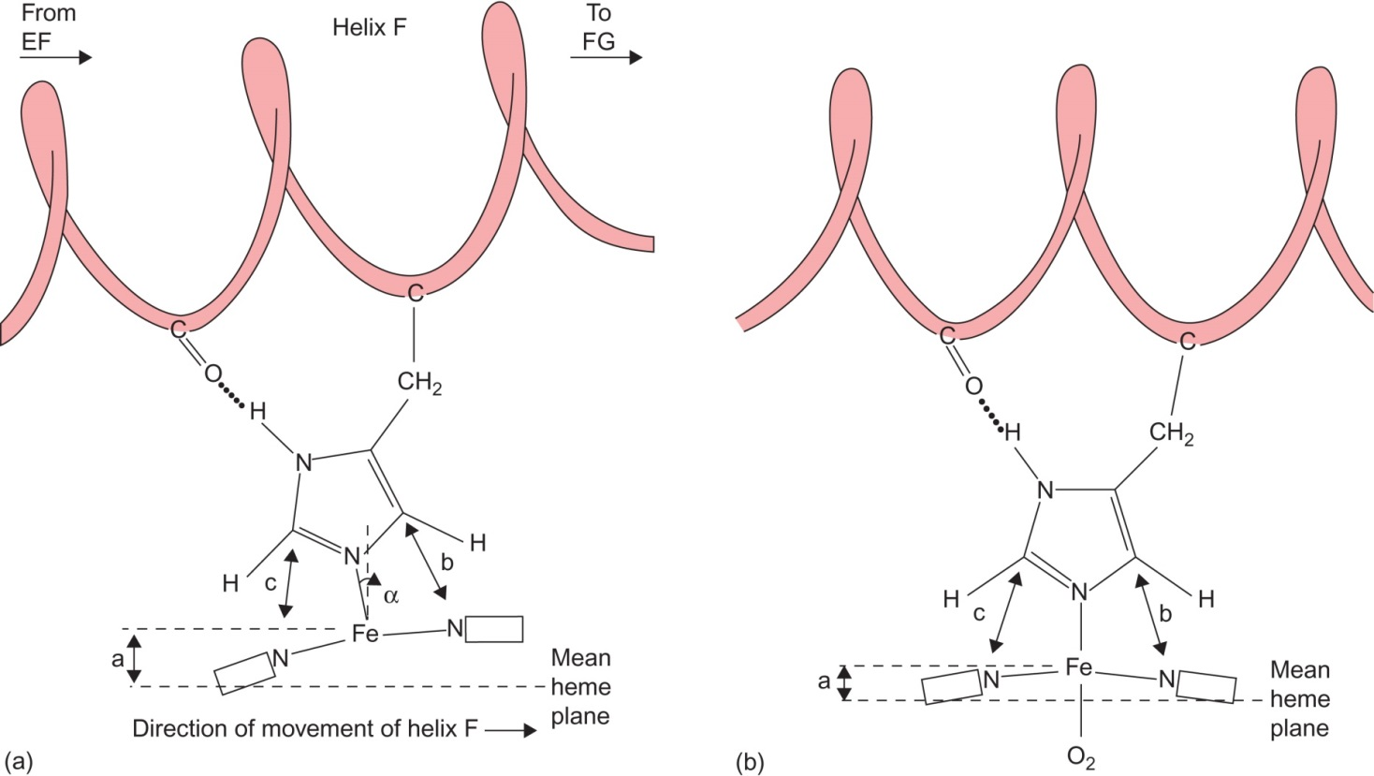
Figure 26 .4

Slide 6
Figure 26.5

Slide 7
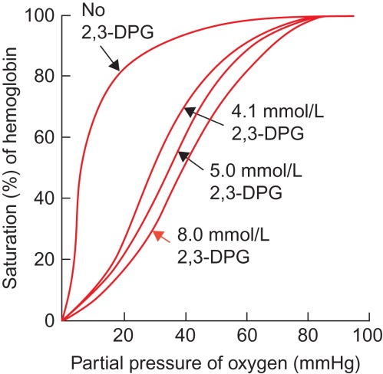
Figure 26.6

Slide 8
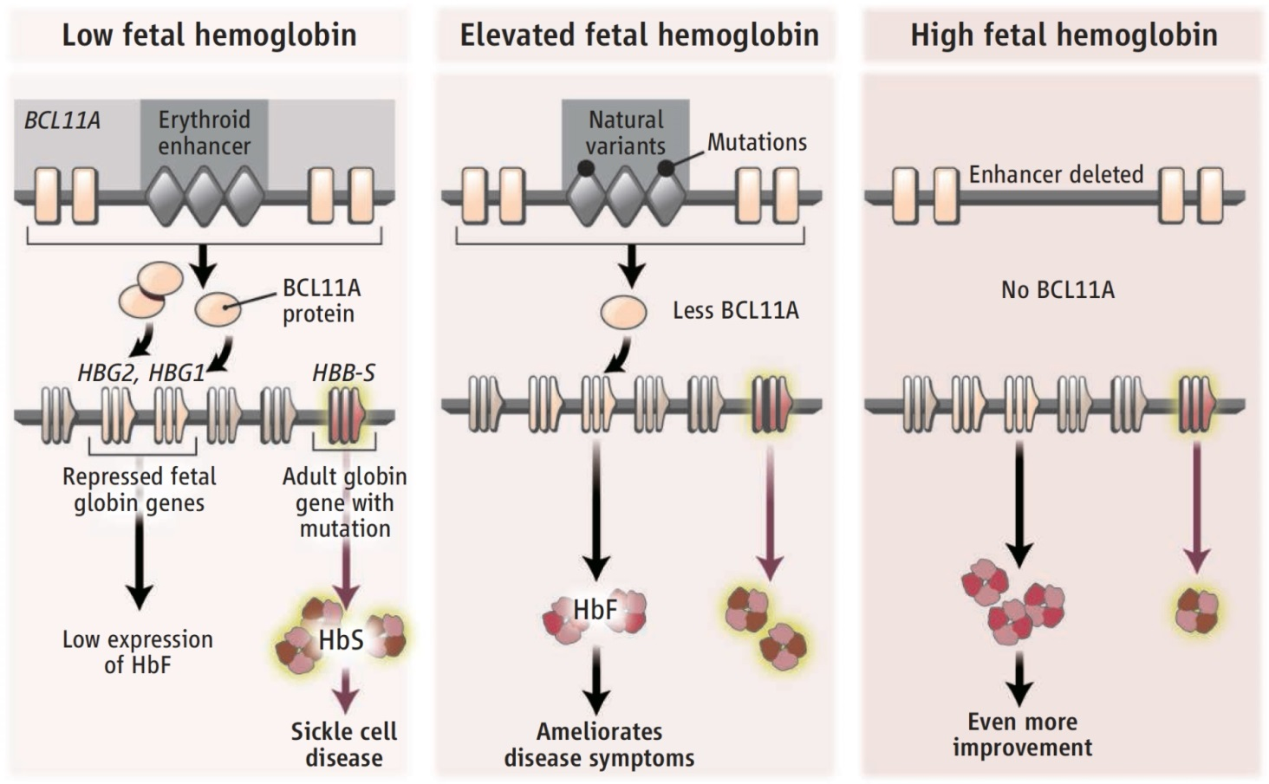
Figure 26.7

Slide 9
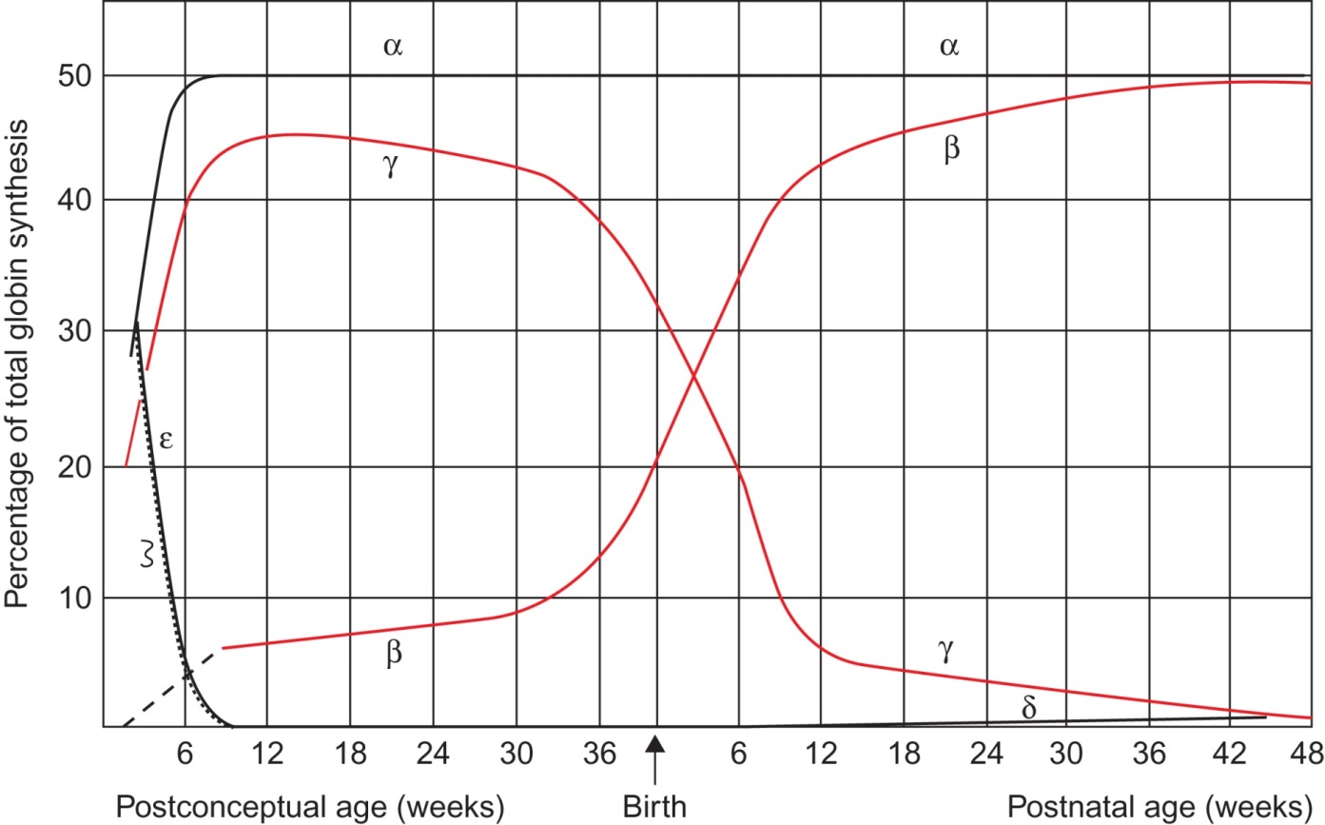
Figure 26.8

Slide 10
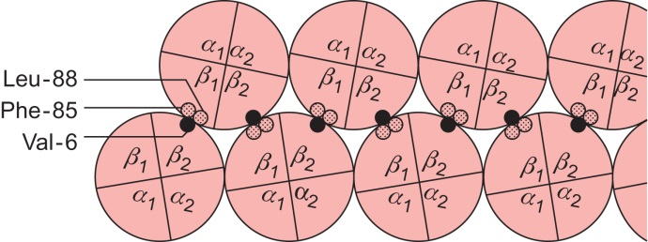
Figure 26.9

Slide 11
Figure 26.10

Slide 12
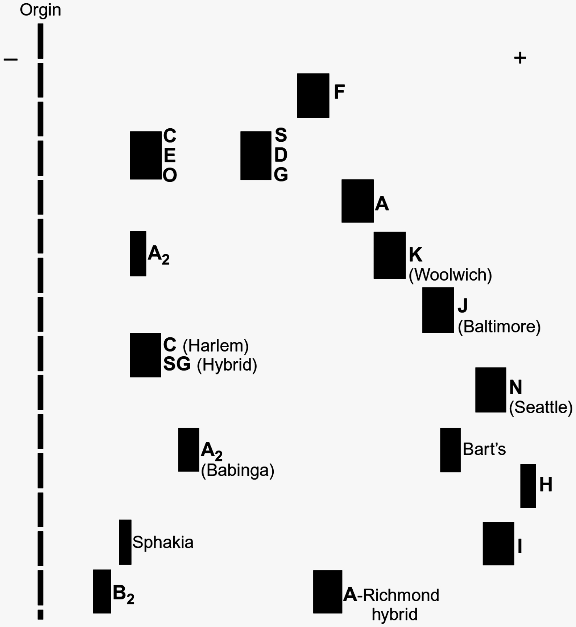
Figure 26.11

Slide 13
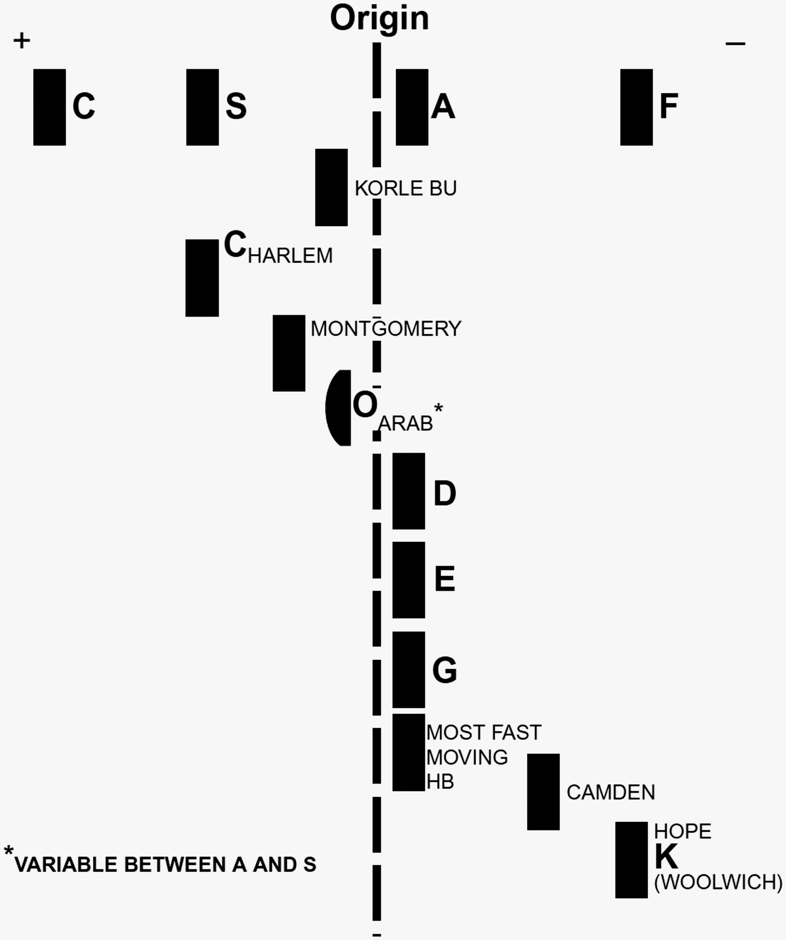
Figure 26.12

Slide 14
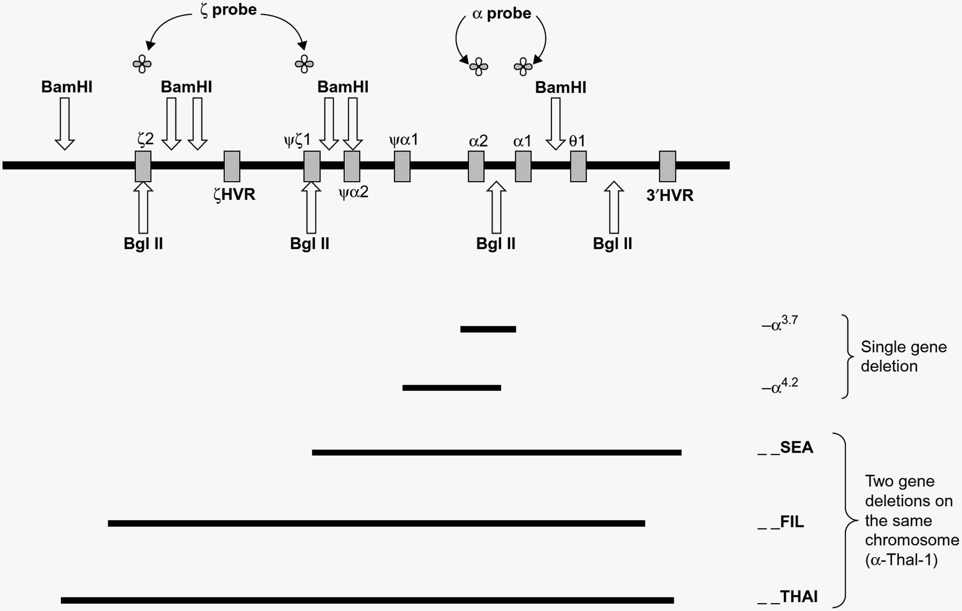
Figure 26.13

Slide 15
Figure 26.14

Slide 16
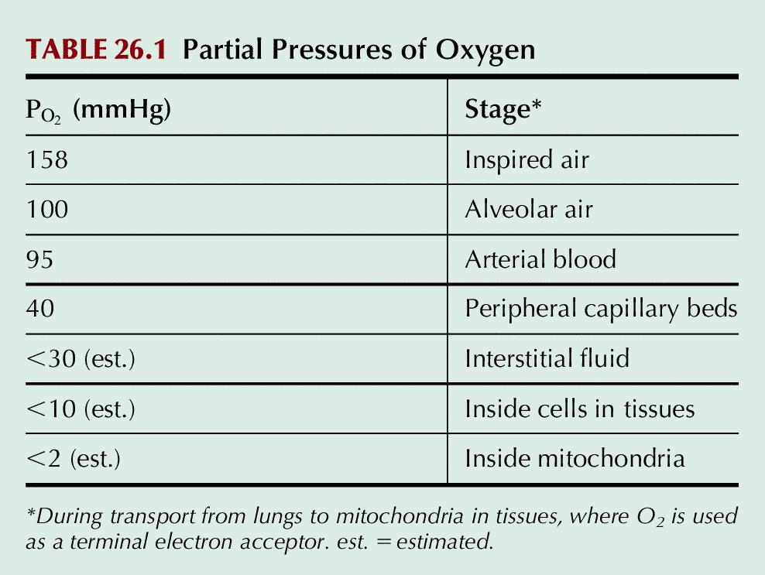
Table 26.1

Slide 17
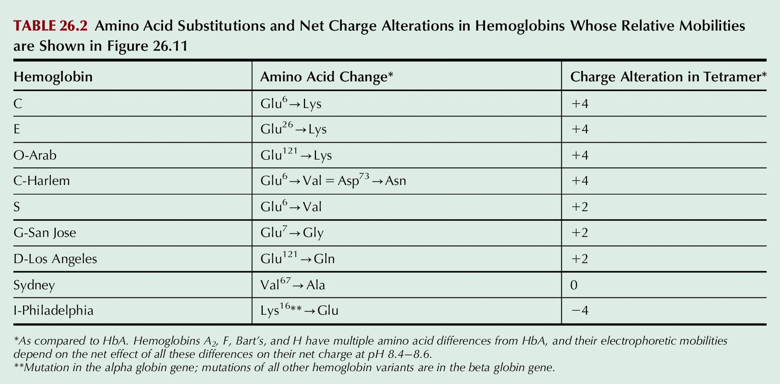
Table 26.2

Slide 18
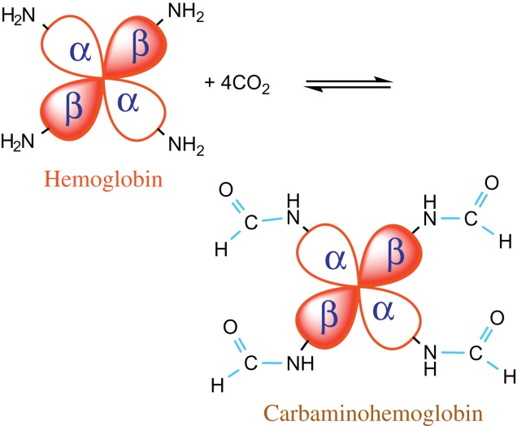
UnFig 26.1

