Slide 1
Chapter 27
Metabolism of Iron and Heme

Slide 2
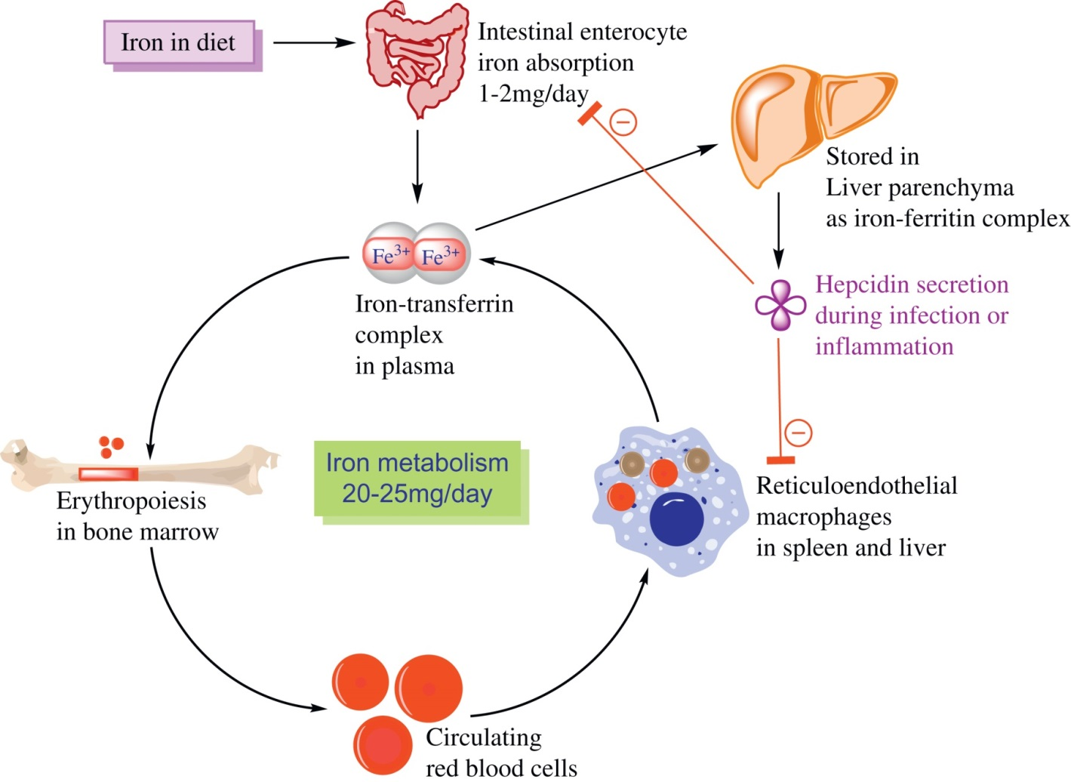
Figure 27.1

Slide 3
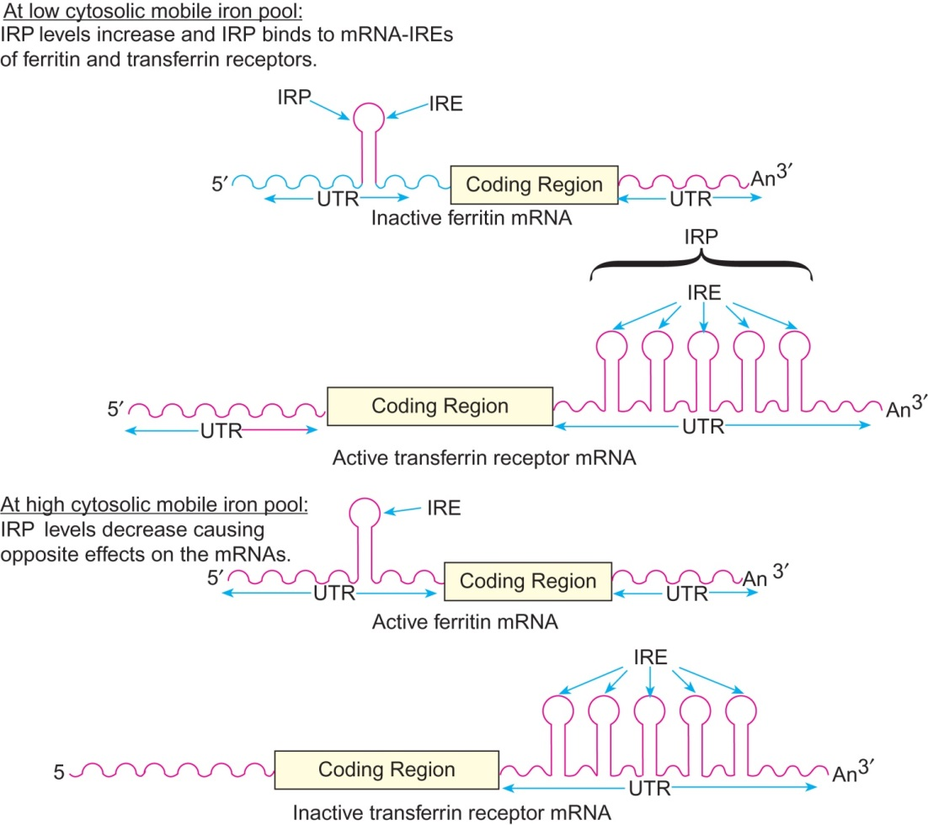
Figure 27.2

Slide 4
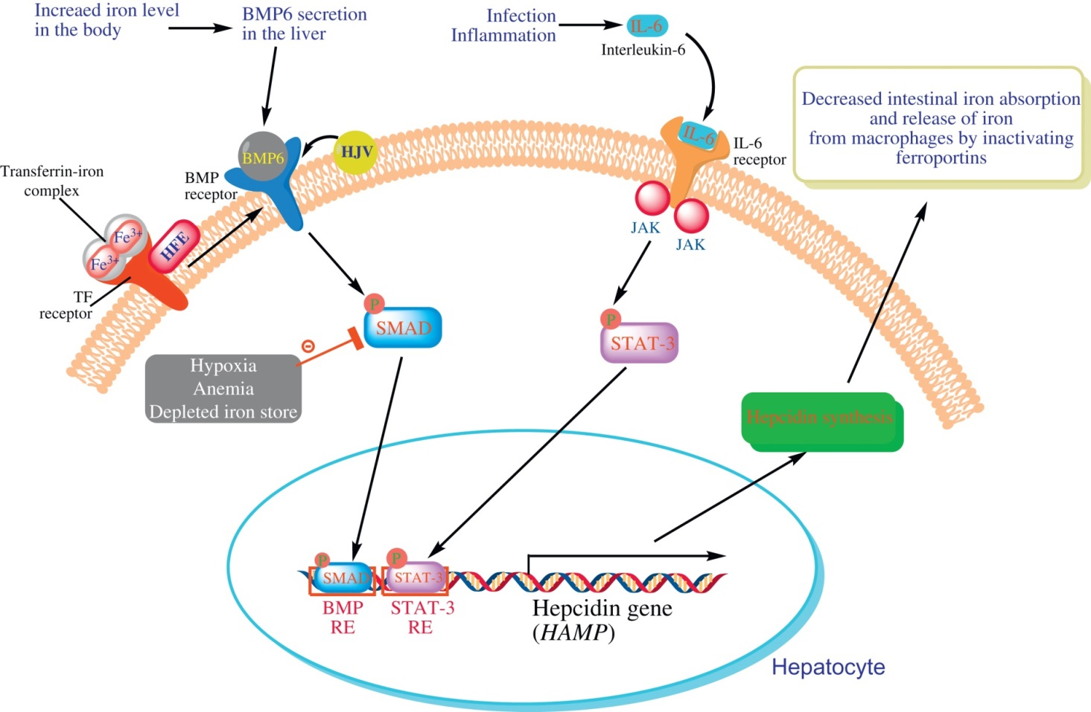
Figure 27.3

Slide 5
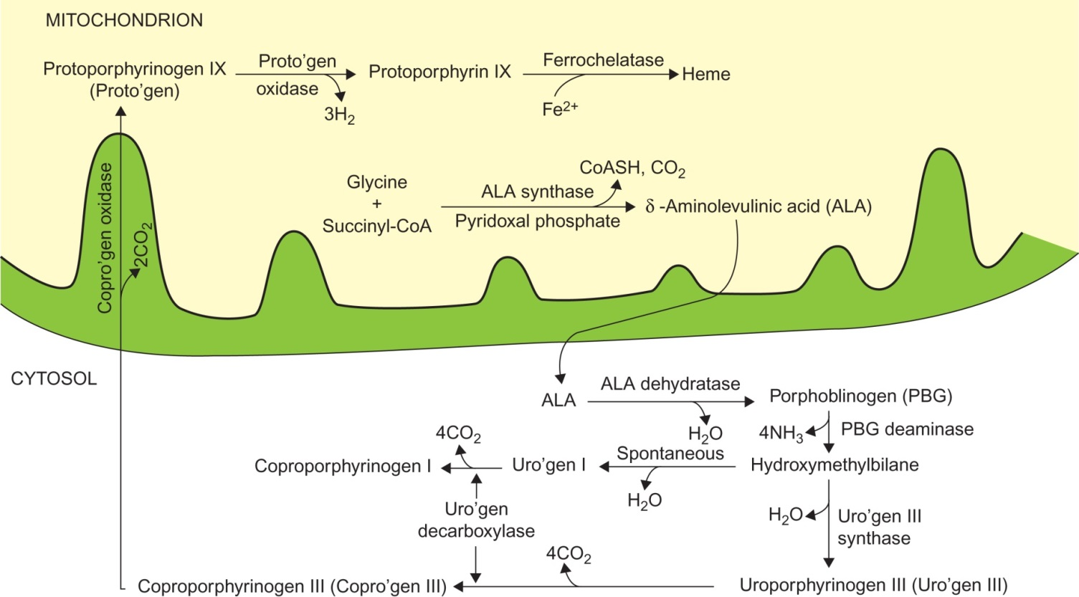
Figure 27.4

Slide 6
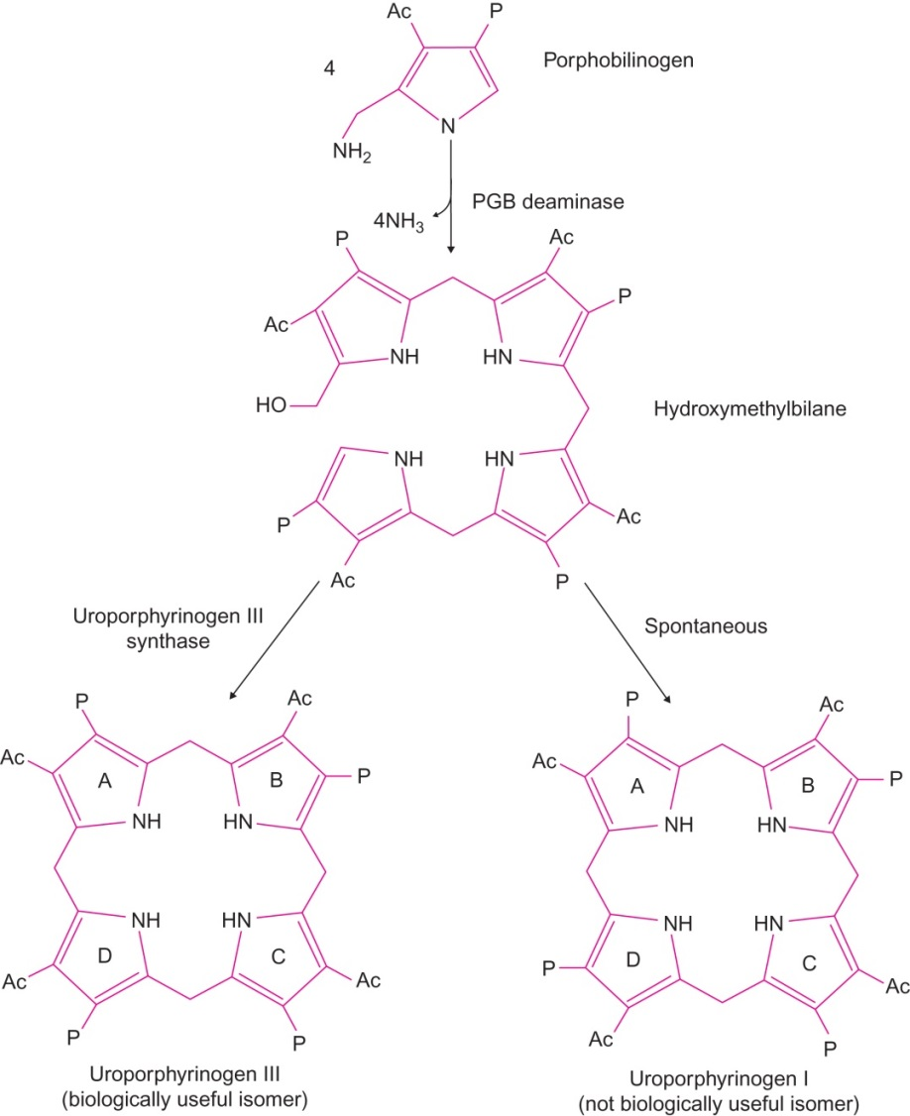
Figure 27.5

Slide 7
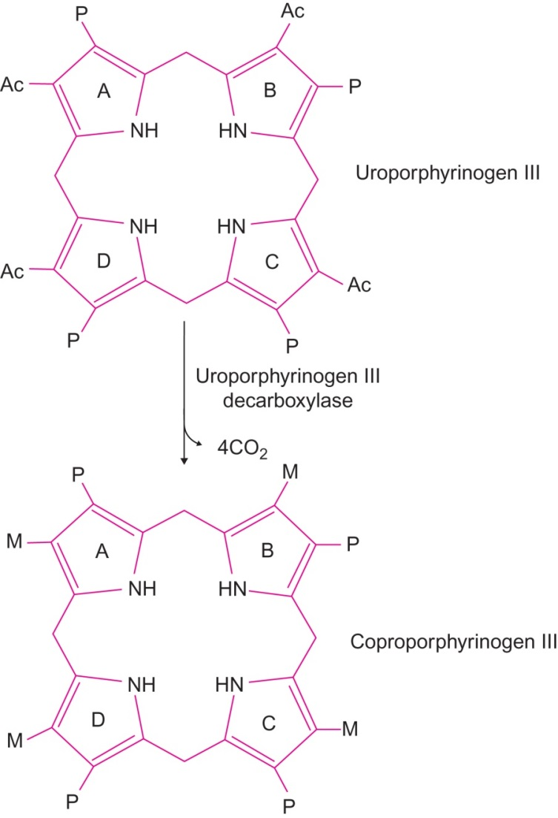
Figure 27.6

Slide 8
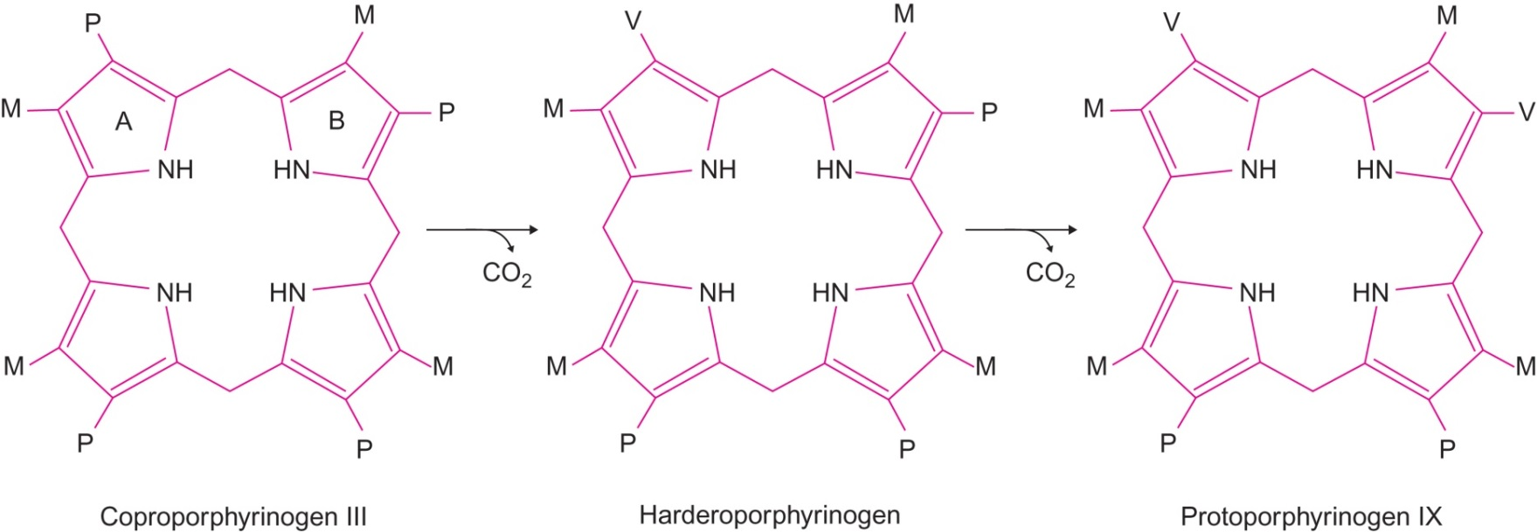
Figure 26.7

Slide 9
Figure 27.8

Slide 10
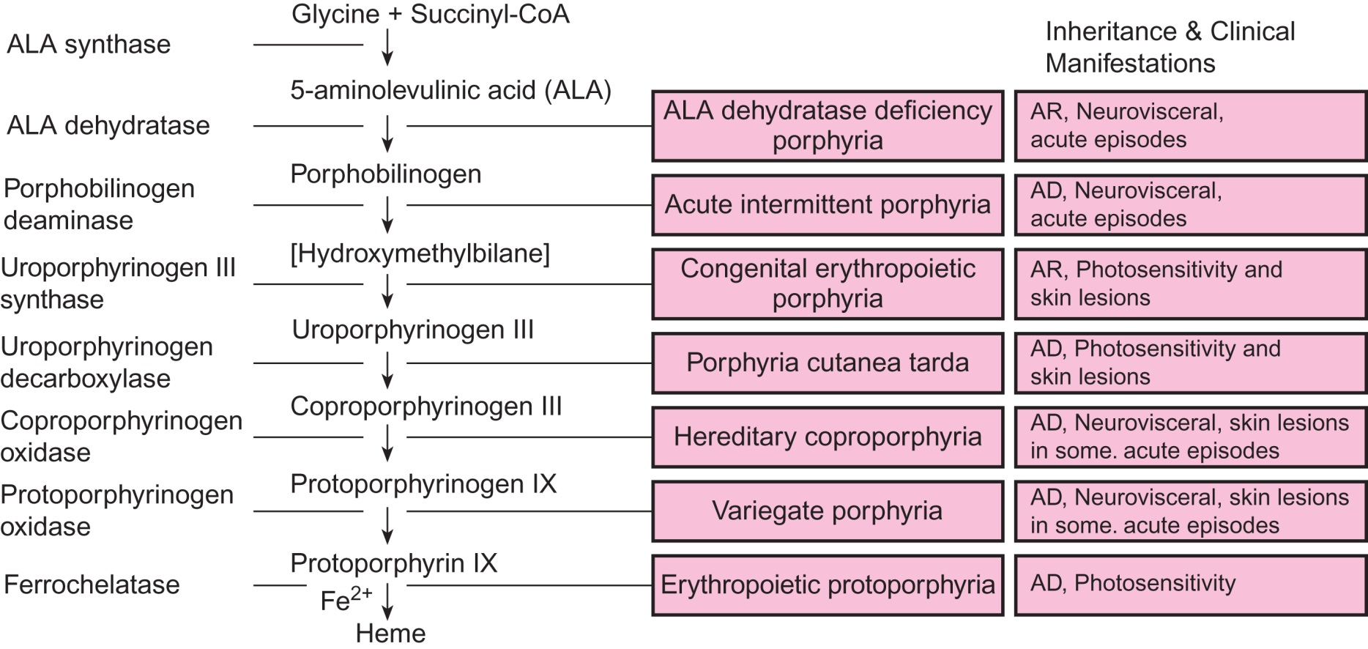
Figure 27.9

Slide 11
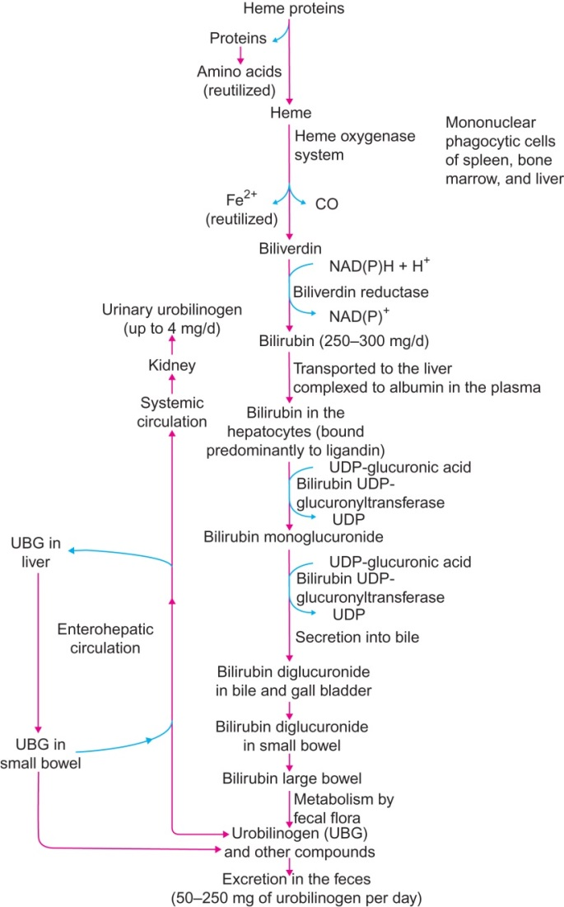
Figure 27.10

Slide 12
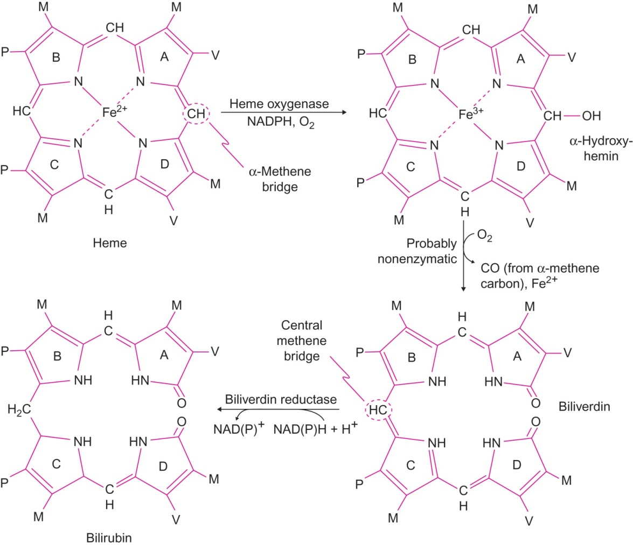
Figure 27.11

Slide 13
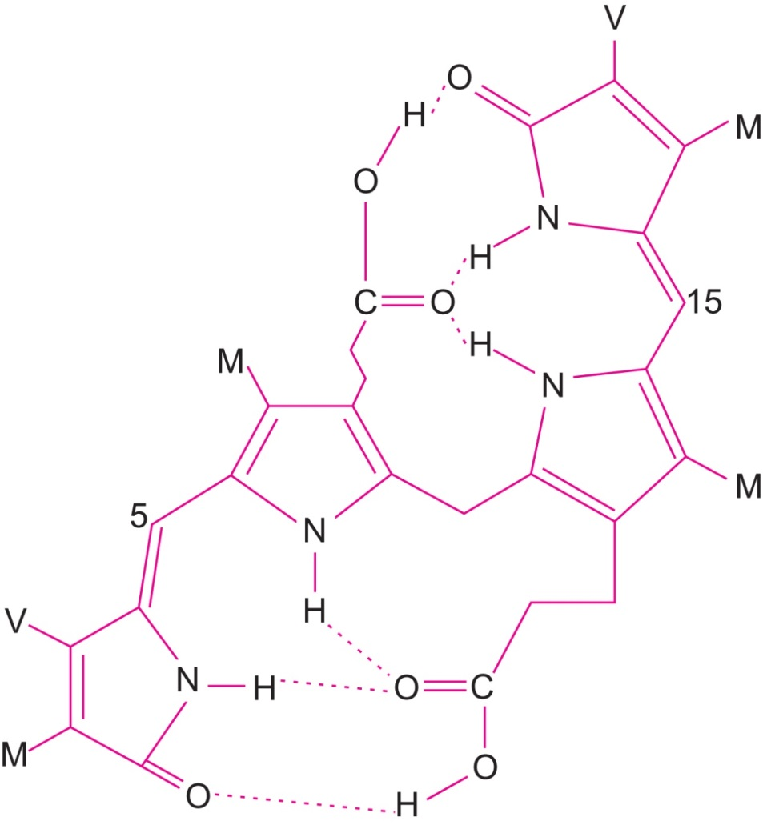
Figure 27.12

Slide 14
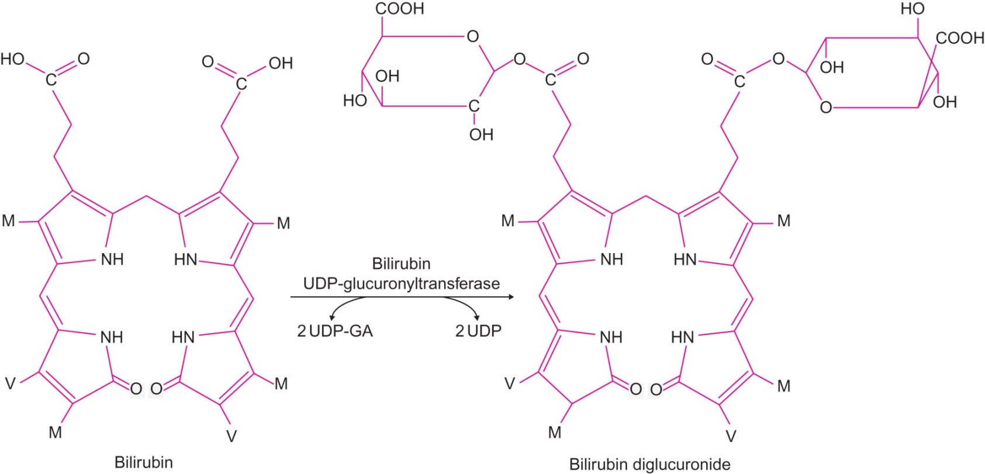
Figure 27.13

Slide 15
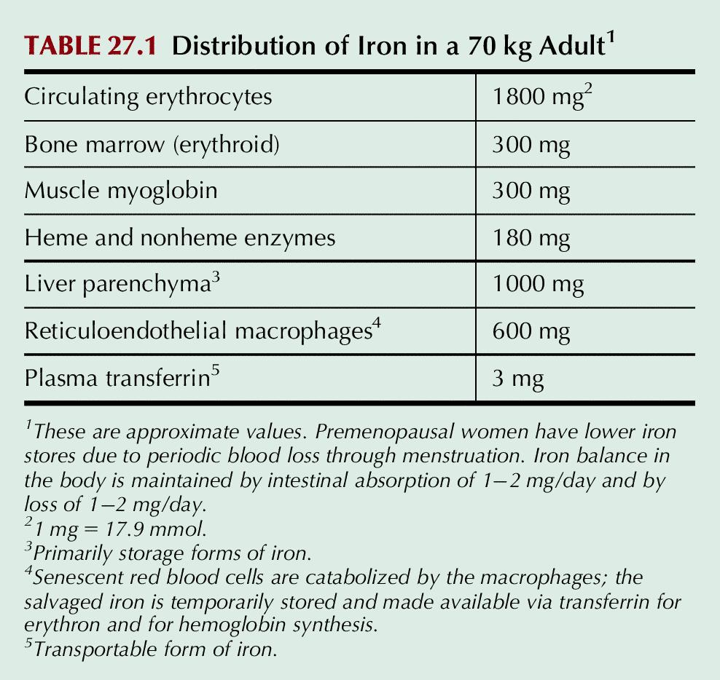
Table 27.1

Slide 16
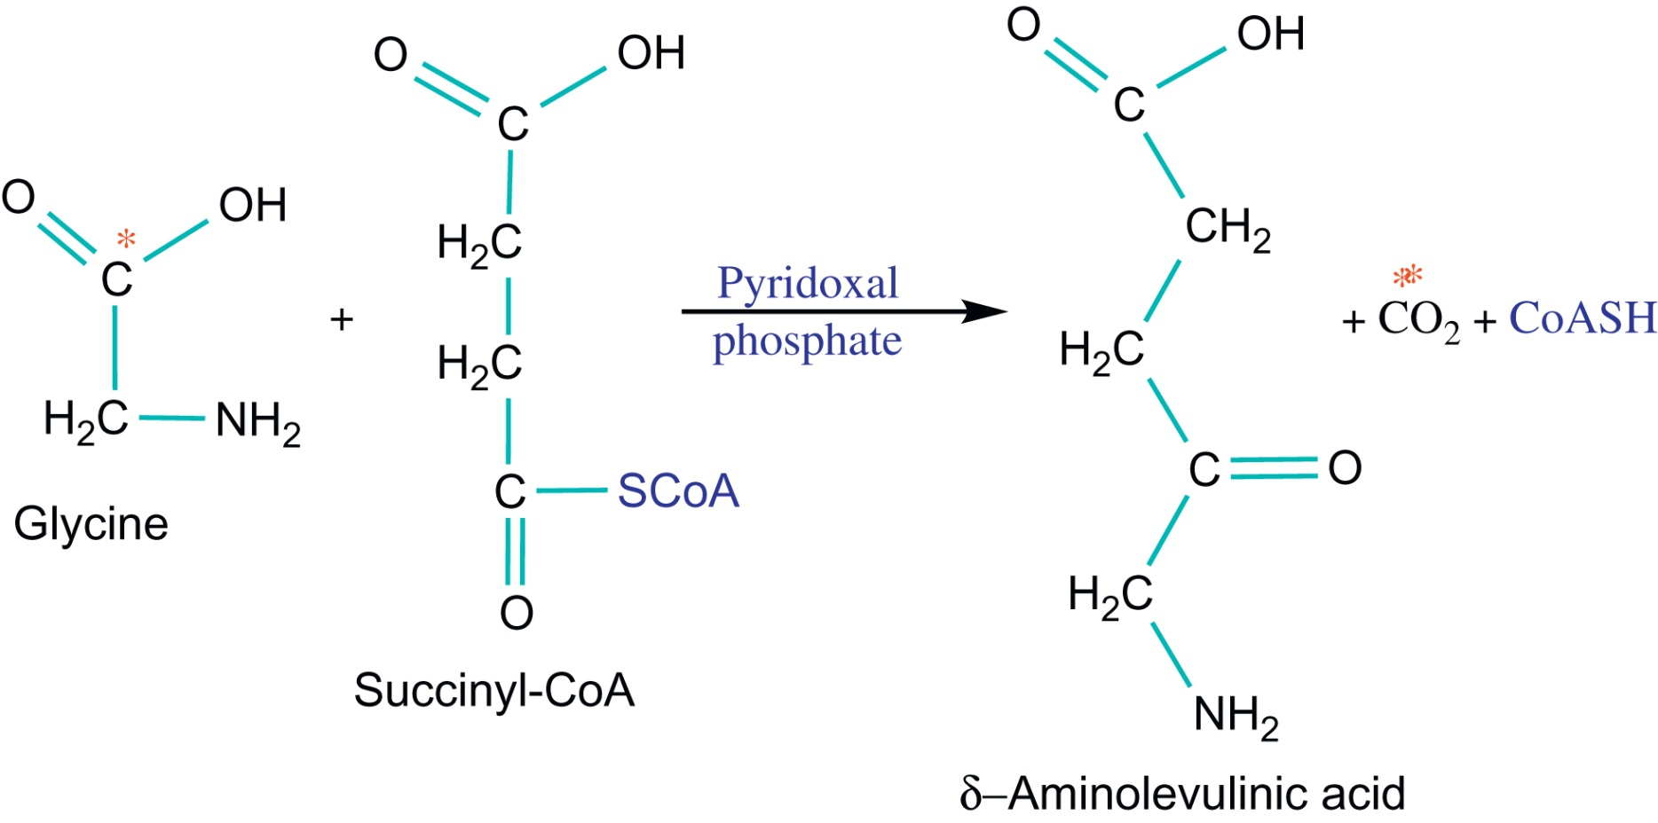
UnFig 27.1

Slide 17
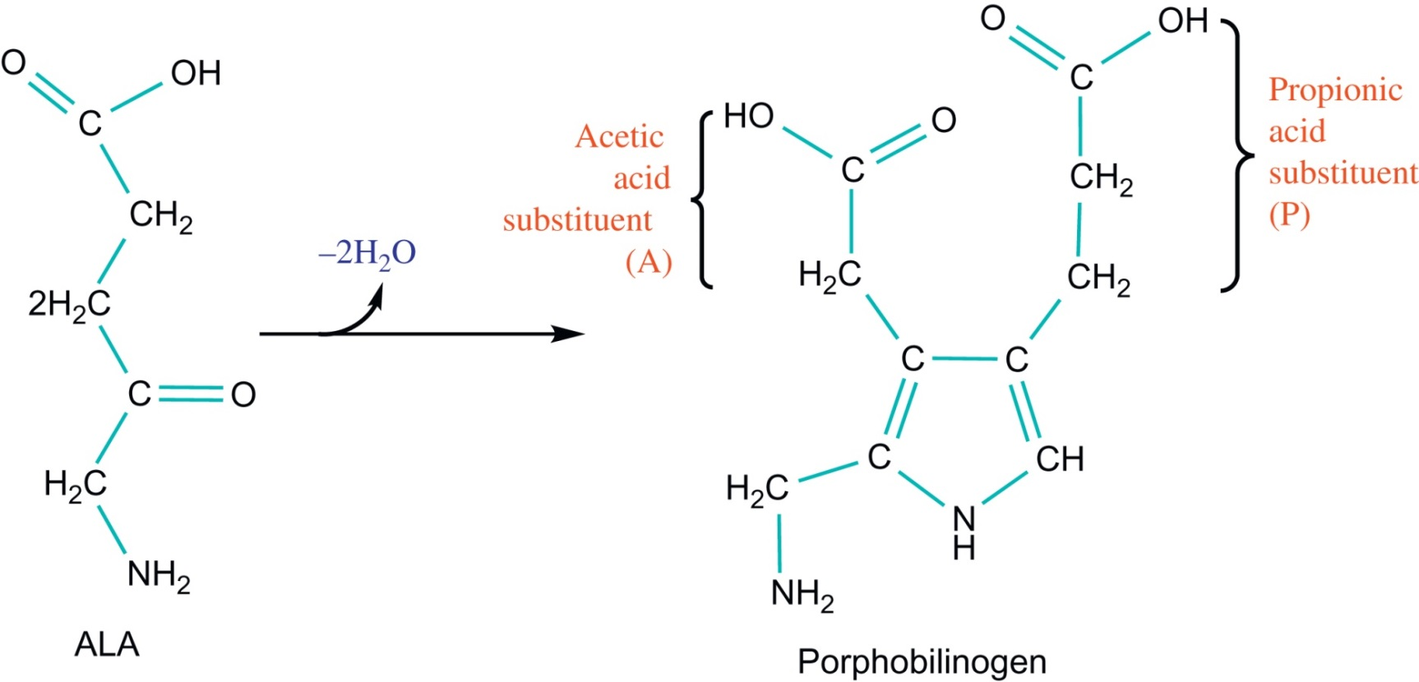
UnFig 27.2

