Slide 1
Chapter 28
Endocrine Metabolism I: Introduction and Signal Transduction

Slide 2
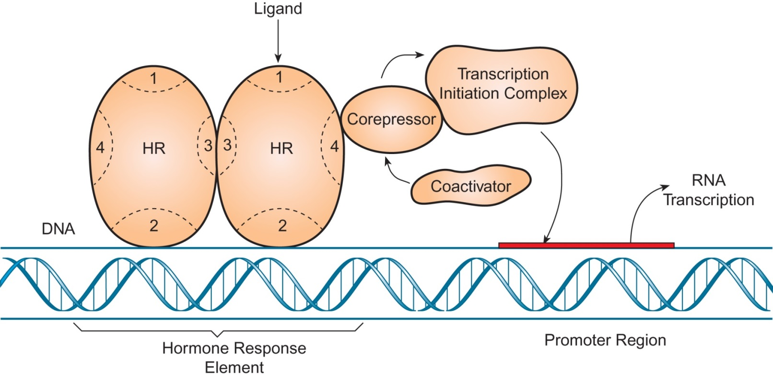
Figure 28.1

Slide 3
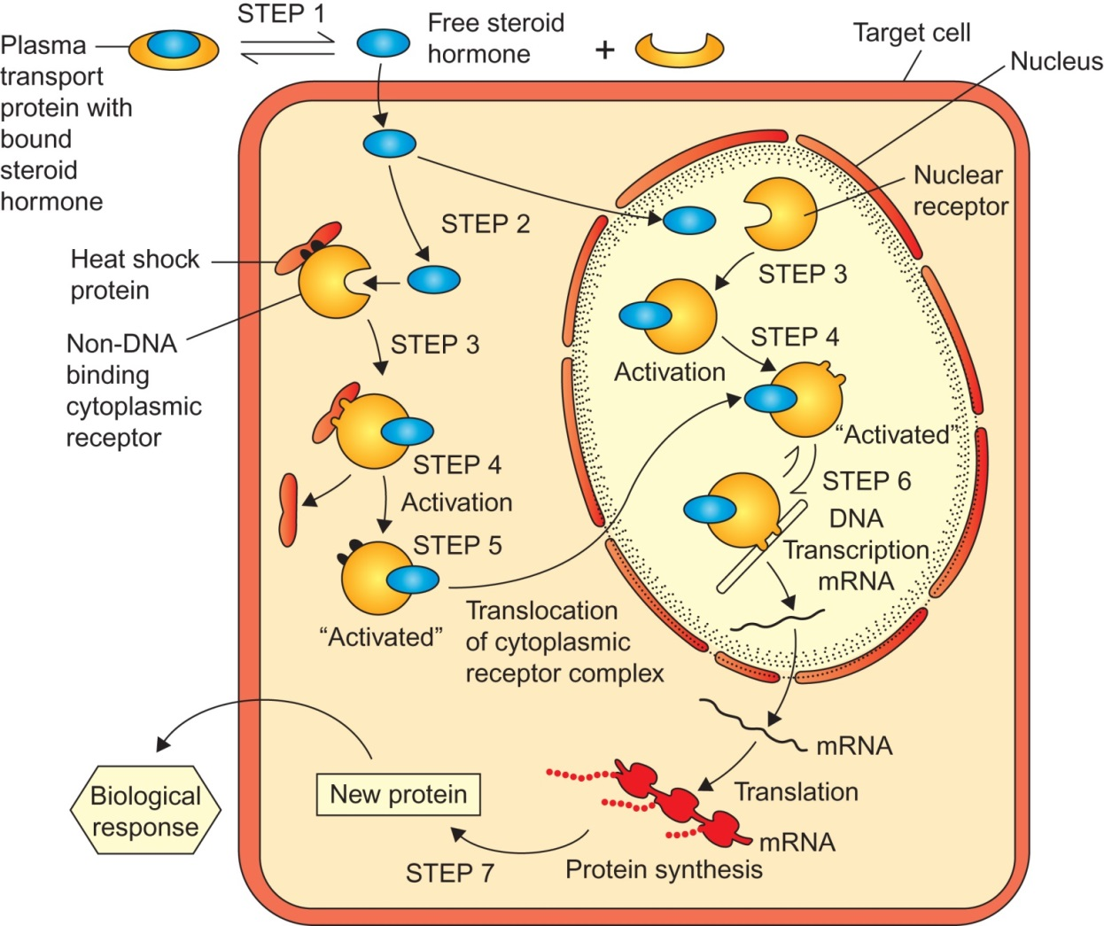
Figure 28.2

Slide 4
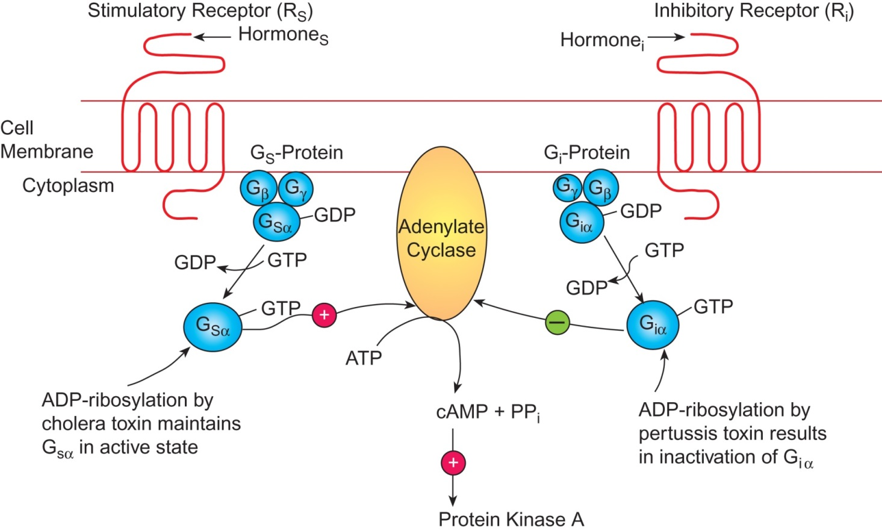
Figure 28.3

Slide 5
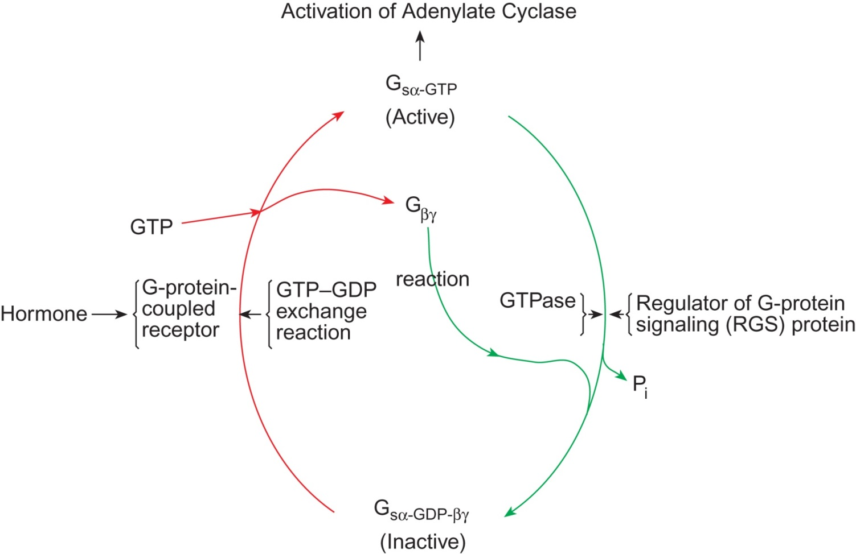
Figure 28.4

Slide 6
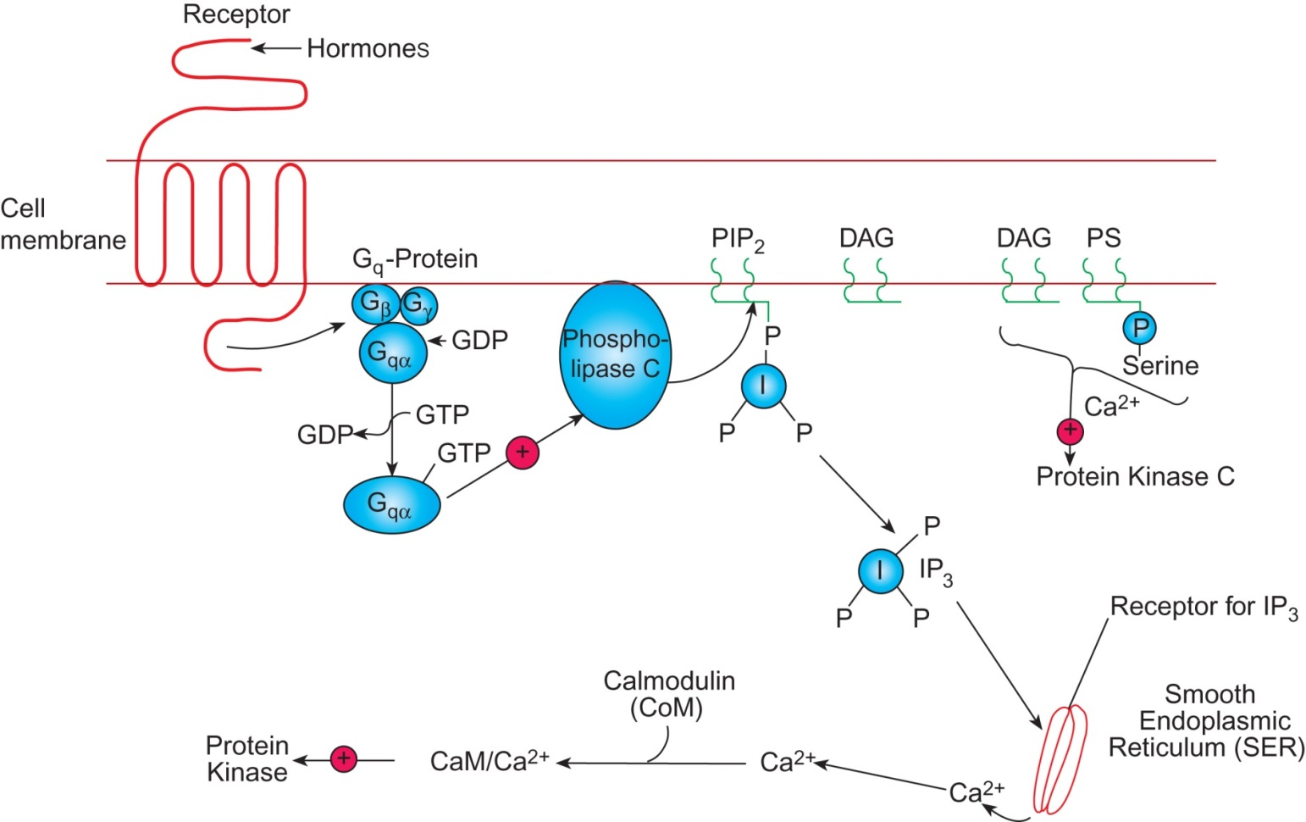
Figure 28.5

Slide 7
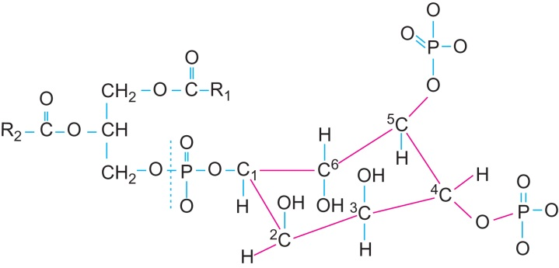
Figure 28.6

Slide 8
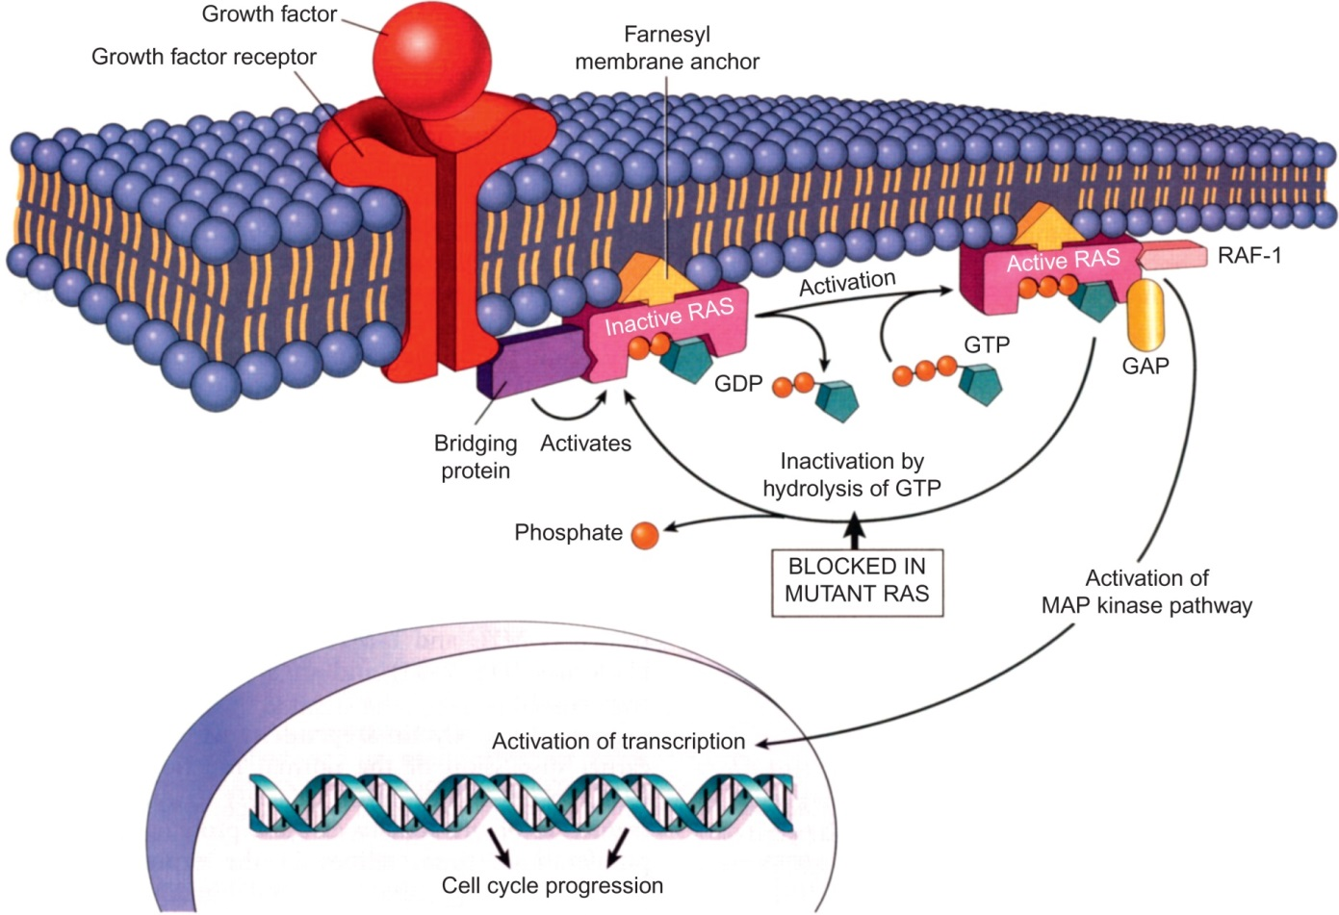
Figure 28.7

Slide 9
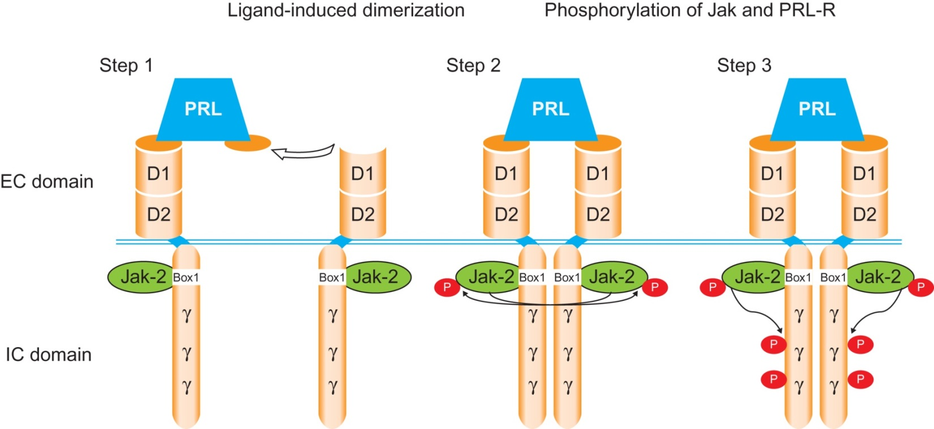
Figure 28.8

Slide 10
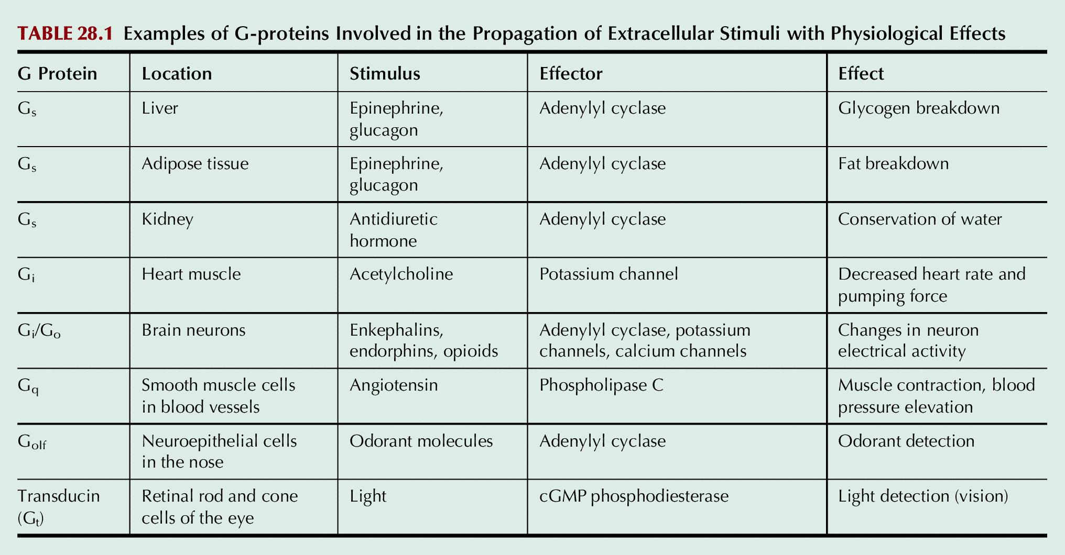
Table 28.1

