Slide 1
Chapter 29
Endocrine Metabolism II: Hypothalamus and Pituitary

Slide 2
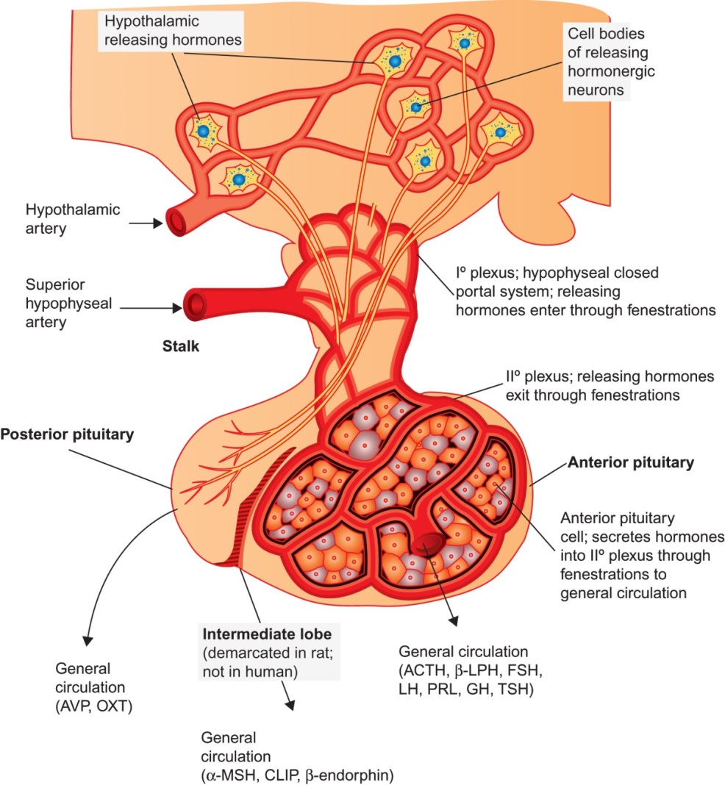
Figure 29.1

Slide 3
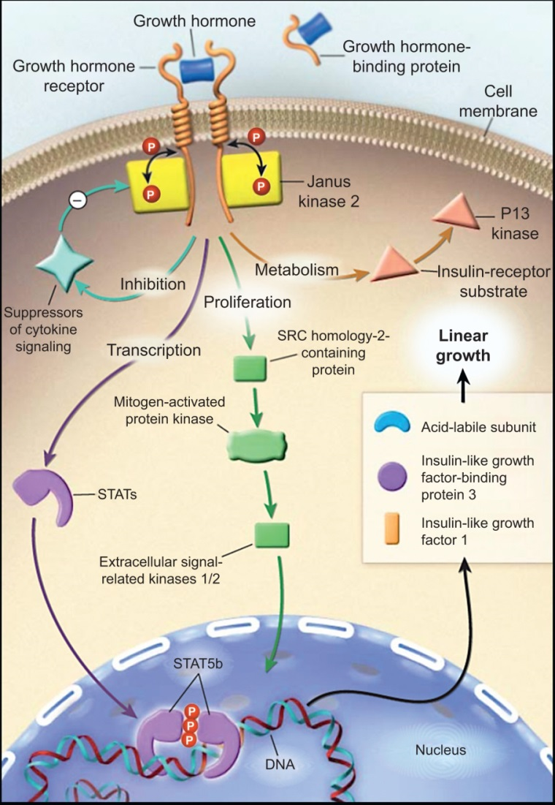
Figure 29.2

Slide 4
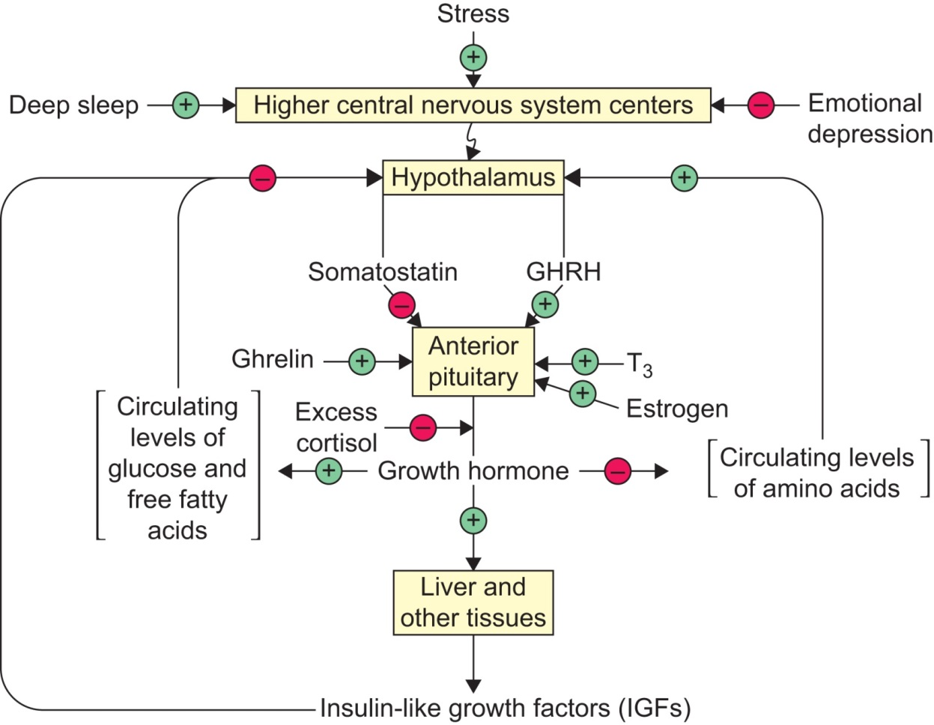
Figure 29.3

Slide 5
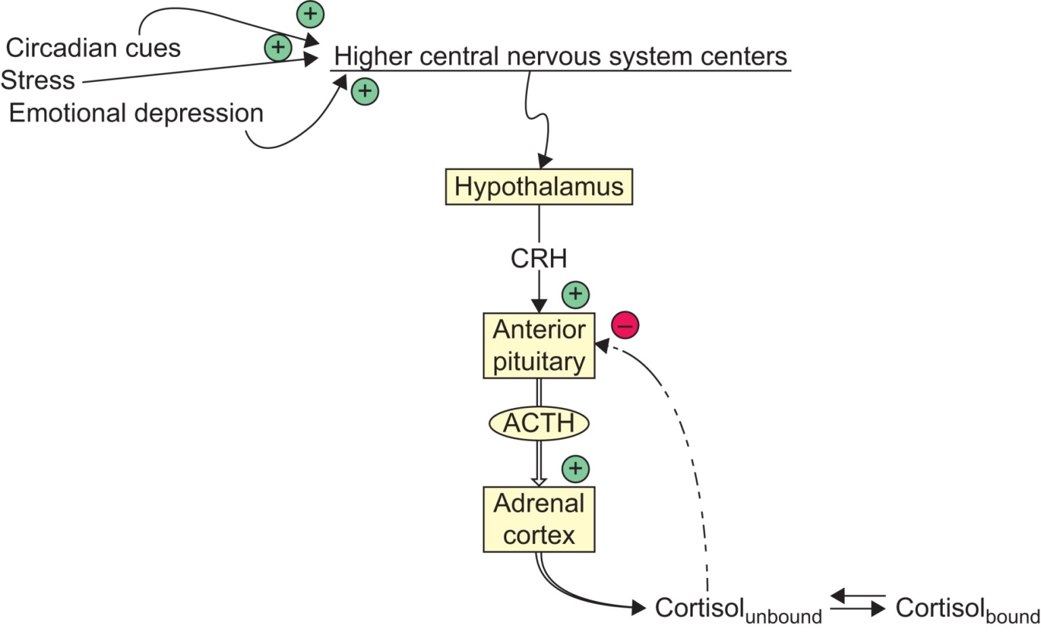
Figure 29.4

Slide 6
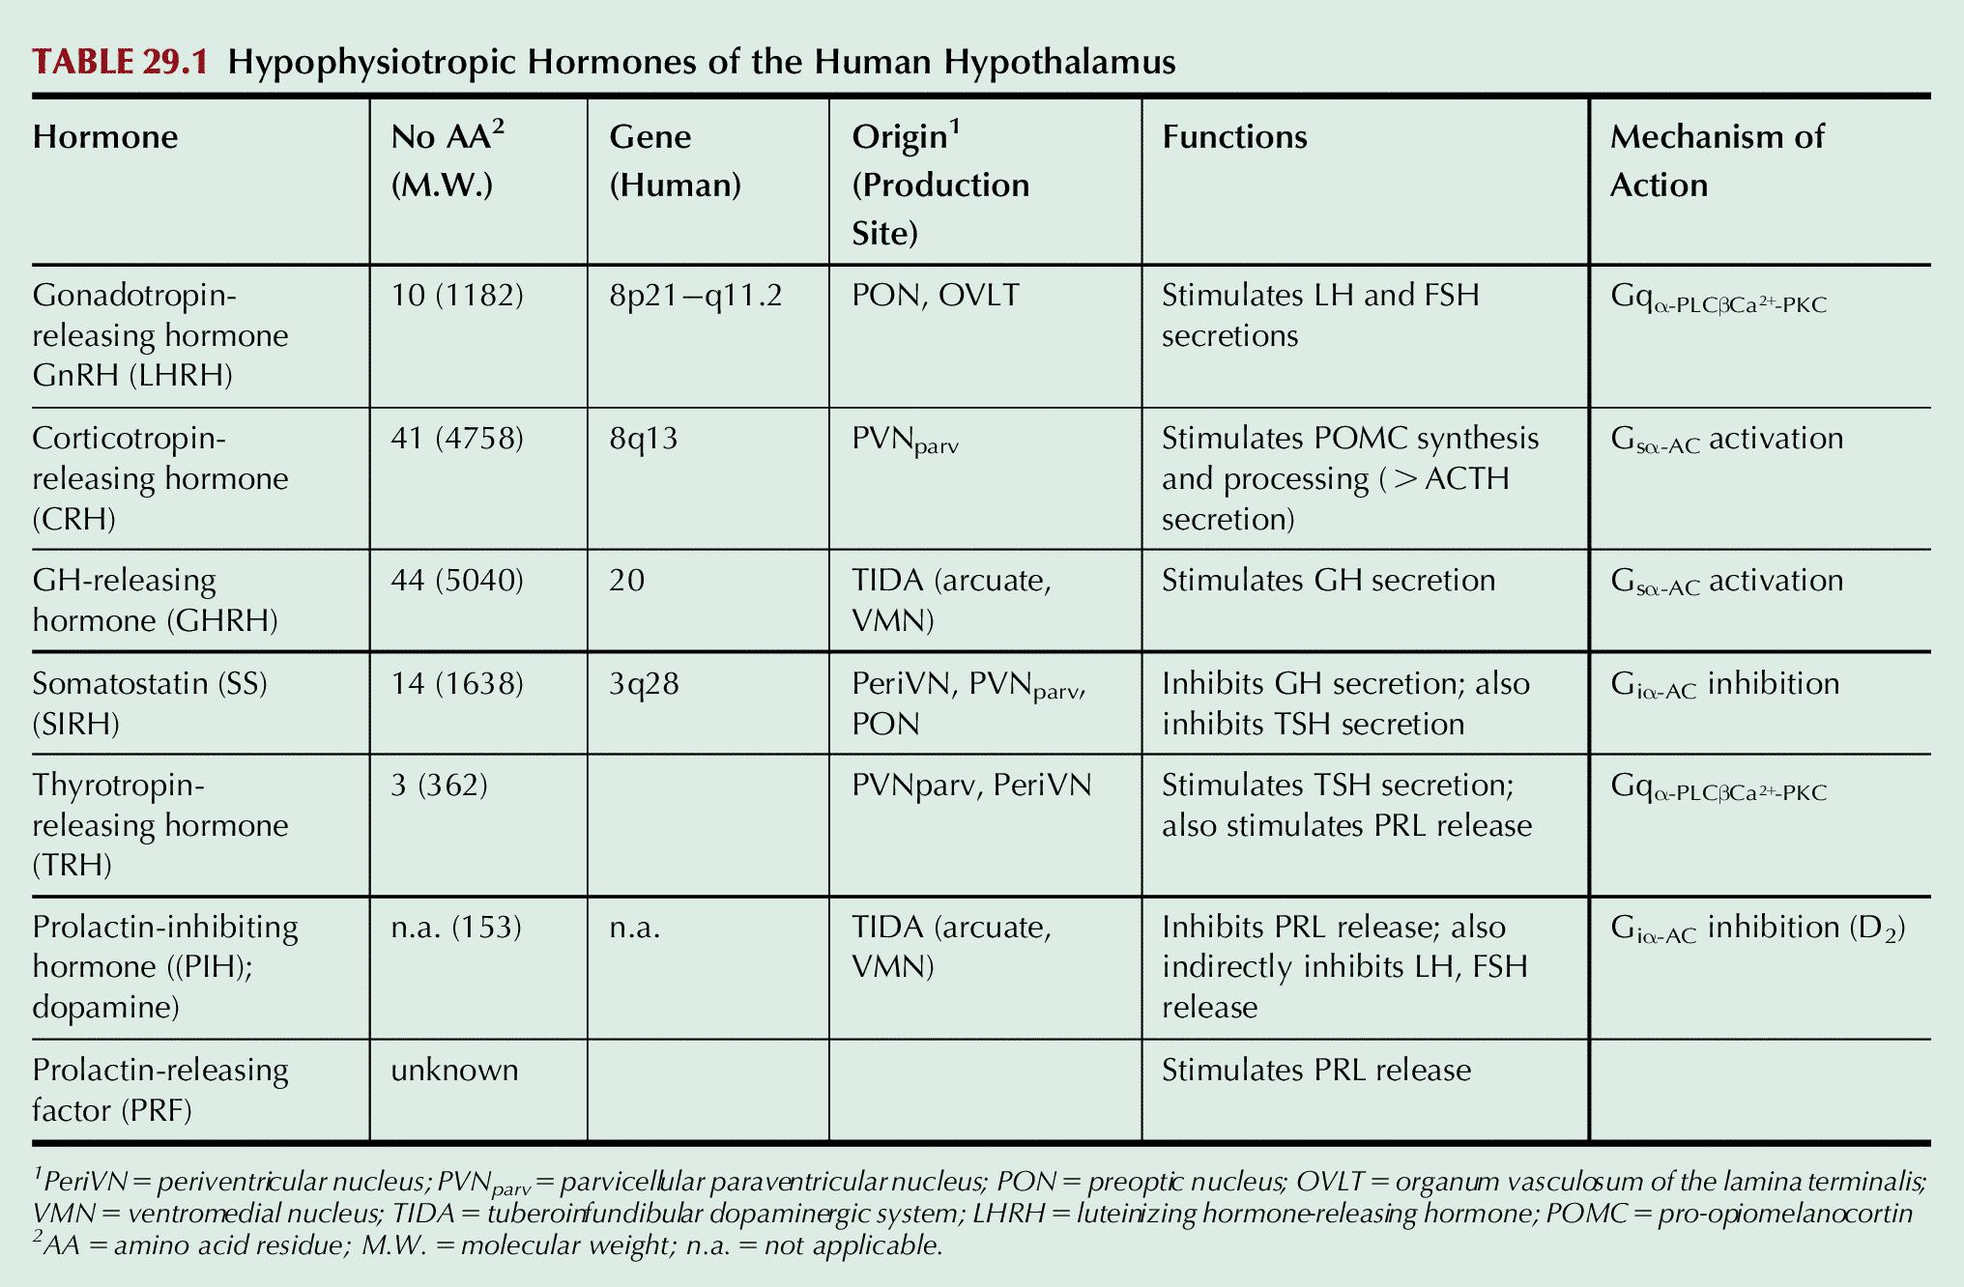
Table 29.1

Slide 7
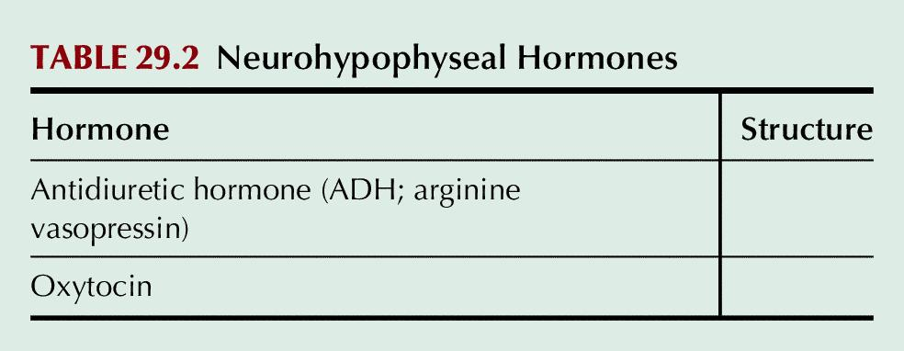
Table 29.2

Slide 8
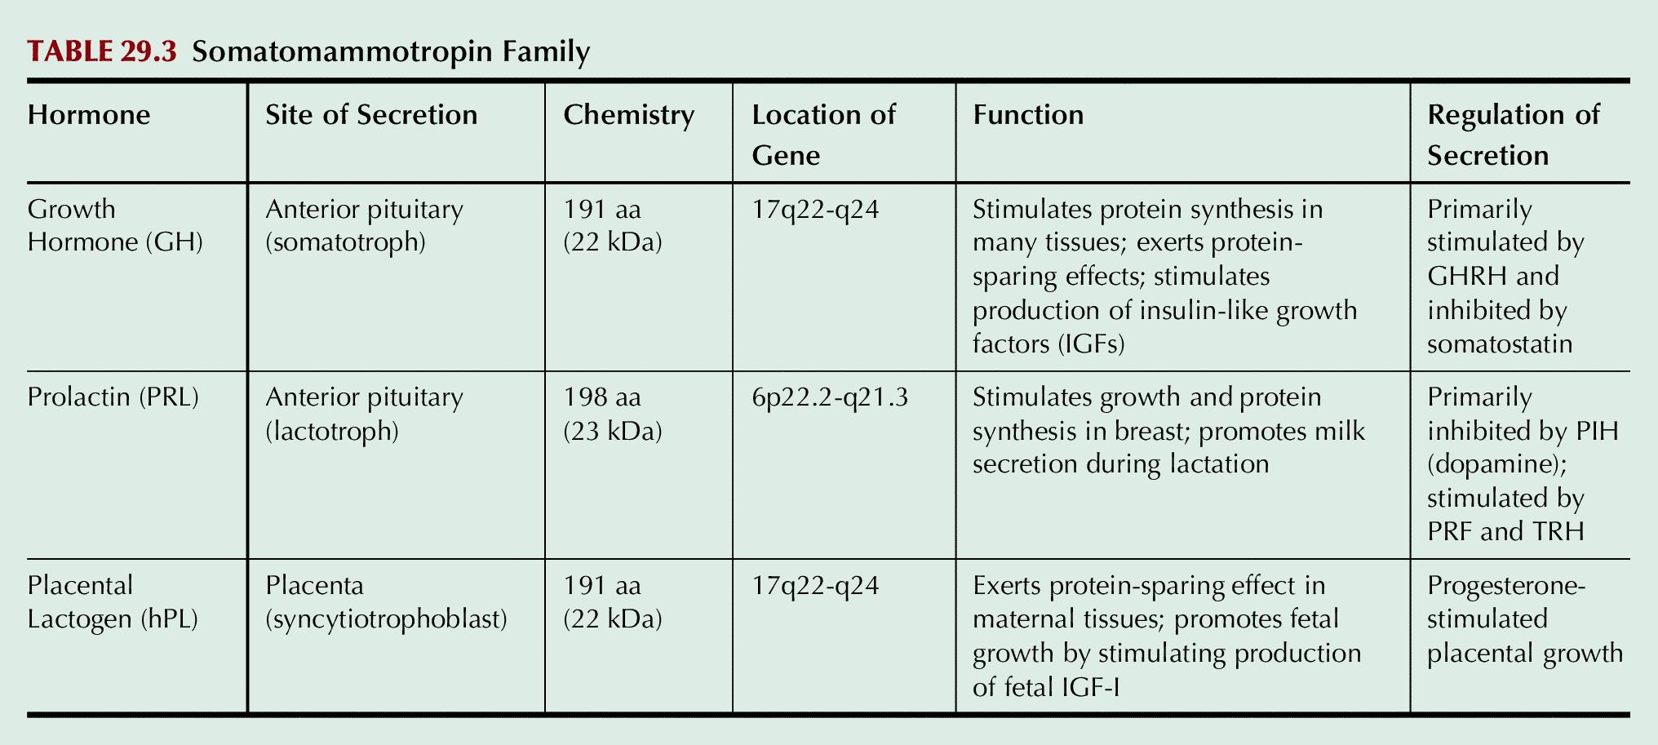
Table 29.3

Slide 9
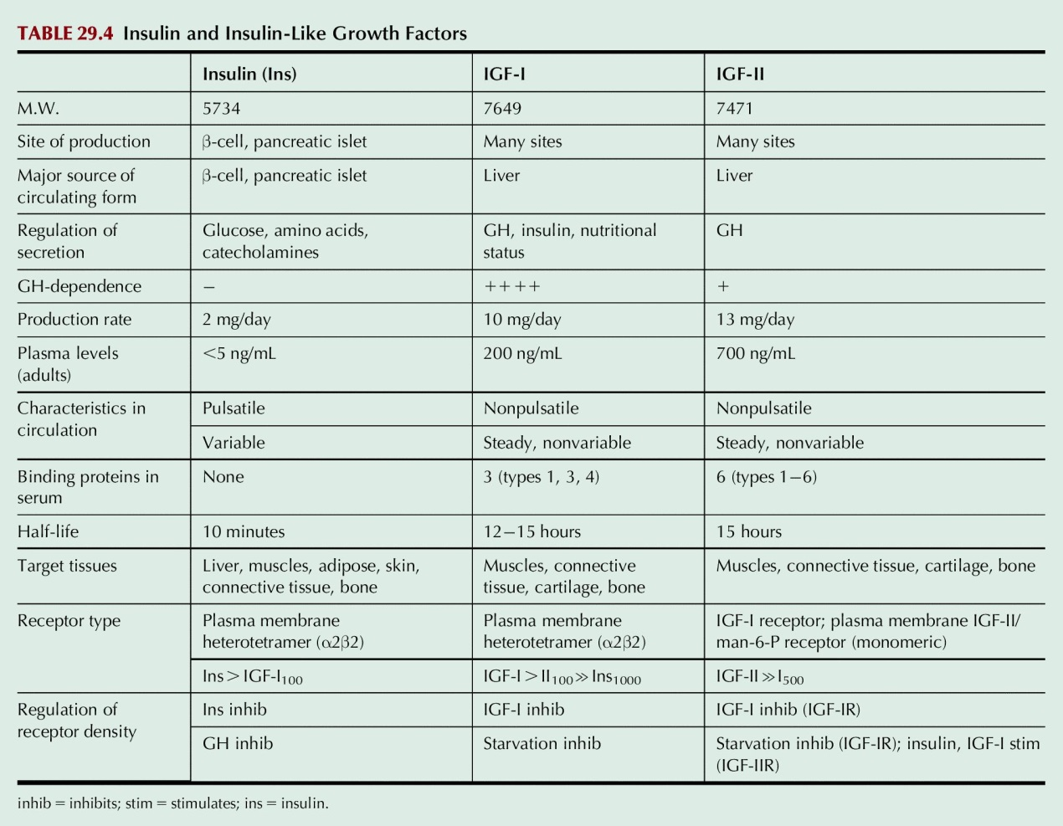
Table 29.4

Slide 10
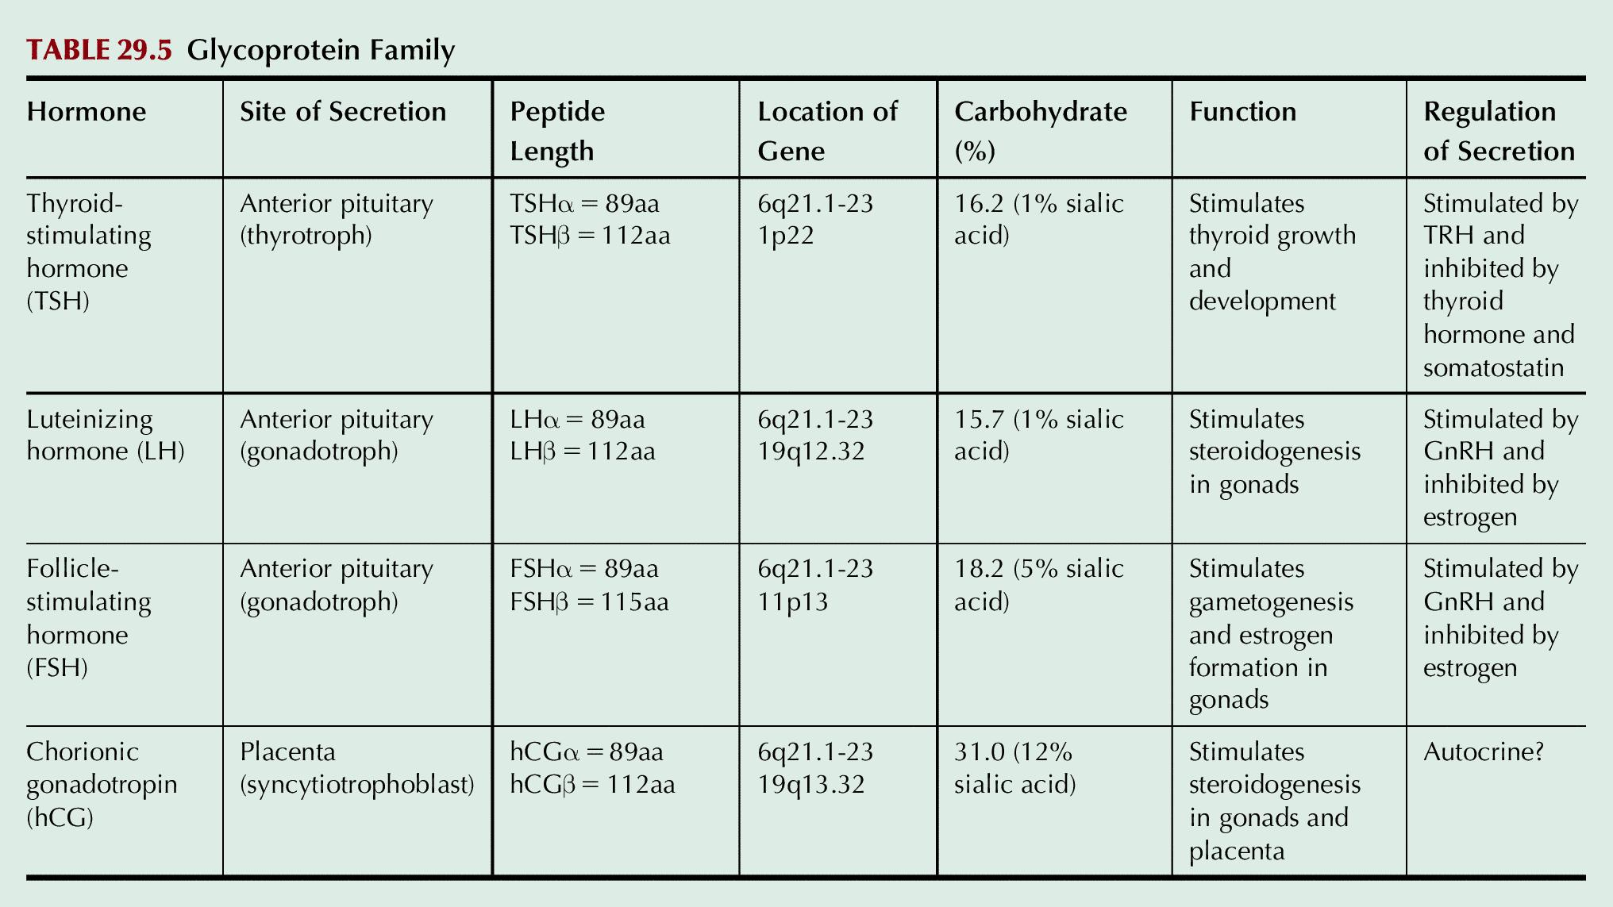
Table 29.5

Slide 11
UnFig 29.1

Slide 12
UnFig 29.2

