Slide 1
Chapter 31
Endocrine Metabolism IV: Thyroid Gland

Slide 2
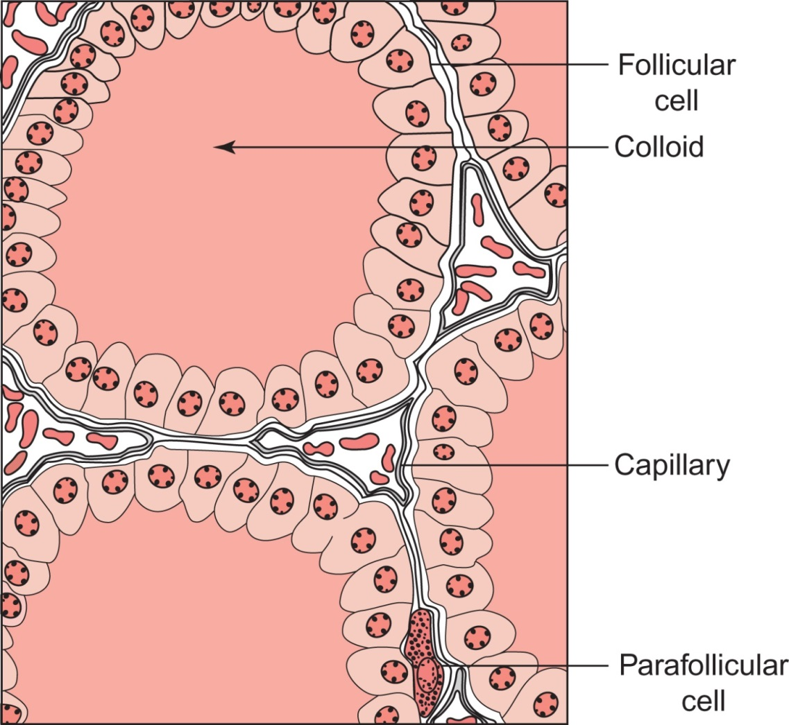
Figure 31.1

Slide 3
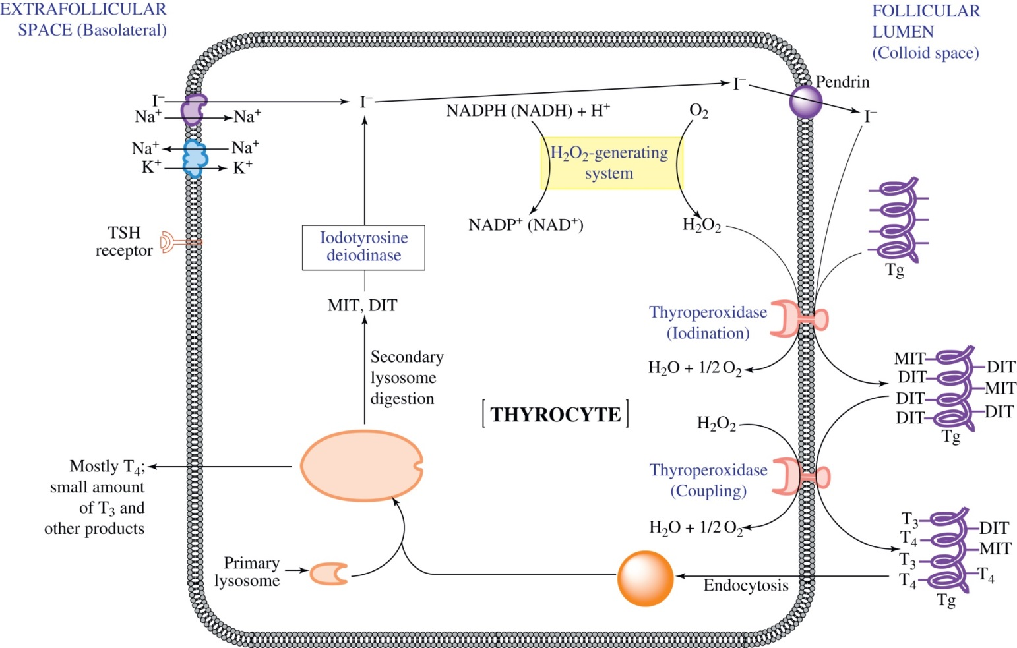
Figure 31.2

Slide 4
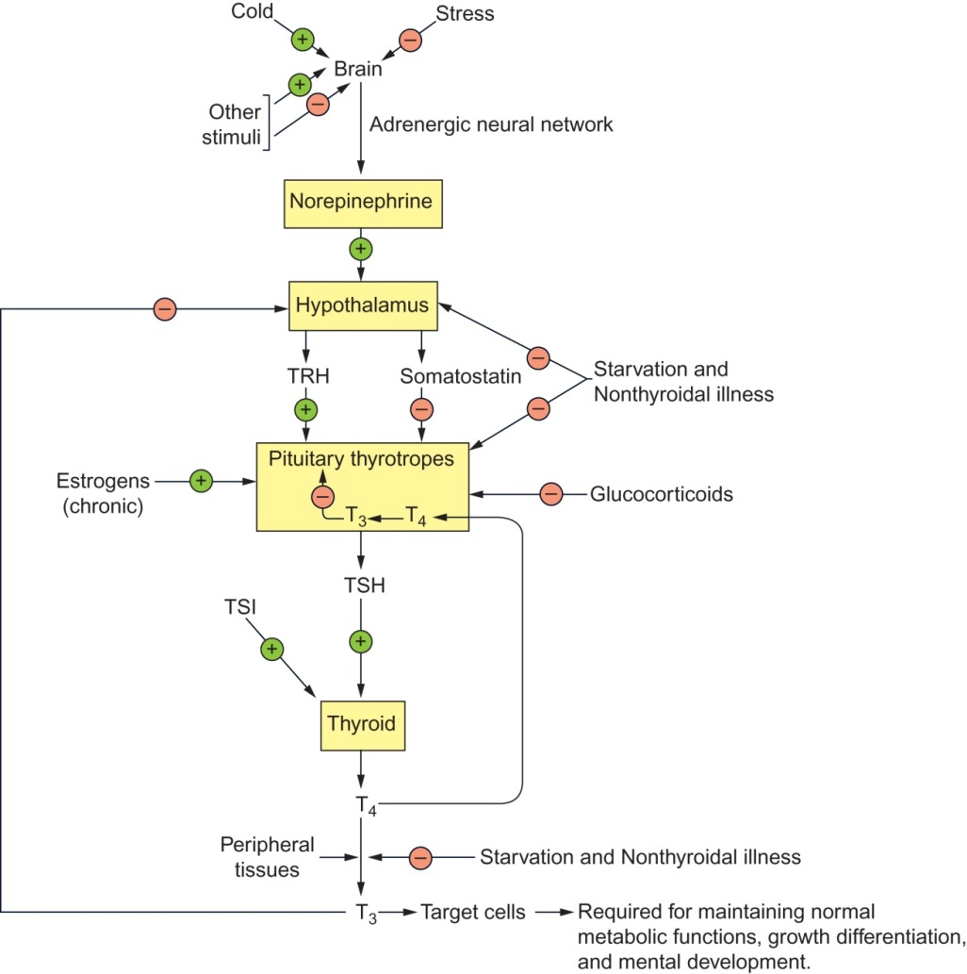
Figure 31.3

Slide 5
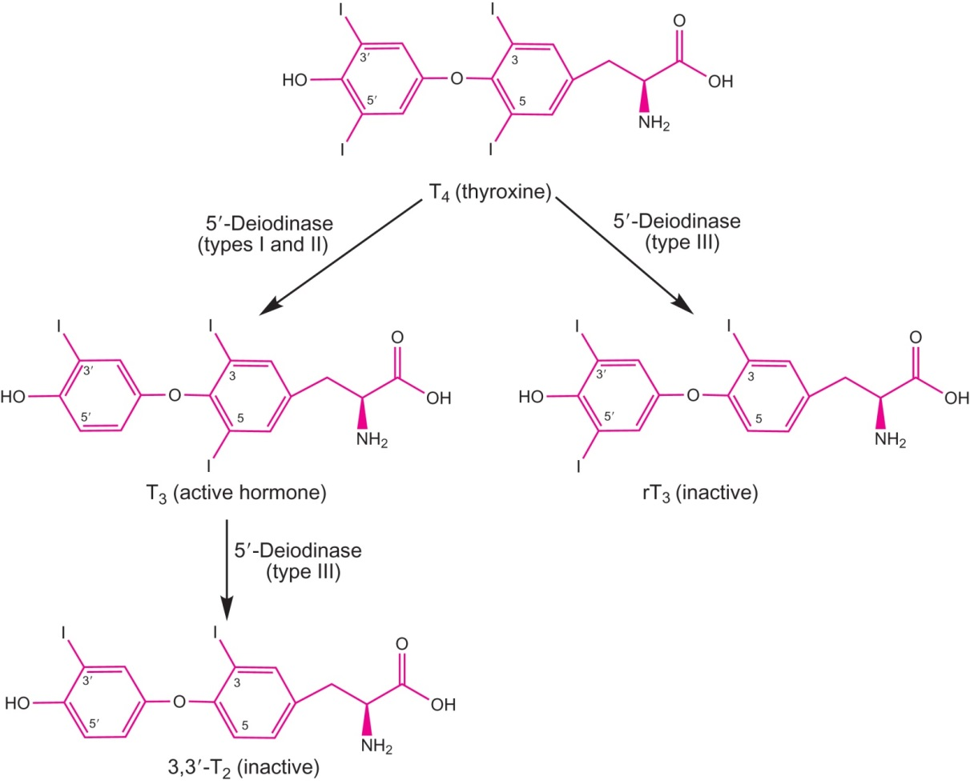
Figure 31.4

Slide 6
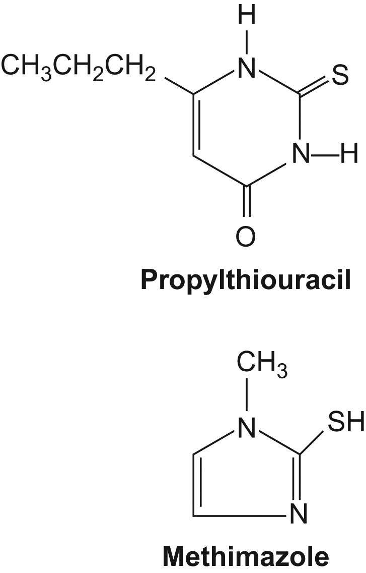
Figure 31.5

Slide 7
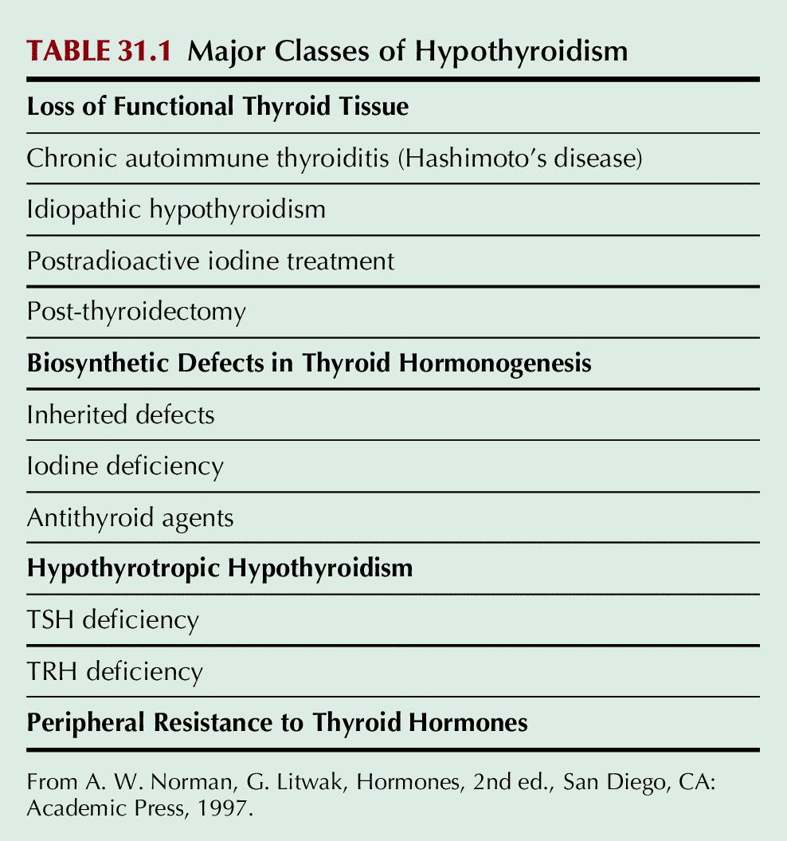
Table 31.1

Slide 8
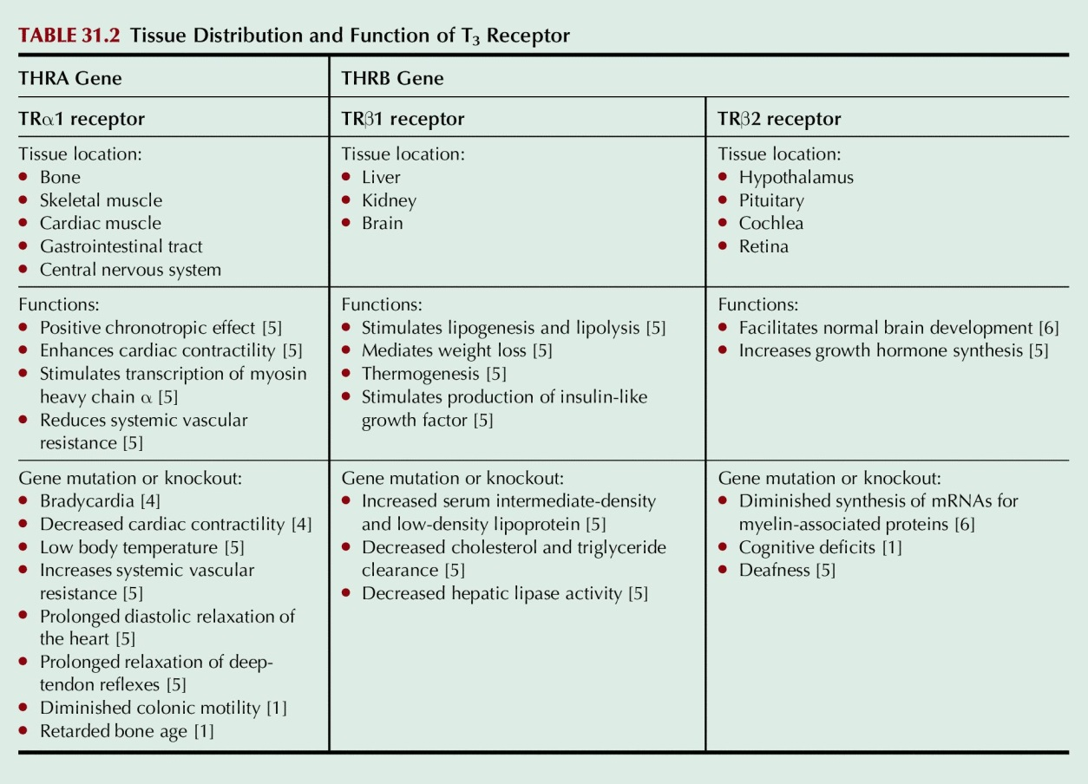
Table 31.2

