Slide 1
Chapter 32
Endocrine Metabolism V: Reproductive System

Slide 2
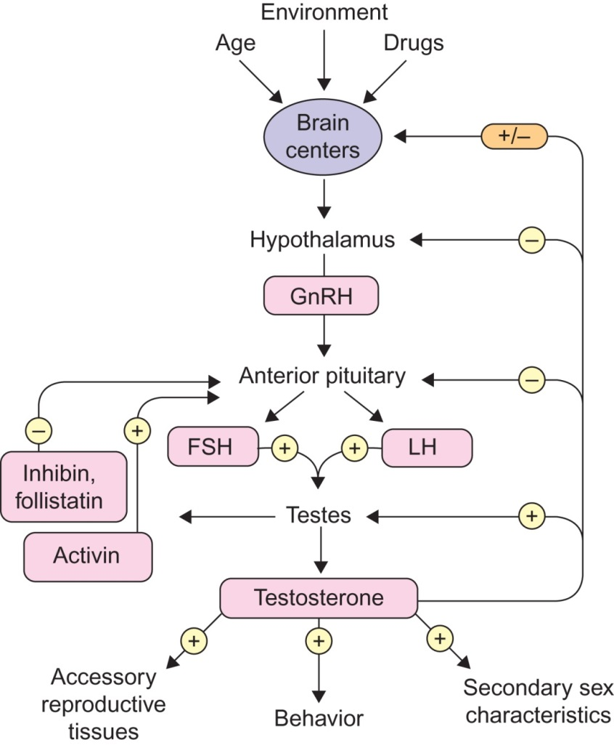
Figure 32.1

Slide 3
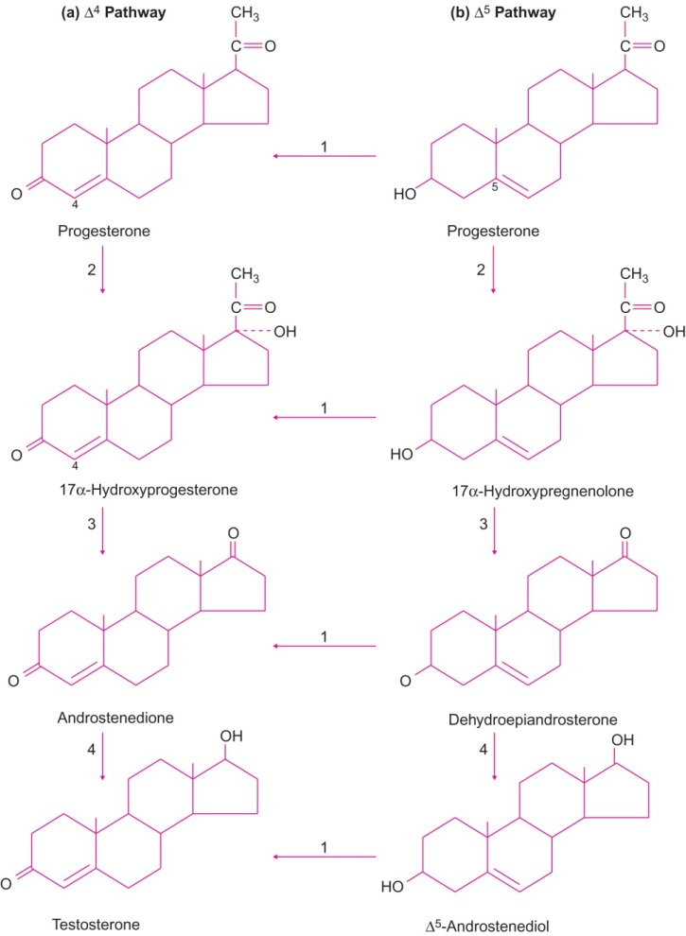
Figure 32.2

Slide 4
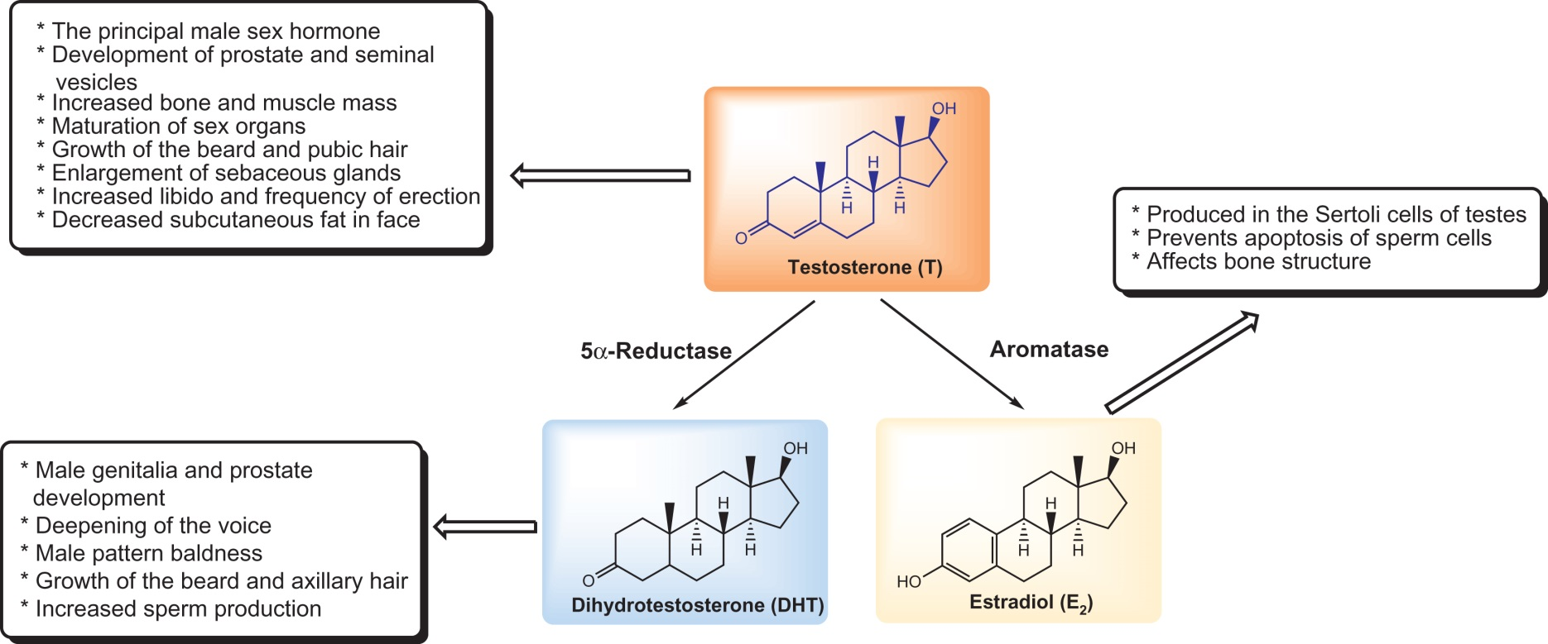
Figure 32.3

Slide 5
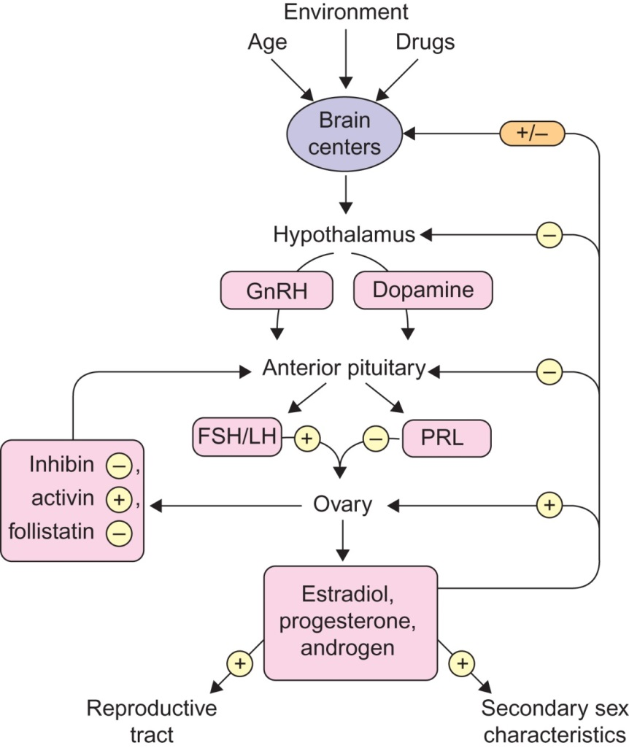
Figure 32.4

Slide 6
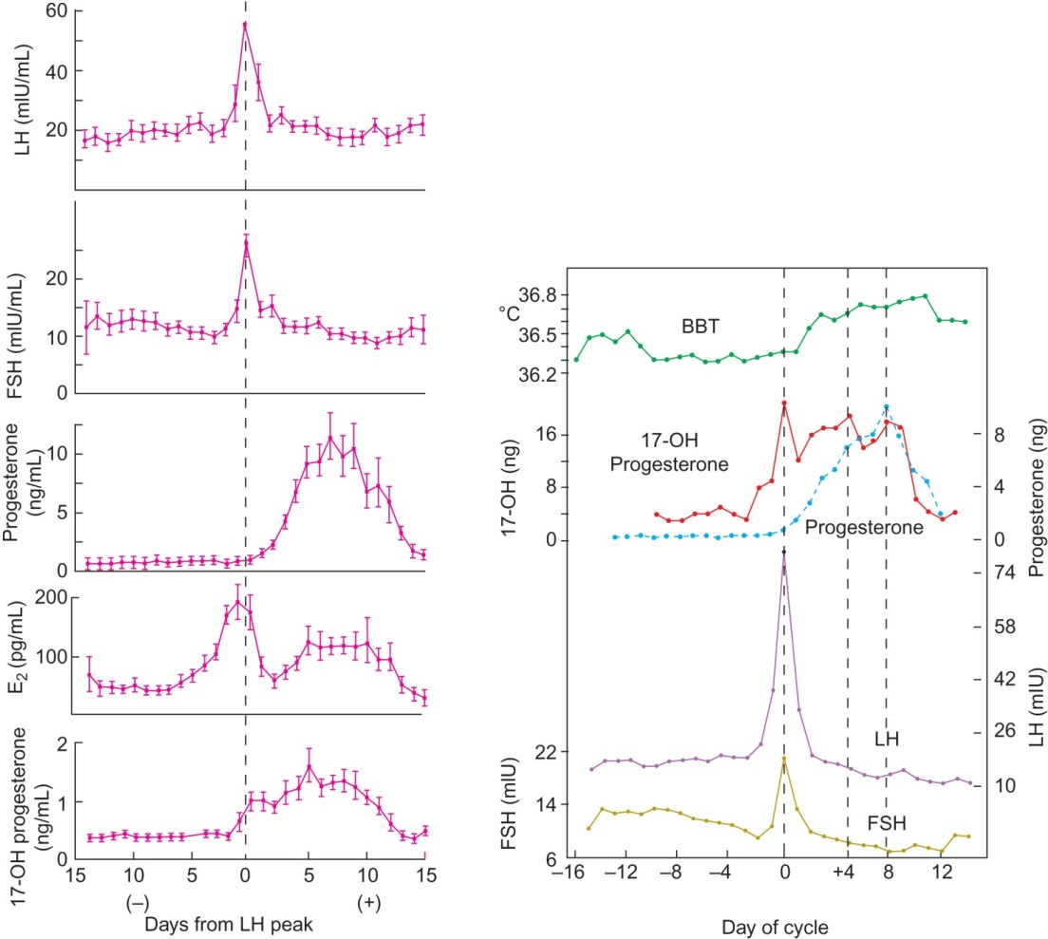
Figure 32.5

Slide 7
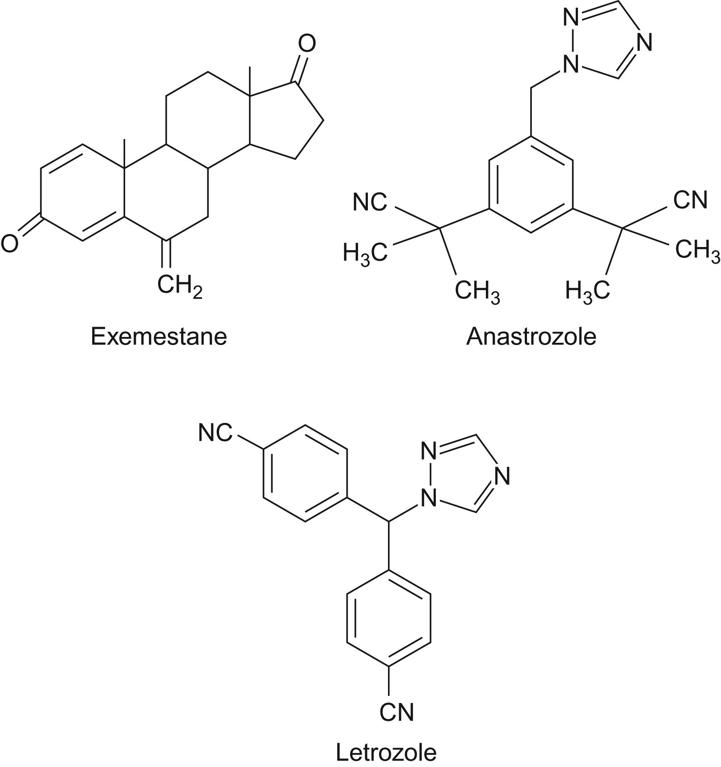
Figure 32.6

Slide 8
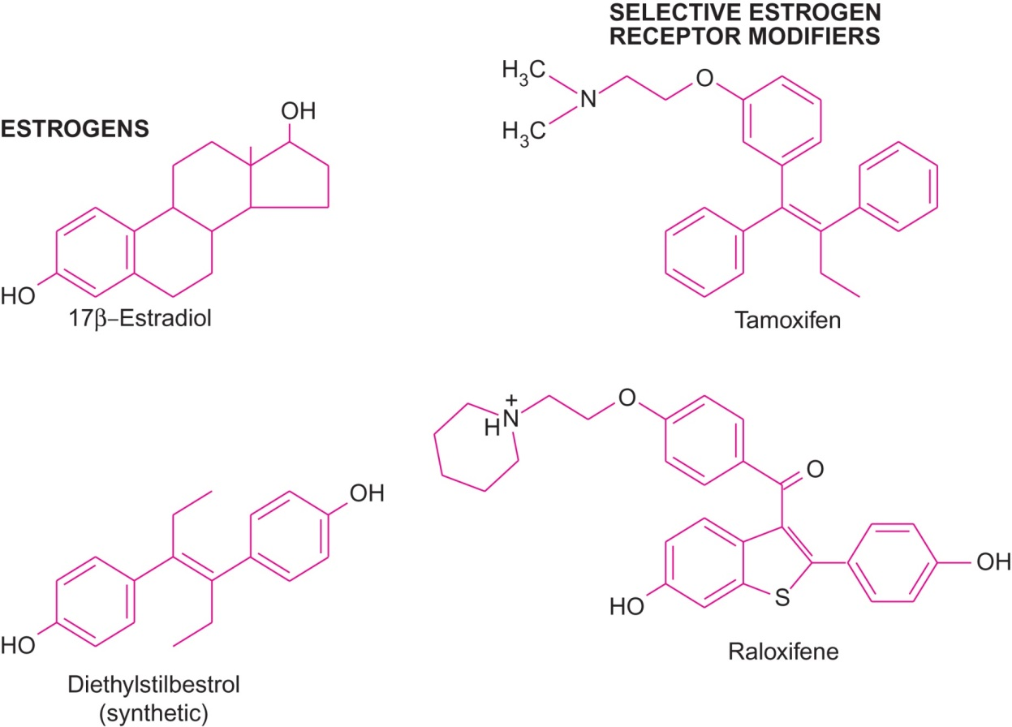
Figure 32.7

Slide 9
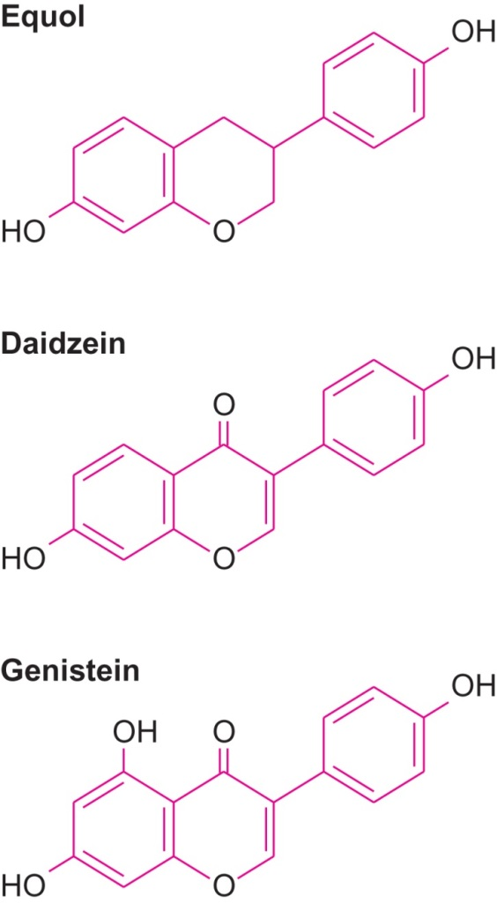
Figure 32.8

Slide 10
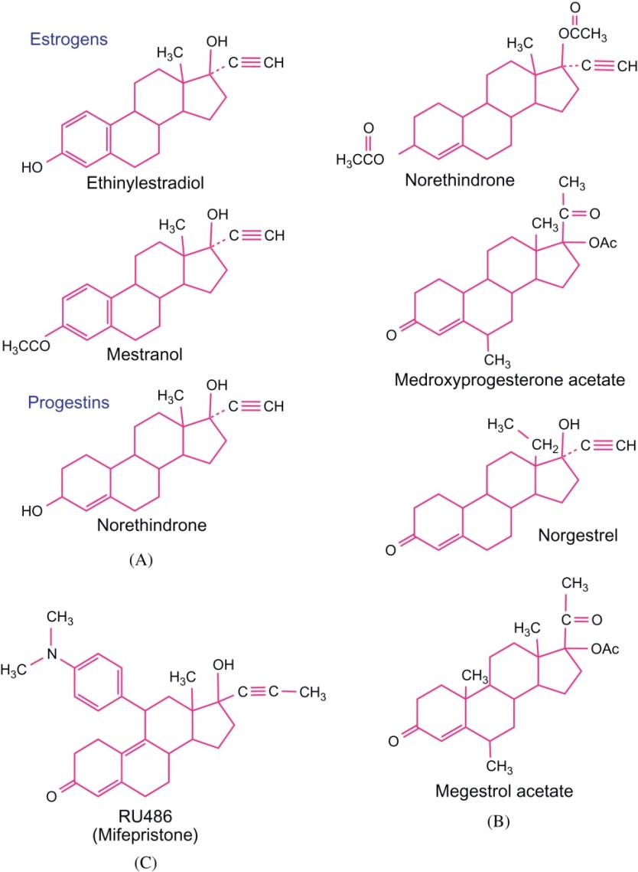
Figure 32.9

Slide 11
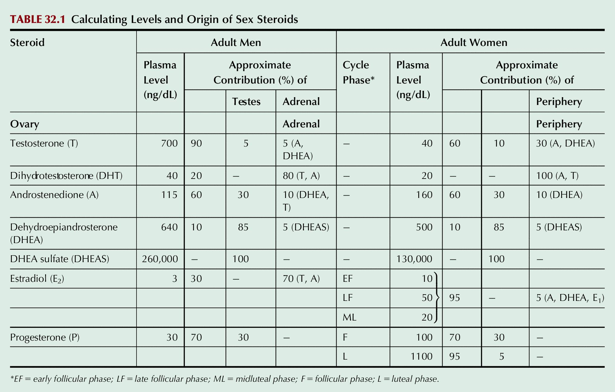
Table 32.1

