Slide 1
Chapter 36
Vitamin Metabolism

Slide 2
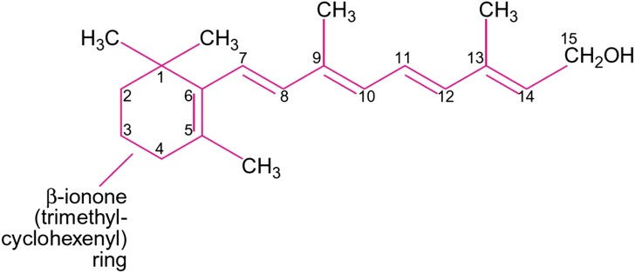
Figure 36.1

Slide 3
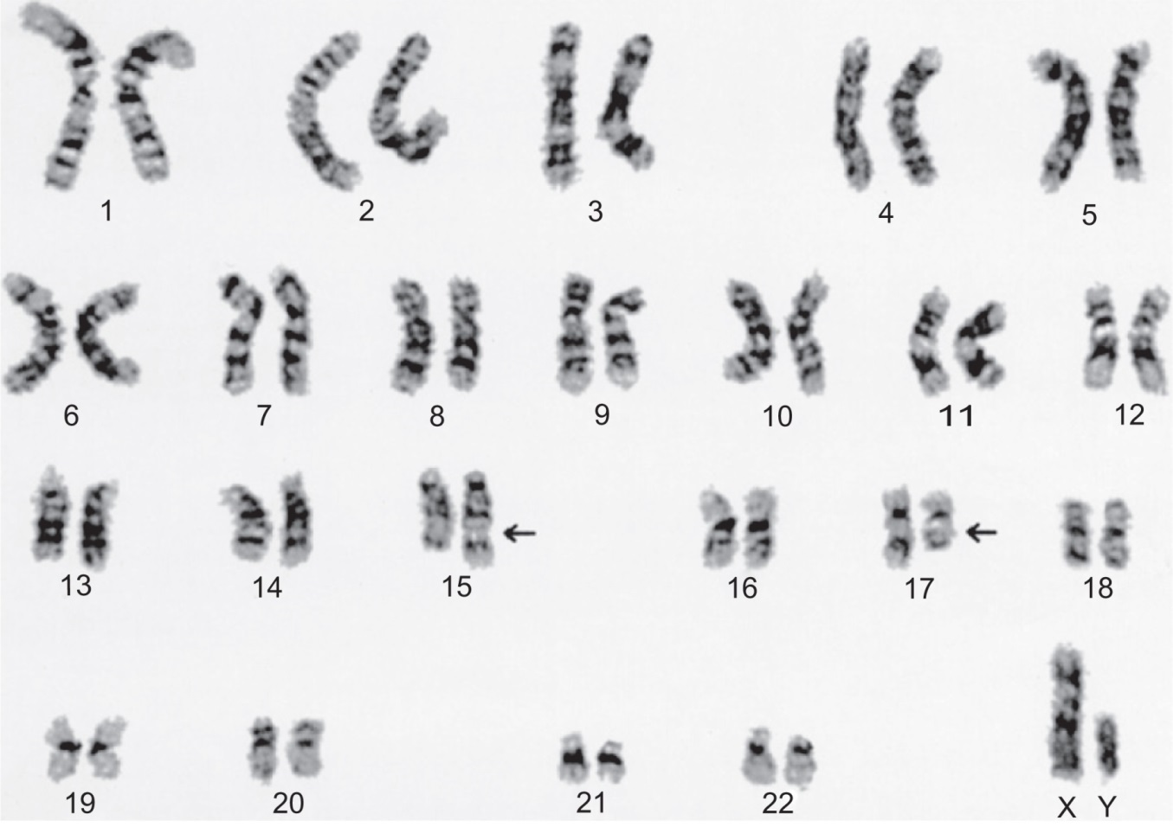
Figure 36.2

Slide 4
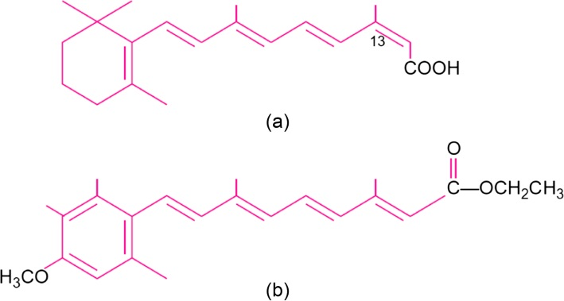
Figure 36.1

Slide 5
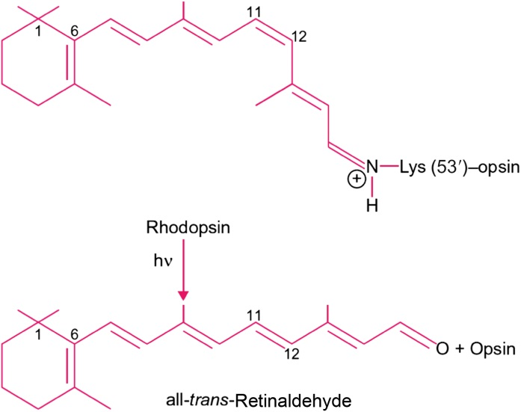
Figure 36.2

Slide 6
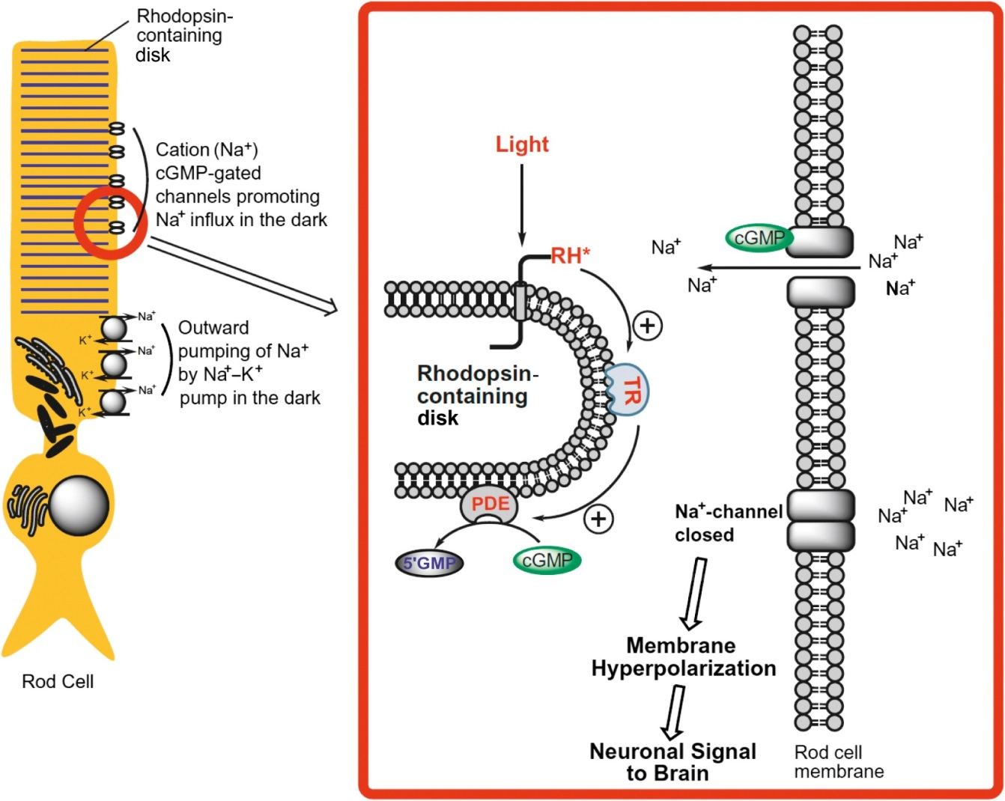
Figure 36.3

Slide 7
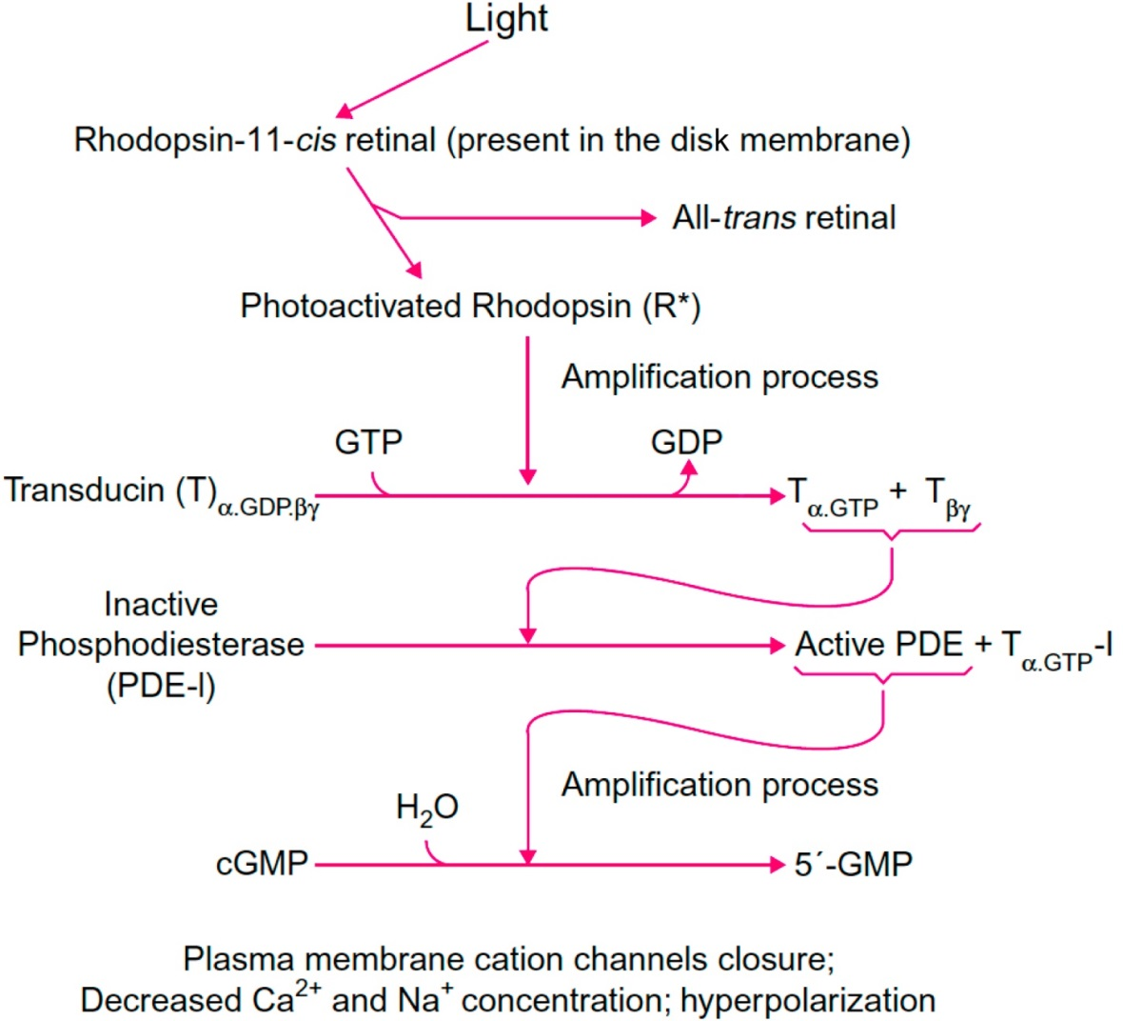
Figure 36.4

Slide 8
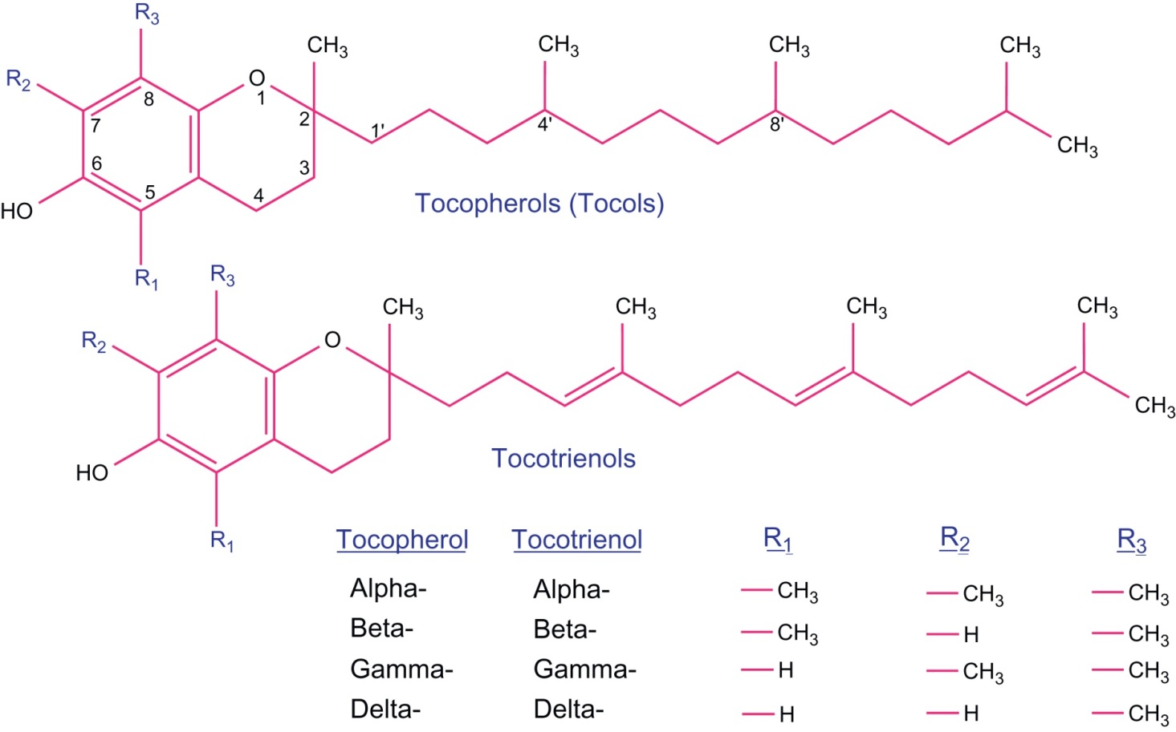
Figure 36.5

Slide 9
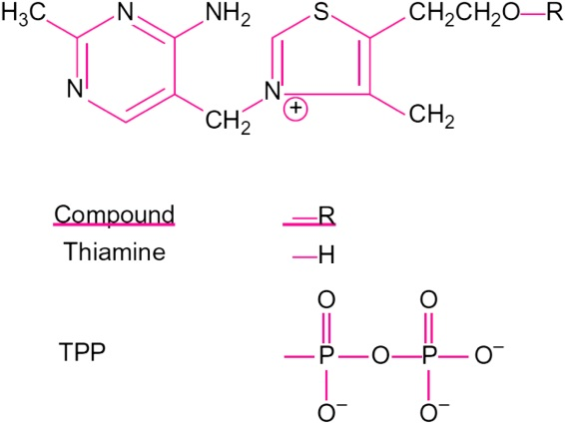
Figure 36.6

Slide 10
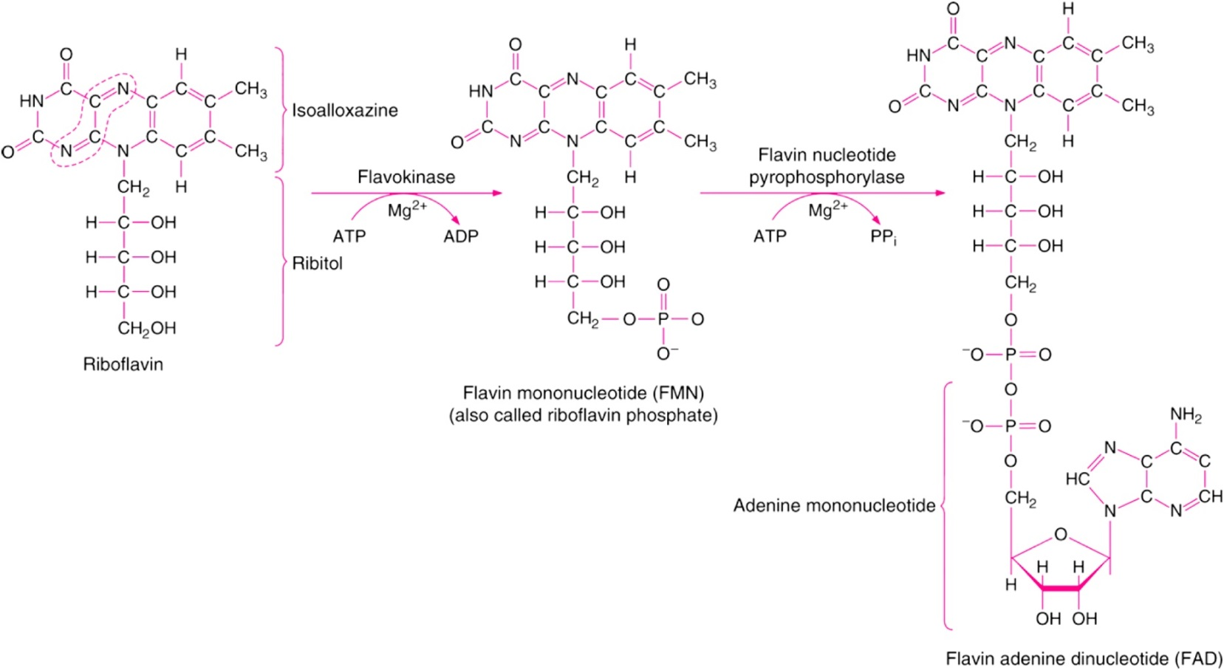
Figure 36.7

Slide 11
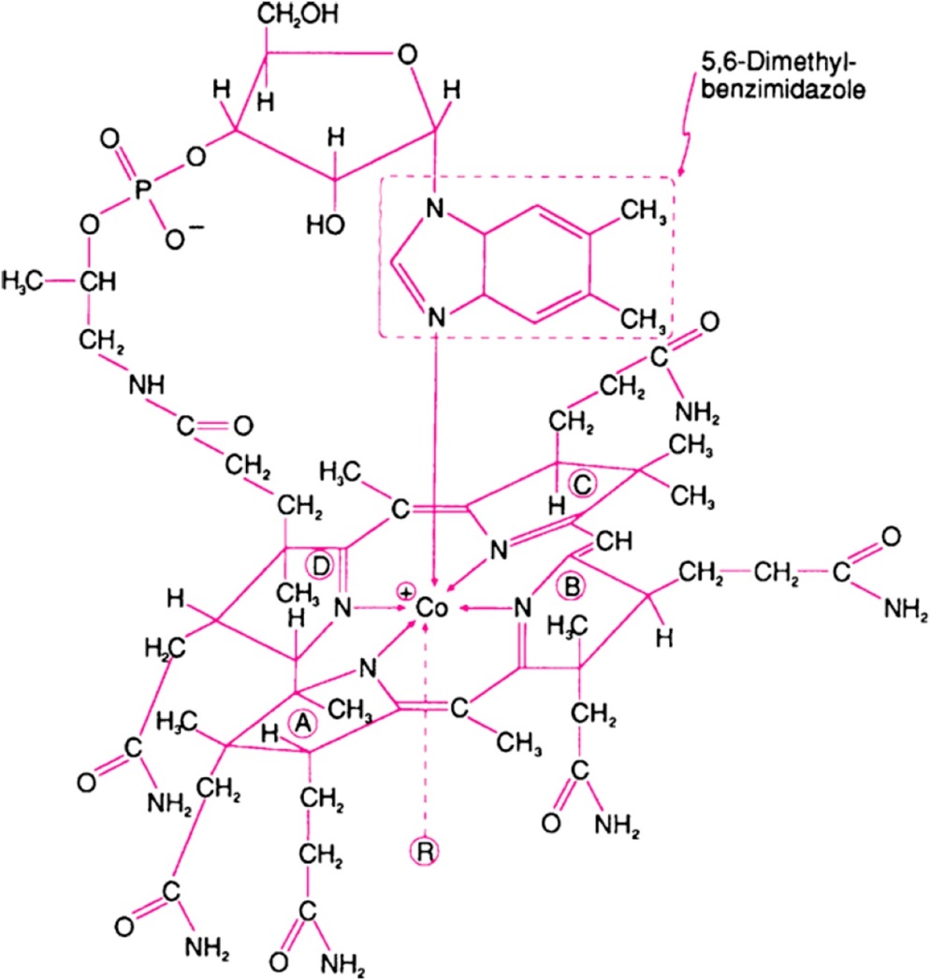
Figure 36.8

Slide 12
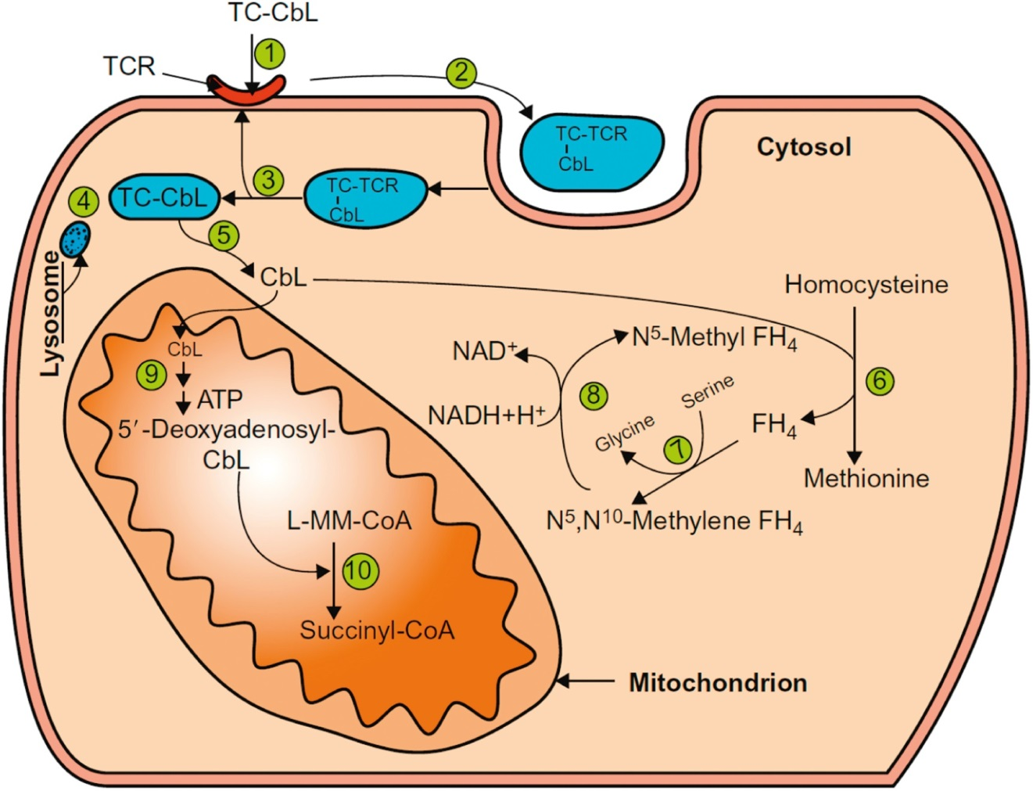
Figure 36.9

Slide 13
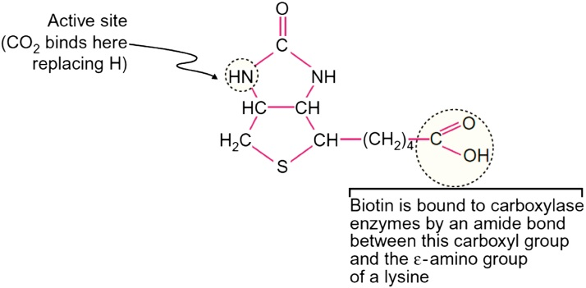
Figure 36.10

Slide 14
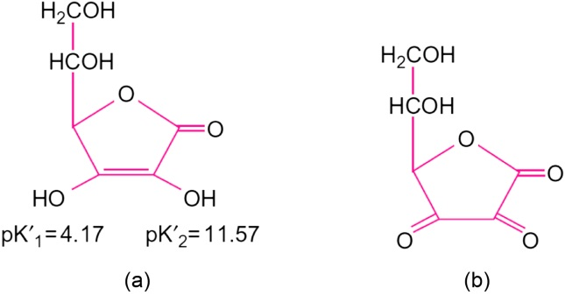
Figure 36.11

Slide 15
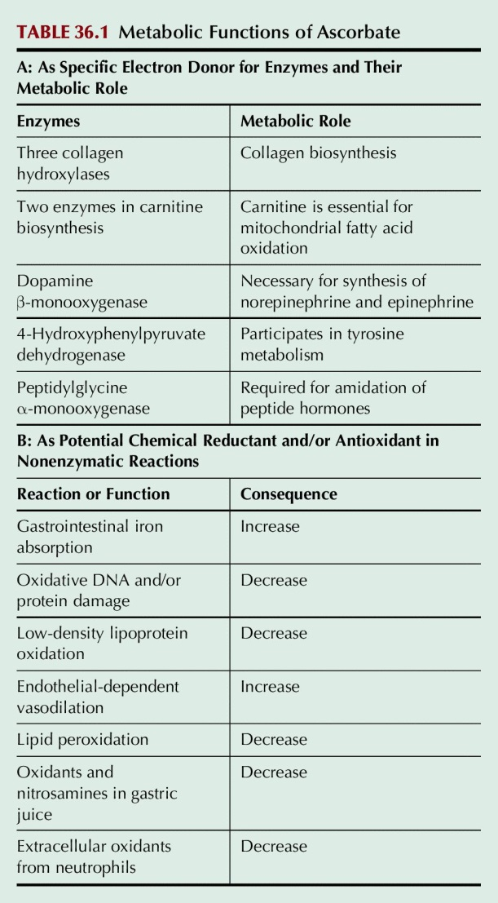
Table 36.1

