Slide 1
Chapter 37
Water, Electrolytes, and Acid-Base Balance

Slide 2
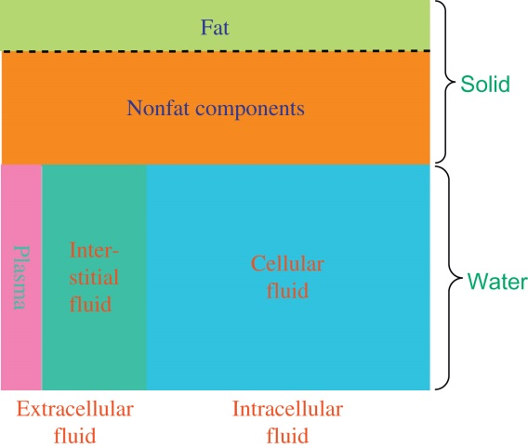
Figure 37.1

Slide 3
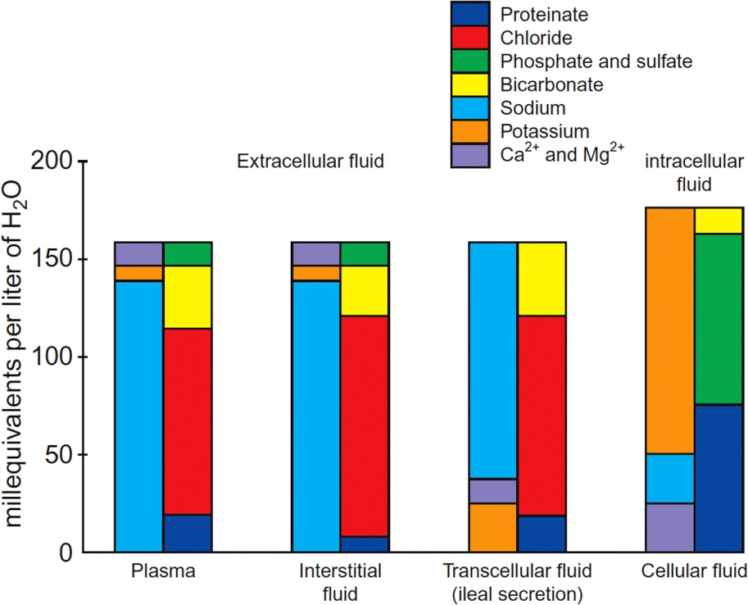
Figure 37.2

Slide 4
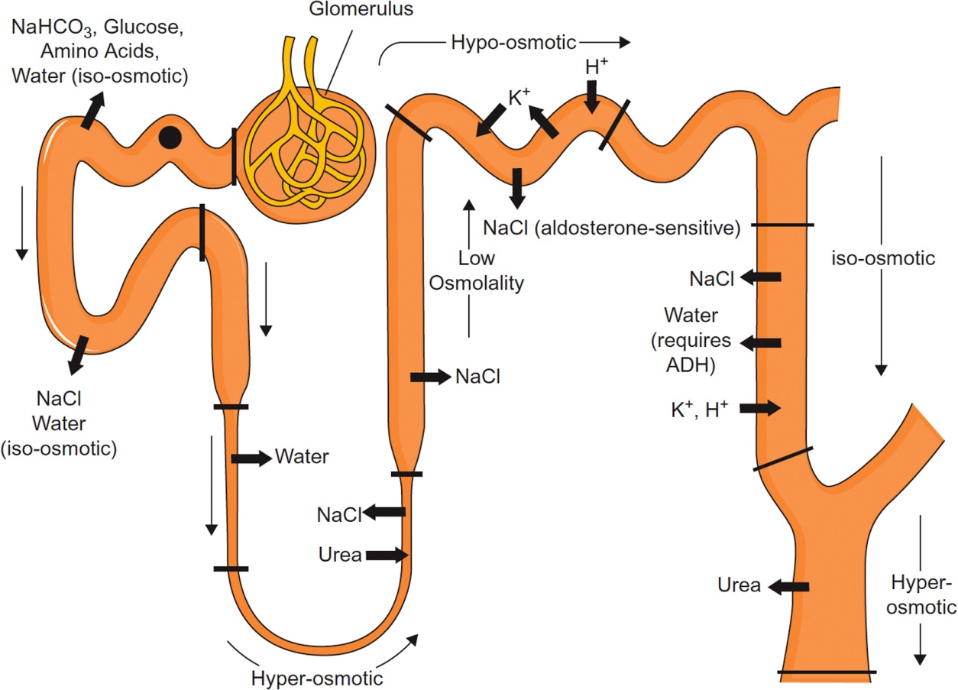
Figure 37.3

Slide 5
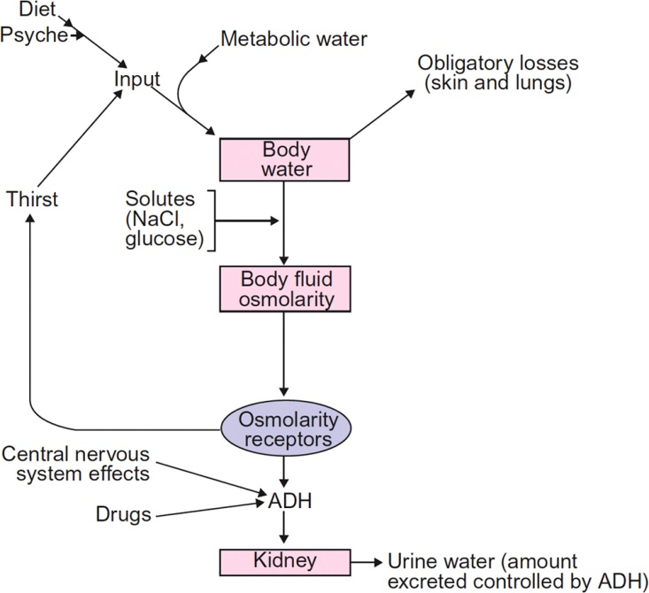
Figure 37.4

Slide 6
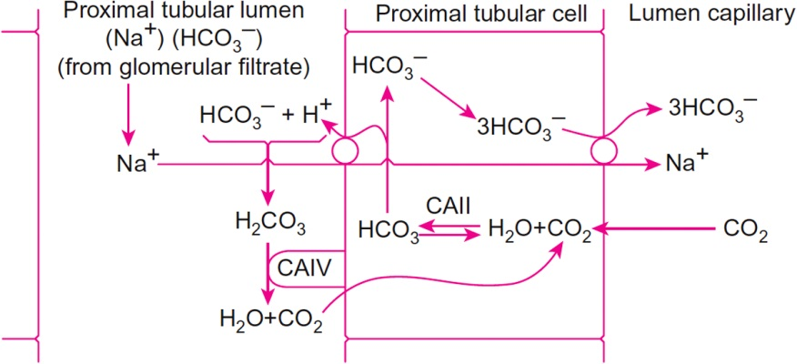
Figure 37.5

Slide 7
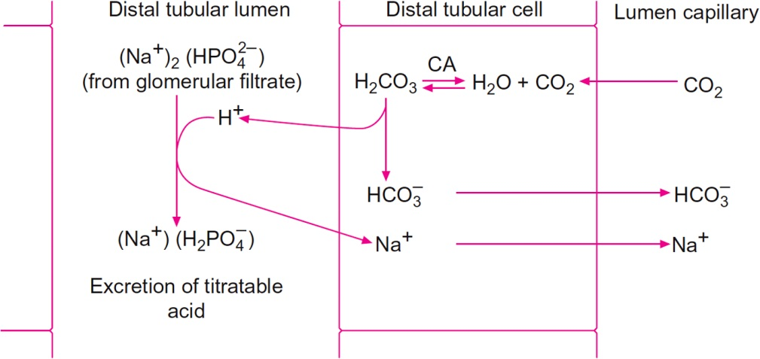
Figure 37.6

Slide 8
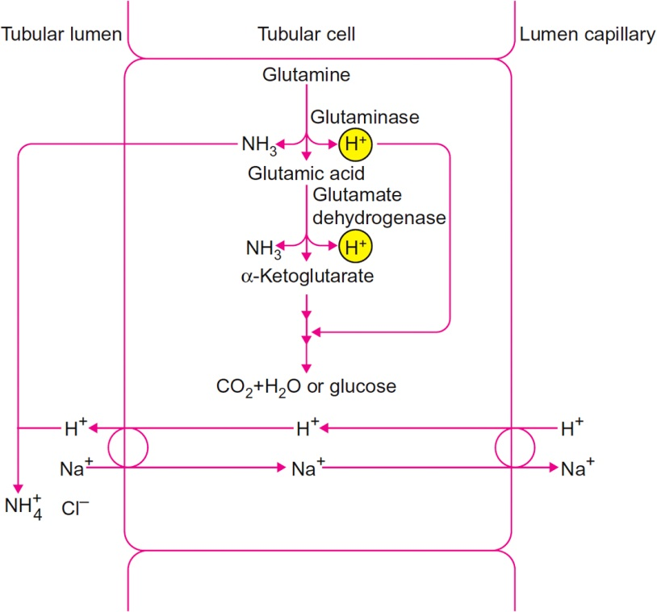
Figure 37.7

Slide 9
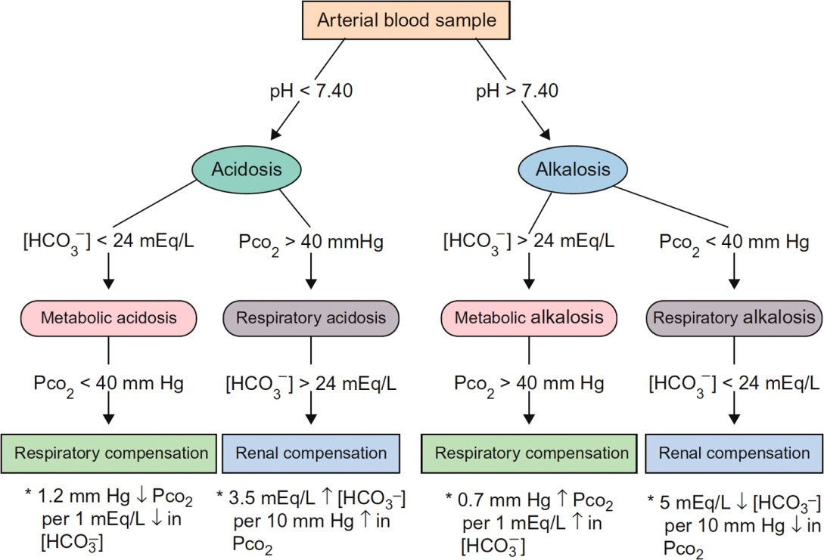
Figure 37.8

Slide 10
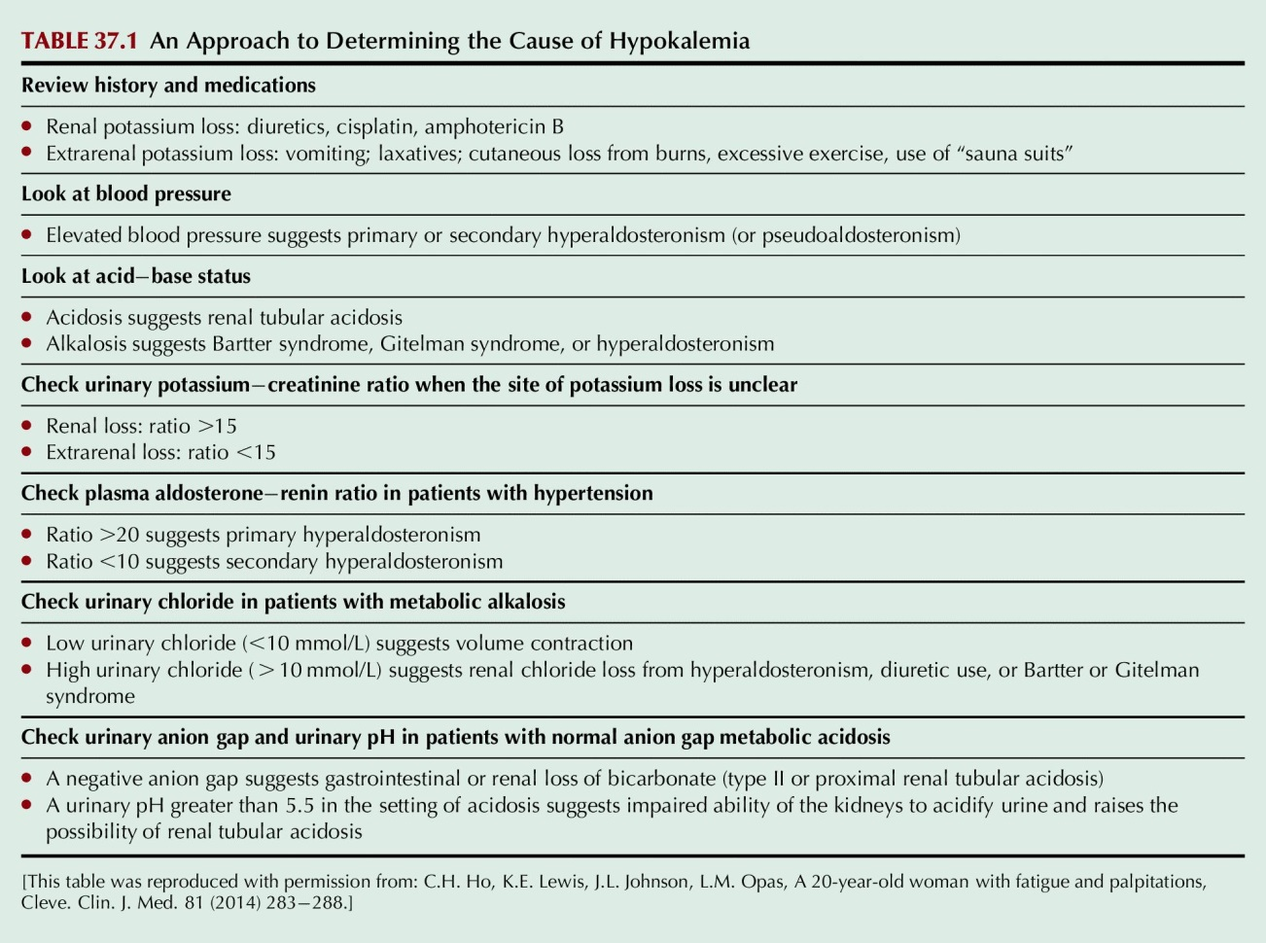
Table 37.1

Slide 11
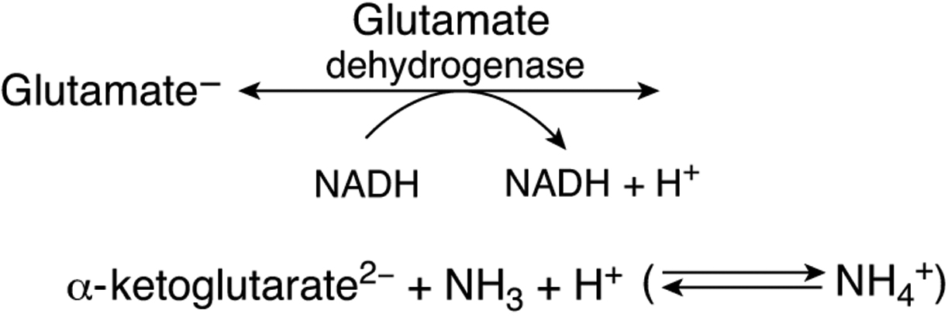
UnFig 37.1

