Slide 1
Digital System Implementation
APPENDIX 1e

Slide 2
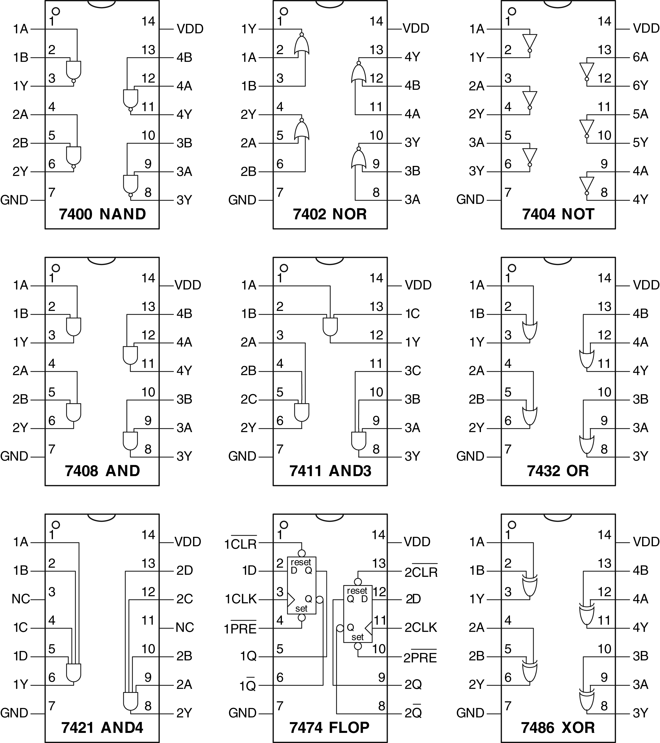
Figure eA.1 Common 74xx-series logic gates

Slide 3
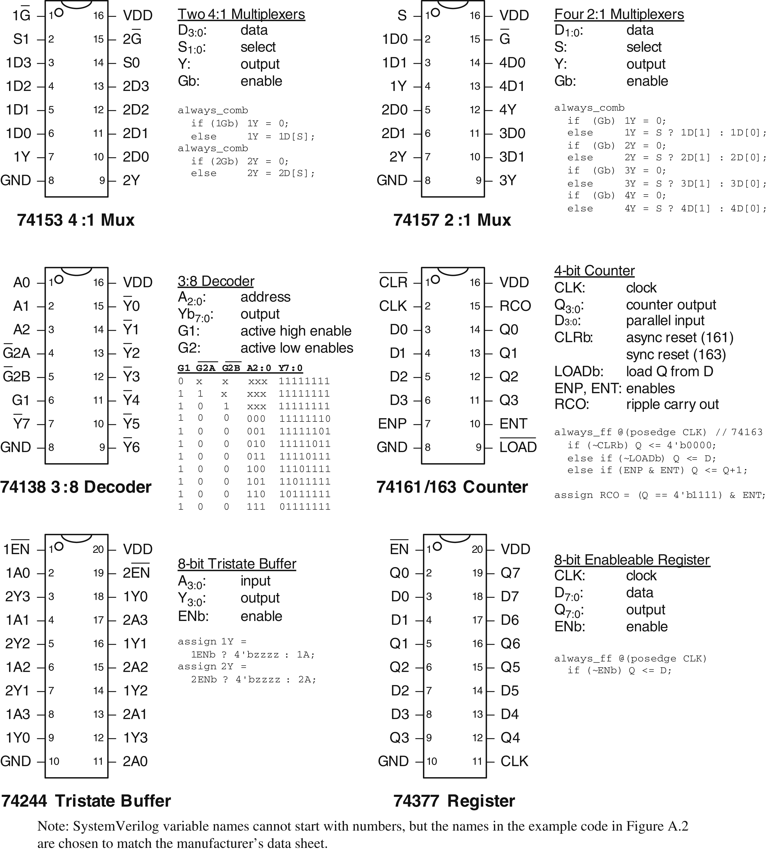
Figure eA.2 Medium-scale integration chips

Slide 4
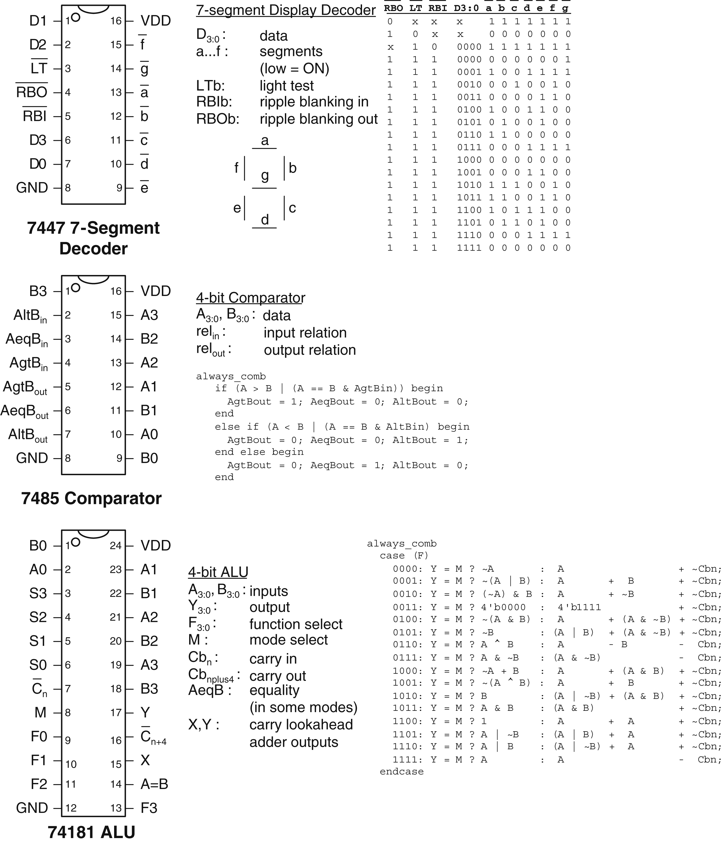
Figure eA.3 More medium-scale integration (MSI) chips

Slide 5
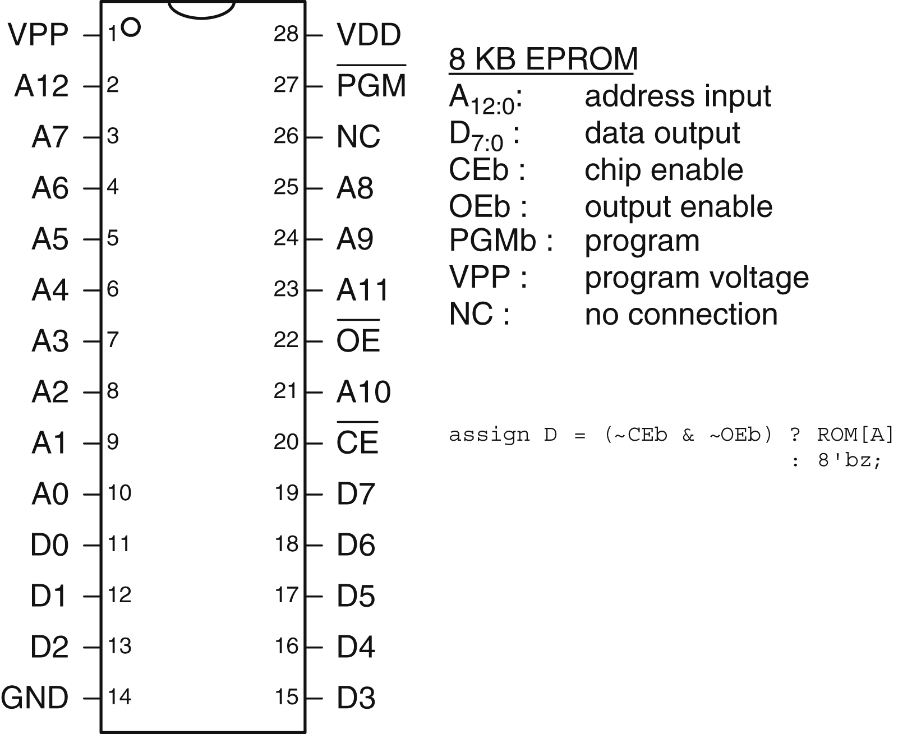
Figure eA.4 2764 8KB EPROM

Slide 6
Figure eA.5 FPGA design flow

Slide 7
Figure eA.6 ASIC design flow

Slide 8
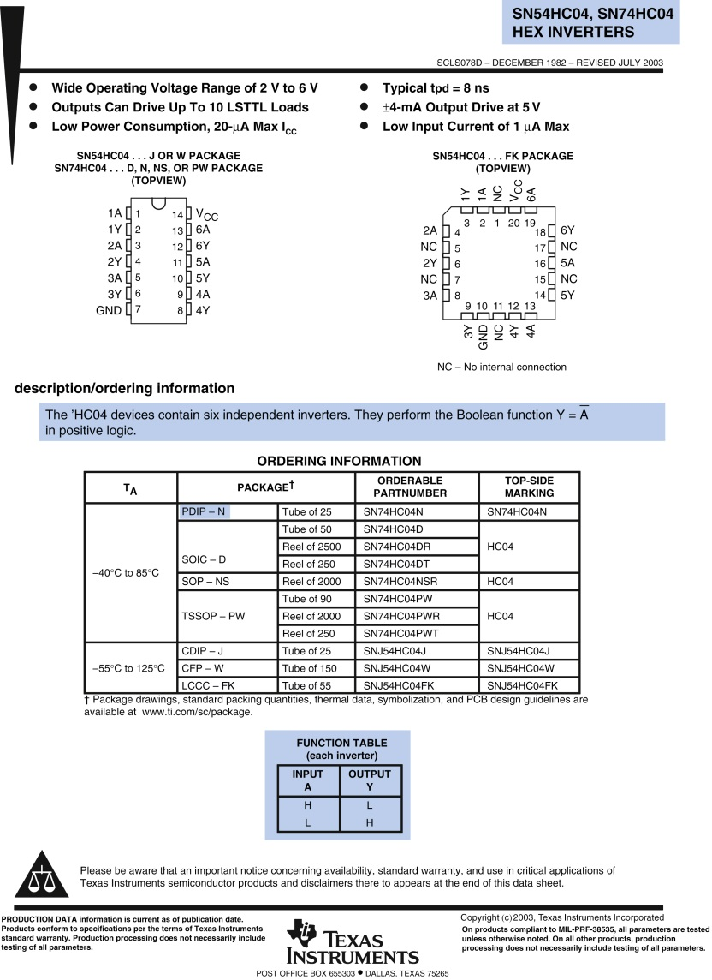
Figure eA.7 7404 data sheet page 1

Slide 9
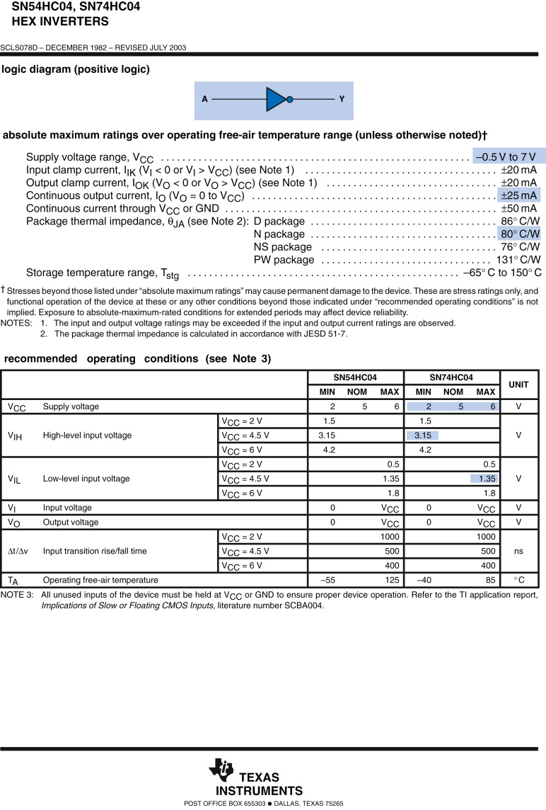
Figure eA.8 7404 data sheet page 2

Slide 10
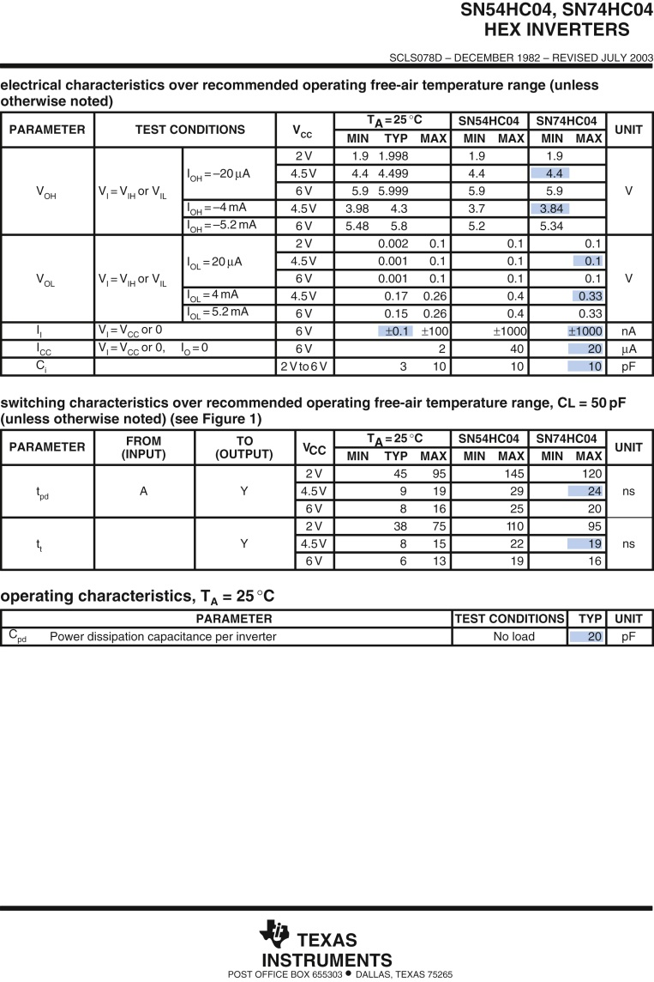
Figure eA.9 7404 data sheet page 3

Slide 11
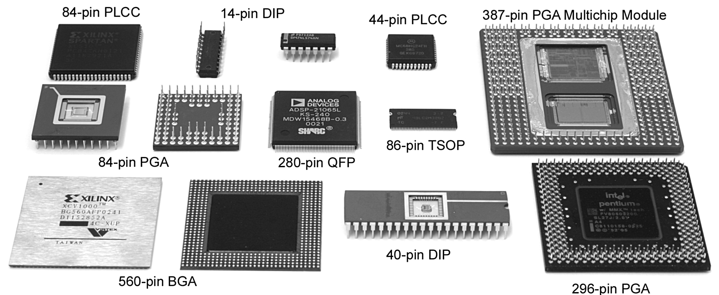
Figure eA.10 Integrated circuit packages

Slide 12
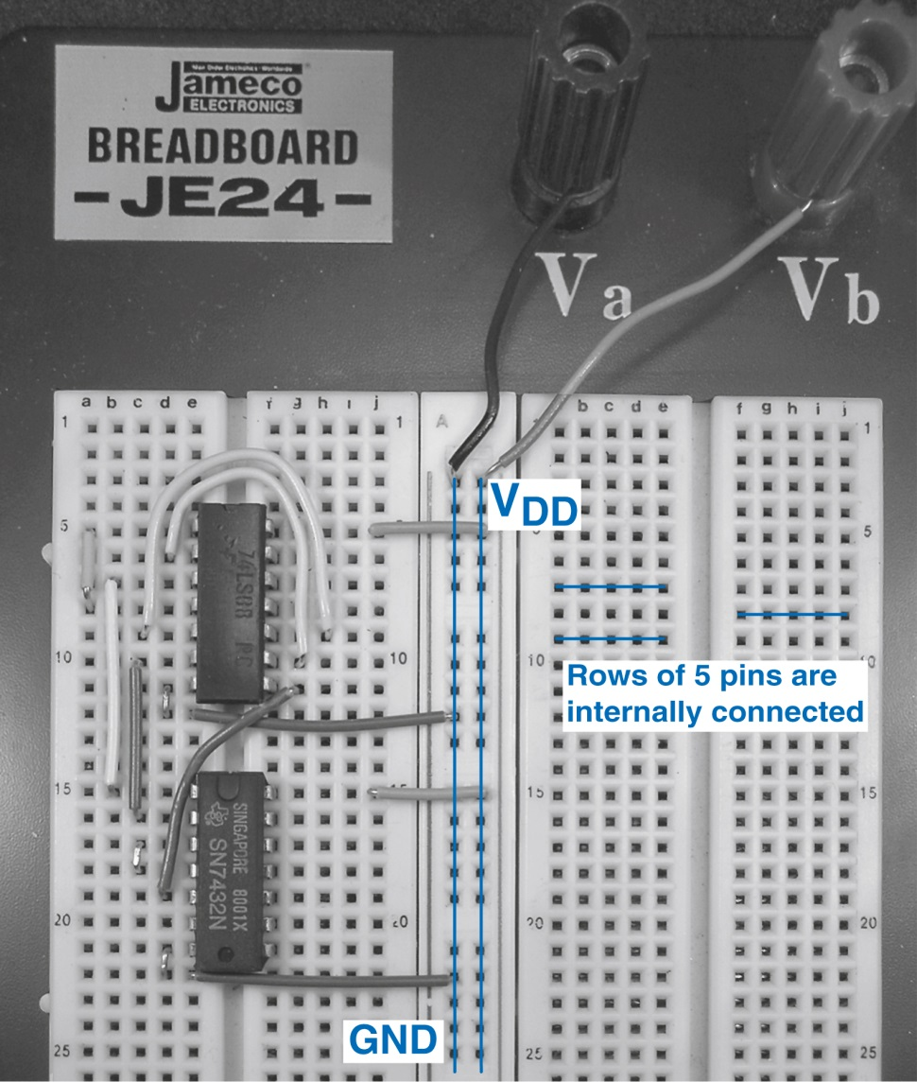
Figure eA.11 Majority circuit on breadboard

Slide 13
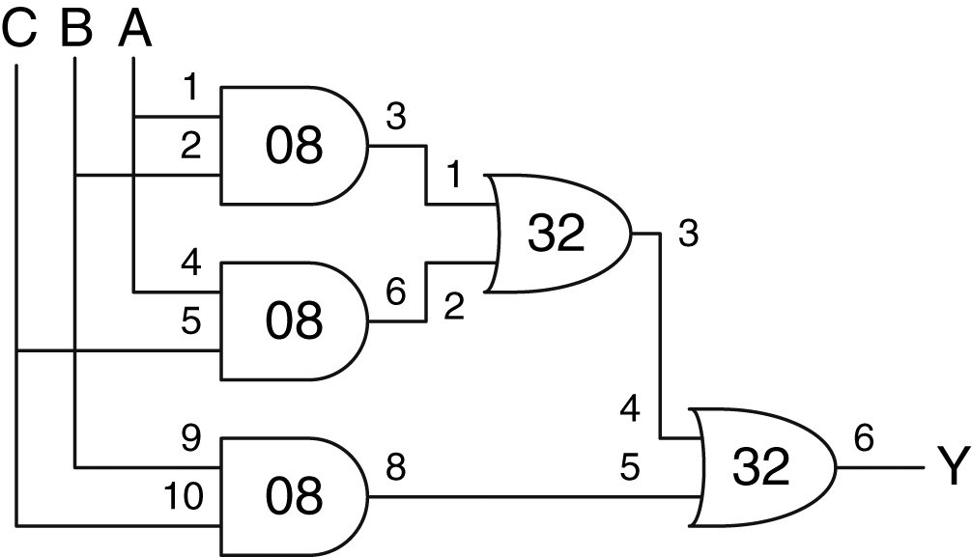
Figure eA.12 Majority gate schematic with chips and pins identified

Slide 14
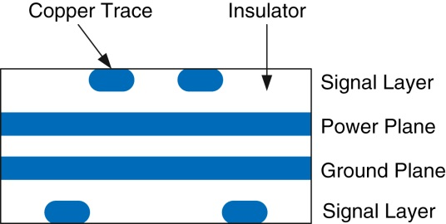
Figure eA.13 Printed circuit board cross-section

Slide 15
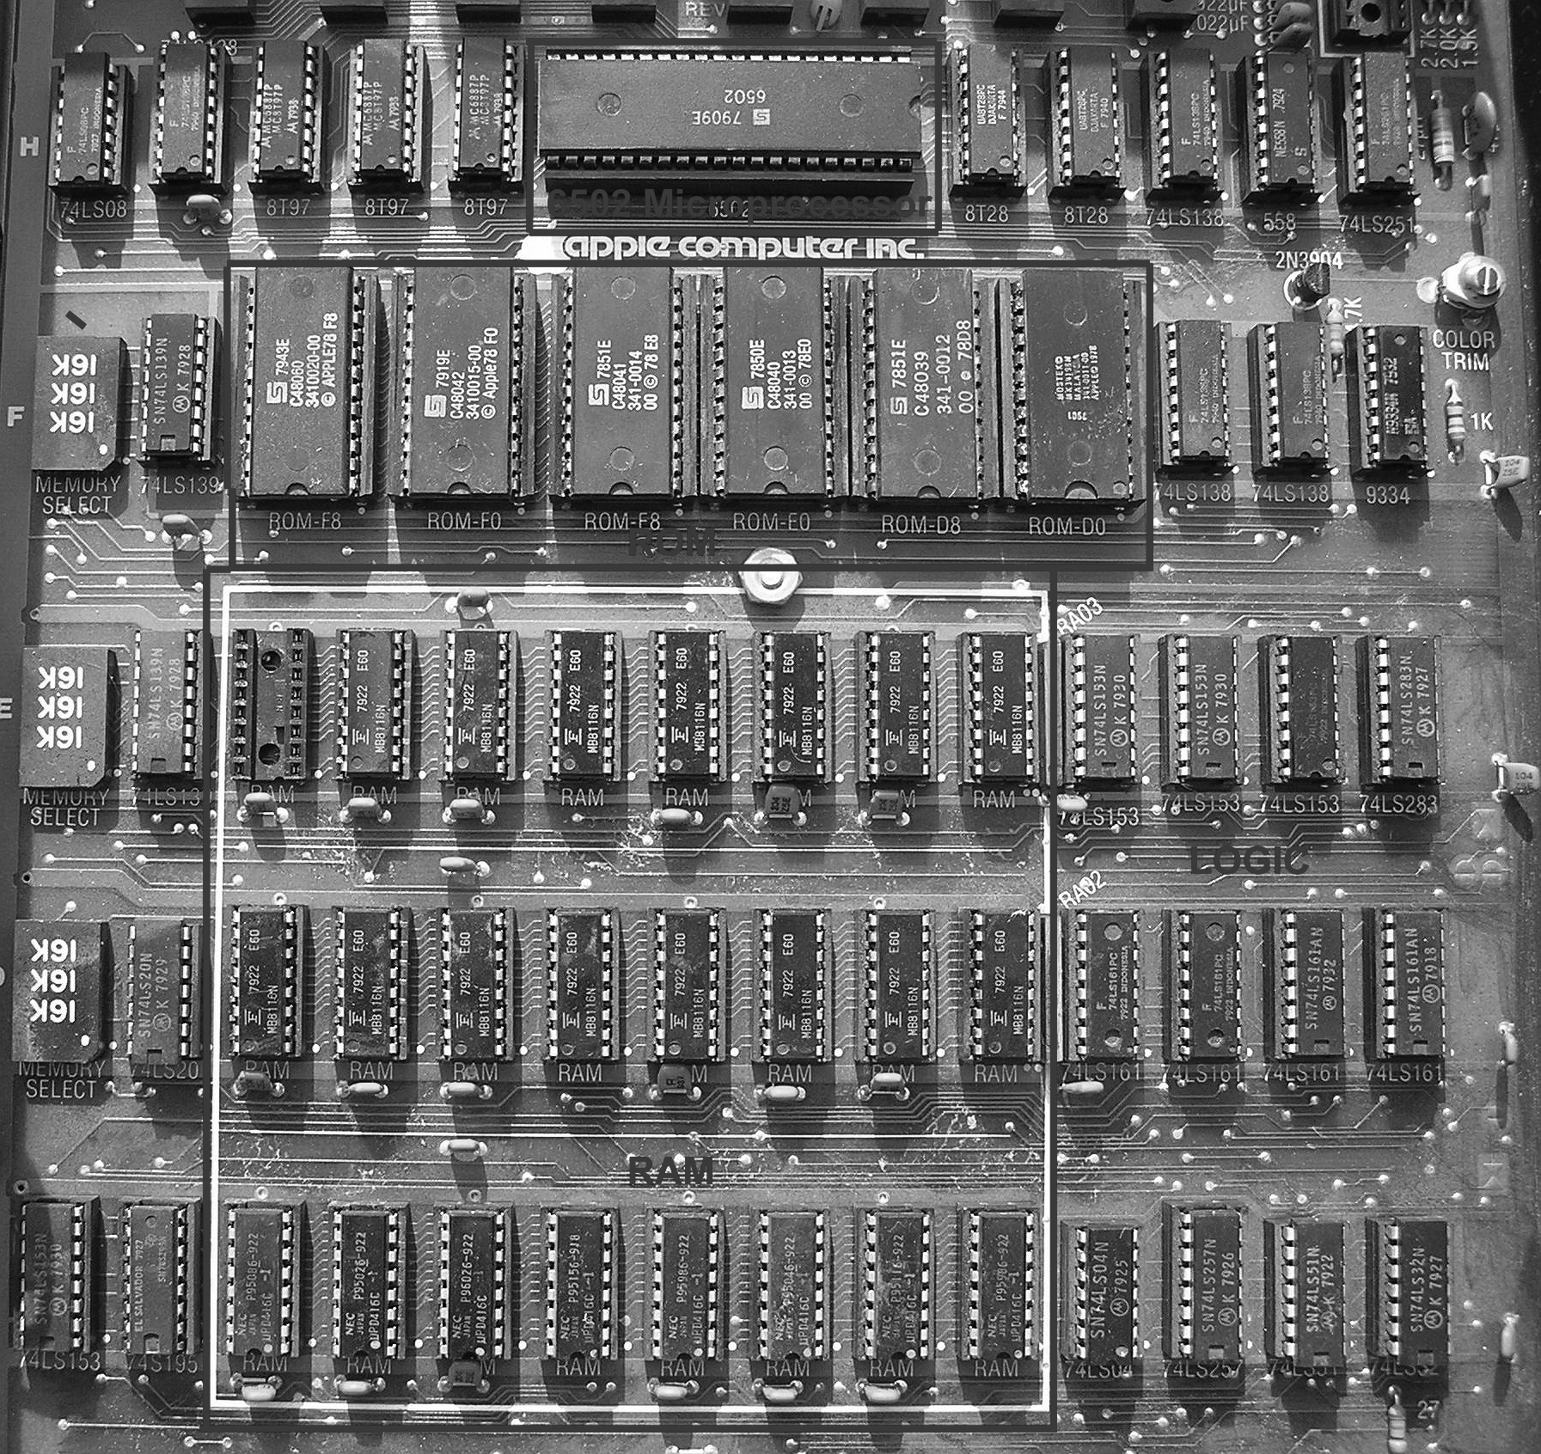
Figure eA.14 Apple II+ circuit board

Slide 16
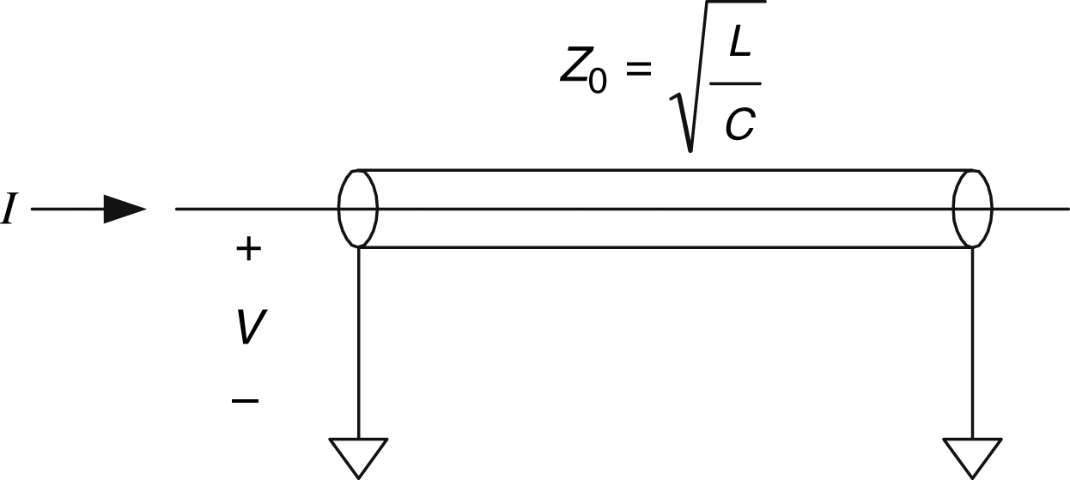
Figure eA.15 Transmission line symbol

Slide 17
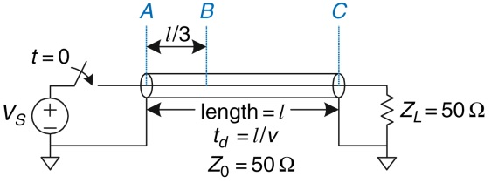
Figure eA.16 Transmission line with matched termination

Slide 18
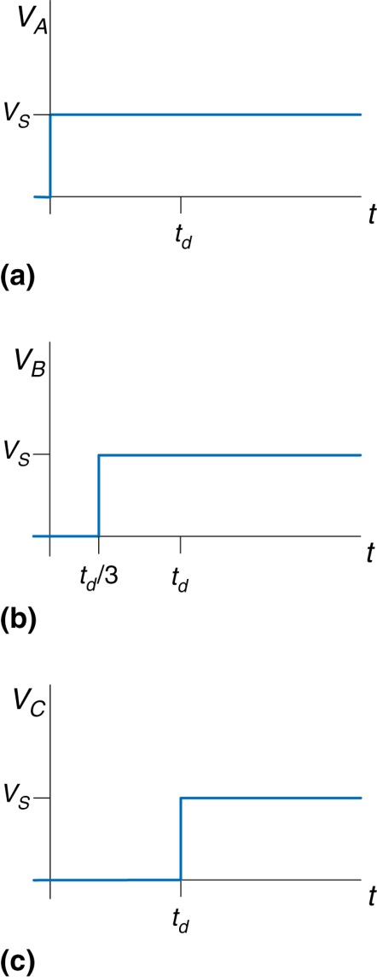
Figure eA.17 Voltage waveforms for Figure eA.16 at points A, B, and C

Slide 19
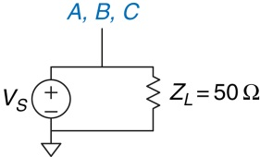
Figure eA.18 Equivalent circuit of Figure eA.16 at steady state

Slide 20
Figure eA.19 Transmission line with matched source and load impedances

Slide 21
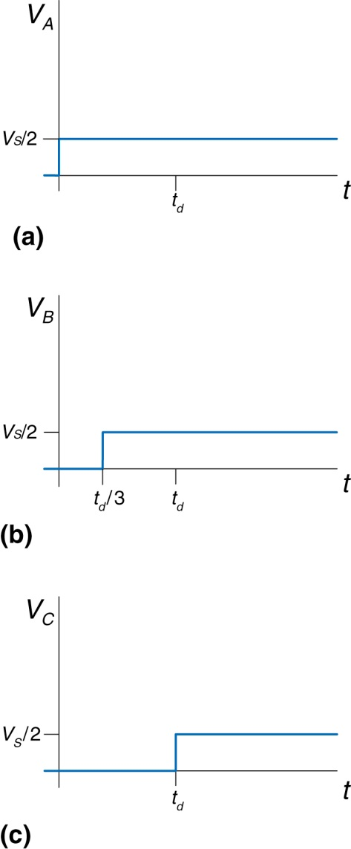
Figure eA.20 Voltage waveforms for Figure eA.19 at points A, B, and C

Slide 22
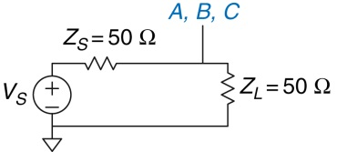
Figure eA.21 Equivalent circuit of Figure eA.19 at steady state

Slide 23
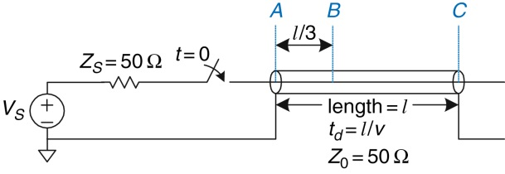
Figure eA.22 Transmission line with open load termination

Slide 24
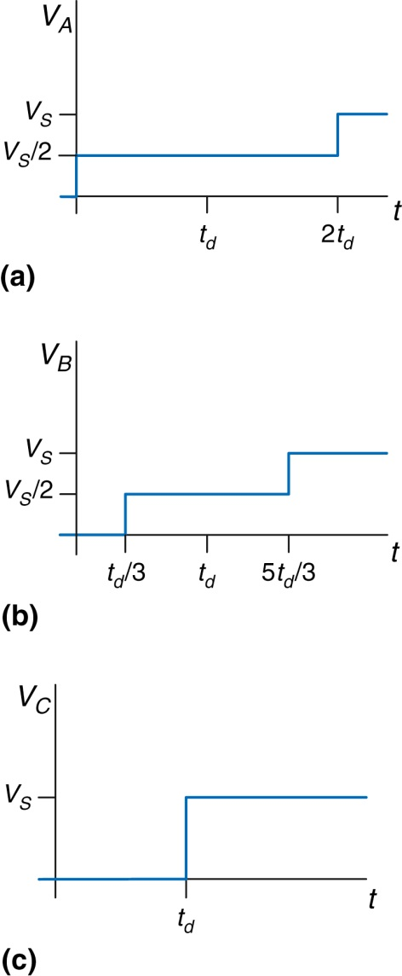
Figure eA.23 Voltage waveforms for Figure eA.22 at points A, B, and C

Slide 25
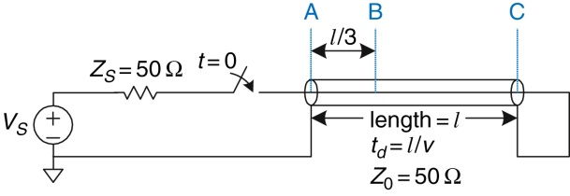
Figure eA.24 Transmission line with short termination

Slide 26
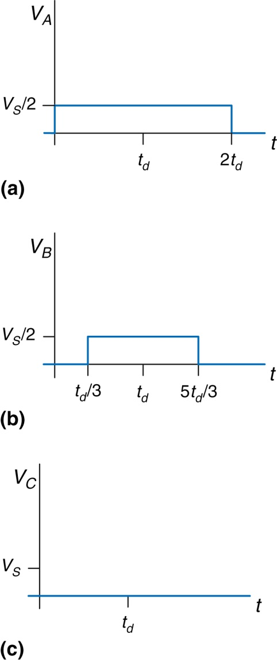
Figure eA.25 Voltage waveforms for Figure eA.24 at points A, B, and C

Slide 27
Figure eA.26 Transmission line with mismatched termination

Slide 28
Figure eA.27 Voltage waveforms for Figure eA.26 at points A, B, and C

Slide 29
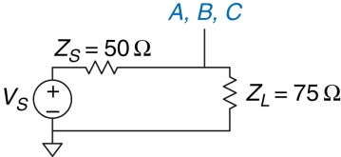
Figure eA.28 Equivalent circuit of Figure eA.26 at steady state

Slide 30
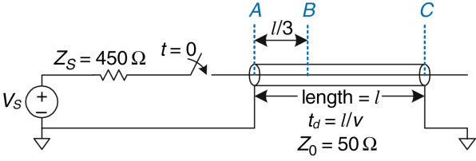
Figure eA.29 Transmission line with mismatched source and load terminations

Slide 31
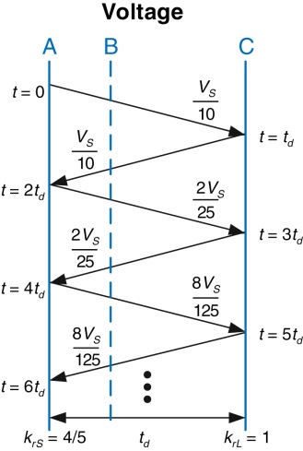
Figure eA.30 Bounce diagram for Figure eA.29

Slide 32
Figure eA.31 Voltage and current waveforms for Figure eA.29

Slide 33
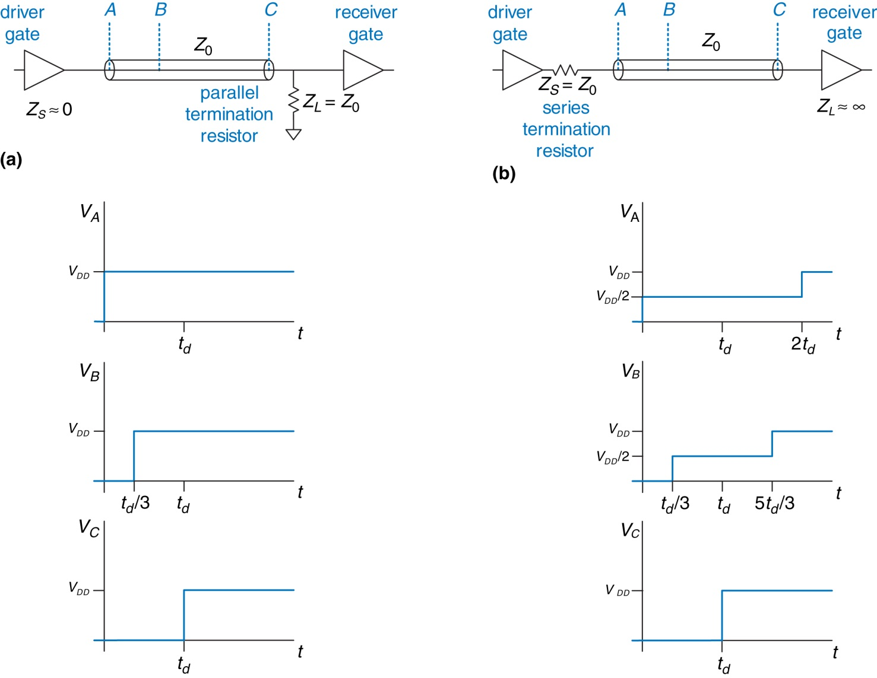
Figure eA.32 Termination schemes: (a) parallel, (b) series

Slide 34
Figure eA.33 Transmission line models: (a) semi-infinite cable, (b) lossy, (c) ideal

Slide 35
Figure eA.34 Transmission line model: (a) for entire line and (b) with additional length, dx

Slide 36
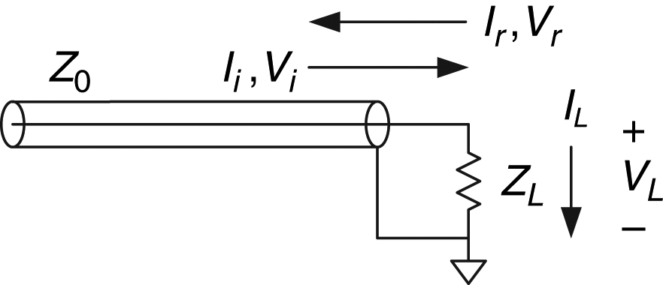
Figure eA.35 Transmission line showing incoming, reflected, and load voltages and currents

Slide 37
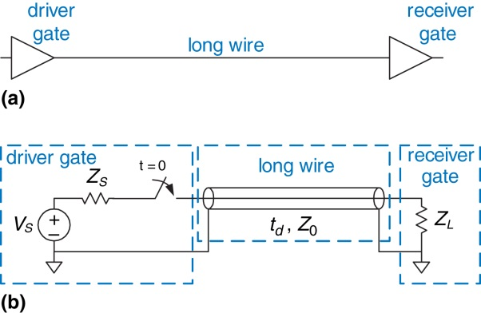
Figure eA.36 Digital system modeled with transmission line

Slide 38
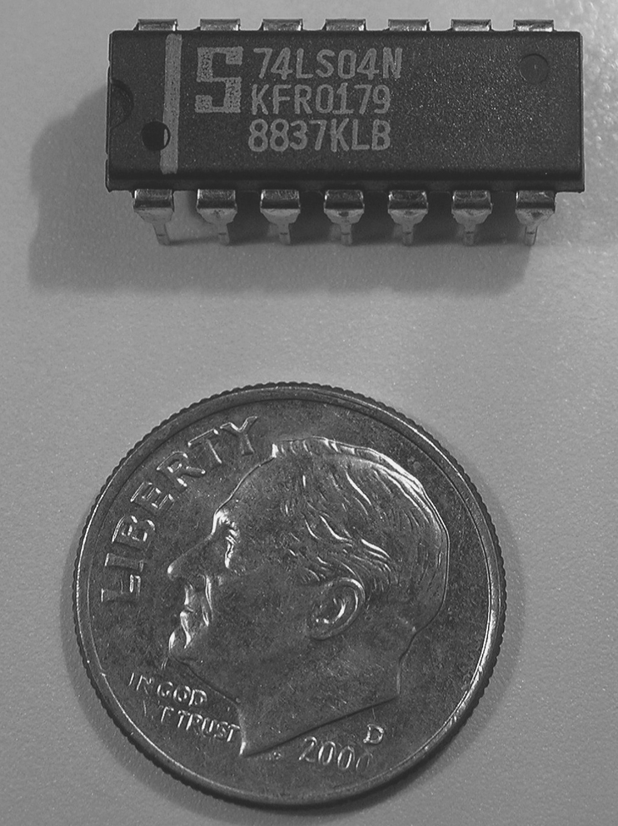

Slide 39
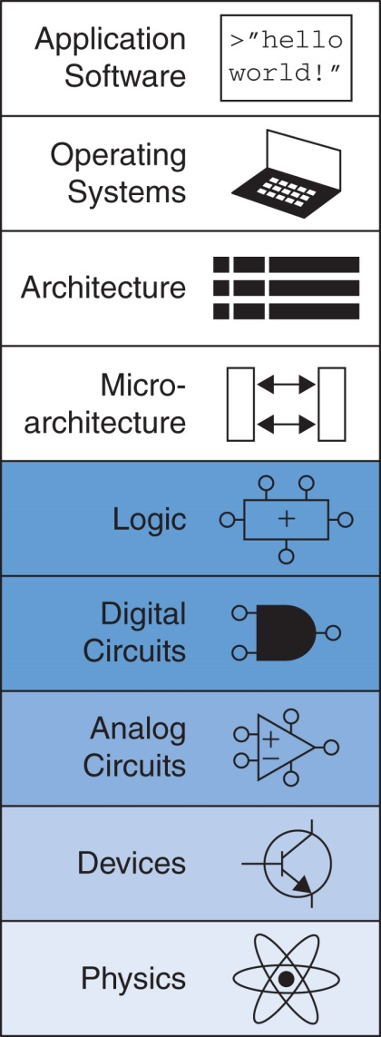
Figure onappa-u01

