Slide 1
ARM Instructions B
APP2

Slide 2
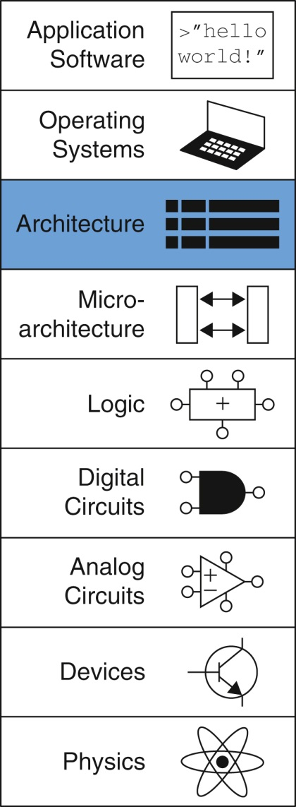
Figure appb-u01

Slide 3
Figure B.1 Data-processing instruction encodings

Slide 4
Figure B.2 Multiply instruction encoding

Slide 5
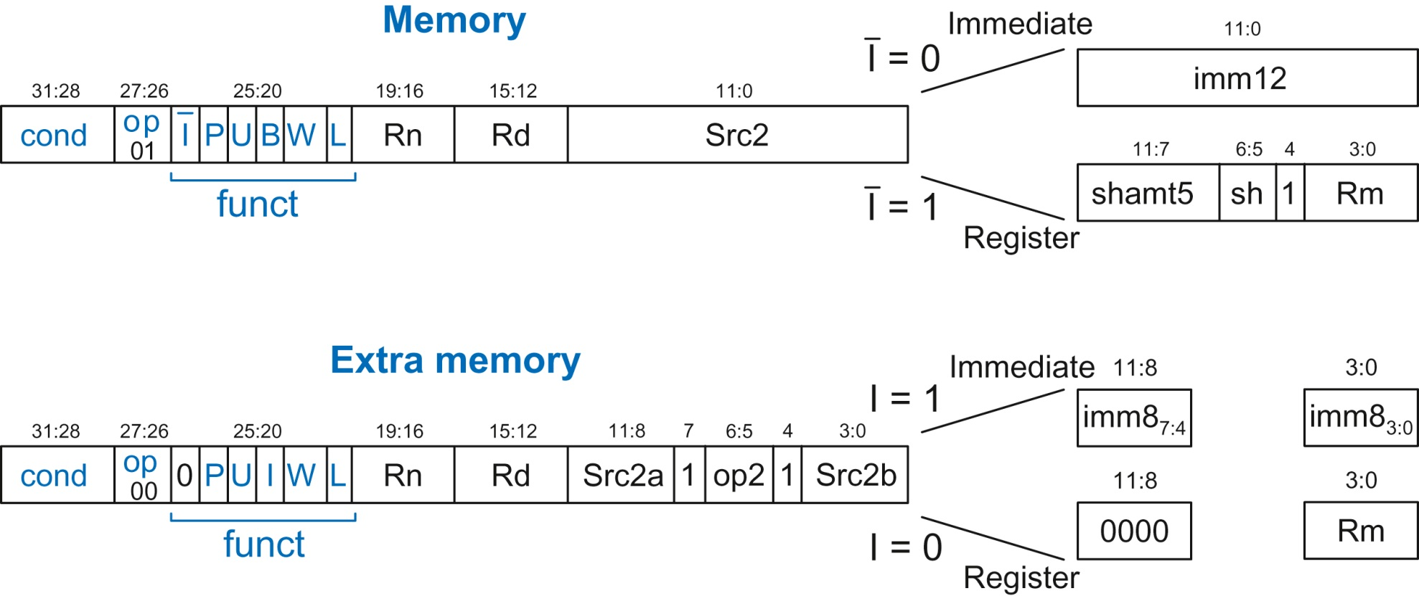
Figure B.3 Memory instruction encodings

Slide 6
Figure B.4 Branch instruction encoding

