Slide 1
C Programming
APP3o

Slide 2
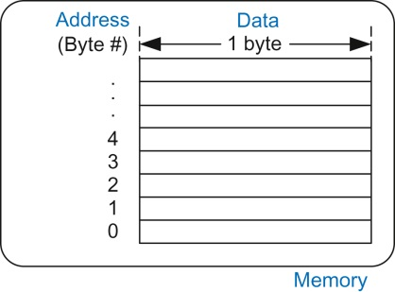
Figure eC.1 C’s view of memory

Slide 3
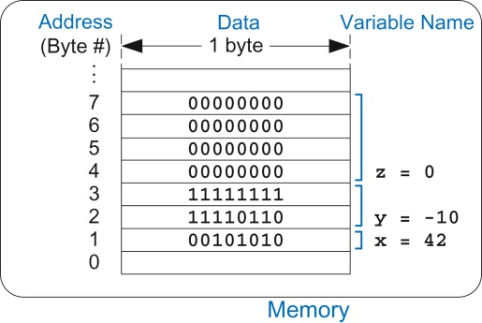
Figure eC.2 Variable storage in memory for C Code Example eC.3

Slide 4
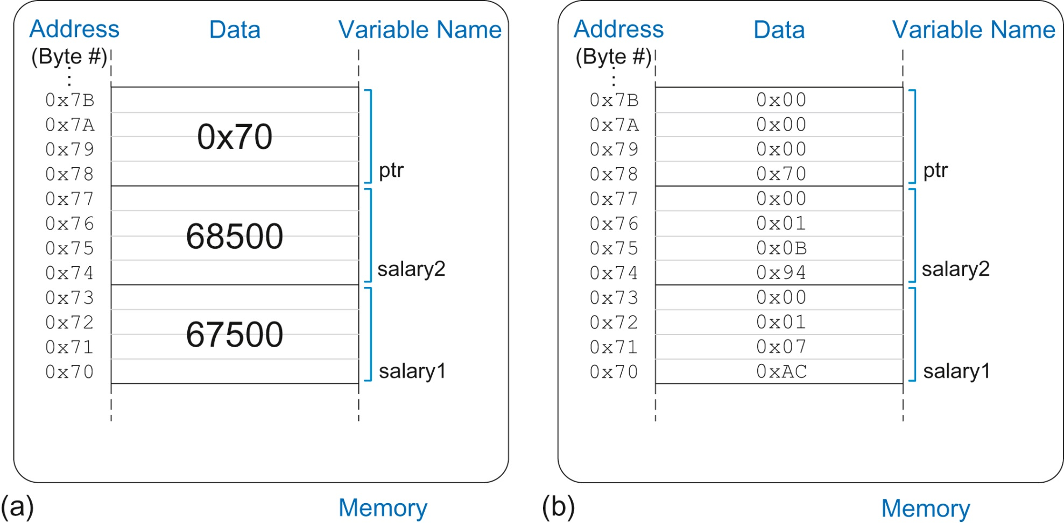
Figure eC.3 Contents of memory after C Code Example eC.18 executes shown (a) by value and (b) by byte using little-endian memory

Slide 5
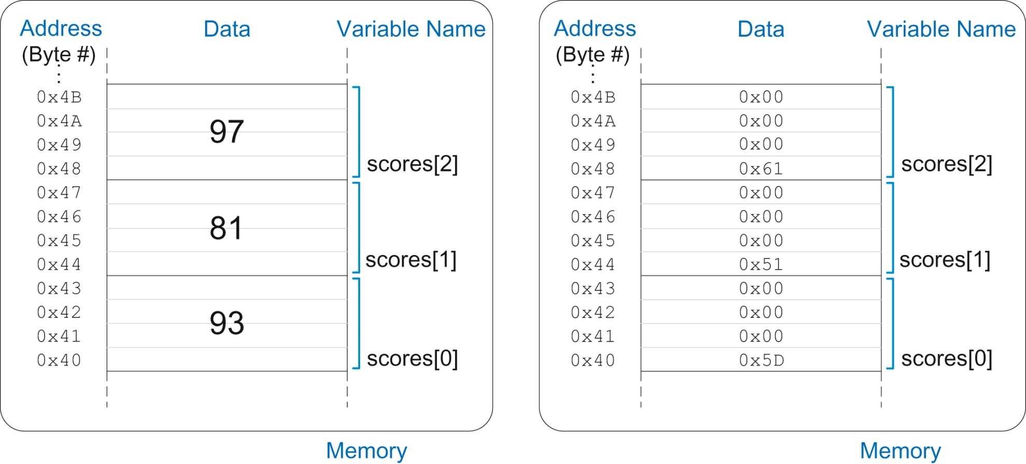
Figure eC.4 scores array stored in memory

Slide 6
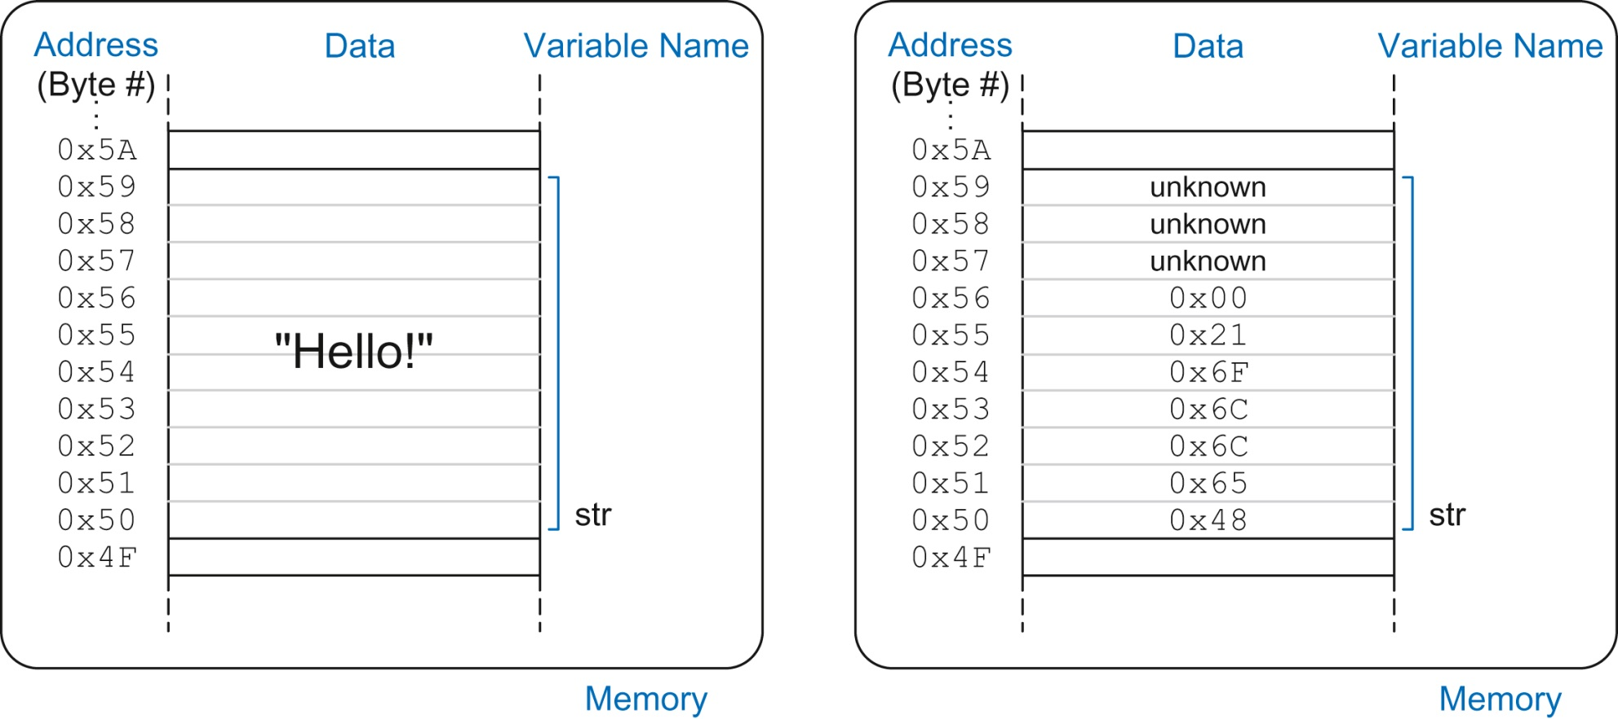
Figure eC.5 The string “Hello!” stored in memory

Slide 7
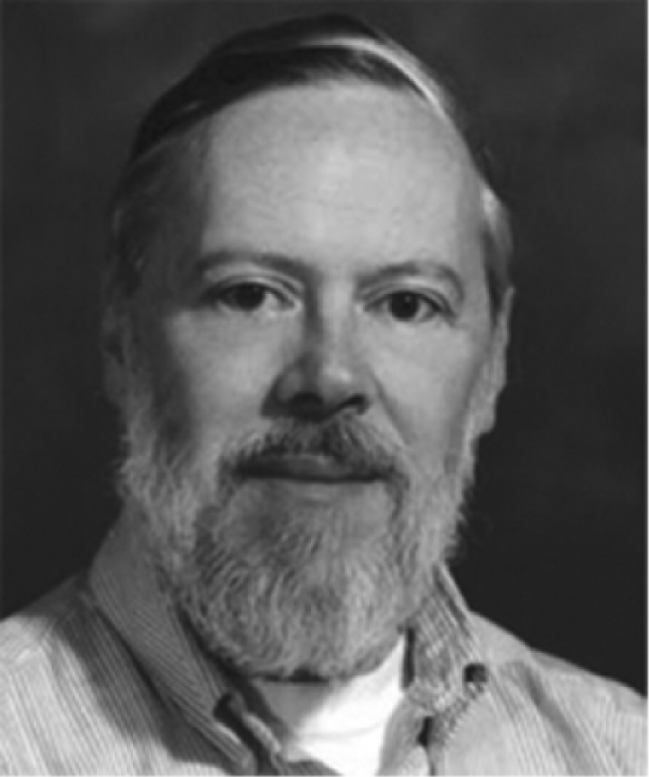

Slide 8
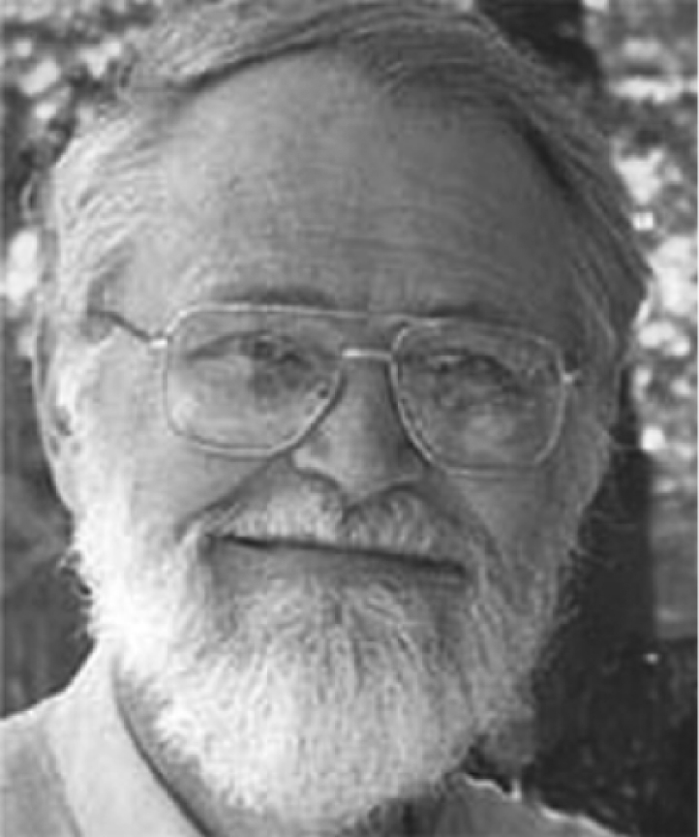

Slide 9
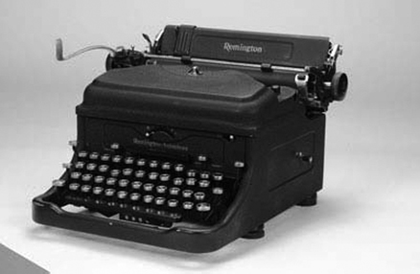

Slide 10
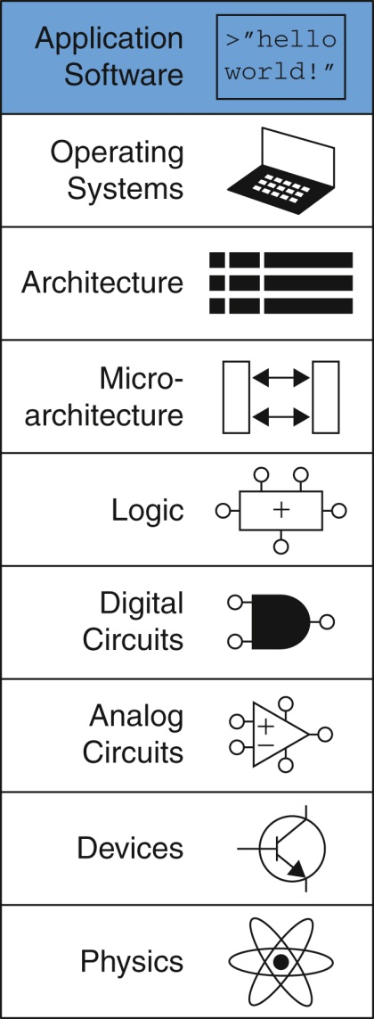
Figure onappc-u03

