Slide 1
From Zero to One
CH001

Slide 2
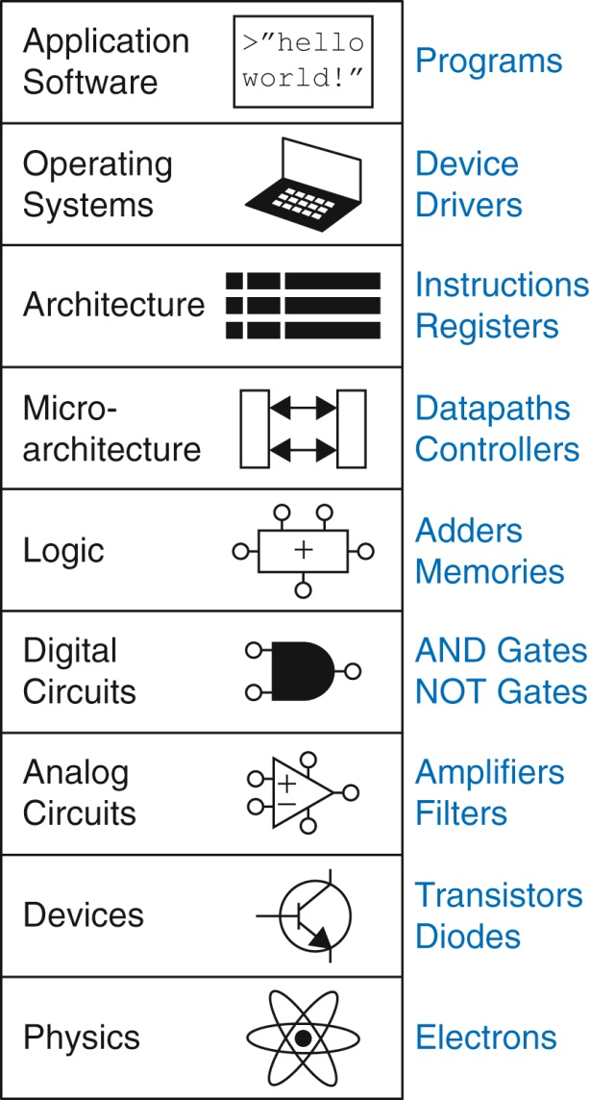
Figure 1.1 Levels of abstraction for an electronic computing system

Slide 3
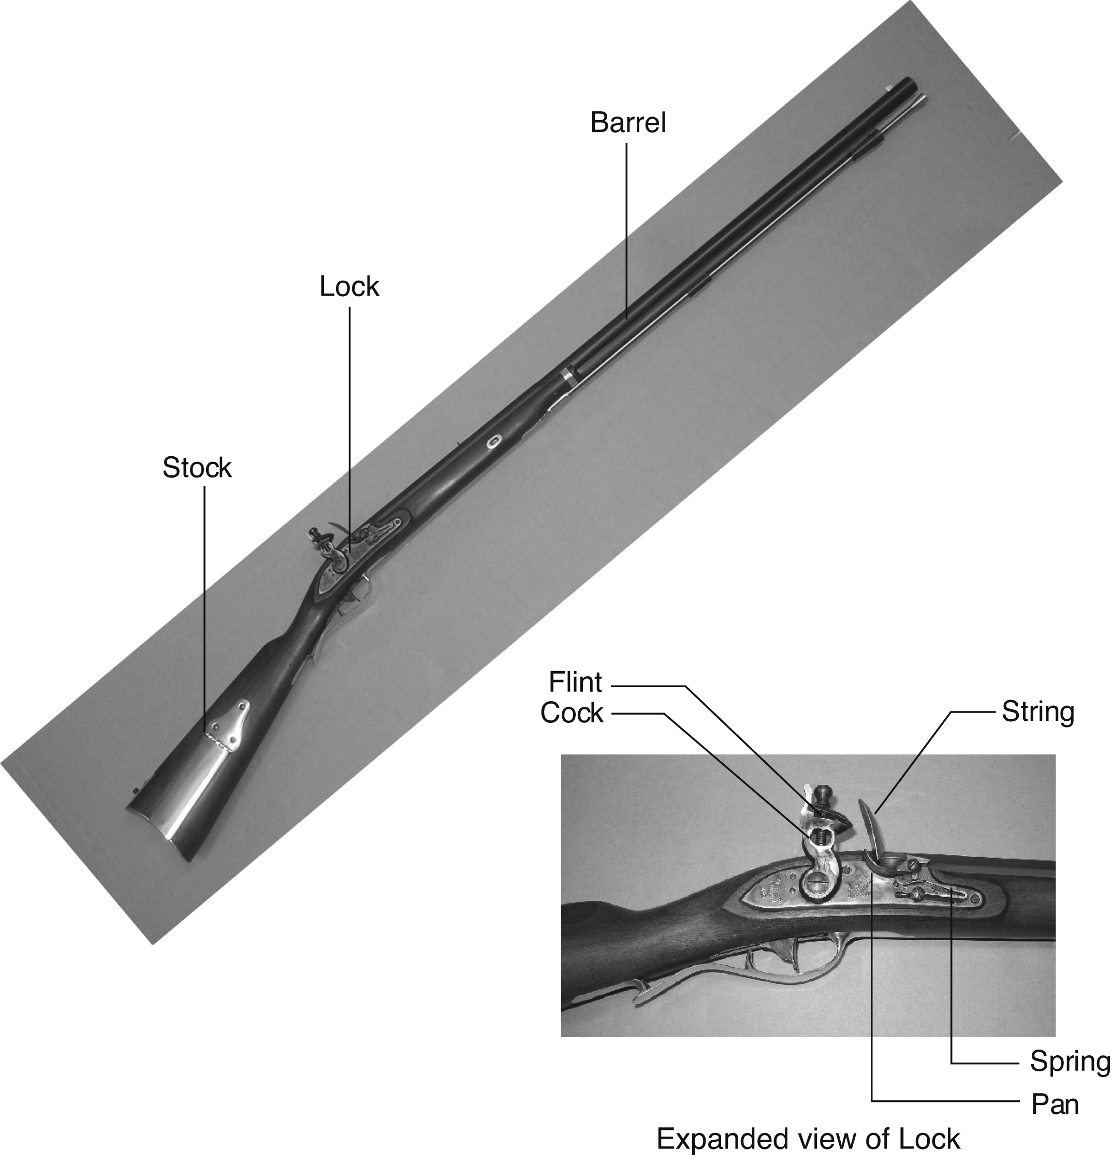
Figure 1.2 Flintlock rifle with a close-up view of the lock (Image by Euroarms Italia. www.euroarms.net © 2006.)

Slide 4
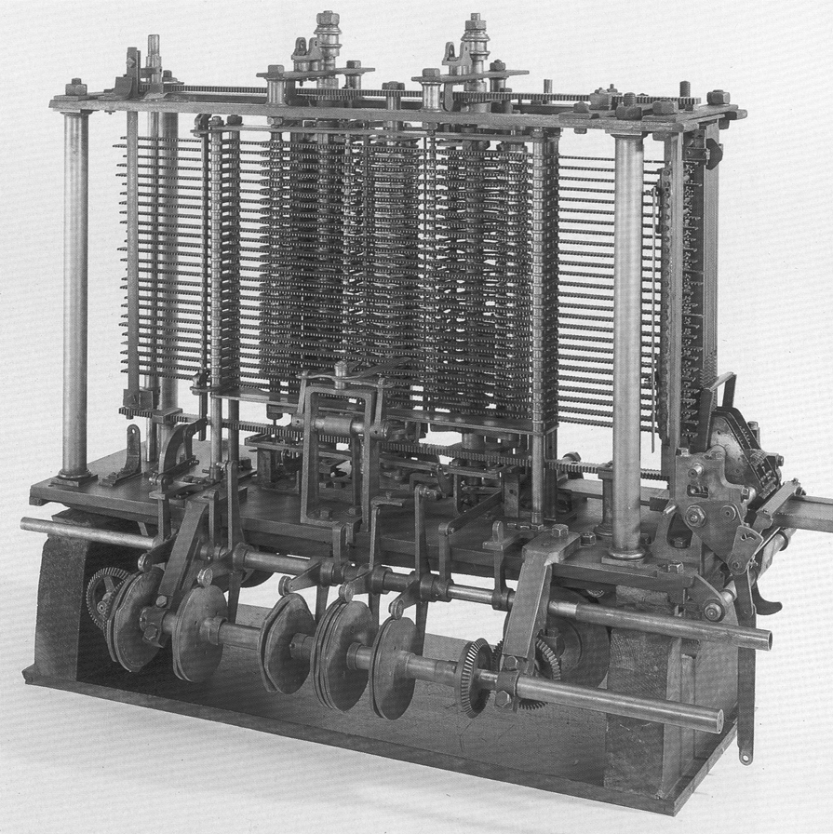
Figure 1.3 Babbage's Analytical Engine, under construction at the time of his death in 1871 (image courtesy of Science Museum/Science and Society Picture Library)

Slide 5
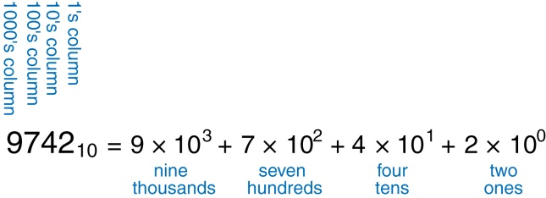
Figure 1.4 Representation of a decimal number

Slide 6
Figure 1.5 Conversion of a binary number to decimal

Slide 7
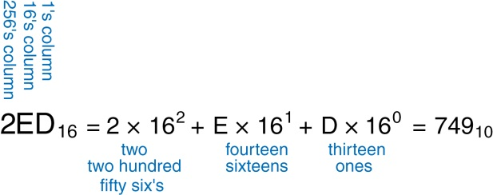
Figure 1.6 Conversion of a hexadecimal number to decimal

Slide 8
Figure 1.7 Least and most significant bits and bytes

Slide 9
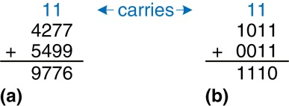
Figure 1.8 Addition examples showing carries: (a) decimal (b) binary

Slide 10
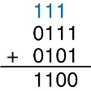
Figure 1.9 Binary addition example

Slide 11
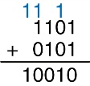
Figure 1.10 Binary addition example with overflow

Slide 12
Figure 1.11 Number line and 4-bit binary encodings

Slide 13
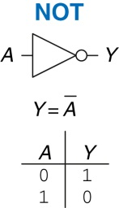
Figure 1.12 NOT gate

Slide 14
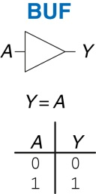
Figure 1.13 Buffer

Slide 15
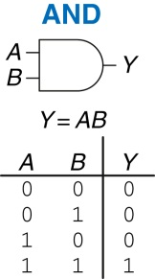
Figure 1.14 AND gate

Slide 16
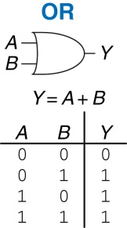
Figure 1.15 OR gate

Slide 17
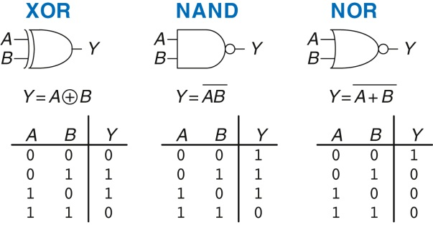
Figure 1.16 More two-input logic gates

Slide 18
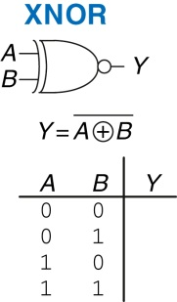
Figure 1.17 XNOR gate

Slide 19
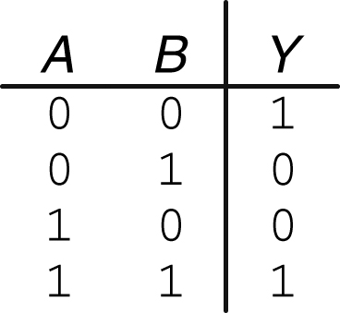
Figure 1.18 XNOR truth table

Slide 20
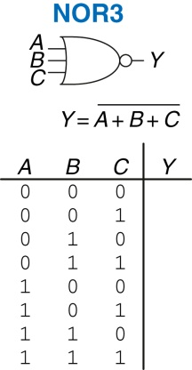
Figure 1.19 Three-input NOR gate

Slide 21
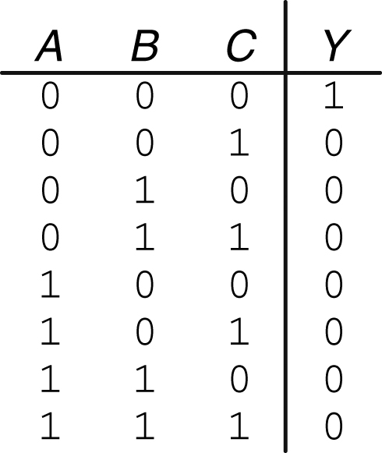
Figure 1.20 Three-input NOR truth table

Slide 22
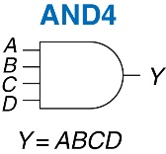
Figure 1.21 Four-input AND gate

Slide 23
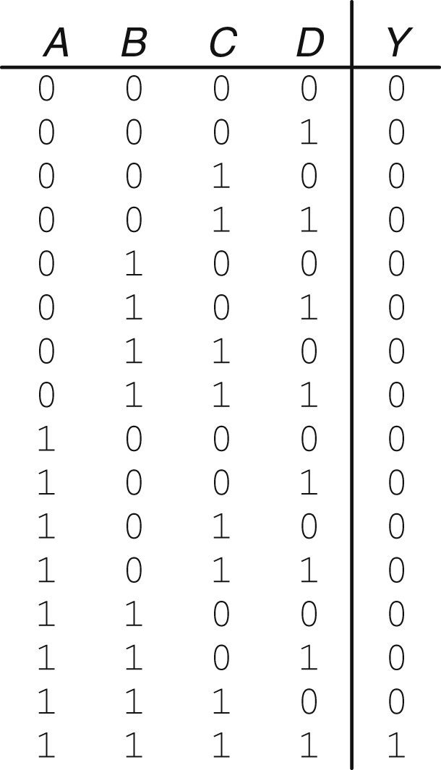
Figure 1.22 Four-input AND truth table

Slide 24
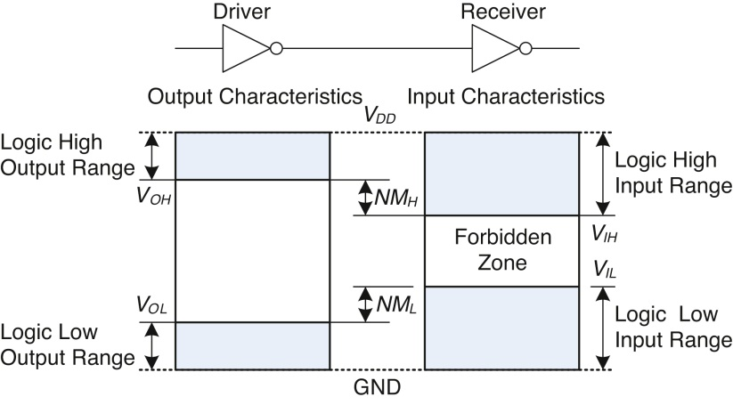
Figure 1.23 Logic levels and noise margins

Slide 25
Figure 1.24 Inverter circuit

Slide 26
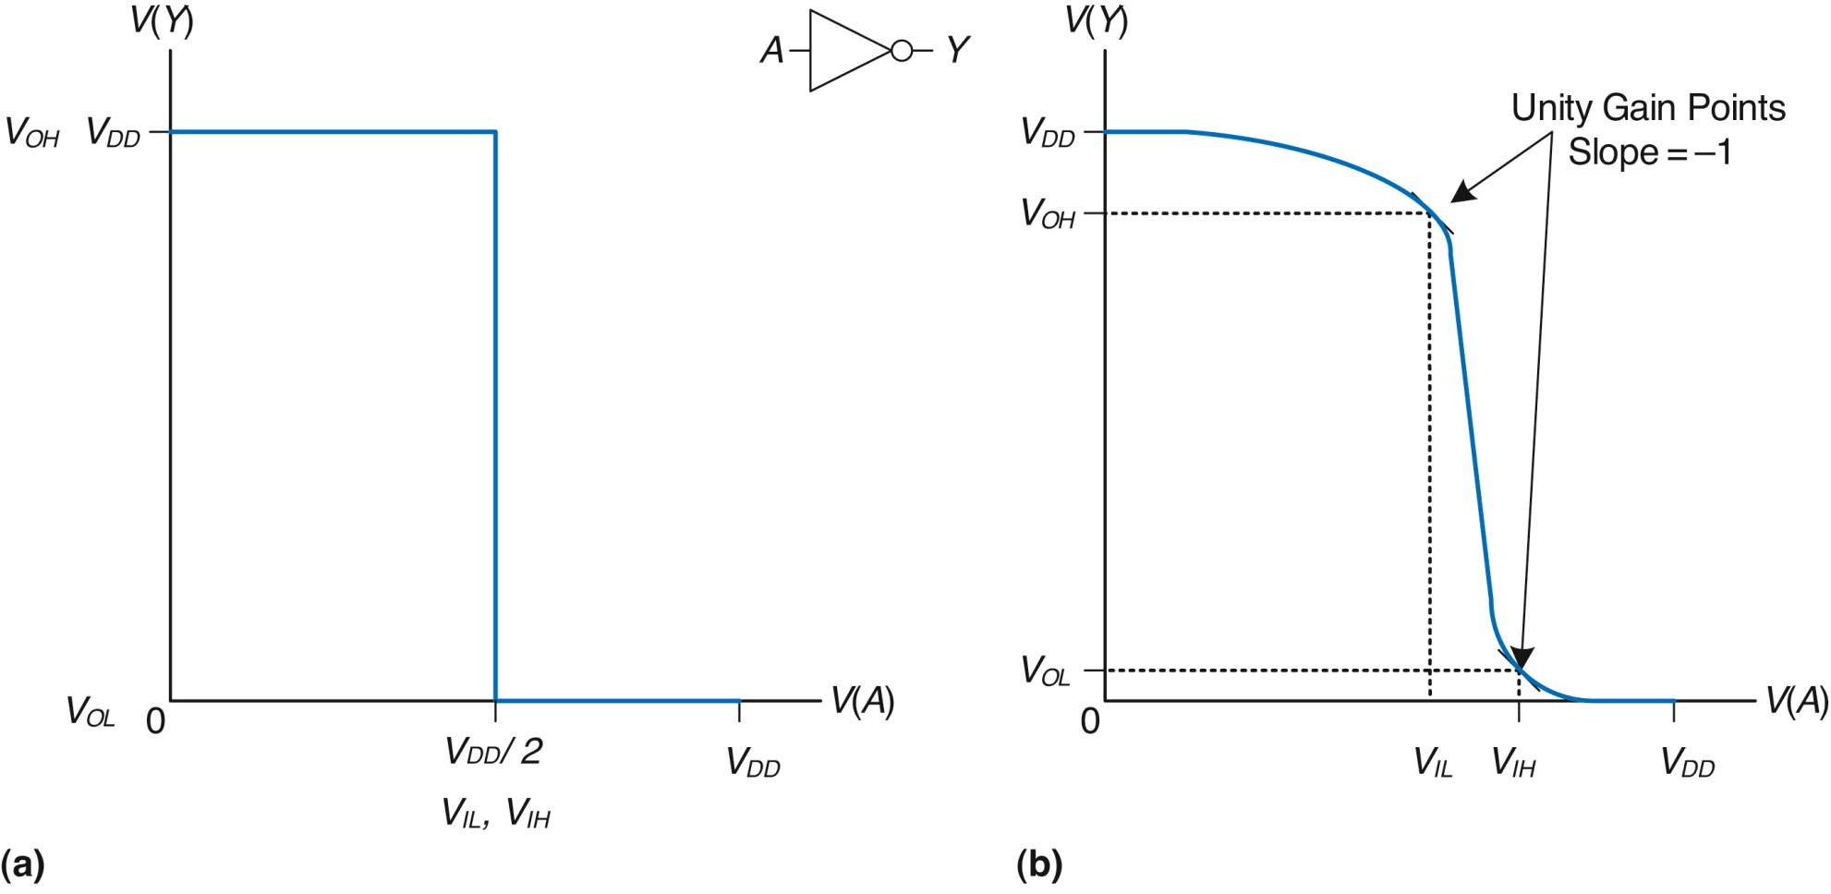
Figure 1.25 DC transfer characteristics and logic levels

Slide 27
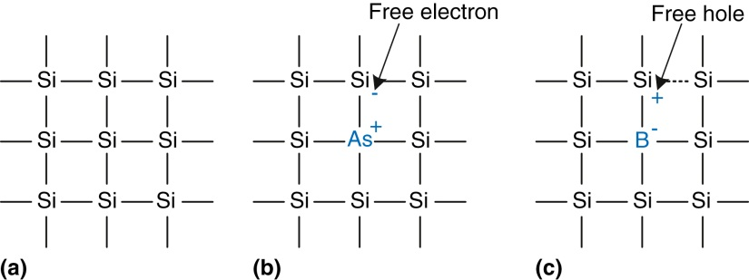
Figure 1.26 Silicon lattice and dopant atoms

Slide 28
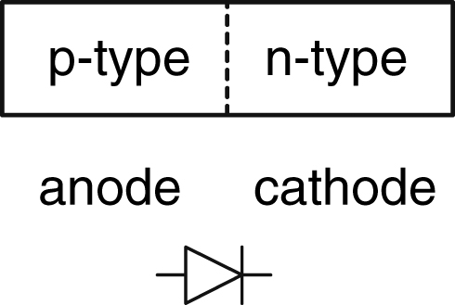
Figure 1.27 The p-n junction diode structure and symbol

Slide 29
Figure 1.28 Capacitor symbol

Slide 30
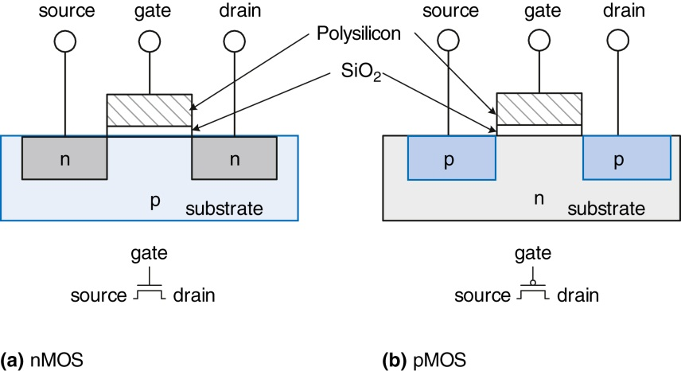
Figure 1.29 nMOS and pMOS transistors

Slide 31
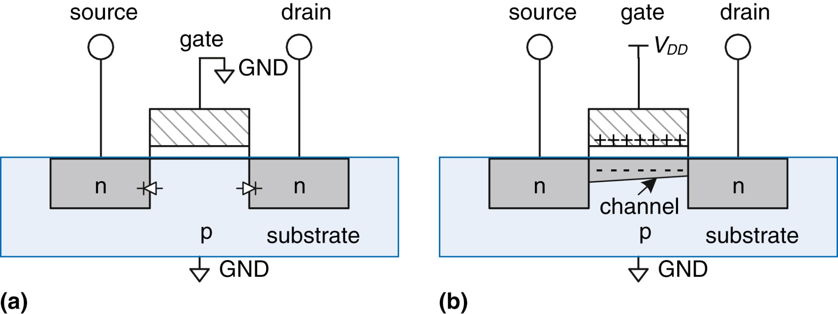
Figure 1.30 nMOS transistor operation

Slide 32
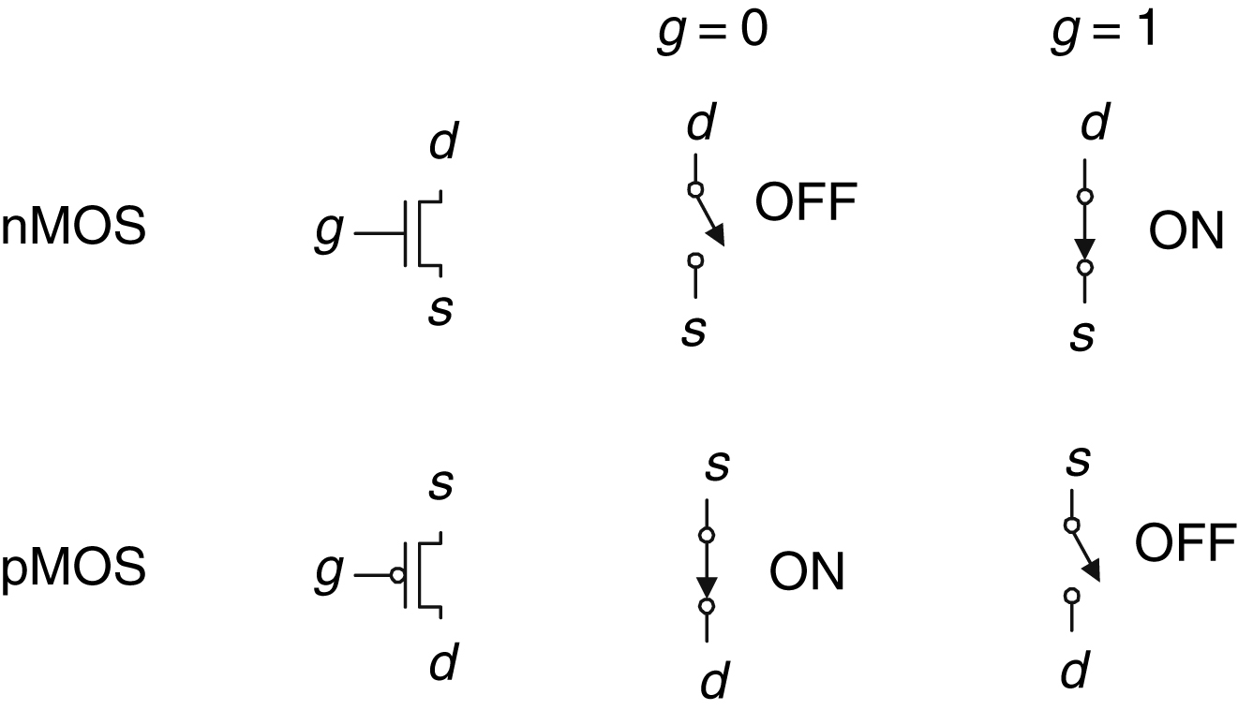
Figure 1.31 Switch models of MOSFETs

Slide 33
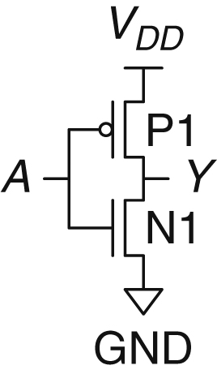
Figure 1.32 NOT gate schematic

Slide 34
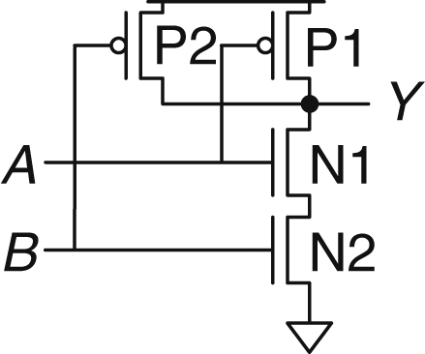
Figure 1.33 Two-input NAND gate schematic

Slide 35
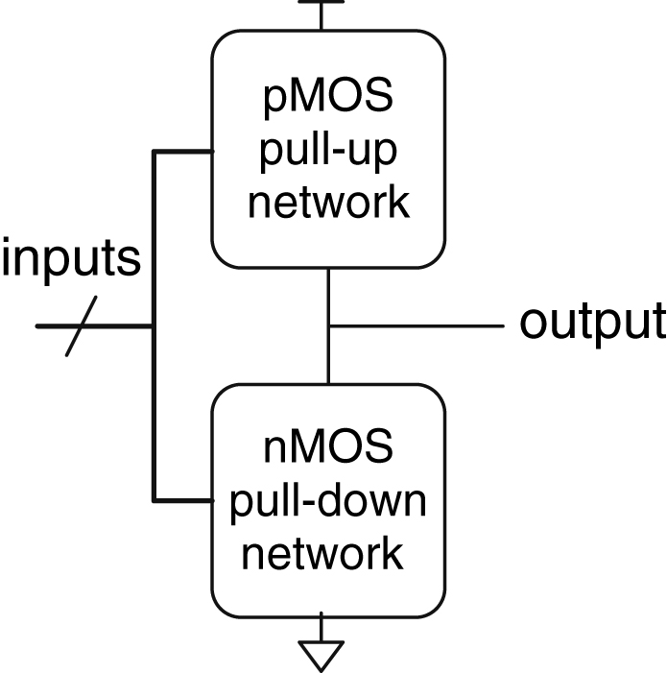
Figure 1.34 General form of an inverting logic gate

Slide 36
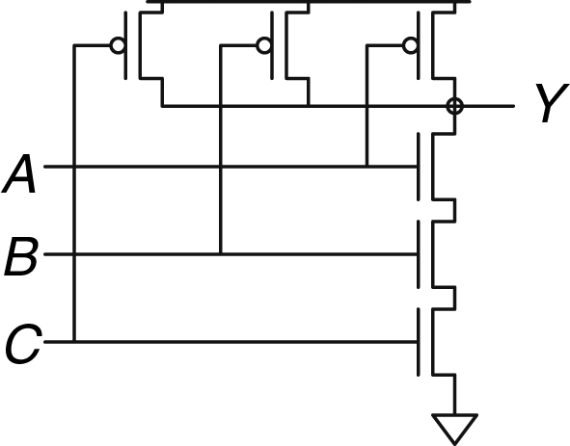
Figure 1.35 Three-input NAND gate schematic

Slide 37
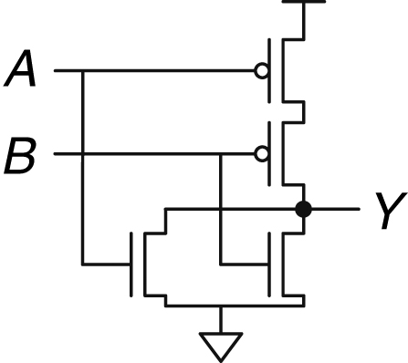
Figure 1.36 Two-input NOR gate schematic

Slide 38
Figure 1.37 Two-input AND gate schematic

Slide 39
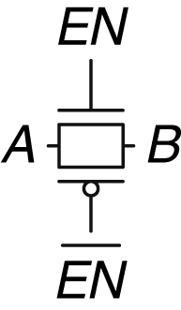
Figure 1.38 Transmission gate

Slide 40
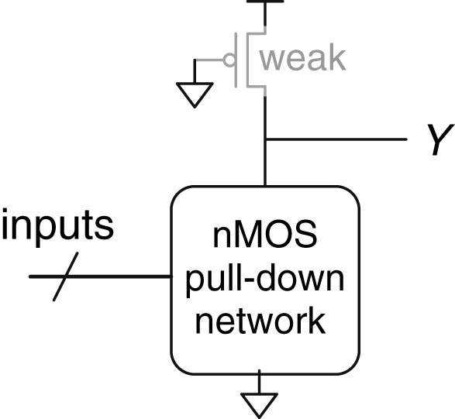
Figure 1.39 Generic pseudo-nMOS gate

Slide 41
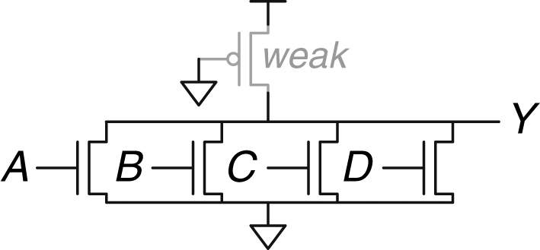
Figure 1.40 Pseudo-nMOS four-input NOR gate

Slide 42
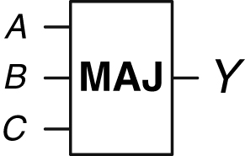
Figure 1.41 Three-input majority gate

Slide 43
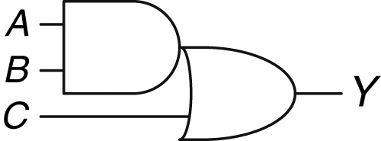
Figure 1.42 Three-input AND-OR gate

Slide 44
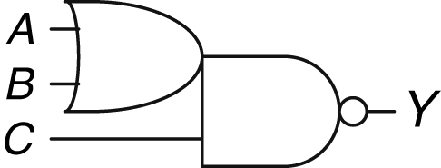
Figure 1.43 Three-input OR-AND-INVERT gate

Slide 45
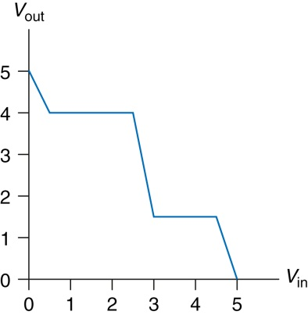
Figure 1.44 DC transfer characteristics

Slide 46
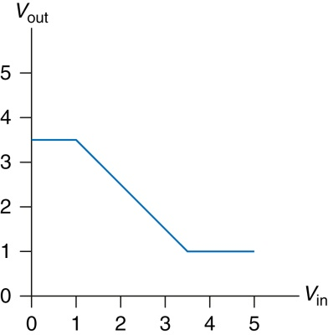
Figure 1.45 DC transfer characteristics

Slide 47
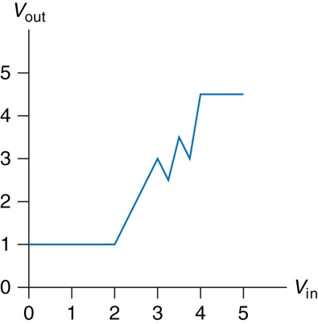
Figure 1.46 DC transfer characteristics

Slide 48
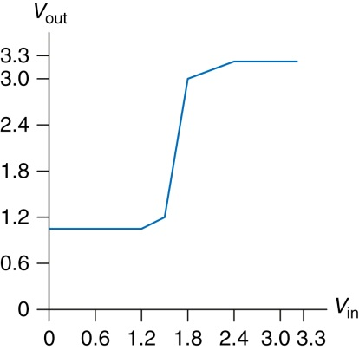
Figure 1.47 Ben's buffer DC transfer characteristics

Slide 49
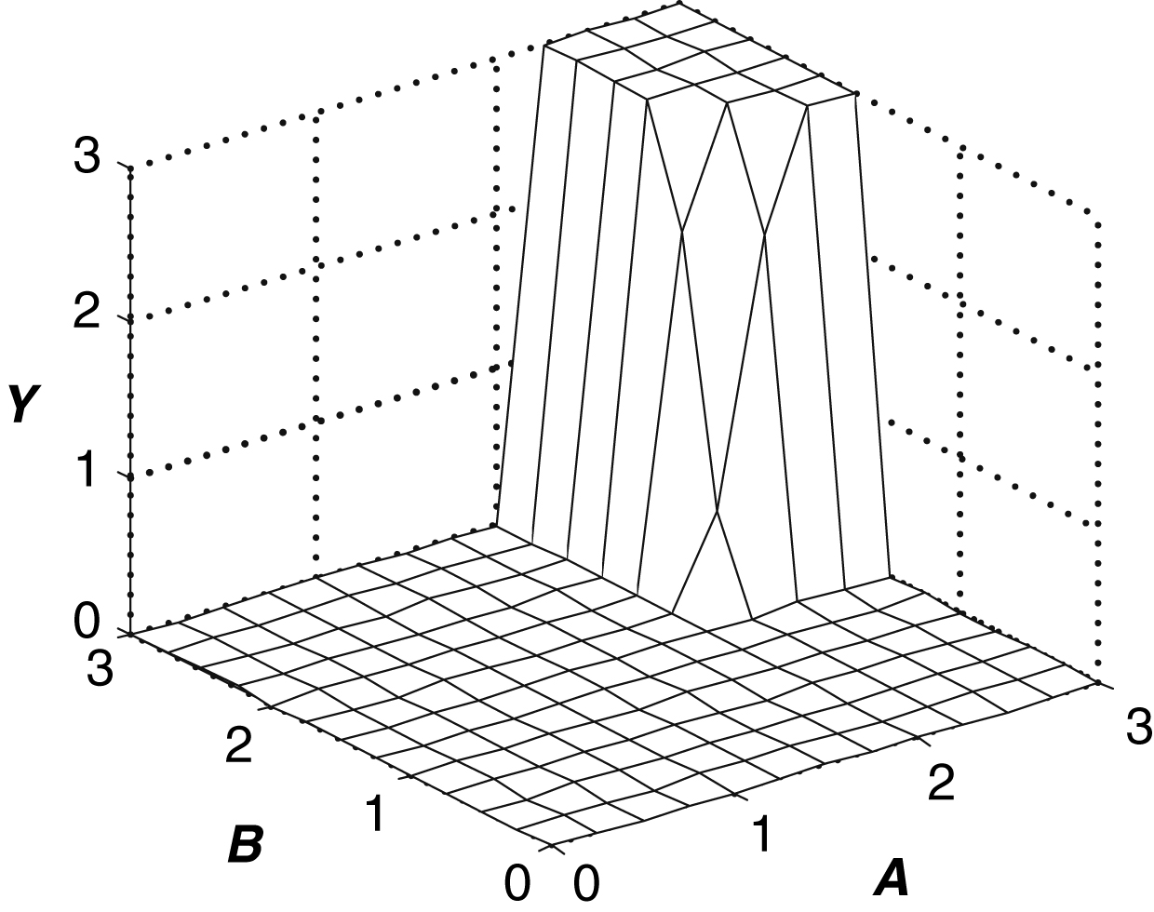
Figure 1.48 Two-input DC transfer characteristics

Slide 50
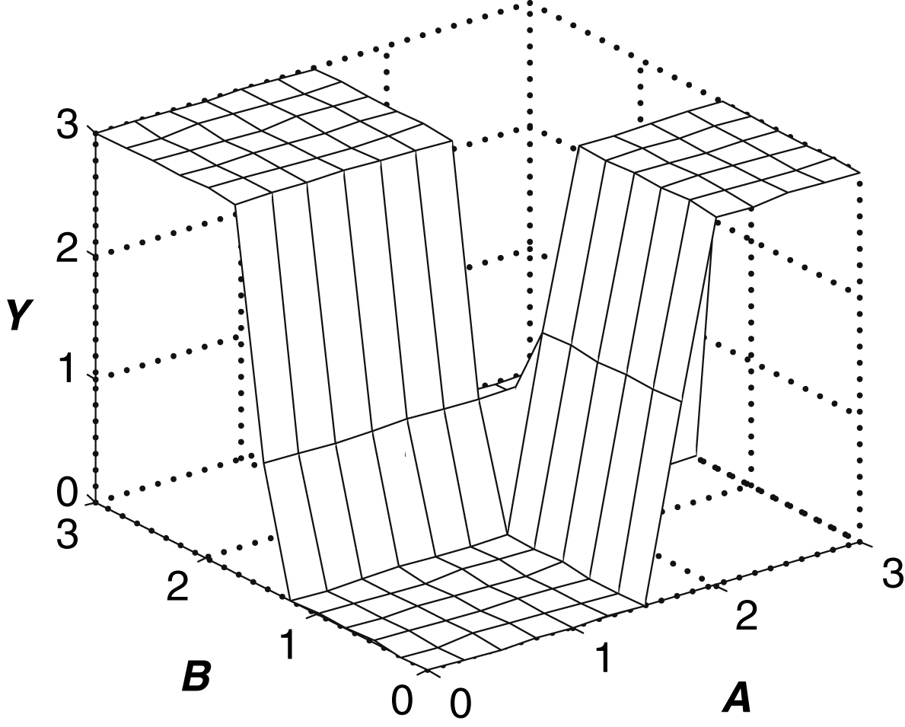
Figure 1.49 Two-input DC transfer characteristics

Slide 51
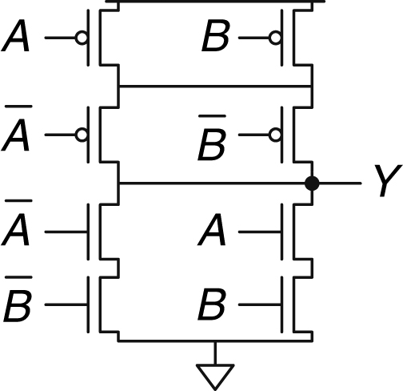
Figure 1.50 Mystery schematic

Slide 52
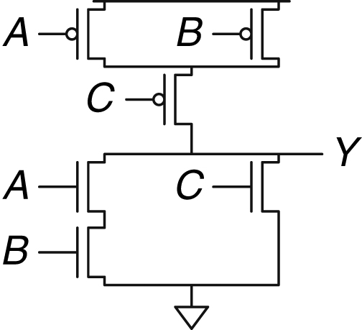
Figure 1.51 Mystery schematic

Slide 53
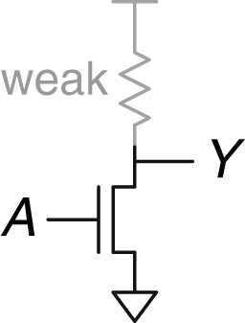
Figure 1.52 RTL NOT gate

Slide 54
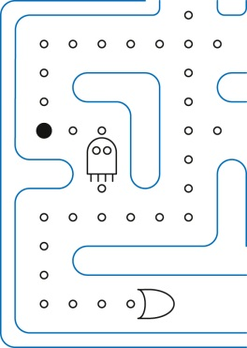

Slide 55
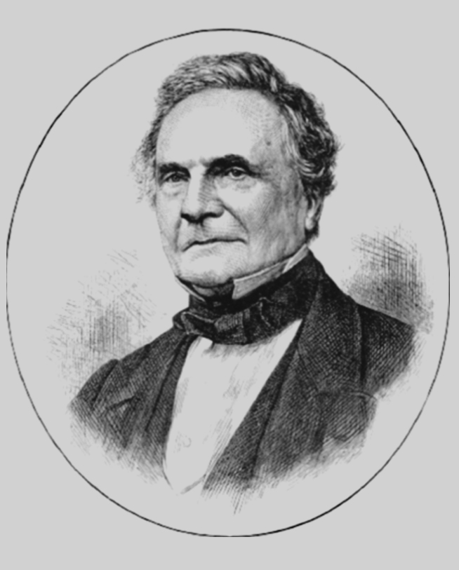

Slide 56
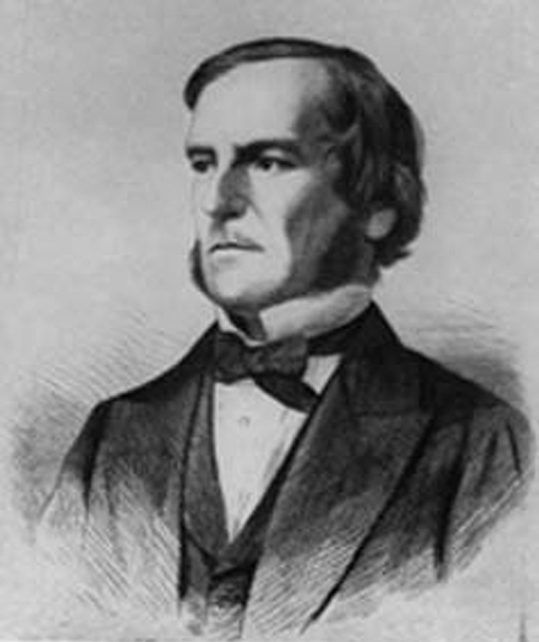

Slide 57
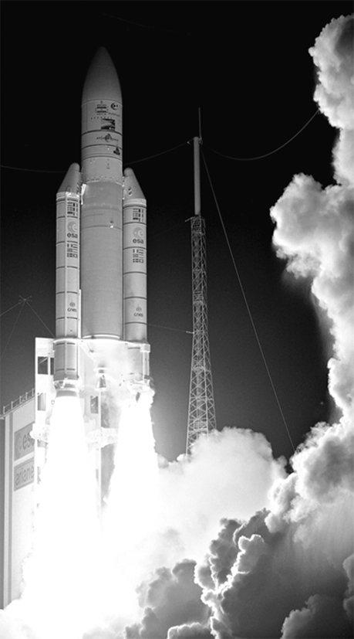

Slide 64
Figure u01-01

