Slide 1
Combinational Logic Design
CH002

Slide 2
Figure 2.1 Circuit as a black box with inputs, outputs, and specifications

Slide 3
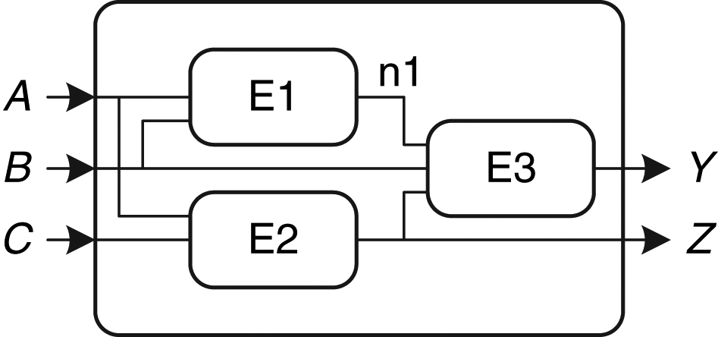
Figure 2.2 Elements and nodes

Slide 4
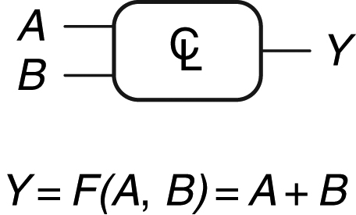
Figure 2.3 Combinational logic circuit

Slide 5
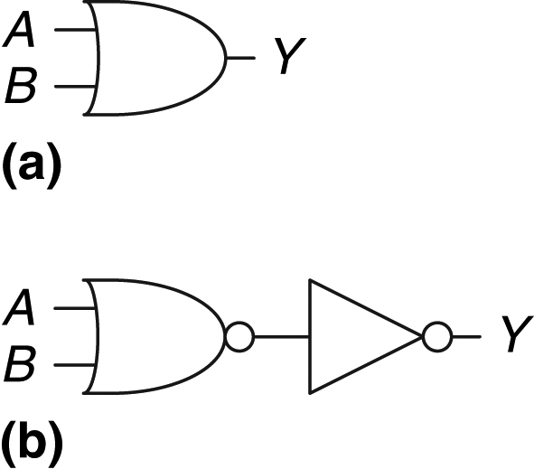
Figure 2.4 Two OR implementations

Slide 6
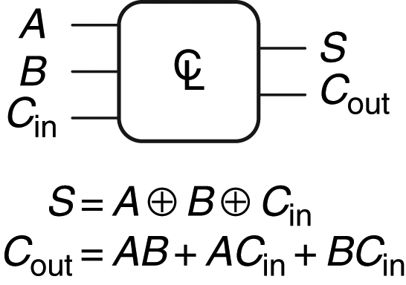
Figure 2.5 Multiple-output combinational circuit

Slide 7
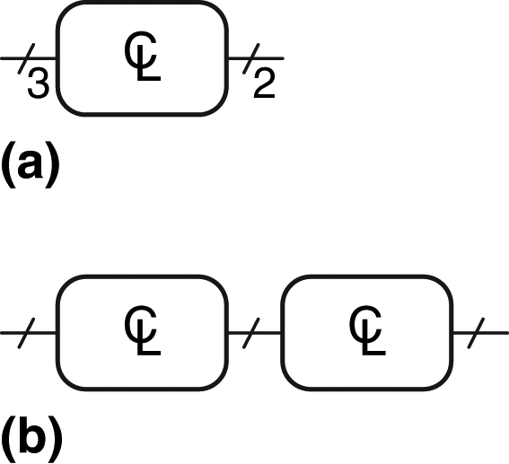
Figure 2.6 Slash notation for multiple signals

Slide 8
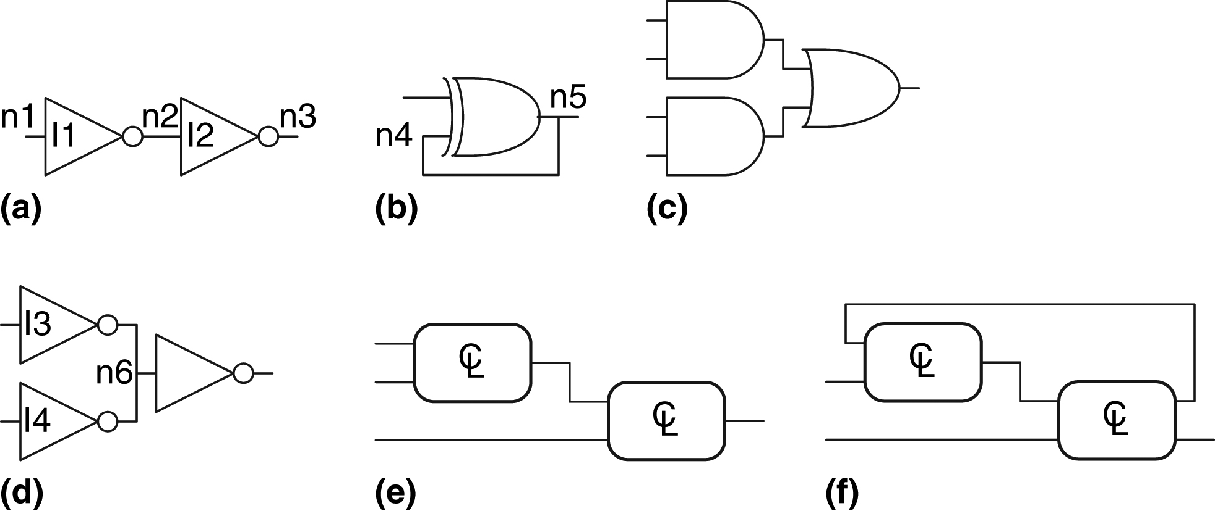
Figure 2.7 Example circuits

Slide 9
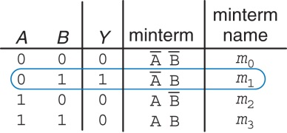
Figure 2.8 Truth table and minterms

Slide 10
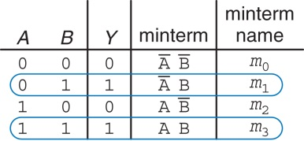
Figure 2.9 Truth table with multiple TRUE minterms

Slide 11
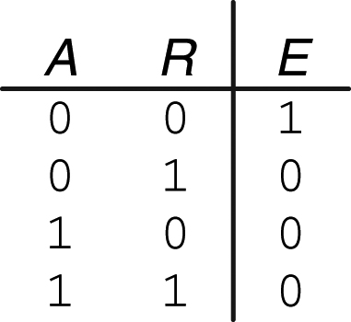
Figure 2.10 Ben's truth table

Slide 12
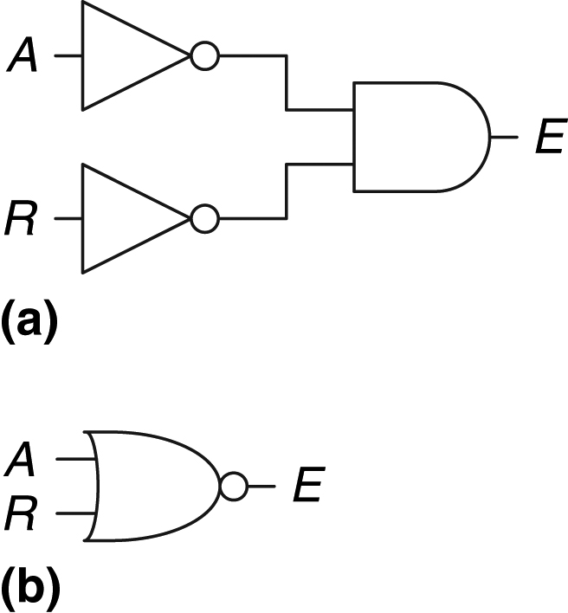
Figure 2.11 Ben's circuit

Slide 13
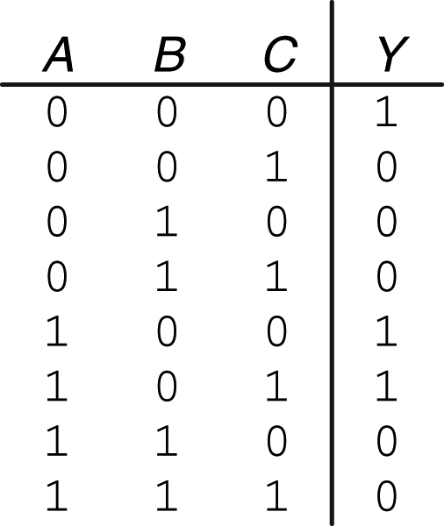
Figure 2.12 Random three-input truth table

Slide 14
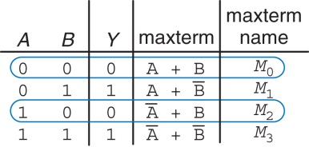
Figure 2.13 Truth table with multiple FALSE maxterms

Slide 15
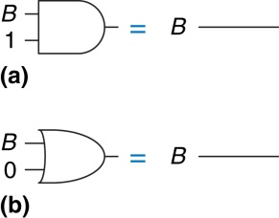
Figure 2.14 Identity theorem in hardware: (a) T1, (b) T1′

Slide 16
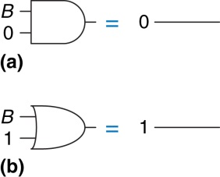
Figure 2.15 Null element theorem in hardware: (a) T2, (b) T2′

Slide 17
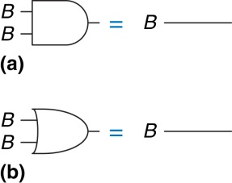
Figure 2.16 Idempotency theorem in hardware: (a) T3, (b) T3′

Slide 18
Figure 2.17 Involution theorem in hardware: T4

Slide 19
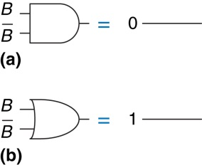
Figure 2.18 Complement theorem in hardware: (a) T5, (b) T5′

Slide 20
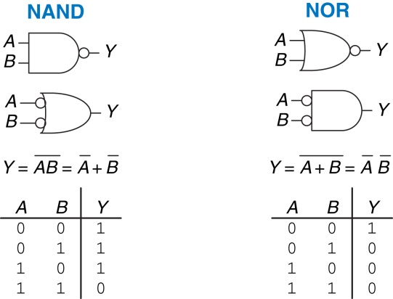
Figure 2.19 De Morgan equivalent gates

Slide 21
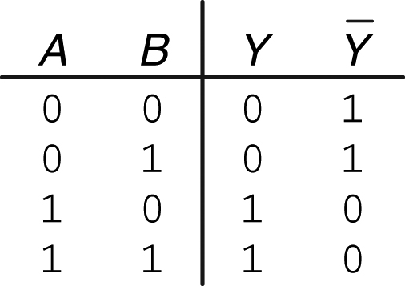
Figure 2.20 Truth table showing

Slide 22
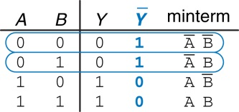
Figure 2.21 Truth table showing minterms for

Slide 23
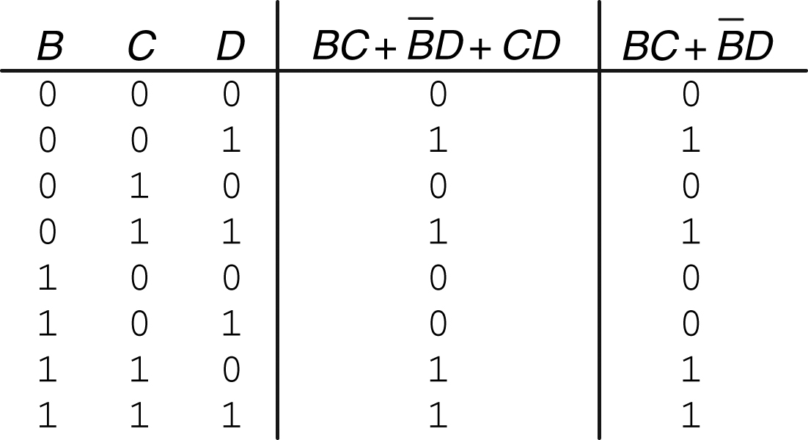
Figure 2.22 Truth table proving T11

Slide 24
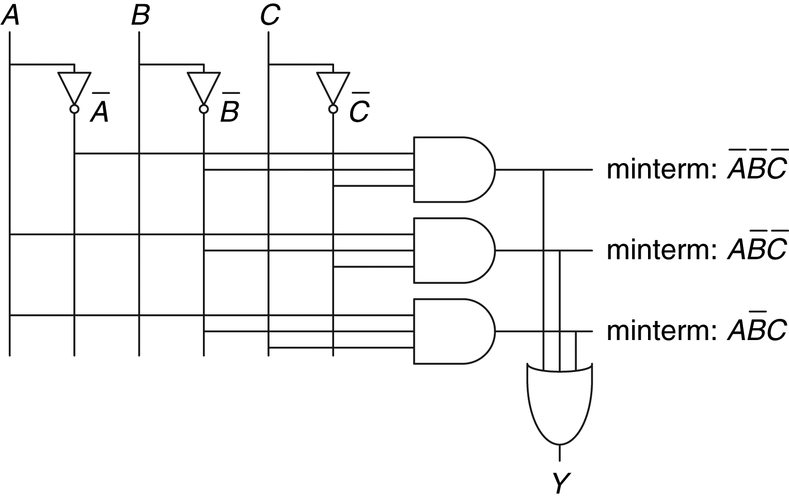
Figure 2.23 Schematic of

Slide 25
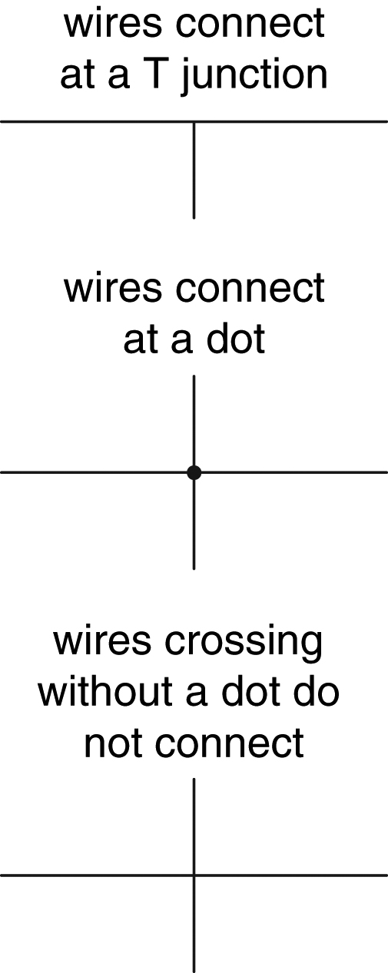
Figure 2.24 Wire connections

Slide 26
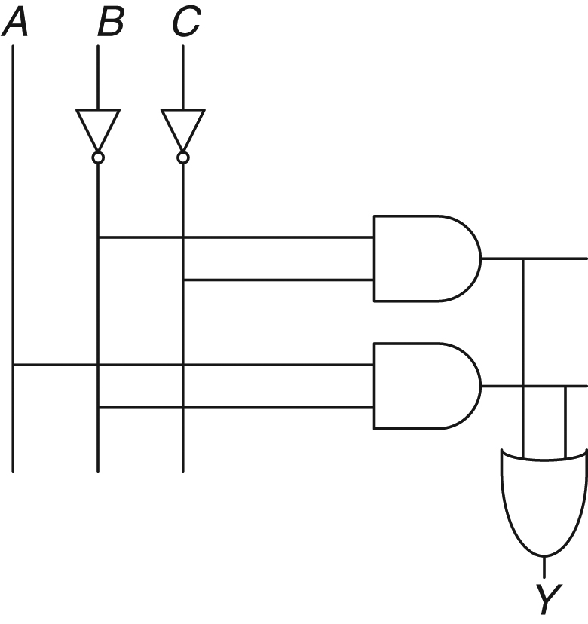
Figure 2.25 Schematic of

Slide 27
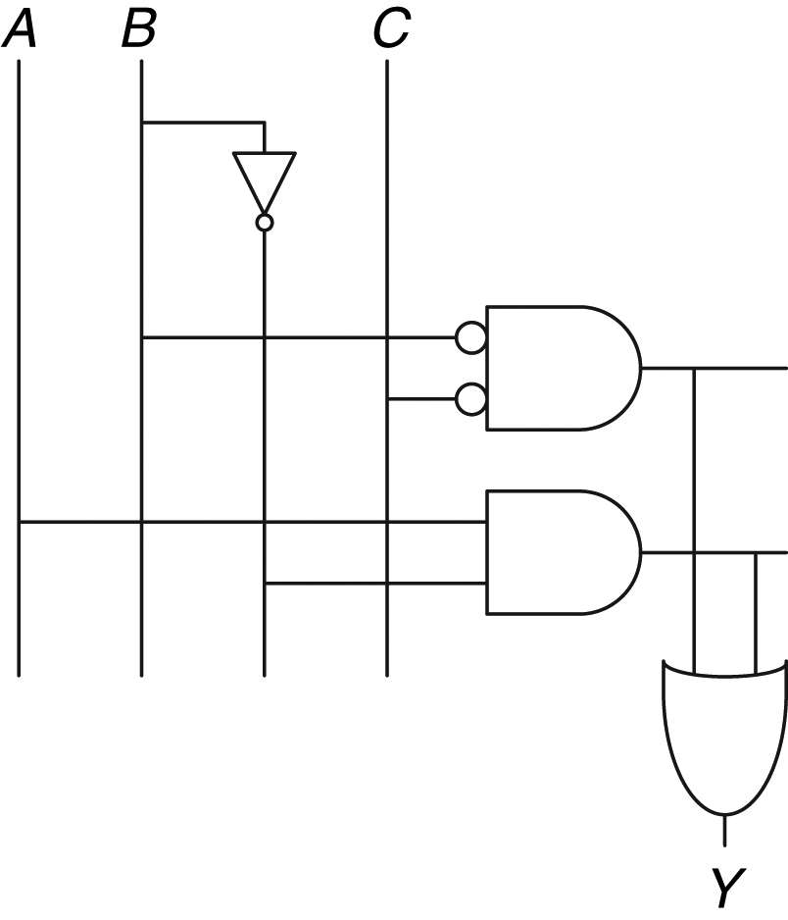
Figure 2.26 Schematic using fewer gates

Slide 28
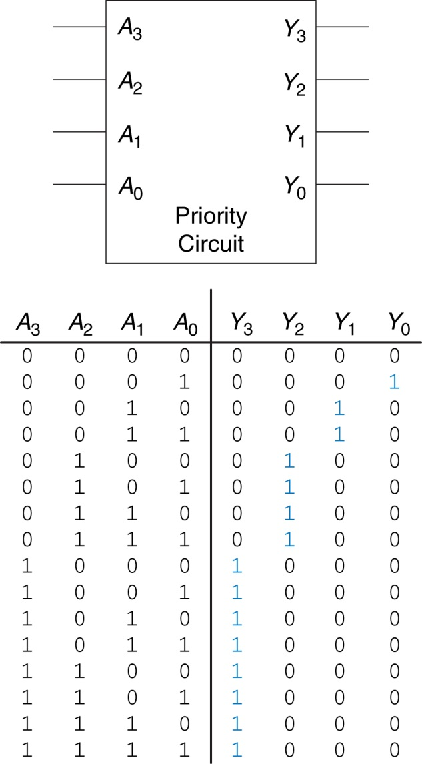
Figure 2.27 Priority circuit

Slide 29
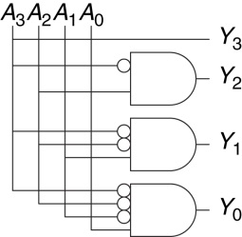
Figure 2.28 Priority circuit schematic

Slide 30
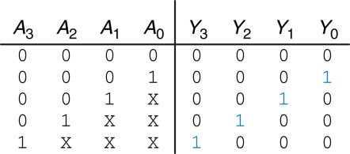
Figure 2.29 Priority circuit truth table with don't cares (X's)

Slide 31
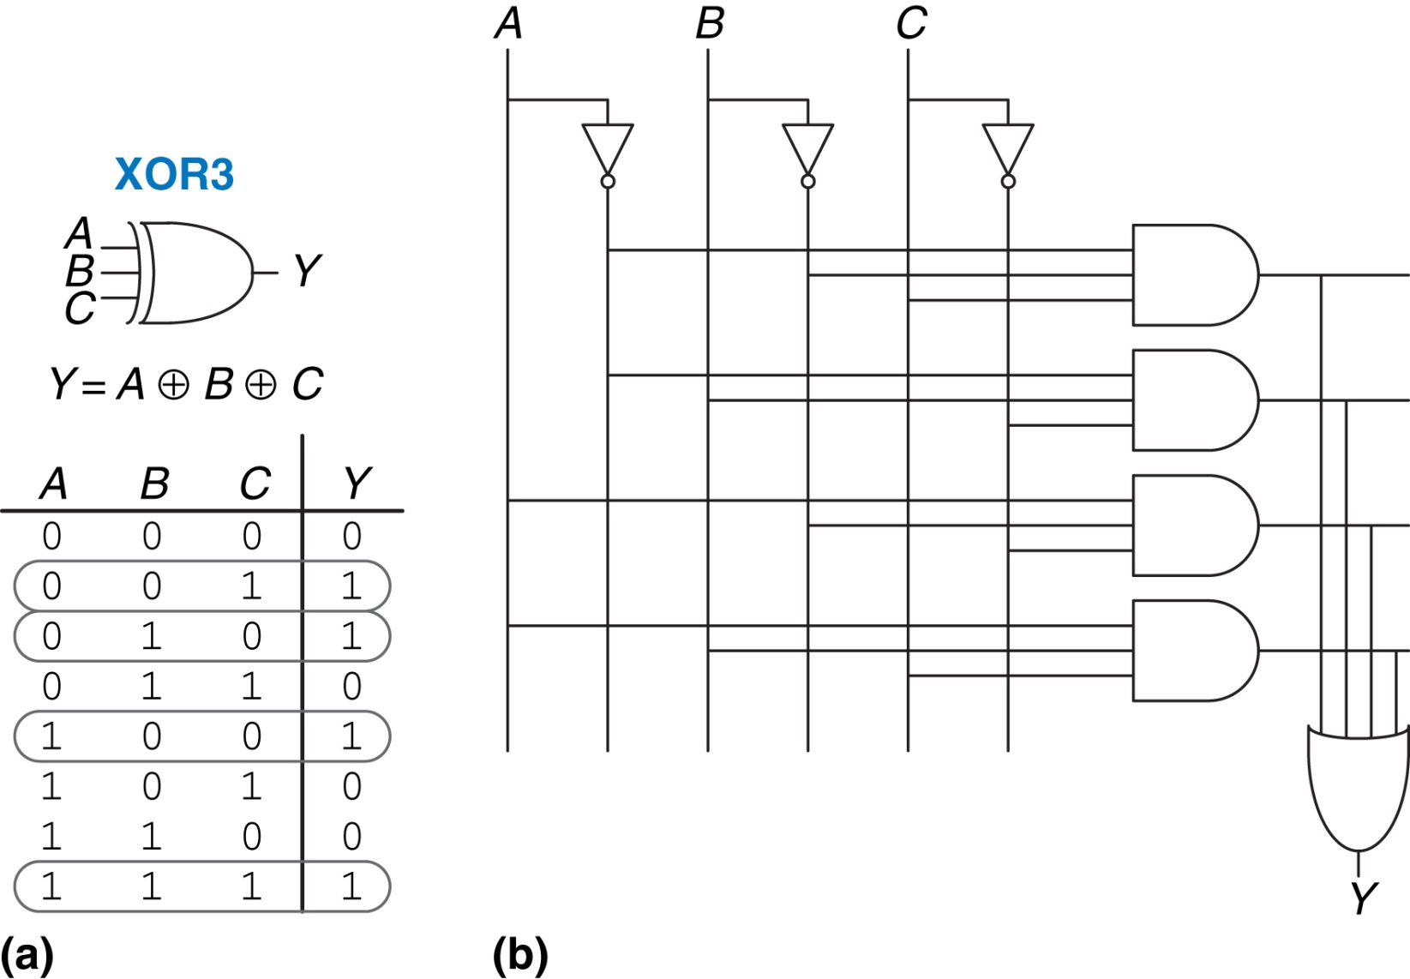
Figure 2.30 Three-input XOR: (a) functional specification and (b) two-level logic implementation

Slide 32
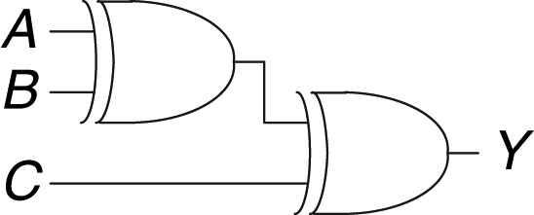
Figure 2.31 Three-input XOR using two-input XORs

Slide 33
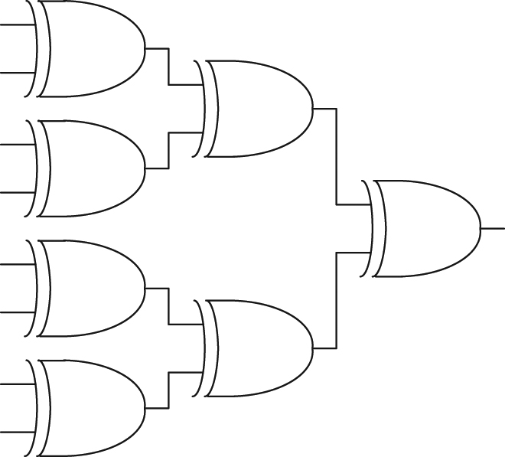
Figure 2.32 Eight-input XOR using seven two-input XORs

Slide 34
Figure 2.33 Multilevel circuit using NANDs and NORs

Slide 35
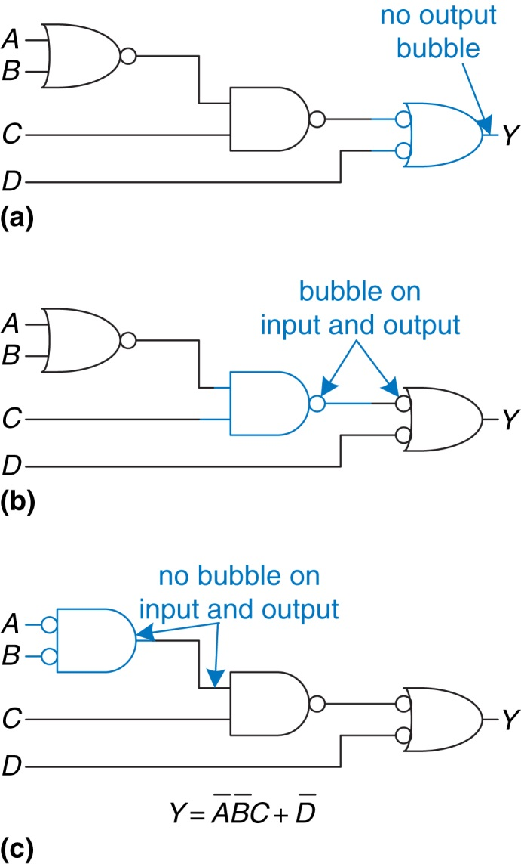
Figure 2.34 Bubble-pushed circuit

Slide 36
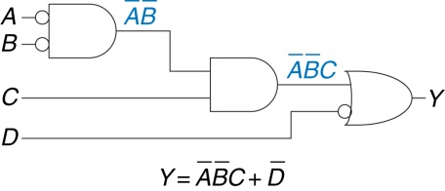
Figure 2.35 Logically equivalent bubble-pushed circuit

Slide 37
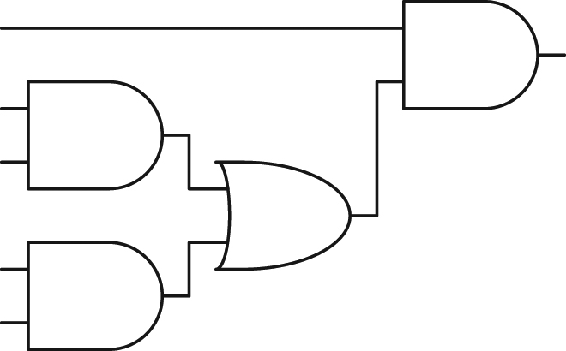
Figure 2.36 Circuit using ANDs and ORs

Slide 38
Figure 2.37 Poor circuit using NANDs and NORs

Slide 39
Figure 2.38 Better circuit using NANDs and NORs

Slide 40
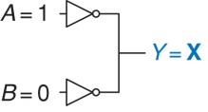
Figure 2.39 Circuit with contention

Slide 41
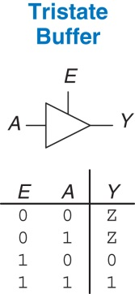
Figure 2.40 Tristate buffer

Slide 42
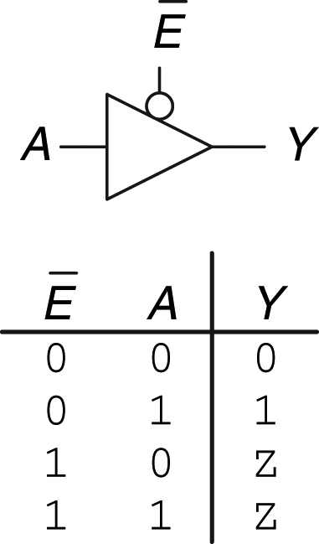
Figure 2.41 Tristate buffer with active low enable

Slide 43
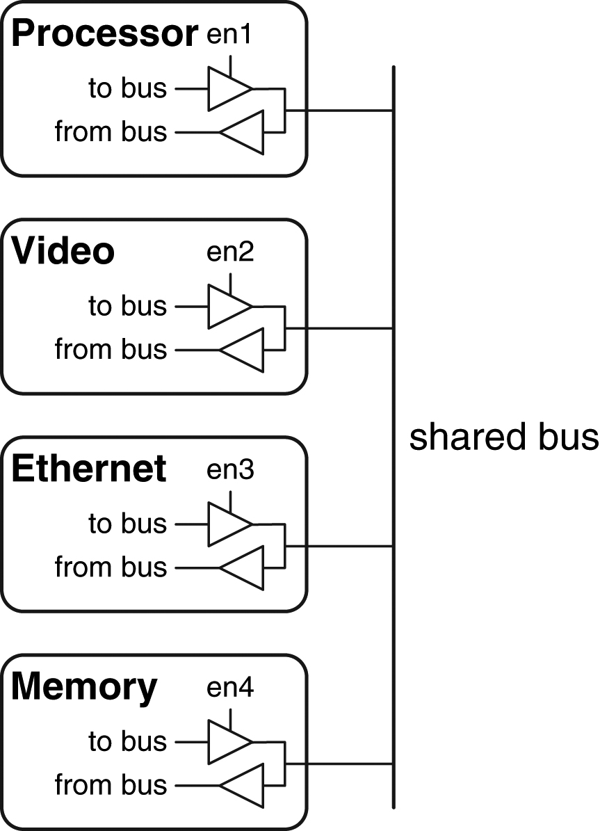
Figure 2.42 Tristate bus connecting multiple chips

Slide 44
Figure 2.43 Three-input function: (a) truth table, (b) K-map, (c) K-map showing minterms

Slide 45
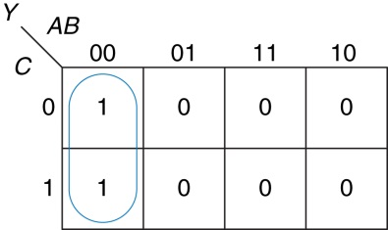
Figure 2.44 K-map minimization

Slide 46
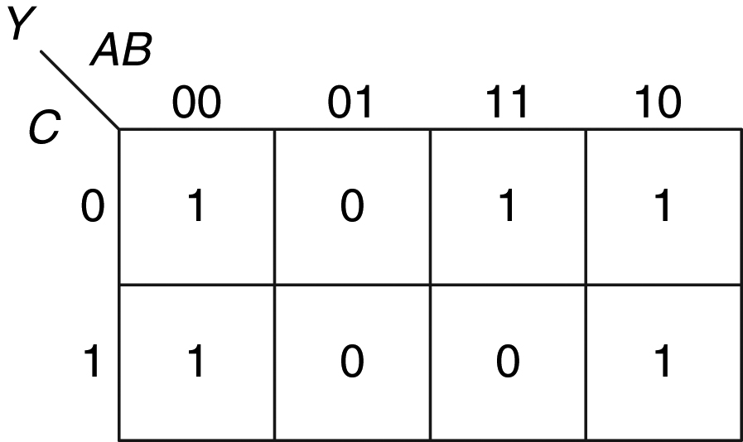
Figure 2.45 K-map for Example 2.9

Slide 47
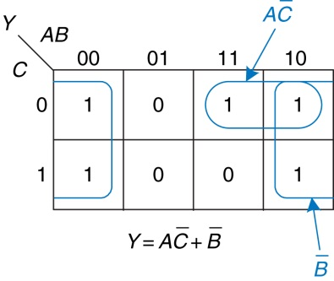
Figure 2.46 Solution for Example 2.9

Slide 48
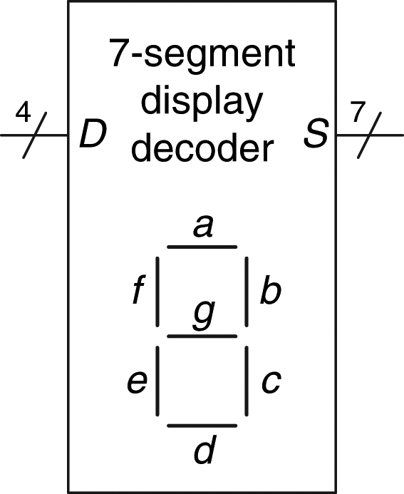
Figure 2.47 Seven-segment display decoder icon

Slide 49
Figure 2.48 Seven-segment display digits

Slide 50
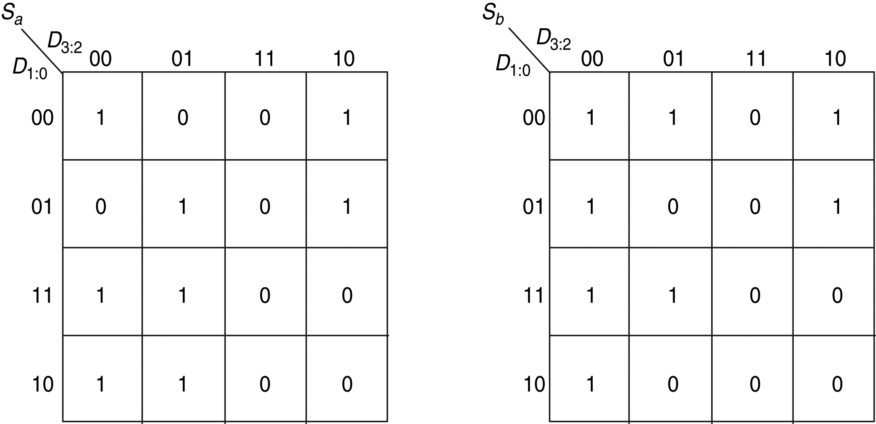
Figure 2.49 Karnaugh maps for S_{a} and S_{b}

Slide 51
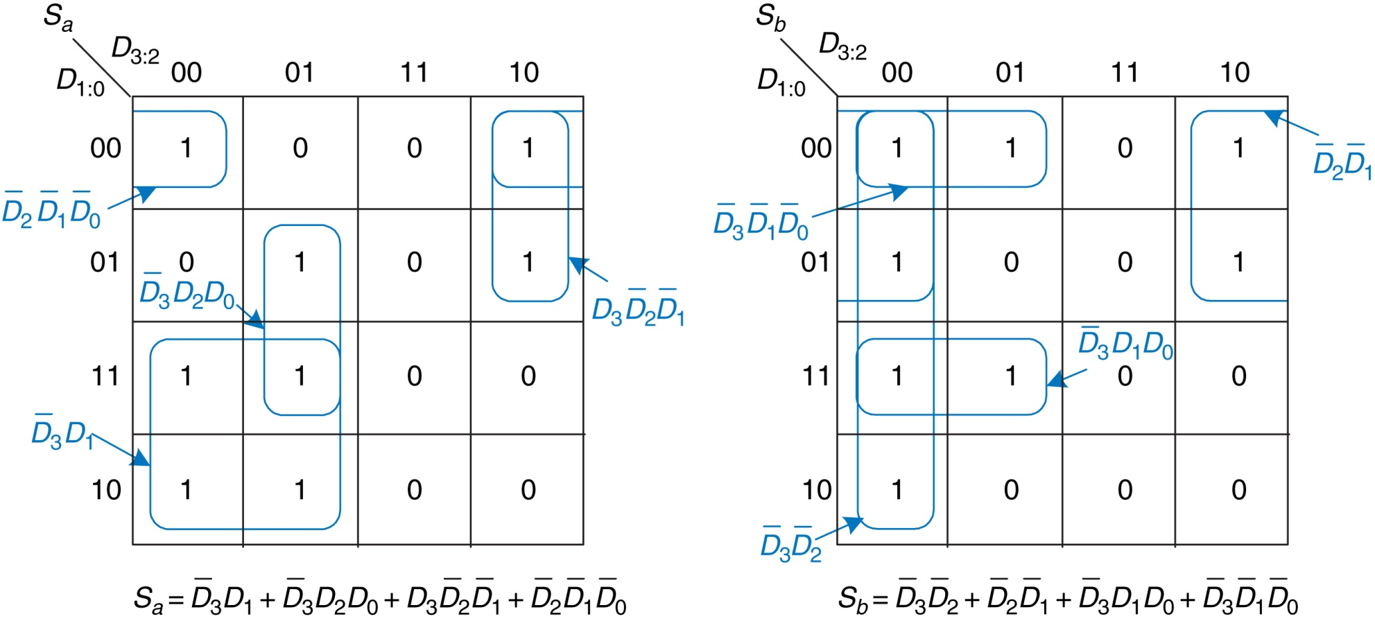
Figure 2.50 K-map solution for Example 2.10

Slide 52
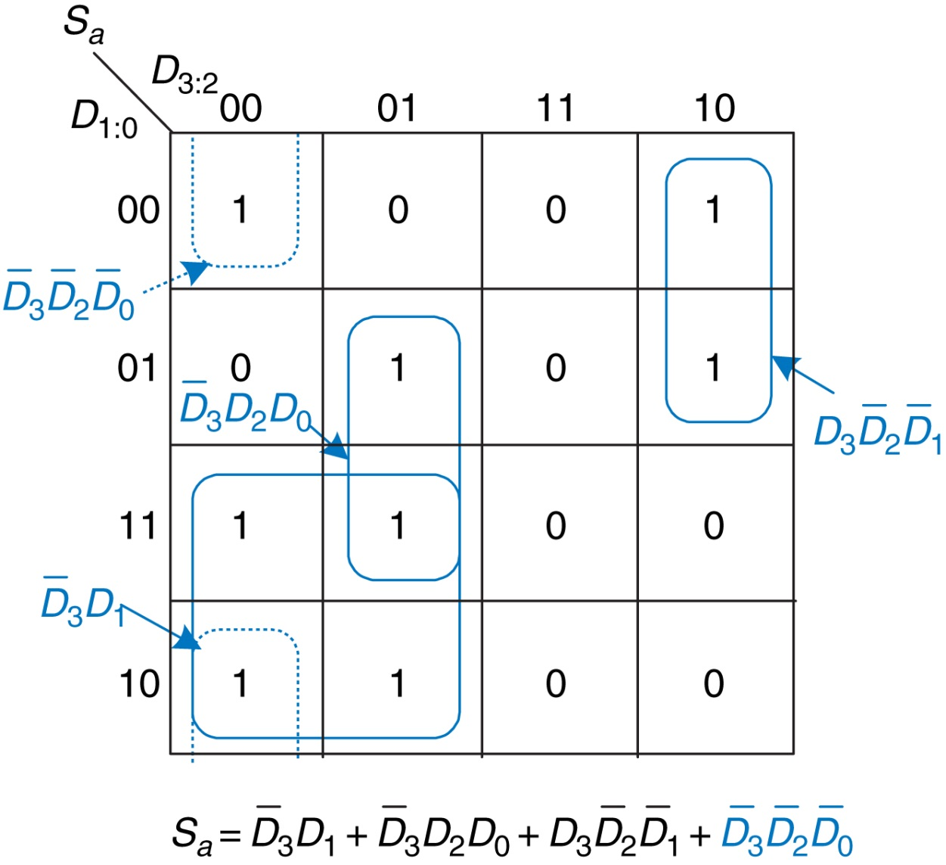
Figure 2.51 Alternative K-map for S_{a} showing different set of prime implicants

Slide 53
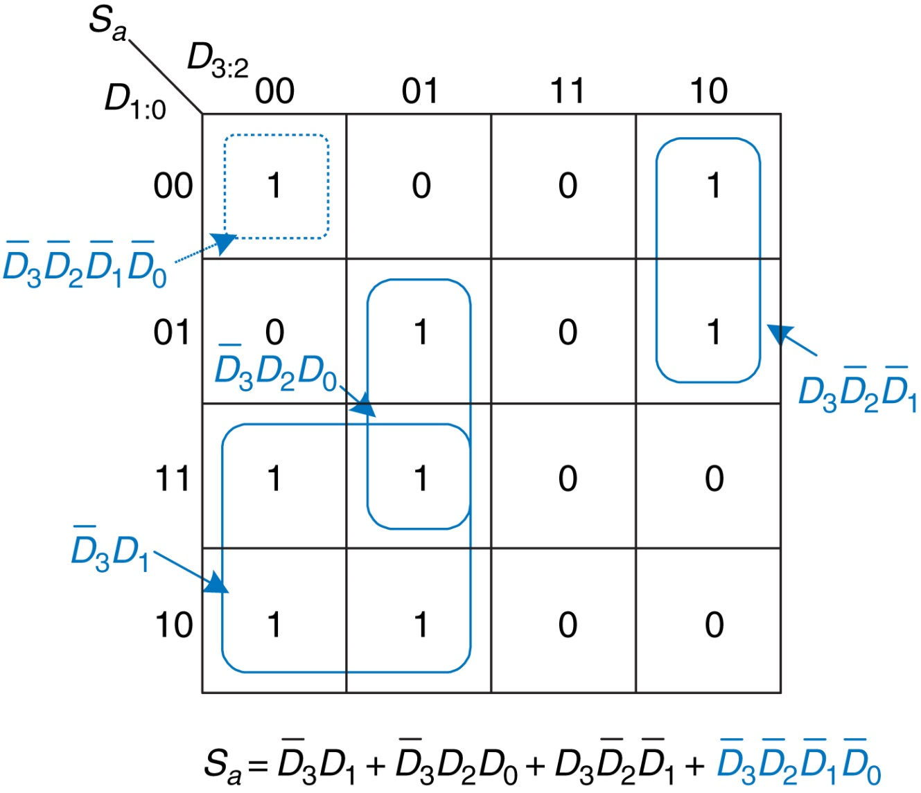
Figure 2.52 Alternative K-map for S_{a} showing incorrect nonprime implicant

Slide 54
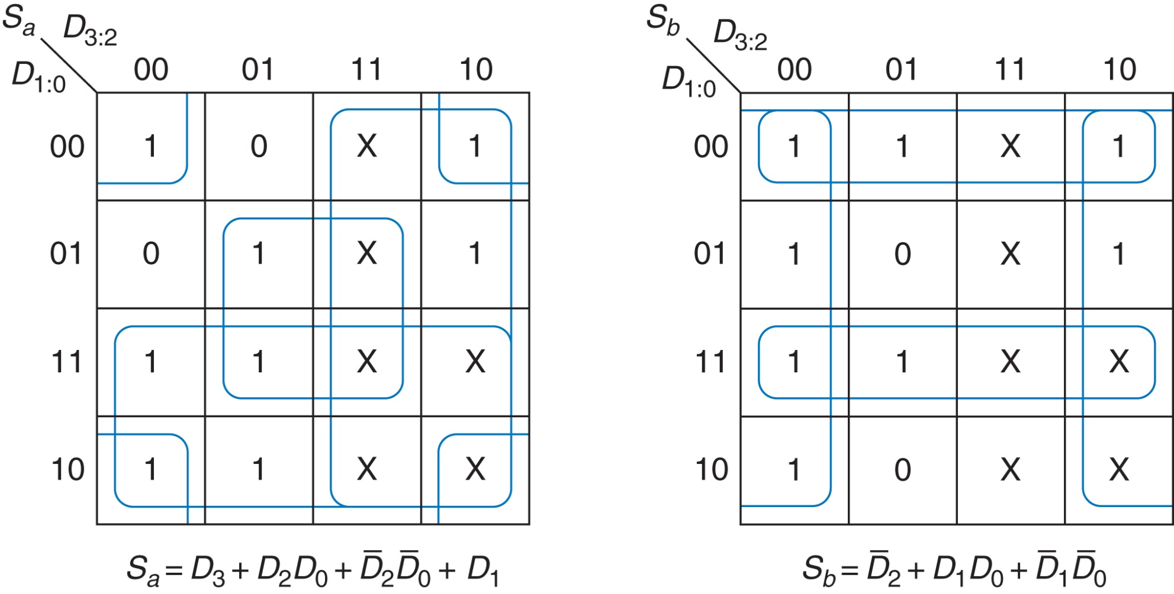
Figure 2.53 K-map solution with don't cares

Slide 55
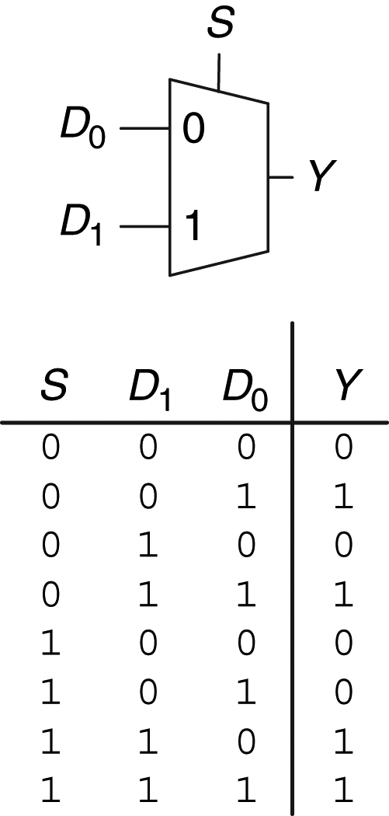
Figure 2.54 2:1 multiplexer symbol and truth table

Slide 56
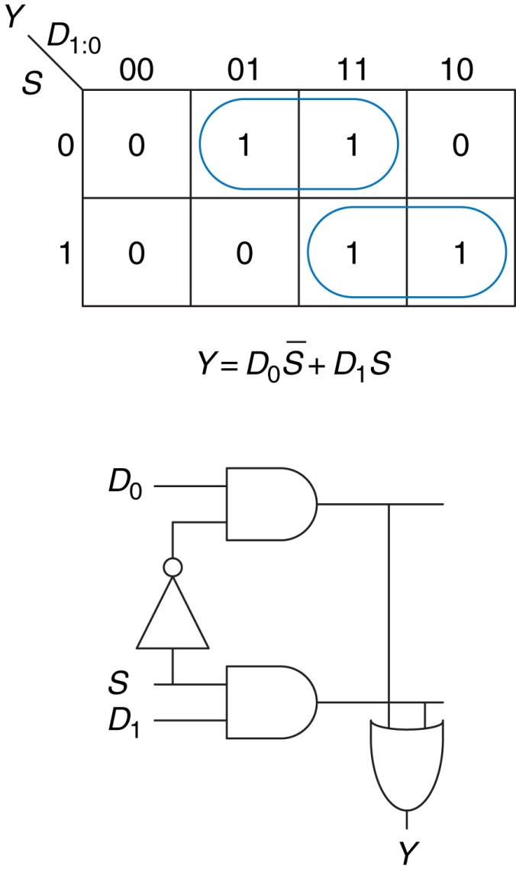
Figure 2.55 2:1 multiplexer implementation using two-level logic

Slide 57
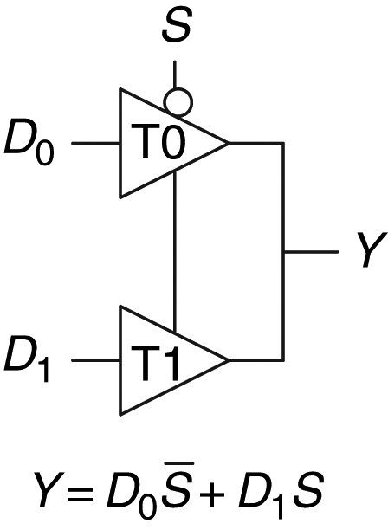
Figure 2.56 Multiplexer using tristate buffers

Slide 58
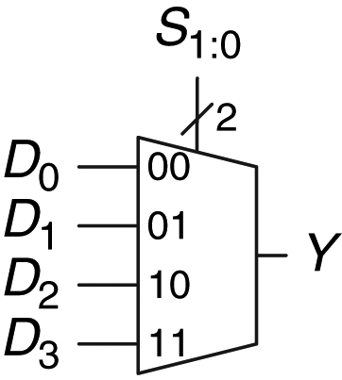
Figure 2.57 4:1 multiplexer

Slide 59
Figure 2.58 4:1 multiplexer implementations: (a) two-level logic, (b) tristates, (c) hierarchical

Slide 60
Figure 2.59 4:1 multiplexer implementation of two-input AND function

Slide 61
Figure 2.60 Multiplexer logic using variable inputs

Slide 62
Figure 2.61 Alyssa's circuit: (a) truth table, (b) 8:1 multiplexer implementation

Slide 63
Figure 2.62 Alyssa's new circuit

Slide 64
Figure 2.63 2:4 decoder

Slide 65
Figure 2.64 2:4 decoder implementation

Slide 66
Figure 2.65 Logic function using decoder

Slide 67
Figure 2.66 Circuit delay

Slide 68
Figure 2.67 Propagation and contamination delay

Slide 69
Figure 2.68 Short path and critical path

Slide 70
Figure 2.69 Critical and short path waveforms

Slide 71
Figure 2.70 Ben's circuit

Slide 72
Figure 2.71 Ben's critical path

Slide 73
Figure 2.72 Ben's shortest path

Slide 74
Figure 2.73 4:1 multiplexer propagation delays: (a) two-level logic, (b) tristate

Slide 75
Figure 2.74 4:1 multiplexer propagation delays: hierarchical using 2:1 multiplexers

Slide 76
Figure 2.75 Circuit with a glitch

Slide 77
Figure 2.76 Timing of a glitch

Slide 78
Figure 2.77 Input change crosses implicant boundary

Slide 79
Figure 2.78 K-map without glitch

Slide 80
Figure 2.79 Circuit without glitch

Slide 81
Figure 2.80 Truth tables for Exercises 2.1 and 2.3

Slide 82
Figure 2.81 Truth tables for Exercises 2.2 and 2.4

Slide 83
Figure 2.82 Circuit schematic

Slide 84
Figure 2.83 Circuit schematic

Slide 85
Figure 2.84 Circuit schematic

Slide 86
Figure 2.85 Truth table for Exercise 2.28

Slide 87
Figure 2.86 Truth table for Exercise 2.31

Slide 88
Figure 2.87 Multiplexer circuit

Slide 89
Figure 2.88 Multiplexer circuit

Slide 92
Figure u02-01

