Slide 1
Sequential Logic Design
CH003

Slide 2
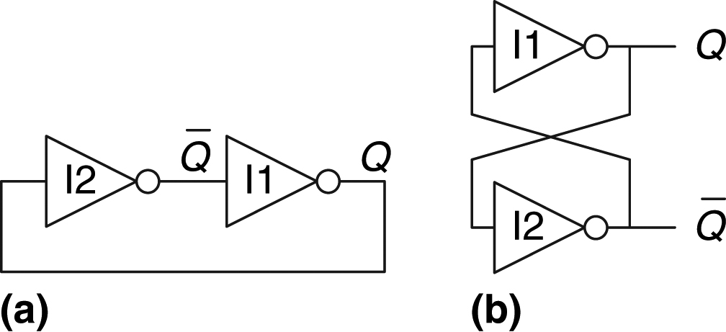
Figure 3.1 Cross-coupled inverter pair

Slide 3
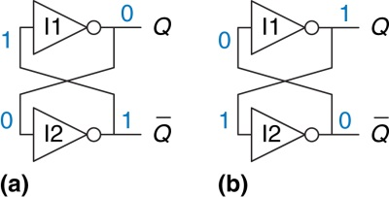
Figure 3.2 Bistable operation of cross-coupled inverters

Slide 4
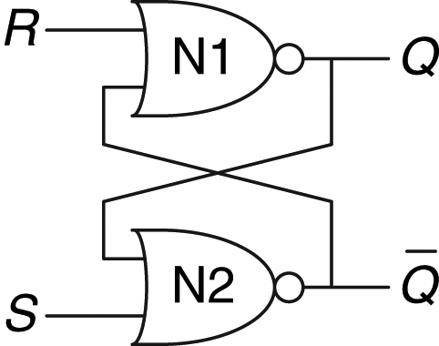
Figure 3.3 SR latch schematic

Slide 5
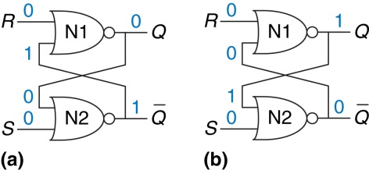
Figure 3.4 Bistable states of SR latch

Slide 6
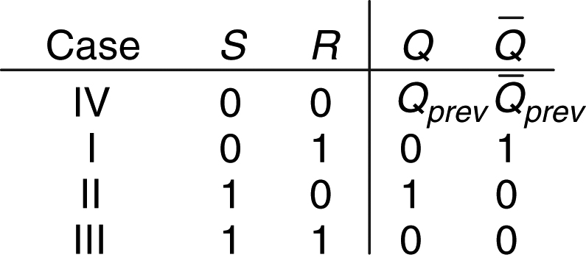
Figure 3.5 SR latch truth table

Slide 7
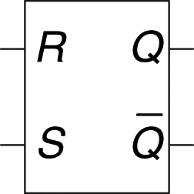
Figure 3.6 SR latch symbol

Slide 8
Figure 3.7 D latch: (a) schematic, (b) truth table, (c) symbol

Slide 9
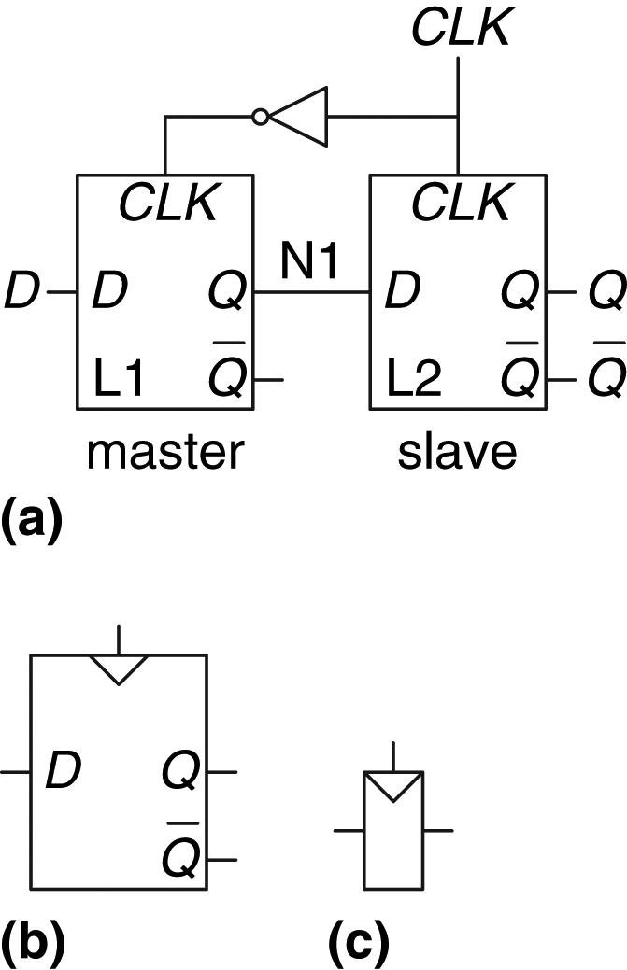
Figure 3.8 D flip-flop: (a) schematic, (b) symbol, (c) condensed symbol

Slide 10
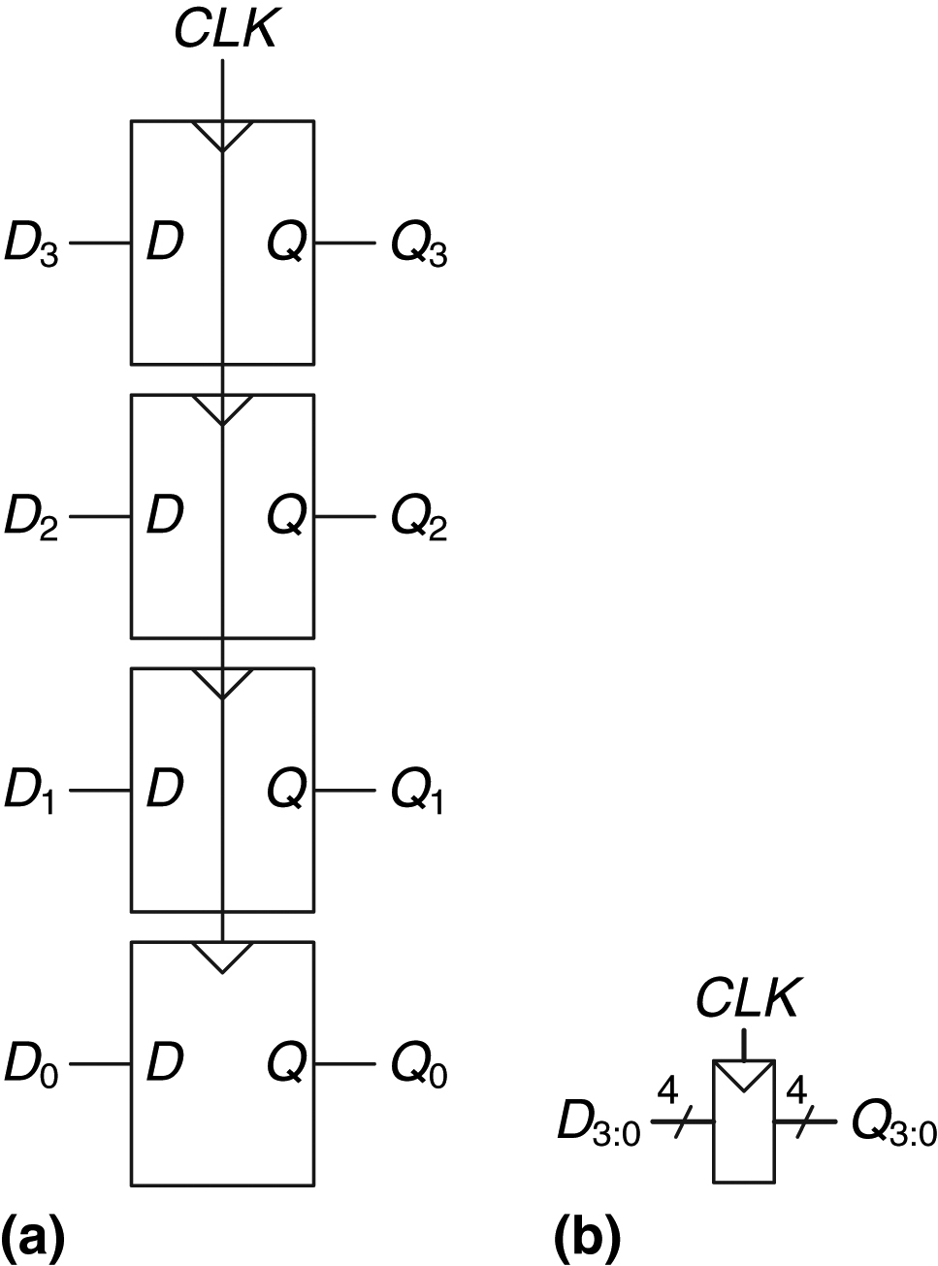
Figure 3.9 A 4-bit register: (a) schematic and (b) symbol

Slide 11
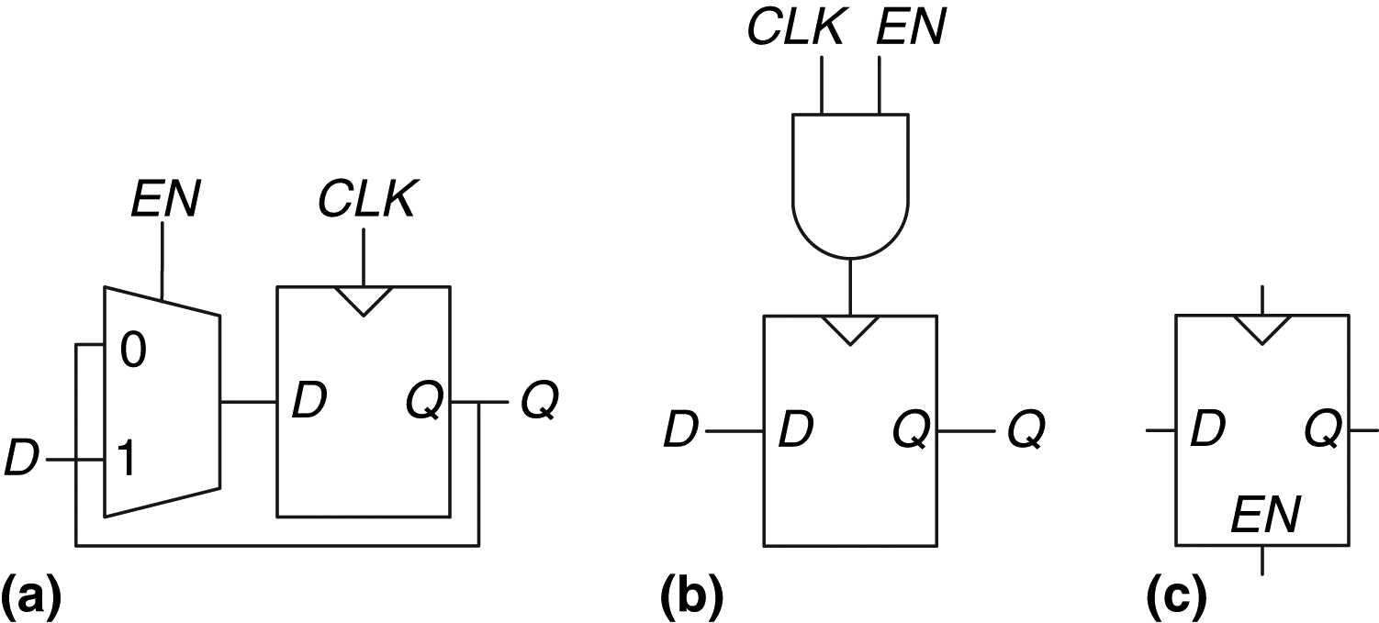
Figure 3.10 Enabled flip-flop: (a, b) schematics, (c) symbol

Slide 12
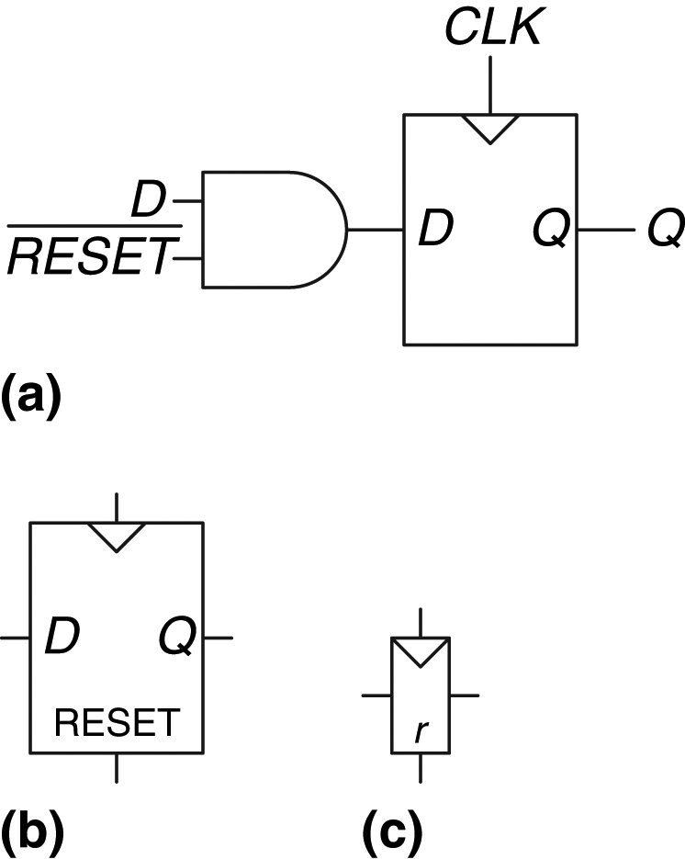
Figure 3.11 Synchronously resettable flip-flop: (a) schematic, (b, c) symbols

Slide 13
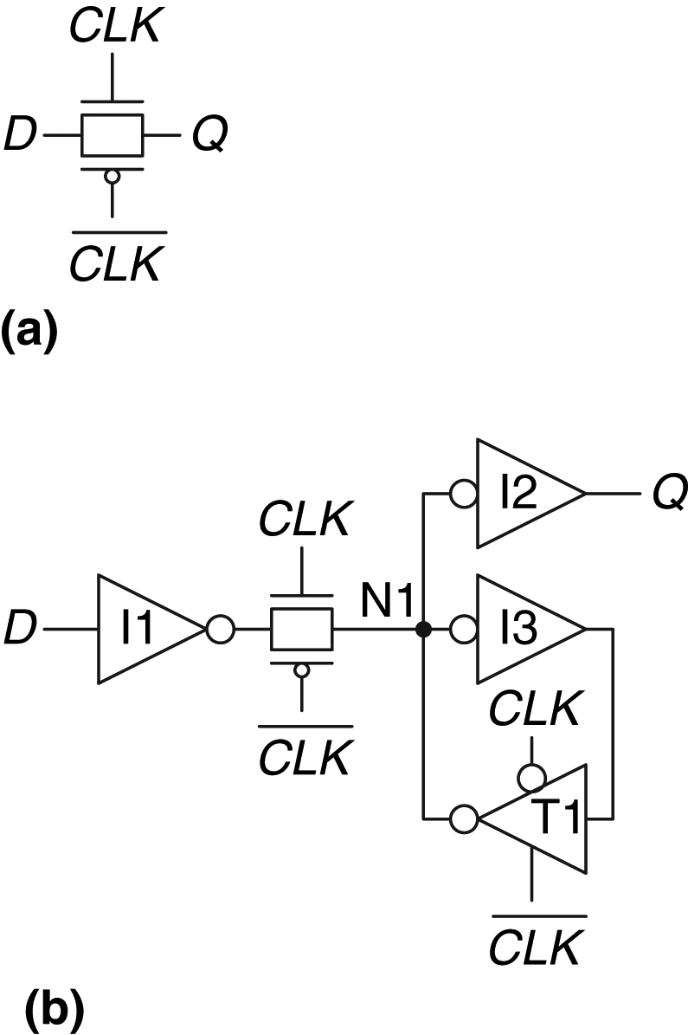
Figure 3.12 D latch schematic

Slide 14
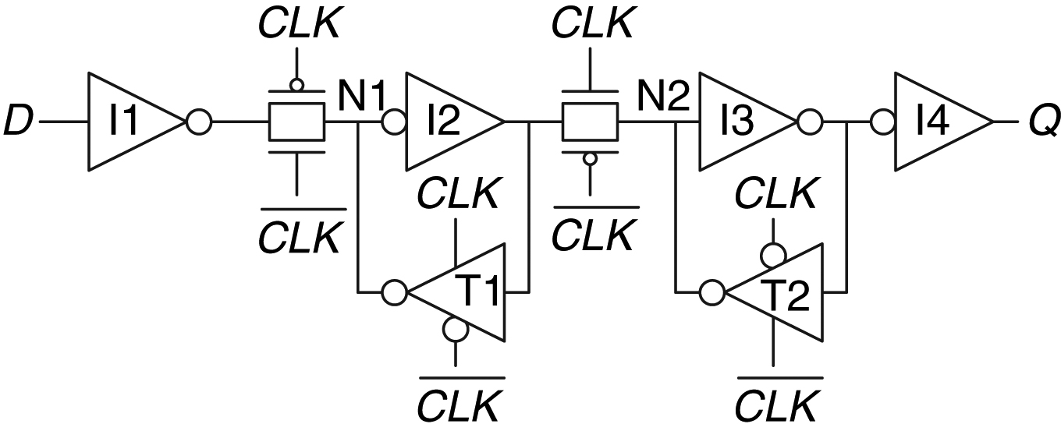
Figure 3.13 D flip-flop schematic

Slide 15
Figure 3.14 Example waveforms

Slide 16
Figure 3.15 Solution waveforms

Slide 17
Figure 3.16 Three-inverter loop

Slide 18
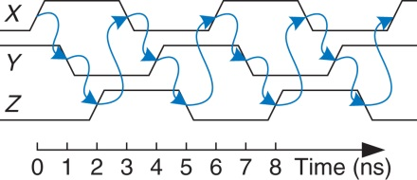
Figure 3.17 Ring oscillator waveforms

Slide 19
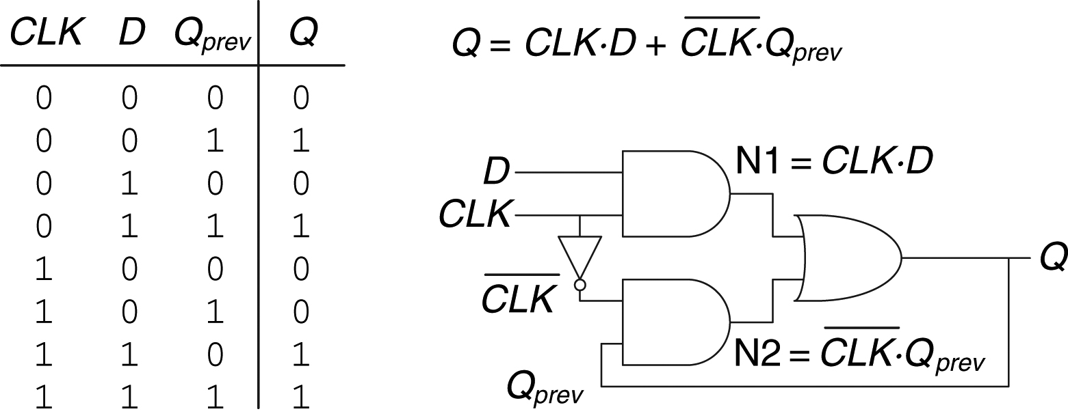
Figure 3.18 An improved (?) D latch

Slide 20
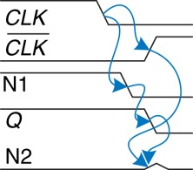
Figure 3.19 Latch waveforms illustrating race condition

Slide 21
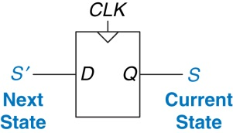
Figure 3.20 Flip-flop current state and next state

Slide 22
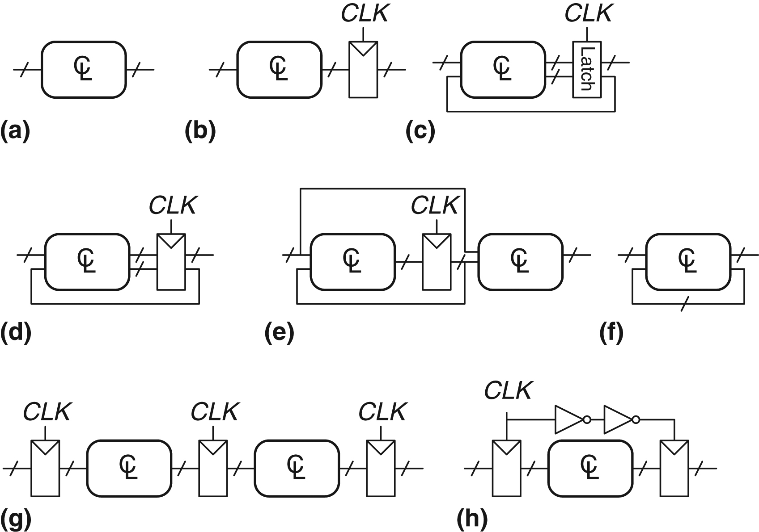
Figure 3.21 Example circuits

Slide 23
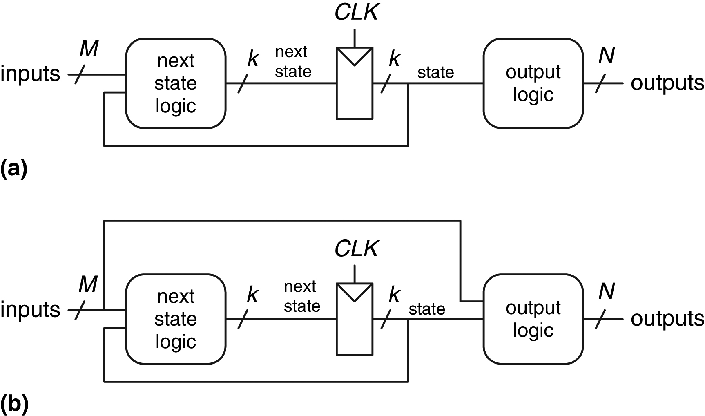
Figure 3.22 Finite state machines: (a) Moore machine, (b) Mealy machine

Slide 24
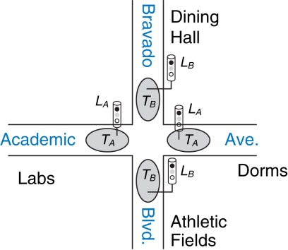
Figure 3.23 Campus map

Slide 25
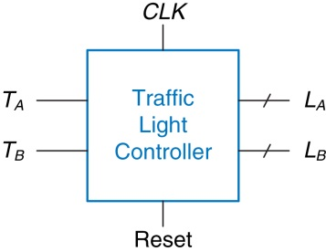
Figure 3.24 Black box view of finite state machine

Slide 26
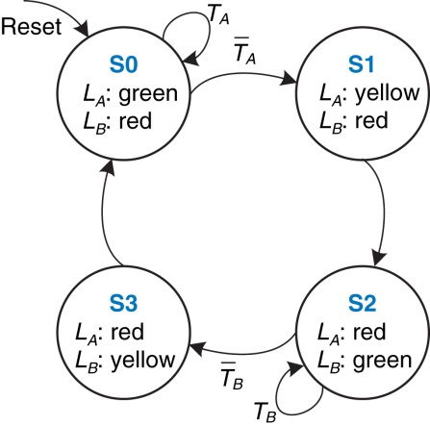
Figure 3.25 State transition diagram

Slide 27
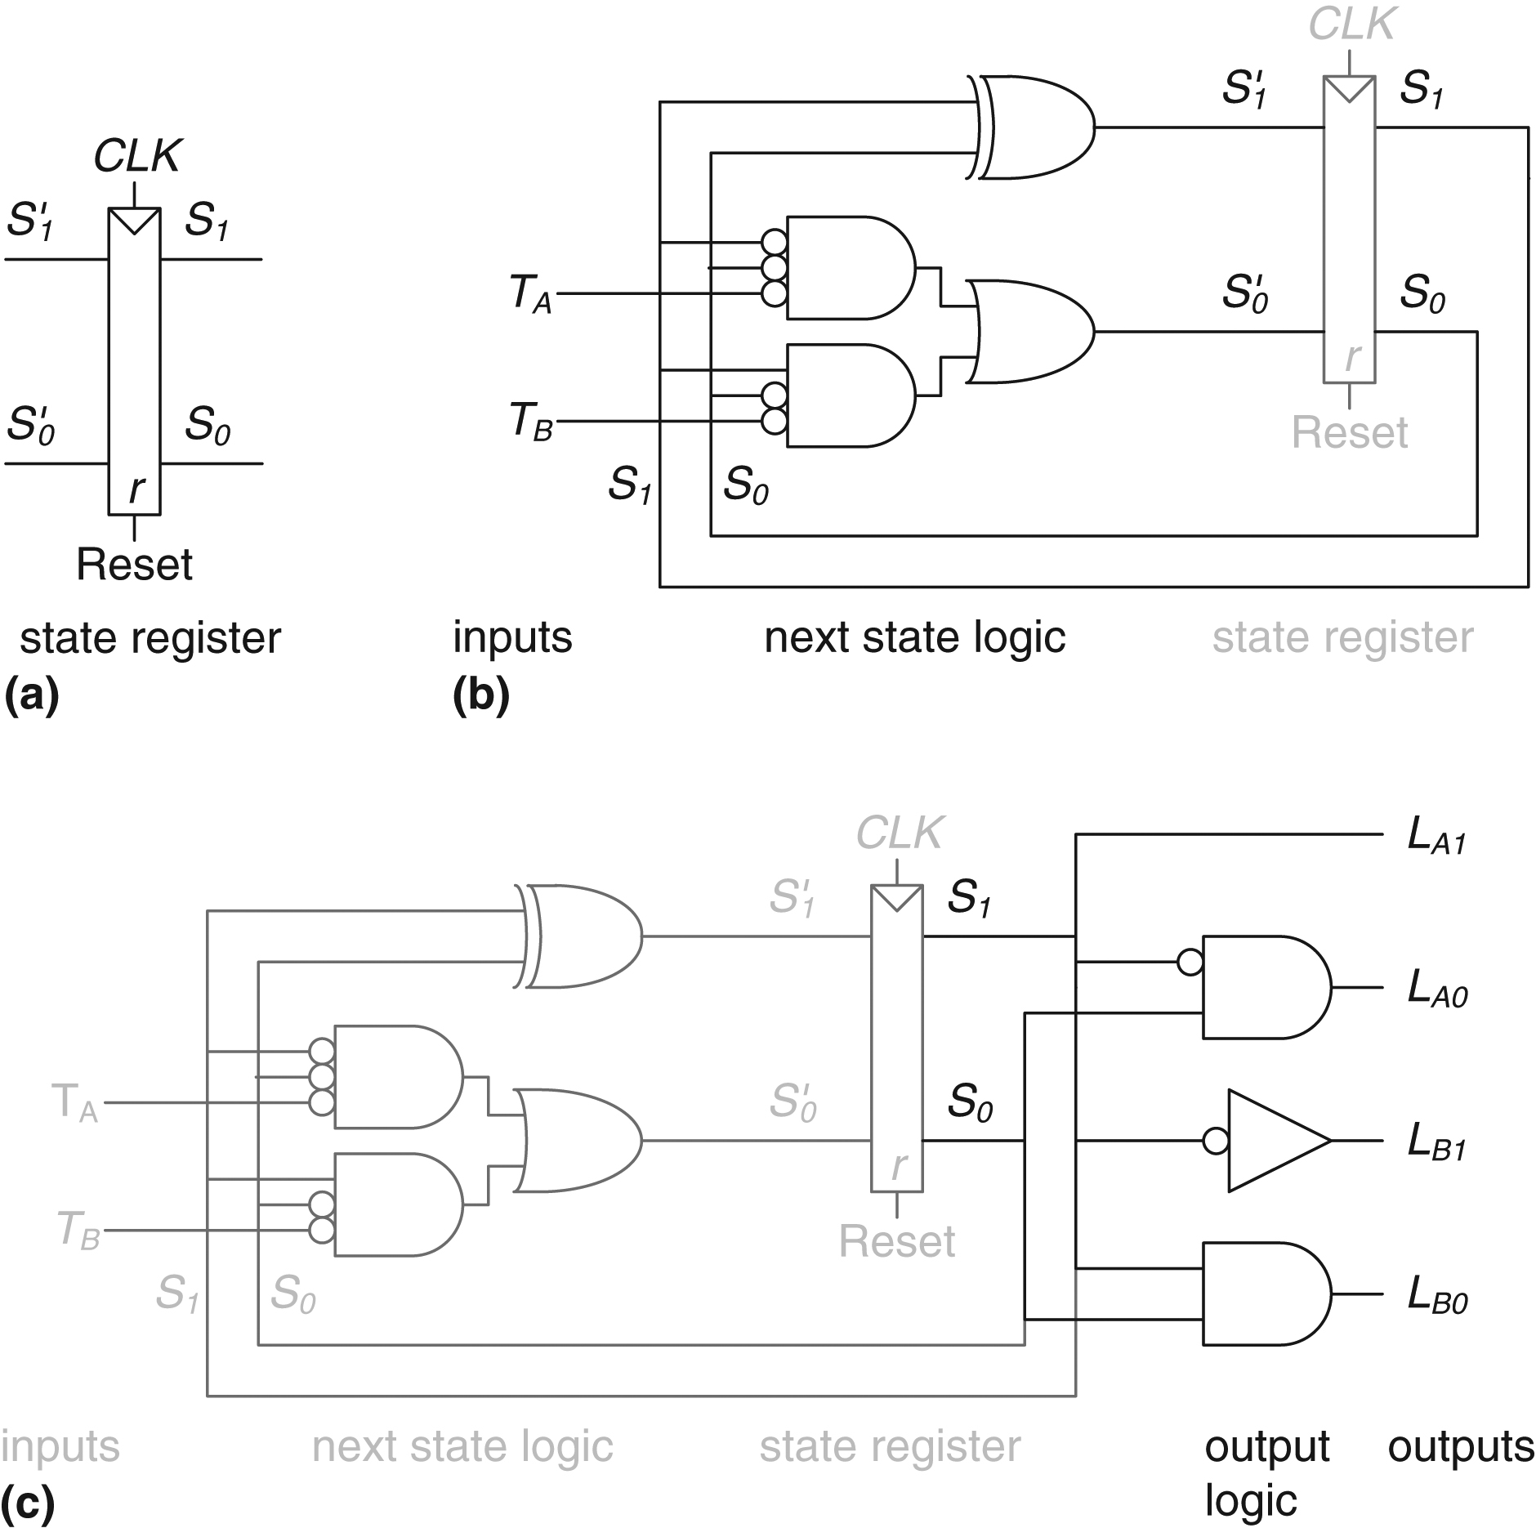
Figure 3.26 State machine circuit for traffic light controller

Slide 28
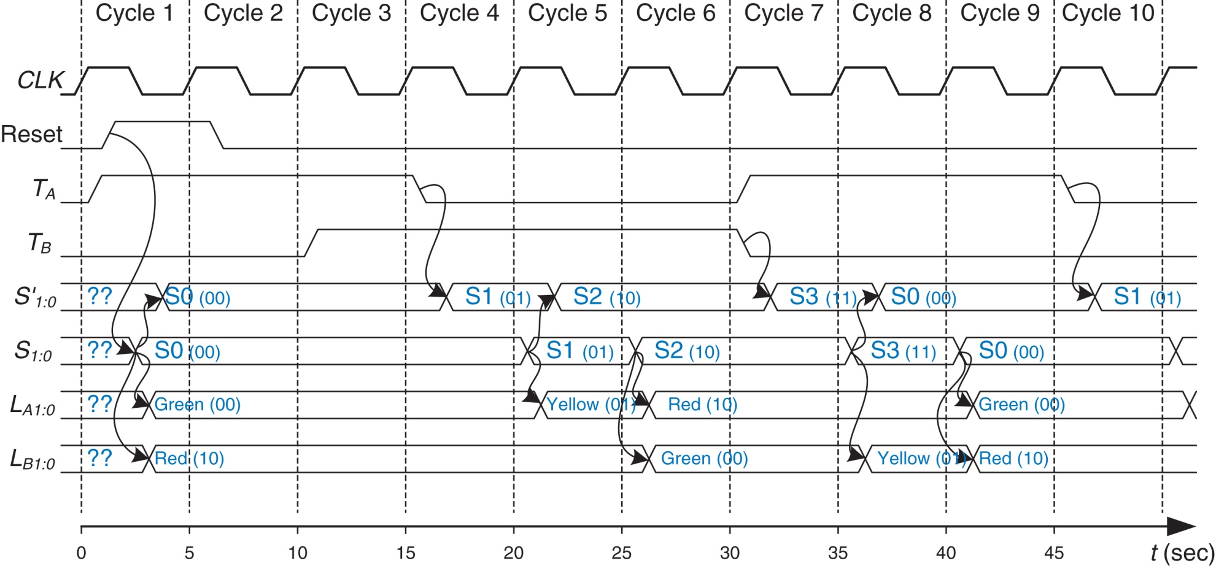
Figure 3.27 Timing diagram for traffic light controller

Slide 29
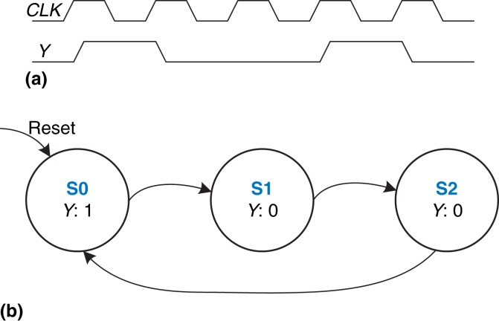
Figure 3.28 Divide-by-3 counter (a) waveform and (b) state transition diagram

Slide 30
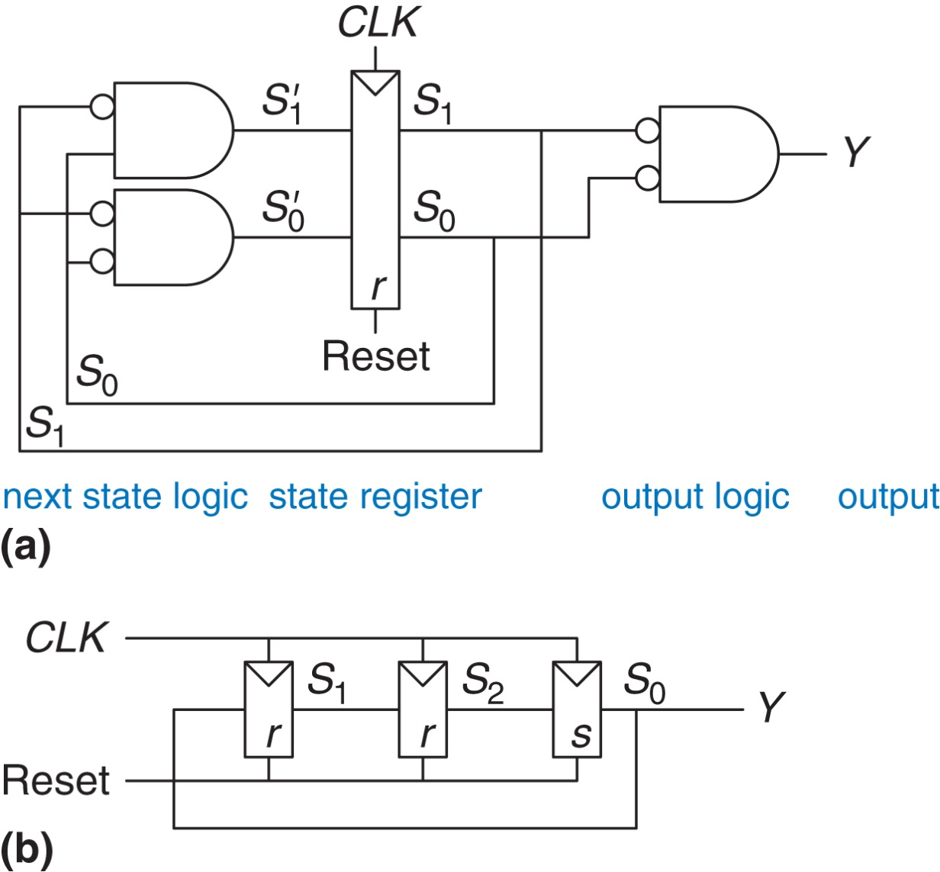
Figure 3.29 Divide-by-3 circuits for (a) binary and (b) one-hot encodings

Slide 31
Figure 3.30 FSM state transition diagrams: (a) Moore machine, (b) Mealy machine

Slide 32
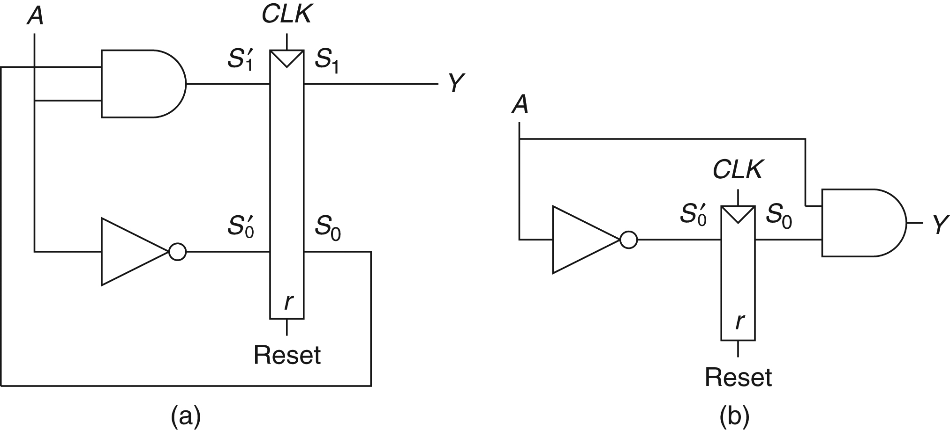
Figure 3.31 FSM schematics for (a) Moore and (b) Mealy machines

Slide 33
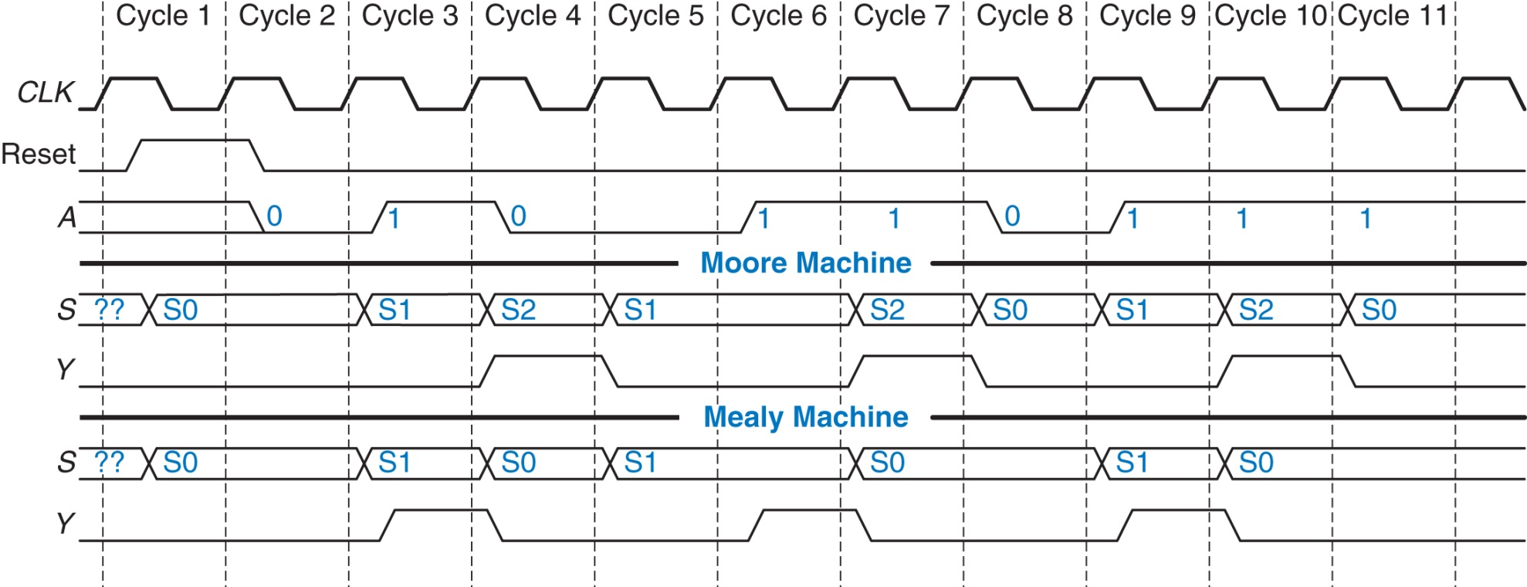
Figure 3.32 Timing diagrams for Moore and Mealy machines

Slide 34
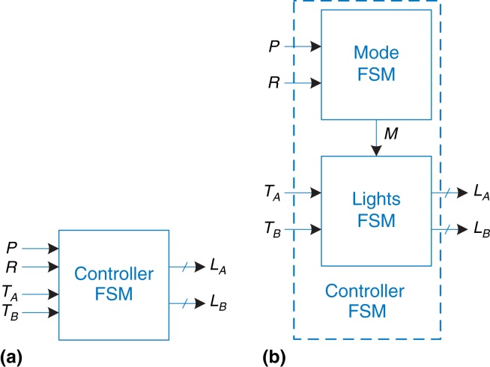
Figure 3.33 (a) single and (b) factored designs for modified traffic light controller FSM

Slide 35
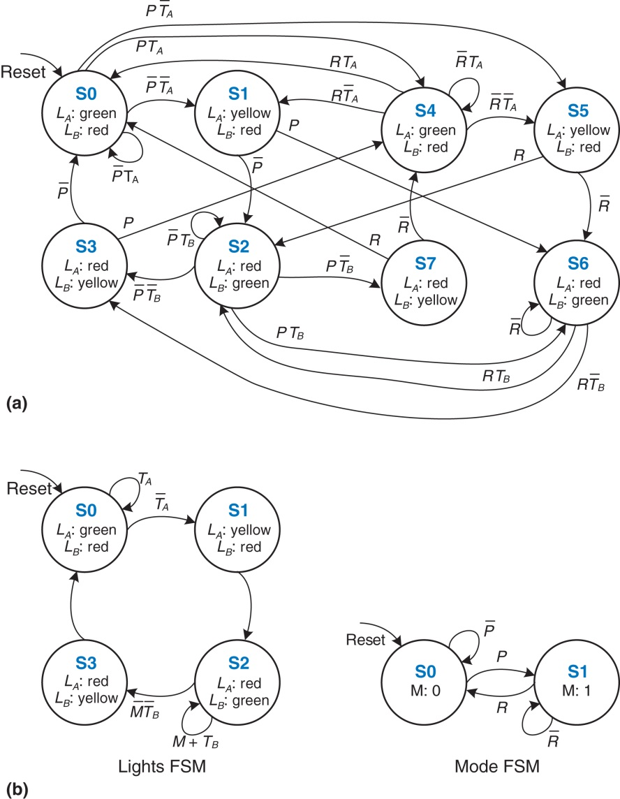
Figure 3.34 State transition diagrams: (a) unfactored, (b) factored

Slide 36
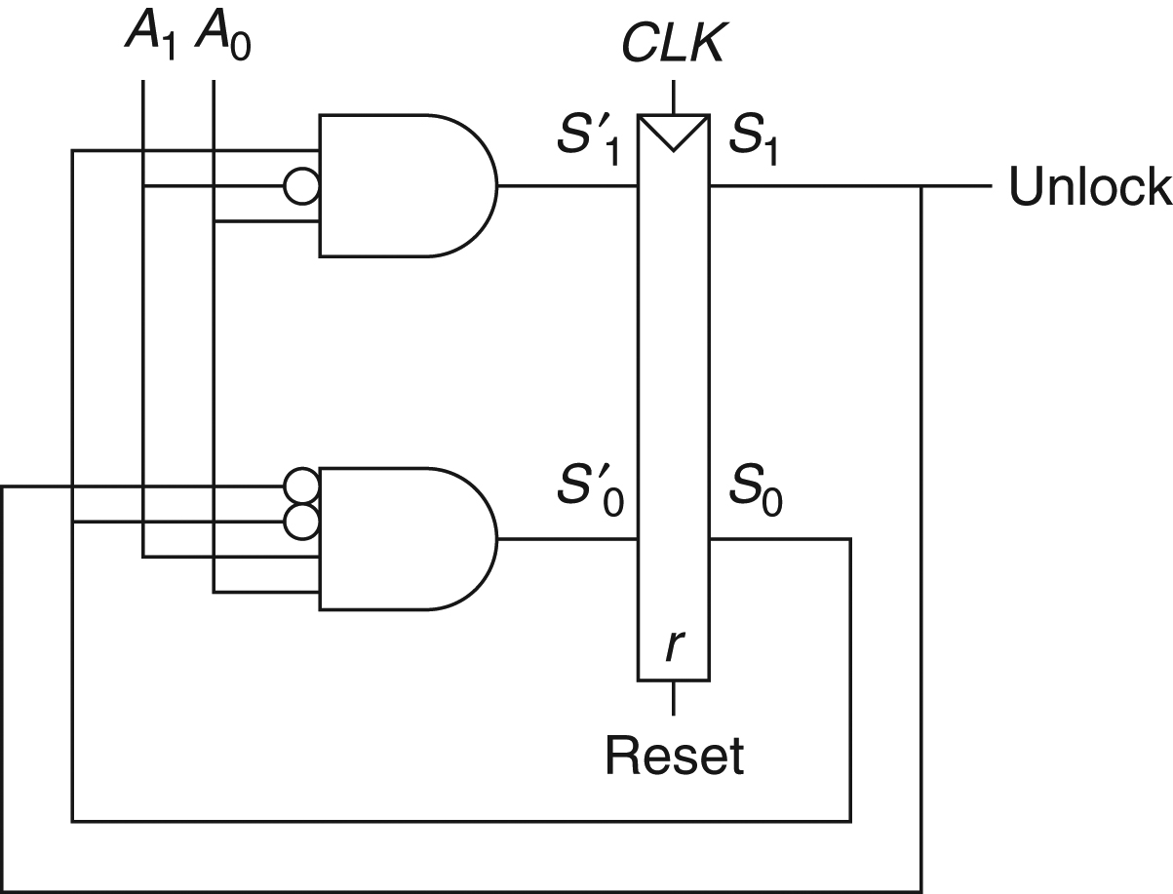
Figure 3.35 Circuit of found FSM for Example 3.9

Slide 37
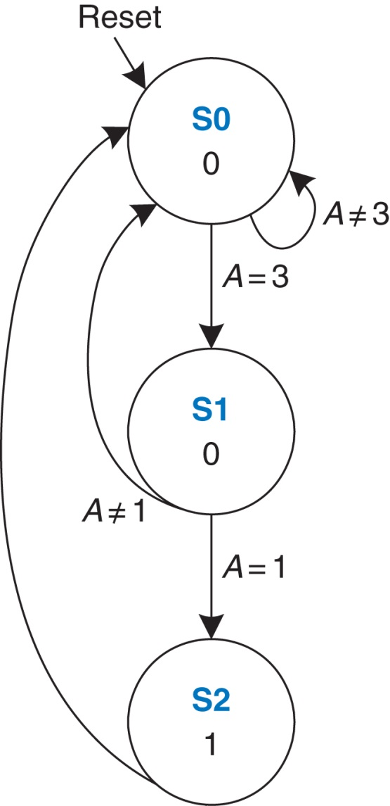
Figure 3.36 State transition diagram of found FSM from Example 3.9

Slide 38
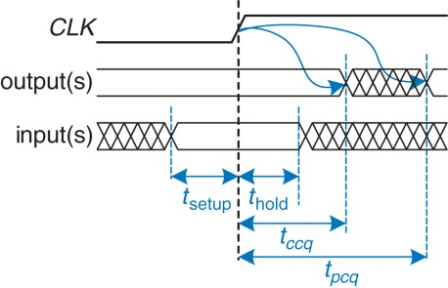
Figure 3.37 Timing specification for synchronous sequential circuit

Slide 39
Figure 3.38 Path between registers and timing diagram

Slide 40
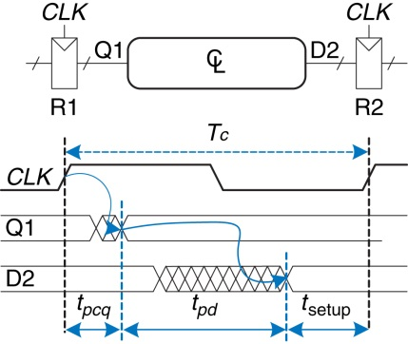
Figure 3.39 Maximum delay for setup time constraint

Slide 41
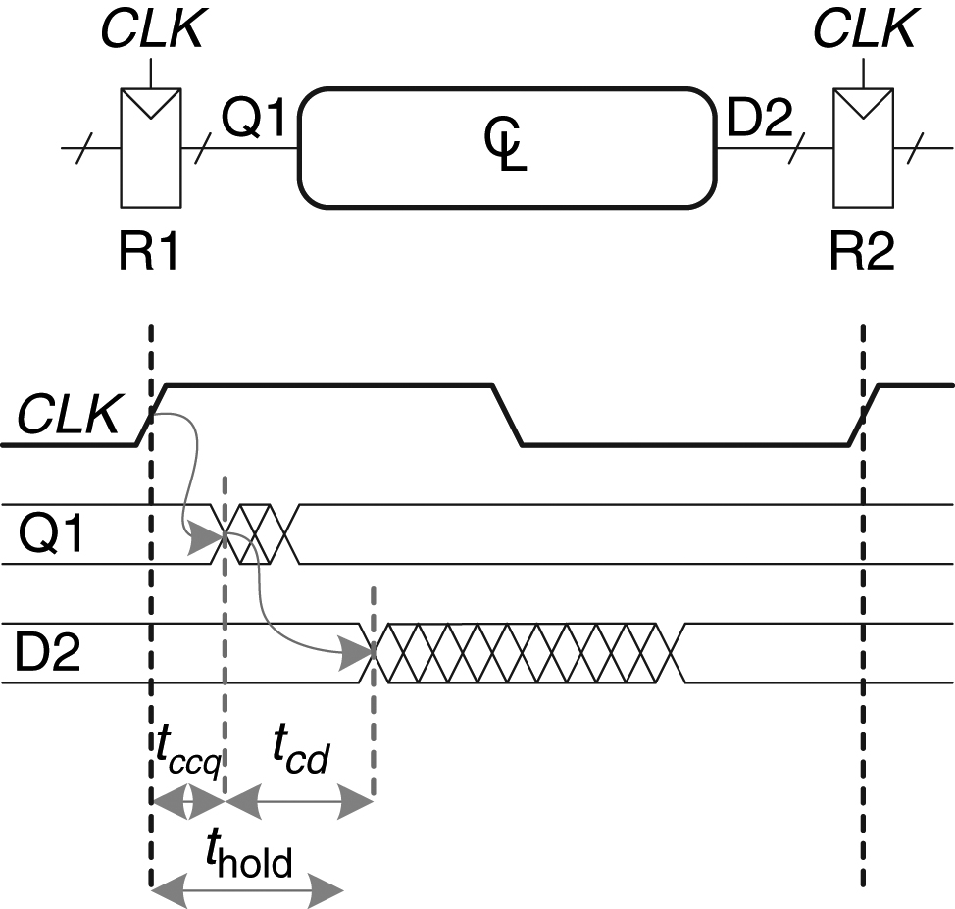
Figure 3.40 Minimum delay for hold time constraint

Slide 42
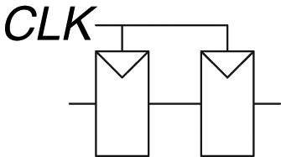
Figure 3.41 Back-to-back flip-flops

Slide 43
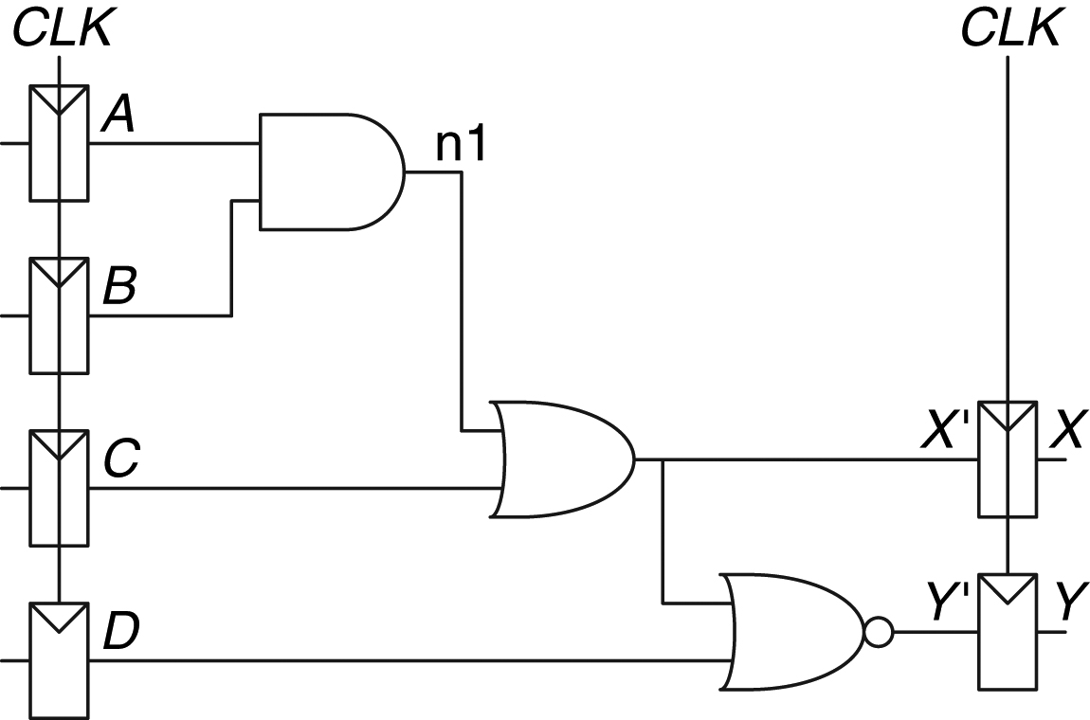
Figure 3.42 Sample circuit for timing analysis

Slide 44
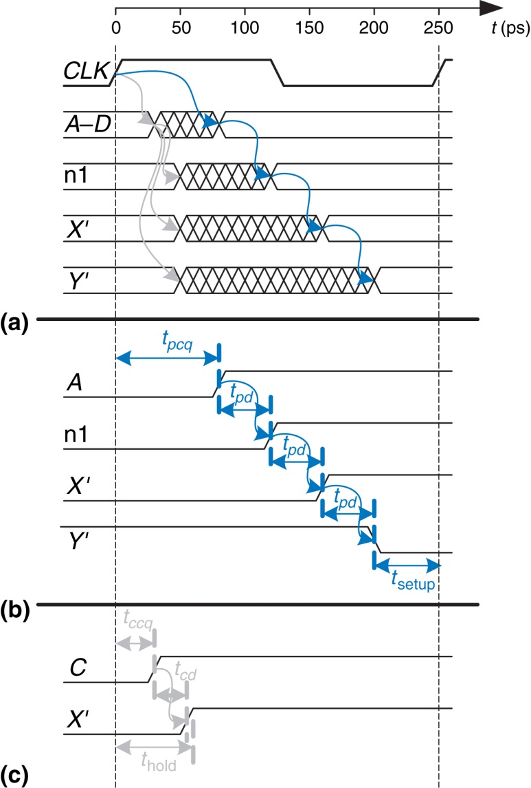
Figure 3.43 Timing diagram: (a) general case, (b) critical path, (c) short path

Slide 45
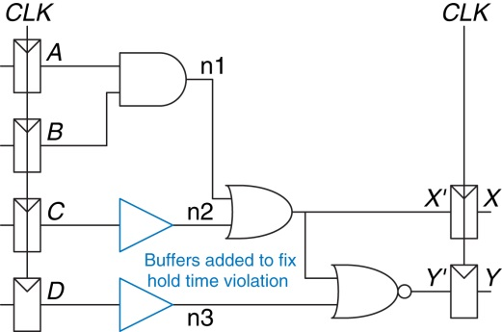
Figure 3.44 Corrected circuit to fix hold time problem

Slide 46
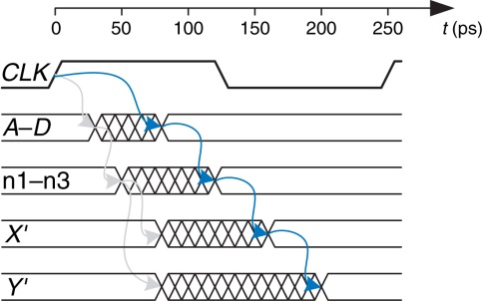
Figure 3.45 Timing diagram with buffers to fix hold time problem

Slide 47
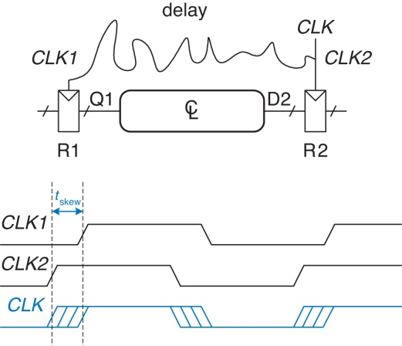
Figure 3.46 Clock skew caused by wire delay

Slide 48
Figure 3.47 Timing diagram with clock skew

Slide 49
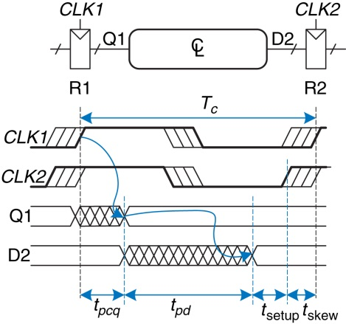
Figure 3.48 Setup time constraint with clock skew

Slide 50
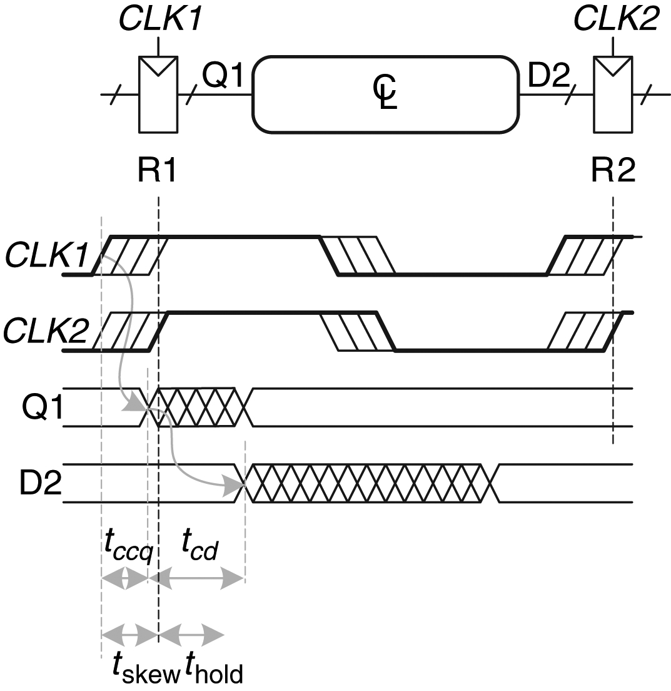
Figure 3.49 Hold time constraint with clock skew

Slide 51
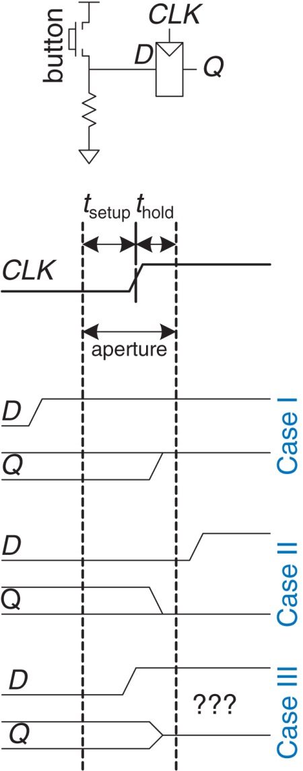
Figure 3.50 Input changing before, after, or during aperture

Slide 52
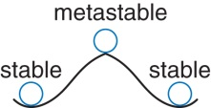
Figure 3.51 Stable and metastable states

Slide 53
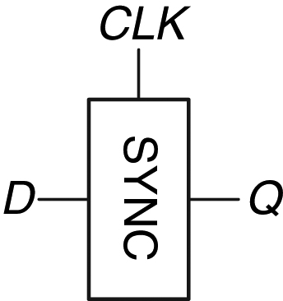
Figure 3.52 Synchronizer symbol

Slide 54
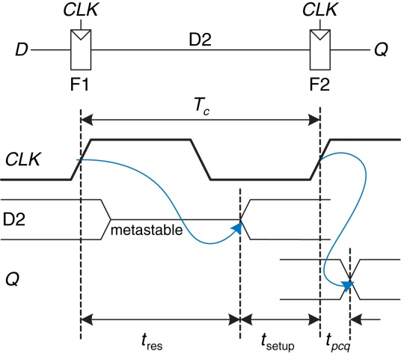
Figure 3.53 Simple synchronizer

Slide 55
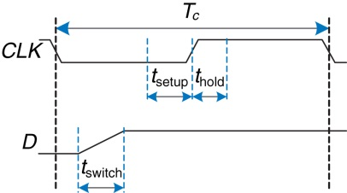
Figure 3.54 Input timing

Slide 56
Figure 3.55 Circuit model of bistable device

Slide 57
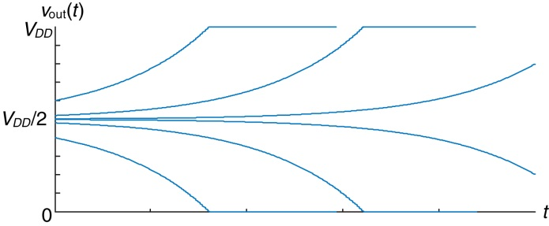
Figure 3.56 Resolution trajectories

Slide 58
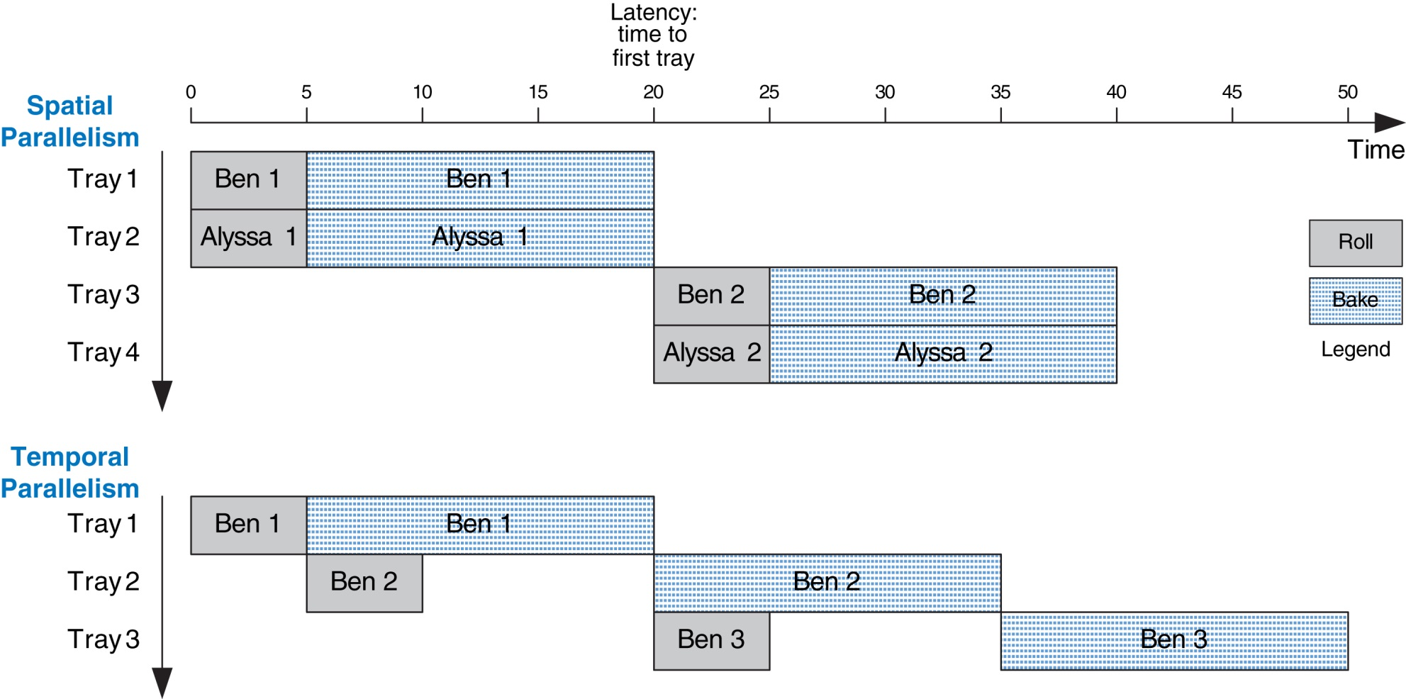
Figure 3.57 Spatial and temporal parallelism in the cookie kitchen

Slide 59
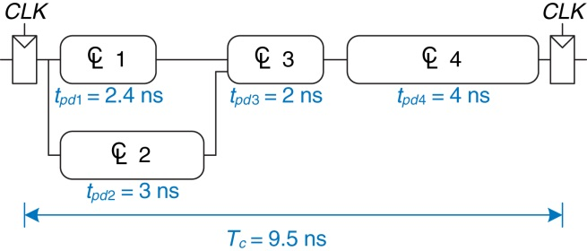
Figure 3.58 Circuit with no pipelining

Slide 60
Figure 3.59 Circuit with two-stage pipeline

Slide 61
Figure 3.60 Circuit with three-stage pipeline

Slide 62
Figure 3.61 Input waveforms of SR latch for Exercise 3.1

Slide 63
Figure 3.62 Input waveforms of SR latch for Exercise 3.2

Slide 64
Figure 3.63 Input waveforms of D latch or flip-flop for Exercises 3.3 and 3.5

Slide 65
Figure 3.64 Input waveforms of D latch or flip-flop for Exercises 3.4 and 3.6

Slide 66
Figure 3.65 Mystery circuit

Slide 67
Figure 3.66 Mystery circuit

Slide 68
Figure 3.67 Muller C-element

Slide 69
Figure 3.68 Circuits

Slide 70
Figure 3.69 State transition diagram

Slide 71
Figure 3.70 State transition diagram

Slide 72
Figure 3.71 FSM input waveforms

Slide 73
Figure 3.72 FSM schematic

Slide 74
Figure 3.73 FSM schematic

Slide 75
Figure 3.74 Registered four-input XOR circuit

Slide 76
Figure 3.75 2-bit adder schematic

Slide 77
Figure 3.76 “New and improved” synchronizer

Slide 78
Figure 3.77 Signal waveforms

Slide 84
Figure u03-01

