Slide 1
Hardware Description Languages
CH004

Slide 2
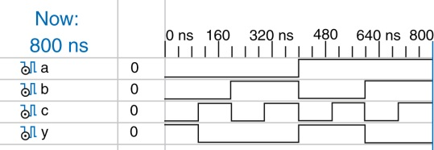
Figure 4.1 Simulation waveforms

Slide 3
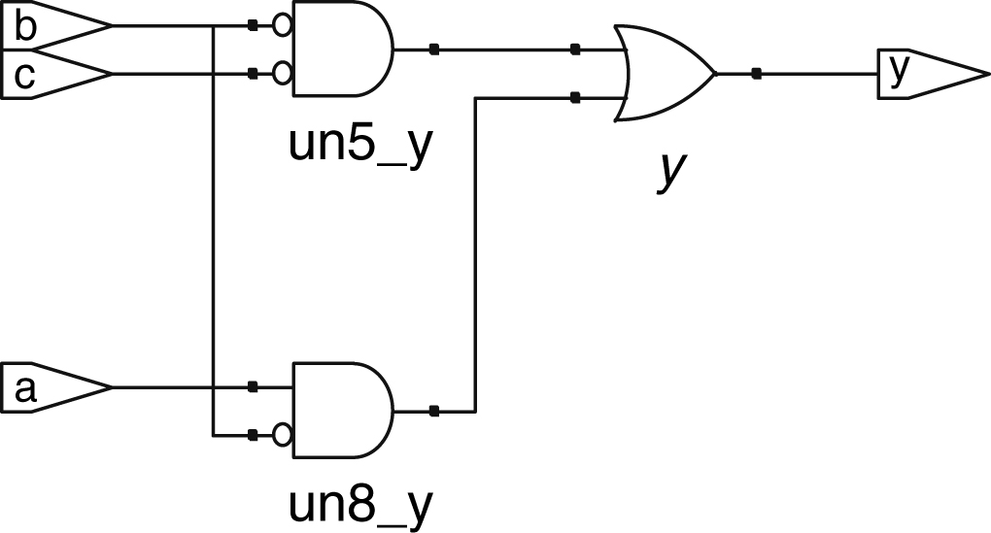
Figure 4.2 Synthesized circuit

Slide 4
Figure 4.3 inv synthesized circuit

Slide 5
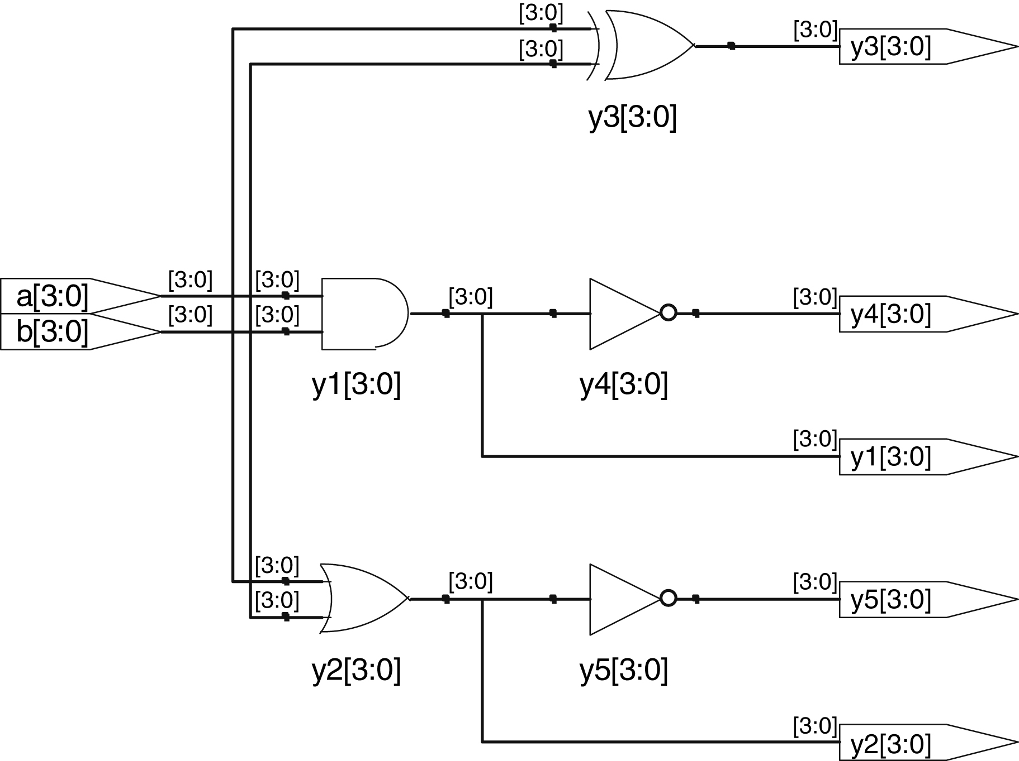
Figure 4.4 gates synthesized circuit

Slide 6
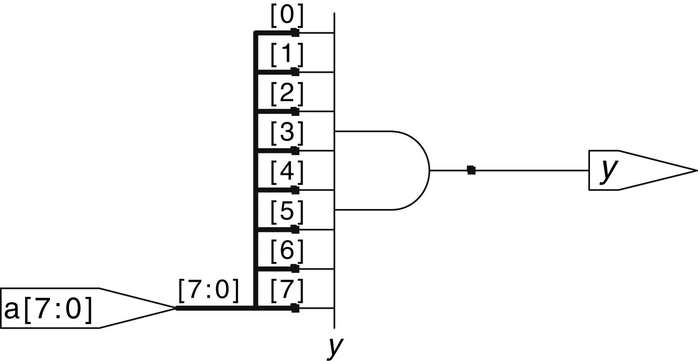
Figure 4.5 and8 synthesized circuit

Slide 7
Figure 4.6 mux2 synthesized circuit

Slide 8
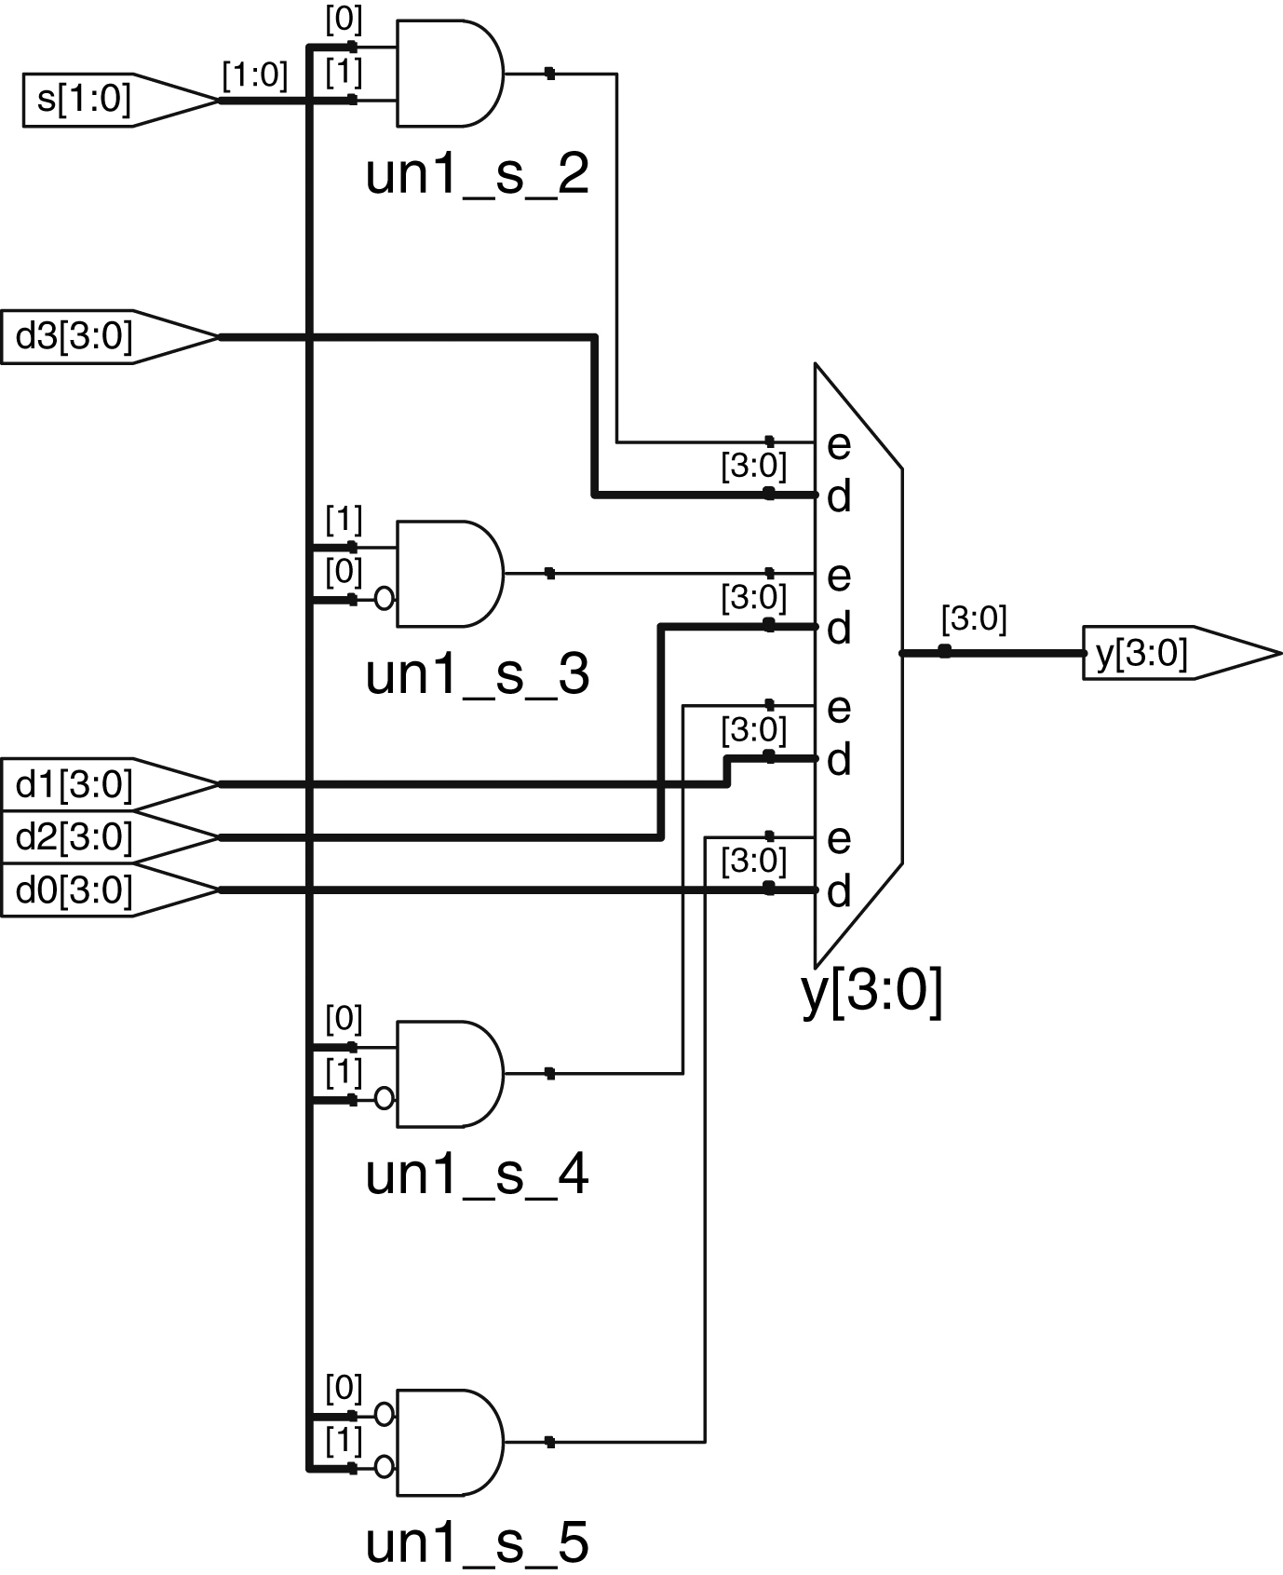
Figure 4.7 mux4 synthesized circuit

Slide 9
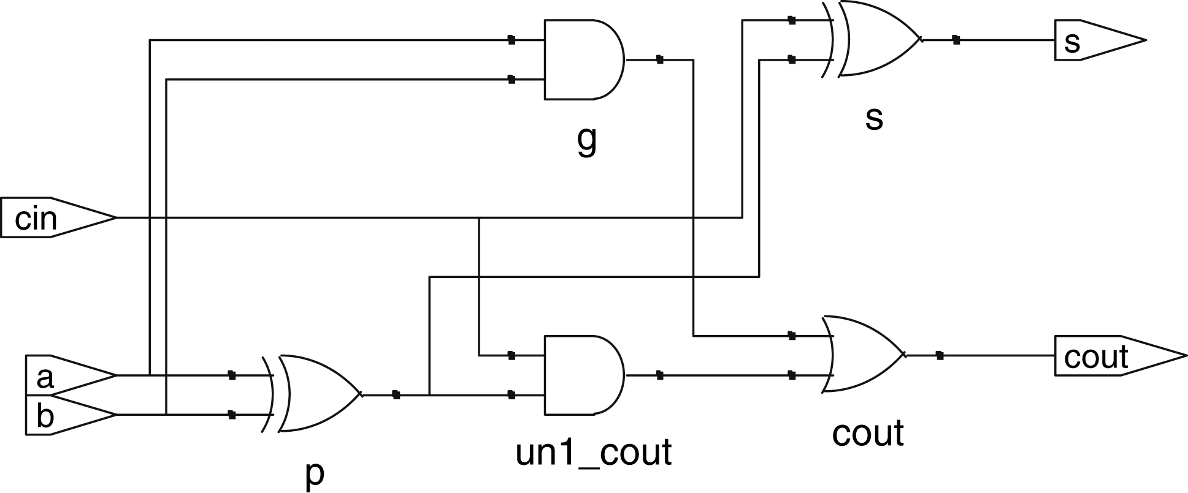
Figure 4.8 fulladder synthesized circuit

Slide 10
Figure 4.9 tristate synthesized circuit

Slide 11
Figure 4.10 Example simulation waveforms with delays (from the ModelSim simulator)

Slide 12
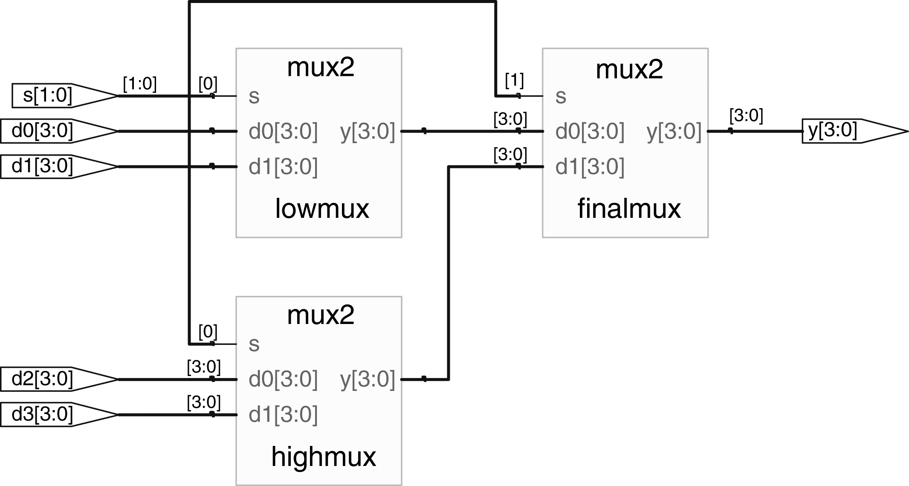
Figure 4.11 mux4 synthesized circuit

Slide 13
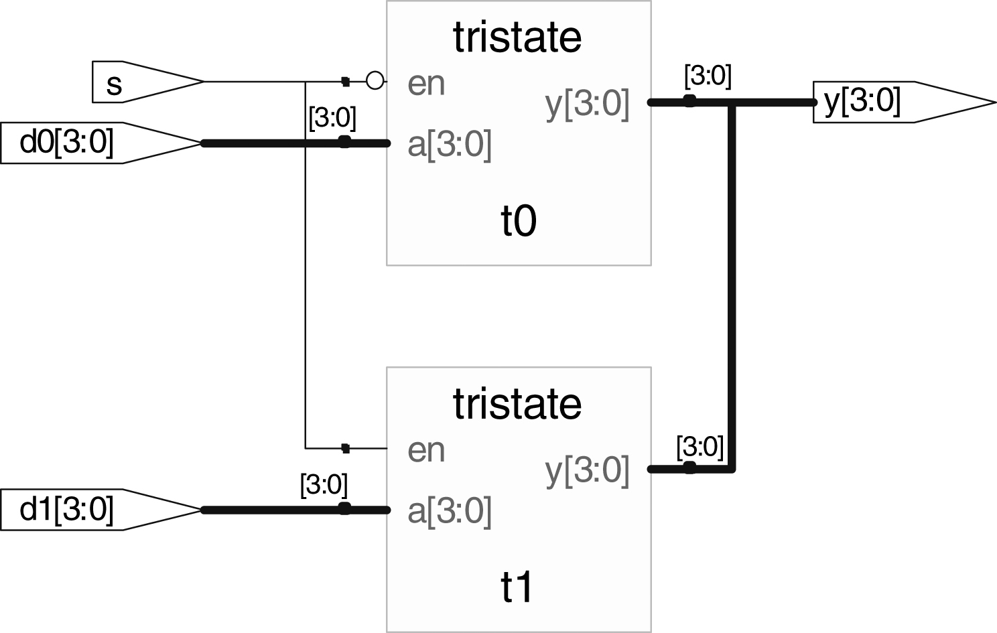
Figure 4.12 mux2 synthesized circuit

Slide 14
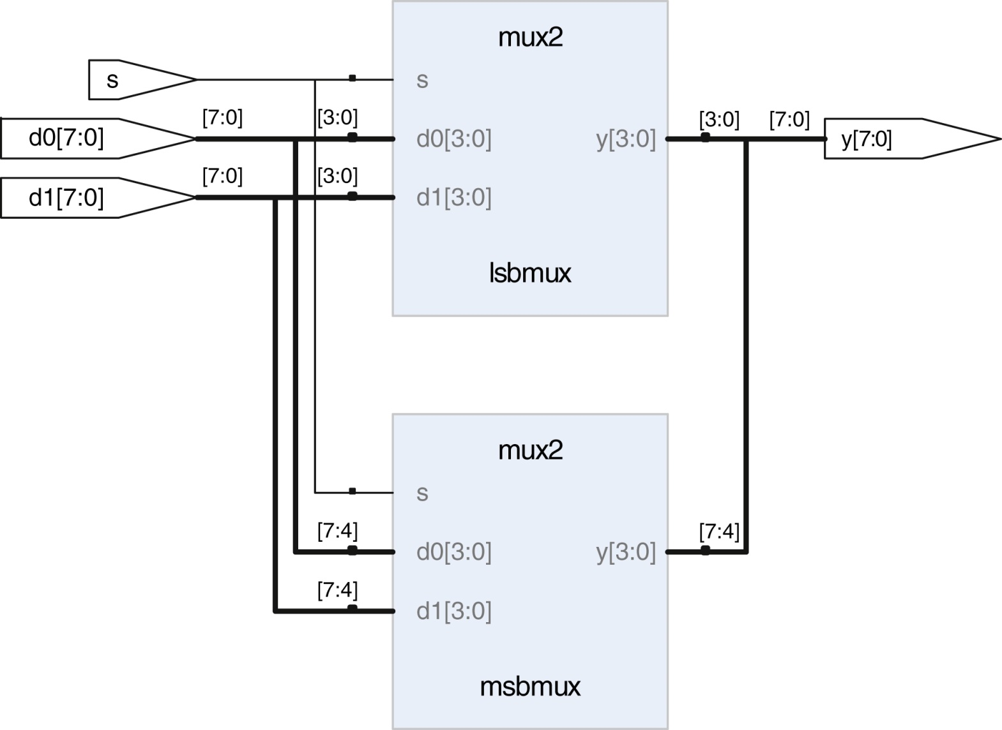
Figure 4.13 mux2_8 synthesized circuit

Slide 15
Figure 4.14 flop synthesized circuit

Slide 16
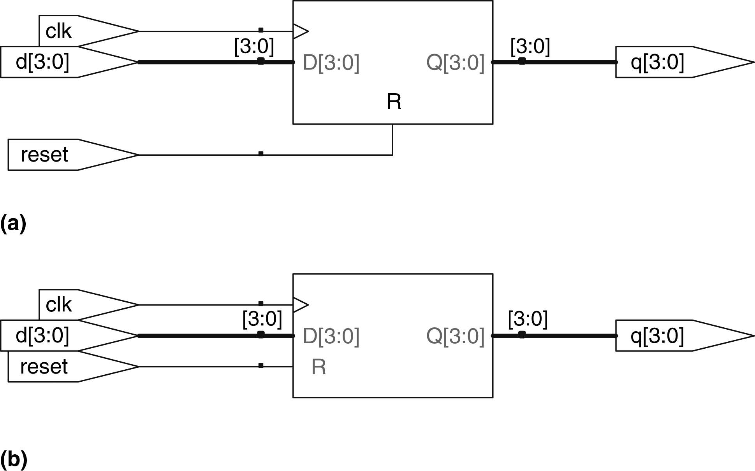
Figure 4.15 flopr synthesized circuit (a) asynchronous reset, (b) synchronous reset

Slide 17
Figure 4.16 flopenr synthesized circuit

Slide 18
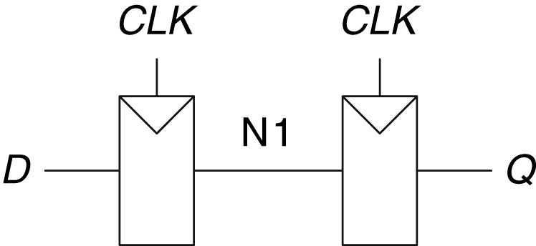
Figure 4.17 Synchronizer circuit

Slide 19
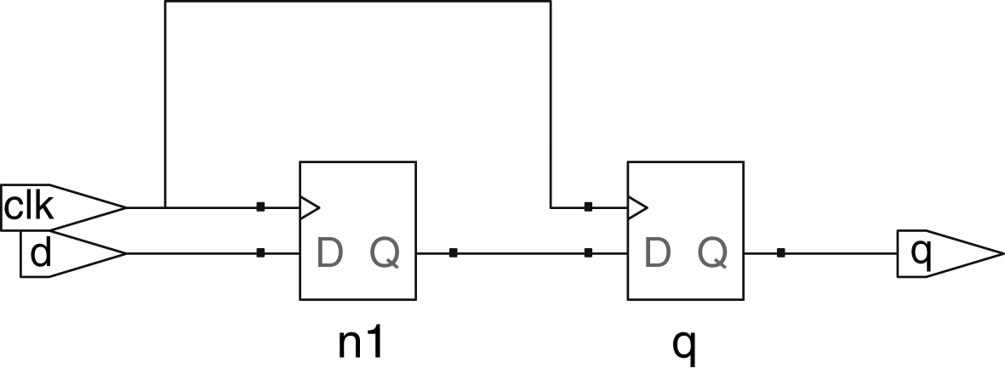
Figure 4.18 sync synthesized circuit

Slide 20
Figure 4.19 latch synthesized circuit

Slide 21
Figure 4.20 sevenseg synthesized circuit

Slide 22
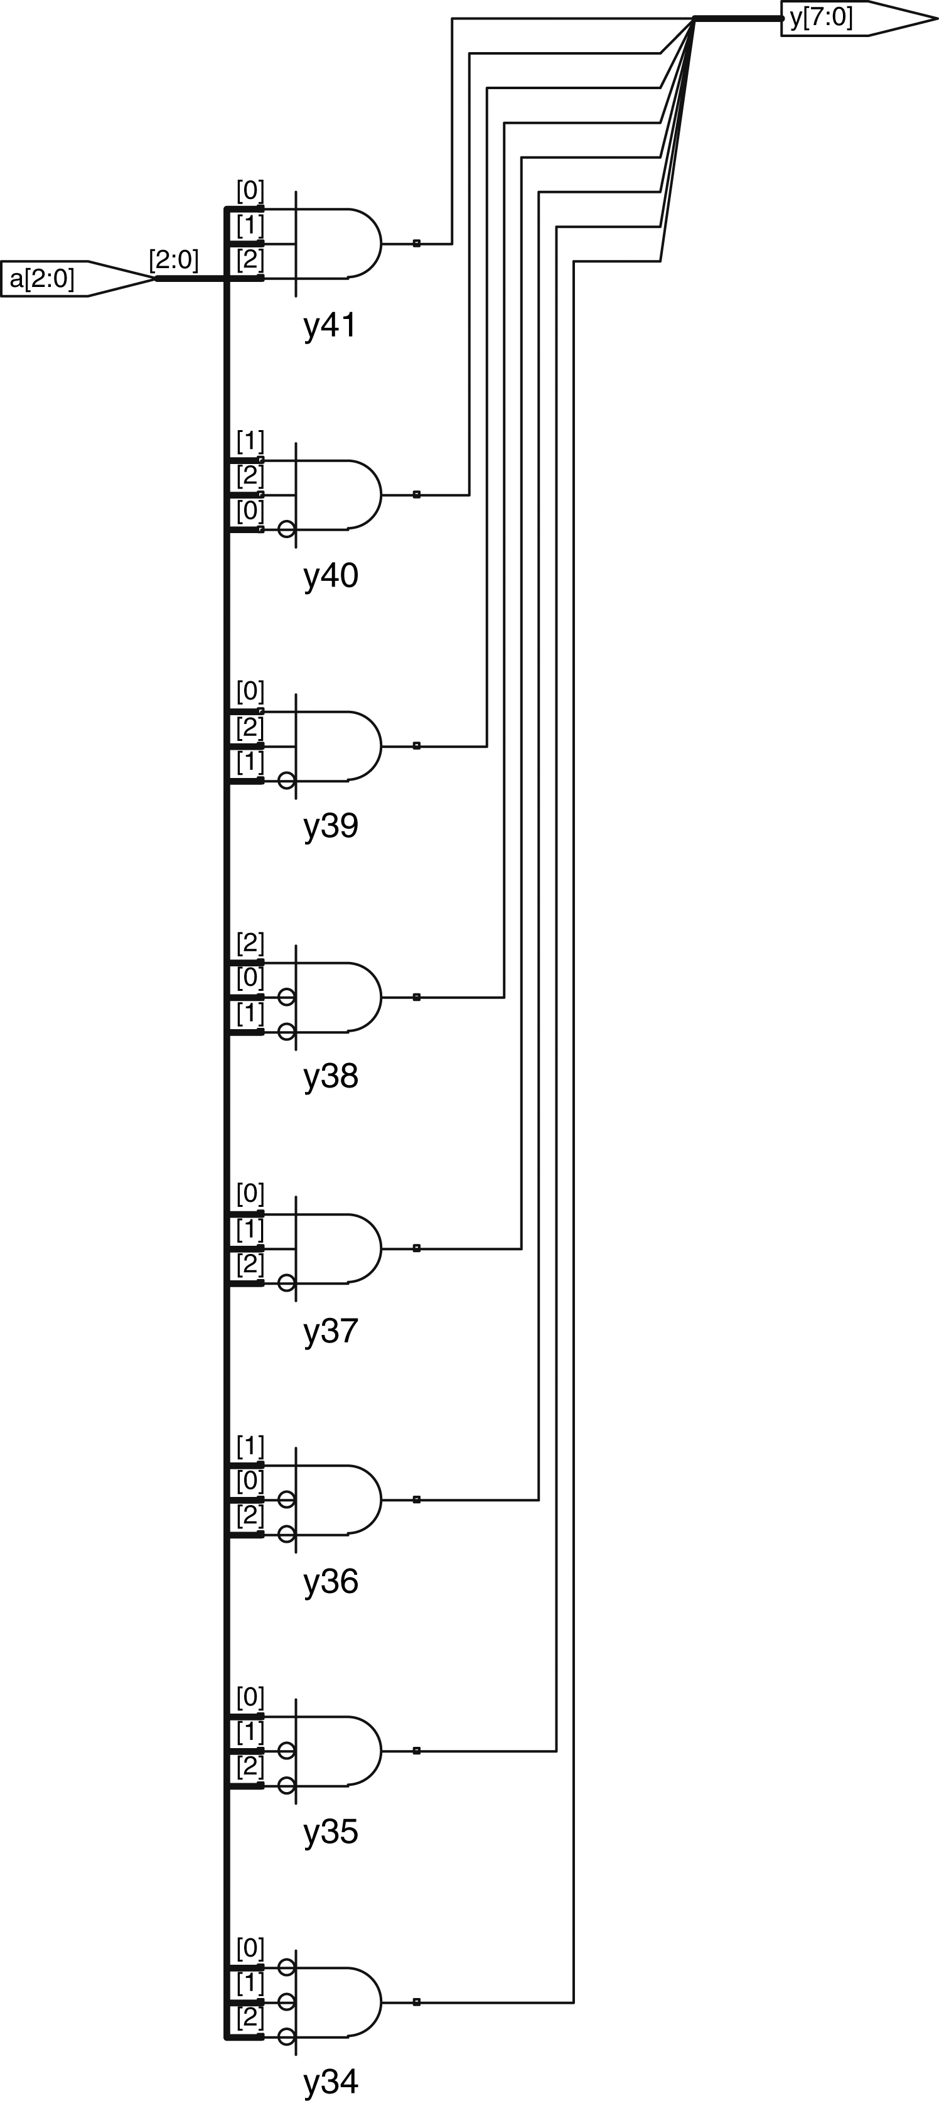
Figure 4.21 decoder3_8 synthesized circuit

Slide 23
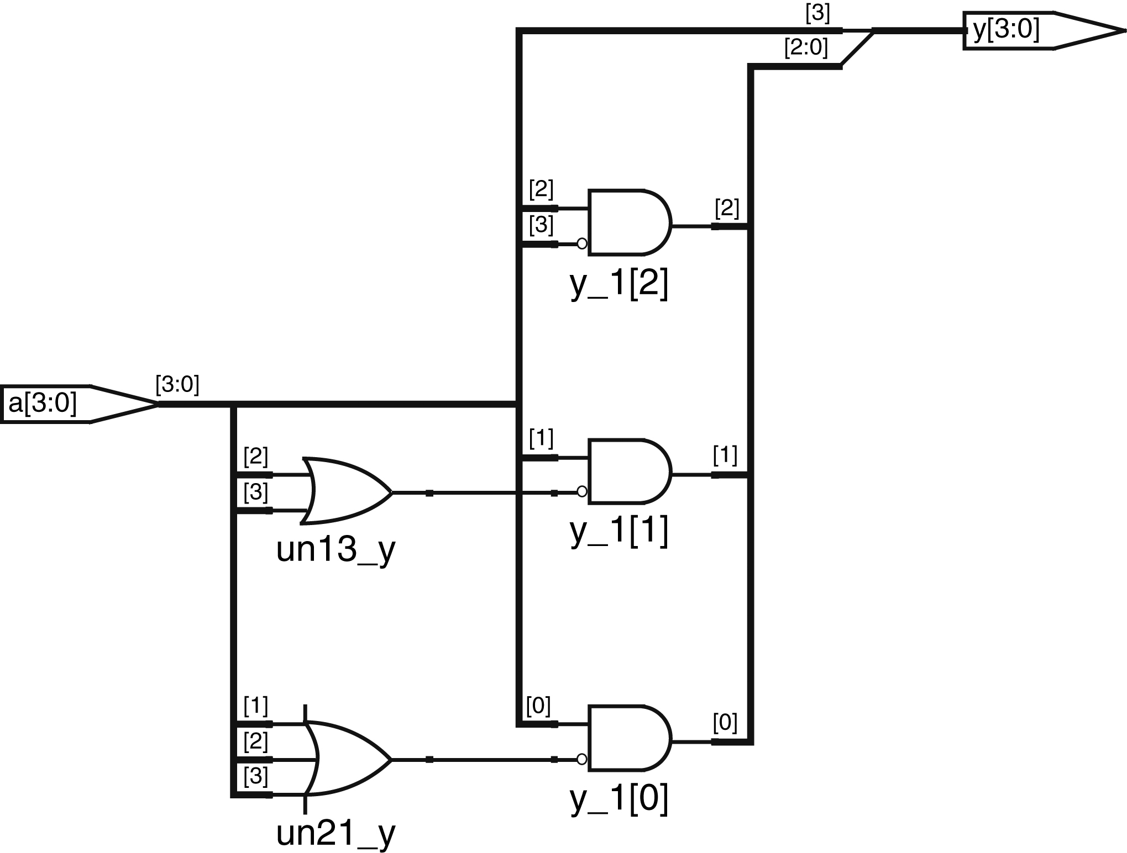
Figure 4.22 priorityckt synthesized circuit

Slide 24
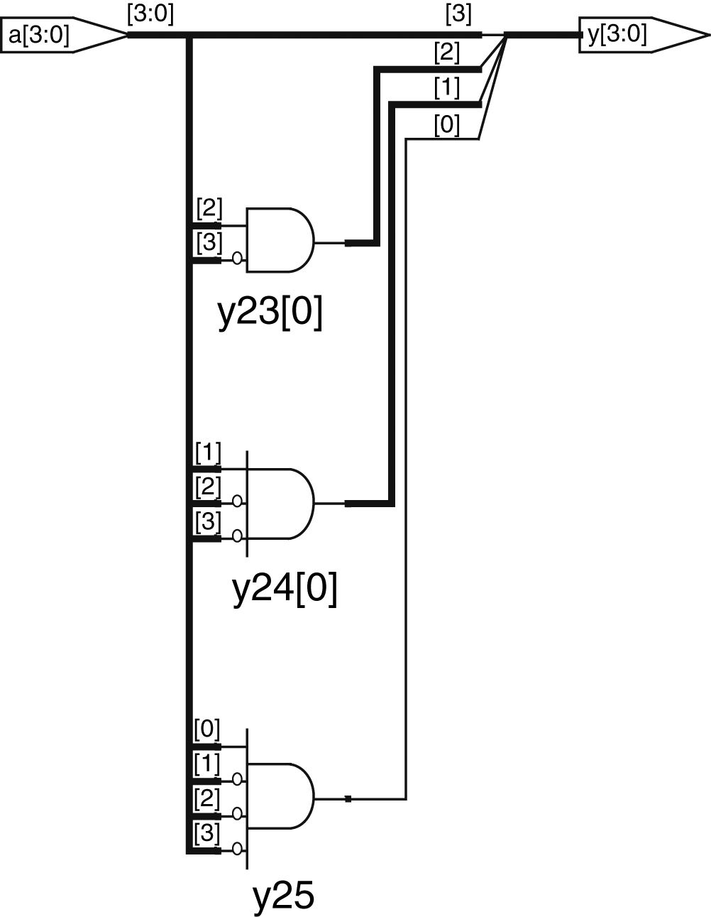
Figure 4.23 priority_casez synthesized circuit

Slide 25
Figure 4.24 syncbad synthesized circuit

Slide 26
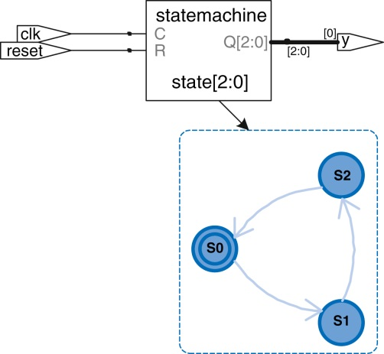
Figure 4.25 priority_casez synthesized circuit

Slide 27
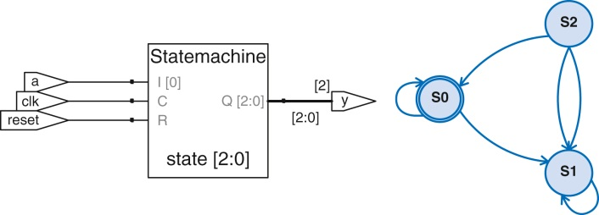
Figure 4.26 patternMoore synthesized circuit

Slide 28
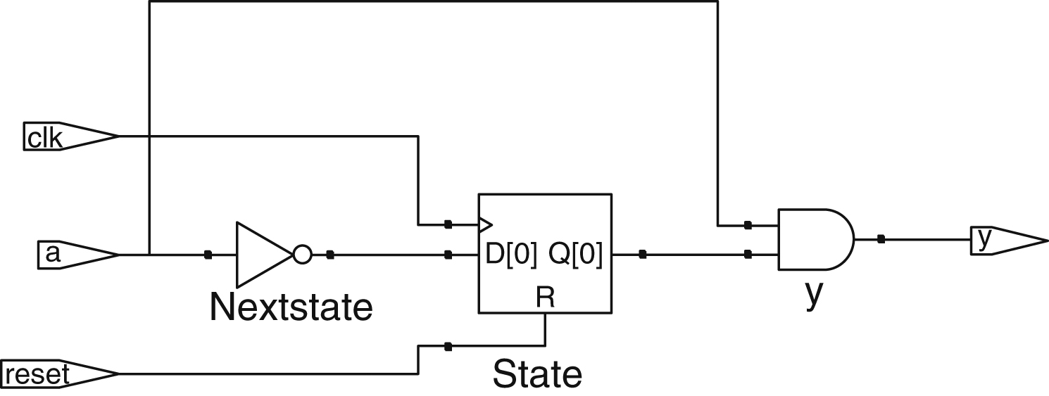
Figure 4.27 patternMealy synthesized circuit

Slide 29
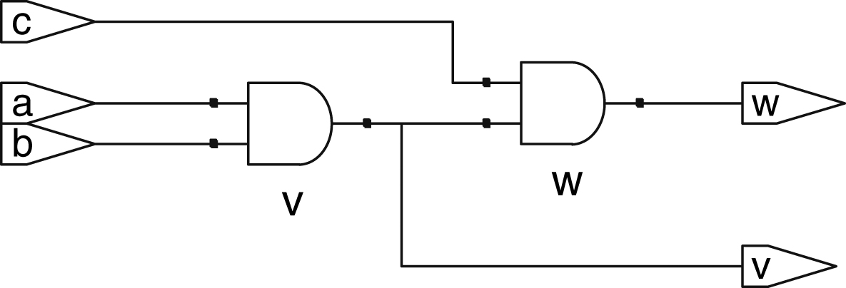
Figure 4.28 and23 synthesized circuit

Slide 30
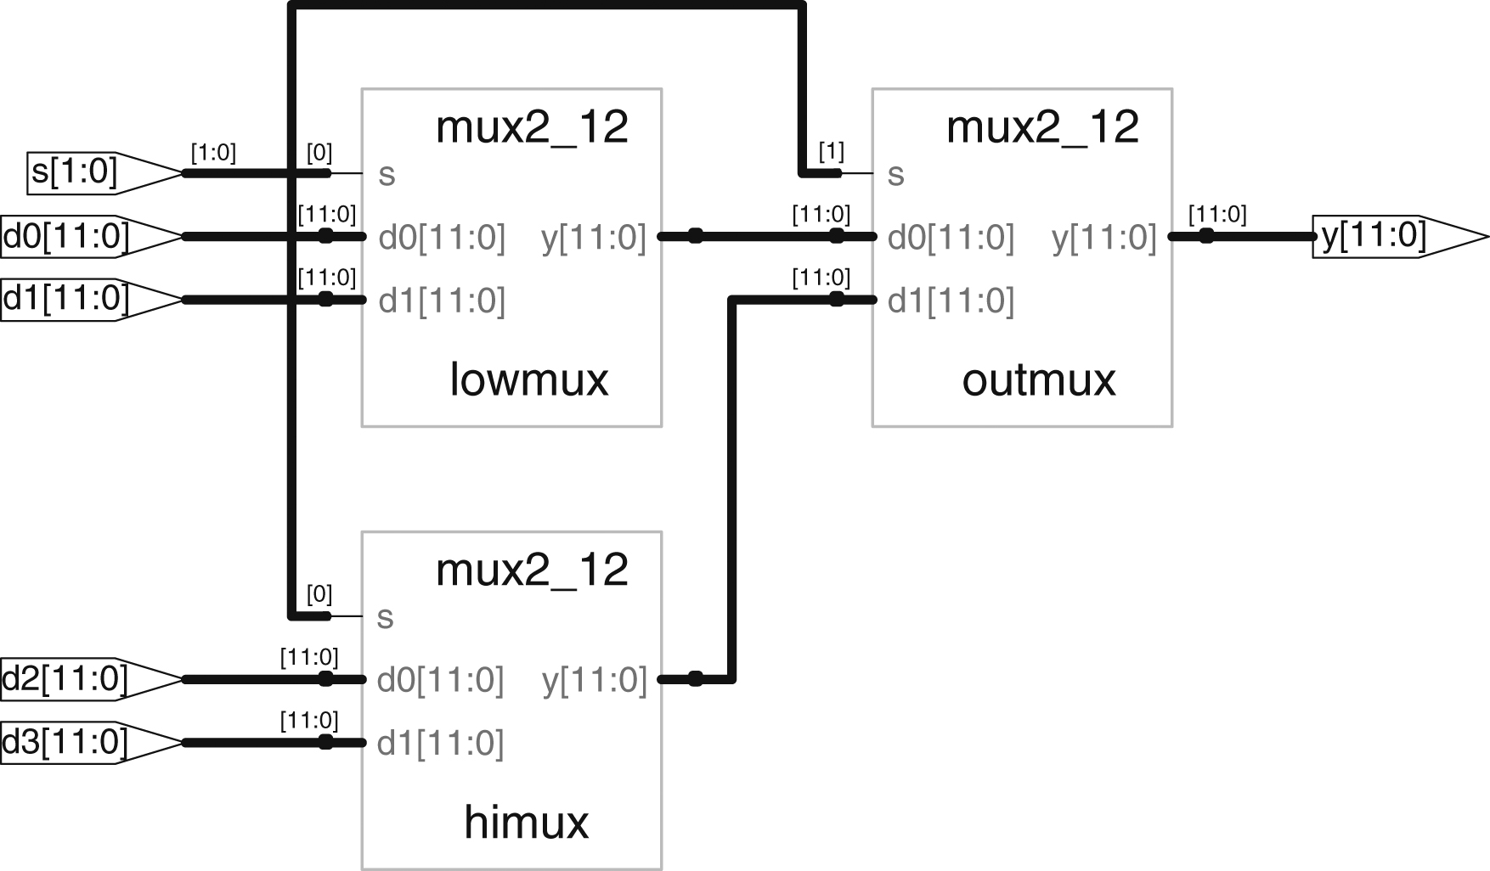
Figure 4.29 mux4_12 synthesized circuit

Slide 31
Figure 4.30 andN synthesized circuit

Slide 32
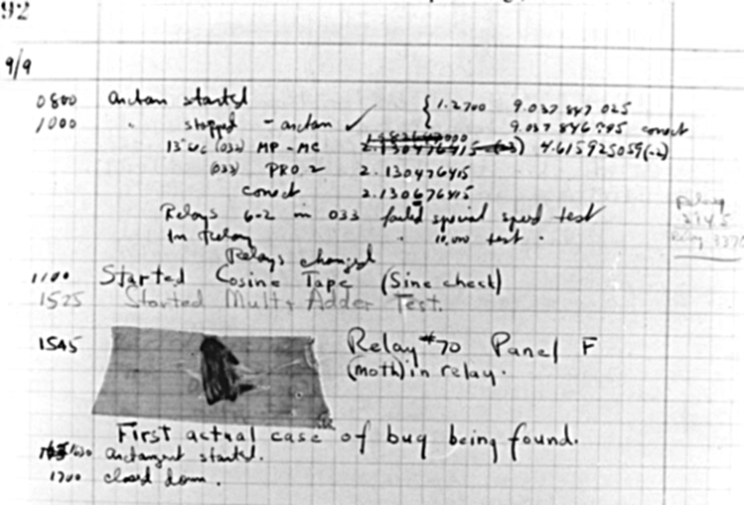

Slide 33
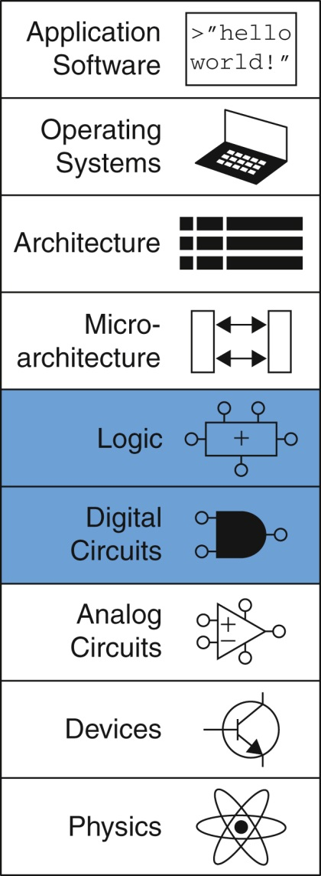
Figure u04-01

