Slide 1
Digital Building Blocks
CH005

Slide 2
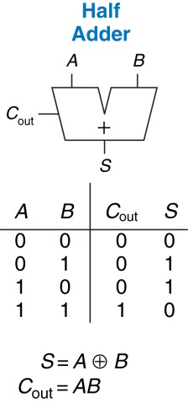
Figure 5.1 1-bit half adder

Slide 3
Figure 5.2 Carry bit

Slide 4
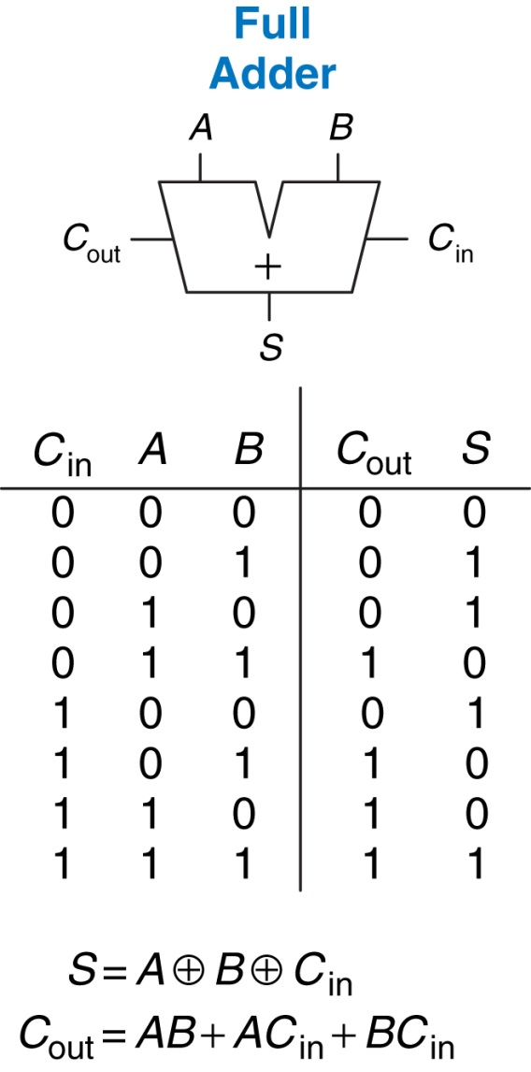
Figure 5.3 1-bit full adder

Slide 5
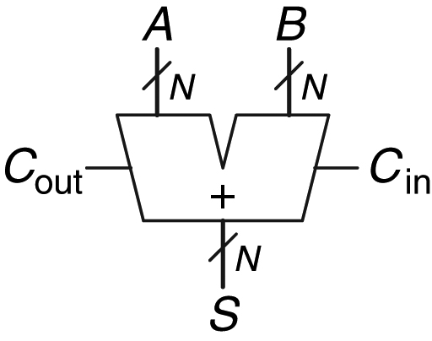
Figure 5.4 Carry propagate adder

Slide 6
Figure 5.5 32-bit ripple-carry adder

Slide 7
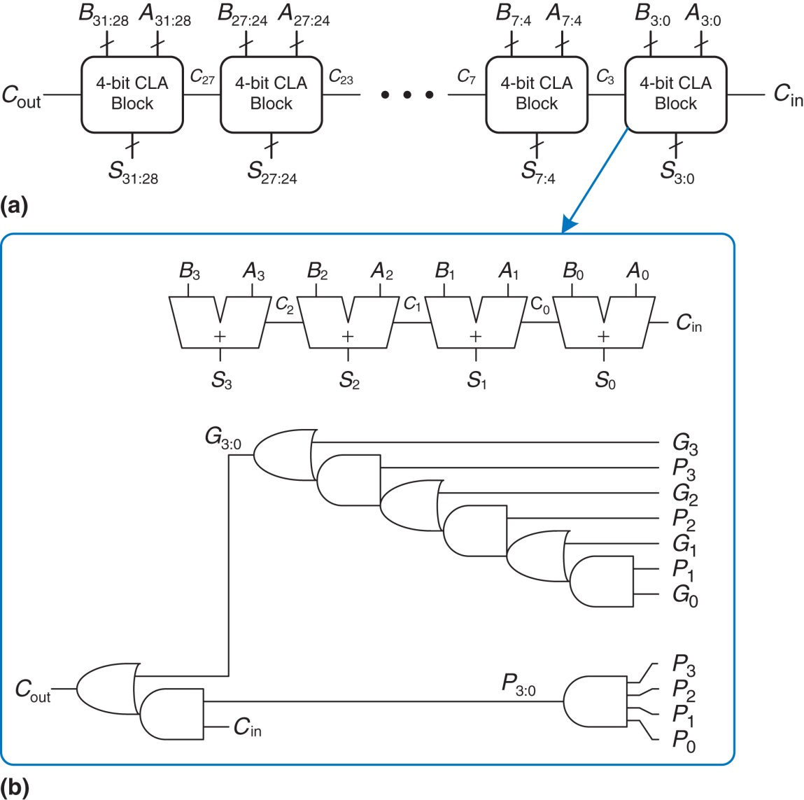
Figure 5.6 (a) 32-bit carry-lookahead adder (CLA), (b) 4-bit CLA block

Slide 8
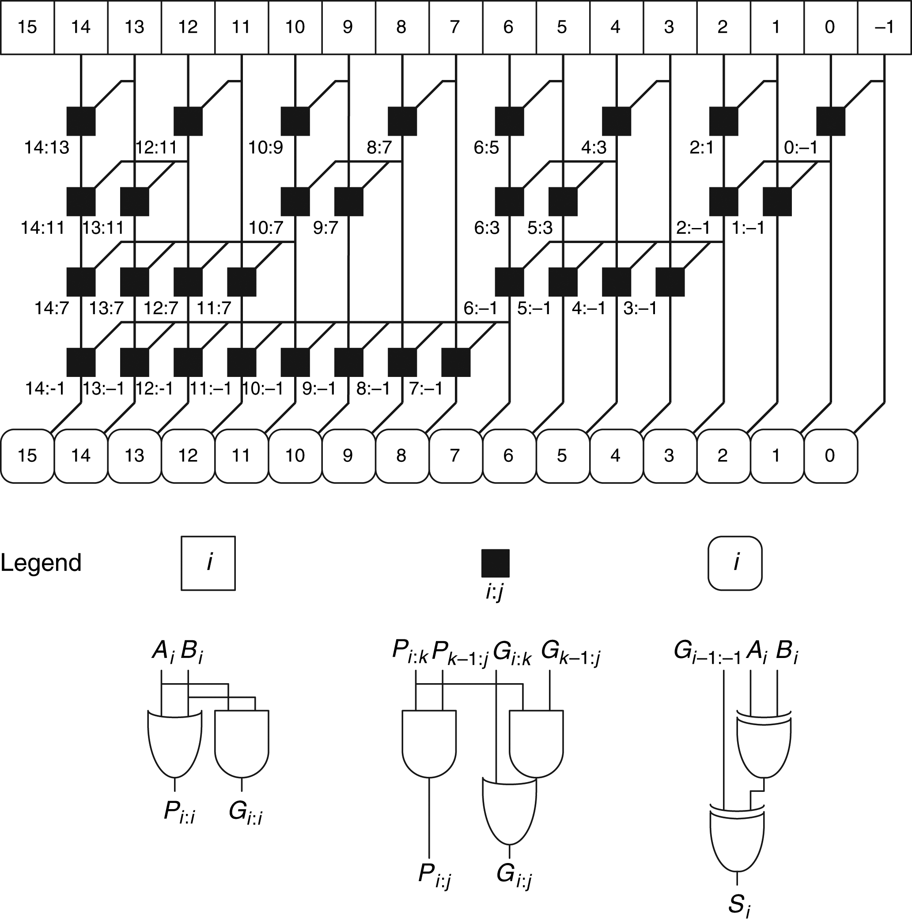
Figure 5.7 16-bit prefix adder

Slide 9
Figure 5.8 Synthesized adder

Slide 10
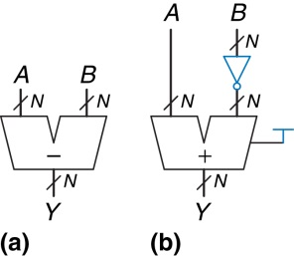
Figure 5.9 Subtractor: (a) symbol, (b) implementation

Slide 11
Figure 5.10 Synthesized subtractor

Slide 12
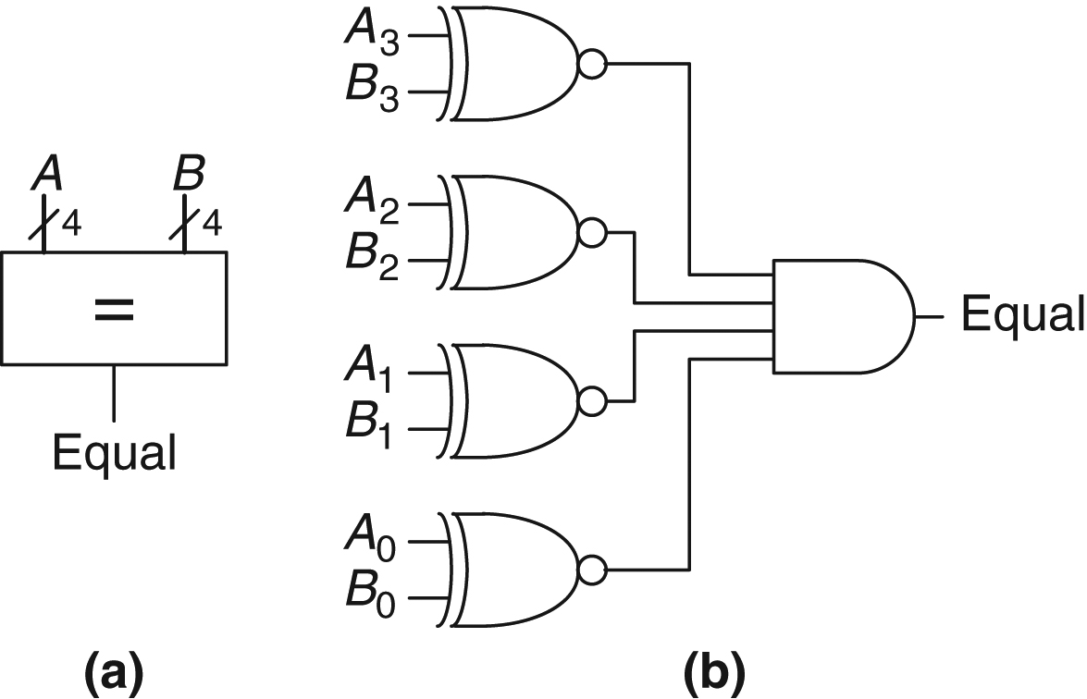
Figure 5.11 4-bit equality comparator: (a) symbol, (b) implementation

Slide 13
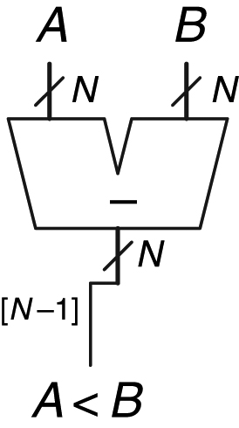
Figure 5.12 N-bit signed comparator

Slide 14
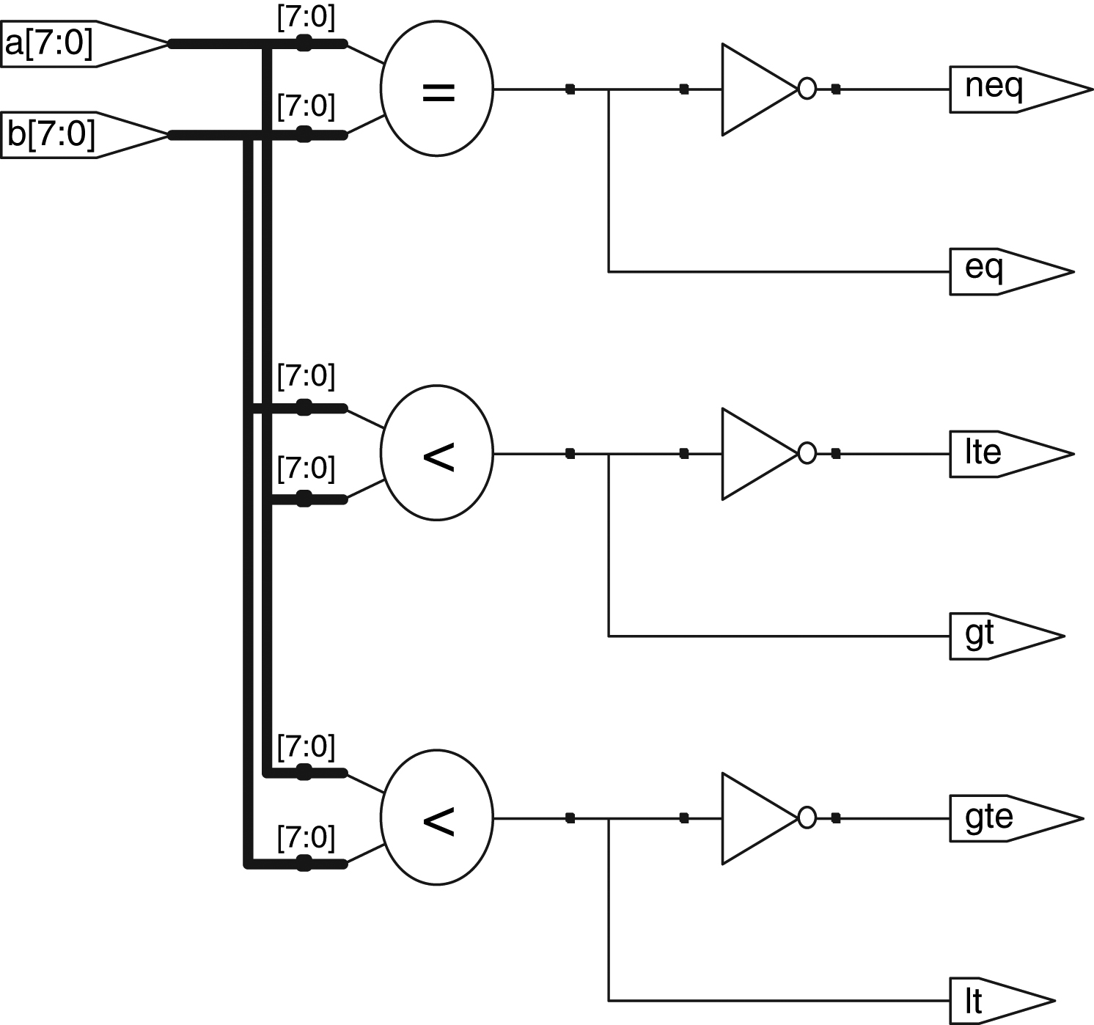
Figure 5.13 Synthesized comparators

Slide 15
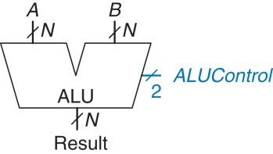
Figure 5.14 ALU symbol

Slide 16
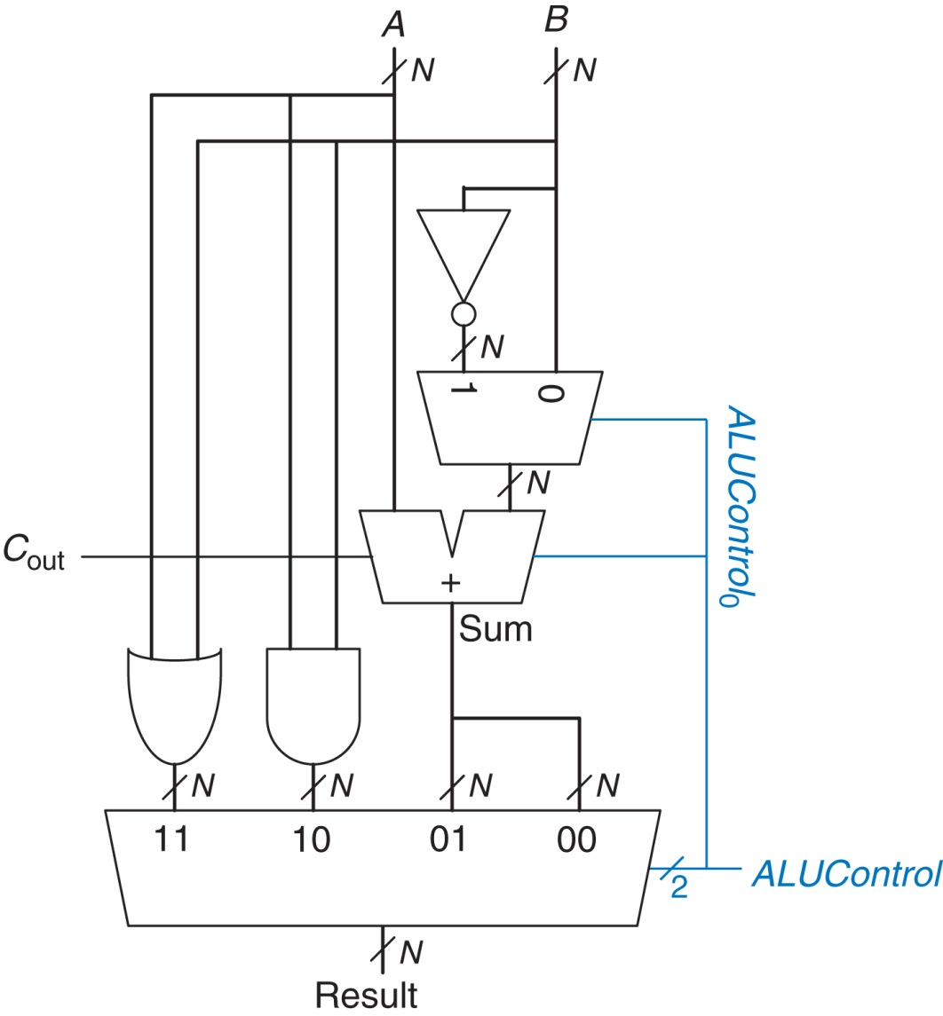
Figure 5.15 N-bit ALU

Slide 17
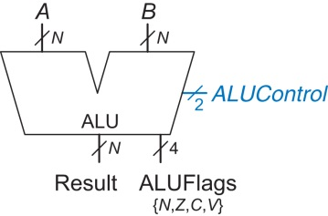
Figure 5.16 ALU symbol with output flags

Slide 18
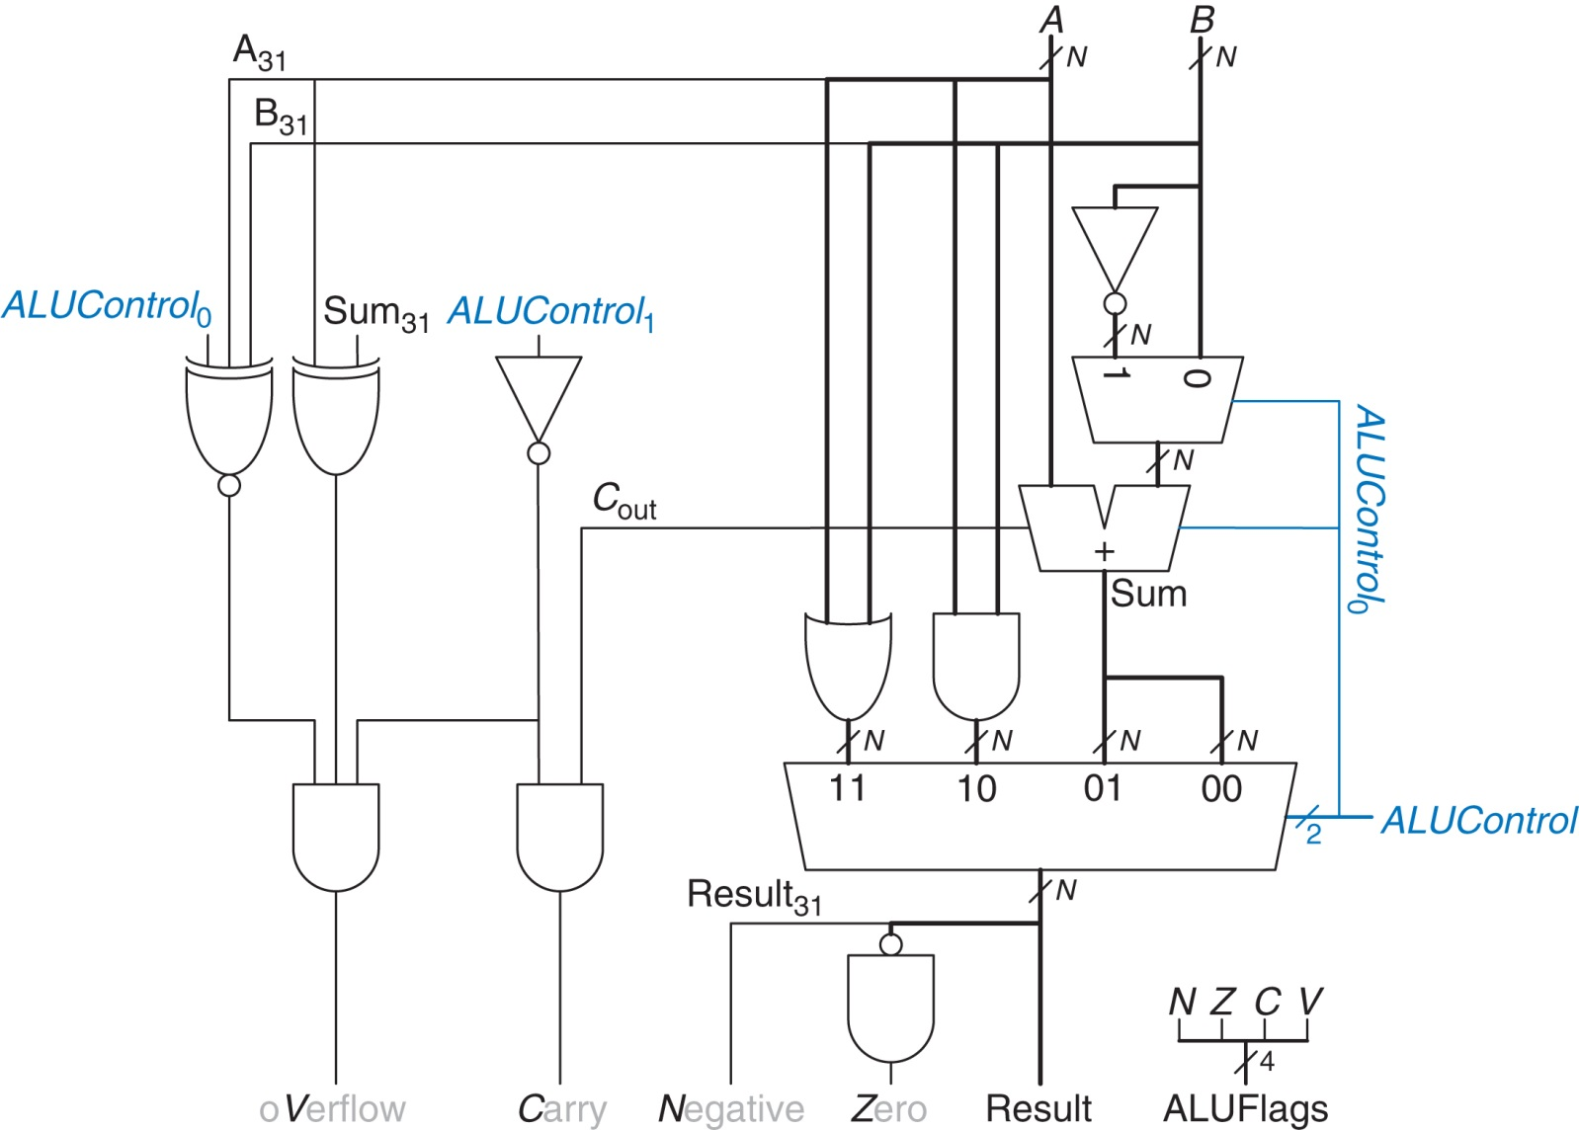
Figure 5.17 N-bit ALU with output flags

Slide 19
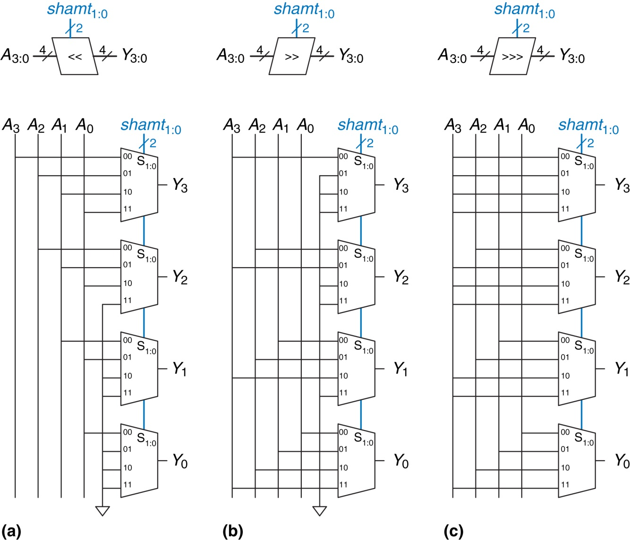
Figure 5.18 4-bit shifters: (a) shift left, (b) logical shift right, (c) arithmetic shift right

Slide 20
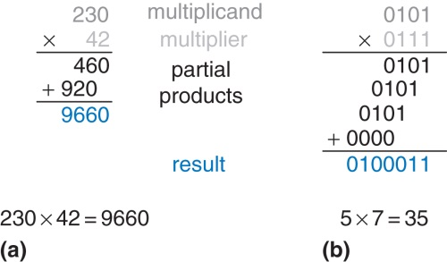
Figure 5.19 Multiplication: (a) decimal, (b) binary

Slide 21
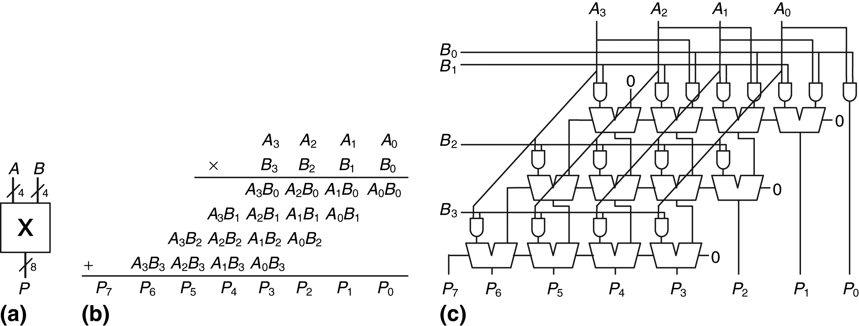
Figure 5.20 4×4 multiplier: (a) symbol, (b) function, (c) implementation

Slide 22
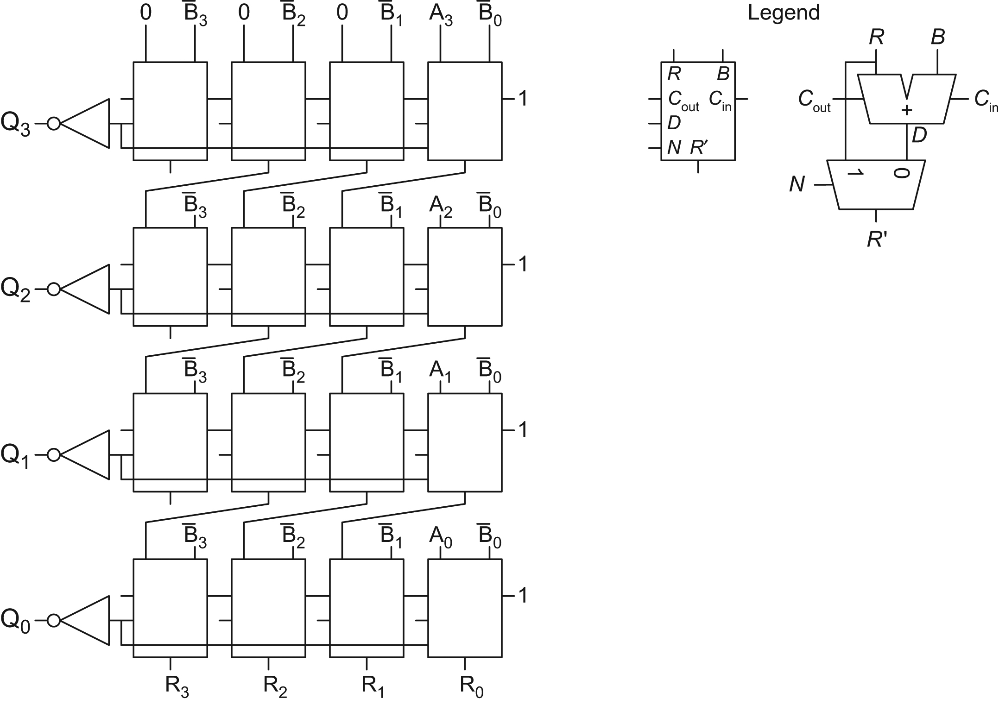
Figure 5.21 Array divider

Slide 23
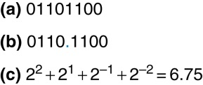
Figure 5.22 Fixed-point notation of 6.75 with four integer bits and four fraction bits

Slide 24
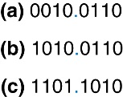
Figure 5.23 Fixed-point representation of −2.375: (a) absolute value, (b) sign and magnitude, (c) two’s complement

Slide 25
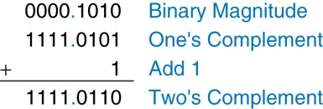
Figure 5.24 Fixed-point two’s complement conversion

Slide 26
Figure 5.25 Addition: (a) binary fixed-point, (b) decimal equivalent

Slide 27
Figure 5.26 Floating-point numbers

Slide 28
Figure 5.27 32-bit floating-point version 1

Slide 29
Figure 5.28 32-bit floating-point version 2

Slide 30
Figure 5.29 IEEE 754 floating-point notation

Slide 31
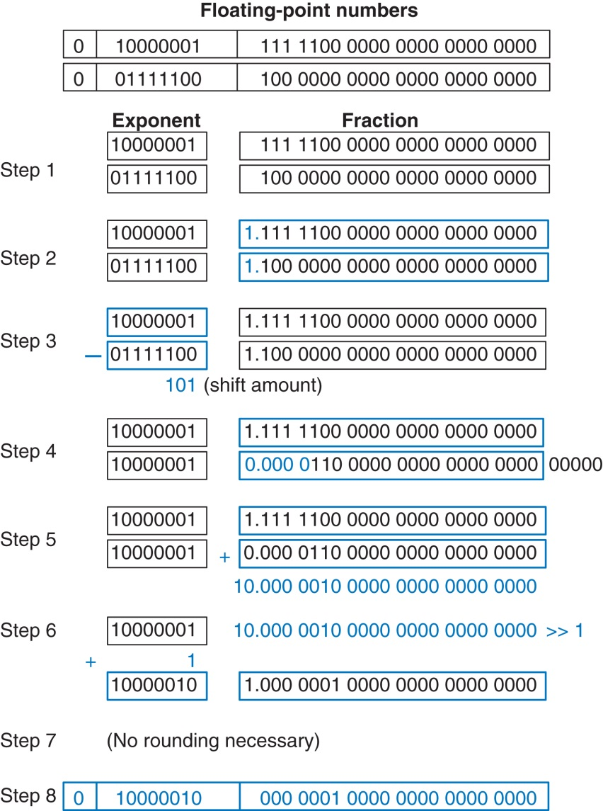
Figure 5.30 Floating-point addition

Slide 32
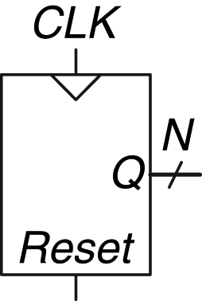
Figure 5.31 Counter symbol

Slide 33
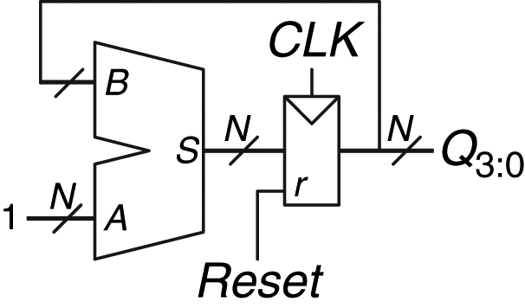
Figure 5.32 N-bit counter

Slide 34
Figure 5.33 Synthesized counter

Slide 35
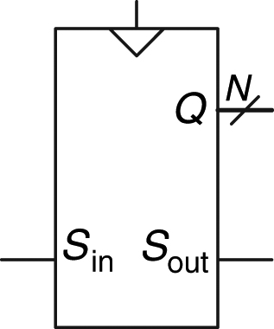
Figure 5.34 Shift register symbol

Slide 36
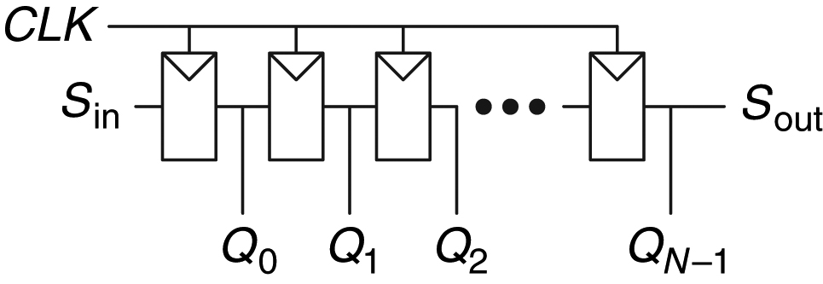
Figure 5.35 Shift register schematic

Slide 37
Figure 5.36 Shift register with parallel load

Slide 38
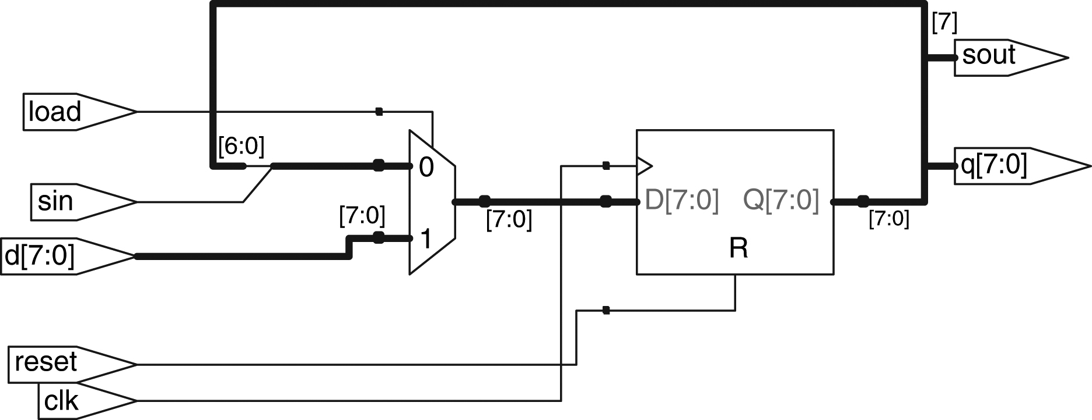
Figure 5.37 Synthesized shiftreg

Slide 39
Figure 5.38 Scannable flip-flop: (a) schematic, (b) symbol, and (c) N-bit scannable register

Slide 40
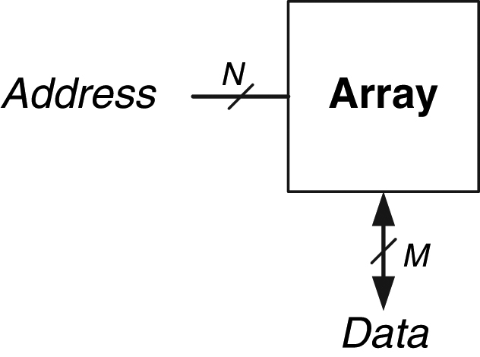
Figure 5.39 Generic memory array symbol

Slide 41
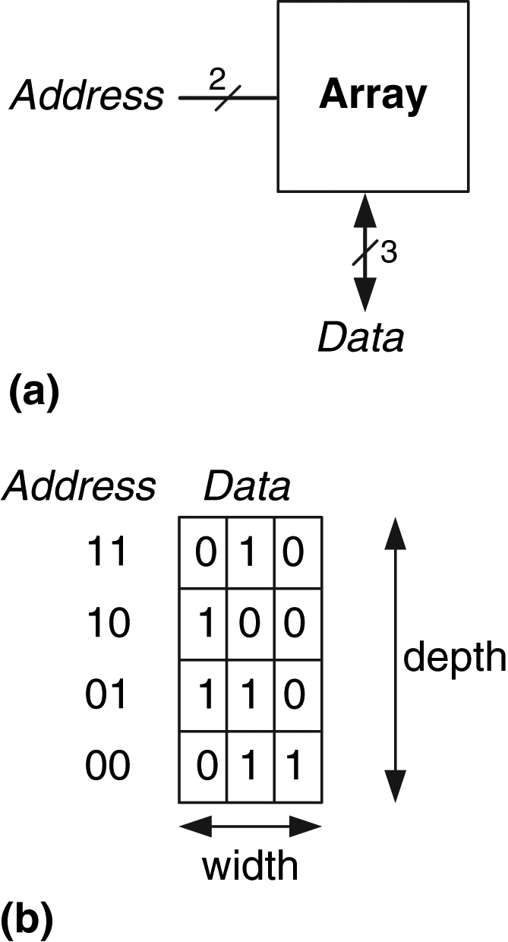
Figure 5.40 4×3 memory array: (a) symbol, (b) function

Slide 42
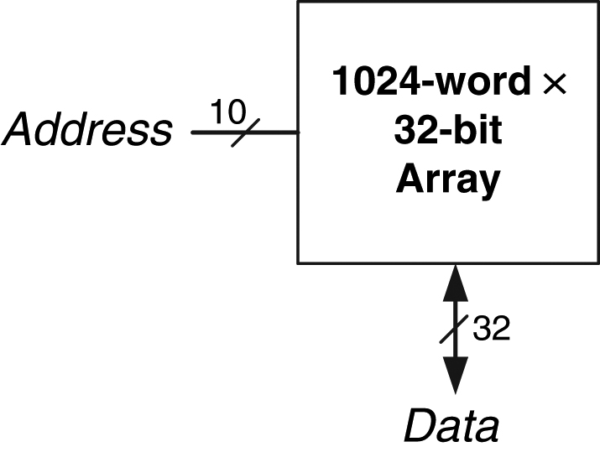
Figure 5.41 32 Kb array: depth = 2<ce:sup>10</ce:sup> = 1024 words, width = 32 bits

Slide 43
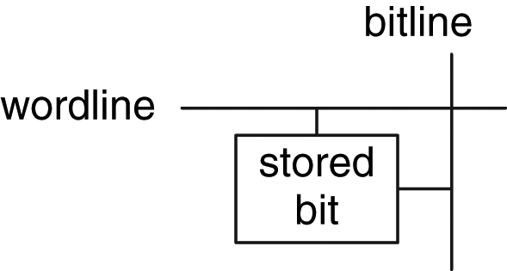
Figure 5.42 Bit cell

Slide 44
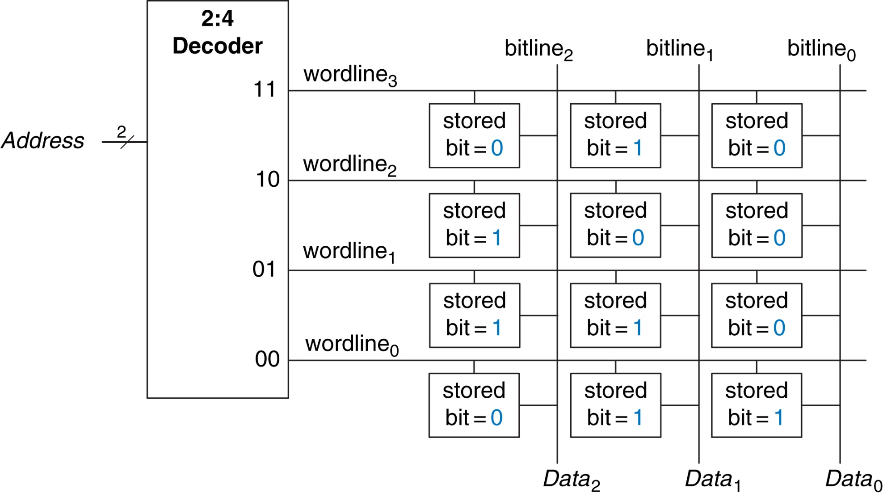
Figure 5.43 4×3 memory array

Slide 45
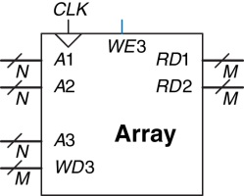
Figure 5.44 Three-ported memory

Slide 46
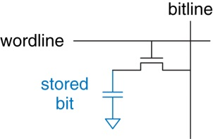
Figure 5.45 DRAM bit cell

Slide 47
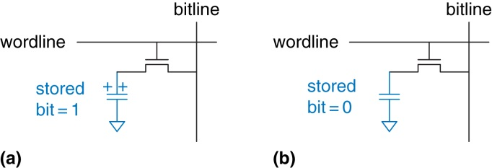
Figure 5.46 DRAM stored values

Slide 48
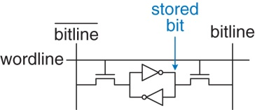
Figure 5.47 SRAM bit cell

Slide 49
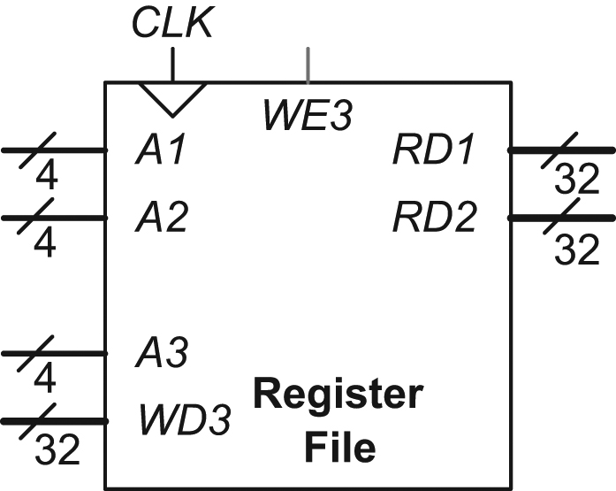
Figure 5.48 16×32 register file with two read ports and one write port

Slide 50
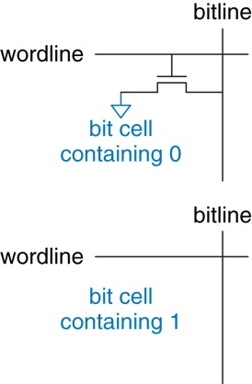
Figure 5.49 ROM bit cells containing 0 and 1

Slide 51
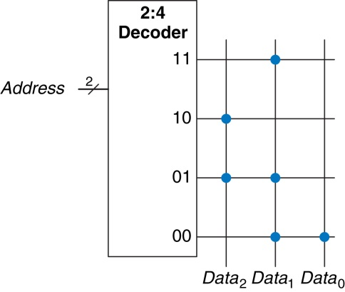
Figure 5.50 4×3 ROM: dot notation

Slide 52
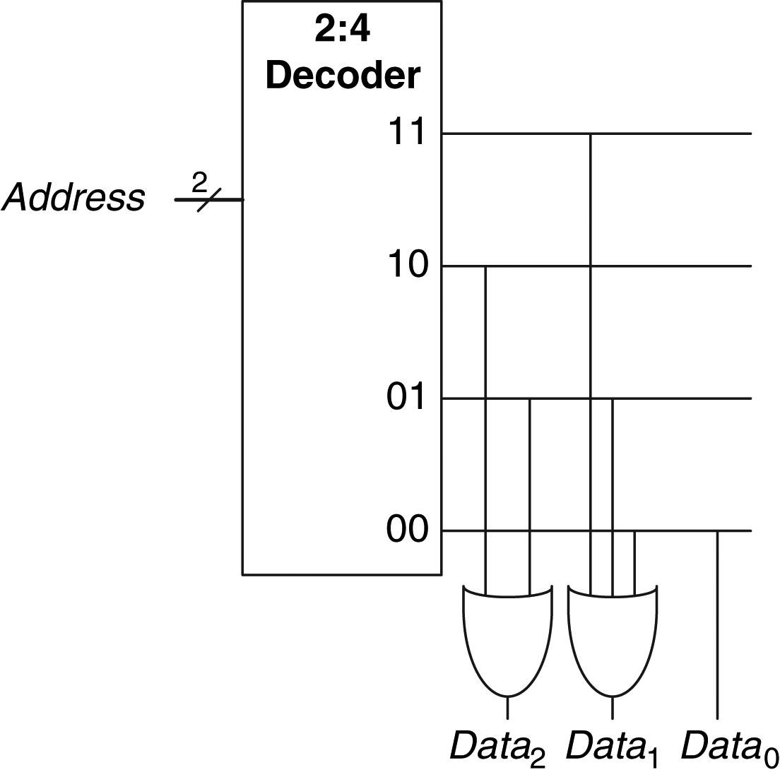
Figure 5.51 4×3 ROM implementation using gates

Slide 53
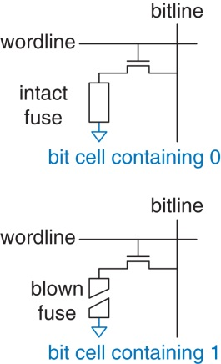
Figure 5.52 Fuse-programmable ROM bit cell

Slide 54
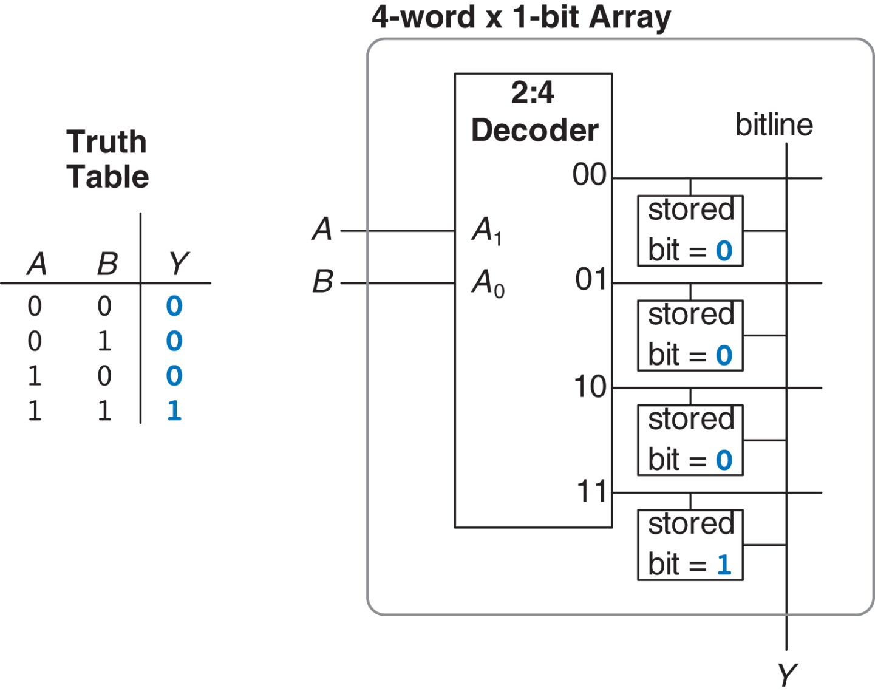
Figure 5.53 4-word×1-bit memory array used as a lookup table

Slide 55
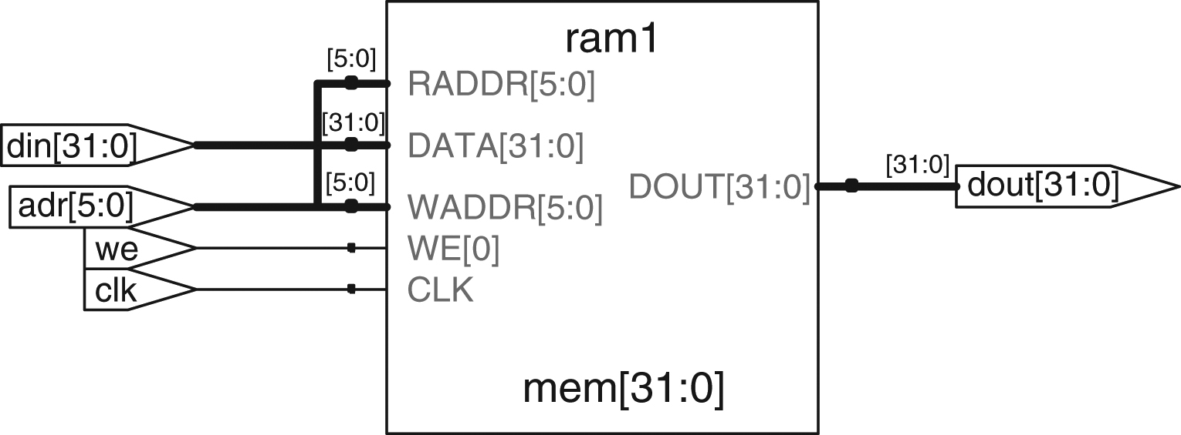
Figure 5.54 Synthesized ram

Slide 56
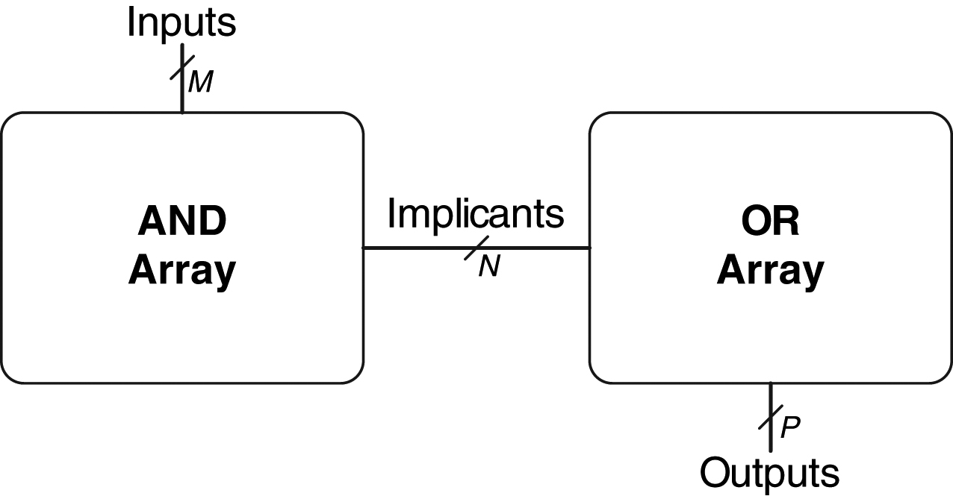
Figure 5.55 M×N×P-bit PLA

Slide 57
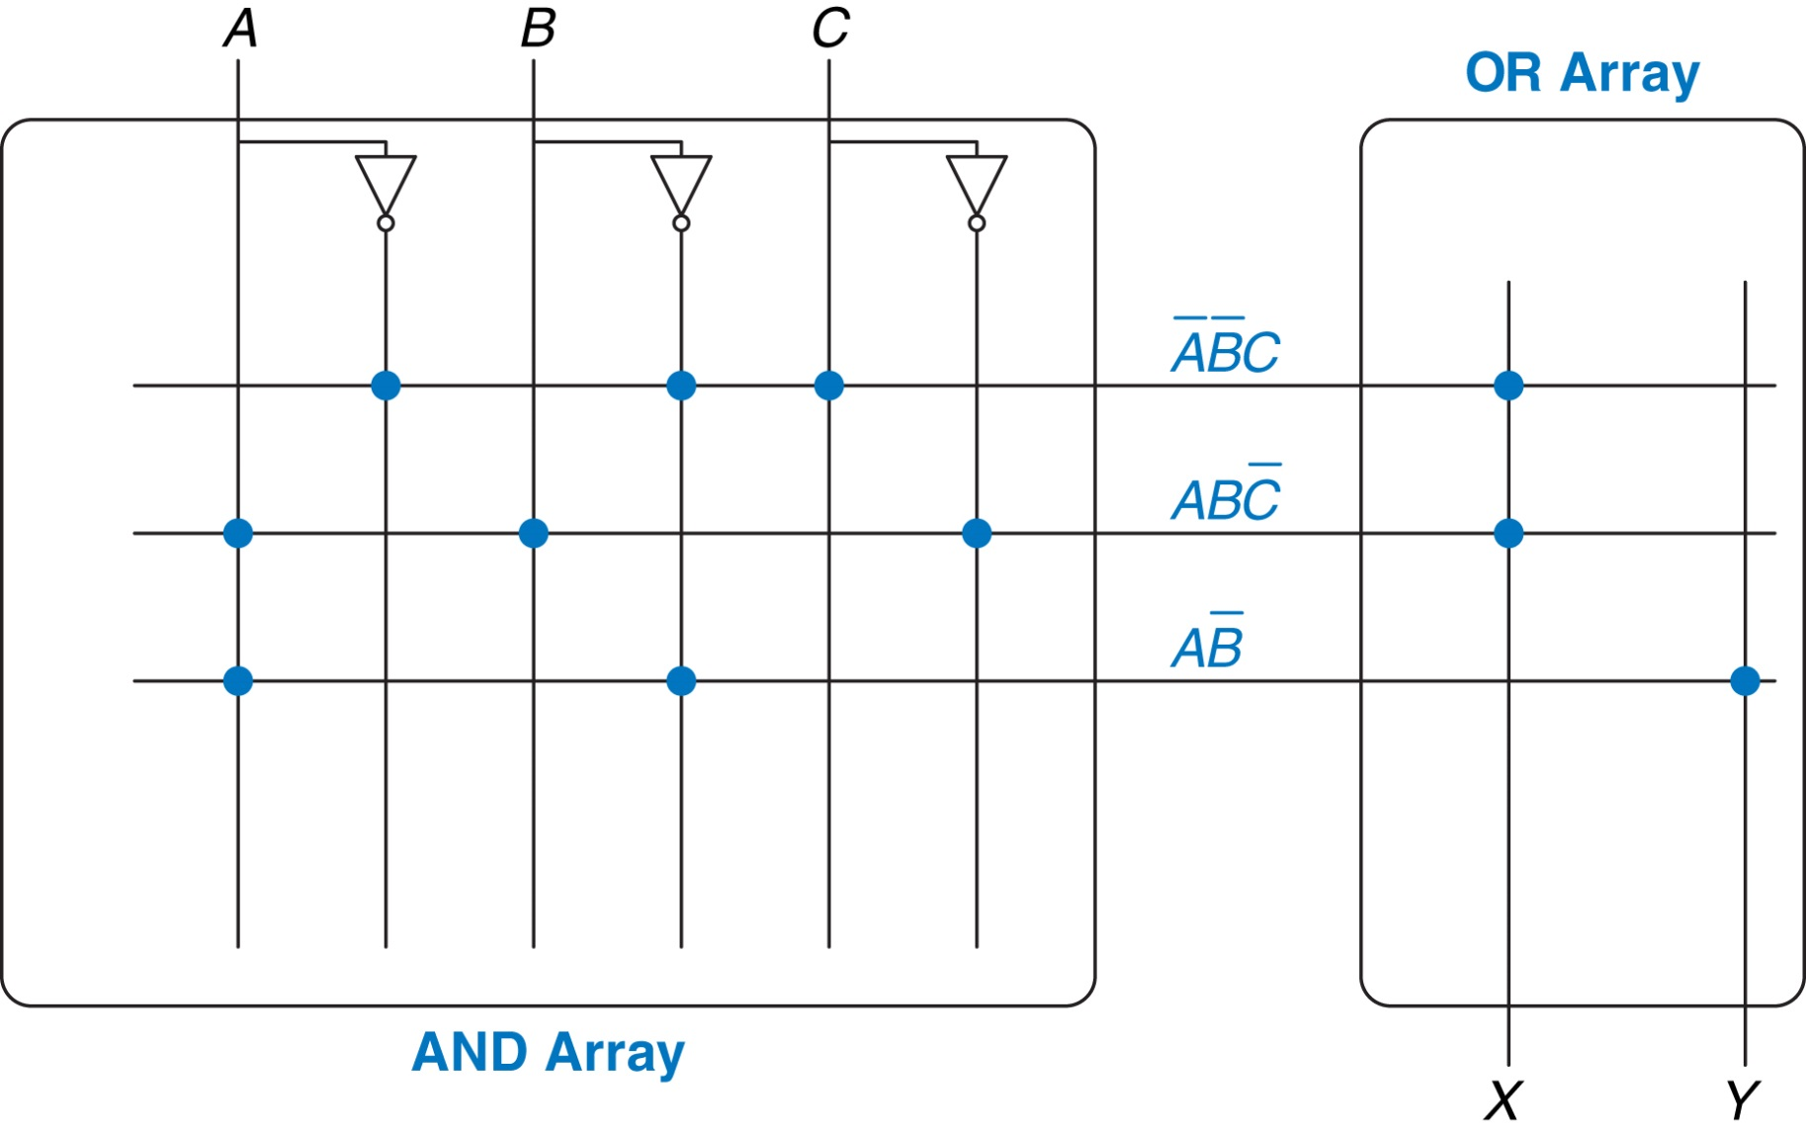
Figure 5.56 3×3×2-bit PLA: dot notation

Slide 58
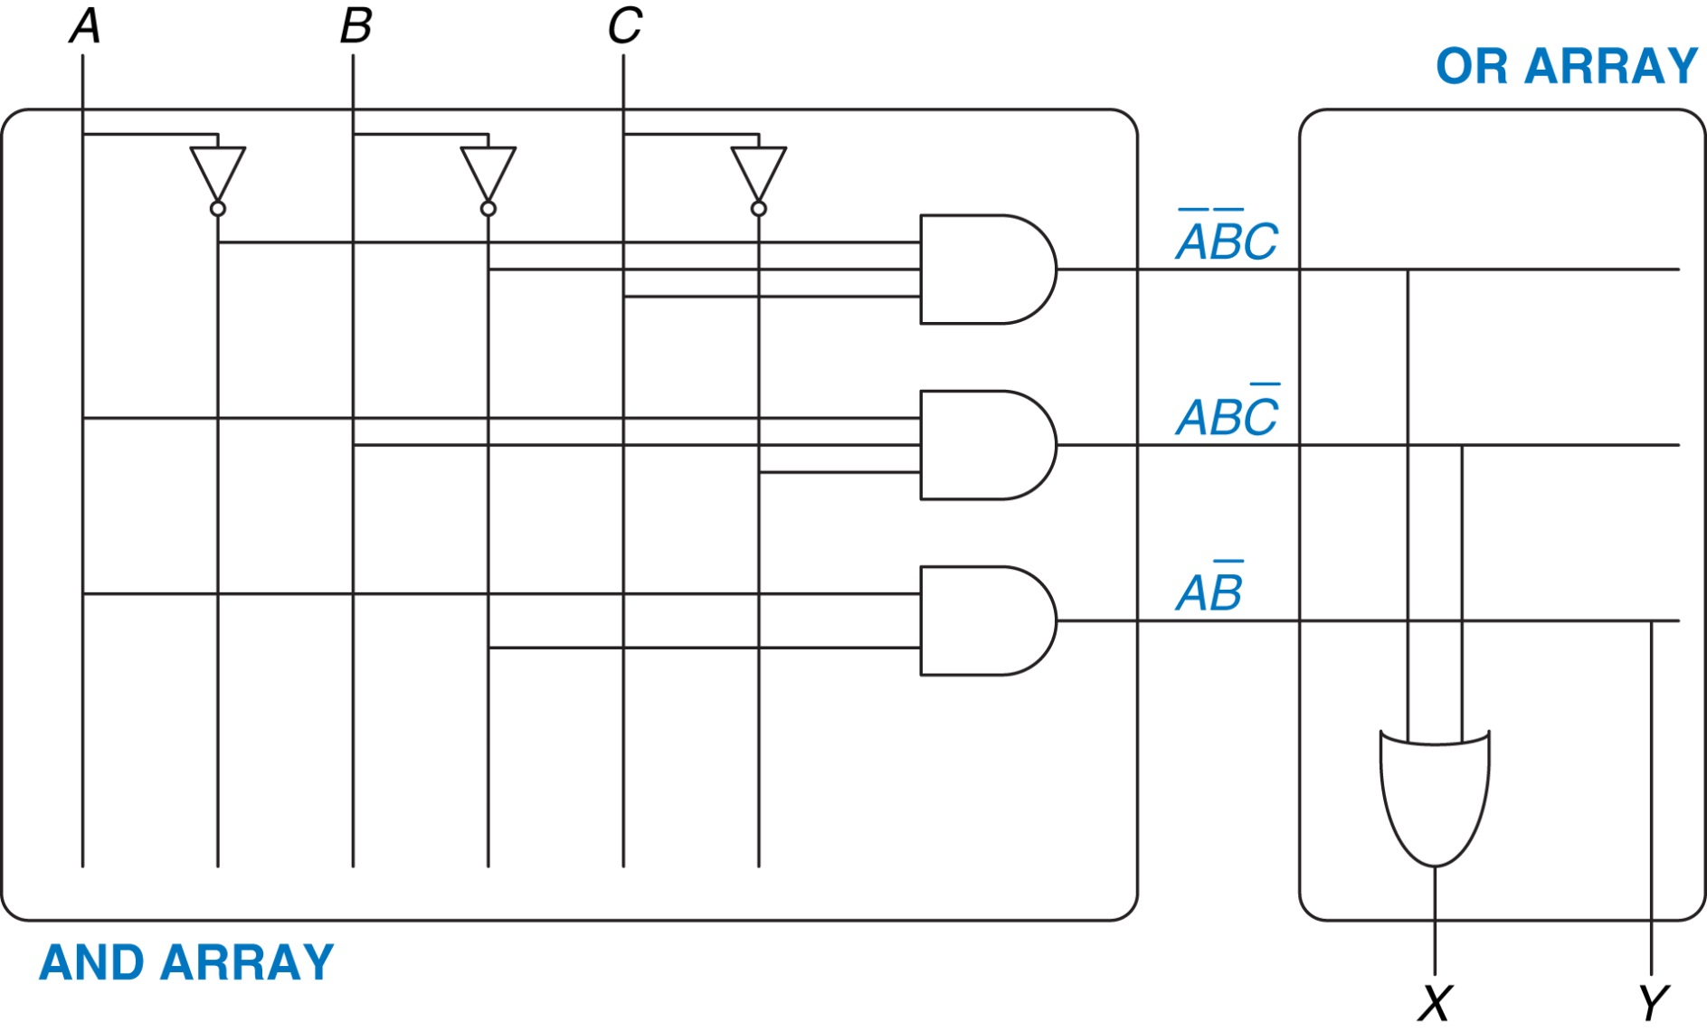
Figure 5.57 3×3×2-bit PLA using two-level logic

Slide 59
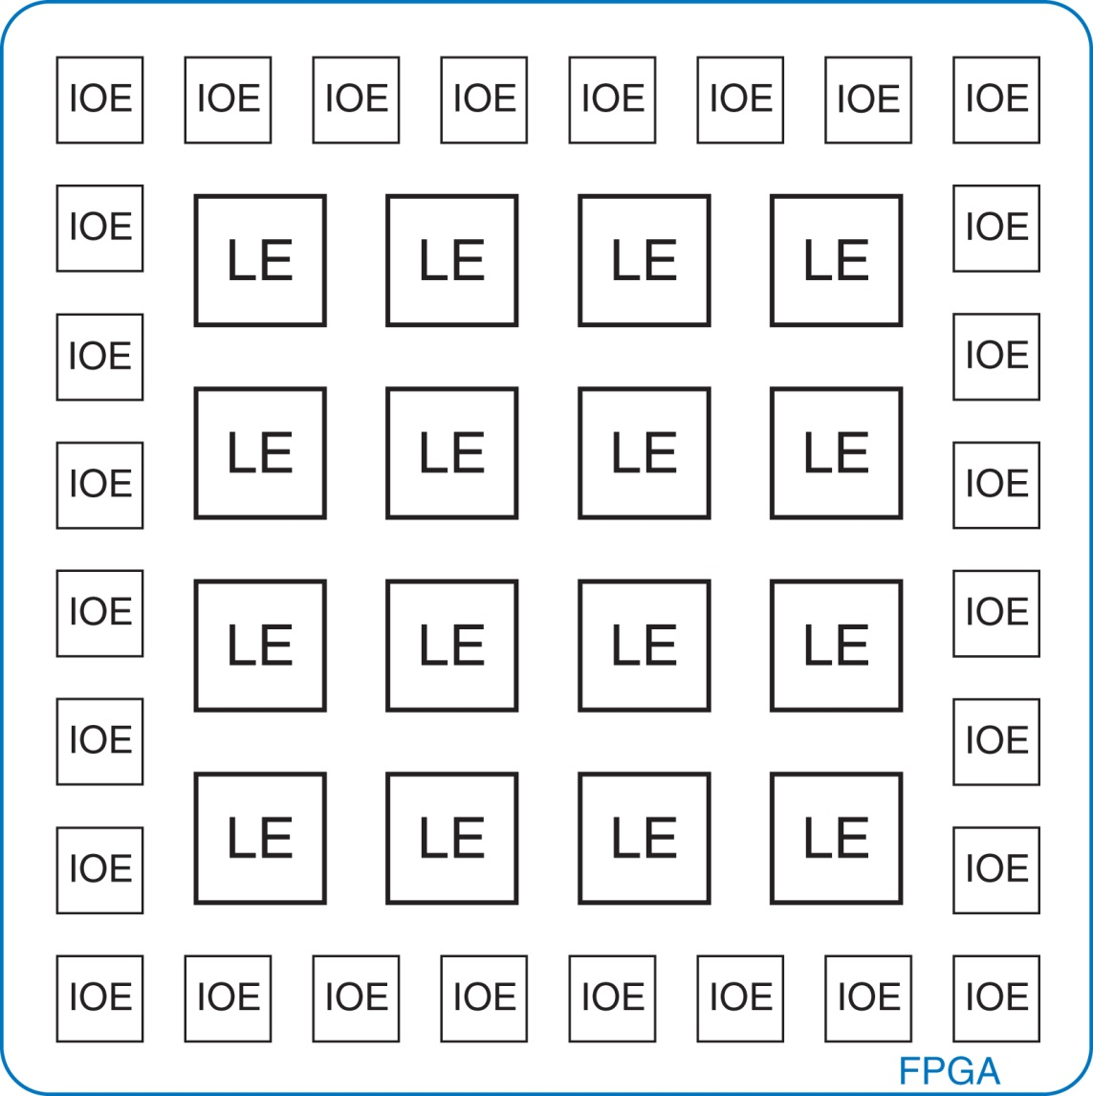
Figure 5.58 General FPGA layout

Slide 60
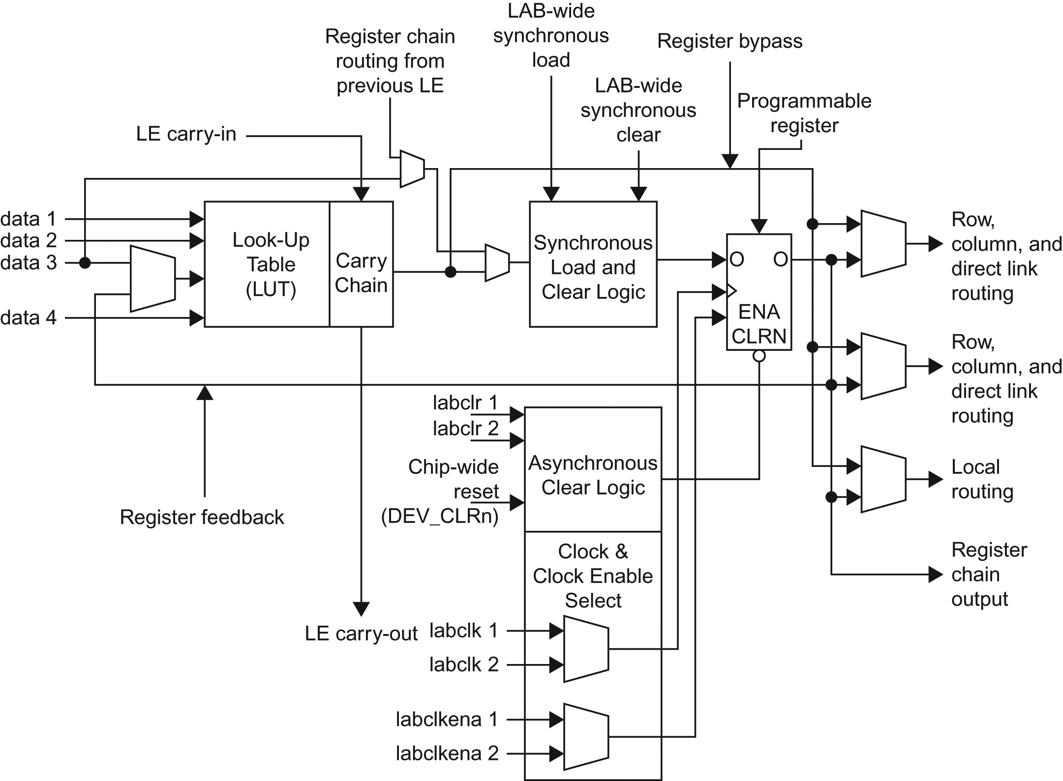
Figure 5.59 Cyclone IV Logic Element (LE). Reproduced with permission from the Altera Cyclone™ IV Handbook © 2010 Altera Corporation.

Slide 61
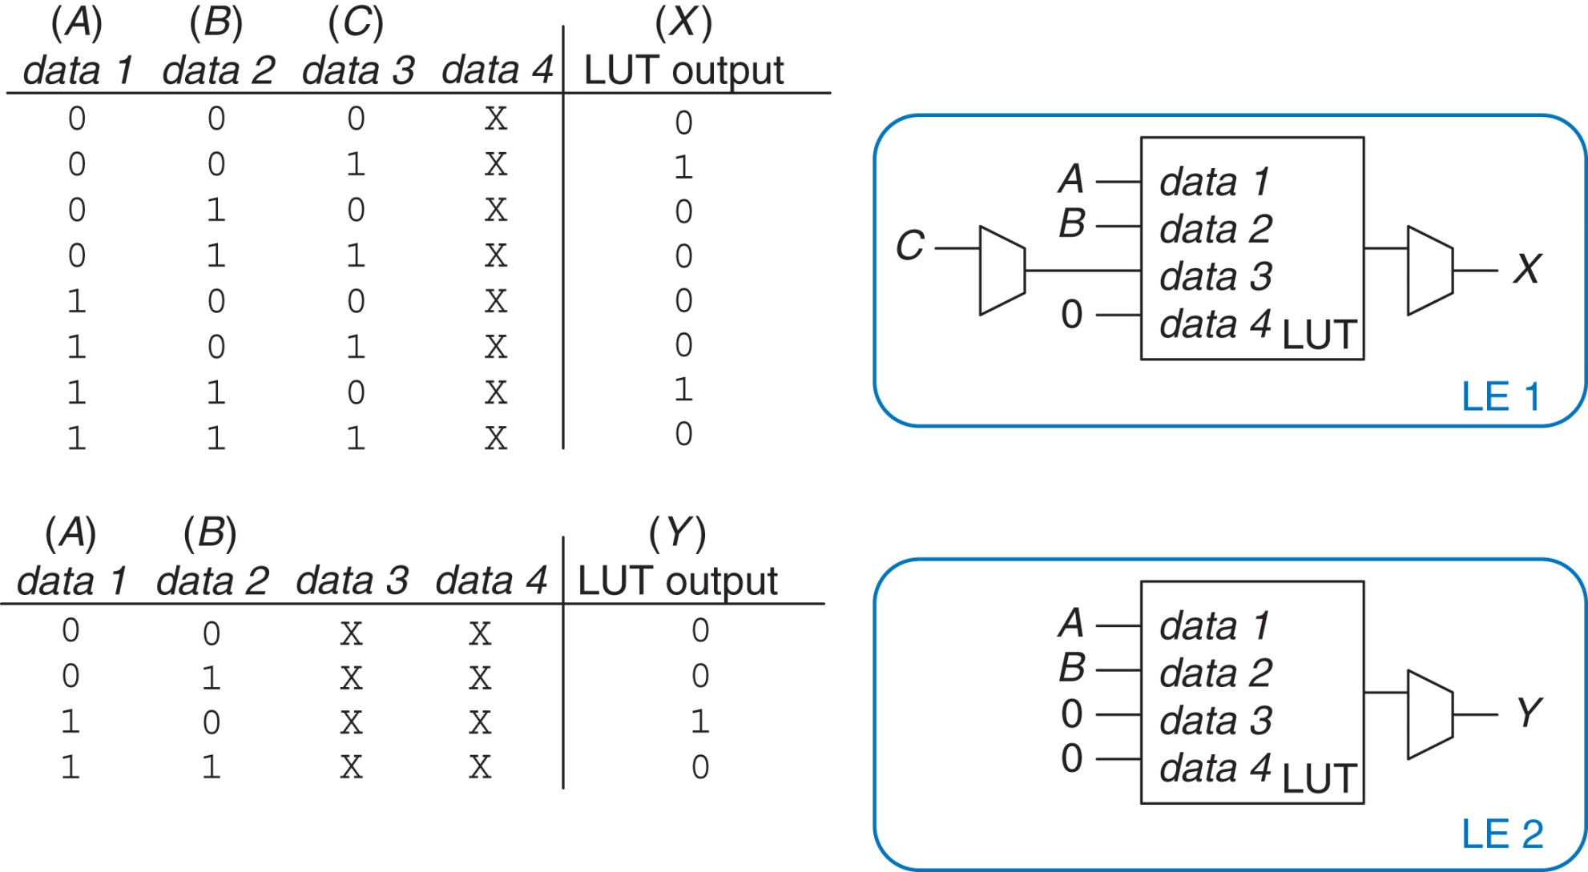
Figure 5.60 LE configuration for two functions of up to four inputs each

Slide 62
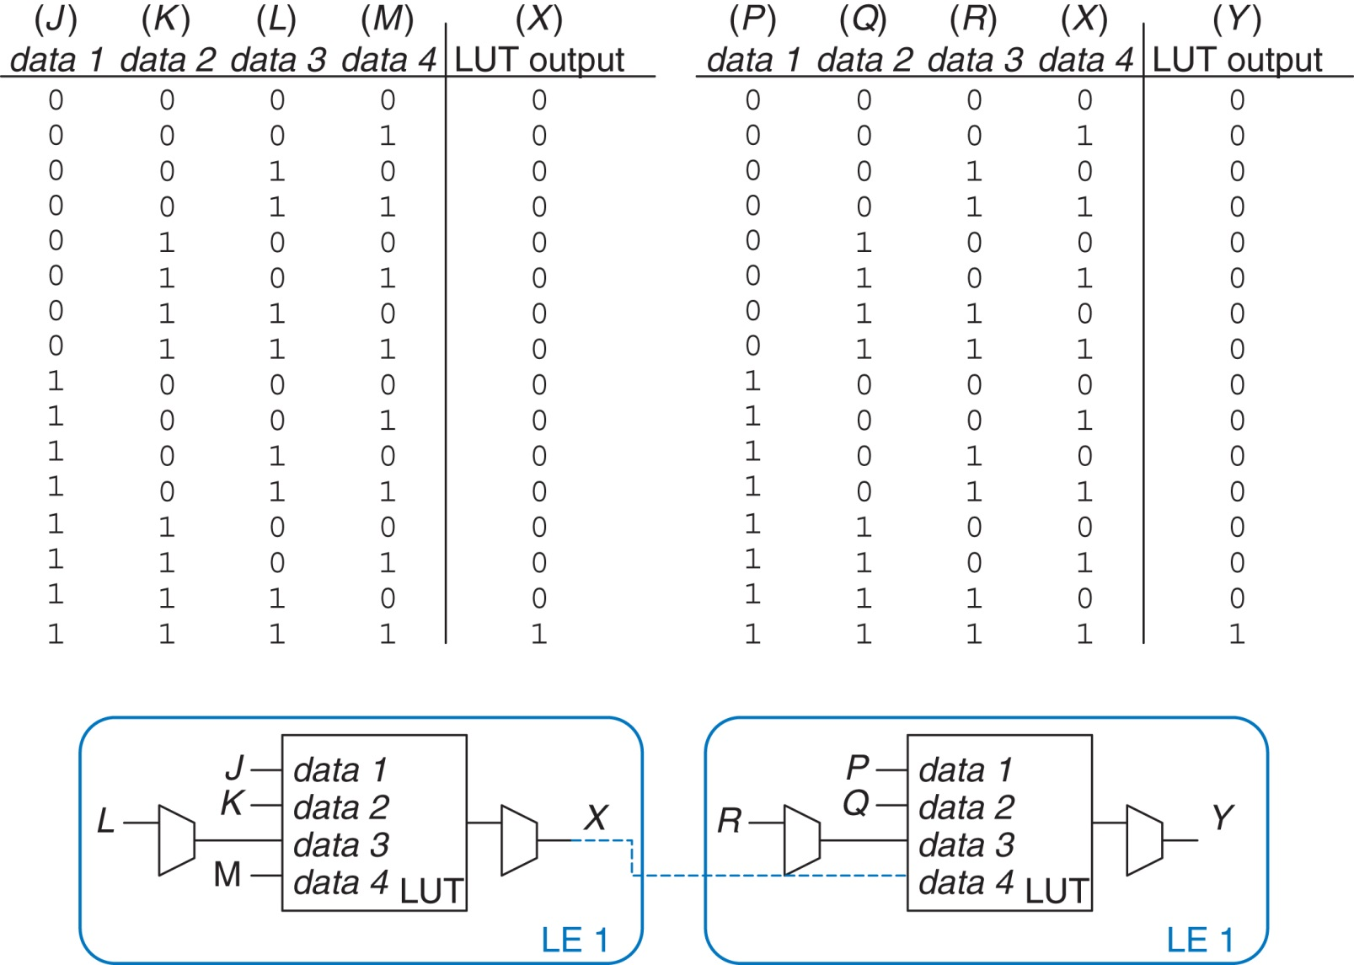
Figure 5.61 LE configuration for one function of more than four inputs

Slide 63
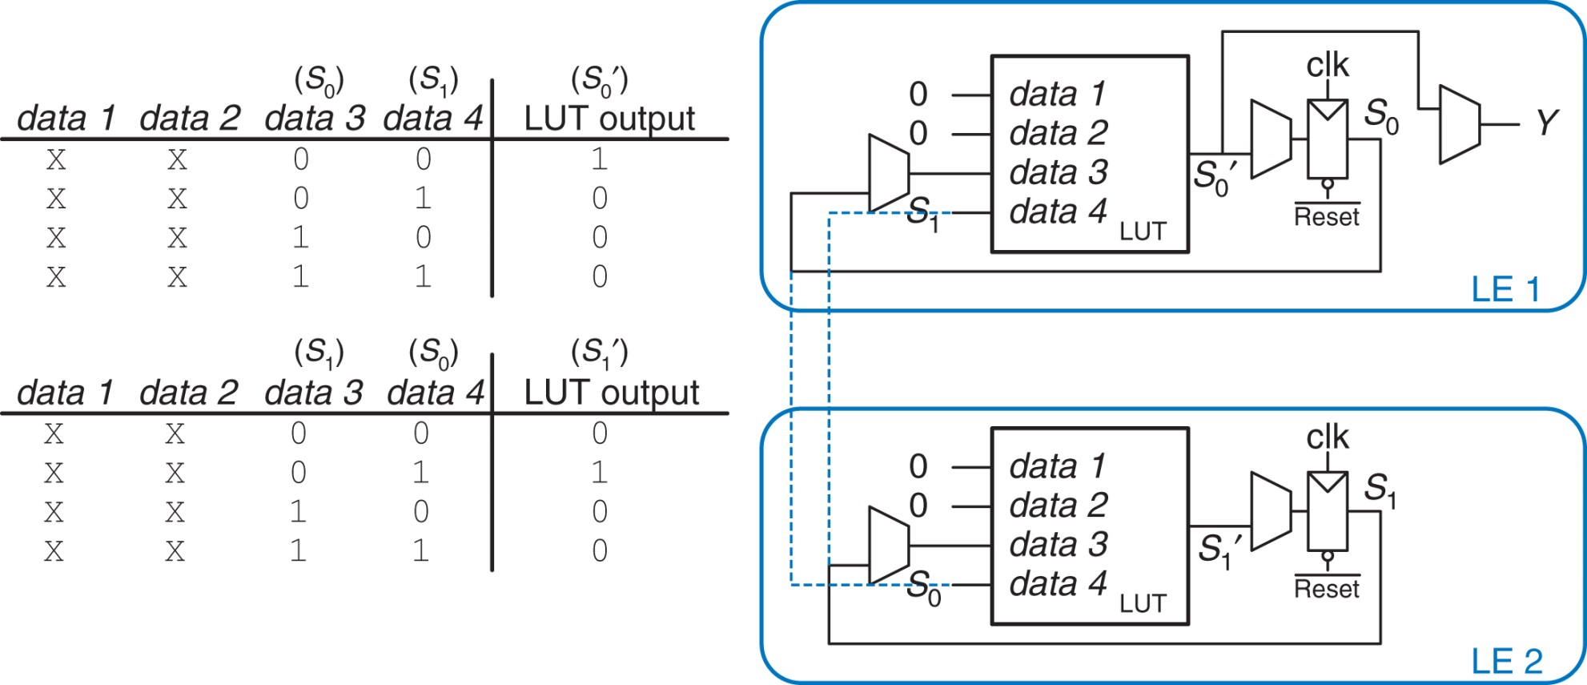
Figure 5.62 LE configuration for FSM with two bits of state

Slide 64
Figure 5.63 ROM implementation: (a) dot notation, (b) pseudo-nMOS circuit

Slide 65
Figure 5.64 3×3×2-bit PLA using pseudo-nMOS circuits

Slide 66
Figure 5.65 Funnel shifter

Slide 67
Figure 5.66 ROM circuits

Slide 74
u05-01-9780128000564

