Slide 1
Architecture
CH006

Slide 2
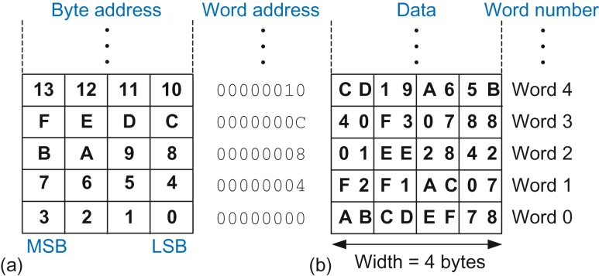
Figure 6.1 ARM byte-addressable memory showing: (a) byte address and (b) data

Slide 3
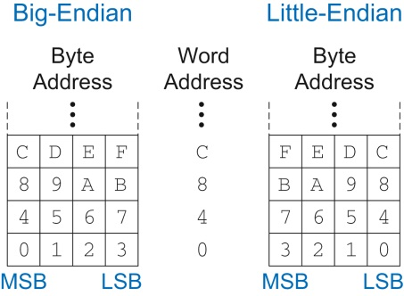
Figure 6.2 Big-endian and little-endian memory addressing

Slide 4
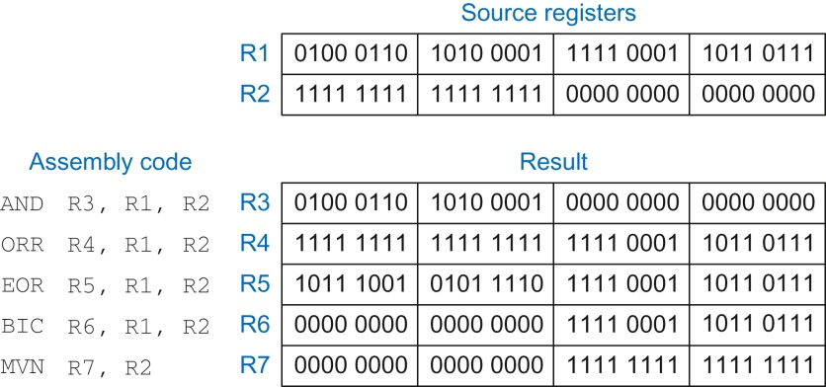
Figure 6.3 Logical operations

Slide 5
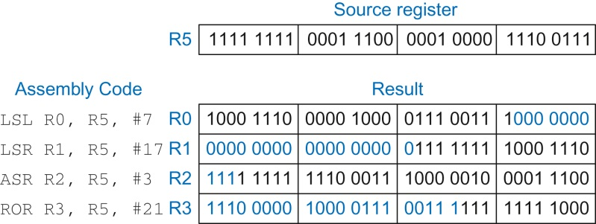
Figure 6.4 Shift instructions with immediate shift amounts

Slide 6
Figure 6.5 Shift instructions with register shift amounts

Slide 7
Figure 6.6 Current Program Status Register (CPSR)

Slide 8
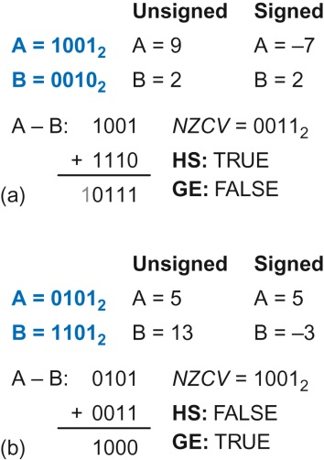
Figure 6.7 Signed vs. unsigned comparison: HS vs. GE

Slide 9
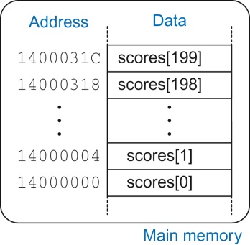
Figure 6.8 Memory holding scores[200] starting at base address 0x14000000

Slide 10
Figure 6.9 Instructions for loading and storing bytes

Slide 11
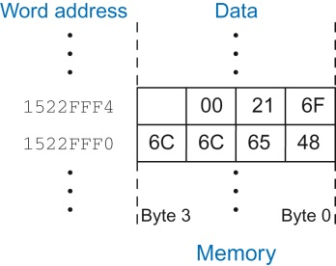
Figure 6.10 The string “Hello!” stored in memory

Slide 12
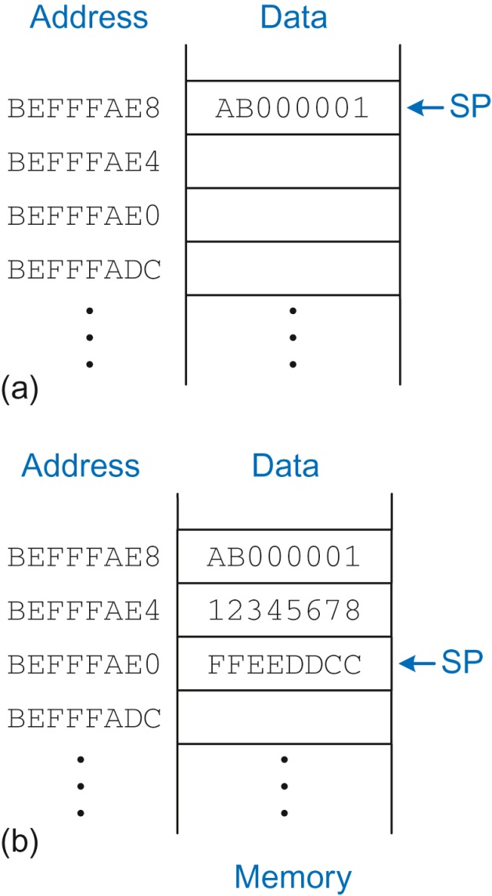
Figure 6.11 The stack (a) before expansion and (b) after two-word expansion

Slide 13
Figure 6.12 The stack: (a) before, (b) during, and (c) after the diffofsums function call

Slide 14
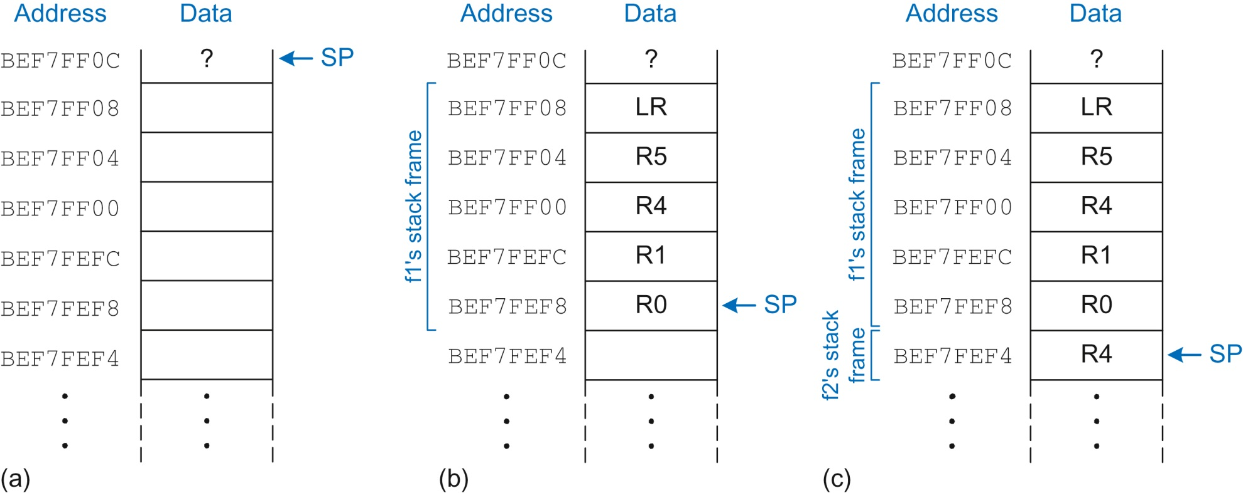
Figure 6.13 The stack: (a) before function calls, (b) during f1, and (c) during f2

Slide 15
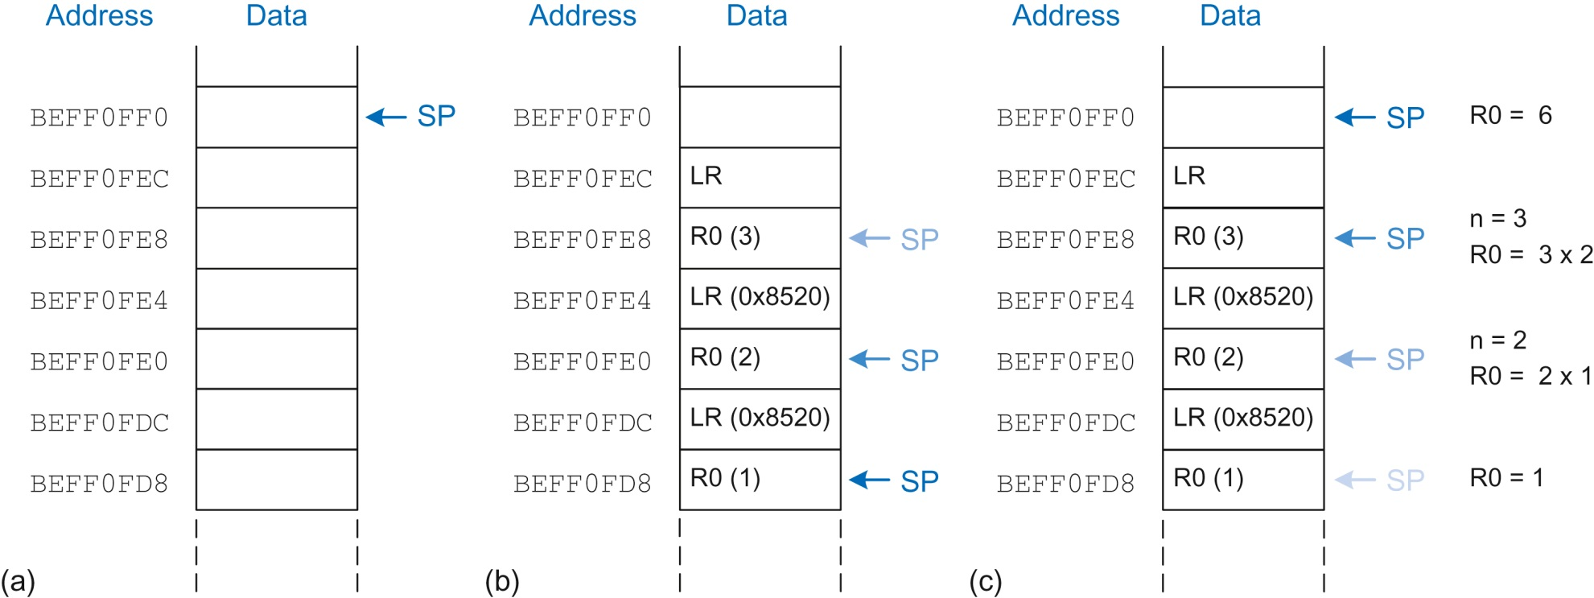
Figure 6.14 Stack: (a) before, (b) during, and (c) after factorial function call with n = 3

Slide 16
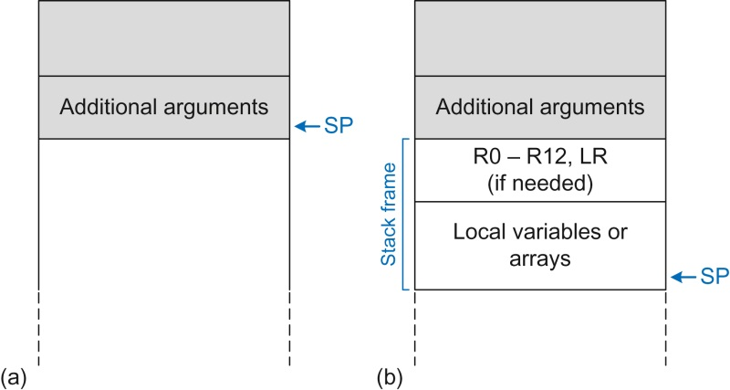
Figure 6.15 Stack usage: (a) before and (b) after call

Slide 17
Figure 6.16 Data-processing instruction format

Slide 18
Figure 6.17 Data-processing instruction format showing the funct field and Src2 variations

Slide 19
Figure 6.18 Data-processing instructions with three register operands

Slide 20
Figure 6.19 Data-processing instructions with an immediate and two register operands

Slide 21
Figure 6.20 Shift instructions with immediate shift amounts

Slide 22
Figure 6.21 Shift instructions with register shift amounts

Slide 23
Figure 6.22 Memory instruction format for LDR, STR, LDRB, and STRB

Slide 24
Figure 6.23 Machine code for the memory instruction of Example 6.3

Slide 25
Figure 6.24 Branch instruction format

Slide 26
Figure 6.25 Machine code for branch if less than (BLT)

Slide 27
Figure 6.26 BL machine code

Slide 28
Figure 6.27 Machine code to assembly code translation

Slide 29
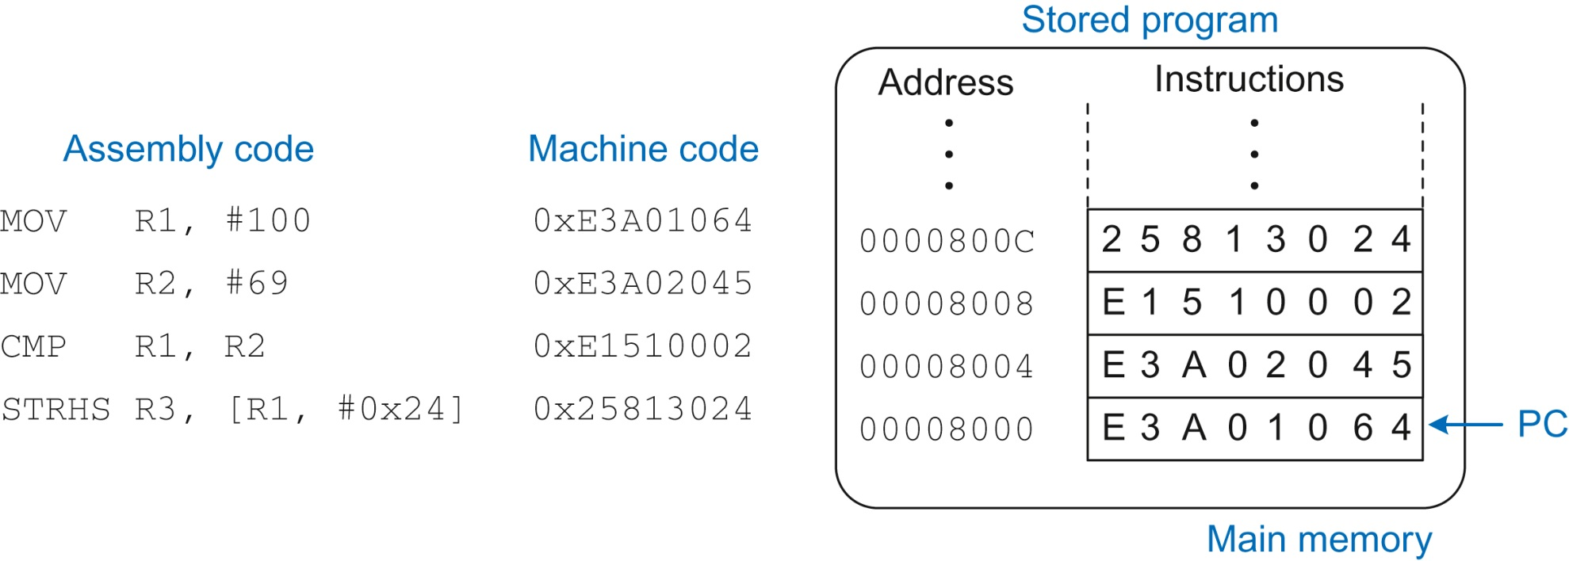
Figure 6.28 Stored program

Slide 30
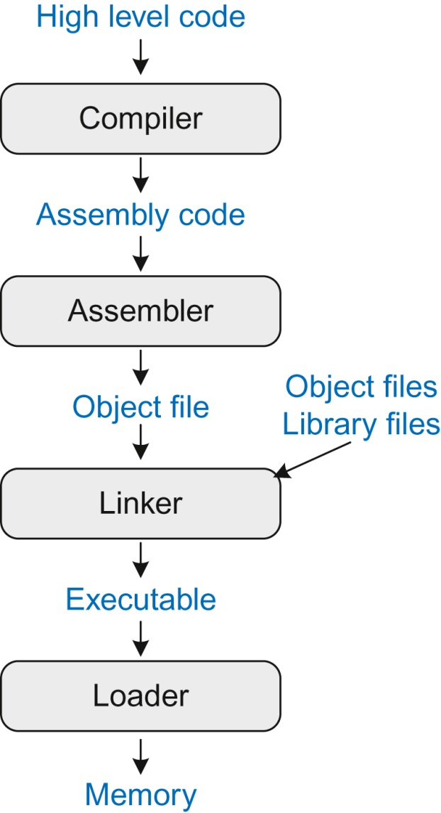
Figure 6.29 Steps for translating and starting a program

Slide 31
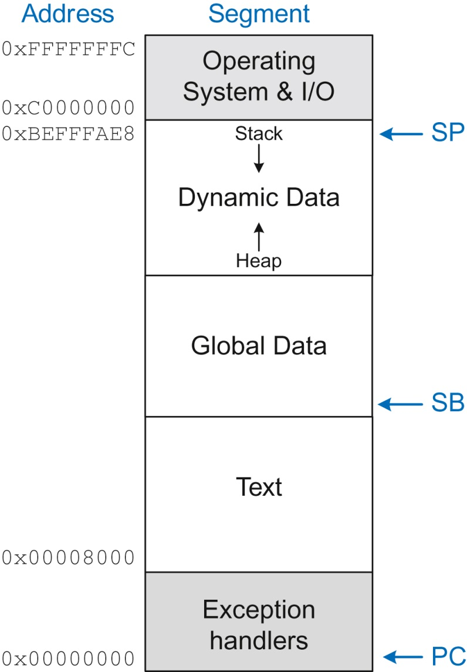
Figure 6.30 Example ARM memory map

Slide 32
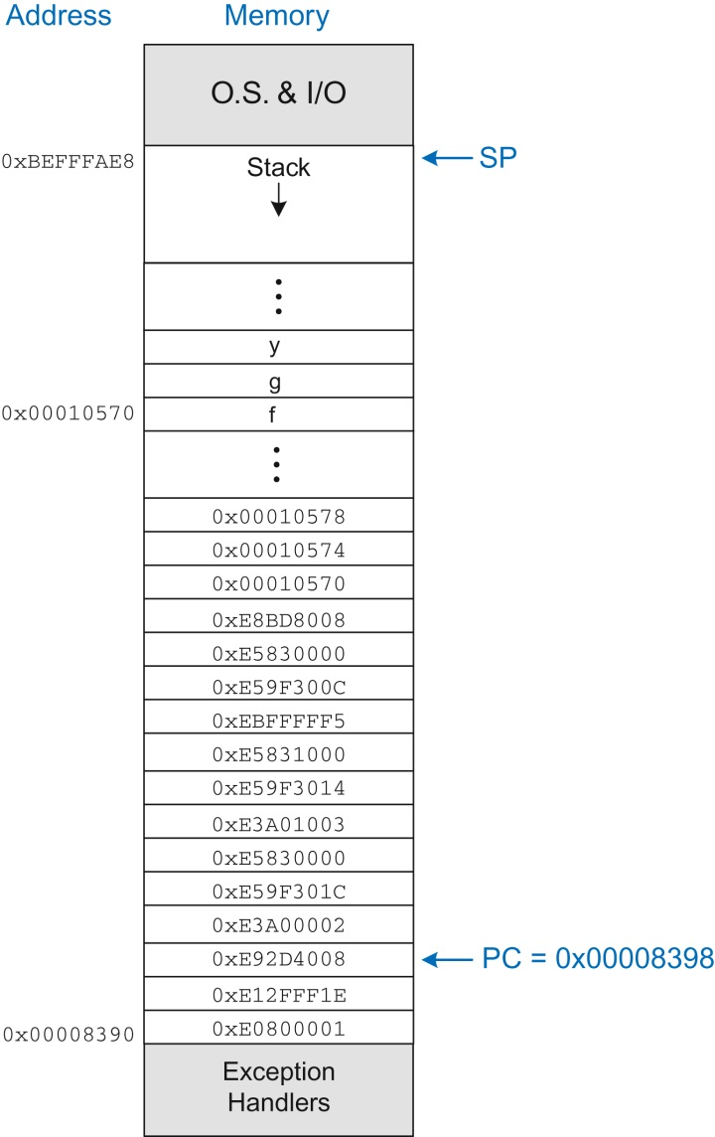
Figure 6.31 Executable loaded in memory

Slide 33
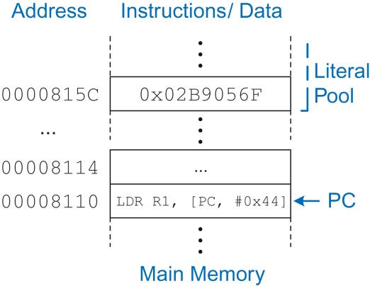
Figure 6.32 Example literal pool

Slide 34
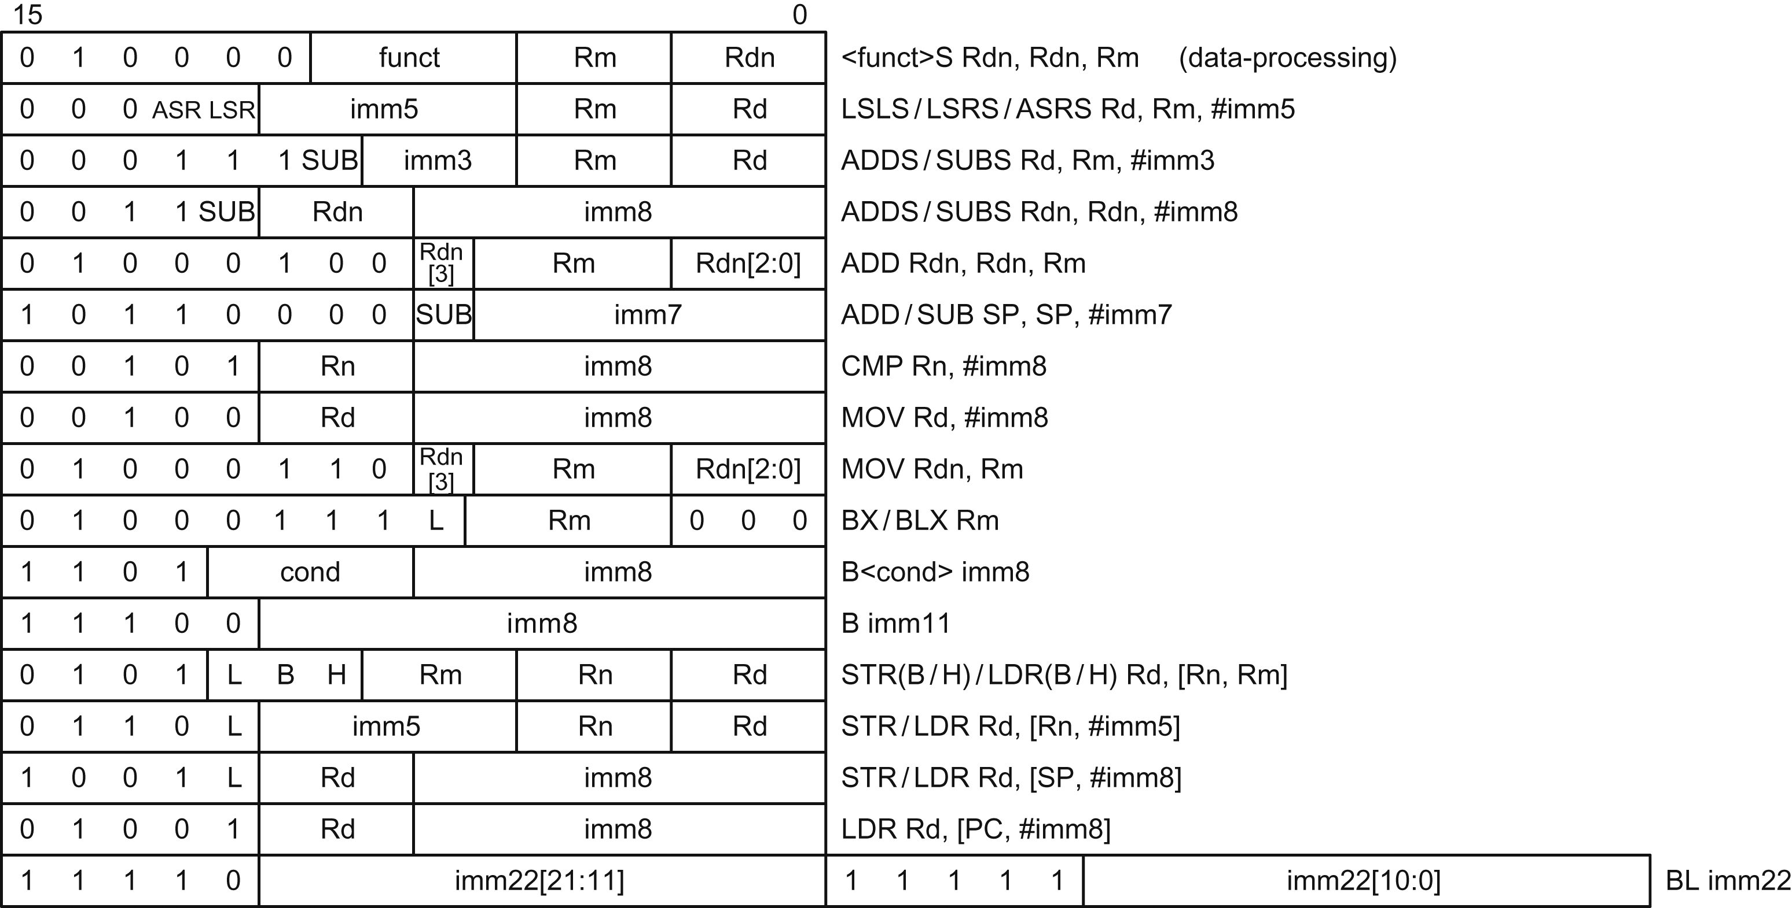
Figure 6.33 Thumb instruction encoding examples

Slide 35
Figure 6.34 Packed arithmetic: eight simultaneous 8-bit additions

Slide 36
Figure 6.35 x86 registers

Slide 37
Figure 6.36 x86 instruction encodings

Slide 38
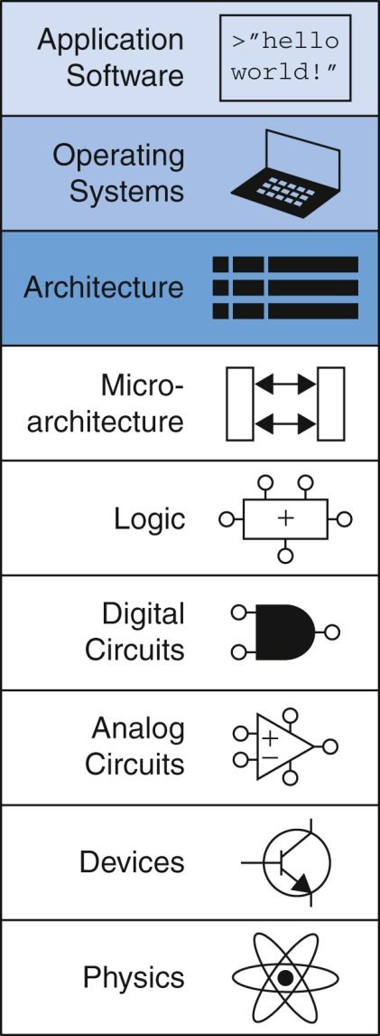
Figure u06-01

