Slide 1
Microarchitecture
CH007

Slide 2
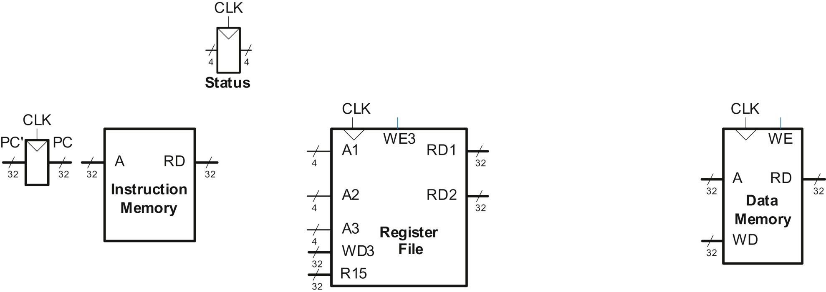
Figure 7.1 State elements of ARM processor

Slide 3
Figure 7.2 Fetch instruction from memory

Slide 4
Figure 7.3 Read source operand from register file

Slide 5
Figure 7.4 Zero-extend the immediate

Slide 6
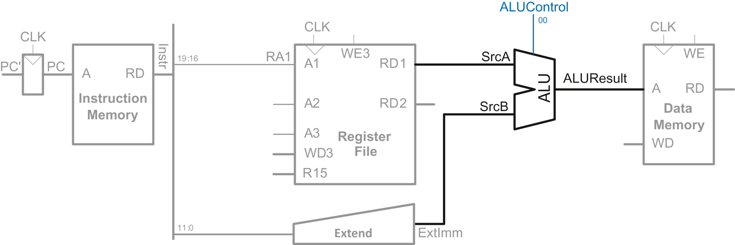
Figure 7.5 Compute memory address

Slide 7
Figure 7.6 Write data back to register file

Slide 8
Figure 7.7 Increment program counter

Slide 9
Figure 7.8 Read or write program counter as R15

Slide 10
Figure 7.9 Write data to memory for STR instruction

Slide 11
Figure 7.10 Datapath enhancements for data-processing instructions with immediate addressing

Slide 12
Figure 7.11 Datapath enhancements for data-processing instructions with register addressing

Slide 13
Figure 7.12 Datapath enhancements for B instruction

Slide 14
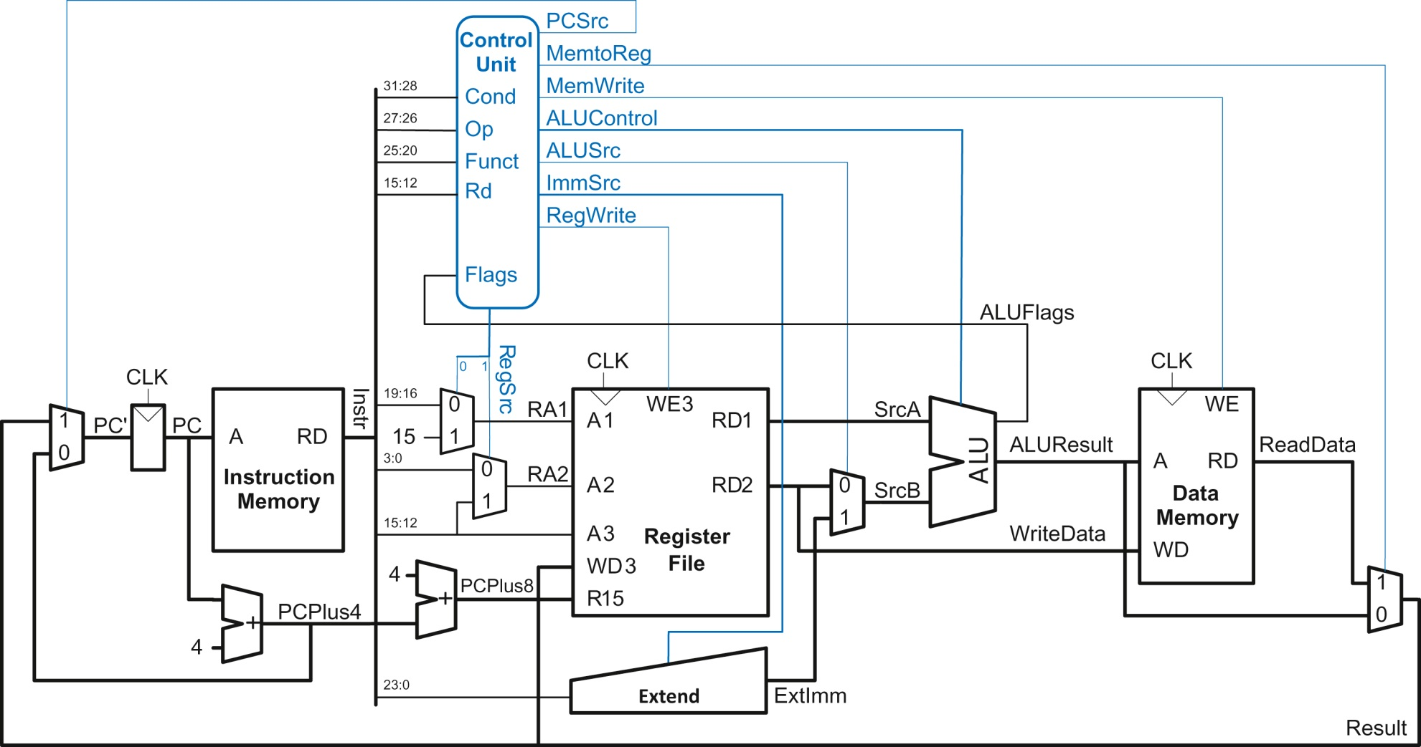
Figure 7.13 Complete single-cycle processor

Slide 15
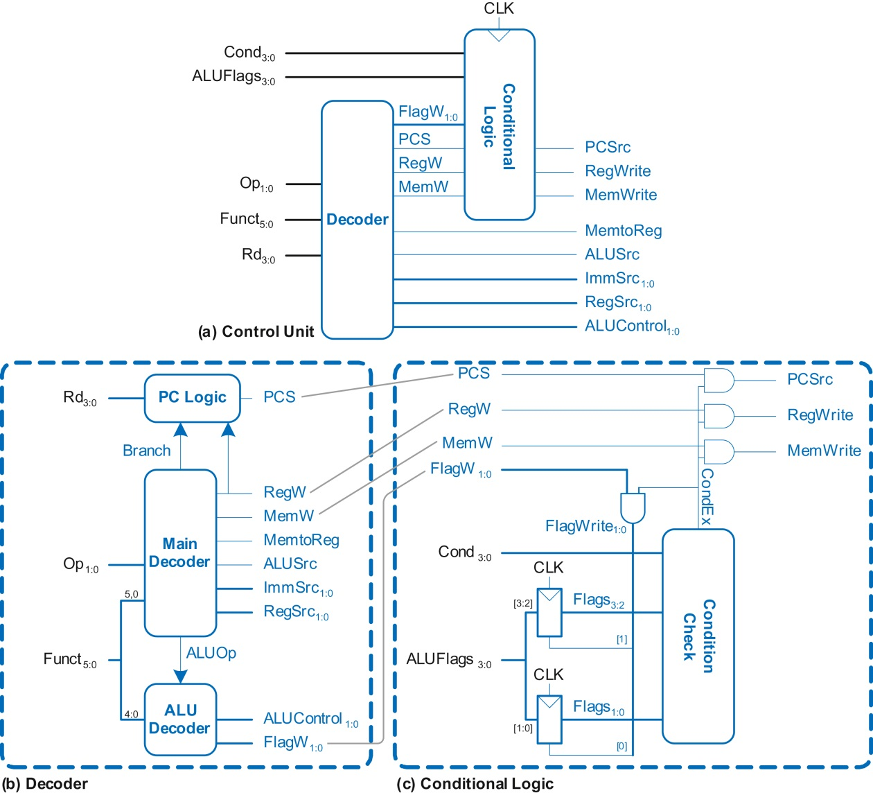
Figure 7.14 Single-cycle control unit

Slide 16
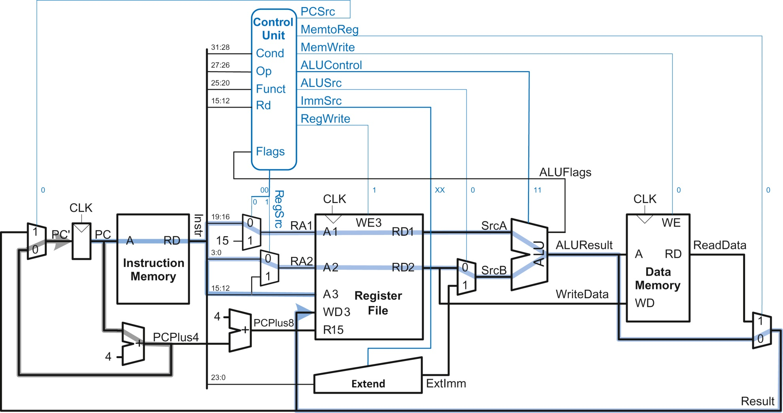
Figure 7.15 Control signals and data flow while executing an ORR instruction

Slide 17
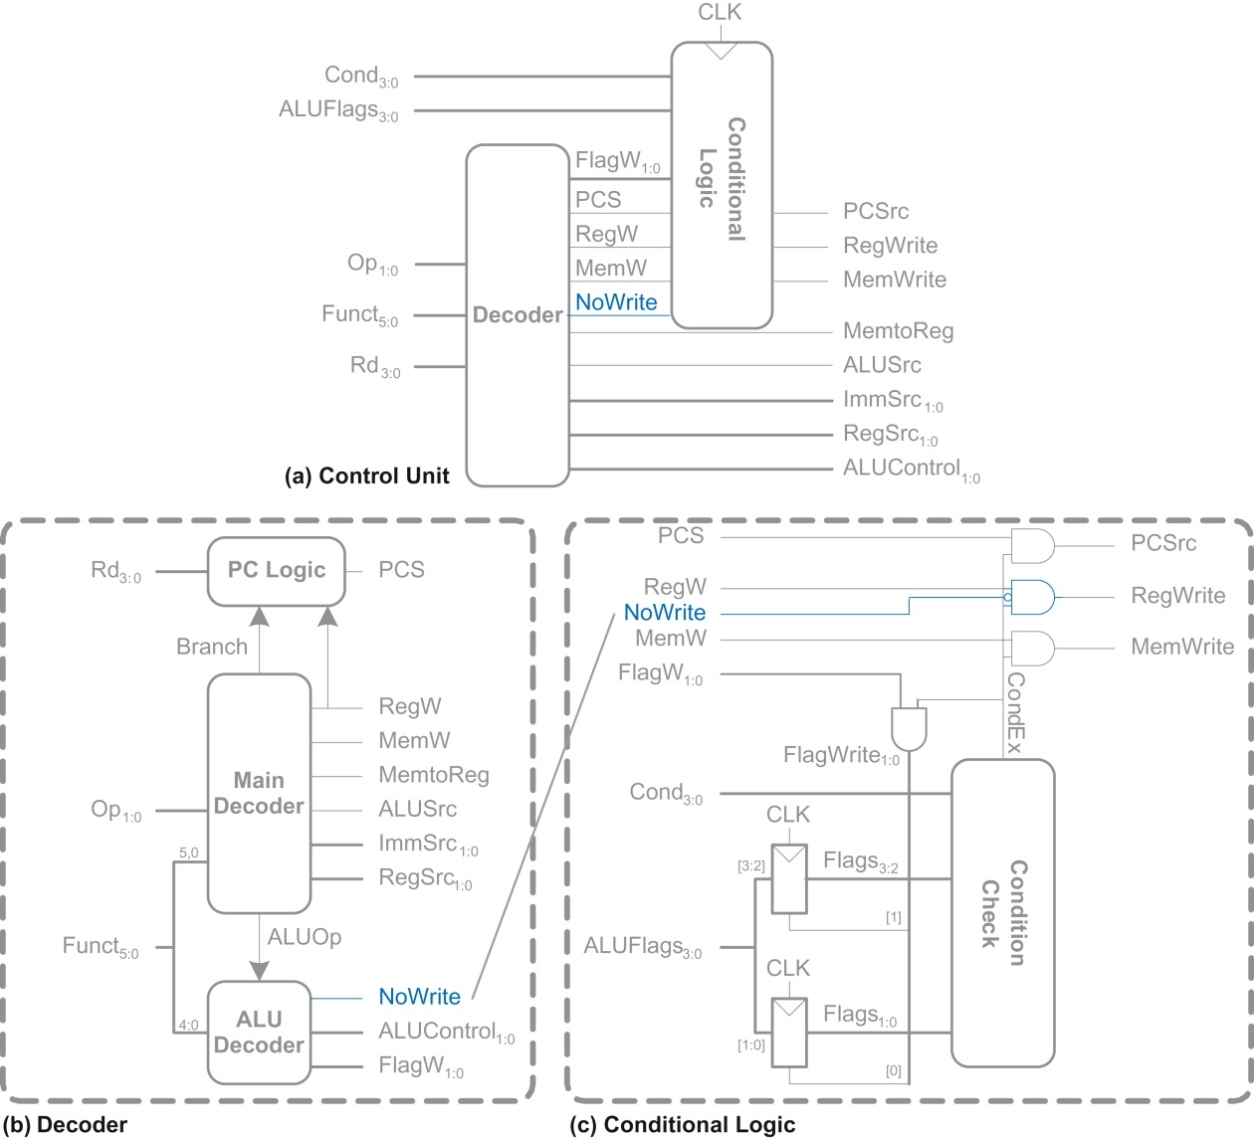
Figure 7.16 Controller modification for CMP

Slide 18
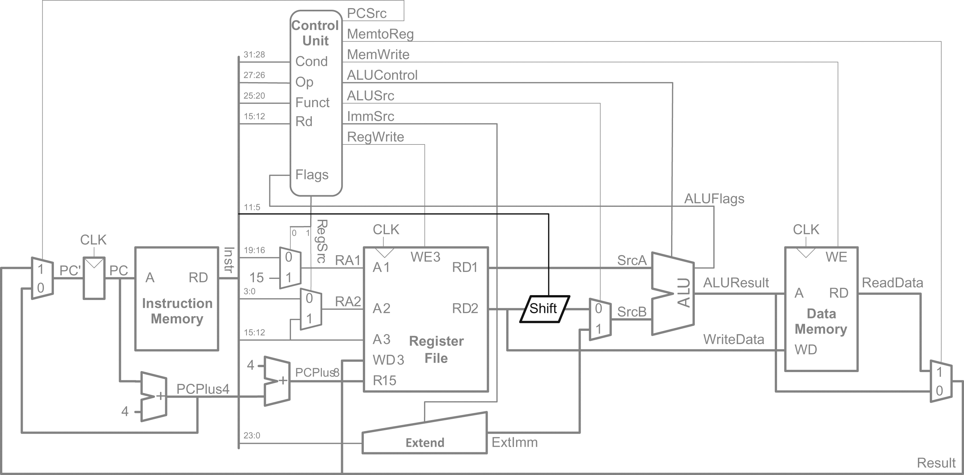
Figure 7.17 Enhanced datapath for register addressing with constant shifts

Slide 19
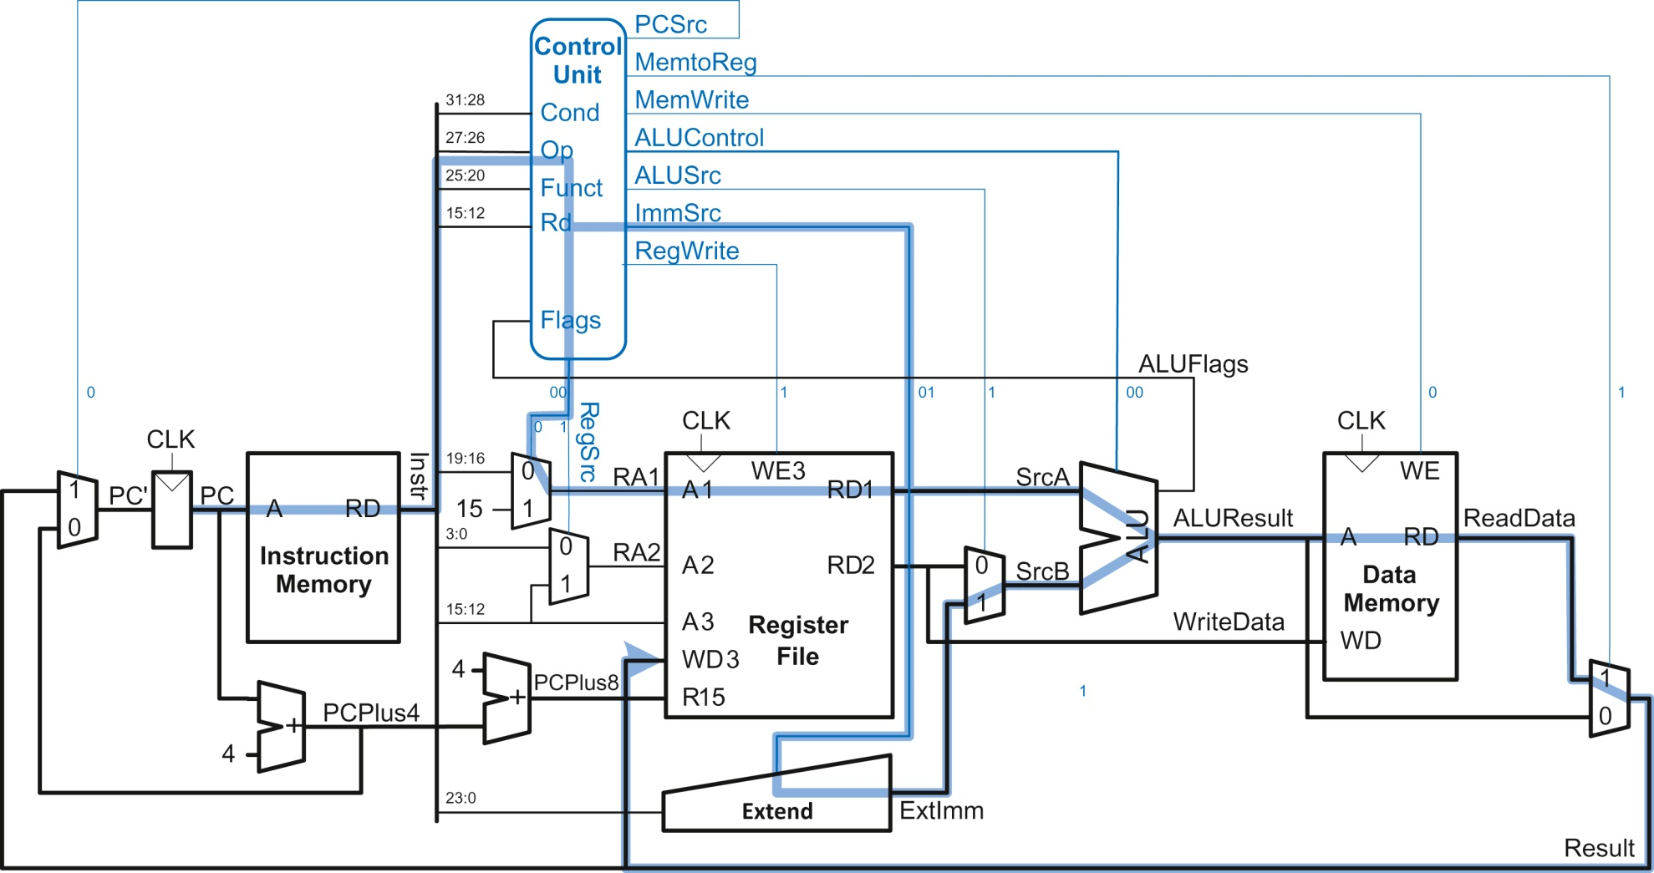
Figure 7.18 LDR critical path

Slide 20
Figure 7.19 State elements with unified instruction/data memory

Slide 21
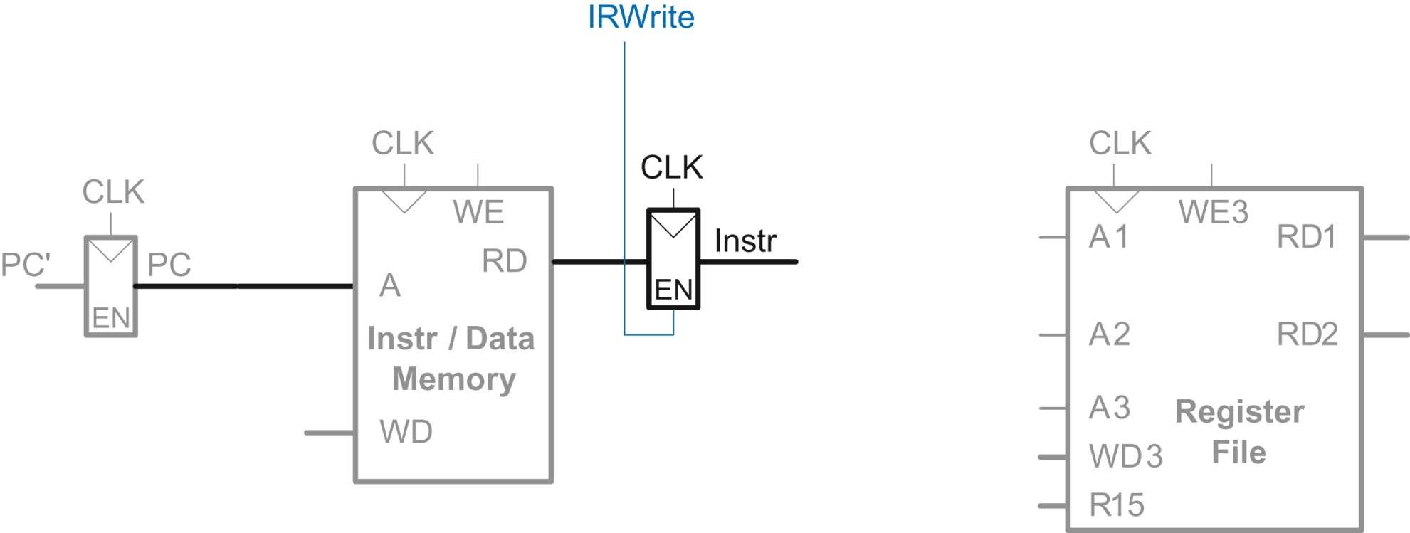
Figure 7.20 Fetch instruction from memory

Slide 22
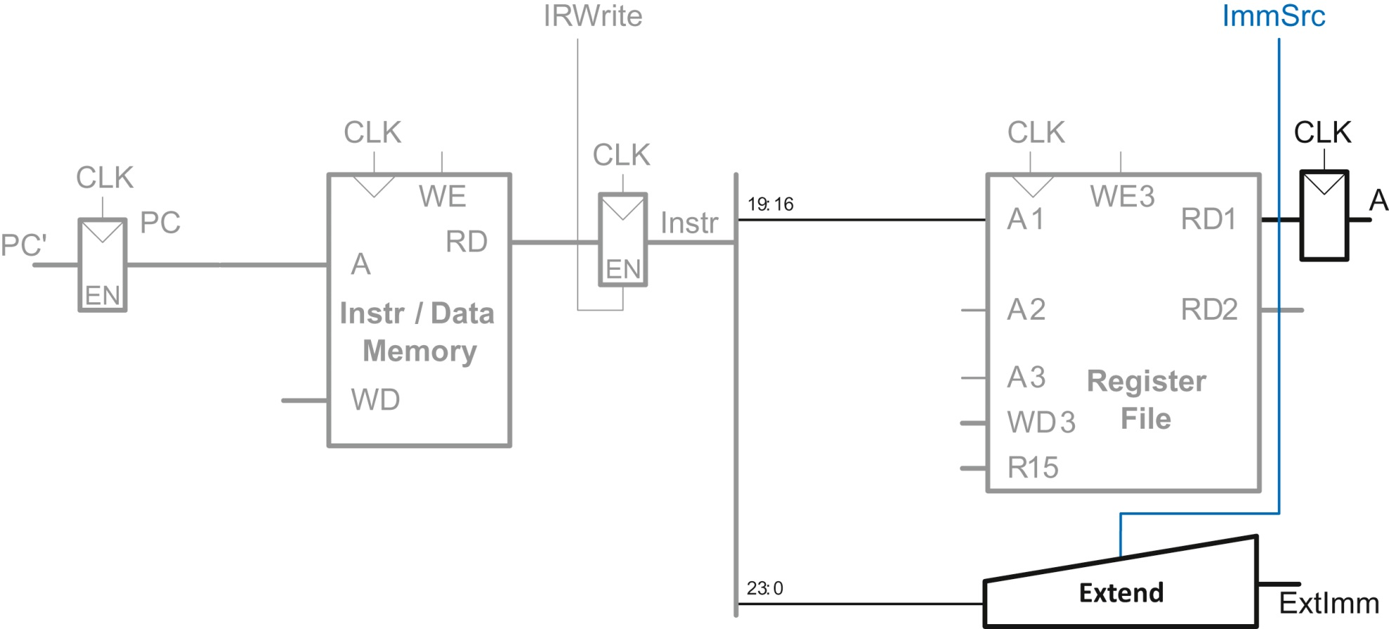
Figure 7.21 Read one source from register file and extend the second source from the immediate field

Slide 23
Figure 7.22 Add base address to offset

Slide 24
Figure 7.23 Load data from memory

Slide 25
Figure 7.24 Write data back to register file

Slide 26
Figure 7.25 Increment PC by 4

Slide 27
Figure 7.26 Handle R15 reads and writes

Slide 28
Figure 7.27 Enhanced datapath for STR instruction

Slide 29
Figure 7.28 Enhanced datapath for data-processing instructions with register addressing

Slide 30
Figure 7.29 Enhanced datapath for the B instruction

Slide 31
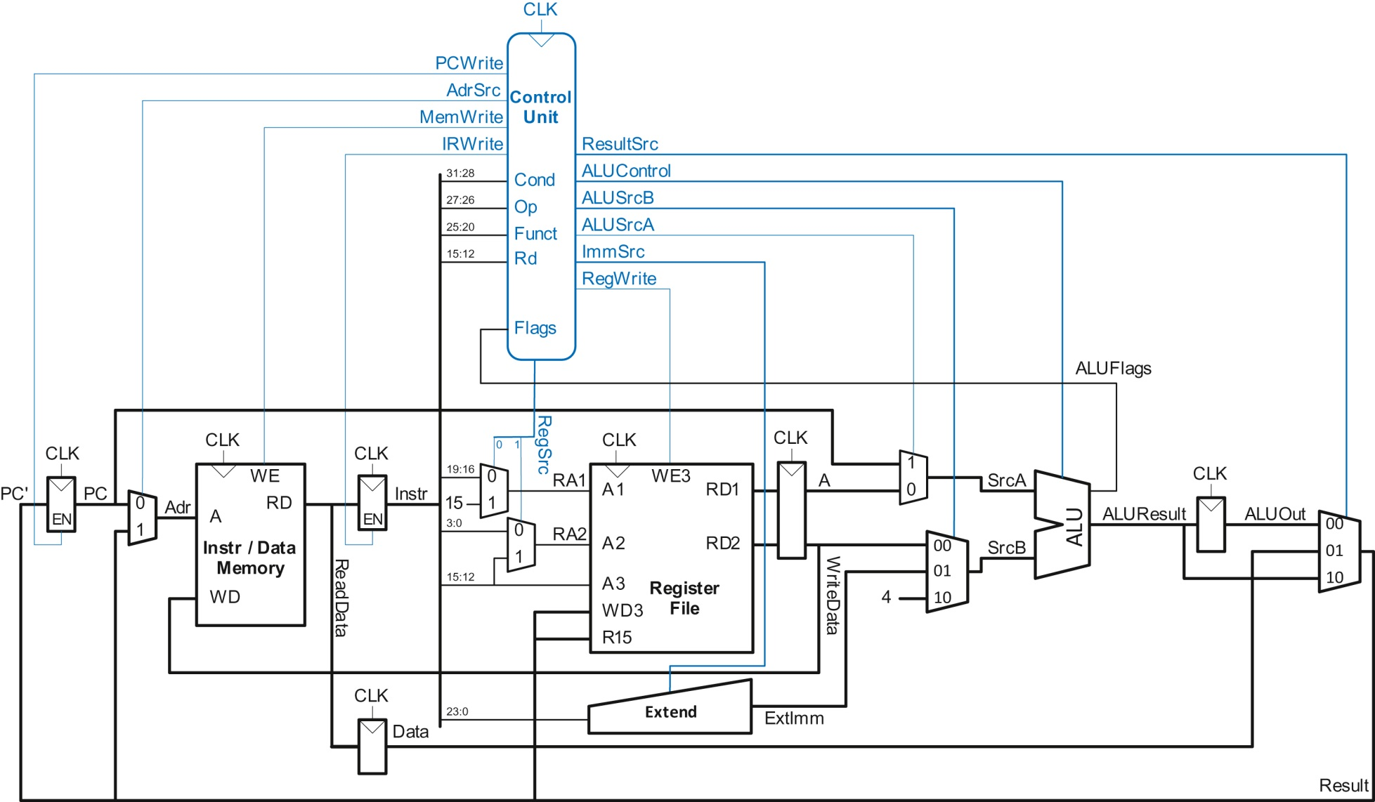
Figure 7.30 Complete multicycle processor

Slide 32
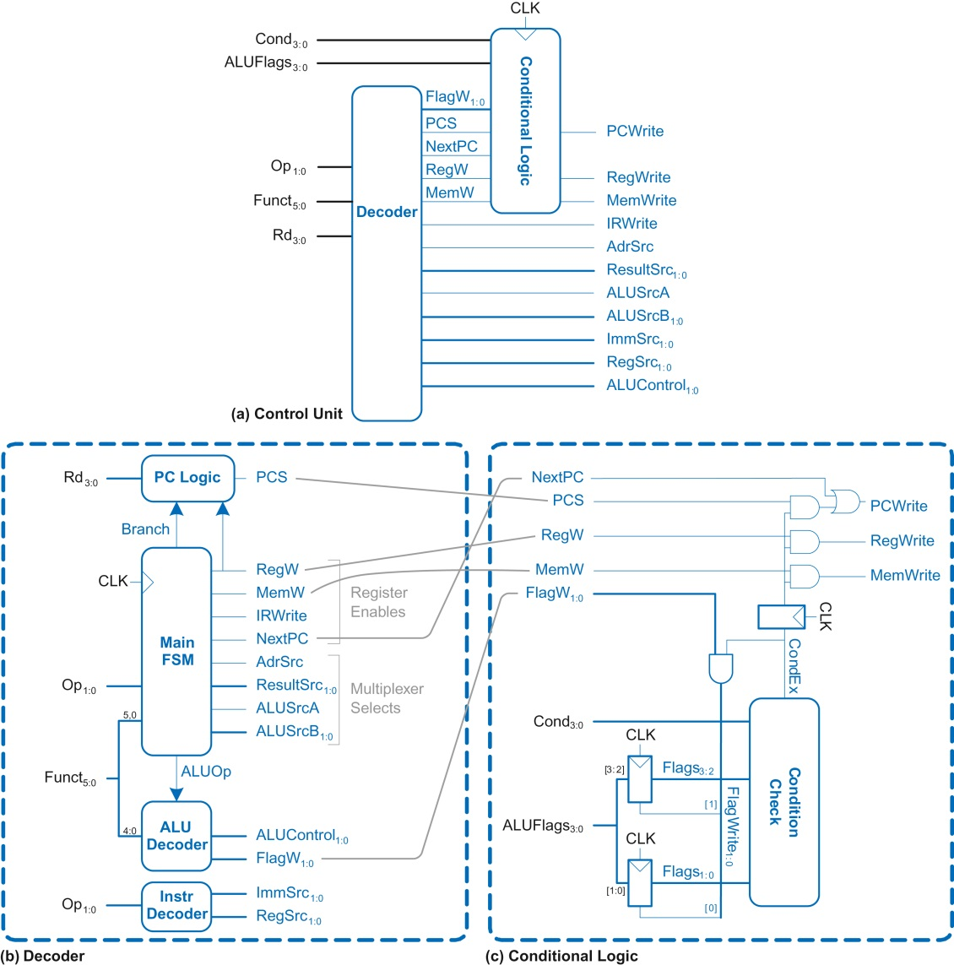
Figure 7.31 Multicycle control unit

Slide 33
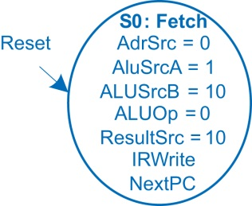
Figure 7.32 Fetch

Slide 34
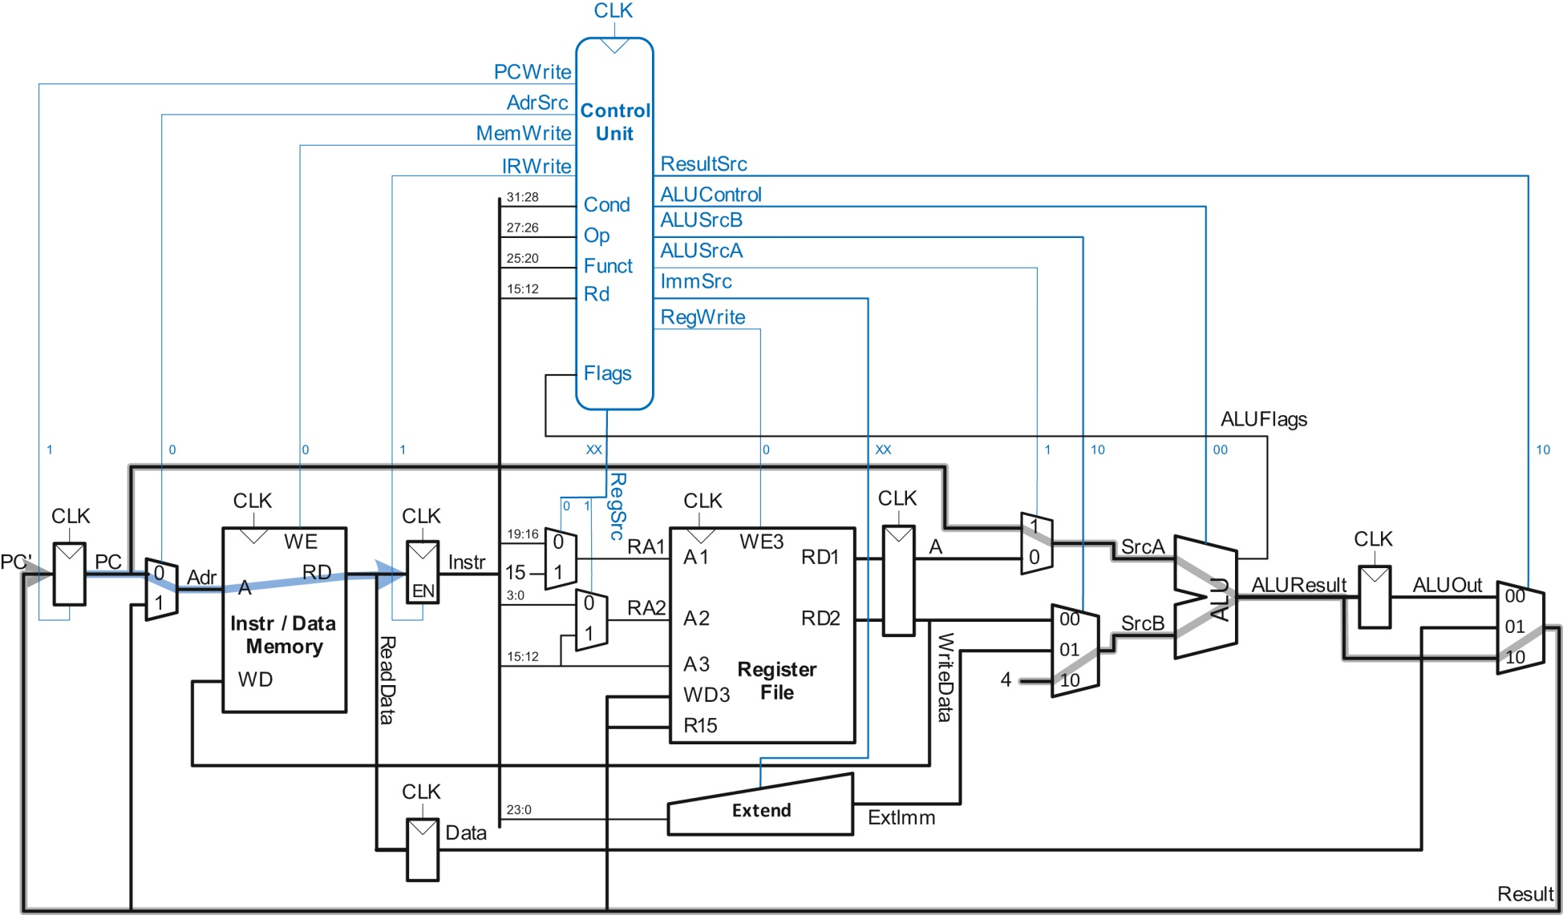
Figure 7.33 Data flow during the fetch step

Slide 35
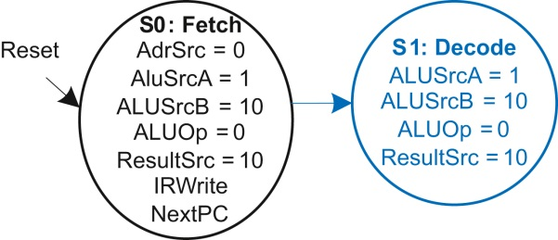
Figure 7.34 Decode

Slide 36
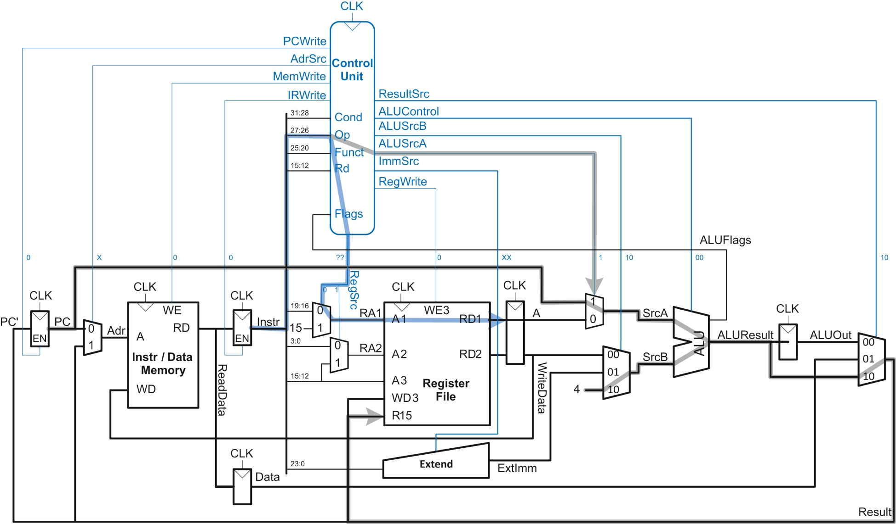
Figure 7.35 Data flow during the Decode step

Slide 37
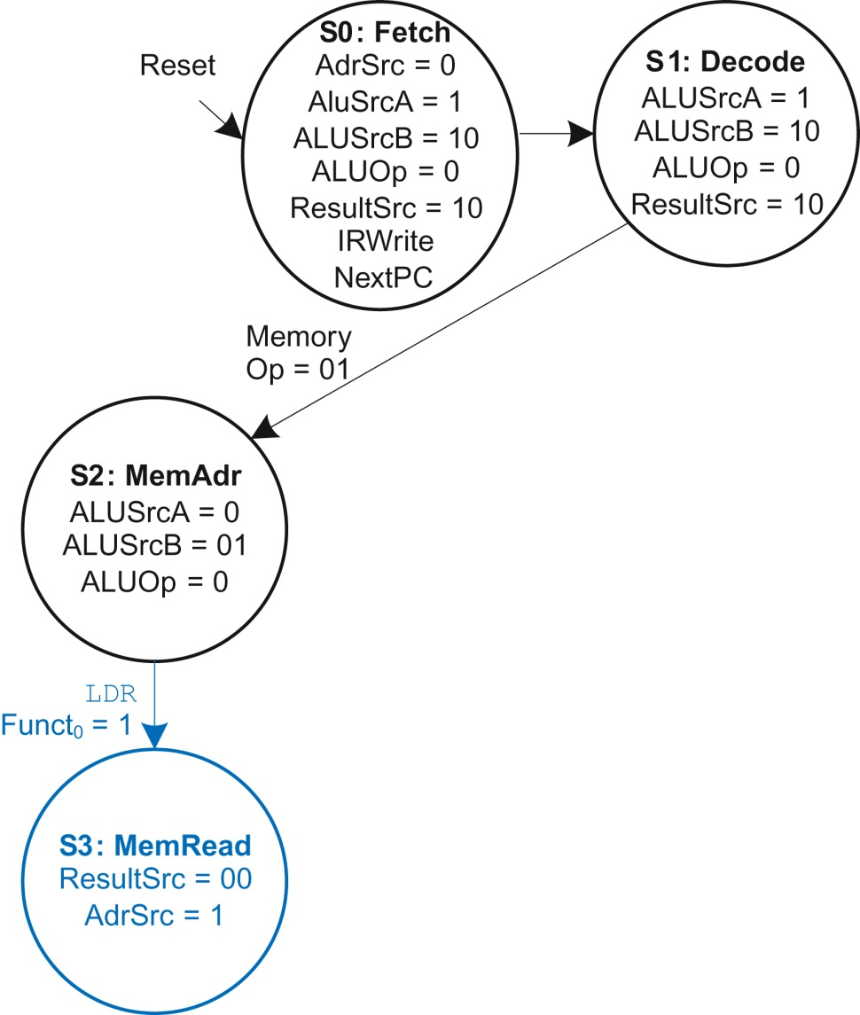
Figure 7.36 Memory address computation

Slide 38
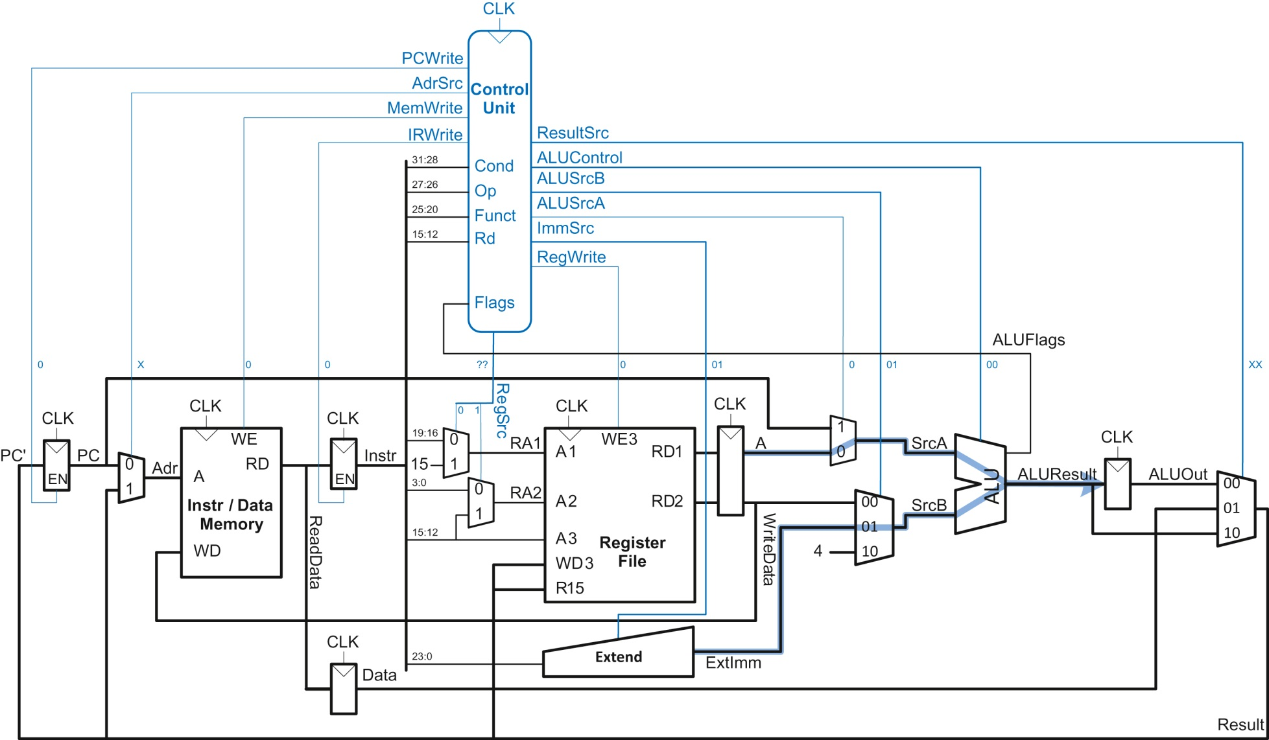
Figure 7.37 Data flow during memory address computation

Slide 39
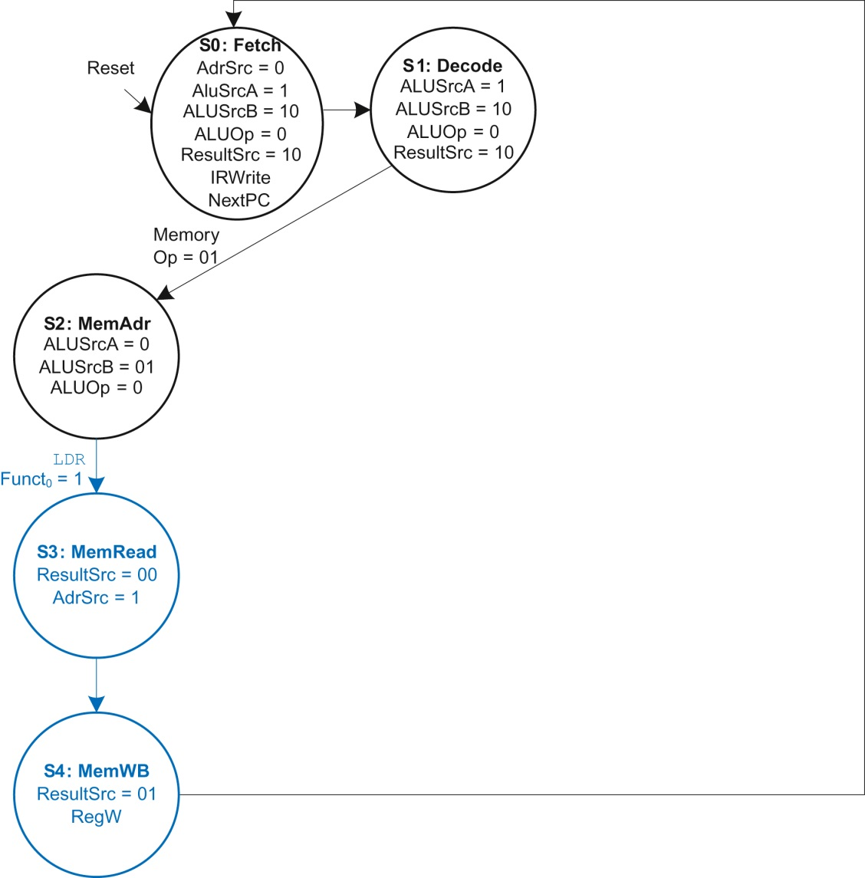
Figure 7.38 Memory read

Slide 40
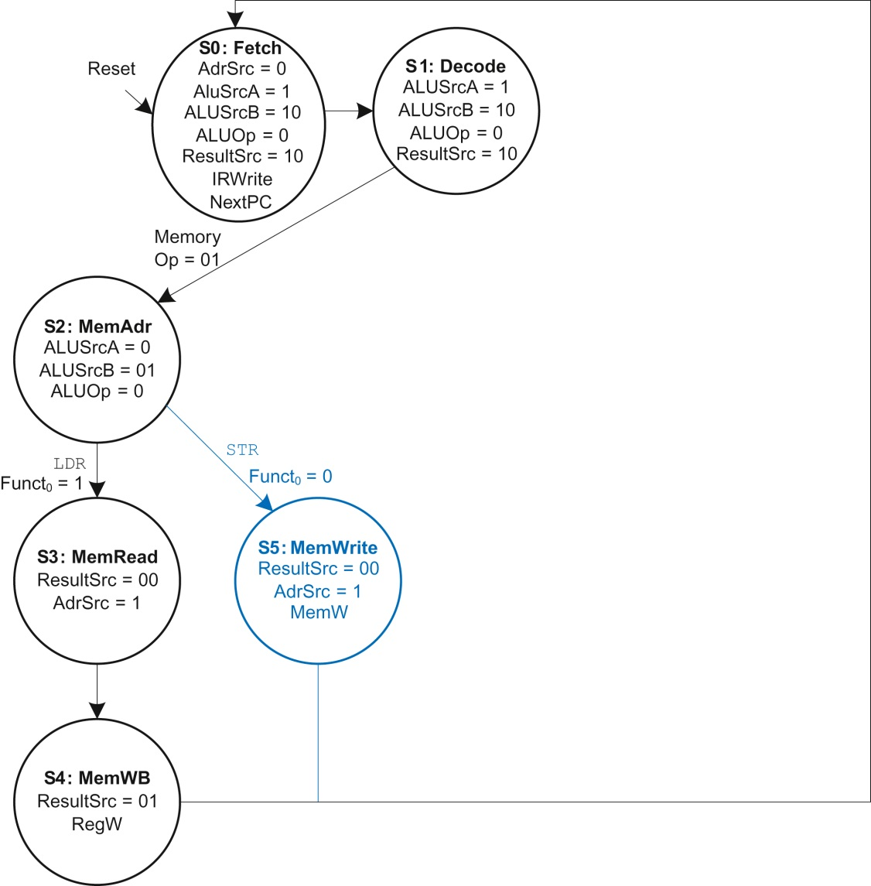
Figure 7.39 Memory write

Slide 41
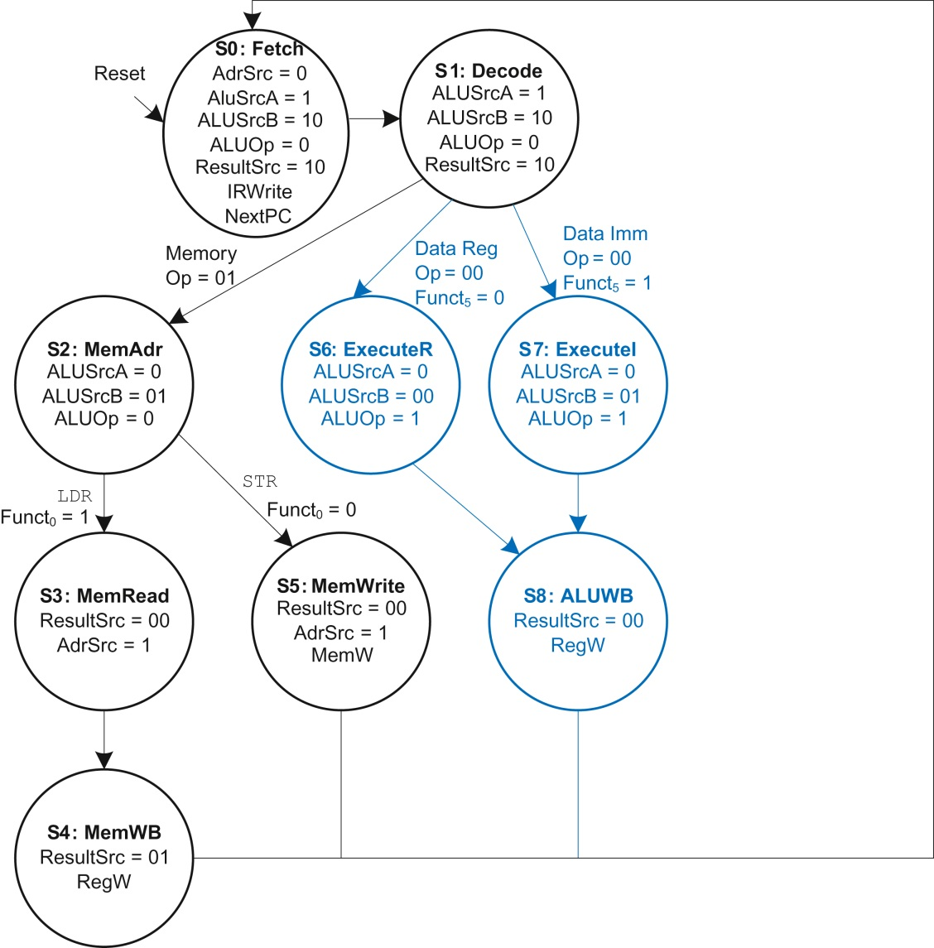
Figure 7.40 Data-processing

Slide 42
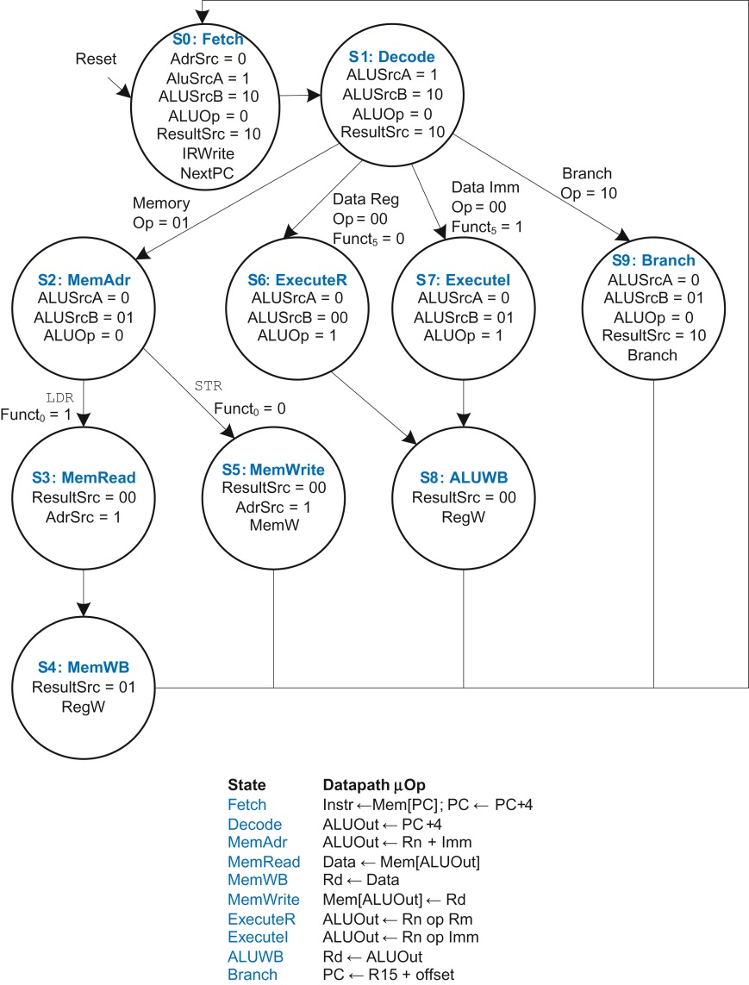
Figure 7.41 Complete multicycle control FSM

Slide 43
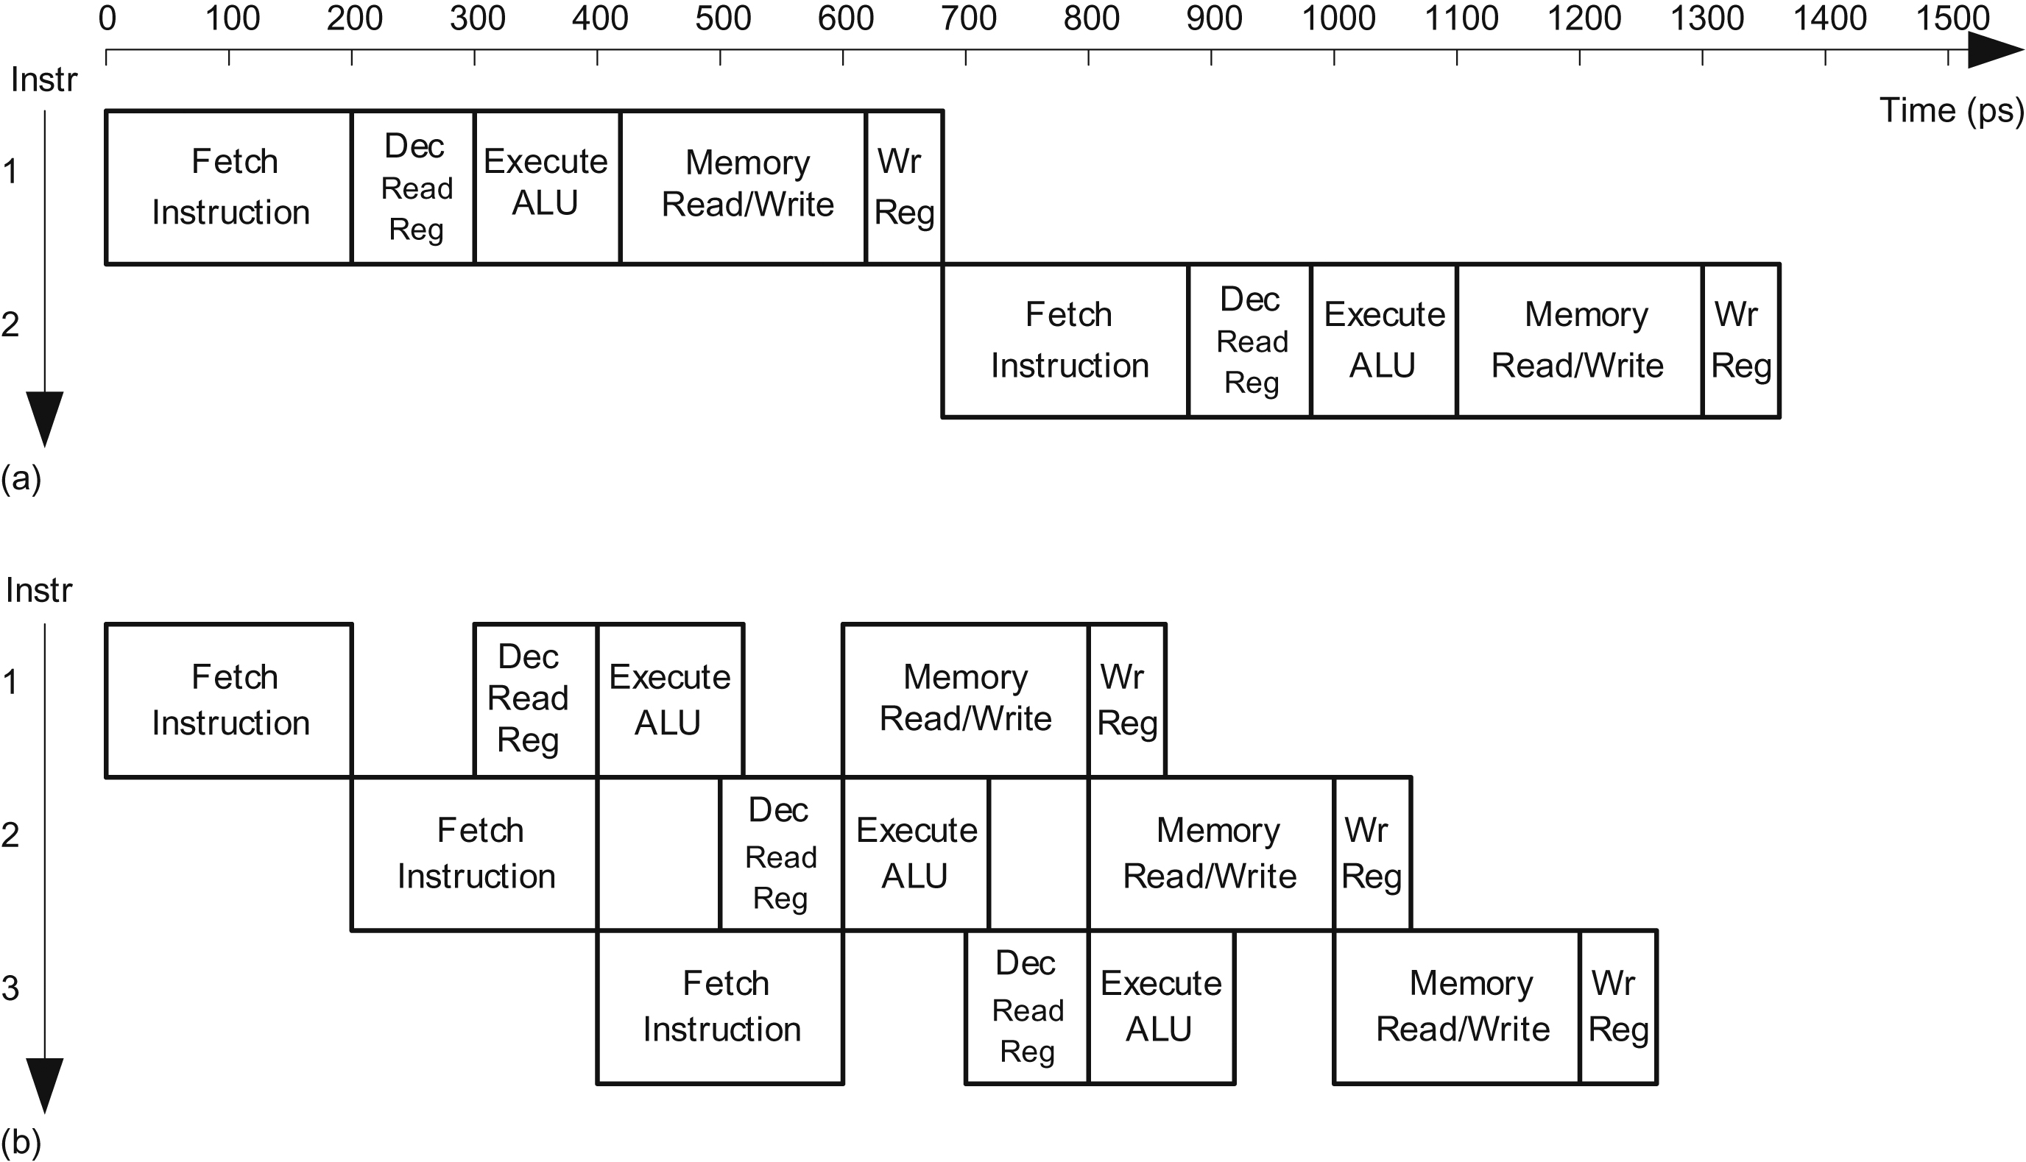
Figure 7.42 Timing diagrams: (a) single-cycle processor and (b) pipelined processor

Slide 44
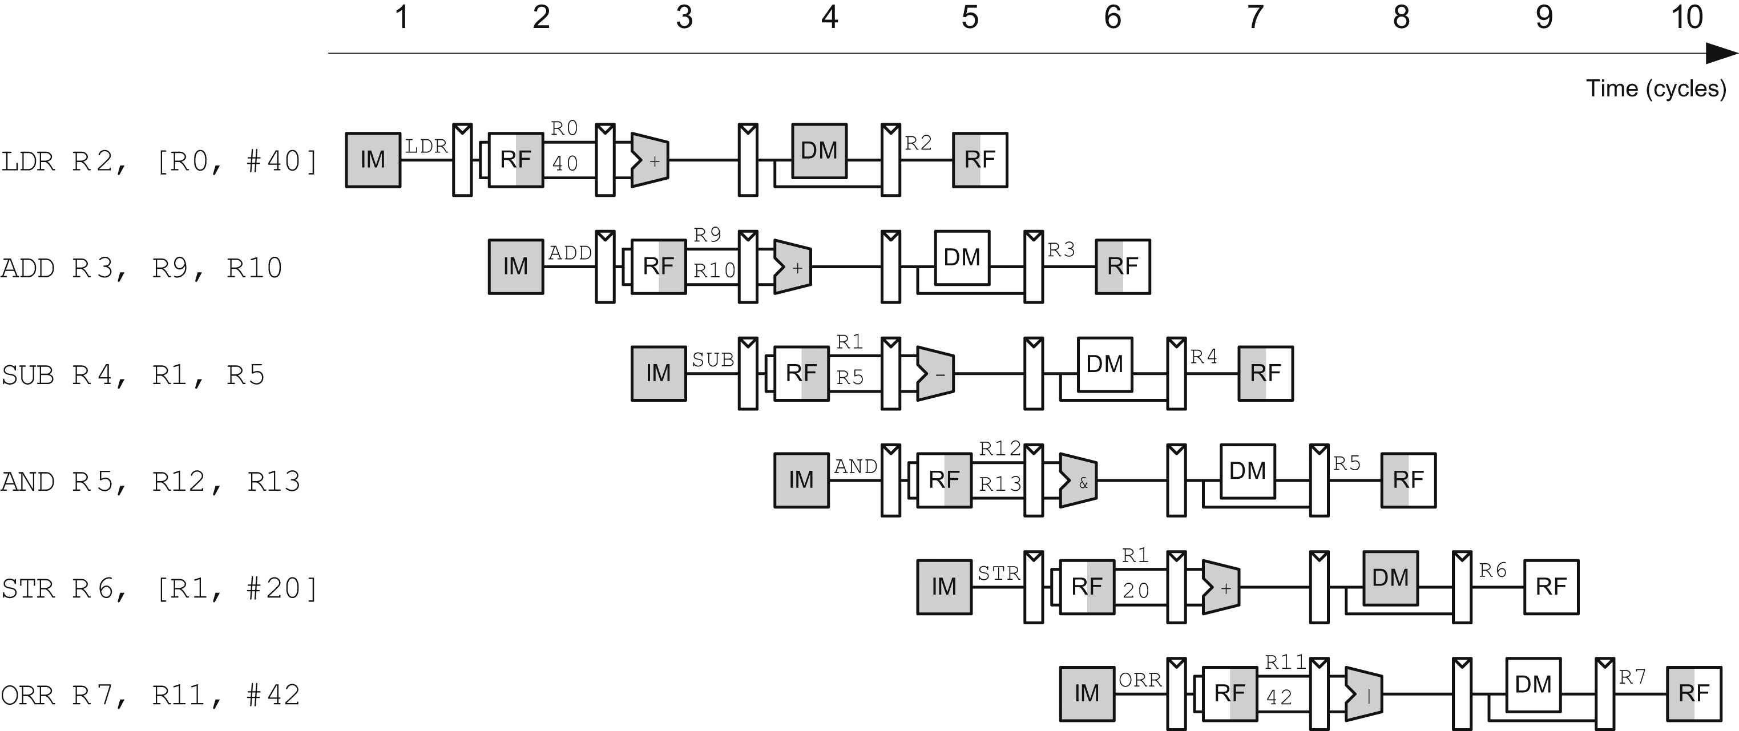
Figure 7.43 Abstract view of pipeline in operation

Slide 45
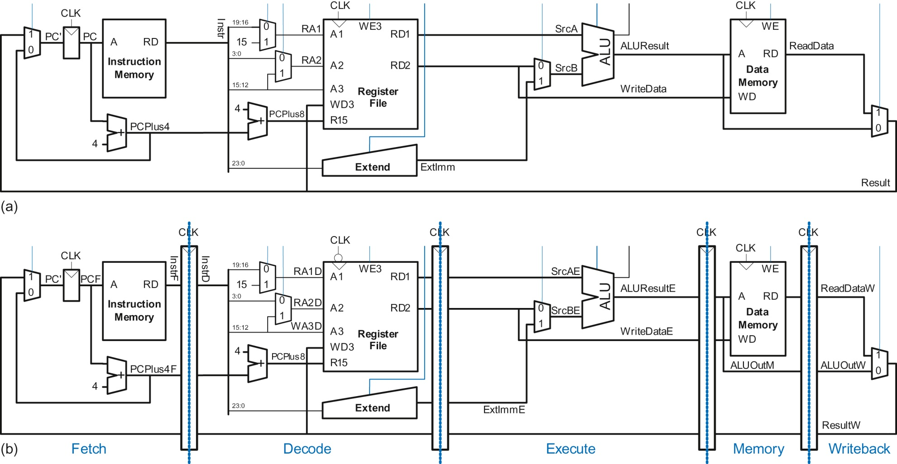
Figure 7.44 Datapaths: (a) single-cycle and (b) pipelined

Slide 46
Figure 7.45 Corrected pipelined datapath

Slide 47
Figure 7.46 Optimized PC logic eliminating a register and adder

Slide 48
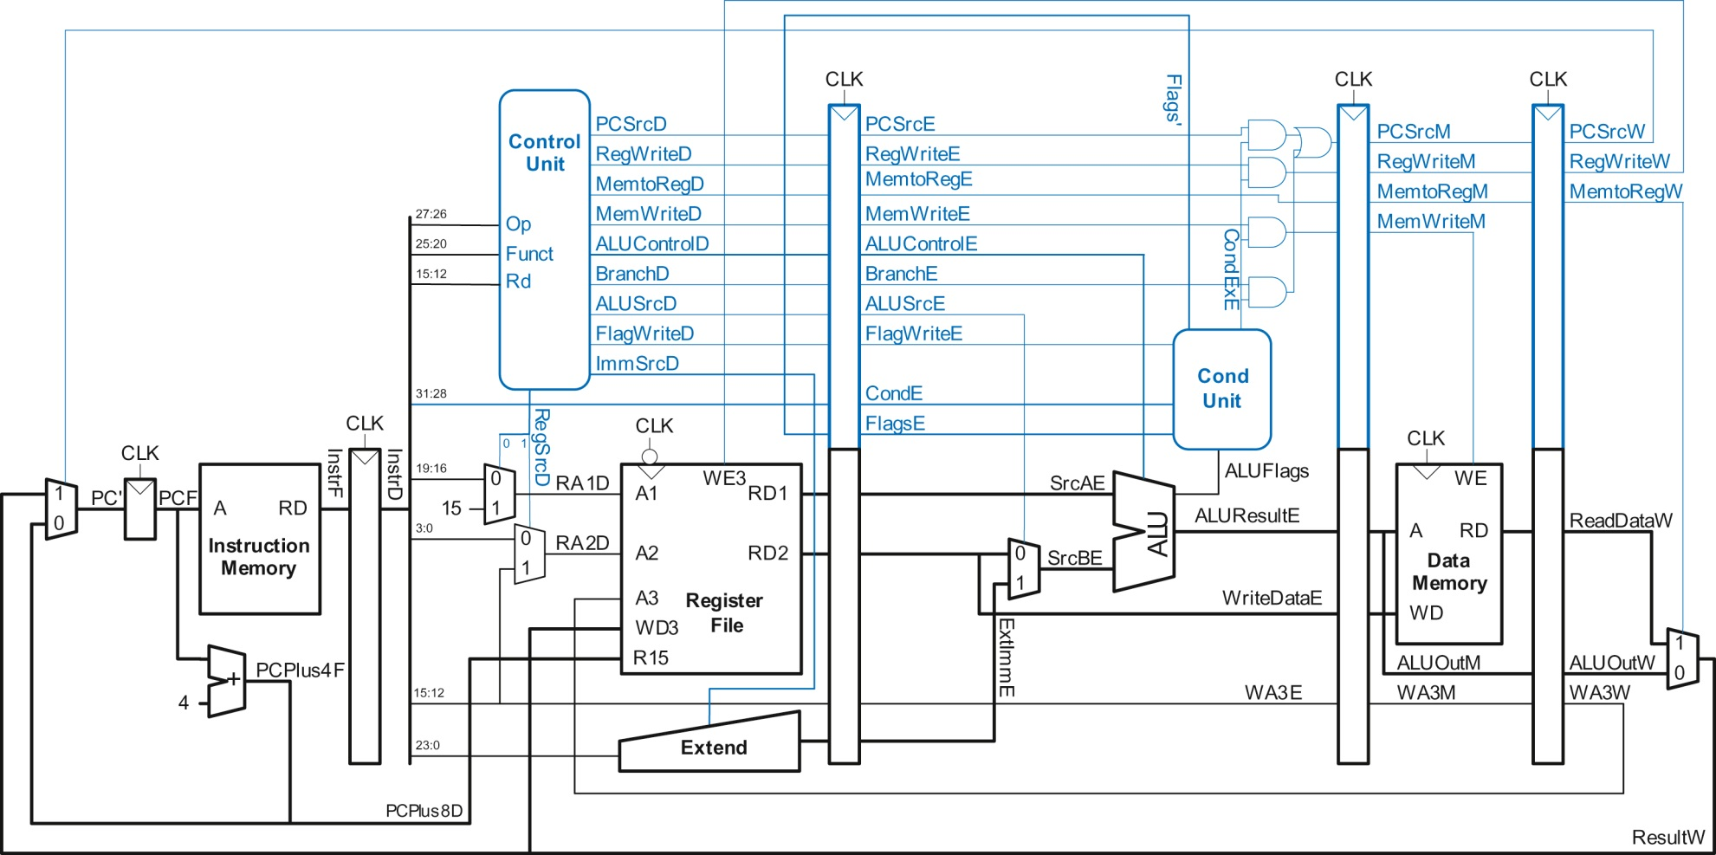
Figure 7.47 Pipelined processor with control

Slide 49
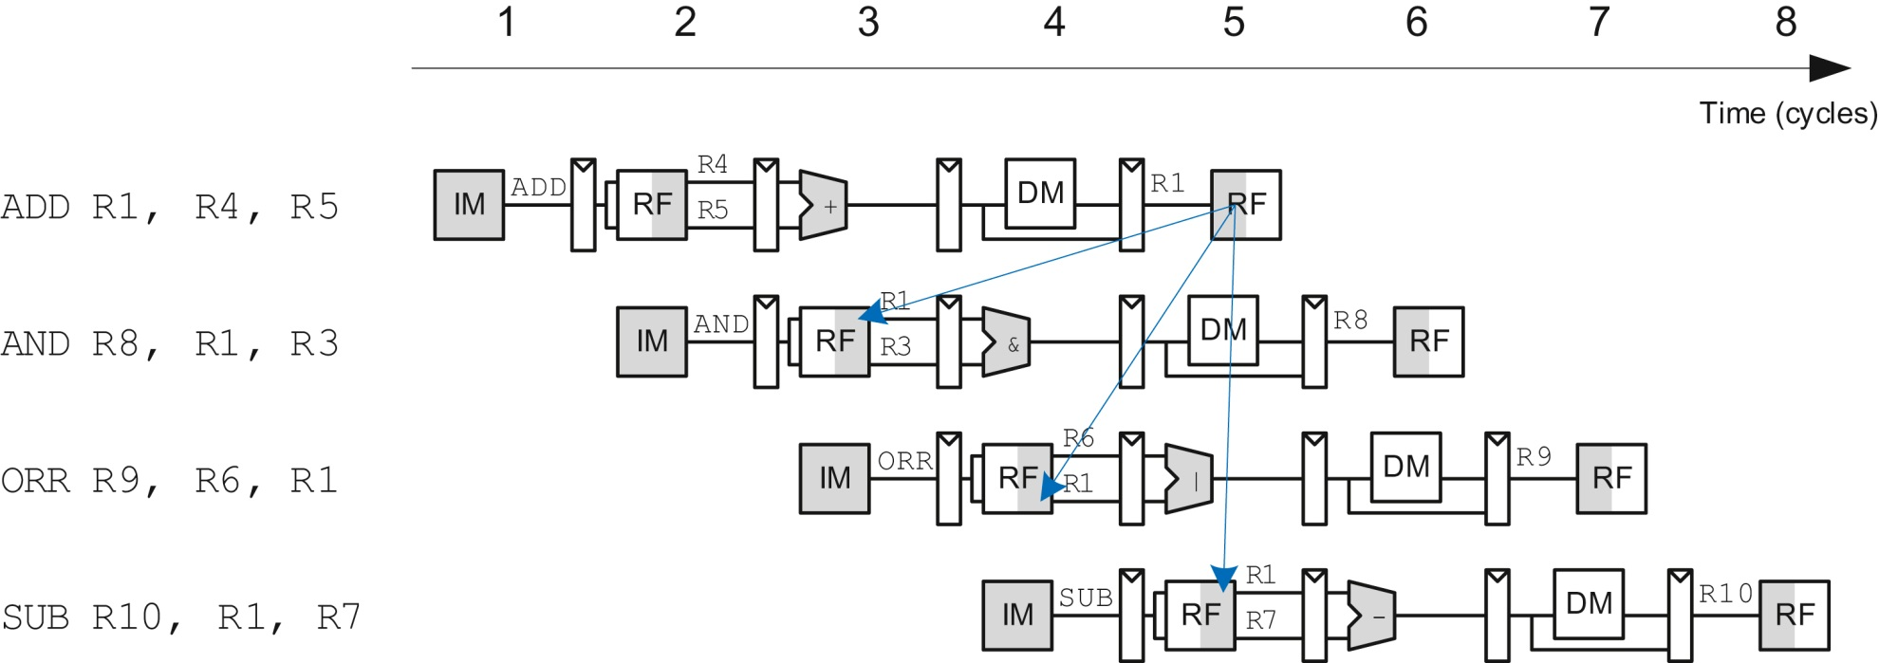
Figure 7.48 Abstract pipeline diagram illustrating hazards

Slide 50
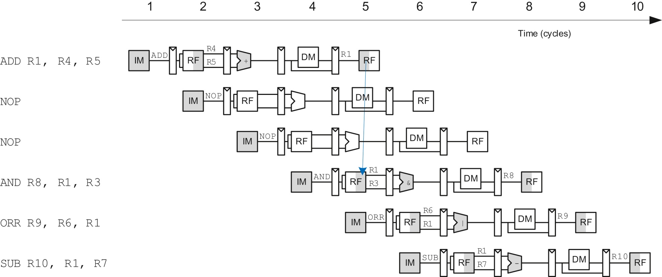
Figure 7.49 Solving data hazard with NOP

Slide 51
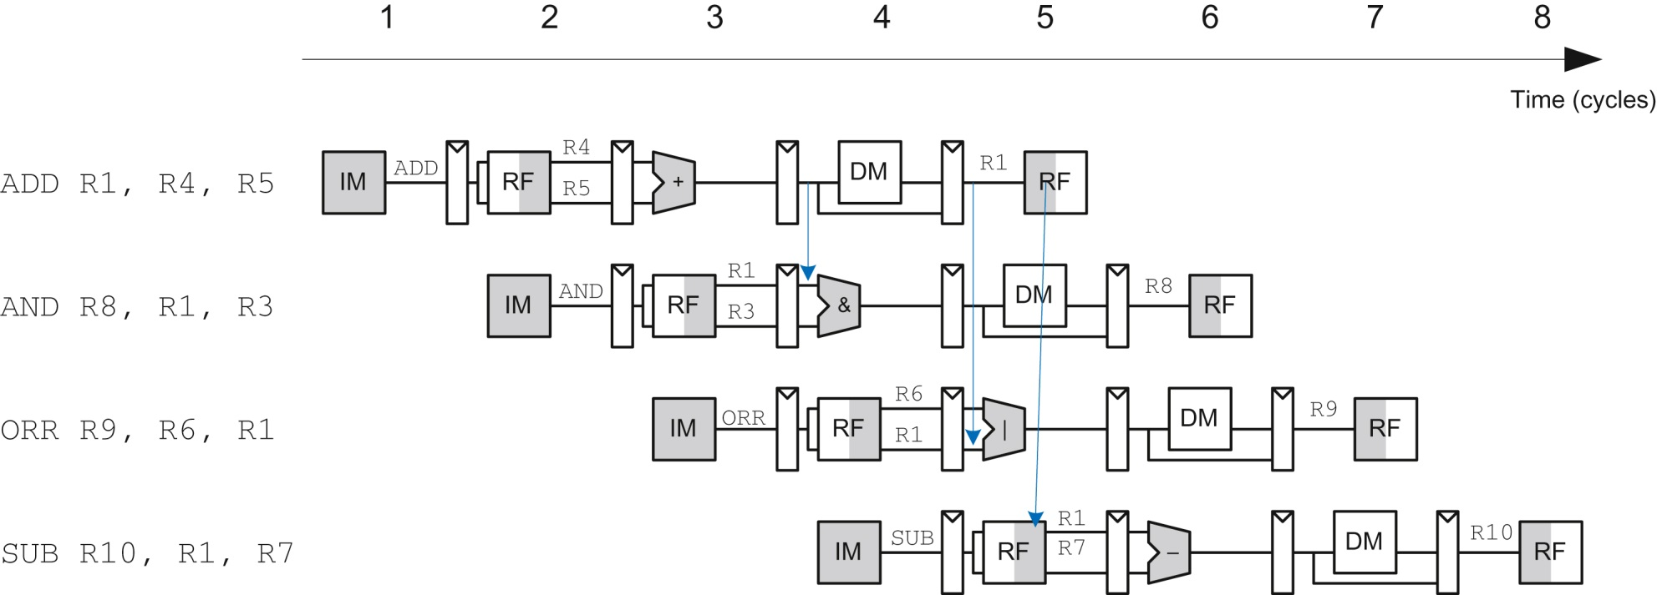
Figure 7.50 Abstract pipeline diagram illustrating forwarding

Slide 52
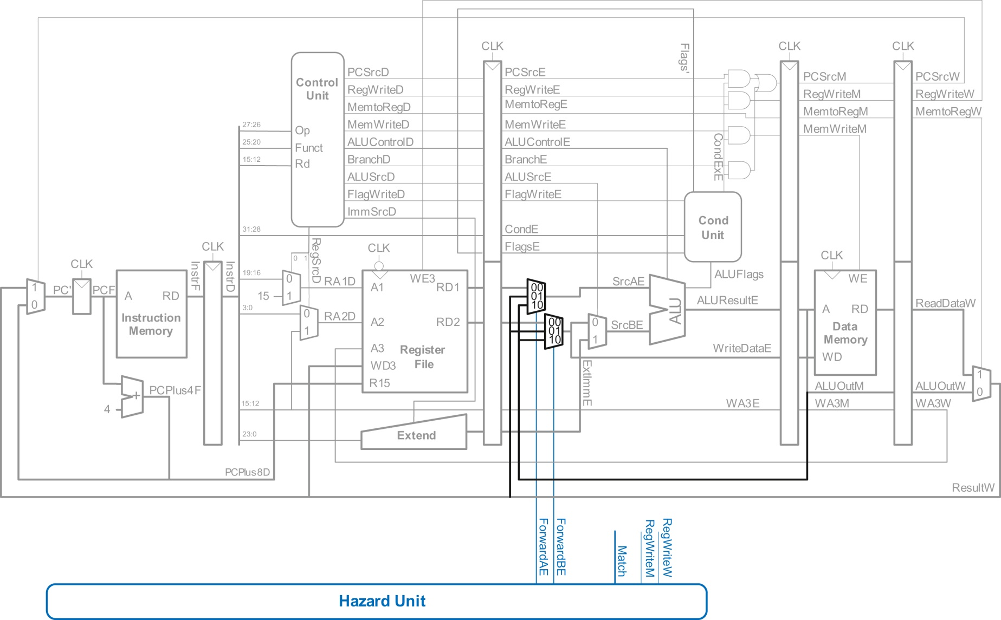
Figure 7.51 Pipelined processor with forwarding to solve hazards

Slide 53
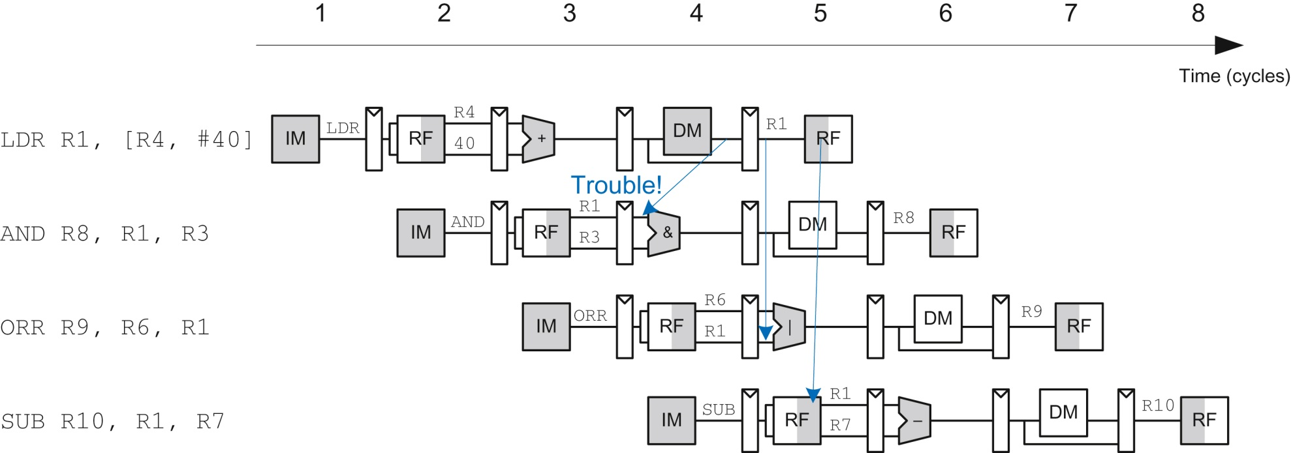
Figure 7.52 Abstract pipeline diagram illustrating trouble forwarding from LDR

Slide 54
Figure 7.53 Abstract pipeline diagram illustrating stall to solve hazards

Slide 55
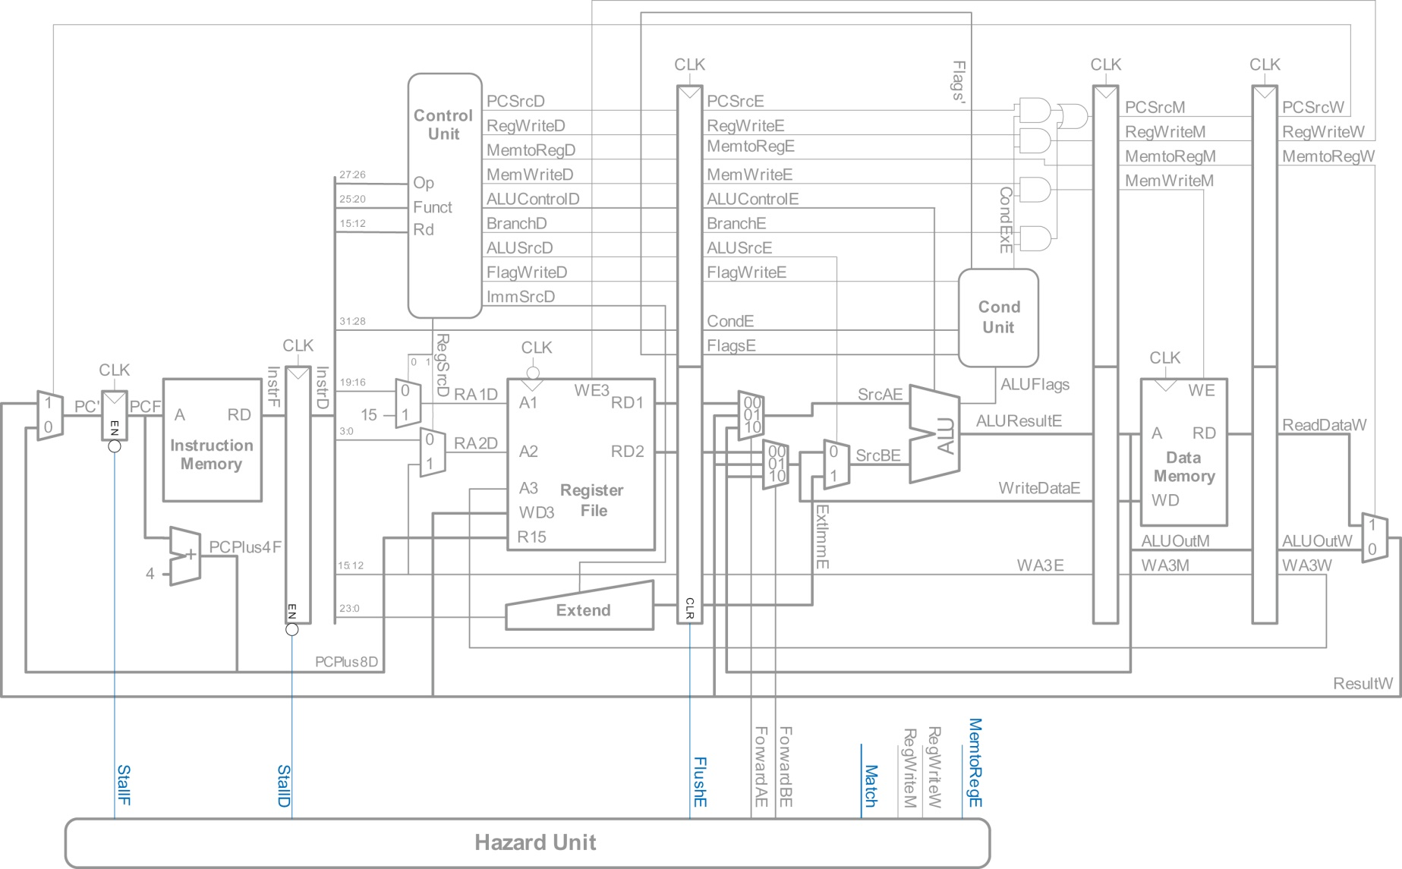
Figure 7.54 Pipelined processor with stalls to solve LDR data hazard

Slide 56
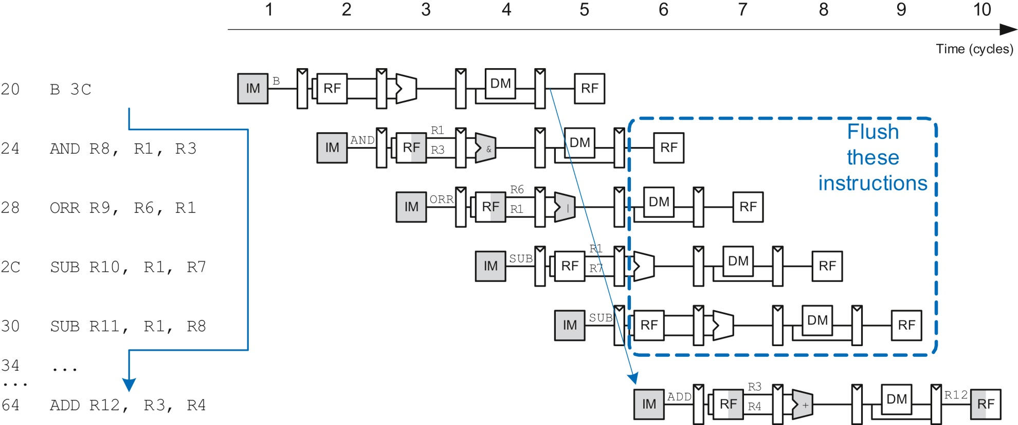
Figure 7.55 Abstract pipeline diagram illustrating flushing when a branch is taken

Slide 57
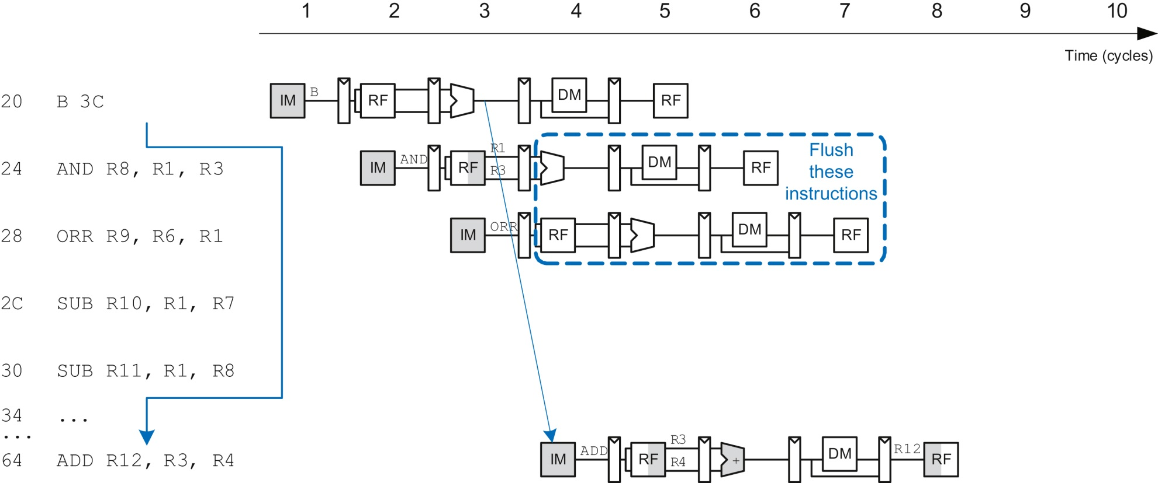
Figure 7.56 Abstract pipeline diagram illustrating earlier branch decision

Slide 58
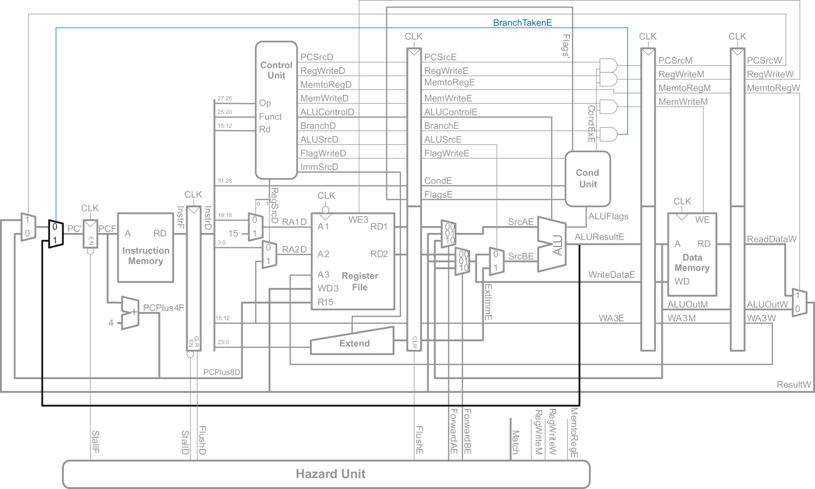
Figure 7.57 Pipelined processor handling branch control hazard

Slide 59
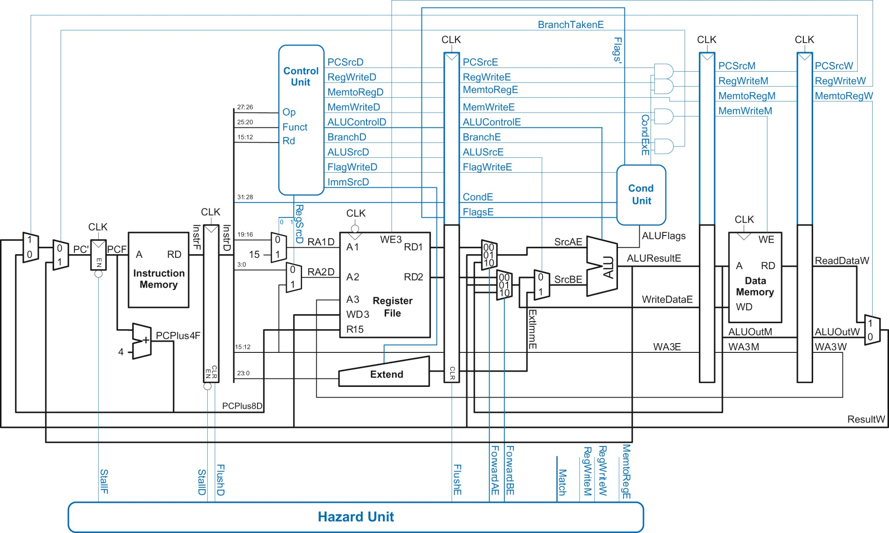
Figure 7.58 Pipelined processor with full hazard handling

Slide 60
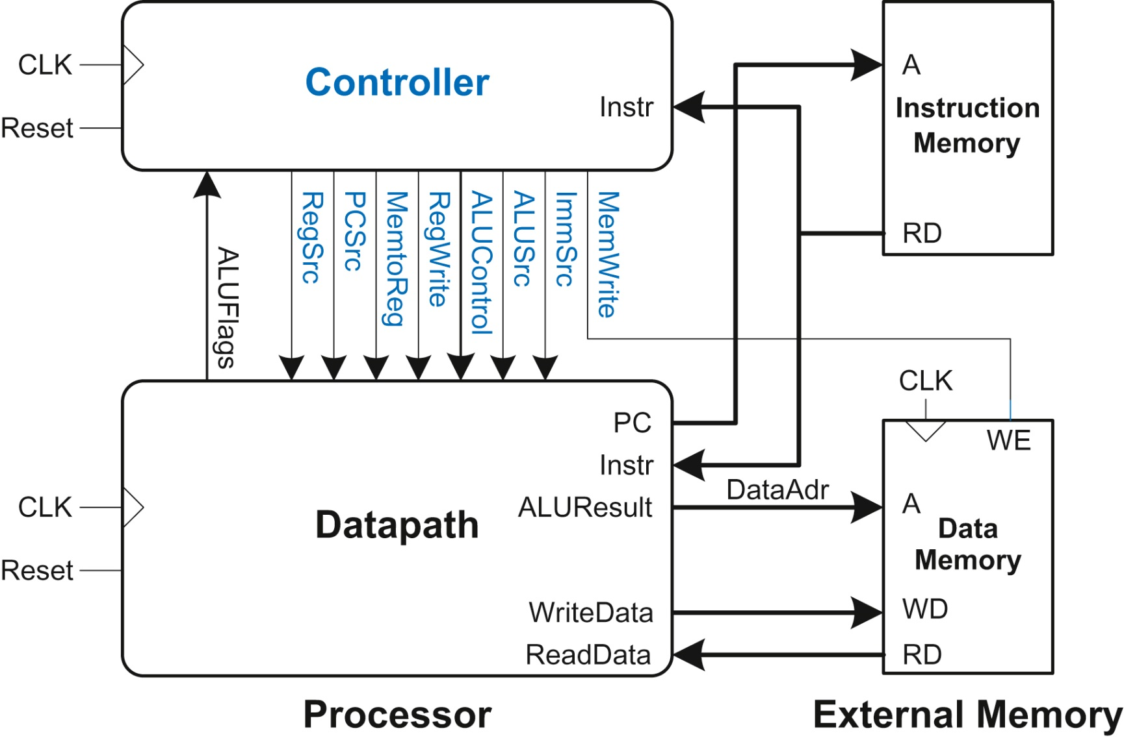
Figure 7.59 Single-cycle processor interfaced to external memory

Slide 61
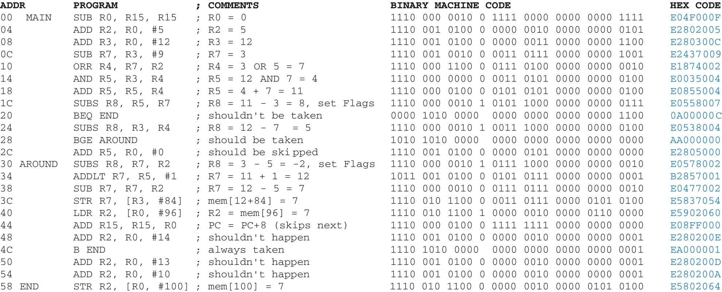
Figure 7.60 Assembly and machine code for test program

Slide 62
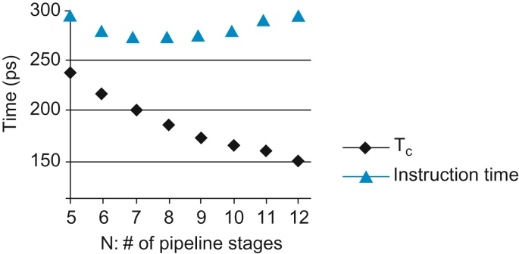
Figure 7.61 Cycle time and instruction time vs. the number of pipeline stages

Slide 63
Figure 7.62 Two-bit branch predictor state transition diagram

Slide 64
Figure 7.63 Superscalar datapath

Slide 65
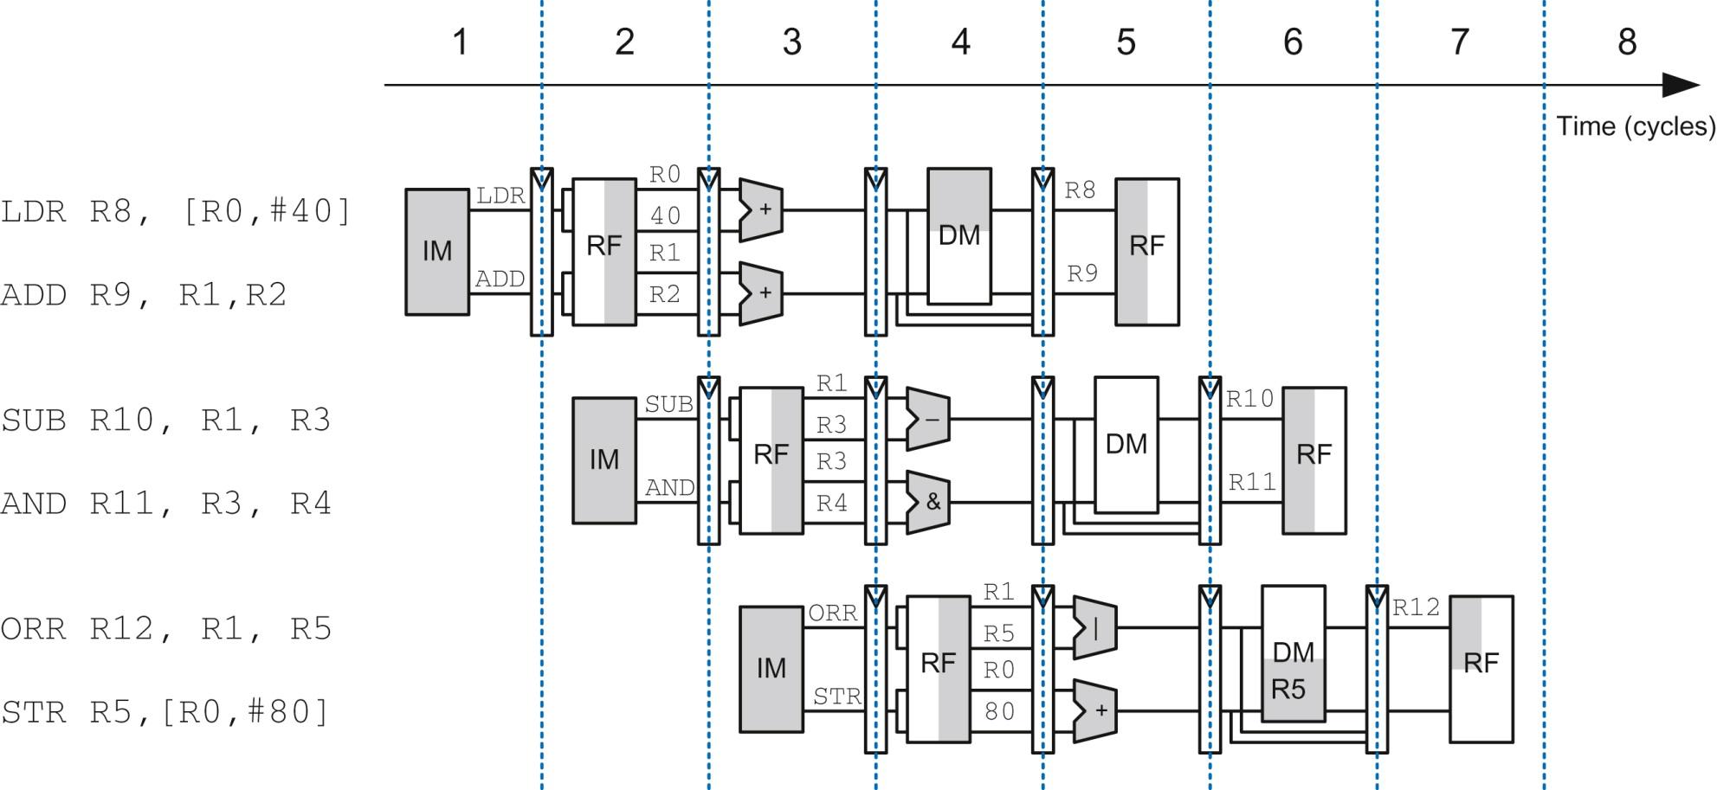
Figure 7.64 Abstract view of a superscalar pipeline in operation

Slide 66
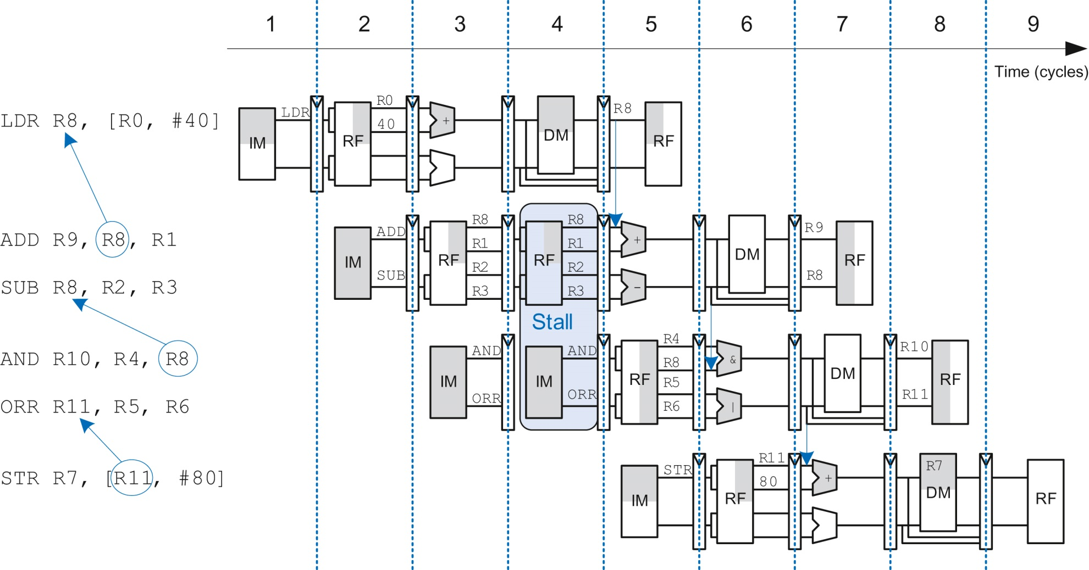
Figure 7.65 Program with data dependencies

Slide 67
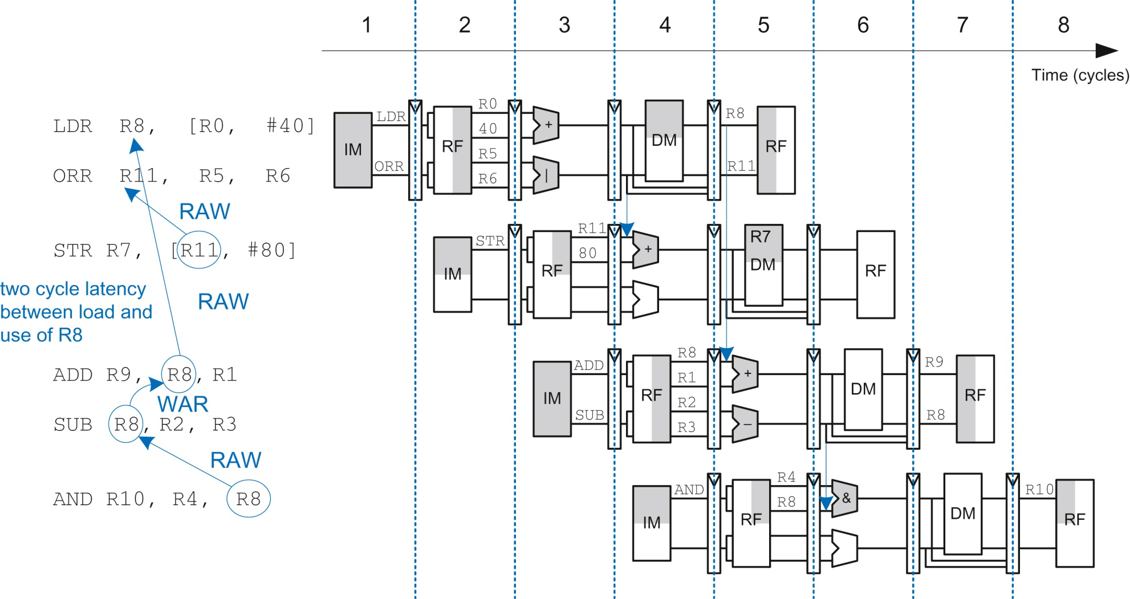
Figure 7.66 Out-of-order execution of a program with dependencies

Slide 68
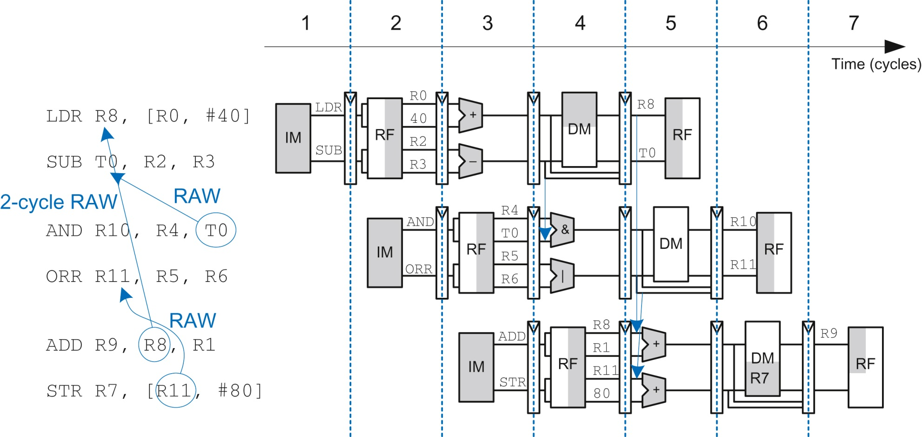
Figure 7.67 Out-of-order execution of a program using register renaming

Slide 69
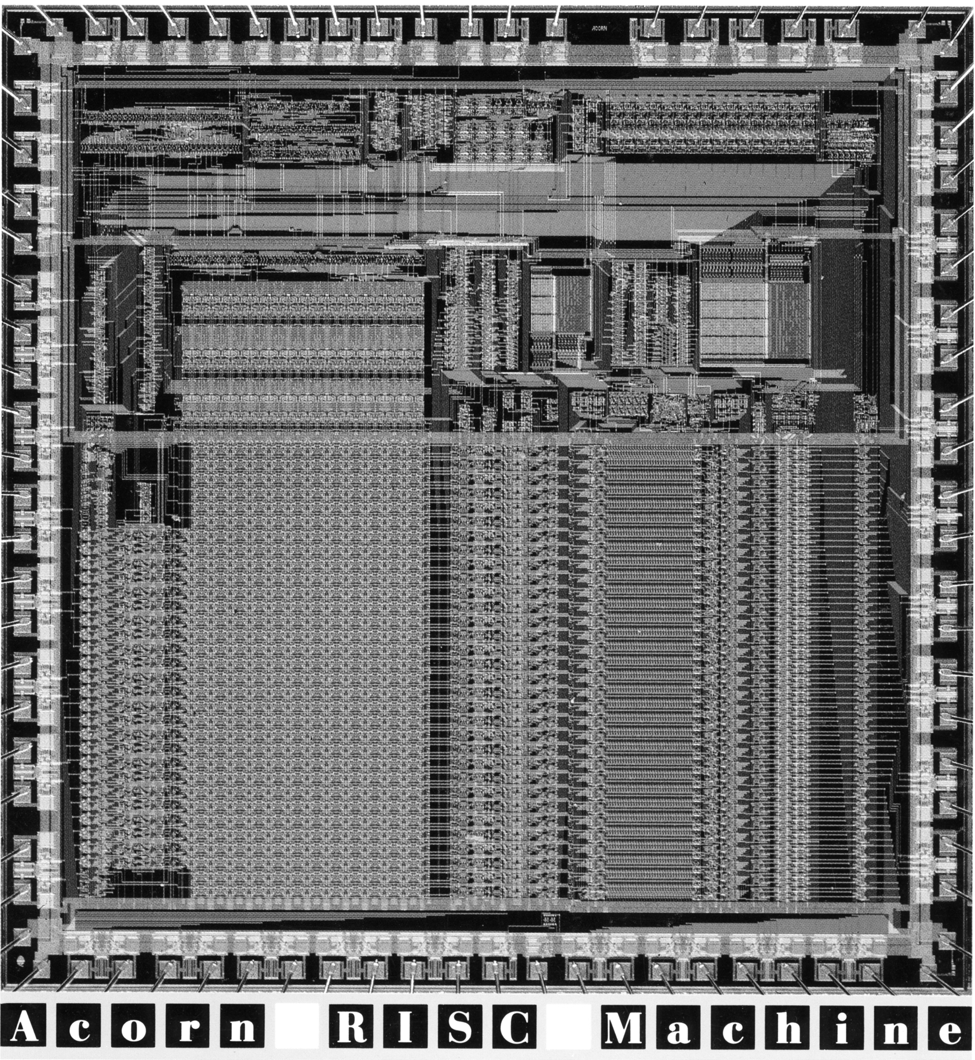
Figure 7.68 ARM1 die photograph. Reproduced with permission from ARM. © 1985 ARM Ltd.

Slide 70
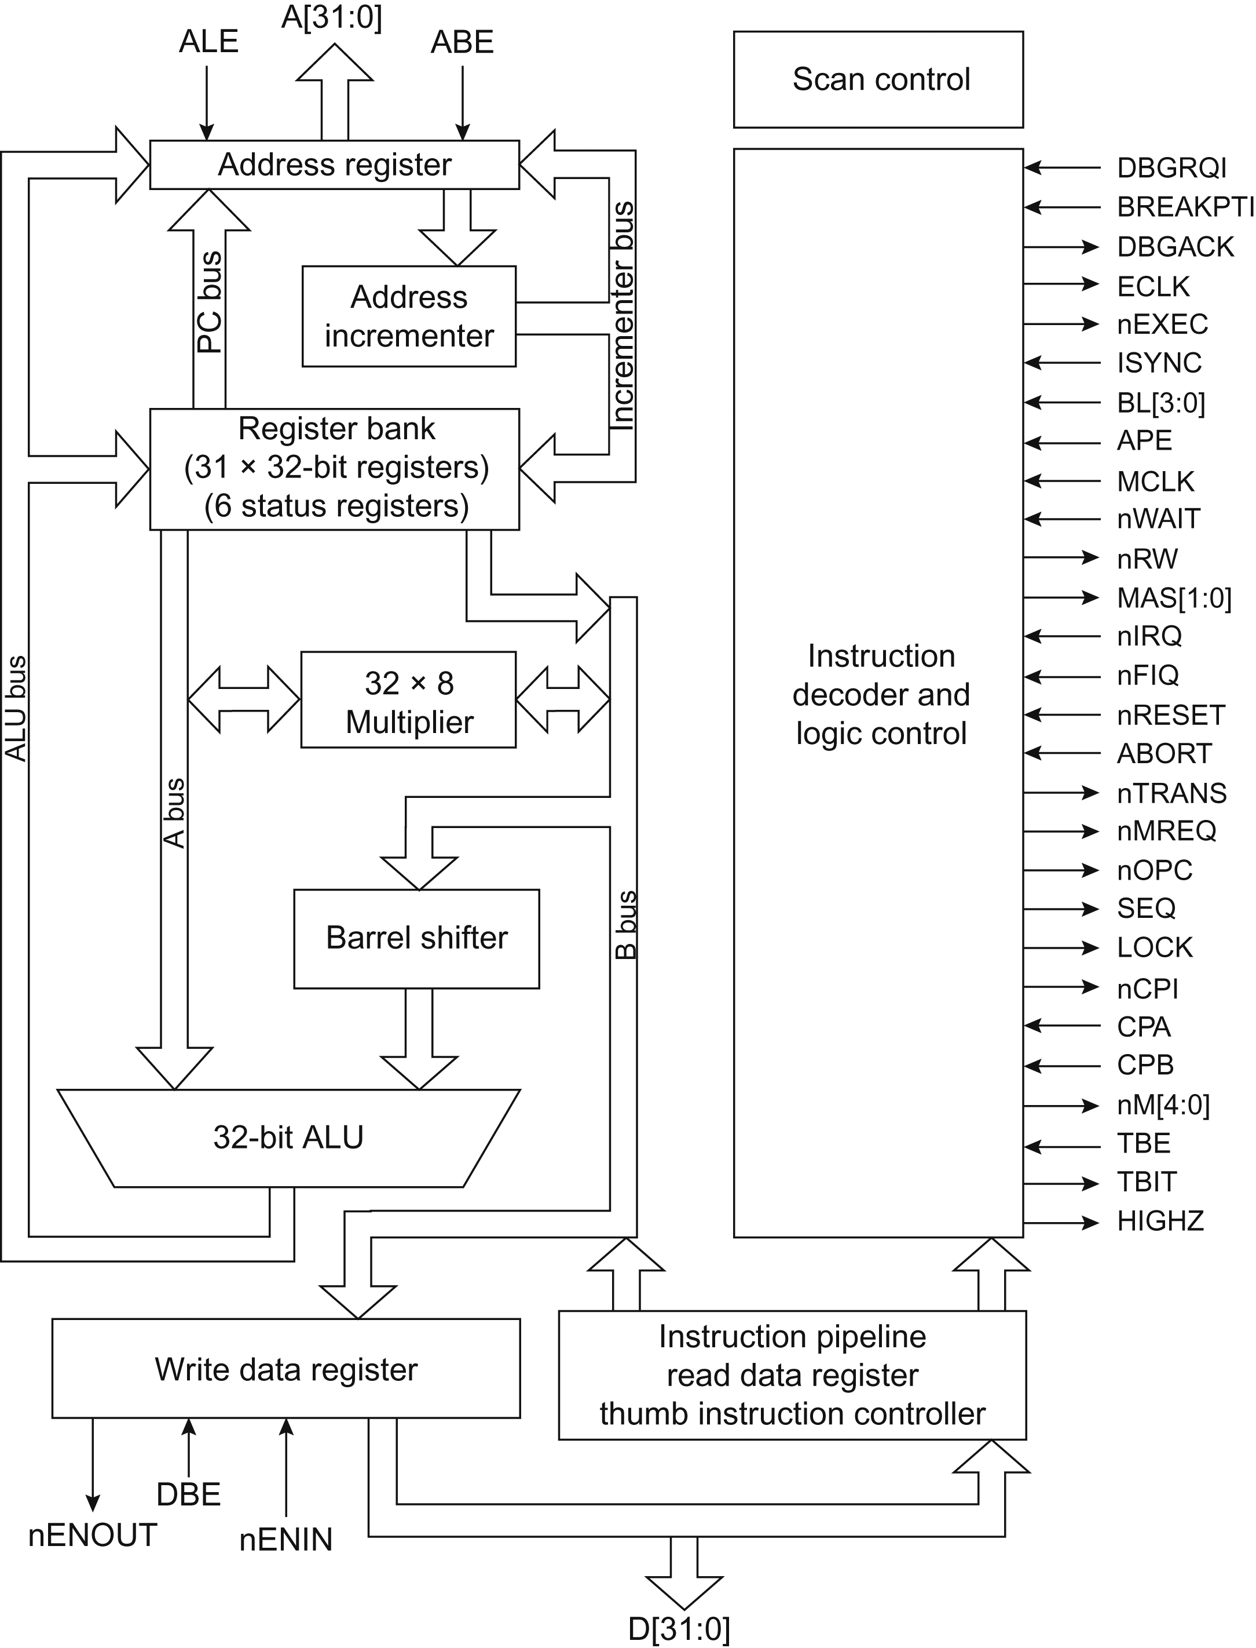
Figure 7.69 ARM7 block diagram. Reproduced with permission from ARM. © 1998 ARM Ltd.

Slide 71
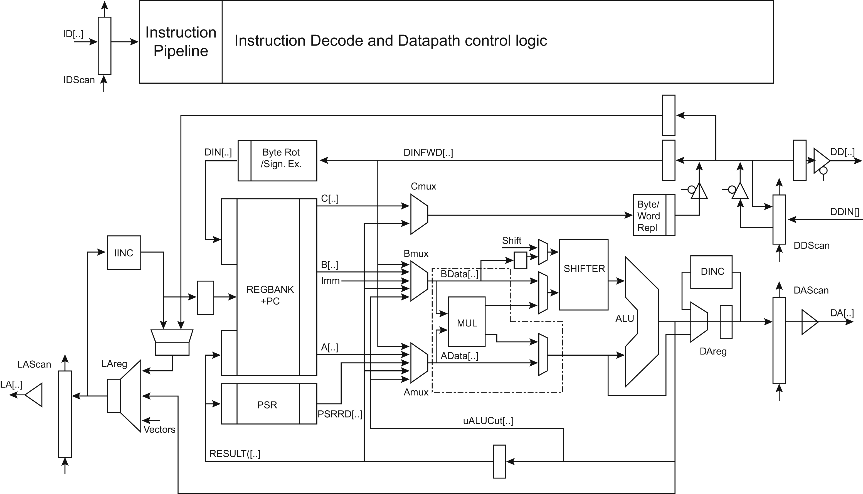
Figure 7.70 ARM9 block diagram. Reproduced with permission from the ARM9TDMI Technical Reference Manual. © 1999 ARM Ltd.

Slide 72
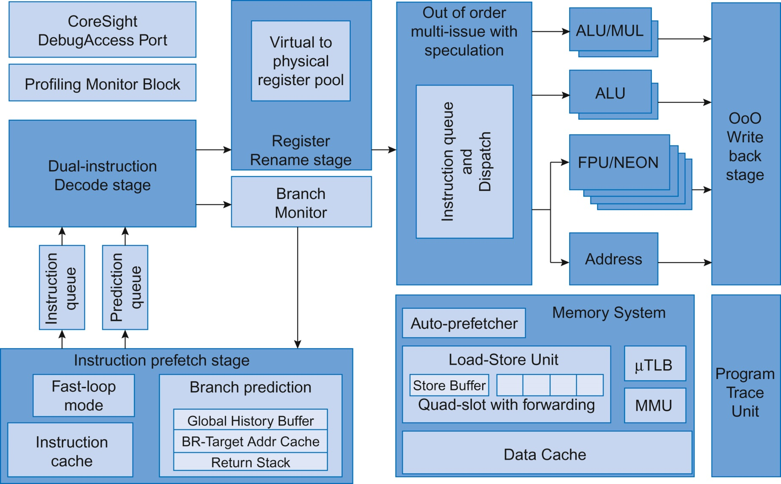
Figure 7.71 Cortex-A9 block diagram. This image has been sourced by the authors and does not imply ARM endorsement.

Slide 73
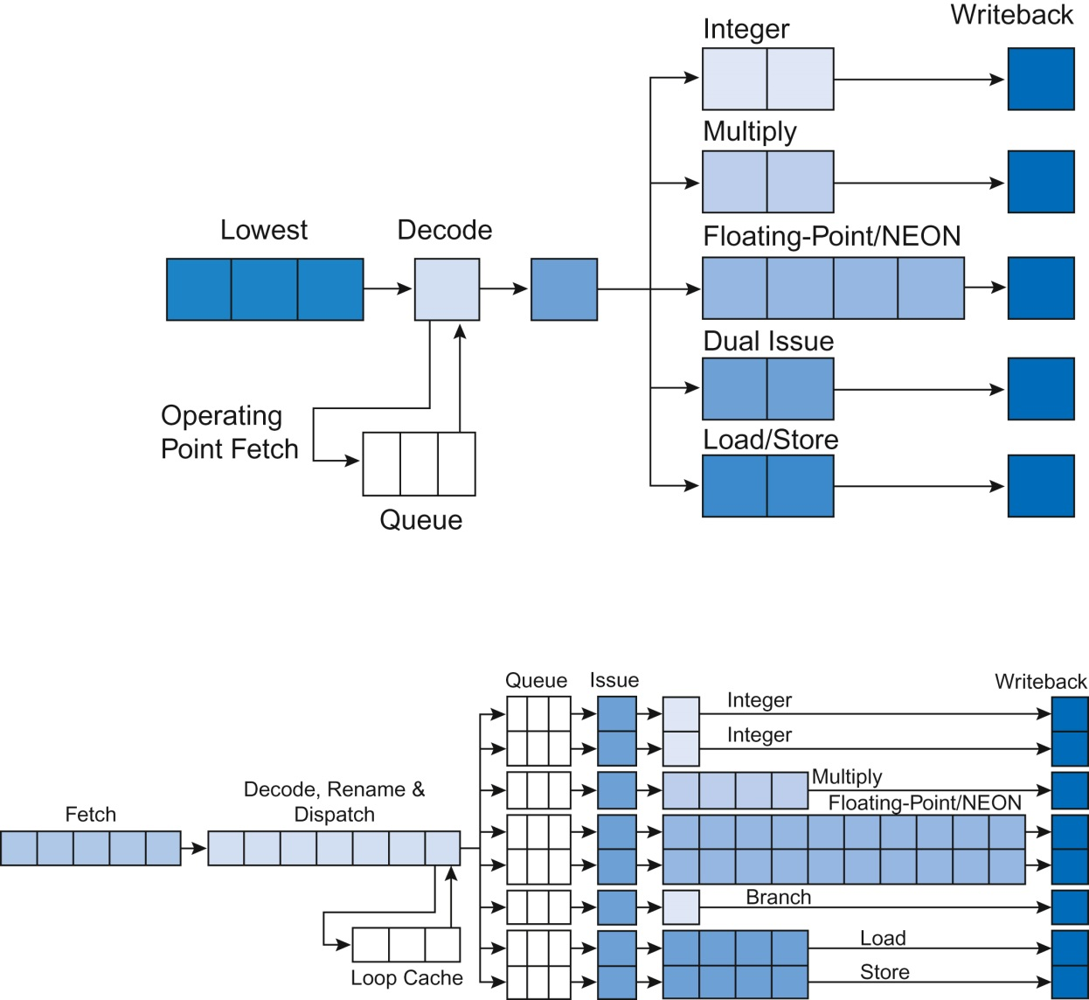
Figure 7.72 Cortex-A7 and -A15 block diagrams. This image has been sourced by the authors and does not imply ARM endorsement.

Slide 74
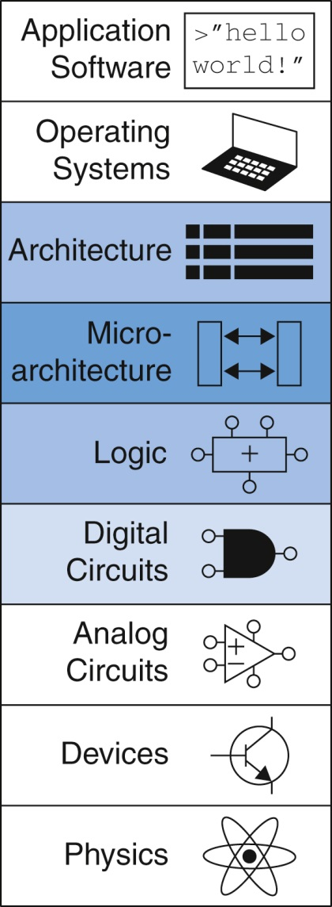
Figure u07-01

