Slide 1
Memory Systems
CH008

Slide 2
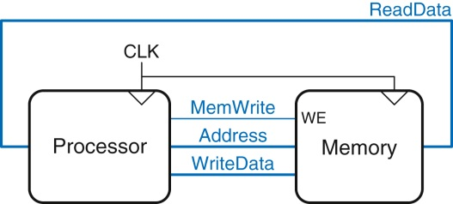
Figure 8.1 The memory interface

Slide 3
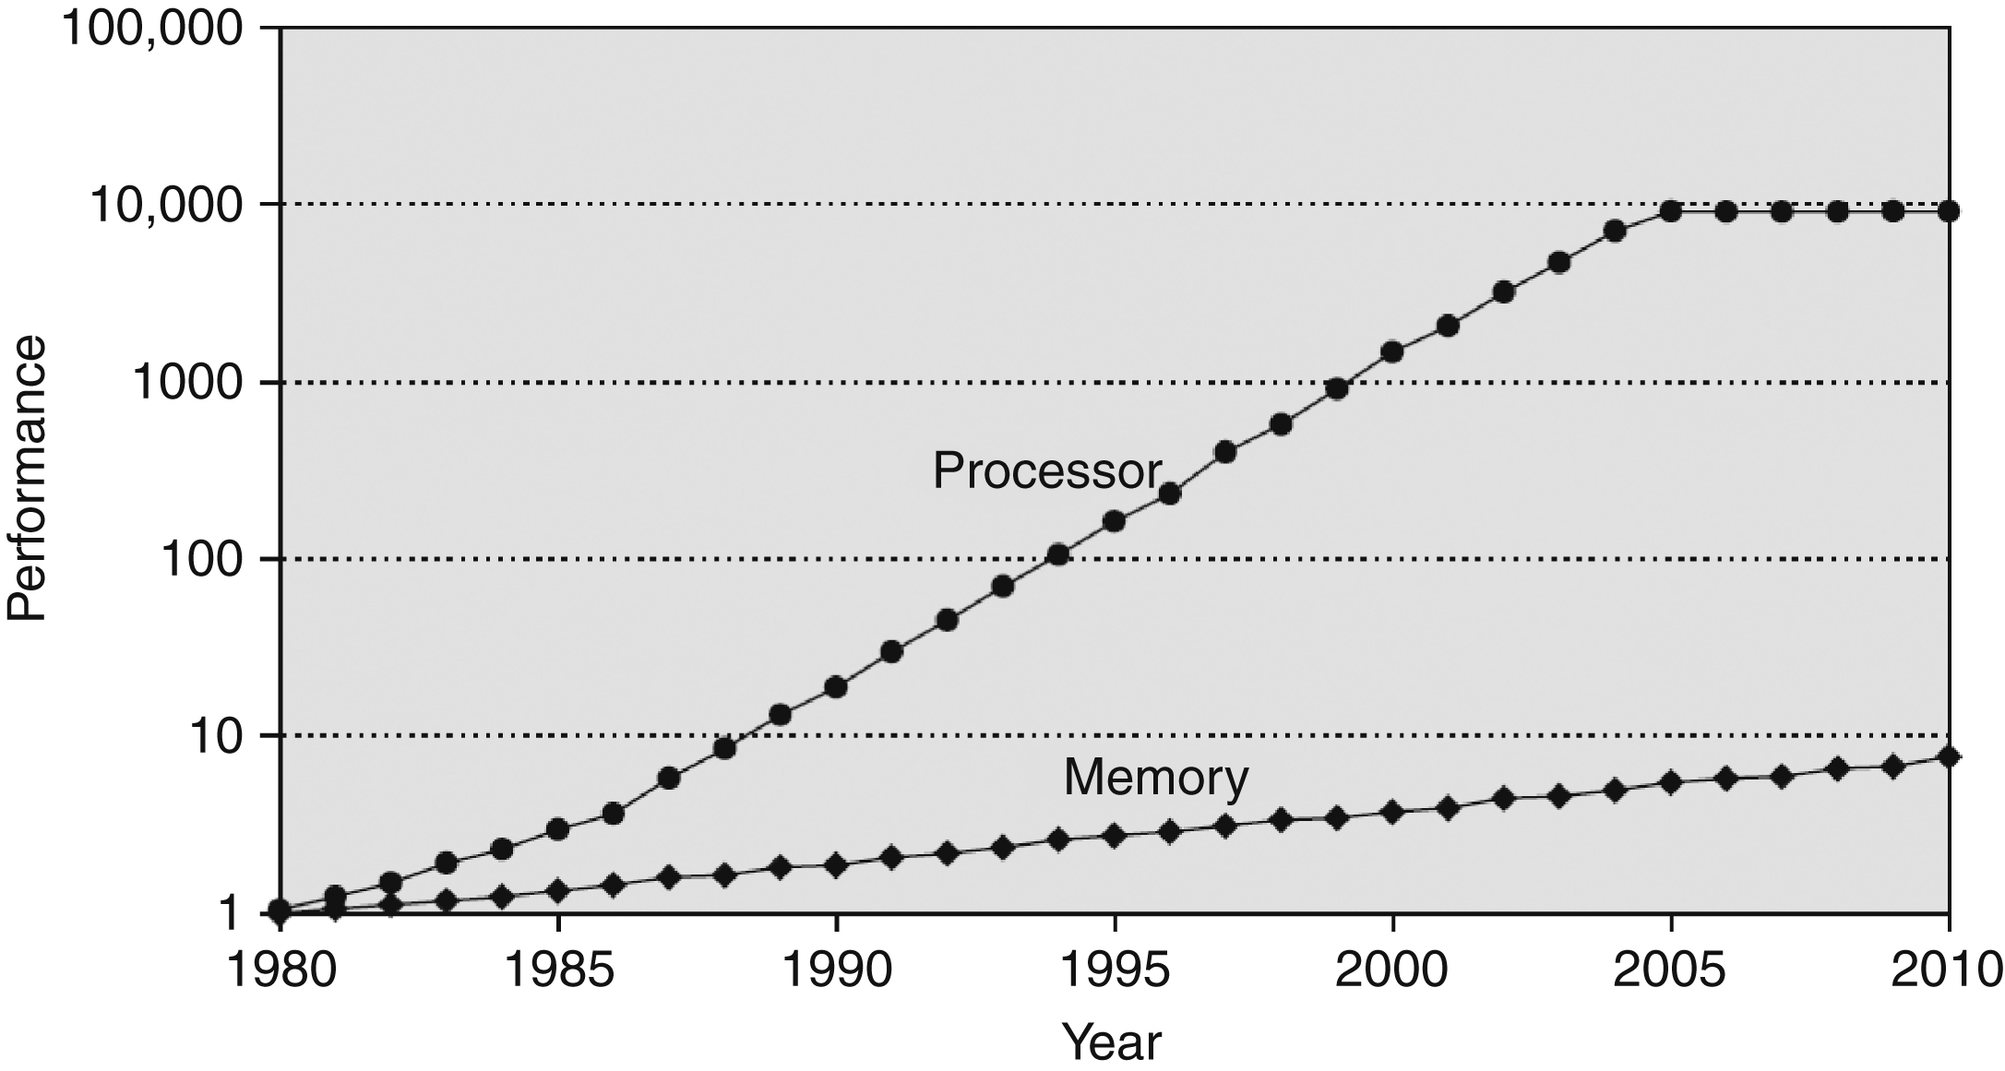
Figure 8.2 Diverging processor and memory performance. Adapted with permission from Hennessy and Patterson, Computer Architecture: A Quantitative Approach, 5th ed., Morgan Kaufmann, 2011.

Slide 4
Figure 8.3 A typical memory hierarchy

Slide 5
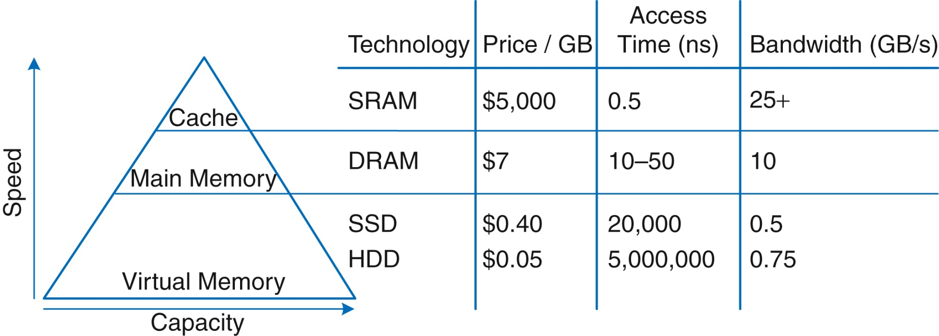
Figure 8.4 Memory hierarchy components, with typical characteristics in 2015

Slide 6
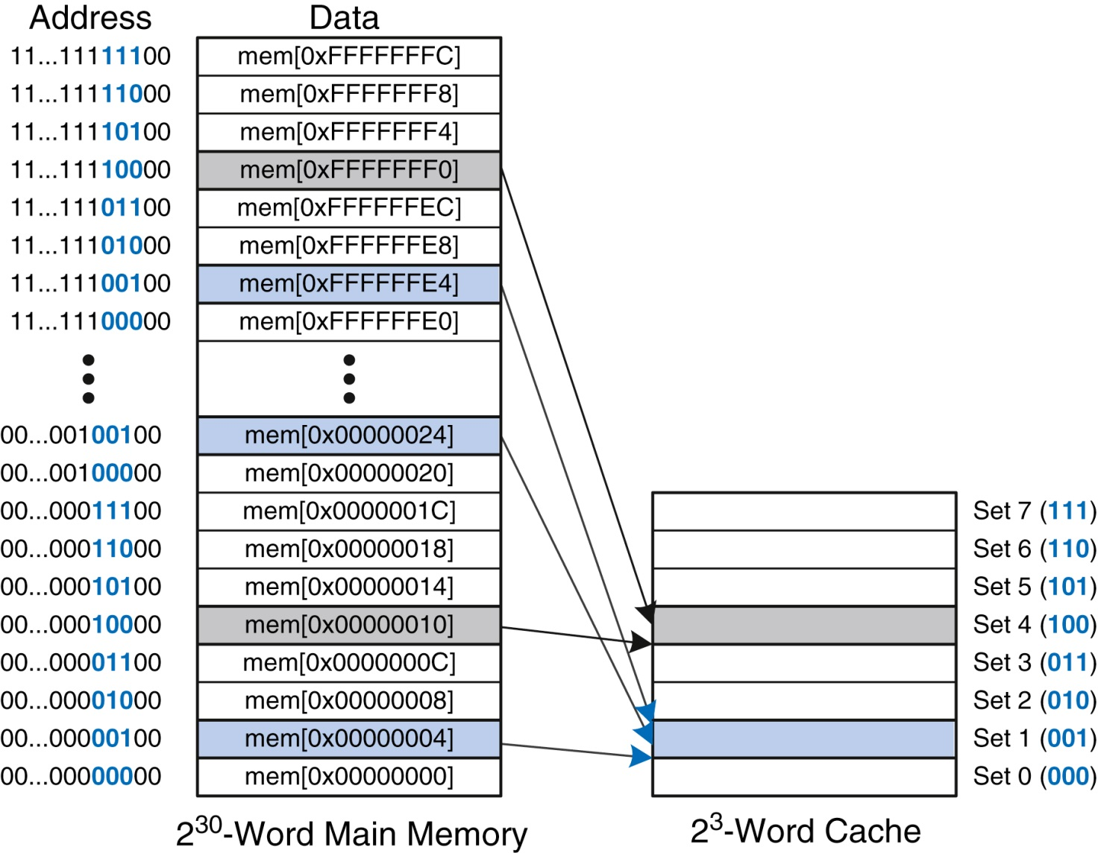
Figure 8.5 Mapping of main memory to a direct mapped cache

Slide 7
Figure 8.6 Cache fields for address 0xFFFFFFE4 when mapping to the cache in Figure 8.5

Slide 8
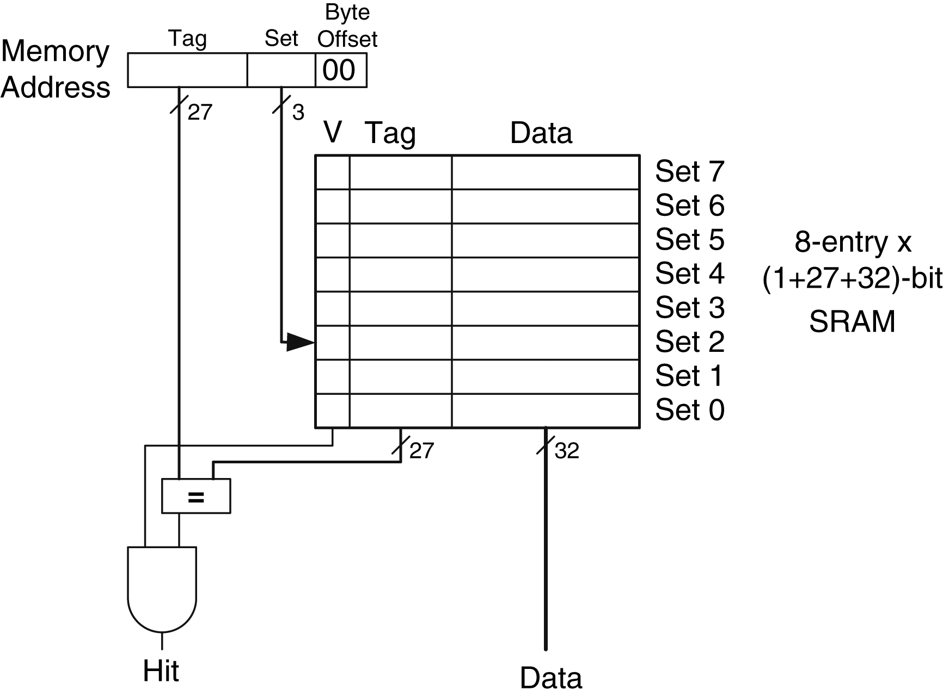
Figure 8.7 Direct mapped cache with 8 sets

Slide 9
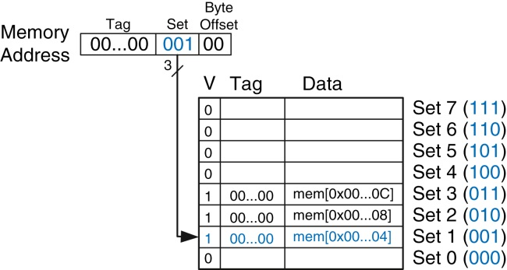
Figure 8.8 Direct mapped cache contents

Slide 10
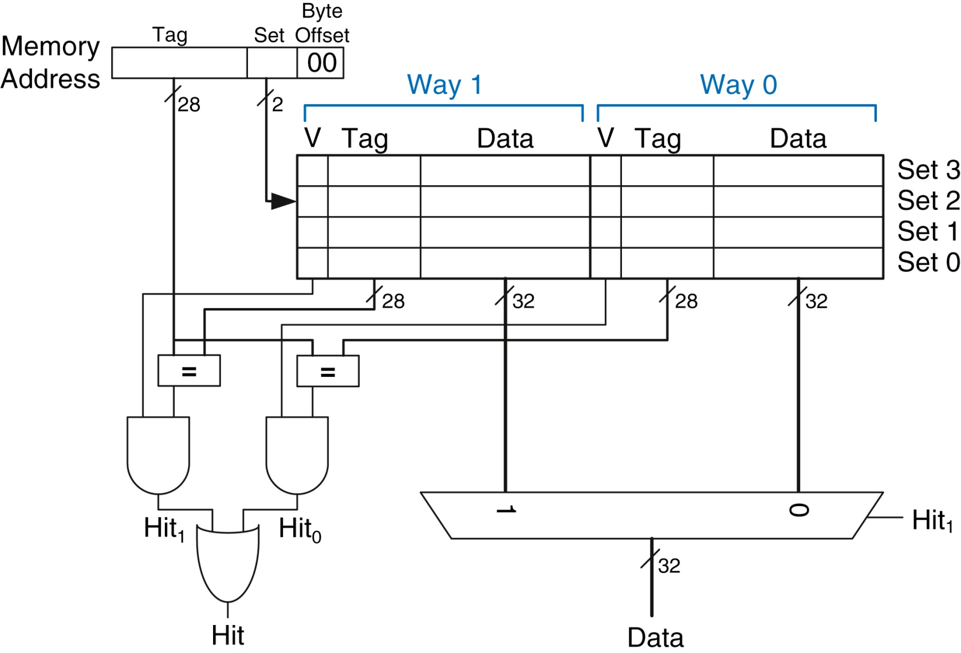
Figure 8.9 Two-way set associative cache

Slide 11
Figure 8.10 Two-way set associative cache contents

Slide 12
Figure 8.11 Eight-block fully associative cache

Slide 13
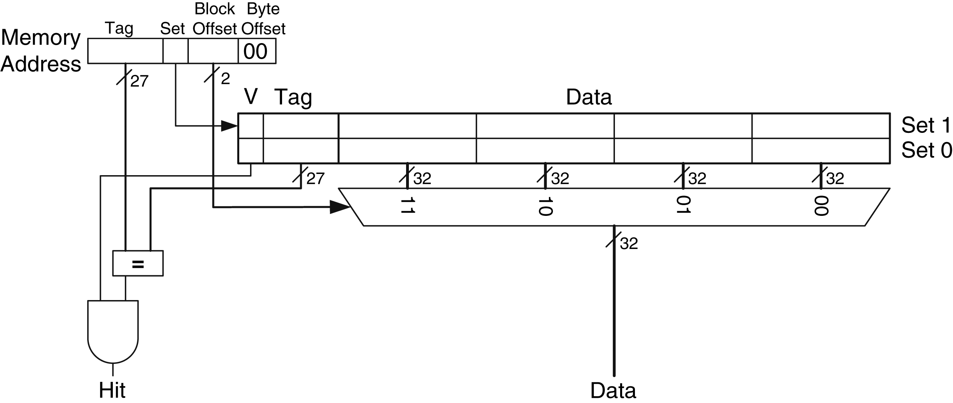
Figure 8.12 Direct mapped cache with two sets and a four-word block size

Slide 14
Figure 8.13 Cache fields for address 0x8000009C when mapping to the cache of Figure 8.12

Slide 15
Figure 8.14 Cache contents with a block size b of four words

Slide 16
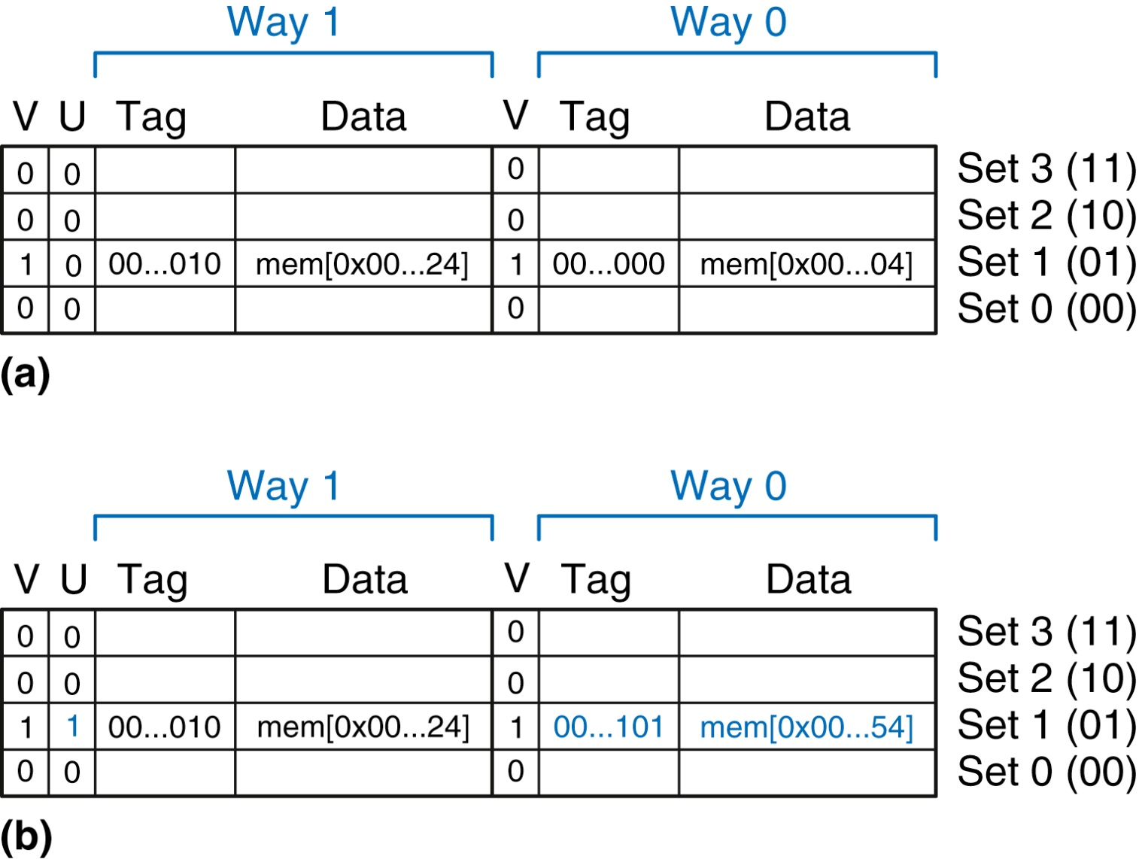
Figure 8.15 Two-way associative cache with LRU replacement

Slide 17
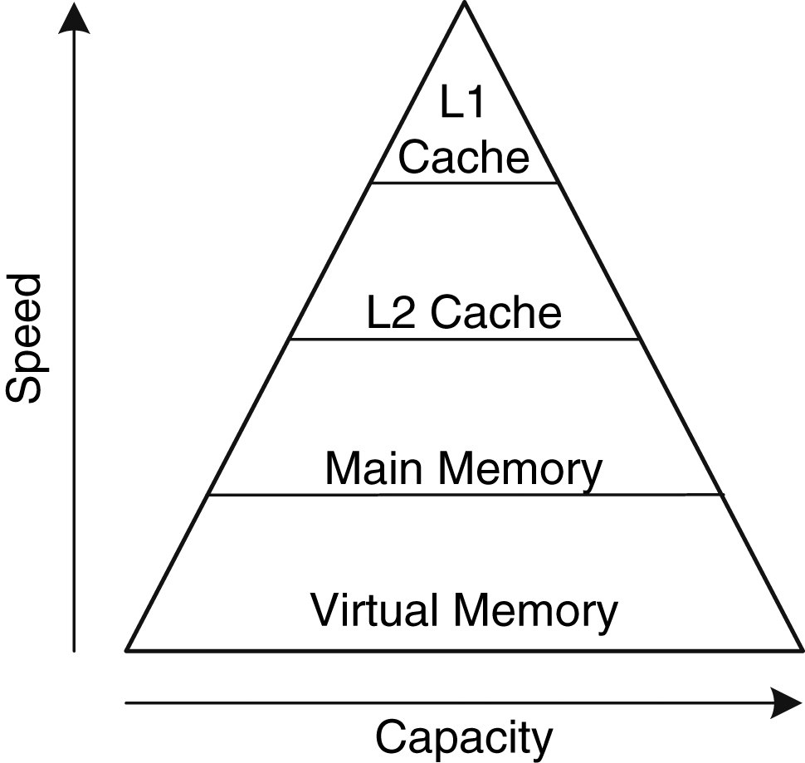
Figure 8.16 Memory hierarchy with two levels of cache

Slide 18
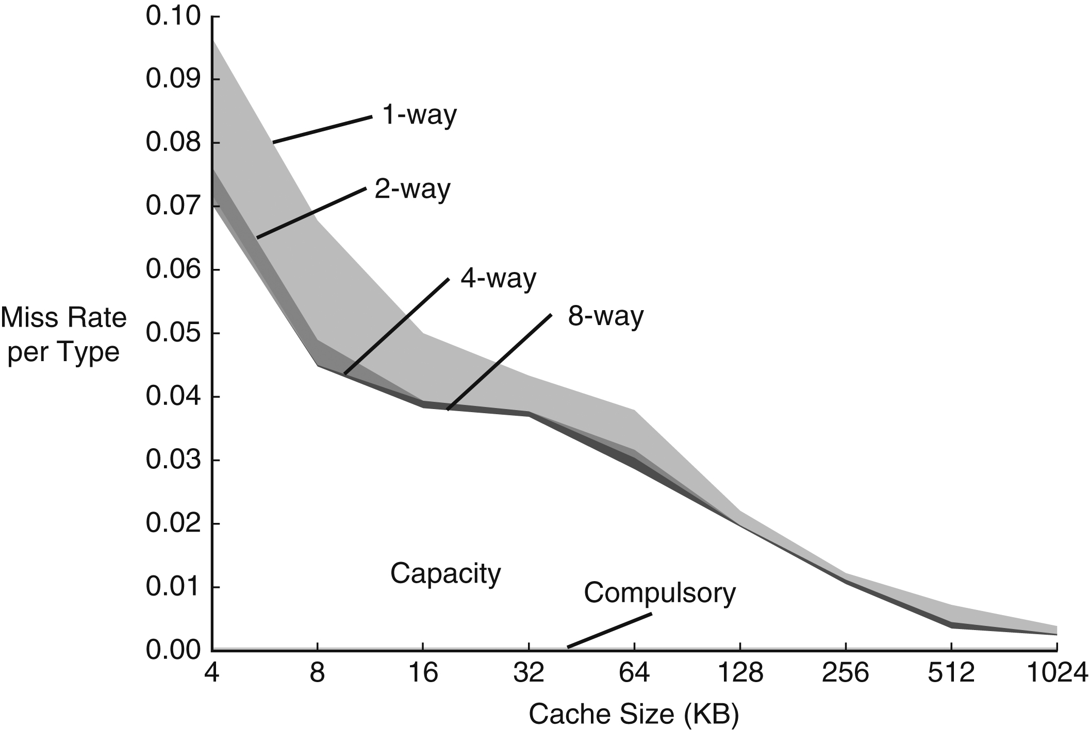
Figure 8.17 Miss rate versus cache size and associativity on SPEC2000 benchmark. (Adapted with permission from Hennessy and Patterson, Computer Architecture: A Quantitative Approach, 5th ed., Morgan Kaufmann, 2012.)

Slide 19
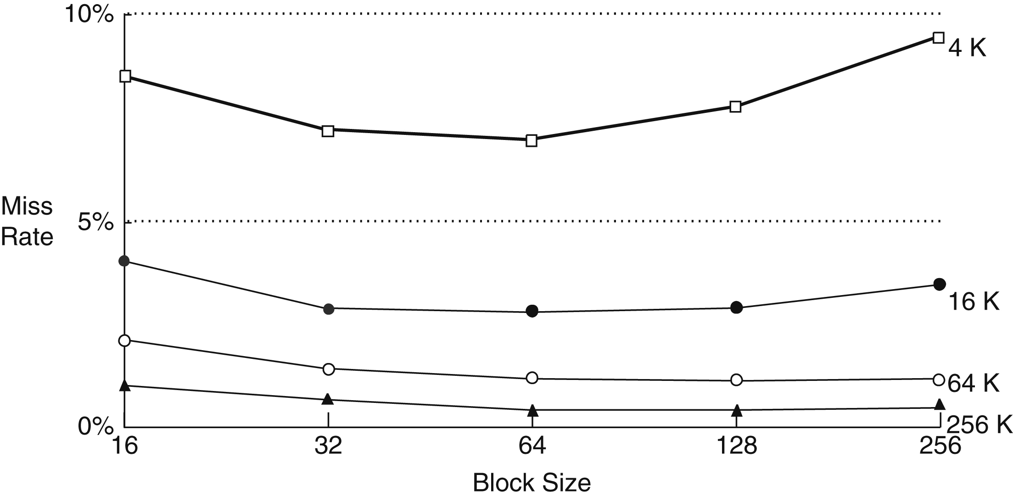
Figure 8.18 Miss rate versus block size and cache size on SPEC92 benchmark. (Adapted with permission from Hennessy and Patterson, Computer Architecture: A Quantitative Approach, 5th ed., Morgan Kaufmann, 2012.)

Slide 20
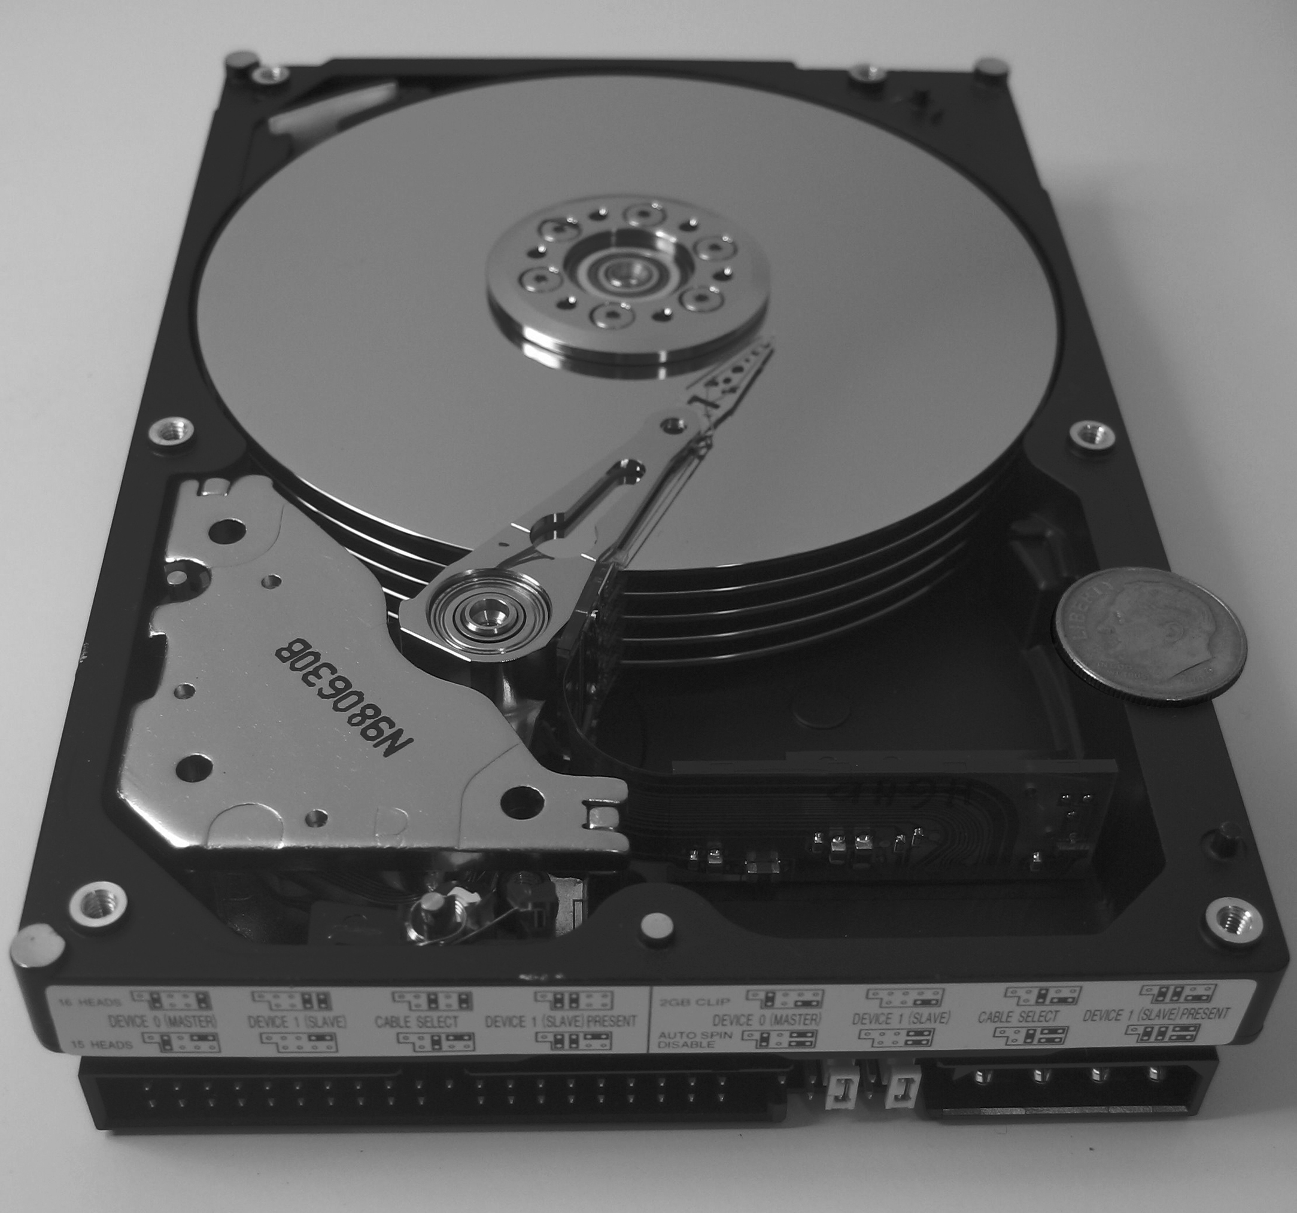
Figure 8.19 Hard disk

Slide 21
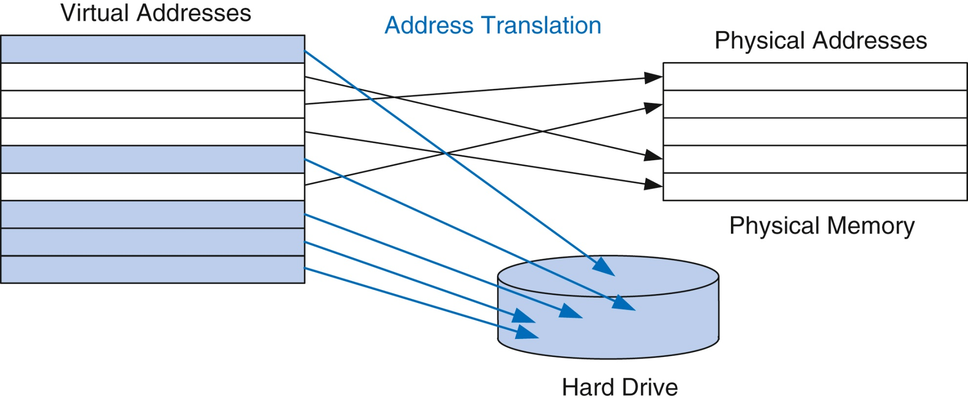
Figure 8.20 Virtual and physical pages

Slide 22
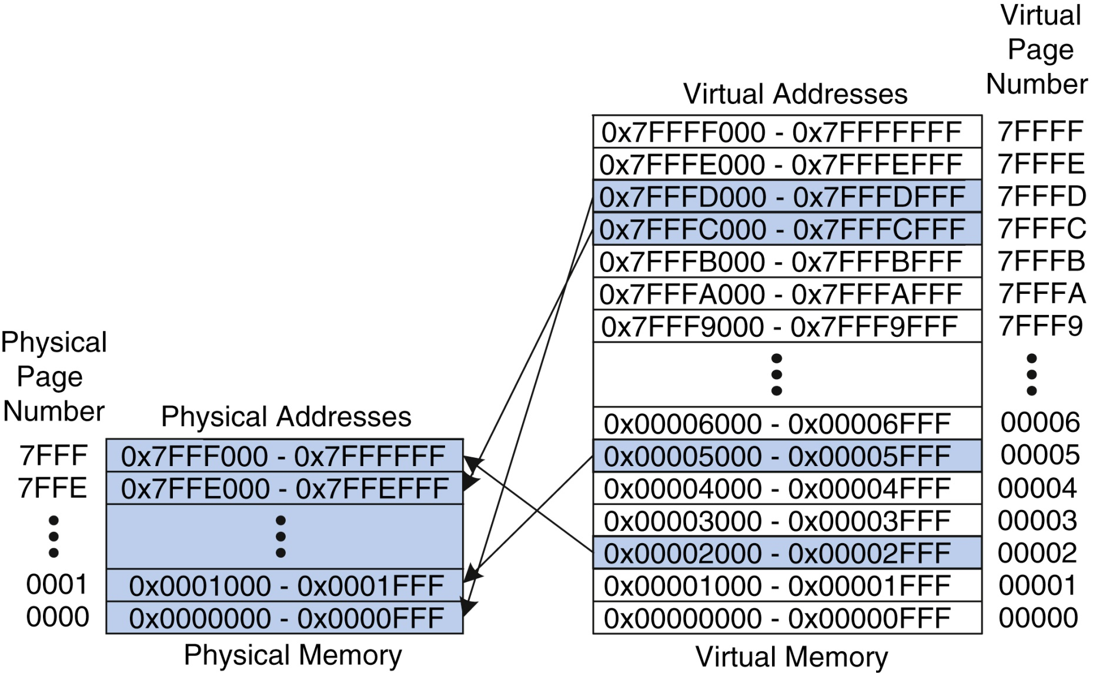
Figure 8.21 Physical and virtual pages

Slide 23
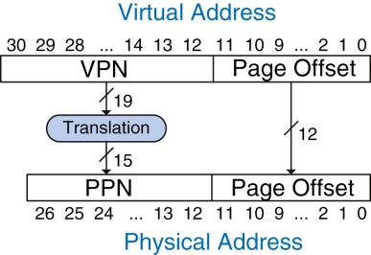
Figure 8.22 Translation from virtual address to physical address

Slide 24
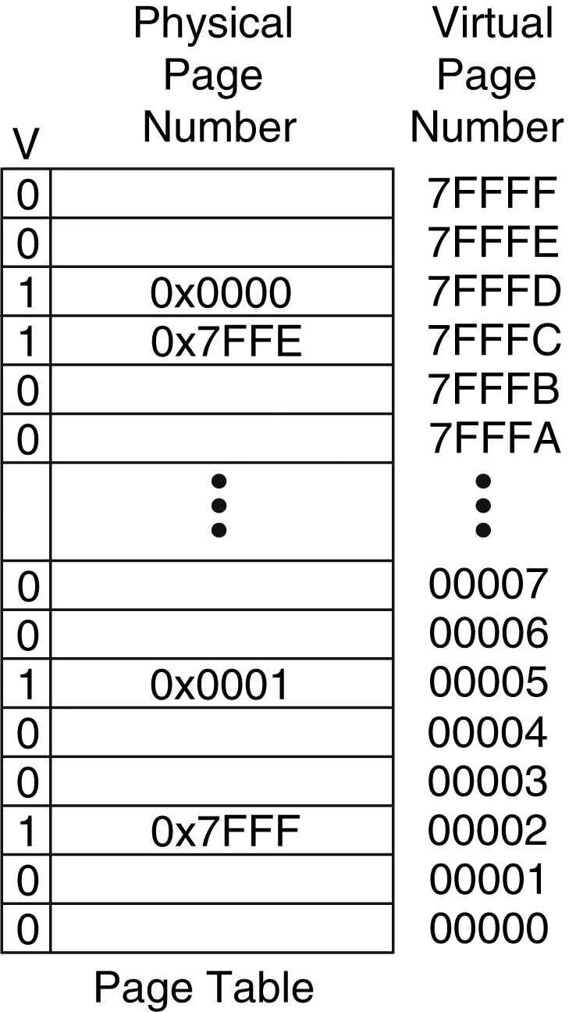
Figure 8.23 The page table for Figure 8.21

Slide 25
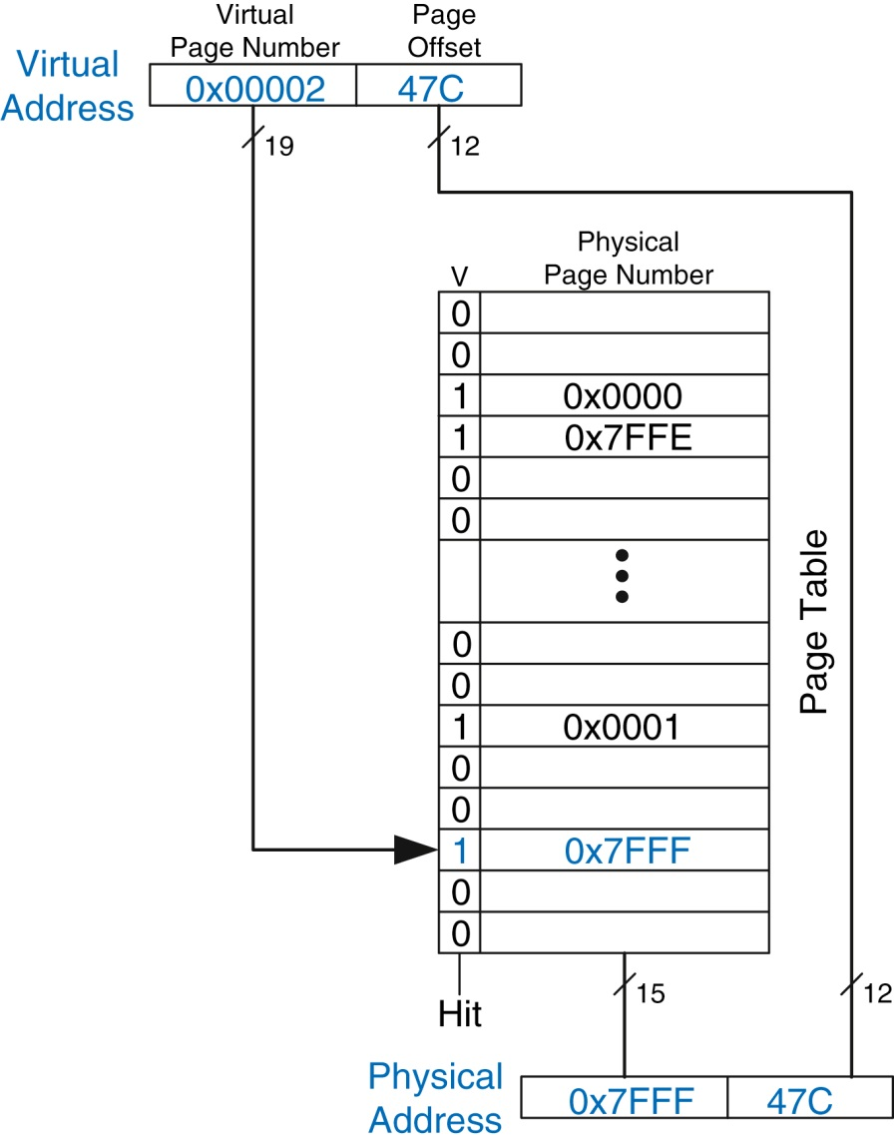
Figure 8.24 Address translation using the page table

Slide 26
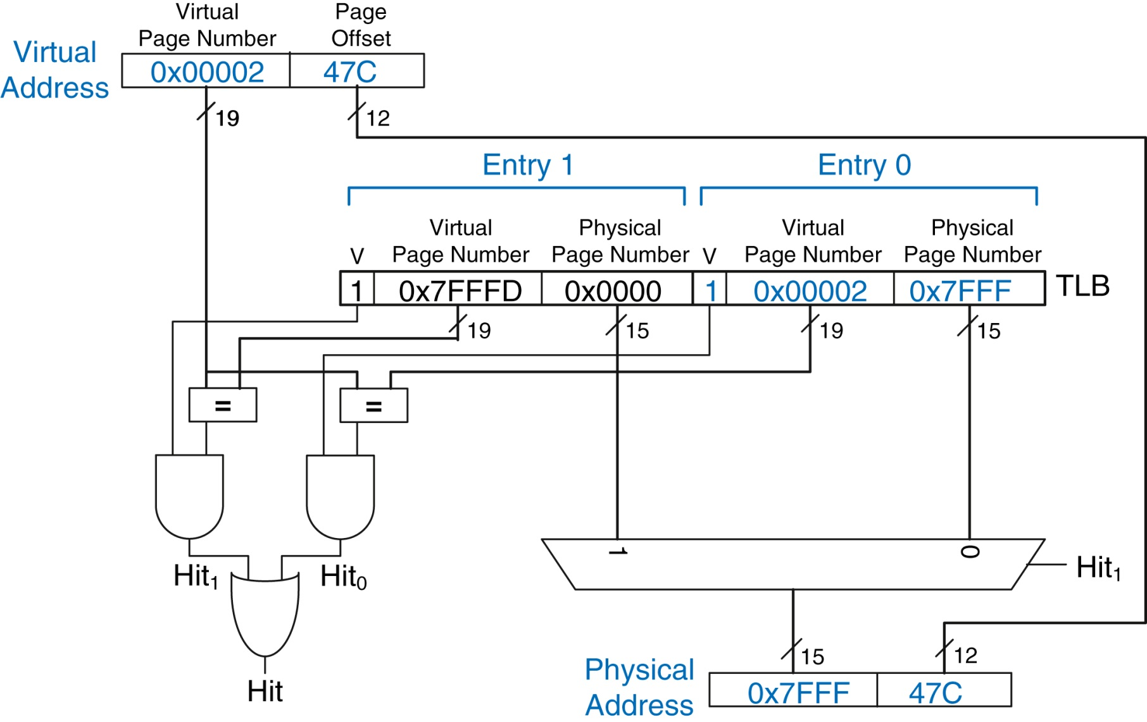
Figure 8.25 Address translation using a two-entry TLB

Slide 27
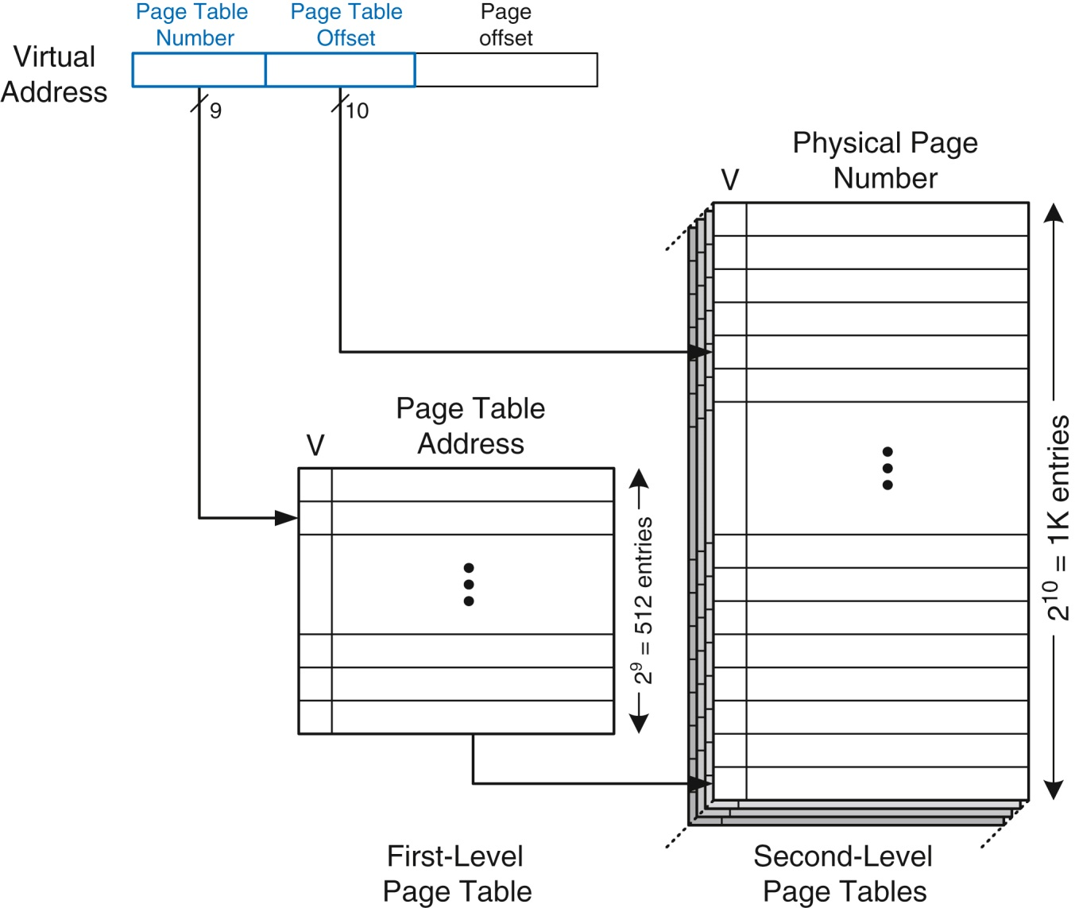
Figure 8.26 Hierarchical page tables

Slide 28
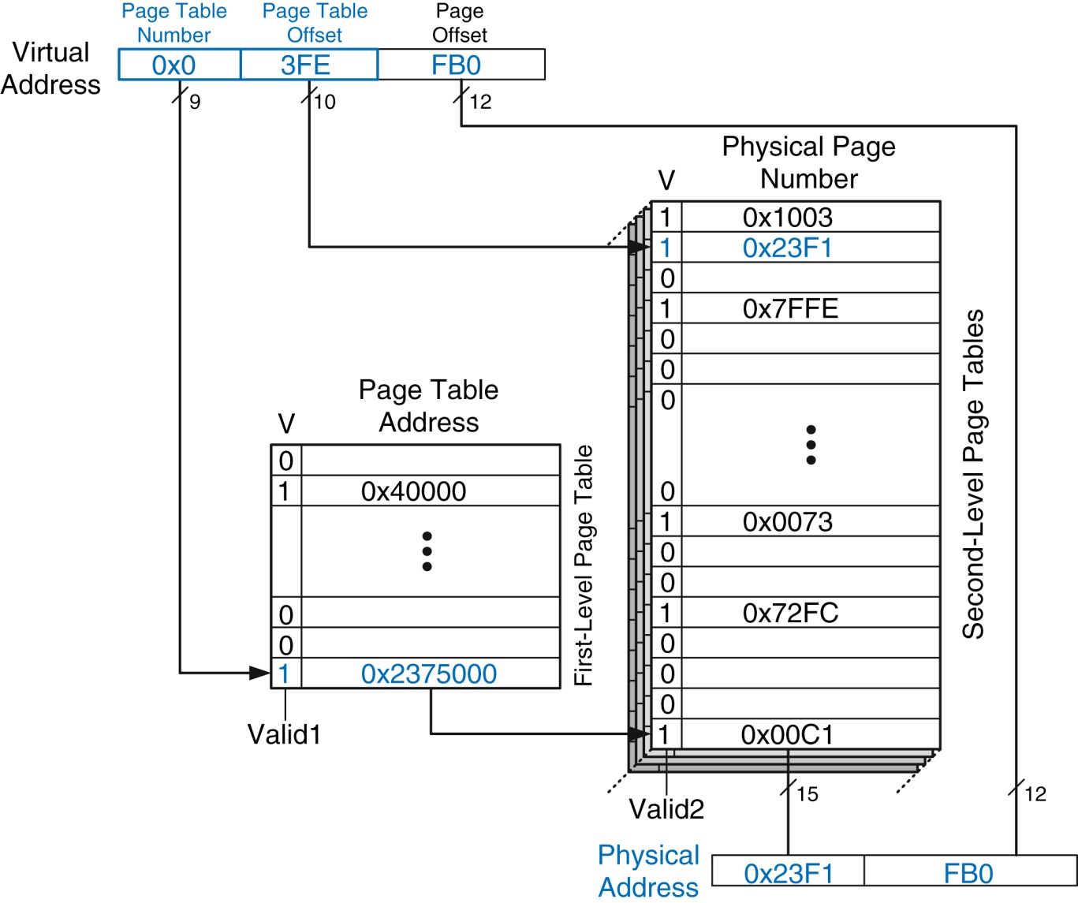
Figure 8.27 Address translation using a two-level page table

Slide 29
Figure 8.28 Building blocks

Slide 30
Figure 8.29 Computer system

Slide 31
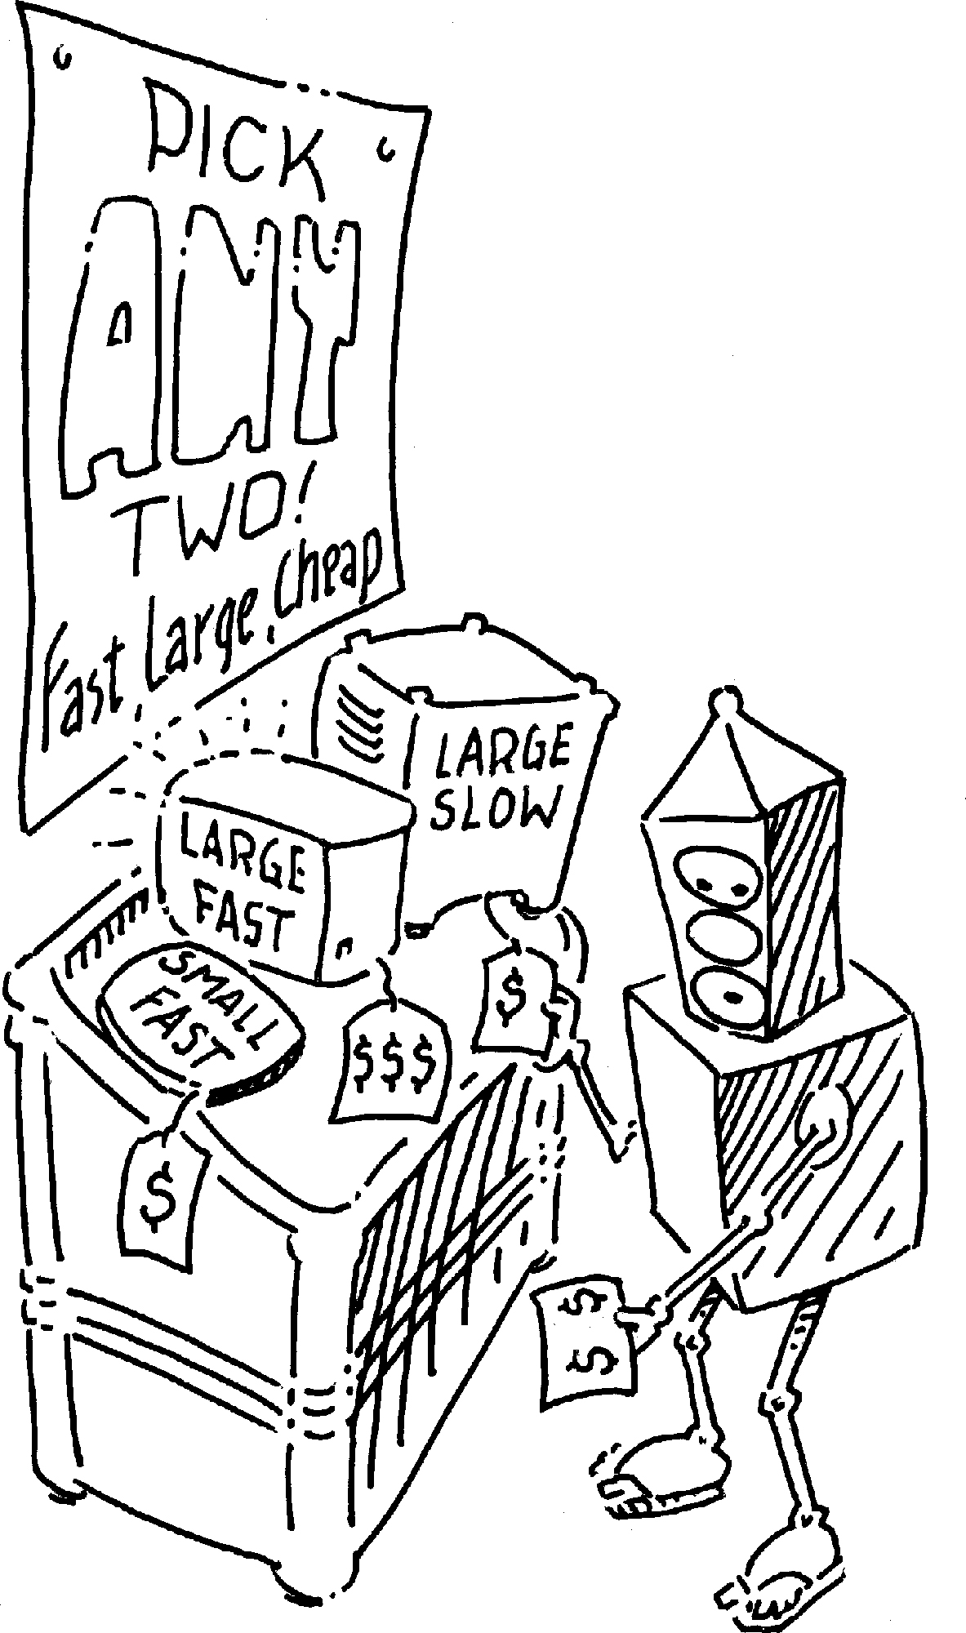

Slide 33
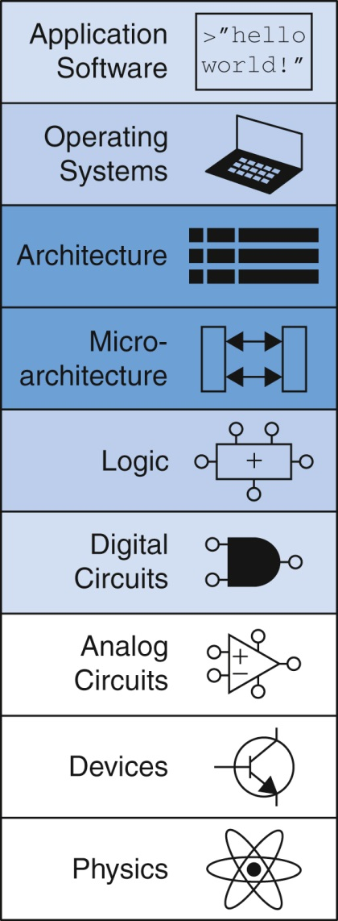
Fig u08-01

