Slide 1
I/O Systems
CH009O

Slide 2
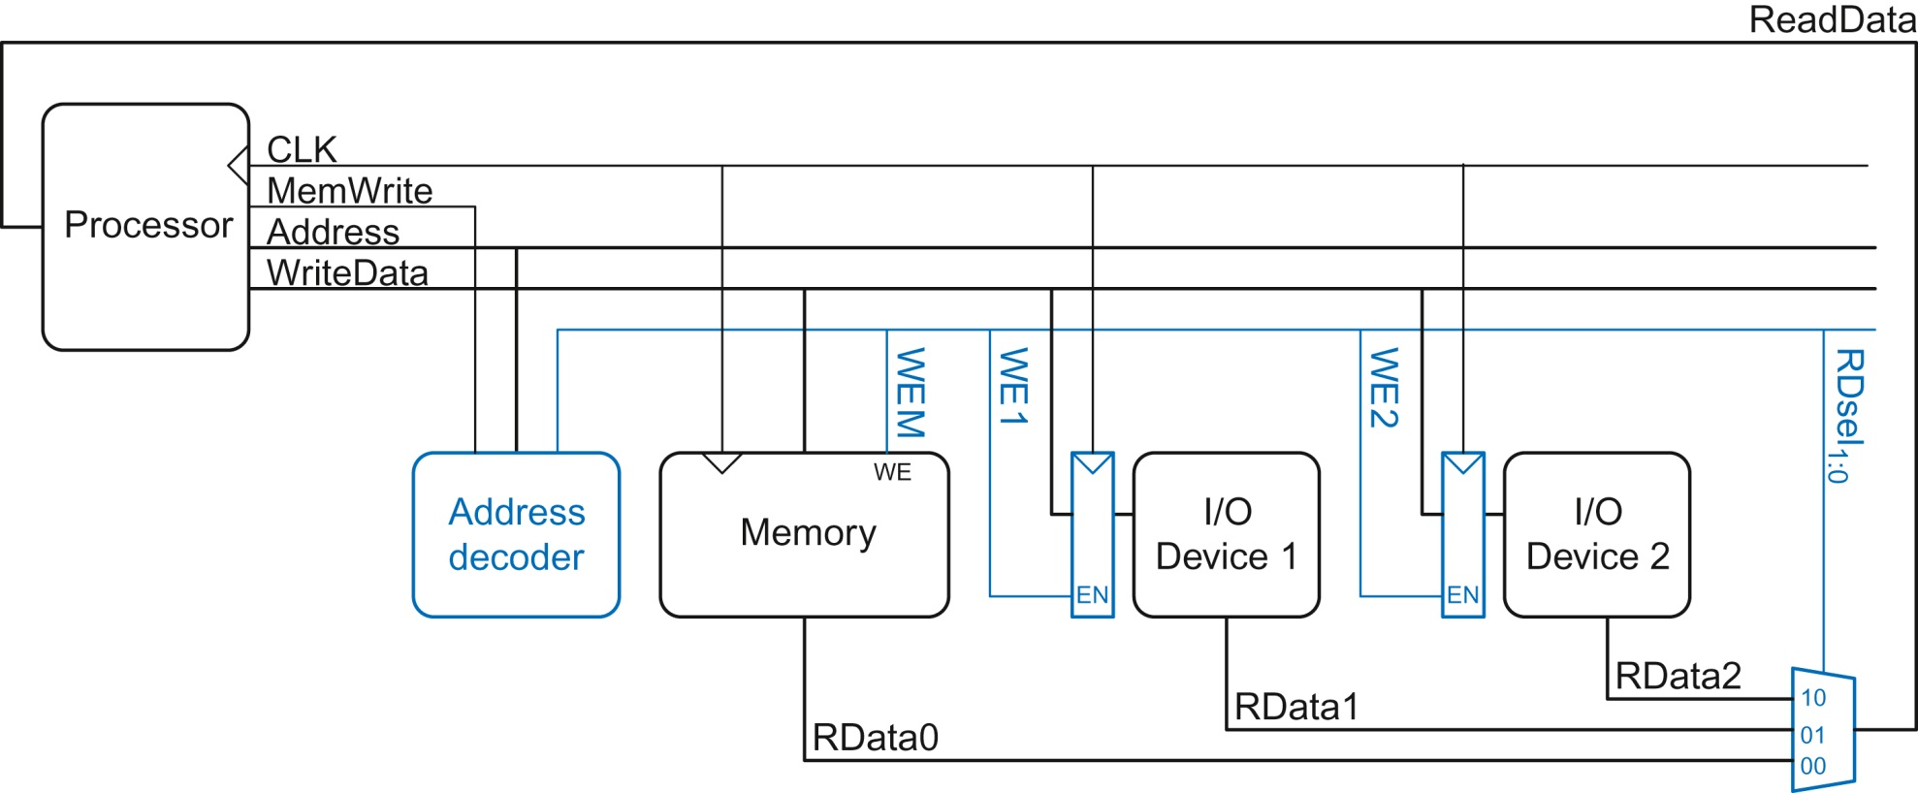
Figure e9.1 Support hardware for memory-mapped I/O

Slide 3
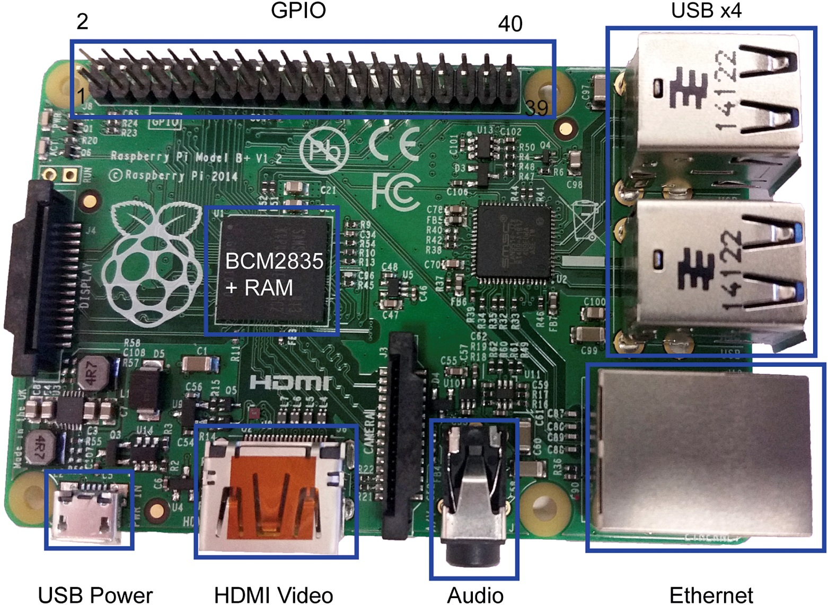
Figure e9.2 Raspbery Pi Model B+

Slide 4
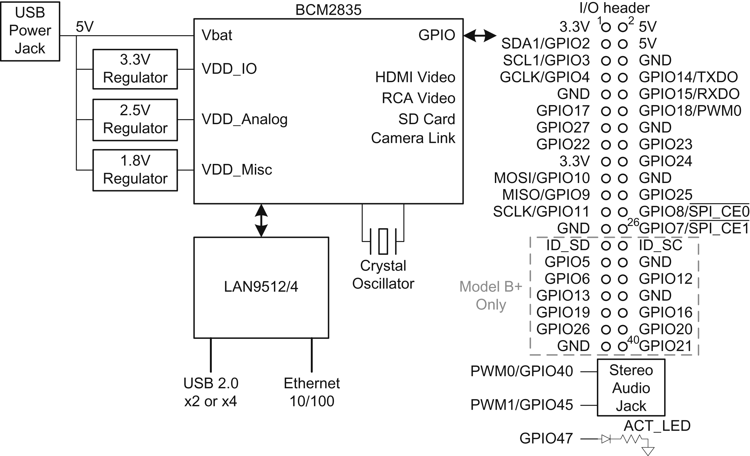
Figure e9.3 Raspberry PI I/O schematic

Slide 5
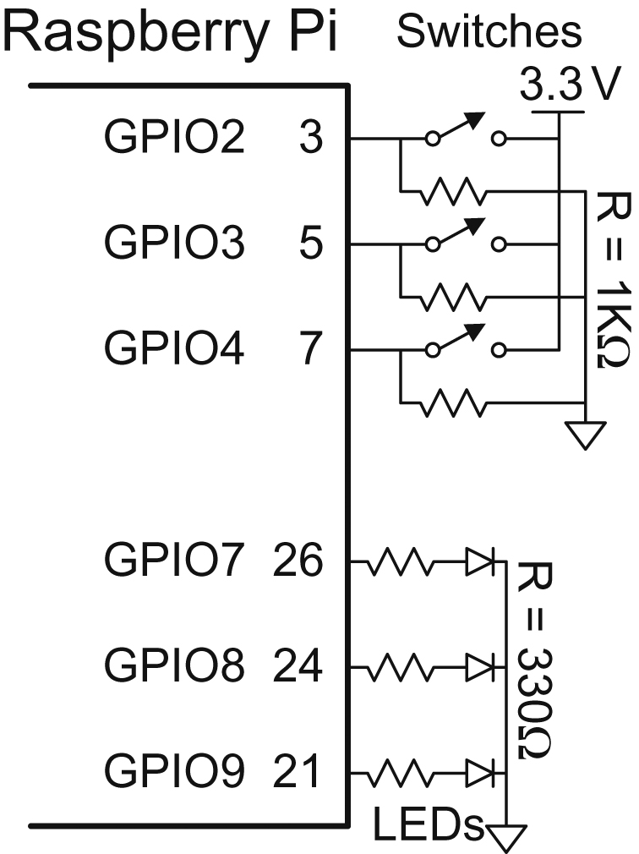
Figure e9.4 LEDs and switches connected to GPIO pins

Slide 6
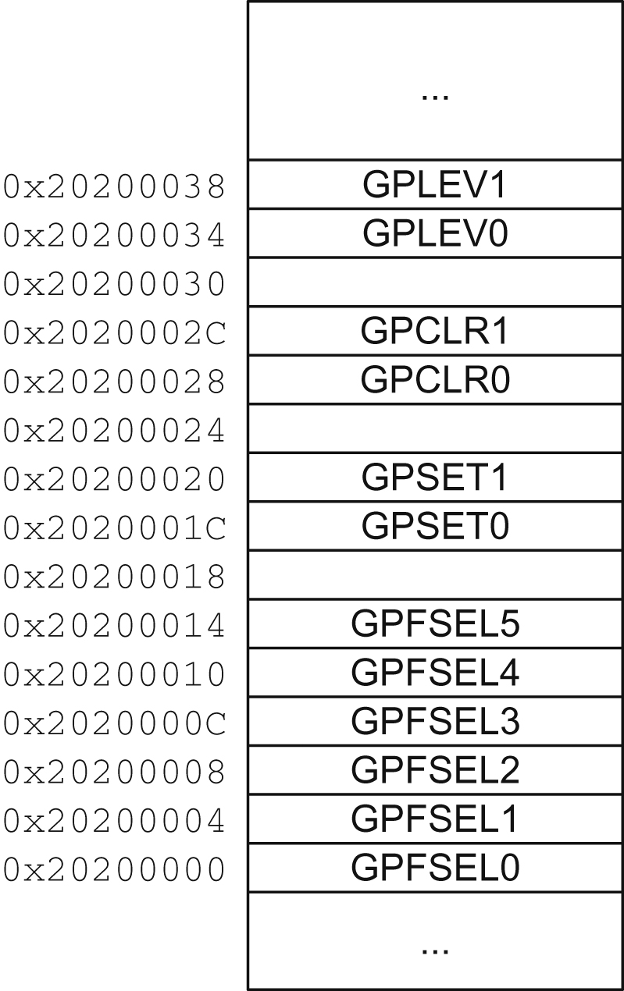
Figure e9.5 GPIO memory map

Slide 7
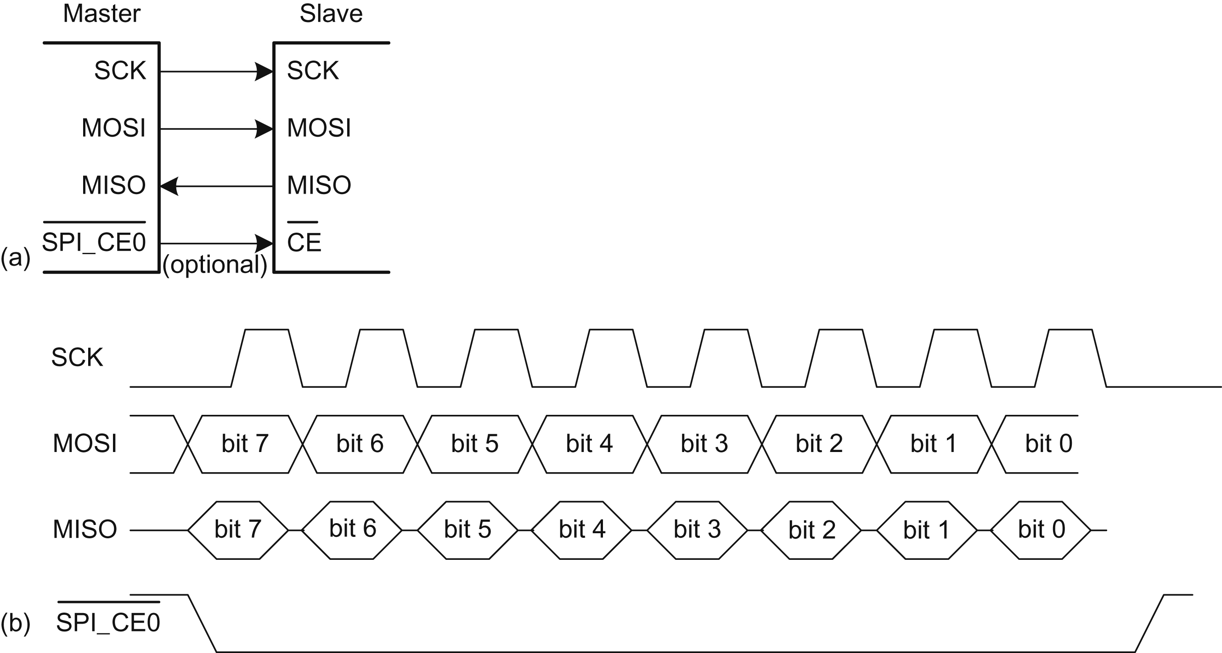
Figure e9.6 SPI connection and waveforms

Slide 8
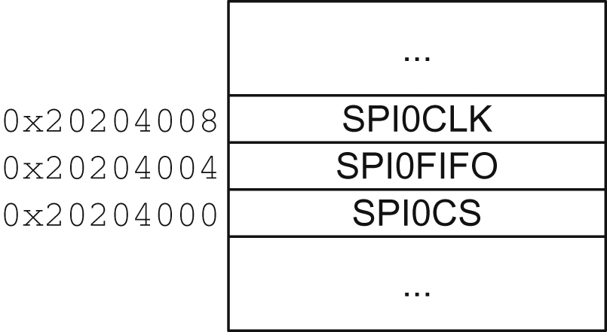
Figure e9.7 SPI Master Port 0 registers

Slide 9
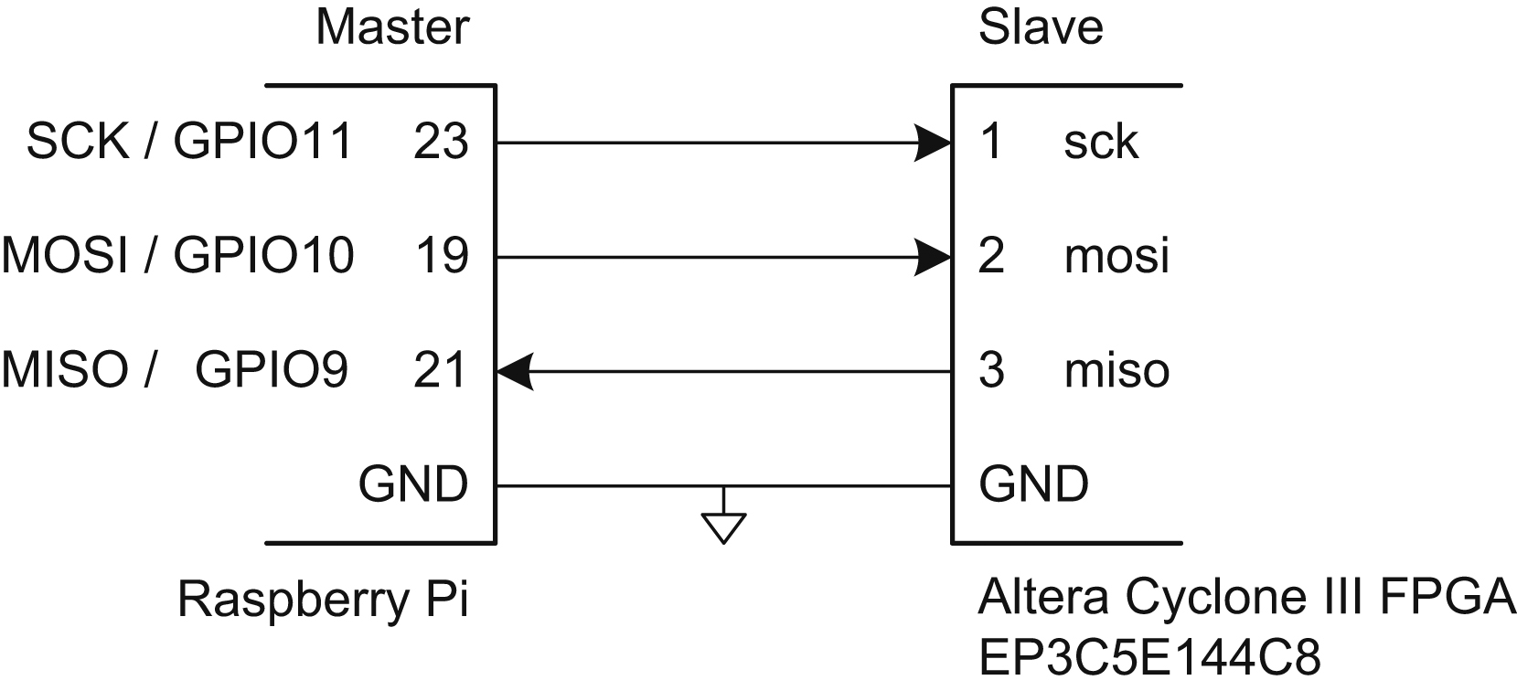
Figure e9.8 SPI connection between Pi and FPGA

Slide 10
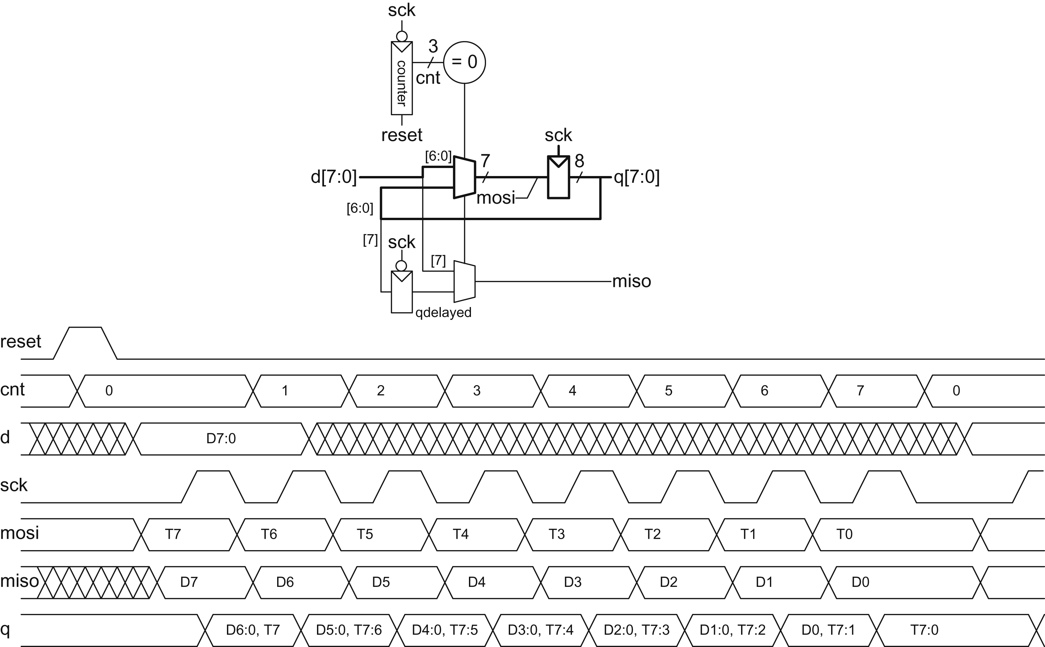
Figure e9.9 SPI slave circuitry and timing

Slide 11
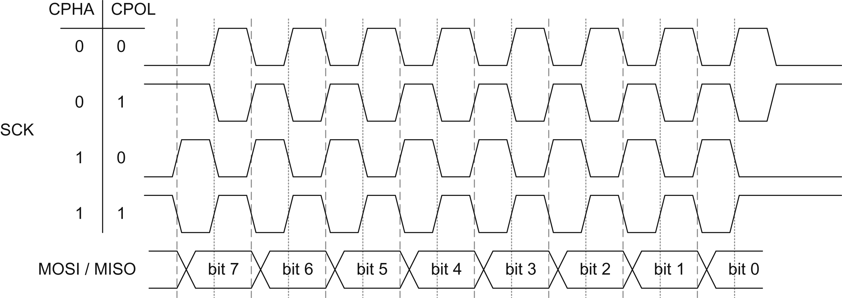
Figure e9.10 SPI clock and data timing configurations

Slide 12
Figure e9.11 Asynchronous serial link

Slide 13
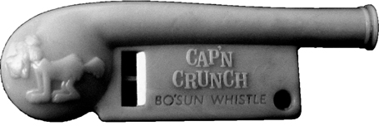
Figure e9.12 Cap’n Crunch Bosun Whistle. (Photograph by Evrim Sen, reprinted with permission

Slide 14
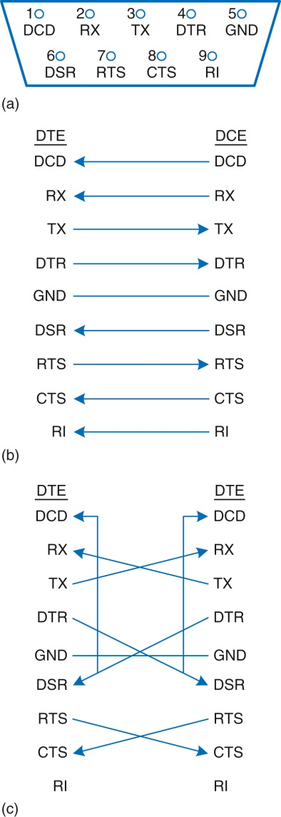
Figure e9.13 DE-9 male cable (a) pinout, (b) standard wiring, and (c) null modem wiring

Slide 15
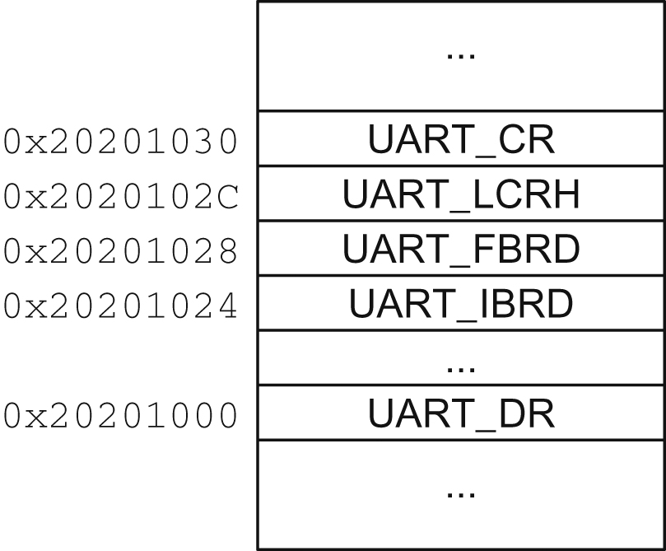
Figure e9.14 UART0 registers

Slide 16
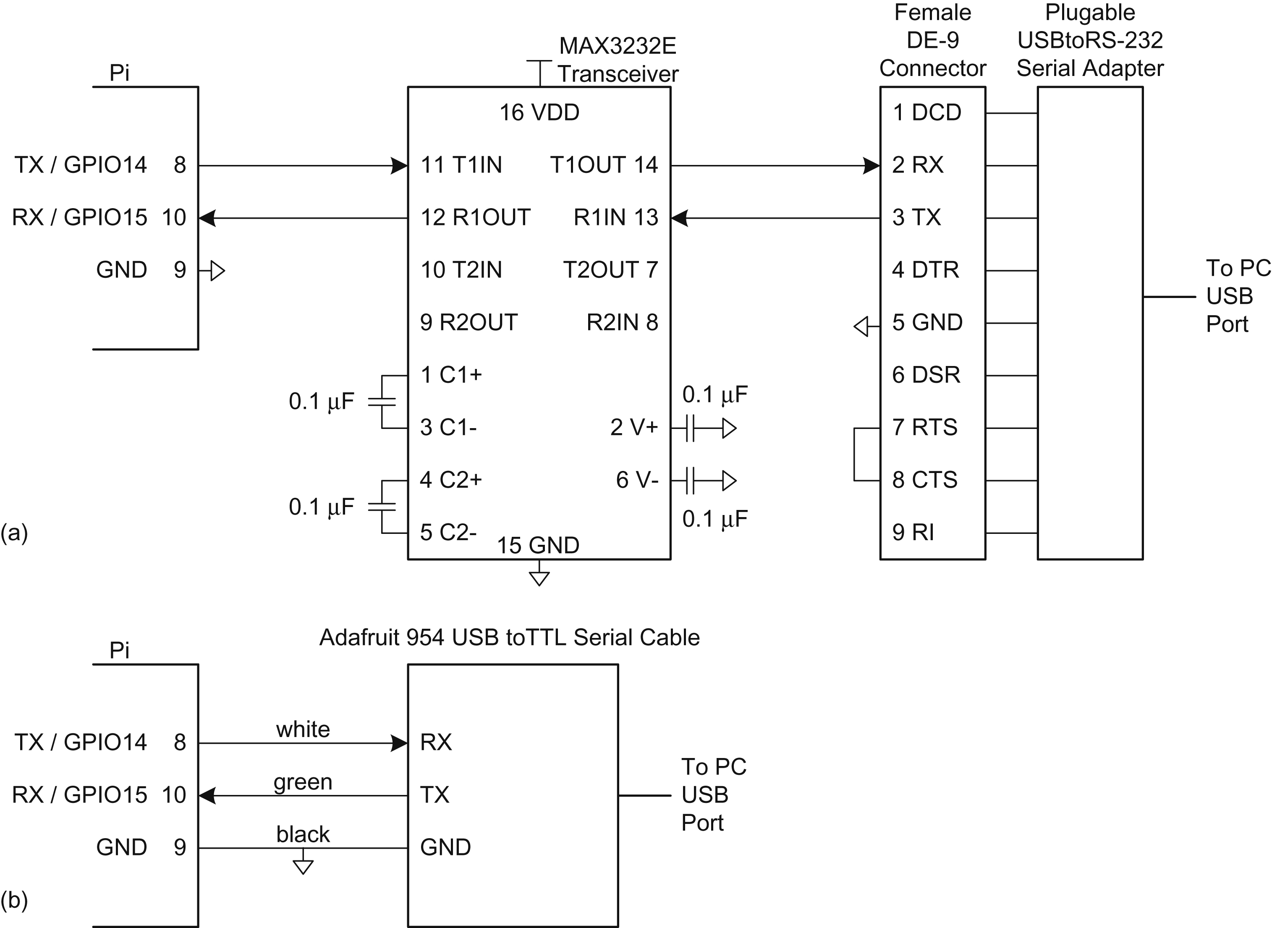
Figure e9.15 Raspberry Pi to PC serial link (a) Plugable cable, (b) Adafruit cable

Slide 17
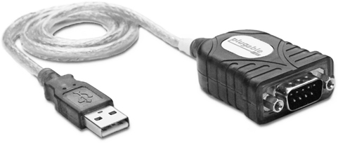
Figure e9.16 Plugable USB to RS-232 DB9 serial adapter. (© 2012 Plugable Technologies; reprinted with permission.)

Slide 18
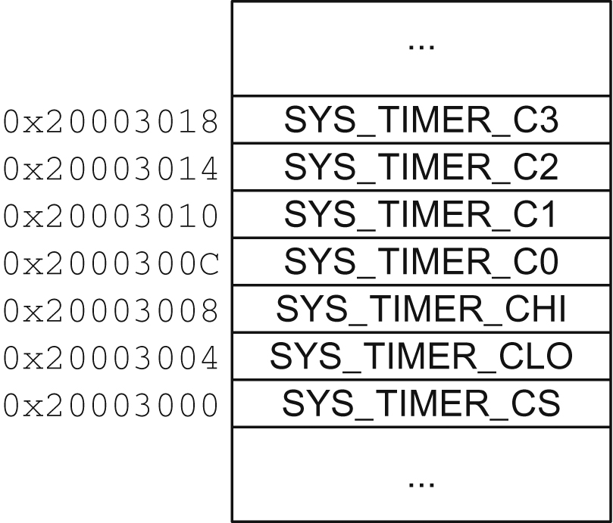
Figure e9.17 System timer registers

Slide 19
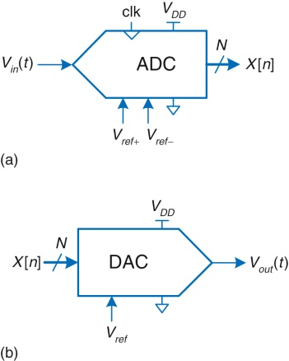
Figure e9.18 ADC and DAC symbols

Slide 20
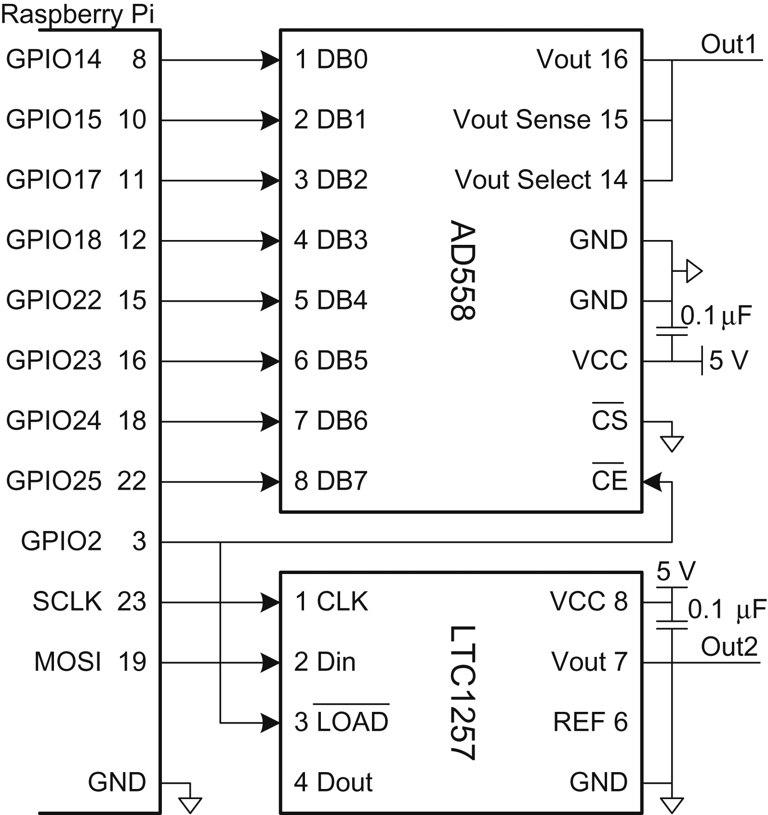
Figure e9.19 DAC parallel and serial interfaces to a Raspberry Pi

Slide 21
Figure e9.20 Pulse-width modulated (PWM) signal

Slide 22
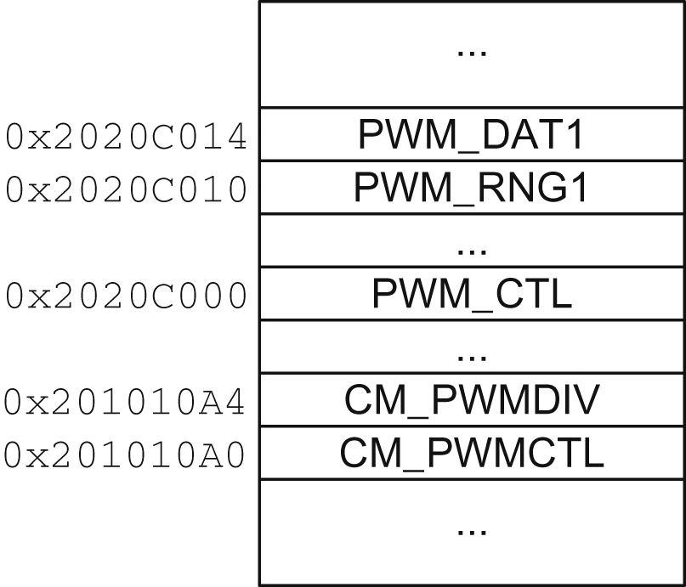
Figure e9.21 PWM and clock manager registers

Slide 23
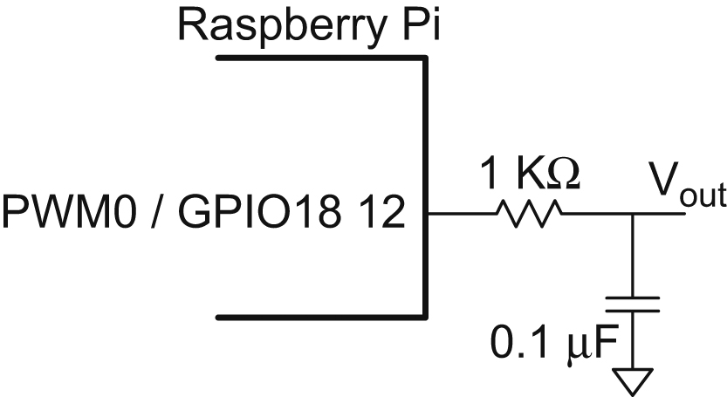
Figure e9.22 Analog output using PWM and low-pass filter

Slide 24
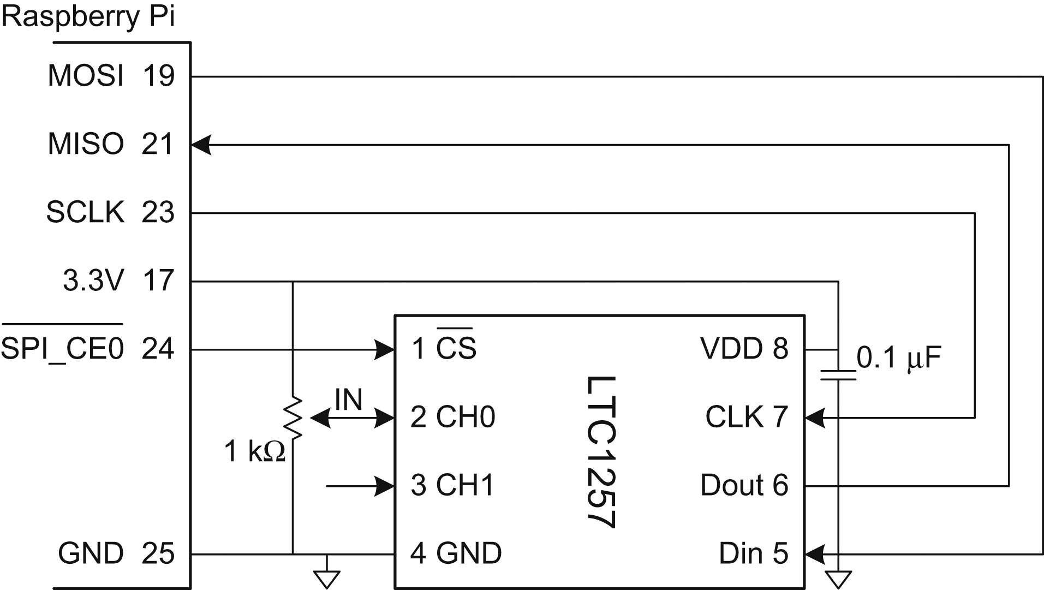
Figure e9.23 Analog input using external ADC

Slide 25
Figure e9.24 Crystalfontz CFAH2002A-TMI 20×2 character LCD. (© 2012 Crystalfontz America; reprinted with permission.)

Slide 26
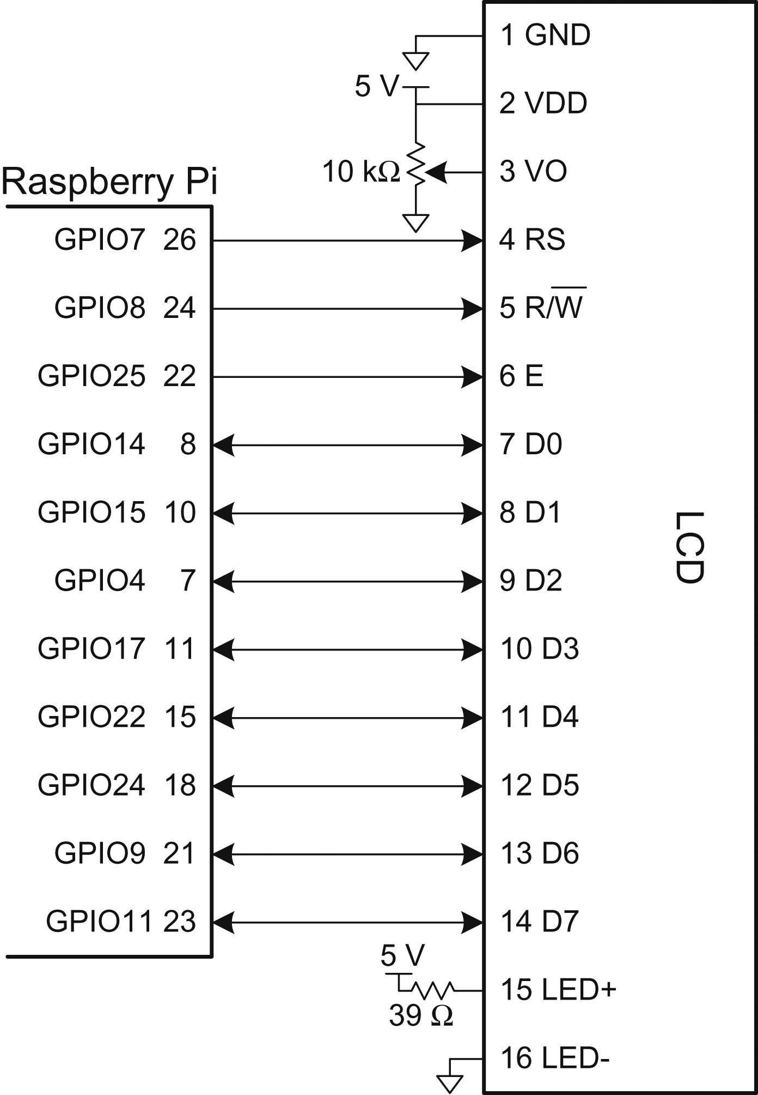
Figure e9.25 Parallel LCD interface

Slide 27
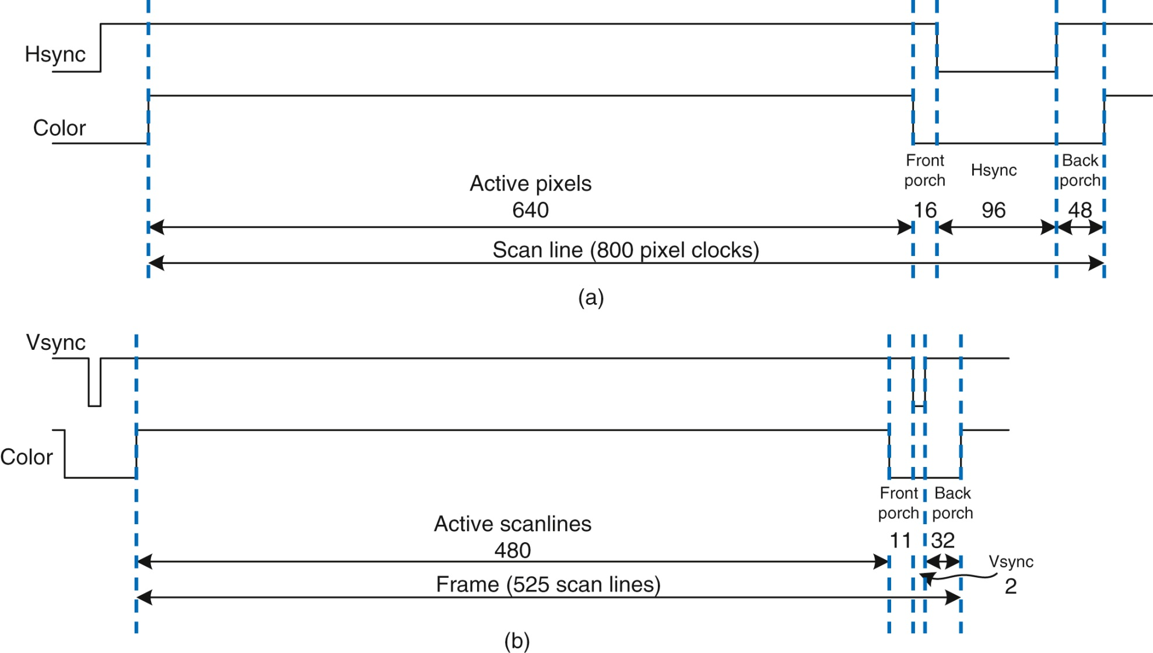
Figure e9.26 VGA timing: (a) horizontal, (b) vertical

Slide 28
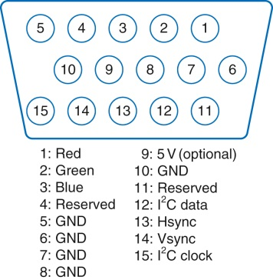
Figure e9.27 VGA connector pinout

Slide 29
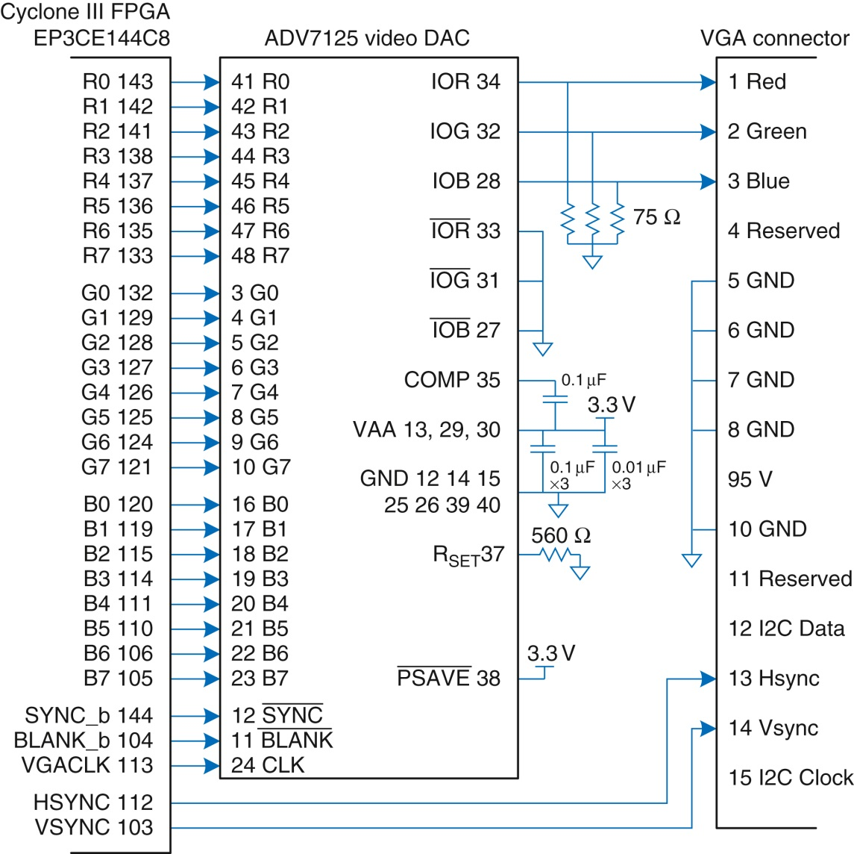
Figure e9.28 FPGA driving VGA cable through video DAC

Slide 30
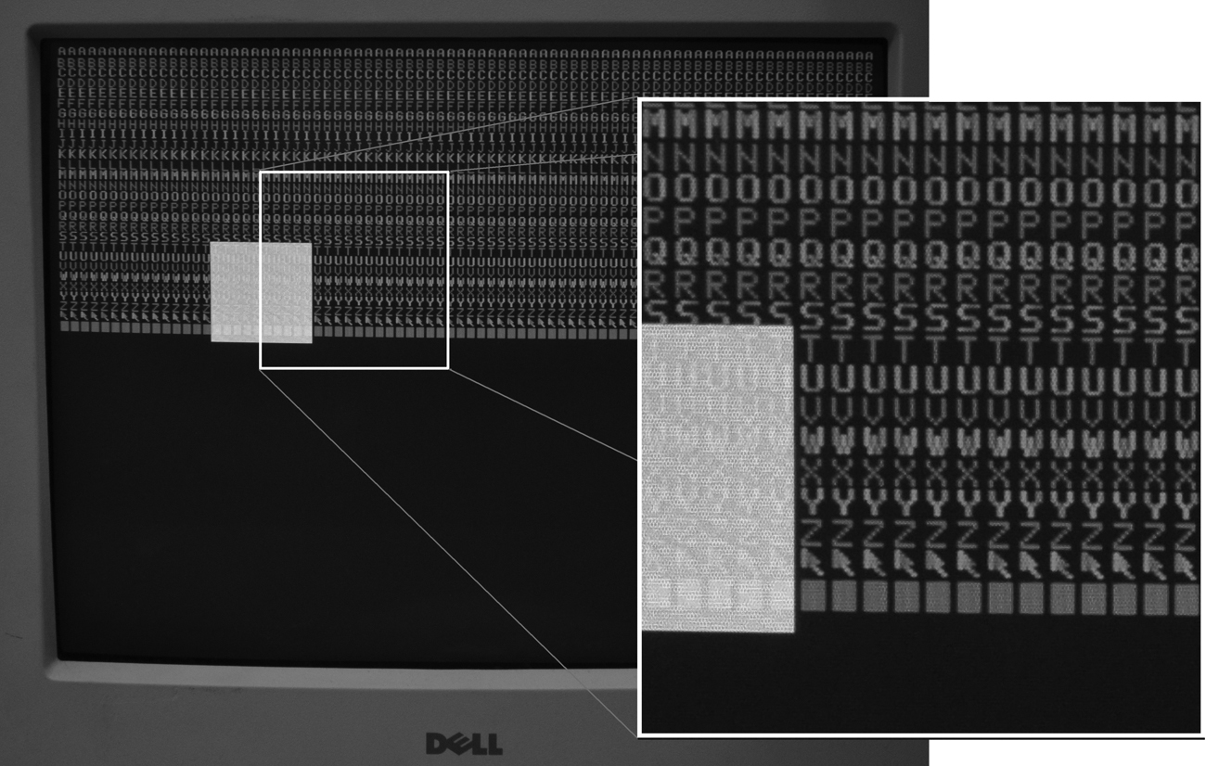
Figure e9.29 VGA output

Slide 31
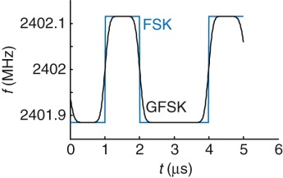
Figure e9.30 FSK and GFSK waveforms

Slide 32
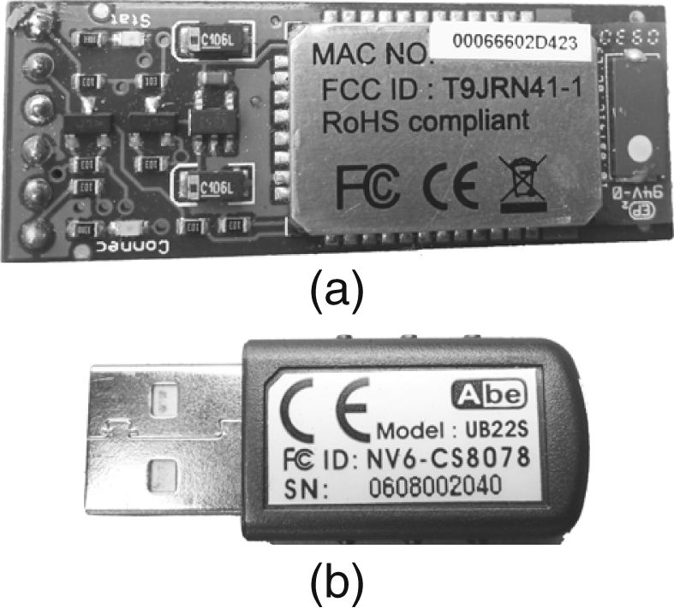
Figure e9.31 BlueSMiRF module and USB dongle

Slide 33
Figure e9.32 BlueSMiRF Raspberry Pi to PC link

Slide 34
Figure e9.33 DC motor

Slide 35
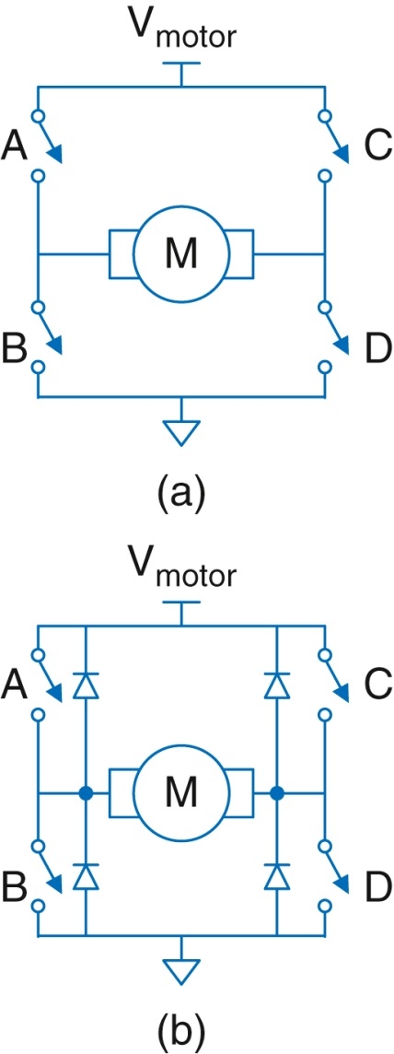
Figure e9.34 H-bridge

Slide 36
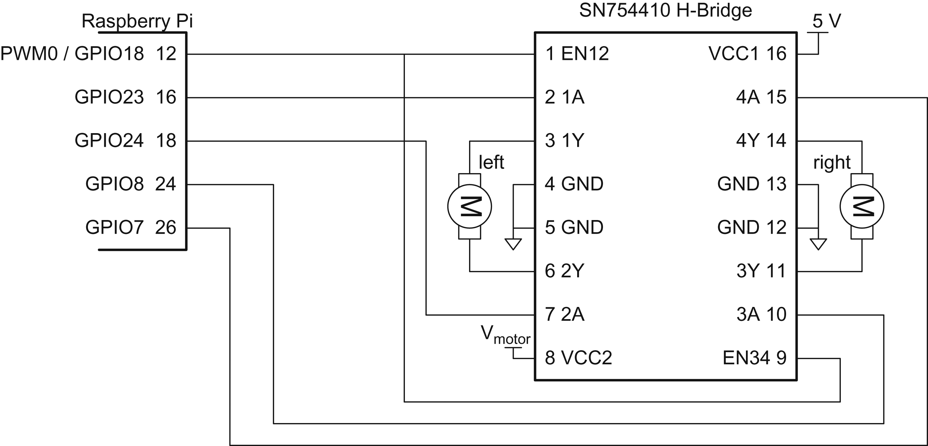
Figure e9.35 Motor control with dual H-bridge

Slide 37
Figure e9.36 Shaft encoder (a) disk, (b) quadrature outputs

Slide 38
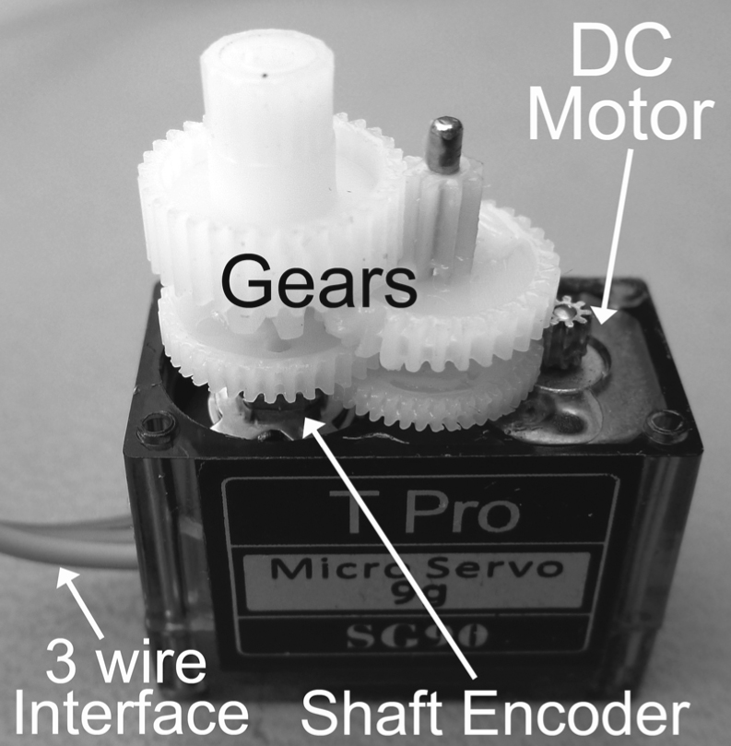
Figure e9.37 SG90 servo motor

Slide 39
Figure e9.38 Servo control waveform

Slide 40
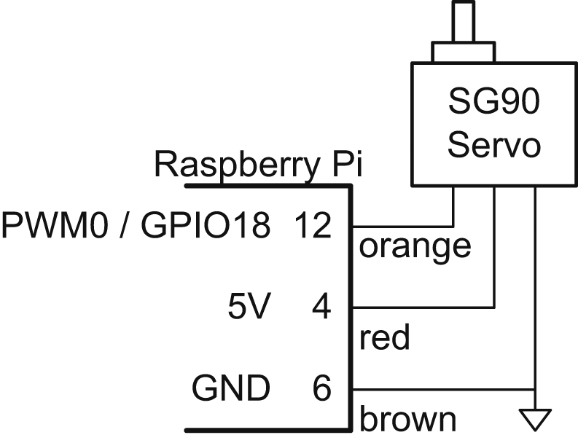
Figure e9.39 Servo motor control

Slide 41
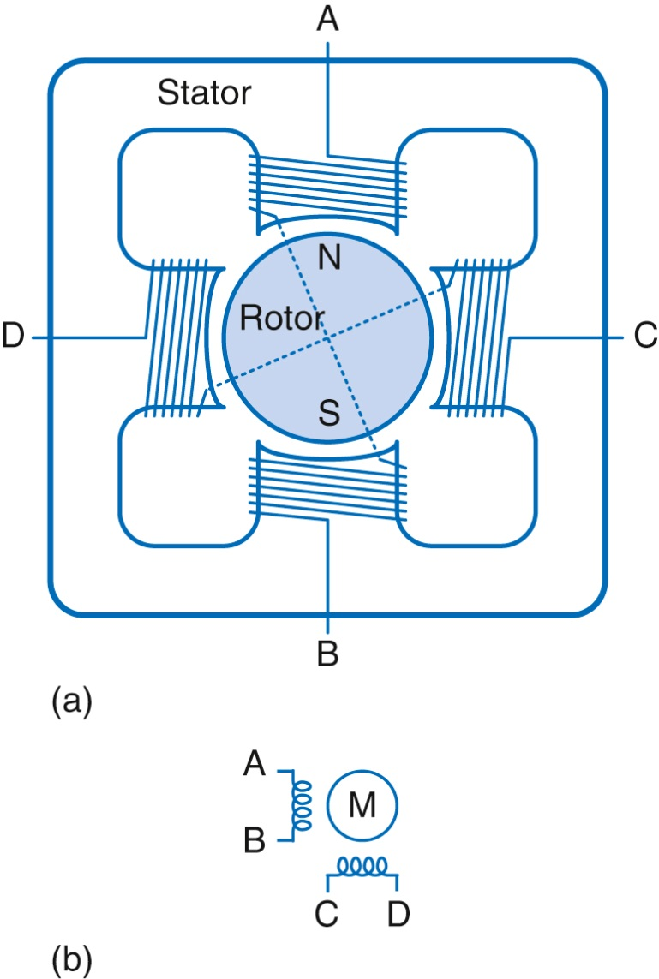
Figure e9.40 Two-phase bipolar motor: (a) simplified diagram, (b) symbol

Slide 42
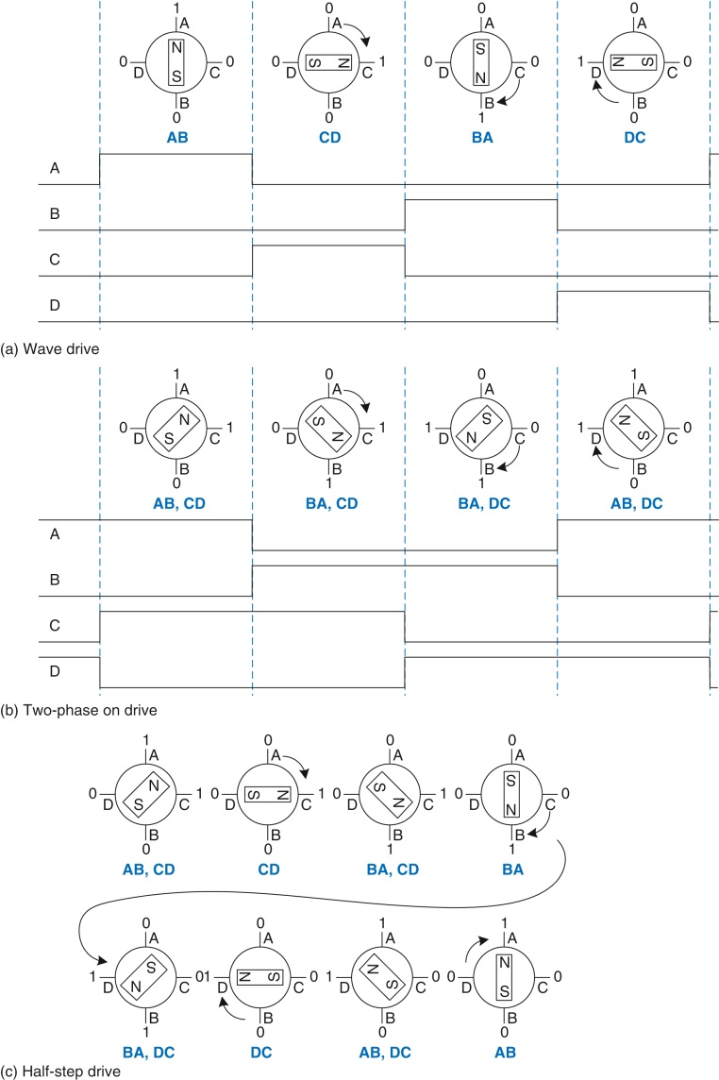
Figure e9.41 Bipolar motor drive

Slide 43
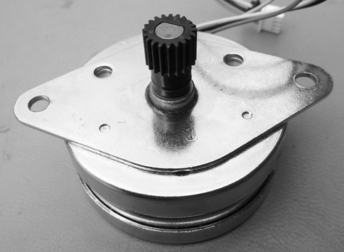
Figure e9.42 AIRPAX LB82773-M1 bipolar stepper motor

Slide 44
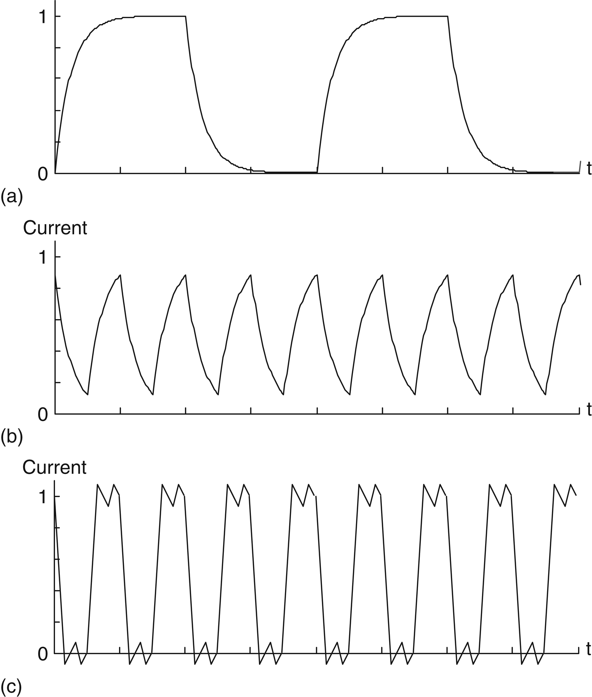
Figure e9.43 Bipolar stepper motor direct drive current: (a) slow rotation, (b) fast rotation, (c) fast rotation with chopper drive

Slide 45
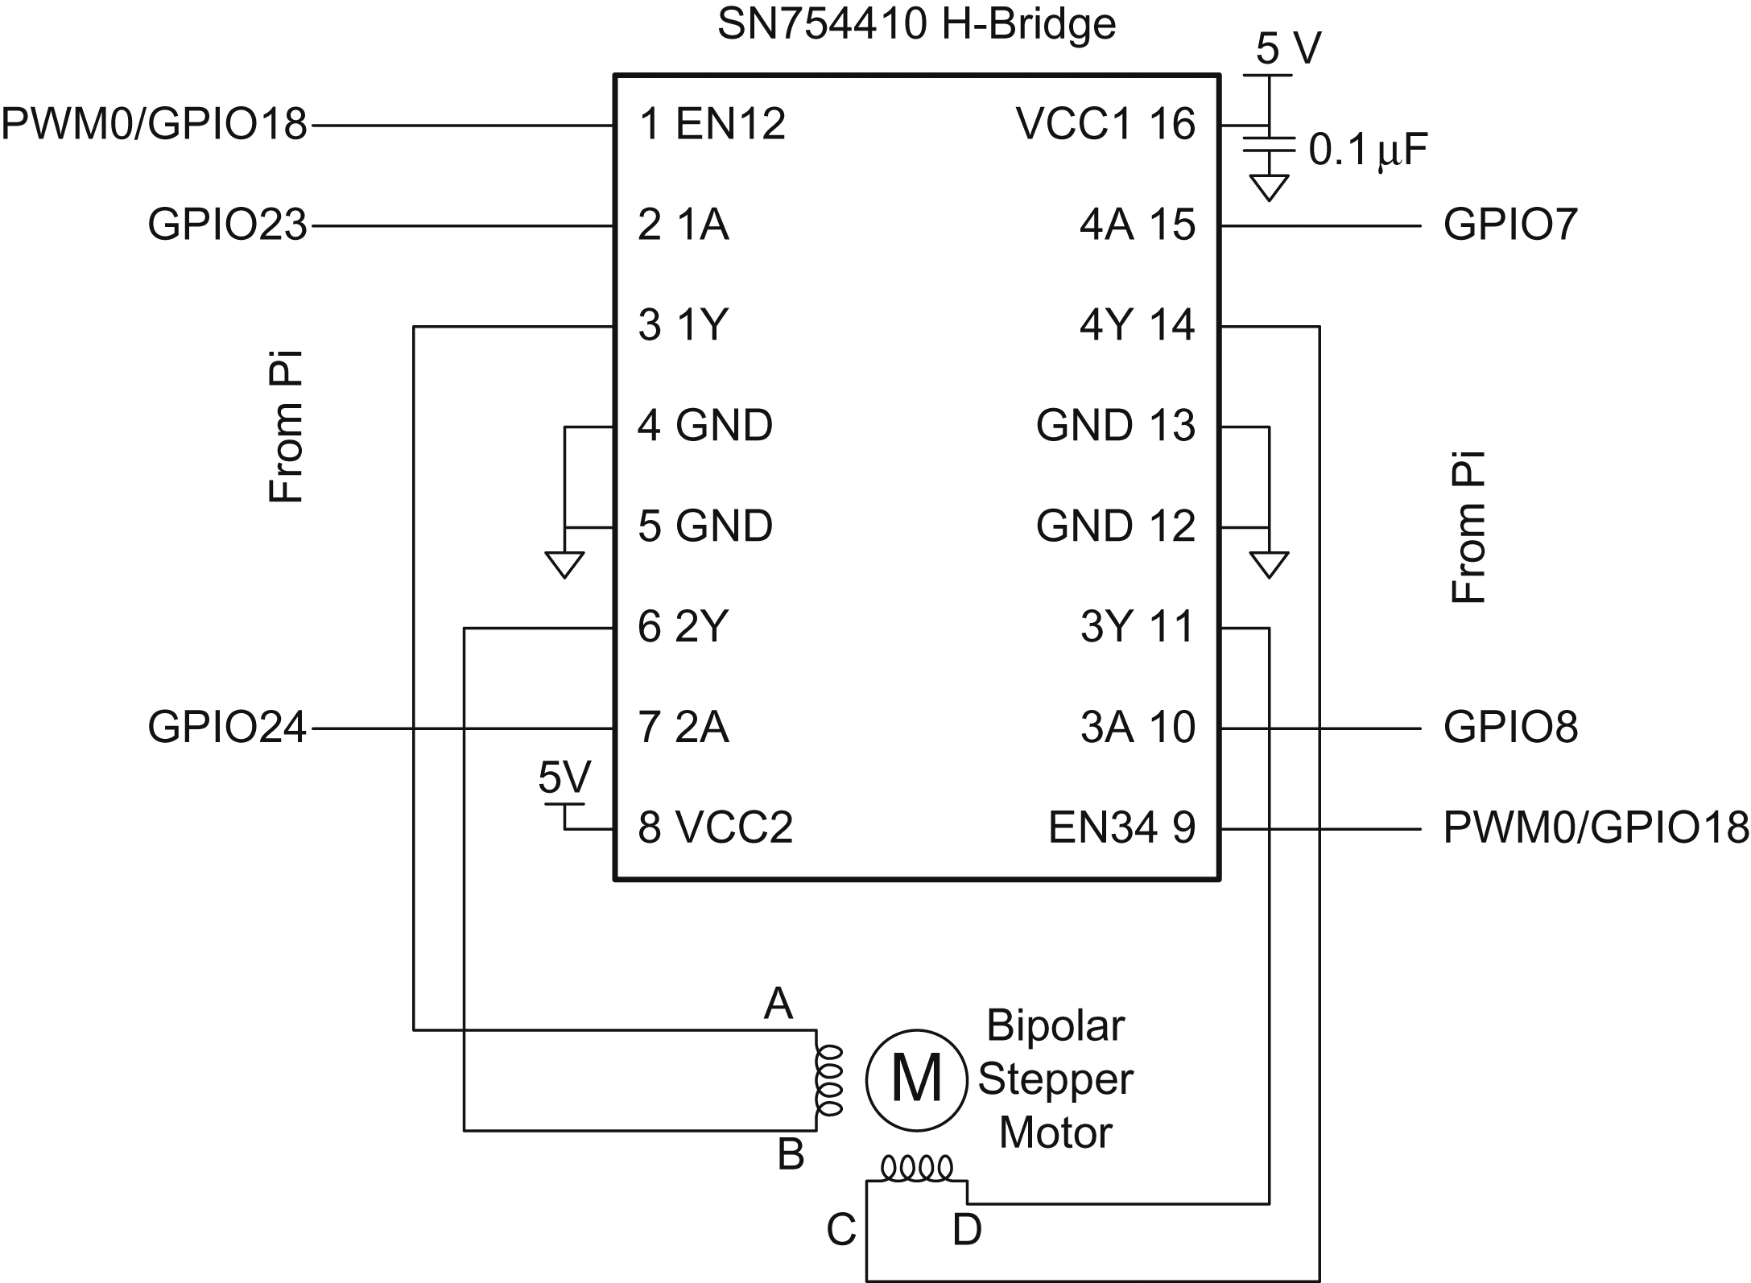
Figure e9.44 Bipolar stepper motor direct drive with H-bridge

Slide 46
Figure e9.45 AHB-Lite bus

Slide 47
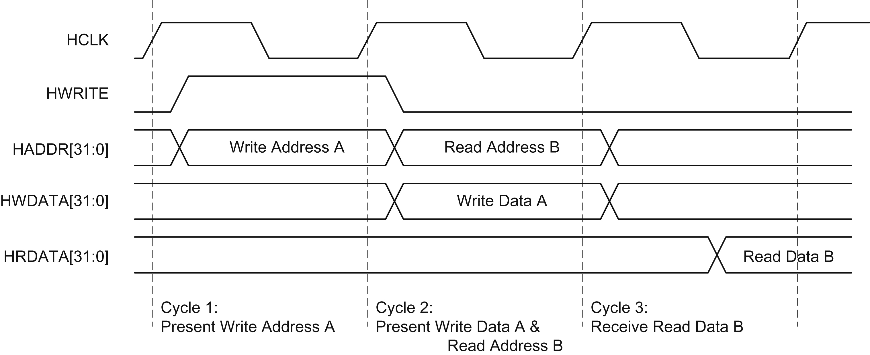
Figure e9.46 AHB-Lite transfer timing

Slide 48
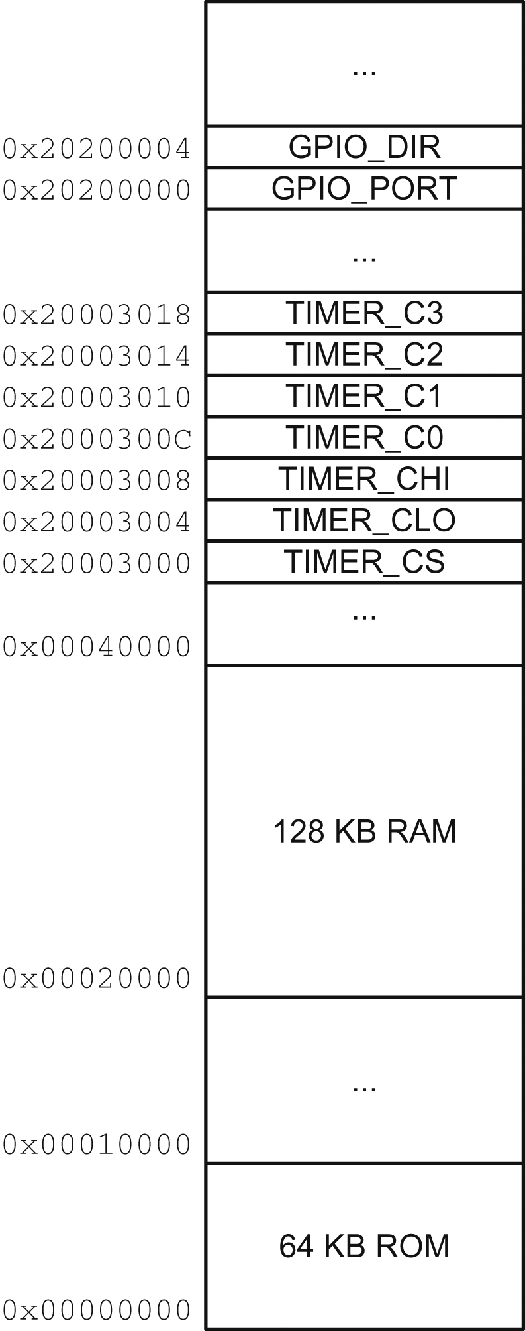
Figure e9.47 System memory map

Slide 49
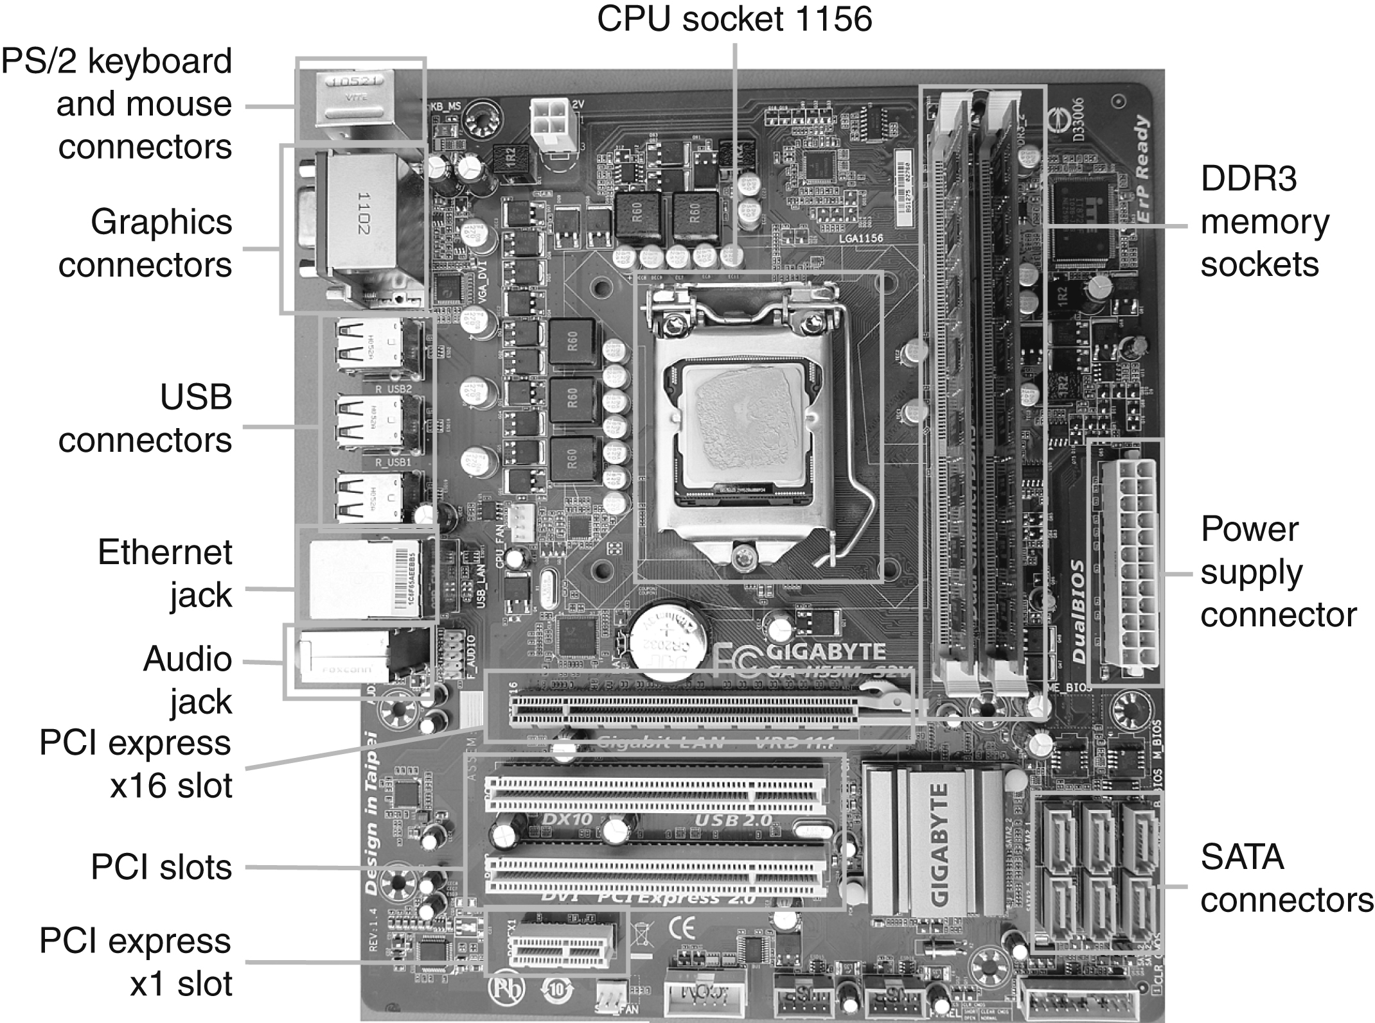
Figure e9.48 Gigabyte GA-H55M-S2V motherboard

Slide 50
Figure e9.49 DDR3 memory module

Slide 51
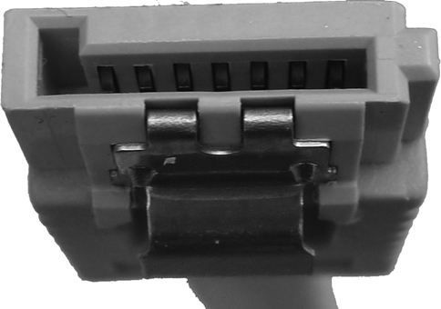
Figure e9.50 SATA cable

Slide 52
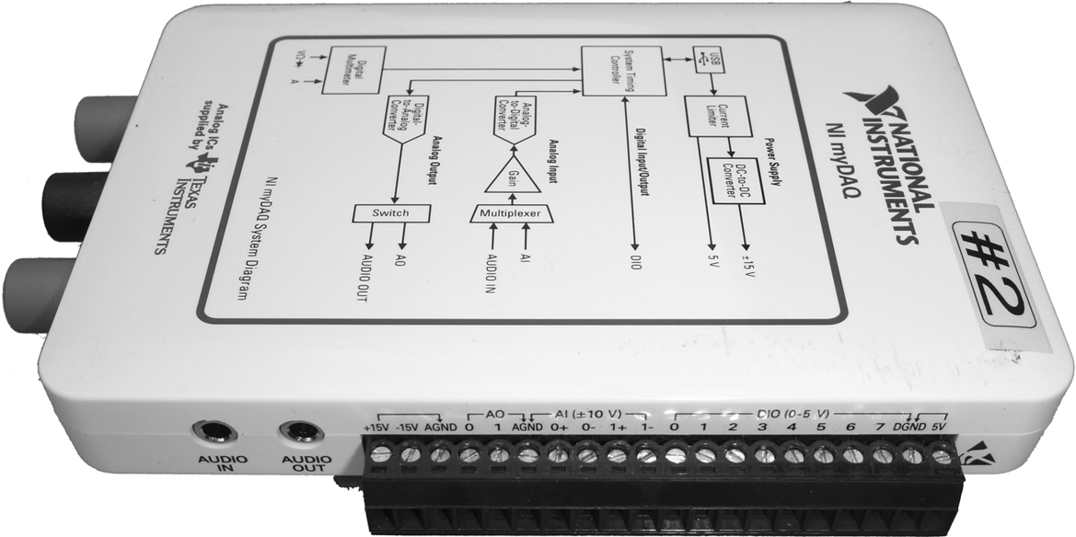
Figure e9.51 NI myDAQ

Slide 53
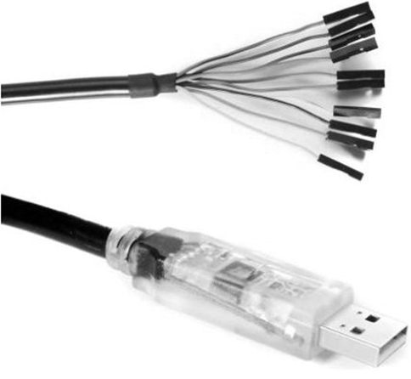
Figure e9.52 FTDI USB to MPSSE cable. (© 2012 by FTDI; reprinted with permission.)

Slide 54
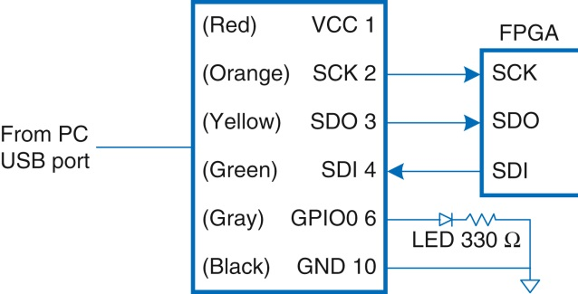
Figure e9.53 C232HM-DDHSL USB to MPSESE interface from PC to FPGA

Slide 55
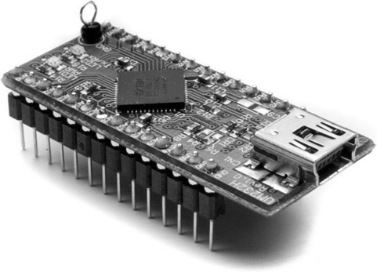
Figure e9.54 FTDI UM232H module. (© 2012 by FTDI; reprinted with permission.)

Slide 56
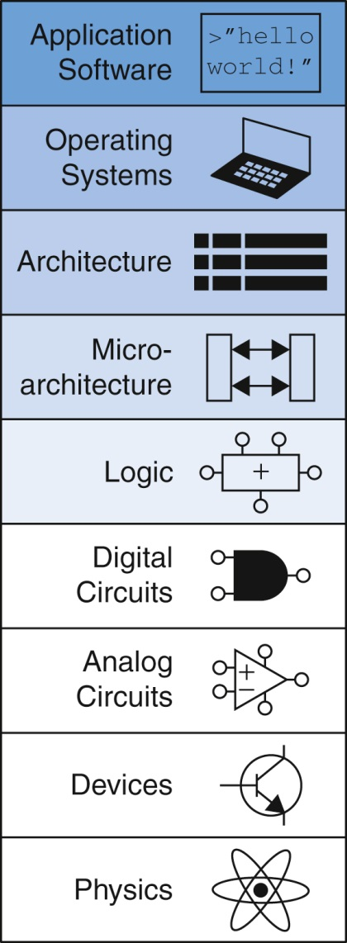
Figure U09O-01

