Slide 1
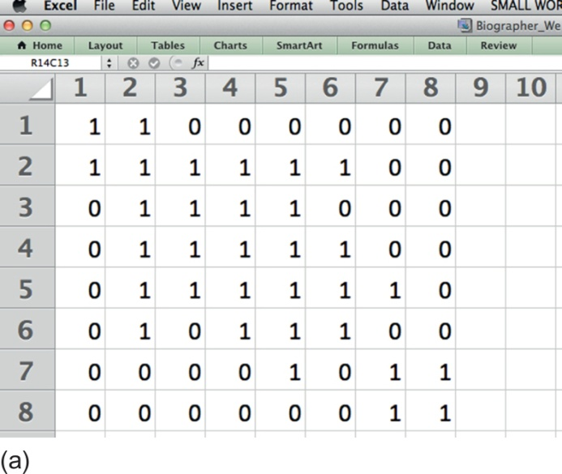
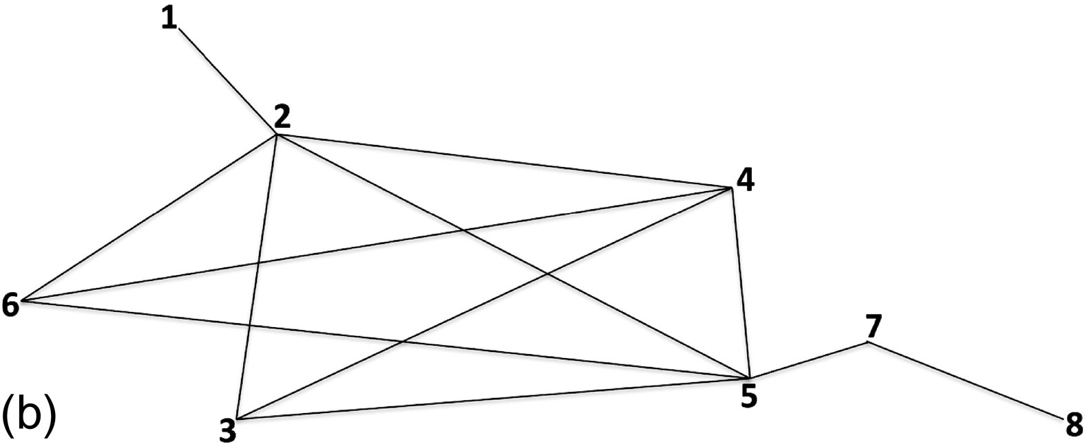
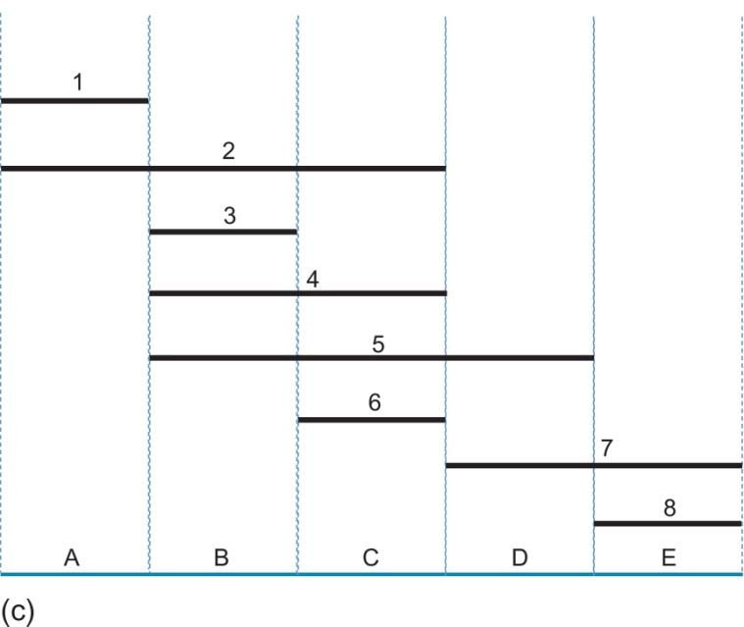
Notes:
FIGURE 1.1 The connection between adjacency matrices, intersection graphs, and interval graphs. (a) The adjacency matrix from the
experimental biological determination of which intervals of finite lengths (fragments, sequences, deletions, etc.) overlap one another.
(b) The corresponding intersection graph of the adjacency matrix connects two vertices u and v with an edge if and only if the intervals
u and v overlap. (c) An interval graph is a set of intervals of finite lengths arranged along a line where the rows represent the intervals of
finite lengths (fragments, sequences, deletions, etc.) and the columns are labeled at the bottom according to the maximal cliques in the
intersections graph (Maximal Clique A: 1 and 2; Maximal Clique B: 2, 3, 4, and 5; Maximal Clique C: 2, 4, 5, and 6; Maximal Clique
D: 5 and 7; Maximal Clique E: 7 and 8). Note that there should be no horizontal gap between adjacent maximal cliques as that would
mean that we have information that cliques which are not maximal exist in such regions (e.g., in Panel c, if interval 5 were shortened on
its right end and interval 8 were shortened on its left end, there would be a clique between intervals 5 and 8 that only contained interval
7 which is obviously not maximal because it is contained in both D and E, each of which contains more members).

Slide 2
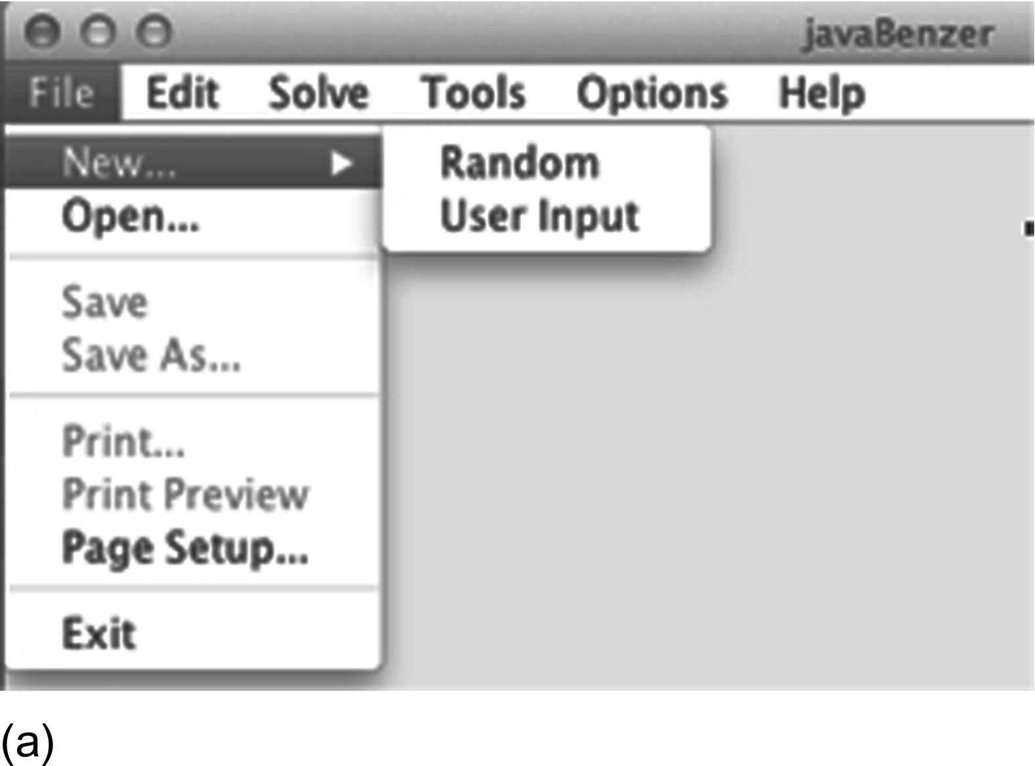
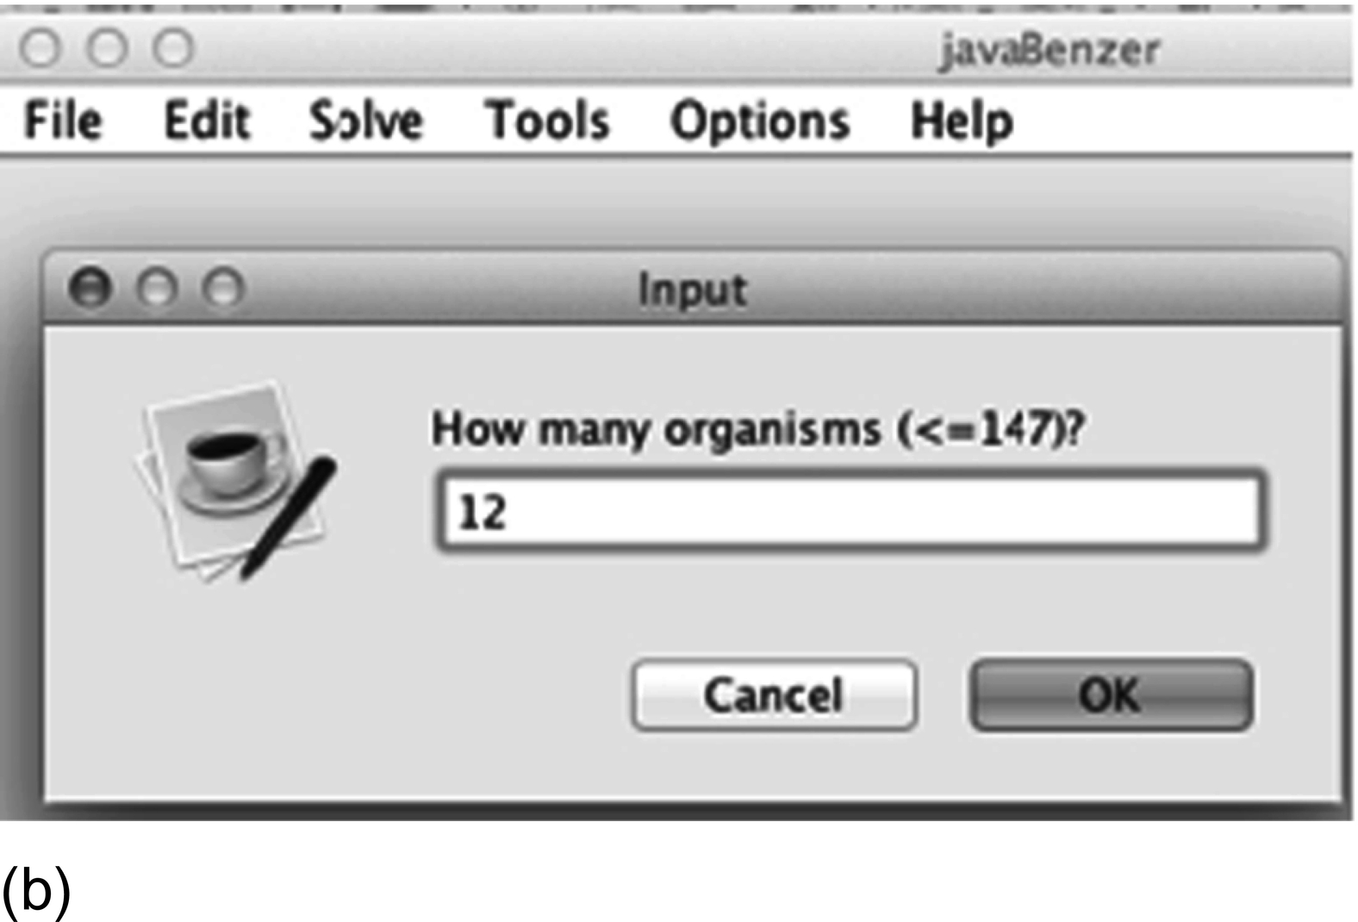
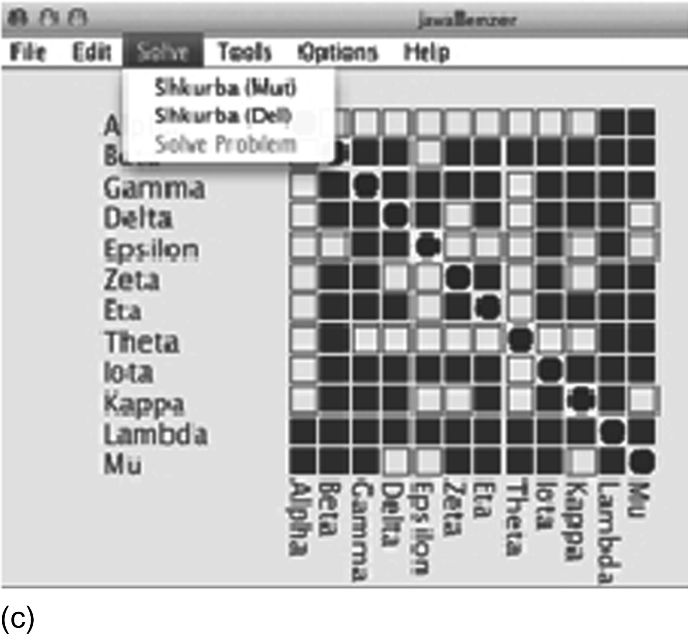
Notes:
FIGURE 1.2 The construction of the symmetrical matrix that shows which fragments overlap with one another in javaBenzer [21].
(a) Choice of user input. (b) Choice of the number of “organisms” (these could be the fragments as above or they could be genes,
proteins, metabolites, etc.; mathematically, in graph theory, these are vertices of a graph). (c) The symmetrical matrix is the adjacency
matrix for the graph and was generated by filling any cell in row i, column j if the fragments overlap with one another according to logic
described above. The empty cells correspond to non-overlapping fragments.

Slide 3
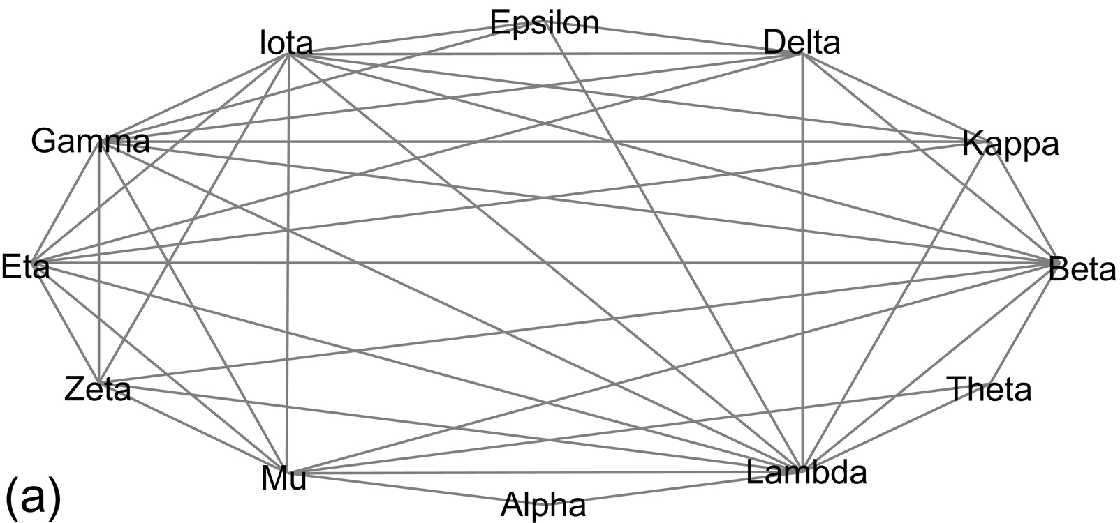
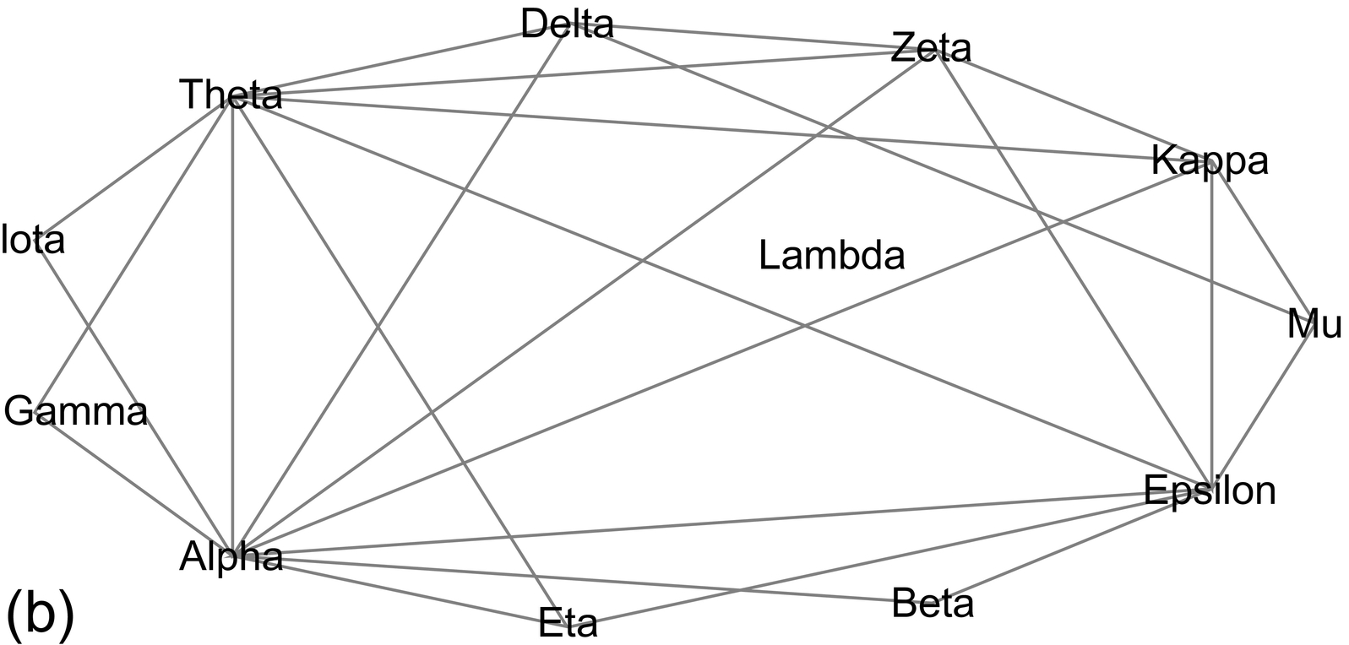
Notes:
FIGURE 1.3 Intersection and complementary graphs. (a) Intersection graph based on hypothetical sample graph data generated by
javaBenzer. (b) Complementary graph of the intersection graph in Figure 1.3a.

Slide 4
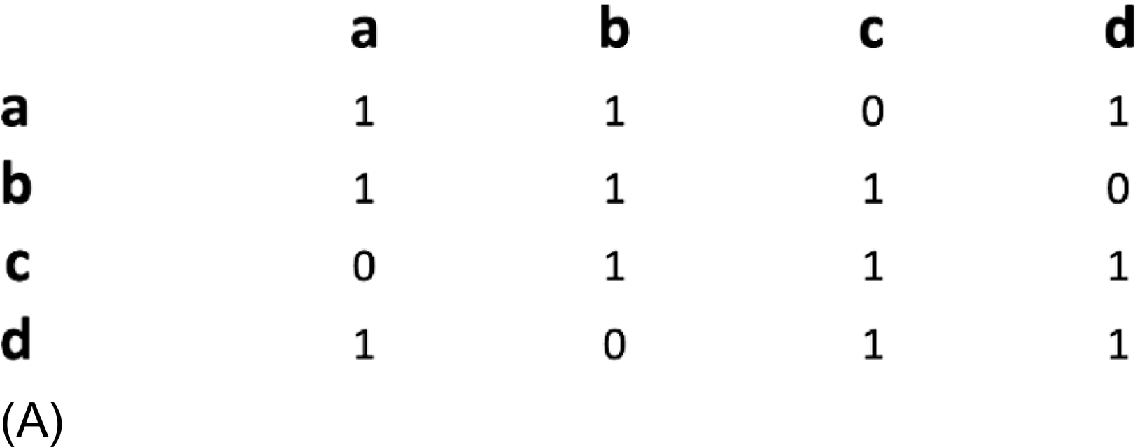
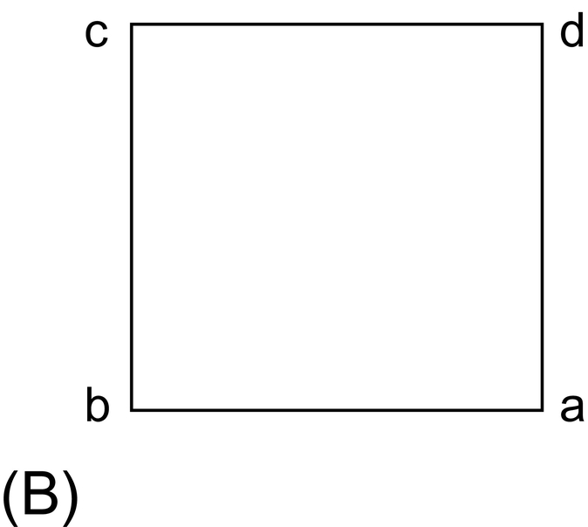
Notes:
FIGURE 1.4 Z4 implies a circular structure. (A) The successive overlapping of four fragments implied by the adjacency matrix on the
left (a) is represented by the intersection graph, a Z4, on the right. (B) The intersection graph of the overlaps in A is a Z4 (on the right).
Such representations imply a circular structure.

Slide 5
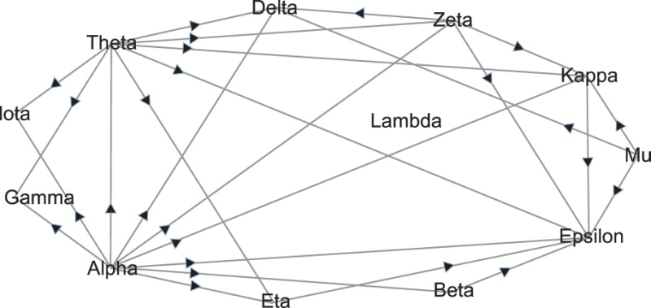
Notes:
FIGURE 1.5 The directed graph with transitively oriented labeling (arrows) superimposed upon the undirected complementary graph of
Figure 1.3b. Such graphs are called comparability graphs; see Ref. [28].

Slide 6
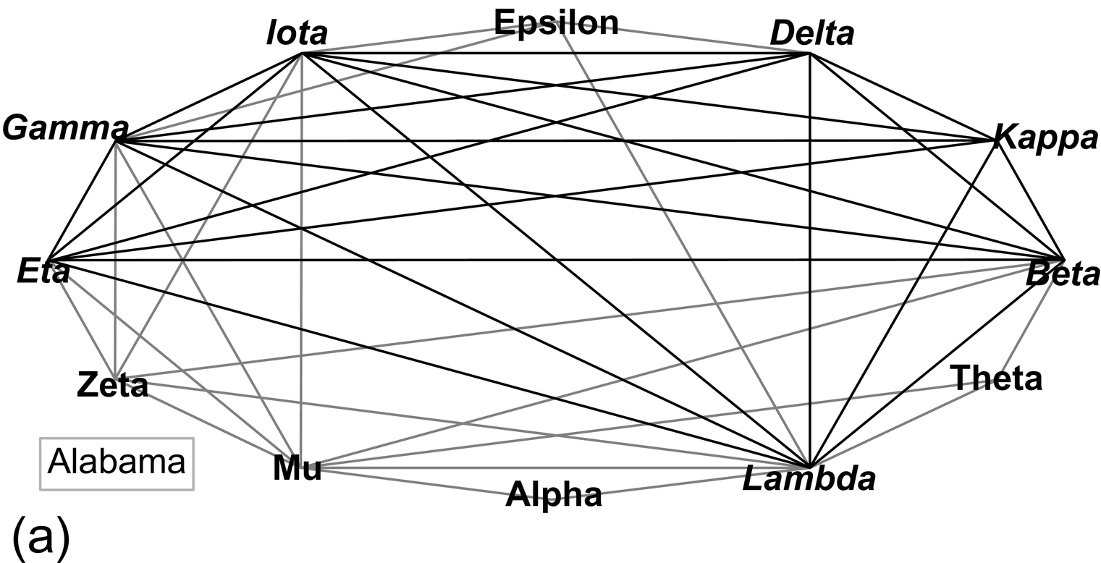
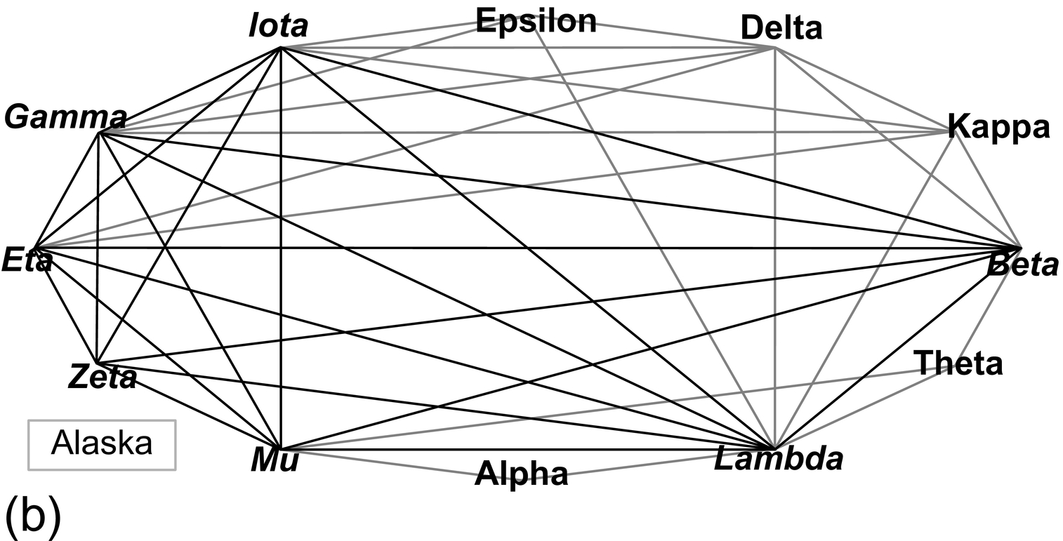
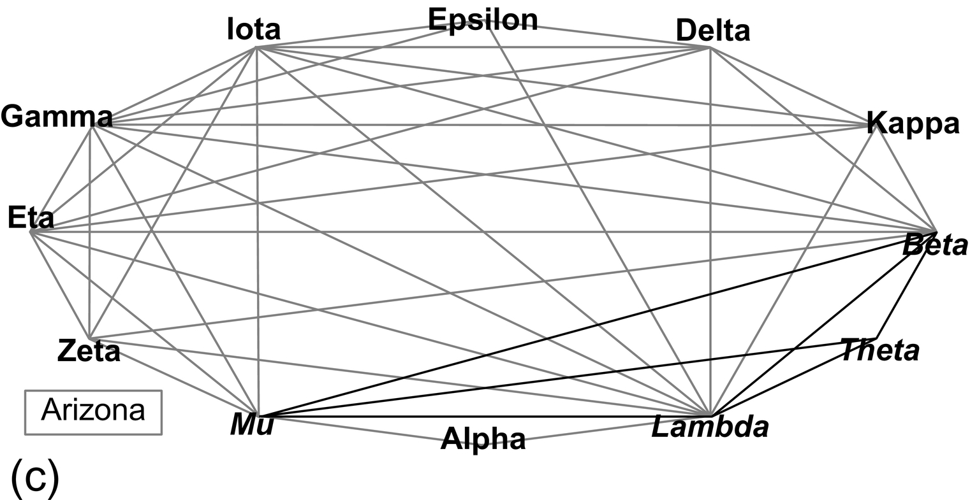
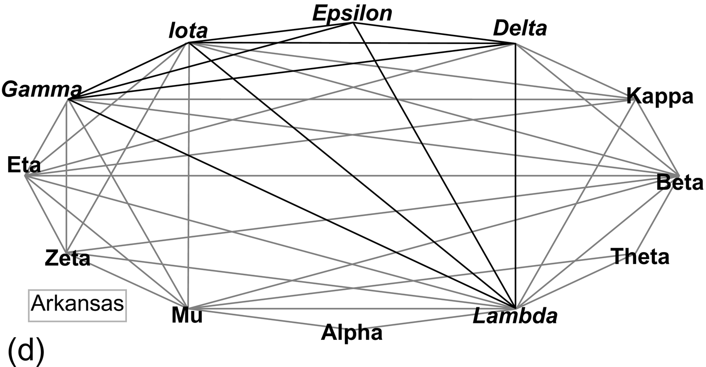
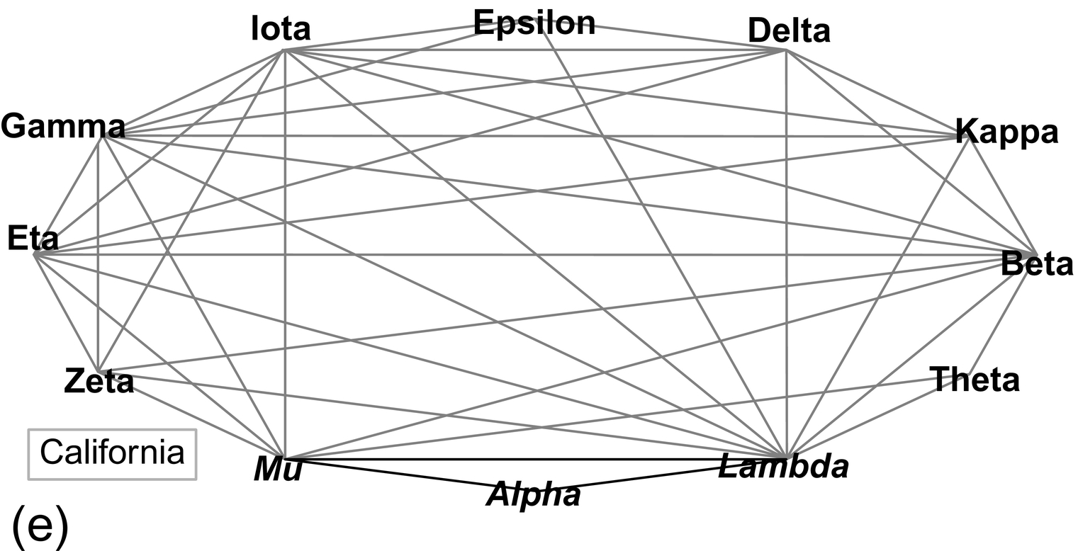
Notes:
FIGURE 1.6 The five maximal cliques in the original intersection graph of connected vertices (Figure 1.3a). (a) Alabama (maximal
clique) is a complete subgraph of the intersection graph containing the vertices beta, delta, eta, gamma, iota, kappa, and lambda.
(b) Alaska = beta, eta, gamma, iota, lambda, mu, and zeta. (c) Arkansas = delta, epsilon, gamma, iota, and lambda. (d) Arizona = beta,
lambda, mu, and theta. (e) California = alpha, mu, and lambda.

Slide 7
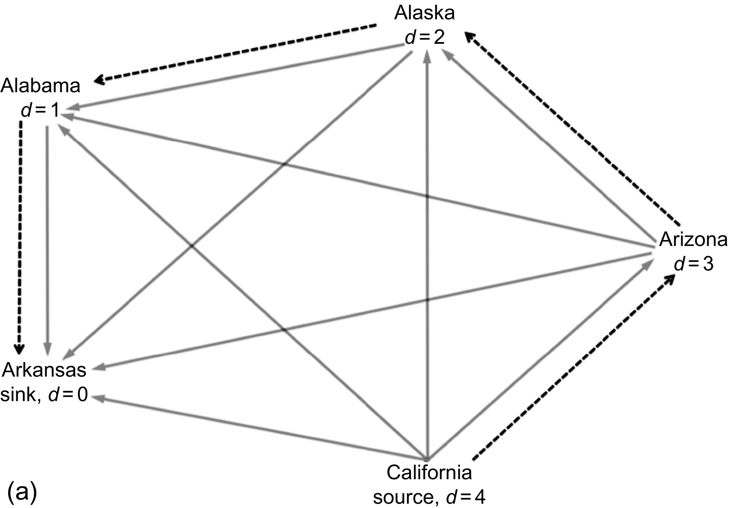
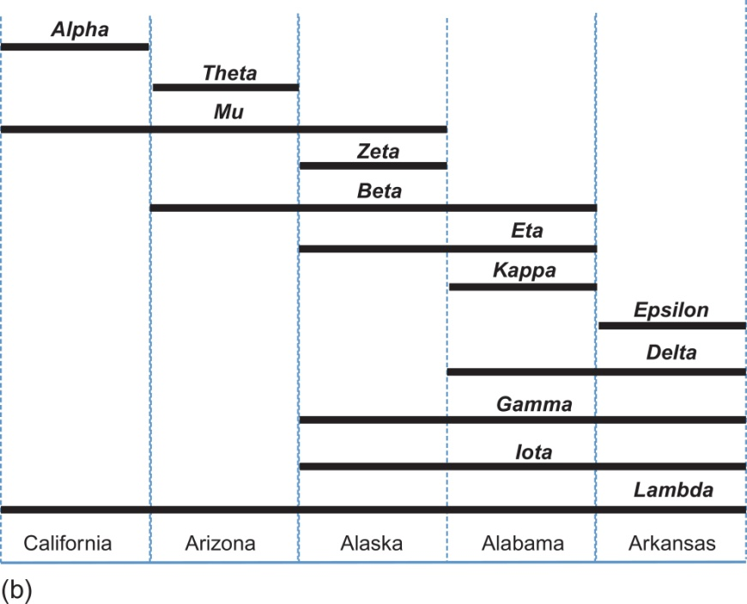
Notes:
FIGURE 1.7 Graphical representation of the Hamiltonian pathway of maximum cliques and interval graph constructed from the
Hamiltonian pathway. (a) The interior complete directed graph of five vertices shows the binary relations between each pair of maximal
cliques determined by the ordering of nonshared vertices in the maximal cliques from the arrows in the comparability graph (the
transitively ordered complementary graph). The dotted line is a Hamiltonian path of maximal cliques that is constructed by moving
from source (degree of outgoing edges equals 4) successively to each maximal clique vertex with one smaller outgoing degree until the
sink (outgoing degree equals zero) is reached. (b) The interval graph is constructed from the Hamiltonian path of maximal cliques. Each
maximal clique is represented at the bottom. Elements of each maximal clique are represented by horizontal line segments that cover
each maximal clique region to which they belong as a member. Please note that all such segments should be contiguous and thus no holes
should occur within any horizontal line. Note that the divisions between maximal cliques are demarcated at the top of the diagram by the
specificity of where particular restriction endonucleases cut the DNA.

Slide 8
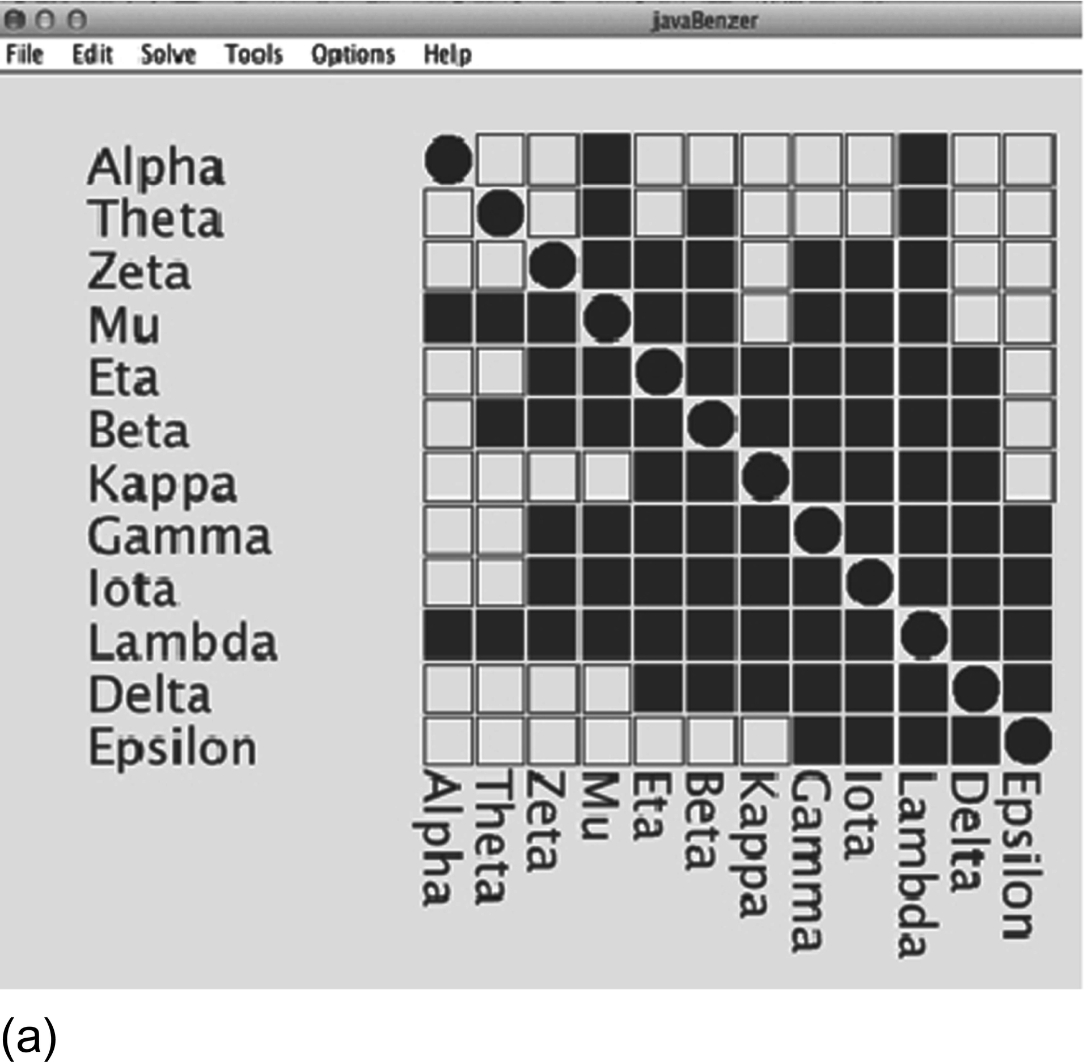
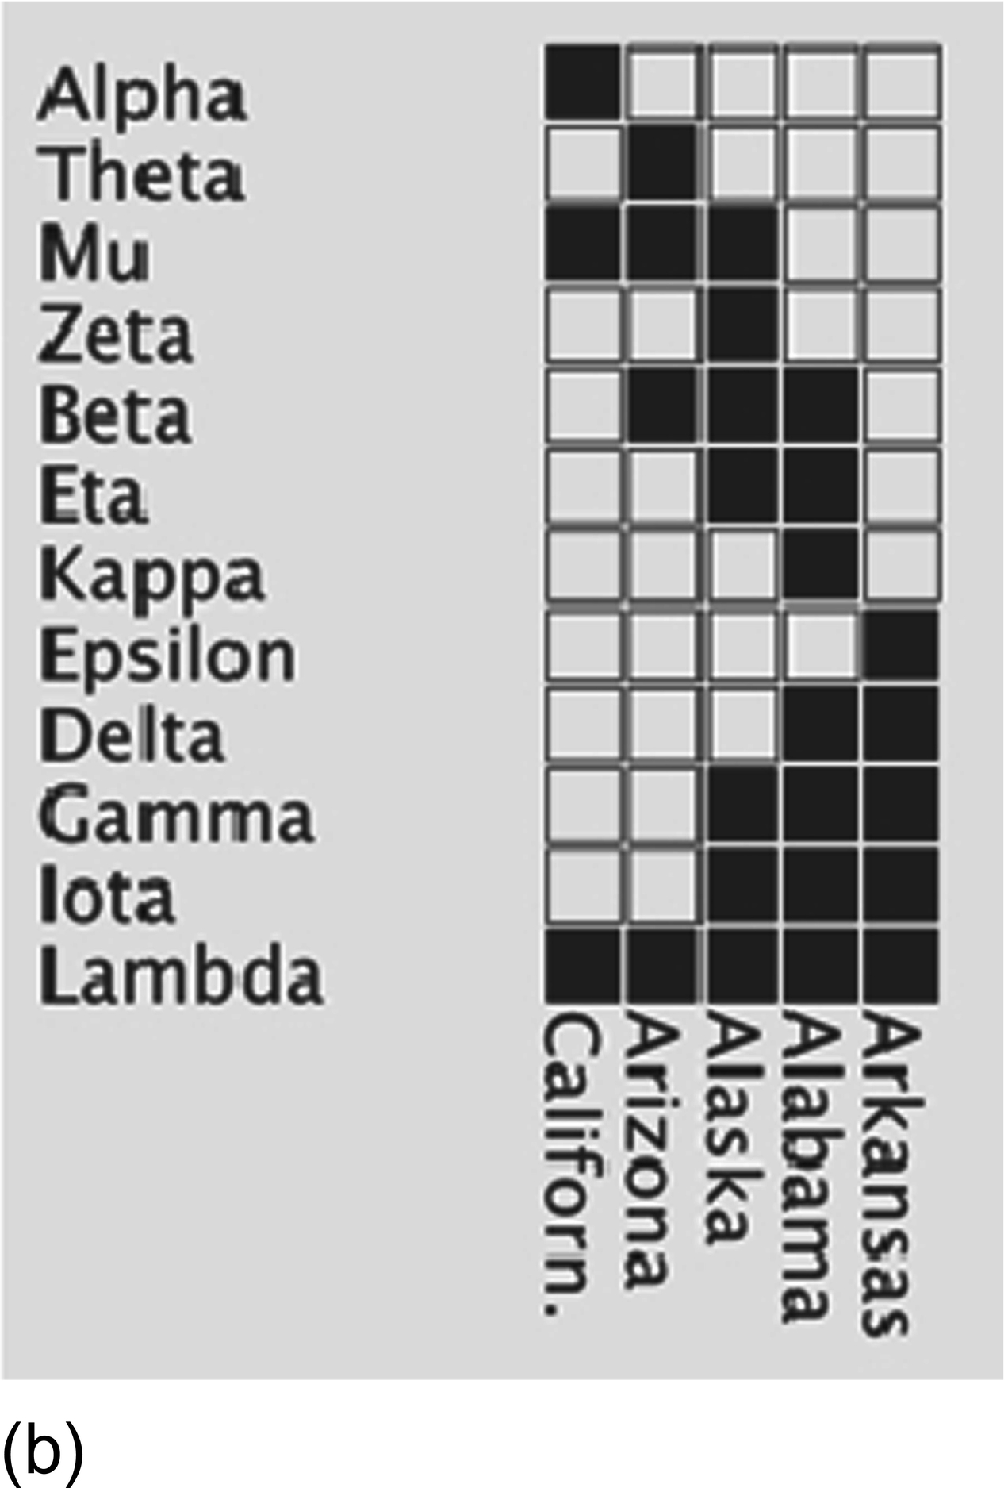
Notes:
FIGURE 1.8 Shkurba form [29] of adjacency matrix and the interval graph of maximum cliques. (a) The adjacency matrix in Figure 1.2c
has been rearranged to the Shkurba form. (b) The interval graph of the maximal cliques. Note that order is from the source maximal clique
California in the upper left of Figure 1.8a to the sink maximal clique Arkansas in the lower right corner of Figure 1.8a. Also, note that
this is a clique matrix.

Slide 9
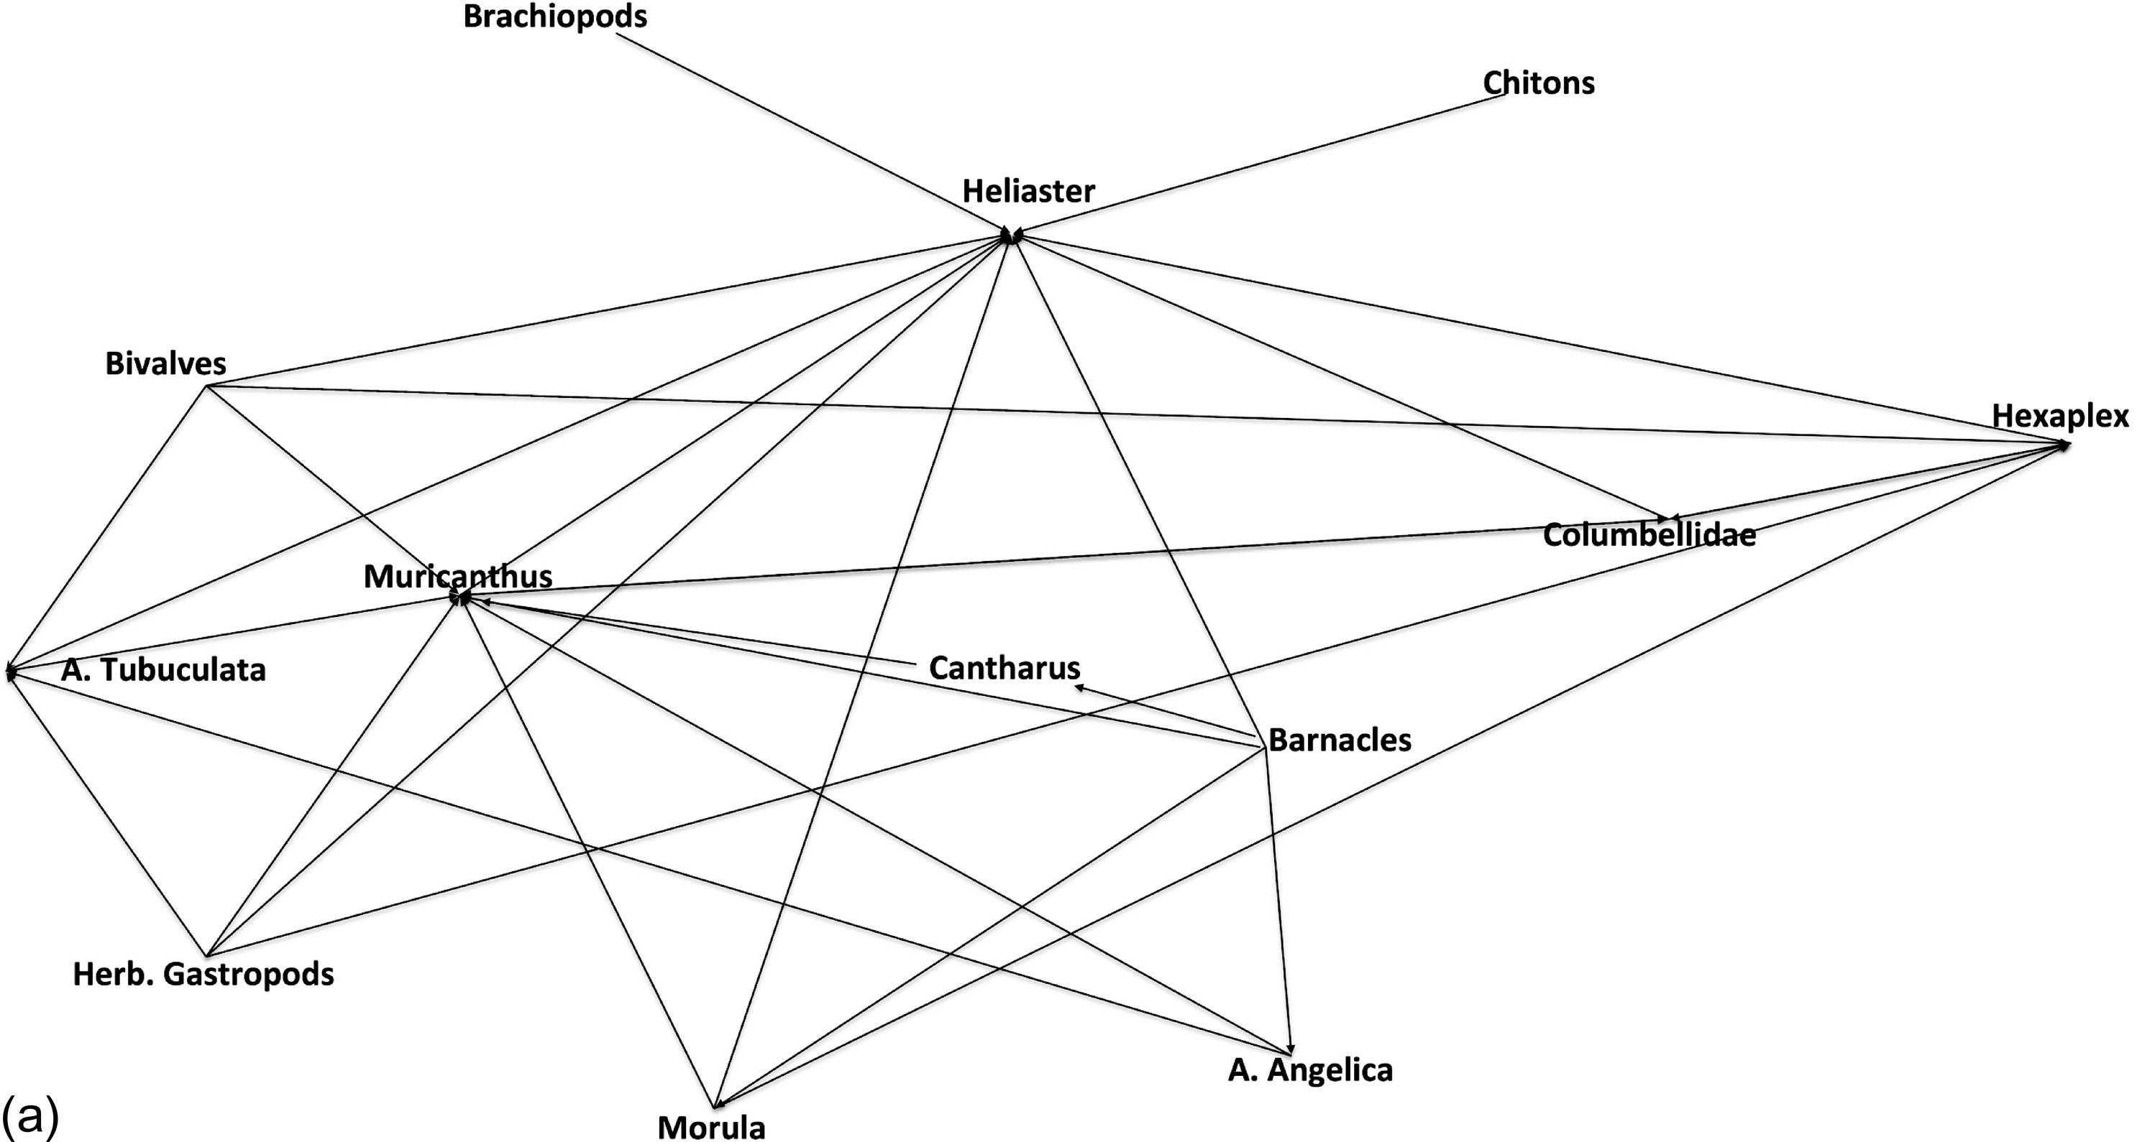
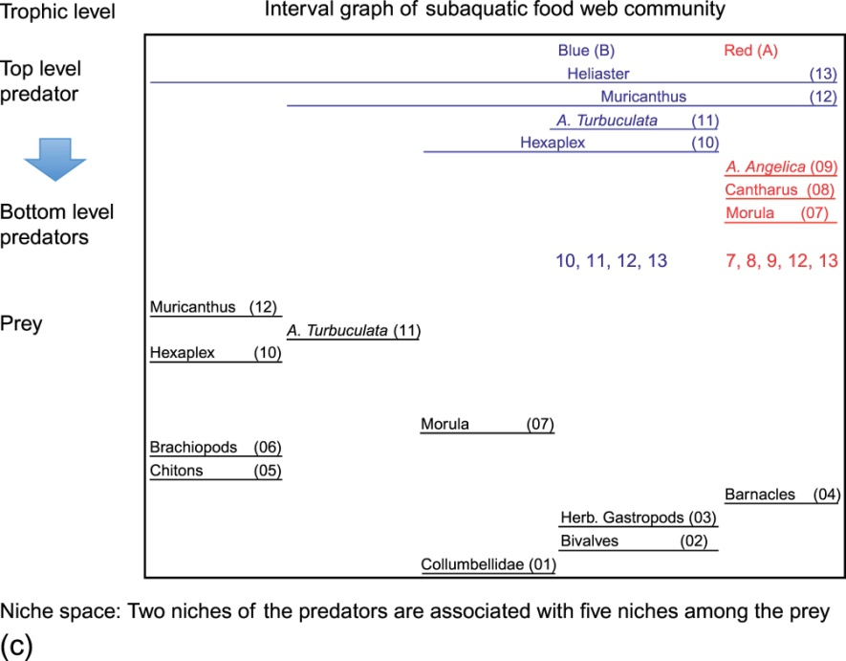
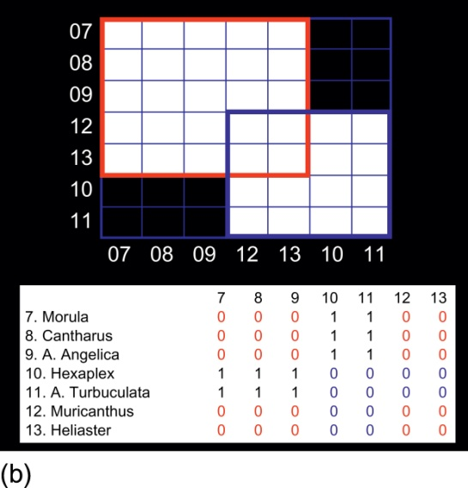
Notes:
FIGURE 1.9 Foodwebs and their interval graphs. (a) A subtropical aquatic food web from Paine [30]. (b) The symmetrical predatorpredator
matrix is constructed (bottom) and the rearrangement in the Shkurba form of the symmetrical predator-predator matrix (top). (c)
Interval graph: the predators are arranged vertically according to their trophic level and the maximal cliques represent communities of
predators (upper half) that compete for common prey (lower half). While there are seven predators, they only occupy two niches in this
representation. Furthermore, this interval graph representation draws attention to the difference between generalist predators (Heliaster
and Meracanthus span both niches) and specialists (the other five only belong to one of the two maximal cliques. However, when we add
the structure among the prey, we see that Hexaplex consumes a greater variety of prey than A. turbuculata.

Slide 10
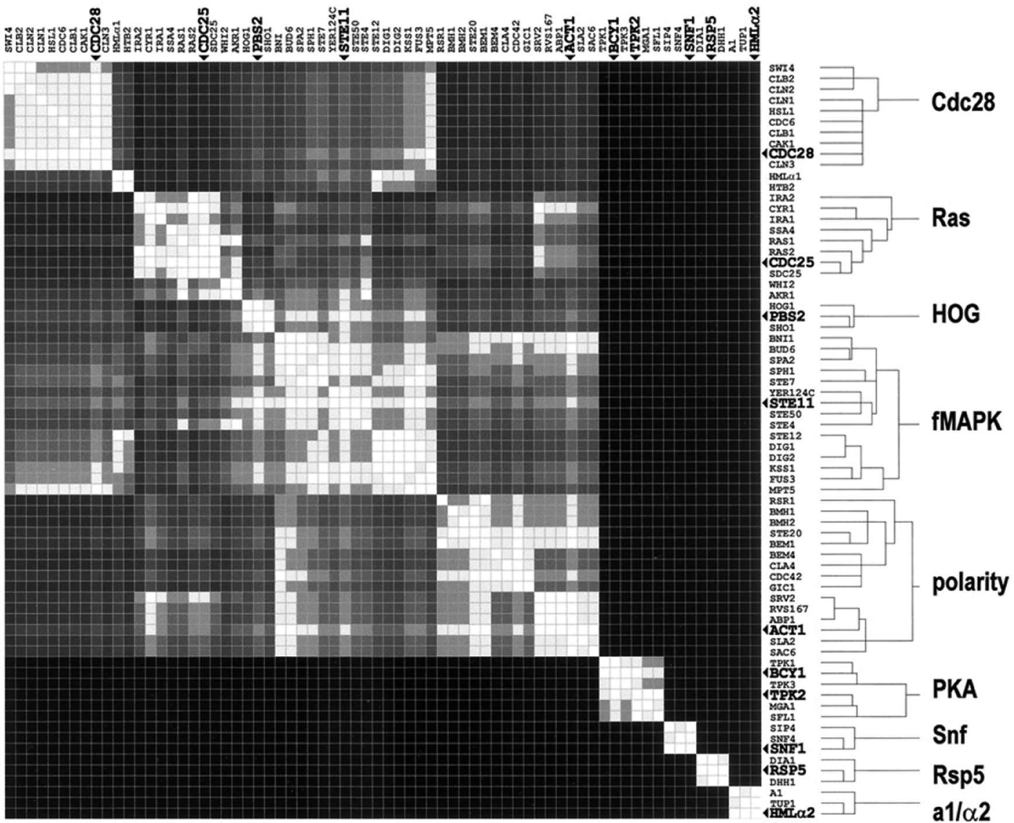
Notes:
FIGURE 1.10 Reproduced from the paper on modular organization of cellular networks by Rives and Galitski [31], with caption.
Clustering of the yeast filamentation network. Proteins of the yeast filamentation network were clustered. A tree-depth threshold was
set. Tree branches with three or more leaves (clusters with three or more proteins) below the tree threshold are shown. Bullets and large
bold labels indicate proteins of highest intracluster connectivity. Copyright (2003) National Academy of Sciences, U.S.

Slide 11
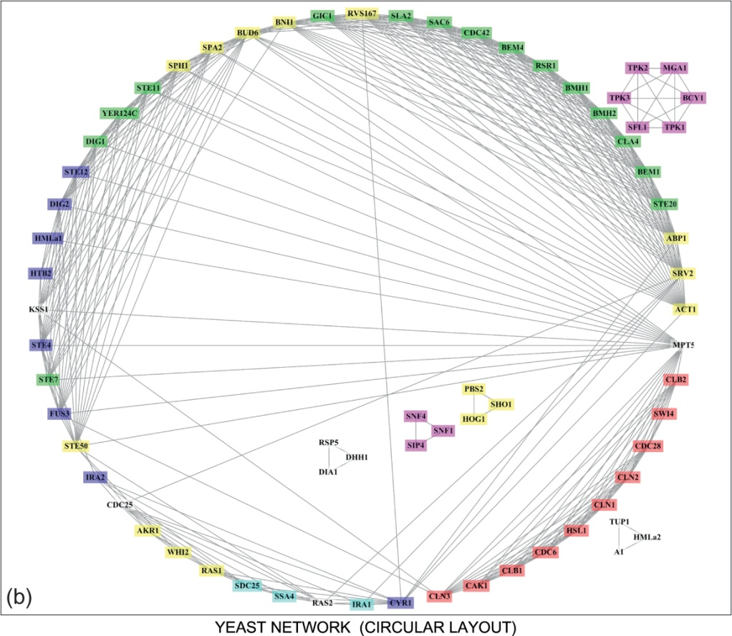
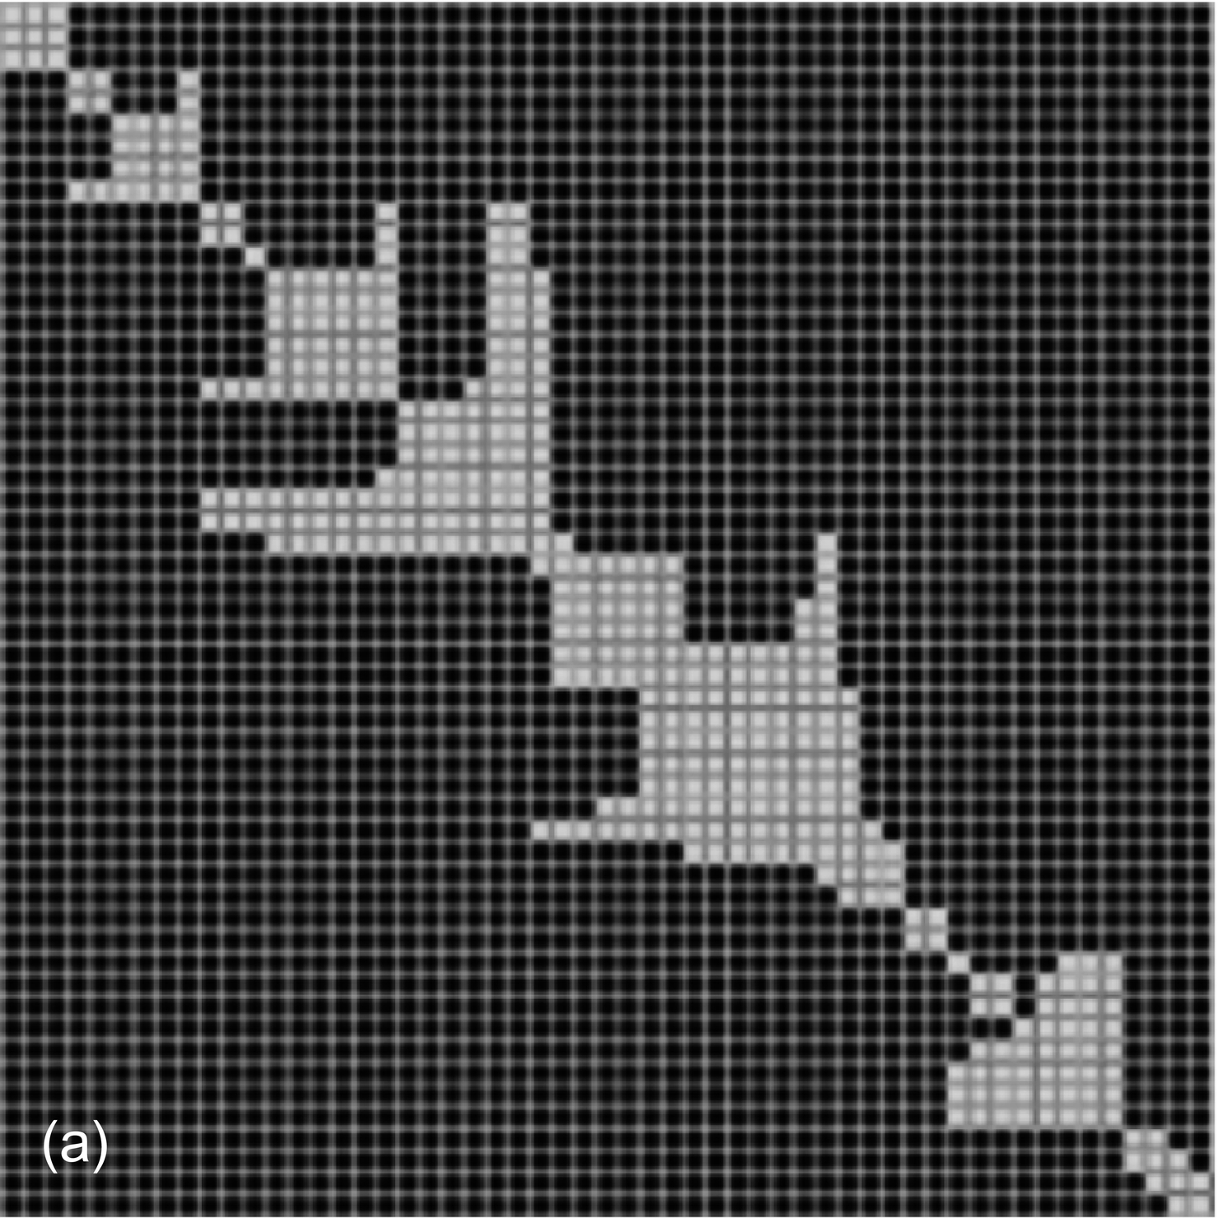
Notes:
FIGURE 1.11 javaBenzer [21] and BioGrapher [24] representations of the data in Figure 1.10. (a) javaBenzer rearrangement of Rives
and Galitski’s adjacency matrix [31] illustrated in Figure 1.10. (b) Spring graph produced by BioGrapher with the entry of this adjacency
matrix and coloring of maximal cliques. Note that in a, arrowheads do not overlap all successive blocks. Thus, we could rearrange the six
independent blocks in 6!/2 distinct orders and still maintain Shkurba form. This is more easily seen in the spring graph, as those small
maximal cliques which are not connected to one another are clearly separate.

Slide 12
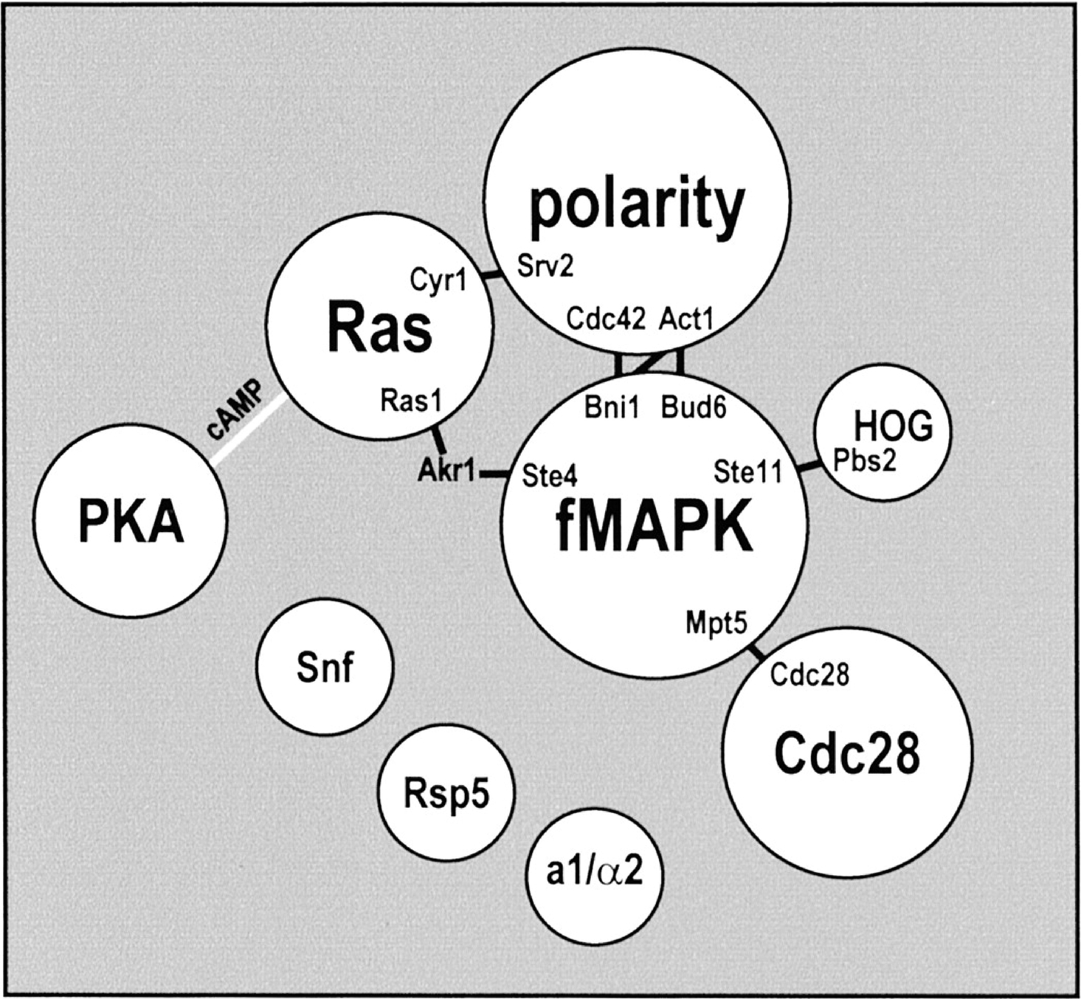
Notes:
FIGURE 1.12 Rives and Galitski’s modular model of the yeast filamentous network. The only differences between their topology and
ours are due to our higher threshold for interaction, causing us to miss the connection of two of our free-standing maximal cliques to the
larger aggregate. We do not know whether the biological association is weaker for these links than others displayed. Copyright (2003)
National Academy of Sciences, U.S.

Slide 13
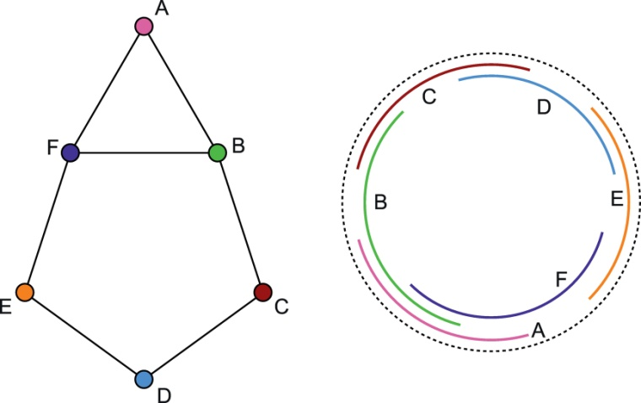
Notes:
FIGURE 1.13 Circular arc graph with associated matrix [35].

Slide 14
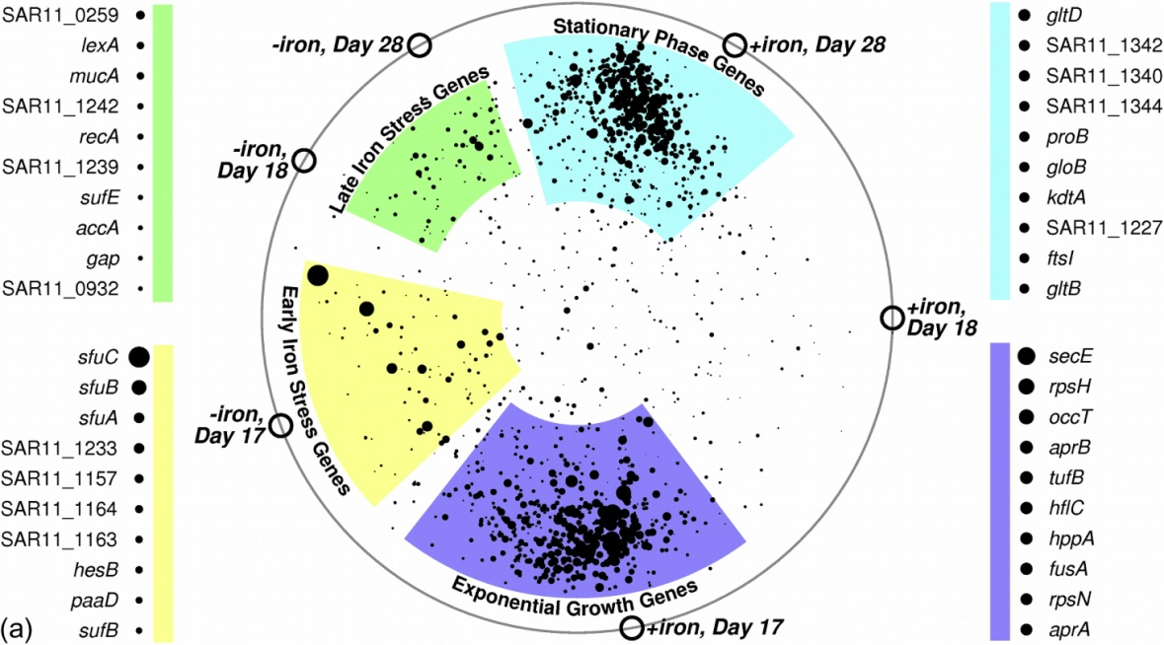
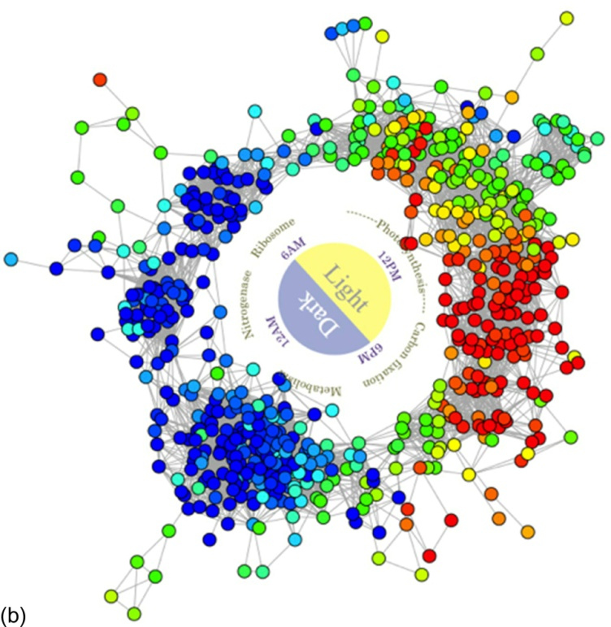
Notes:
FIGURE 1.14 Examples of circular arc graphs. (a) Transcriptional and translational regulatory responses to iron limitation in the globally
distributed marine bacterium Candidatus Pelagibacter ubique [38]. (b) A model of cyclic transcriptomic behavior in Cyanothece species
ATCC 51142 [39].

Slide 15
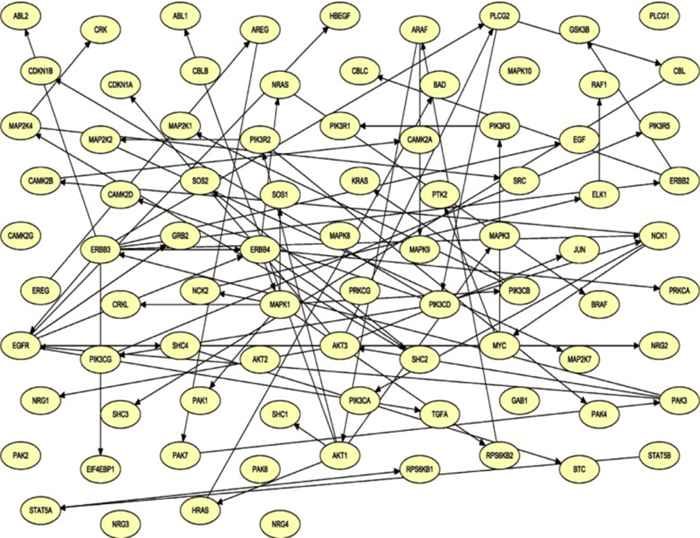
Notes:
FIGURE 1.15 The causal Bayesian network published by Neapolitan et al. [40]. The vertices are genes in the ErbB signal tranduction
pathway associated with modified gene expression in breast cancer patients.

Slide 16
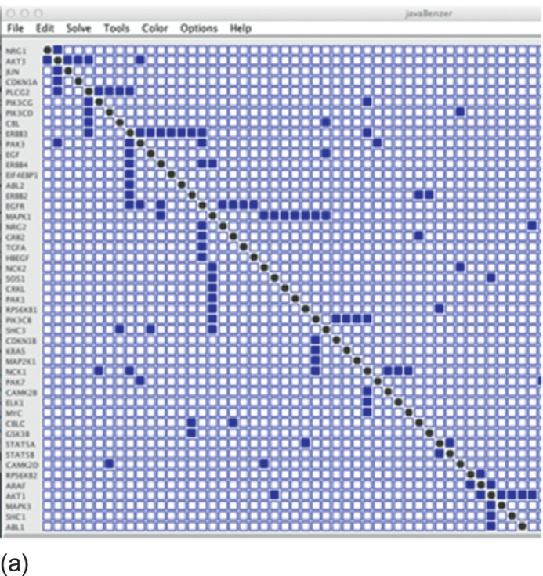
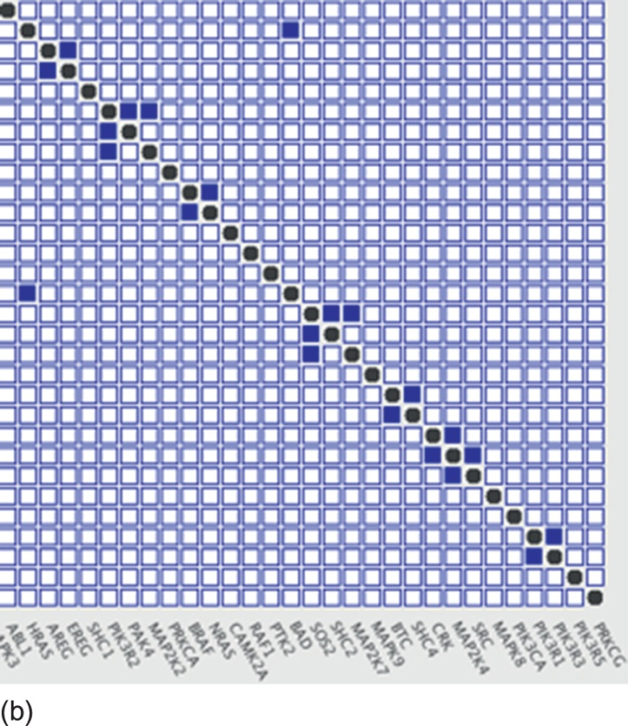
Notes:
FIGURE 1.16 javaBenzer representation of the Bayesian network of Figure 1.15 reorganized to diagonalize the data as much as possible
(the Shkurba form). The whole matrix was bigger than the screen, so it was split into two parts. (a) The upper left portion of the matrix.
(b) The lower right portion with the overlap at gene ABL1.

Slide 17
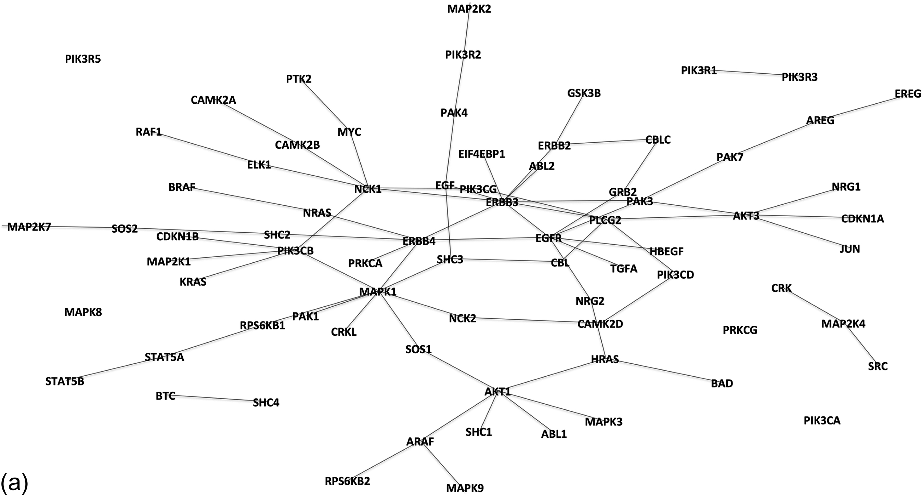
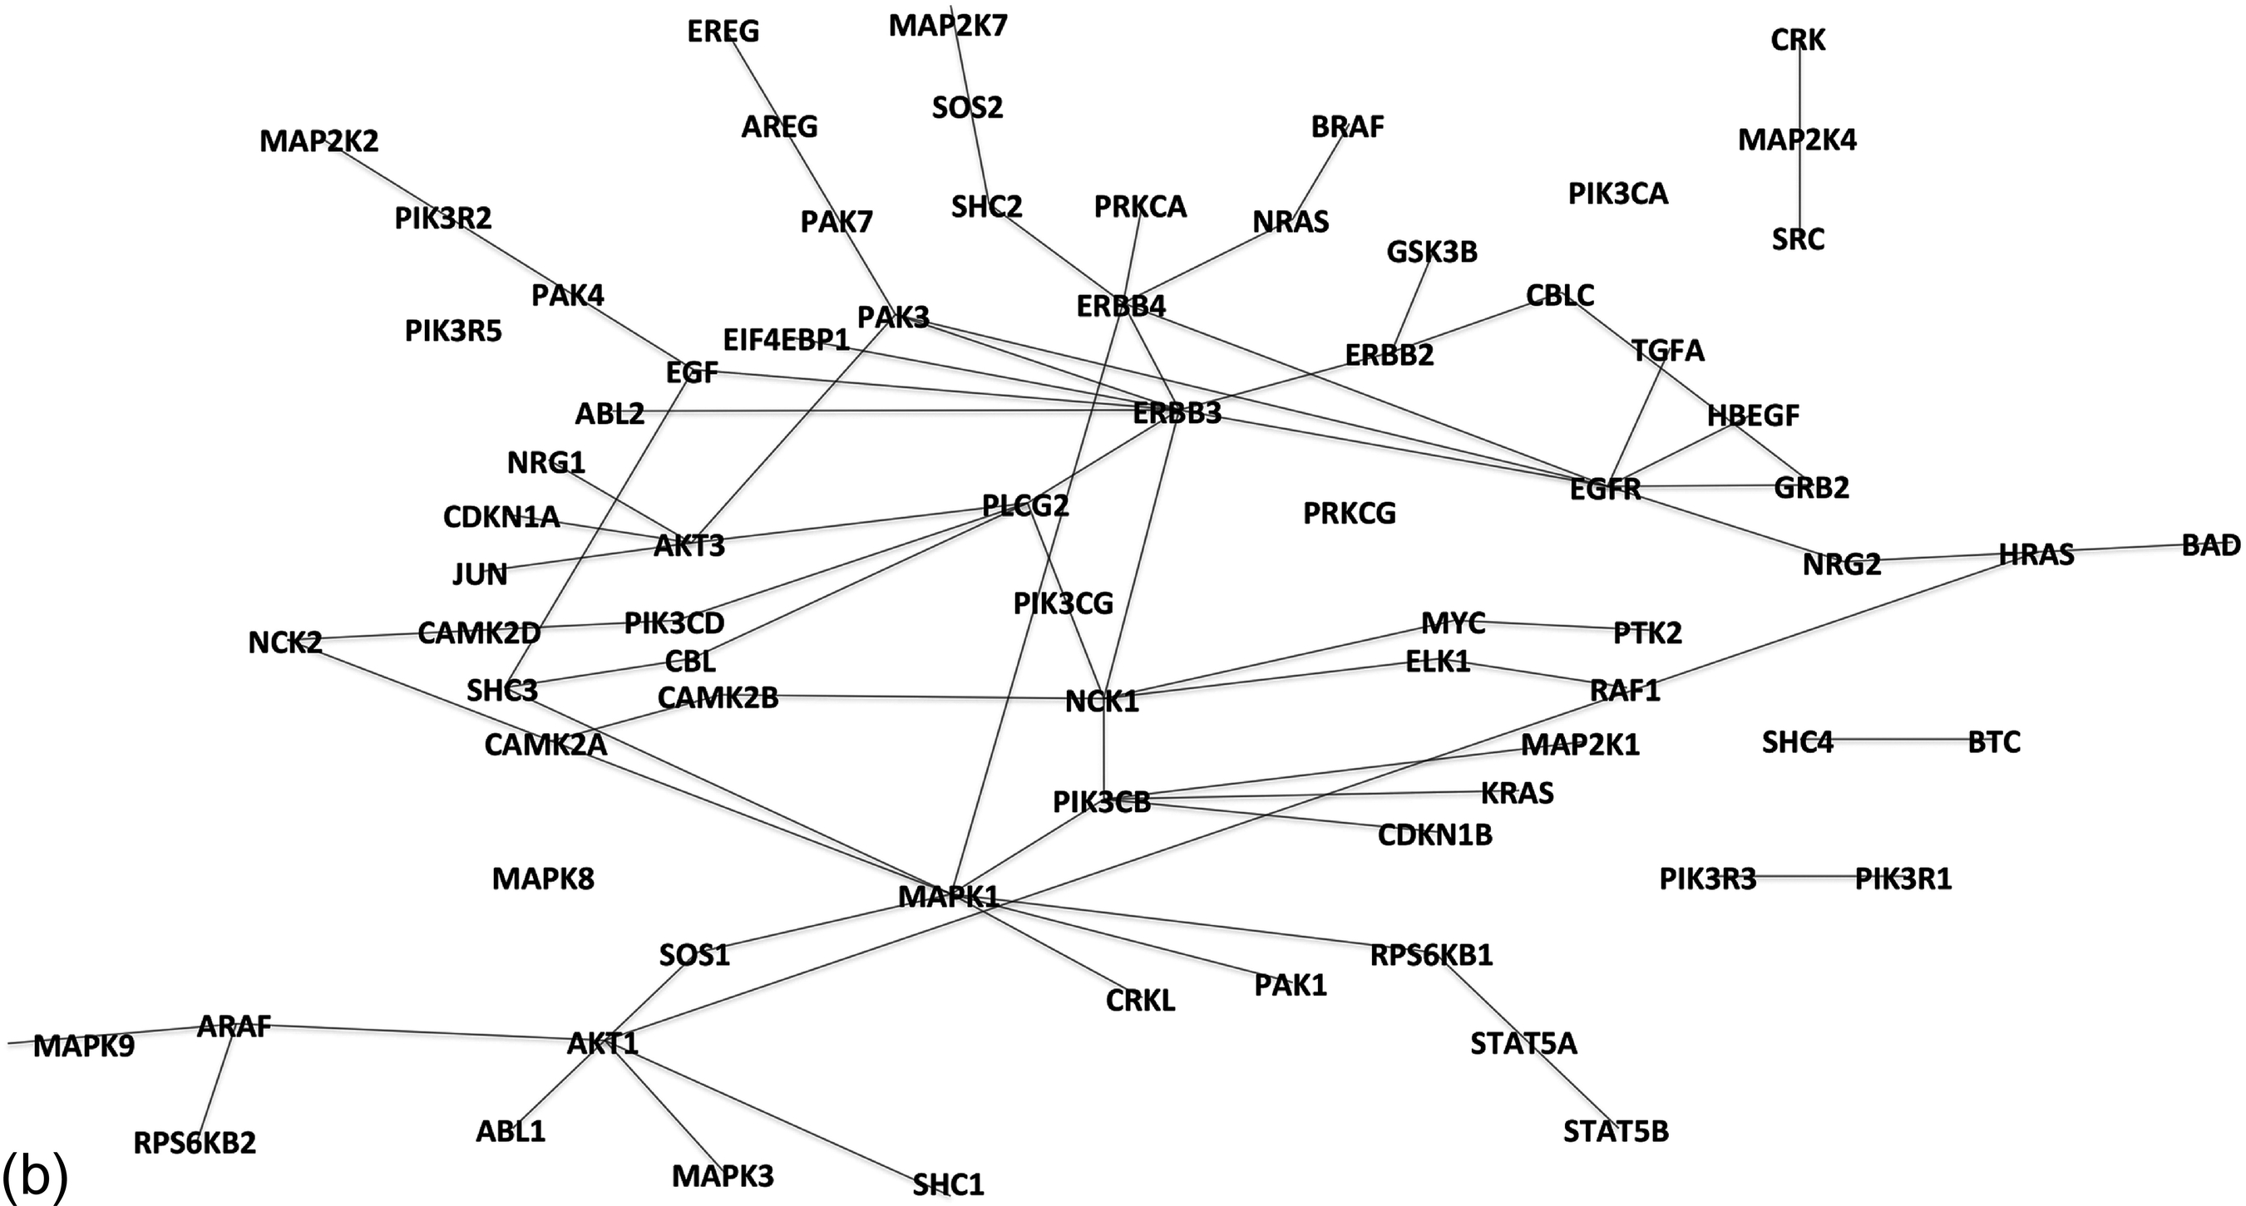
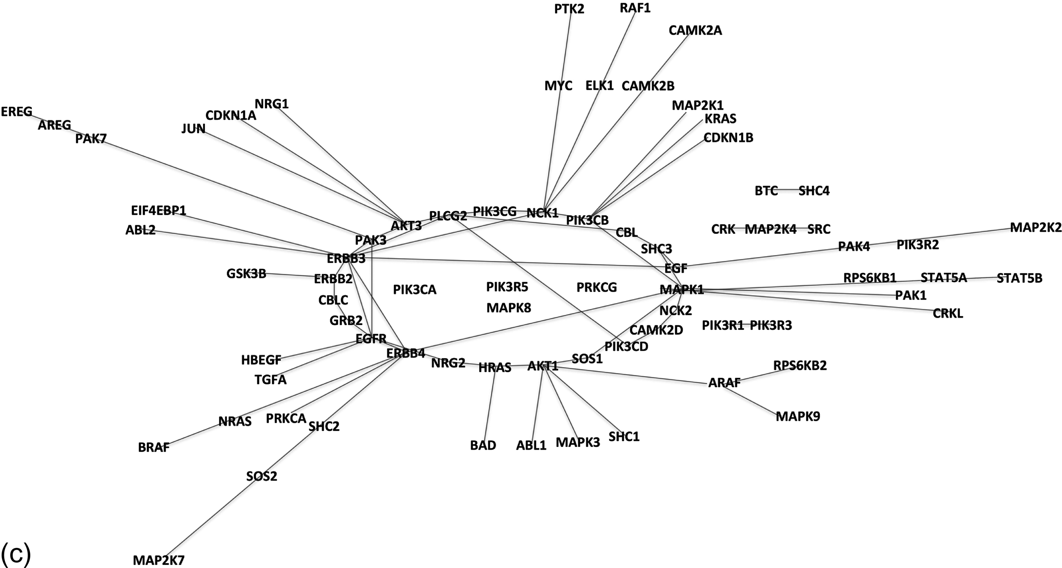
Notes:
FIGURE 1.17 BioGrapher-based visualizations of the adjacency matrix for the Bayesian network in Figure 1.16, using various layouts.
(a) Spring layout. (b) Radial layout. (c) Circular layout.

Slide 18
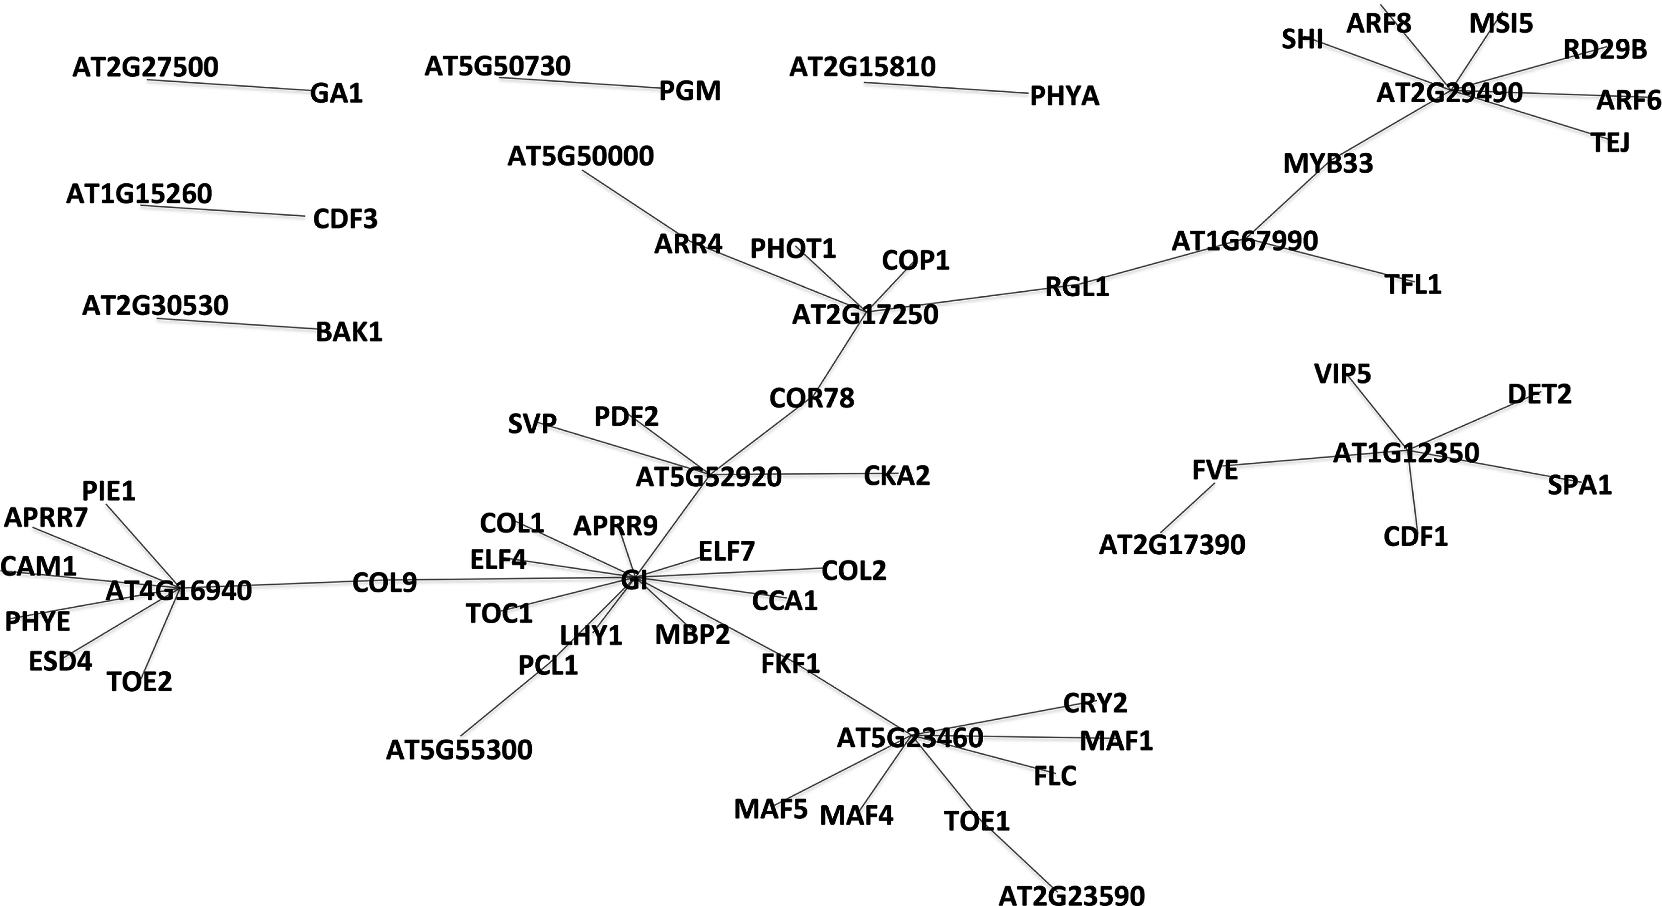
Notes:
FIGURE 1.18 BioGrapher spring layout visualization of the Arabidopsis gene data set published recently by Keurentjes et al. [42]. This
graph is a tree and has some high-degree hubs.

