Slide 1
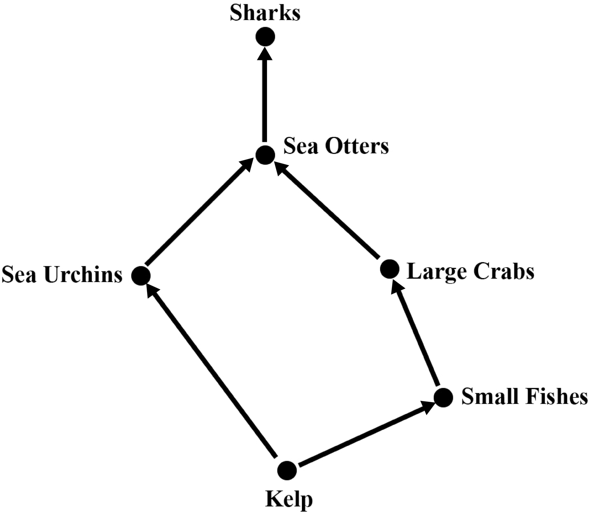
Notes:
FIGURE 2.1 Simple food web.

Slide 2
Notes:
FIGURE 2.2 A food chain.

Slide 3
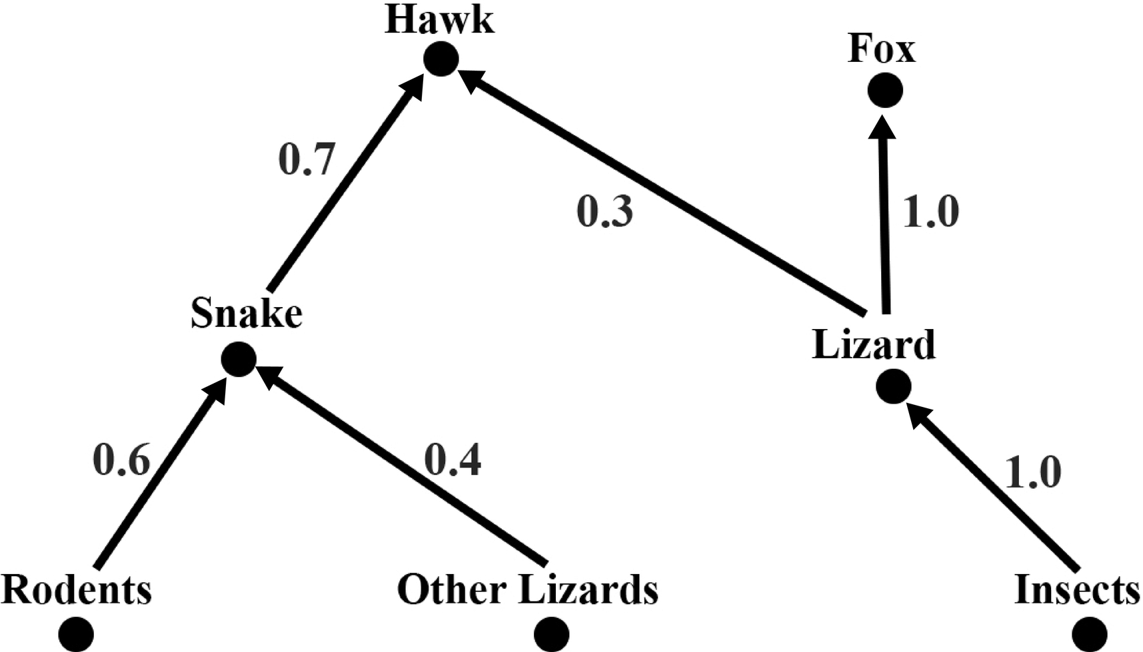
Notes:
FIGURE 2.3 A weighted food web.

Slide 4
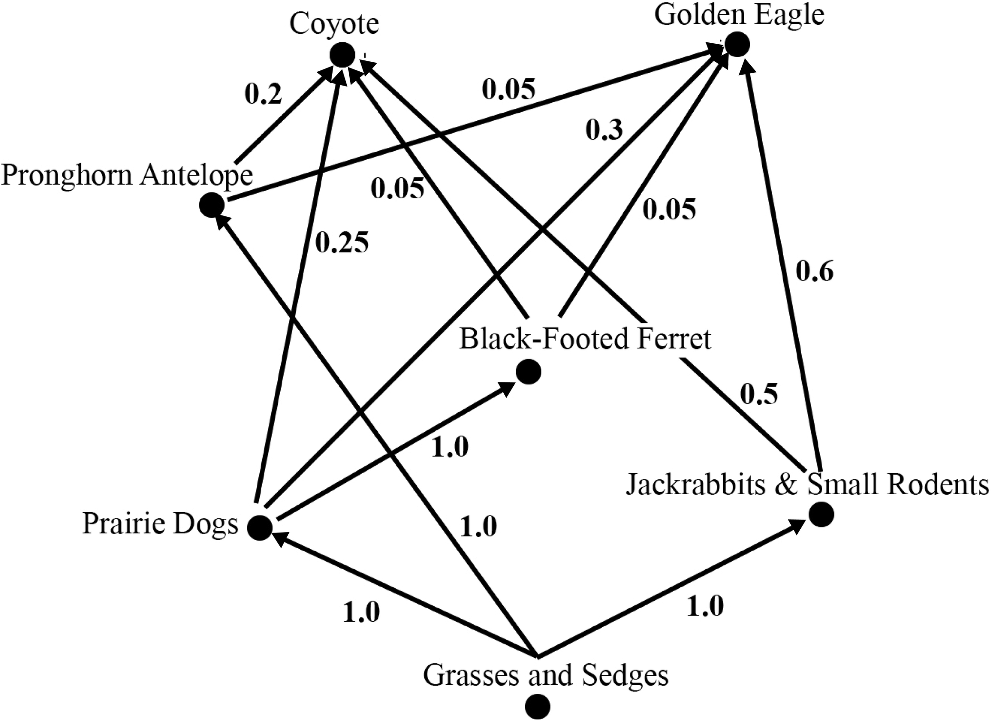
Notes:
FIGURE 2.4 Weighted food web for the coyote.

Slide 5
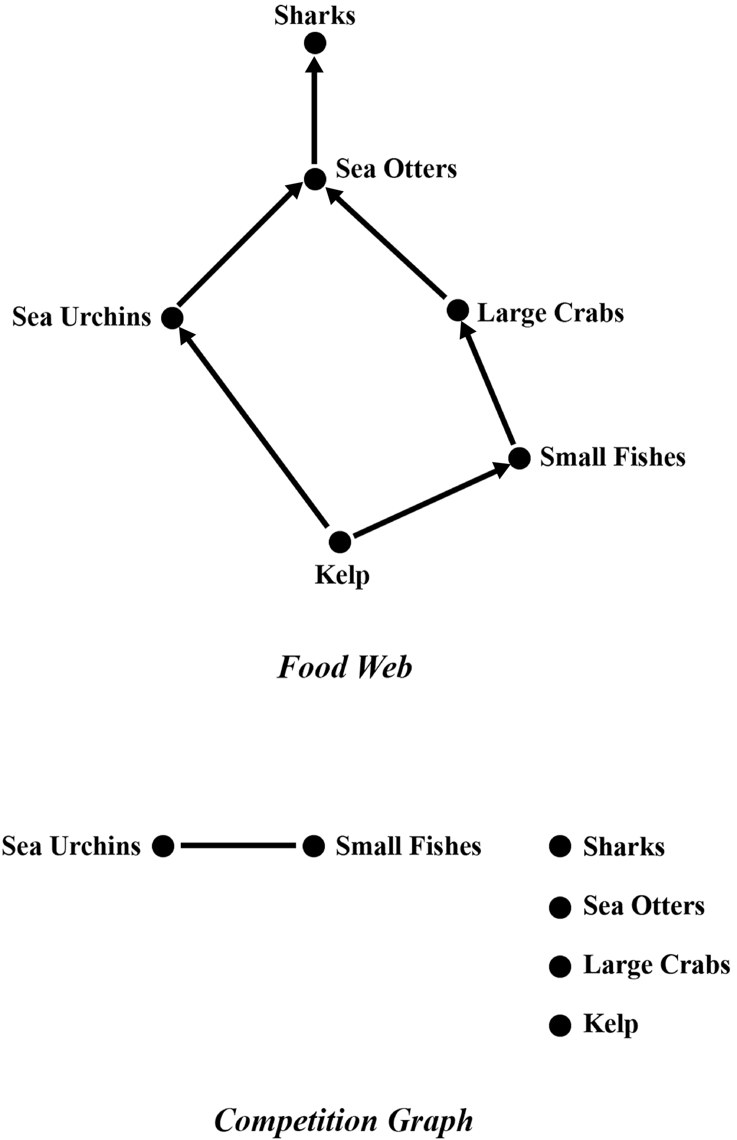
Notes:
FIGURE 2.5 A food web and its corresponding competition graph.

Slide 6
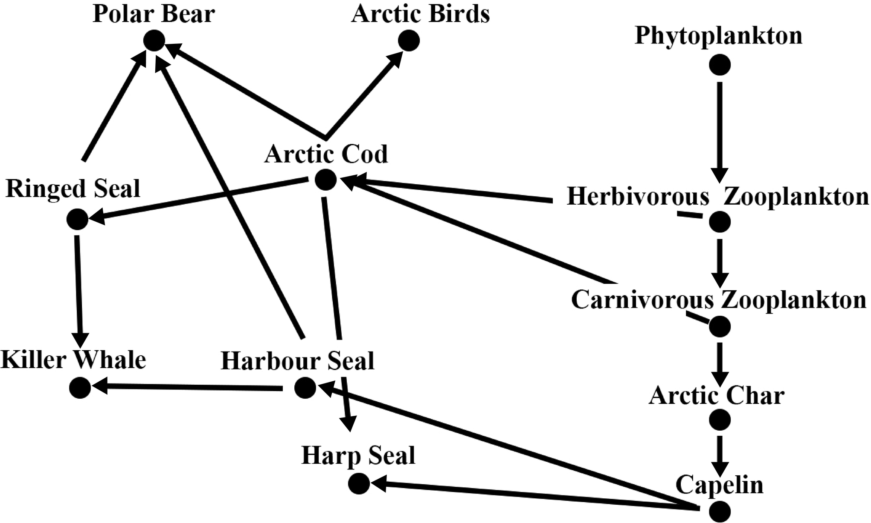
Notes:
FIGURE 2.6 Food web for the polar bear.

Slide 7
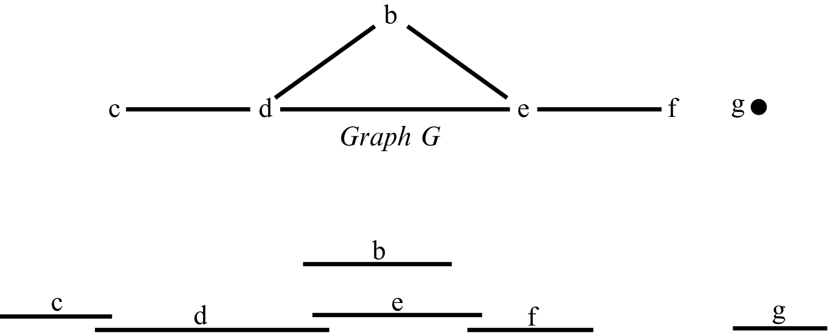
Notes:
FIGURE 2.7 Graph G and a demonstration that G is an interval graph.

Slide 8
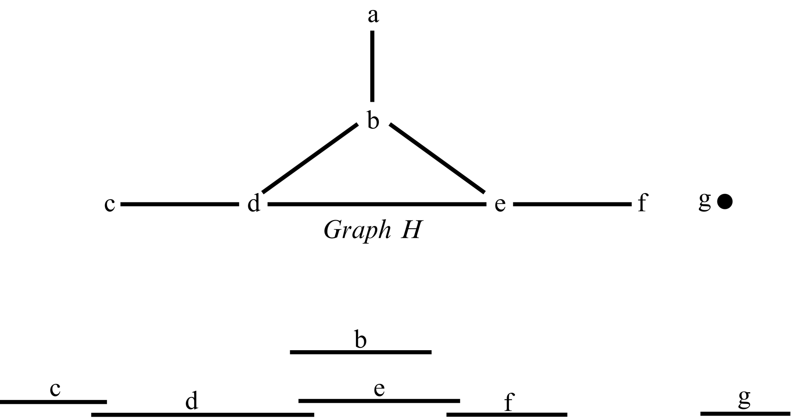
Notes:
FIGURE 2.8 An attempt to find intervals corresponding to graph H. H is not an interval graph.

Slide 9
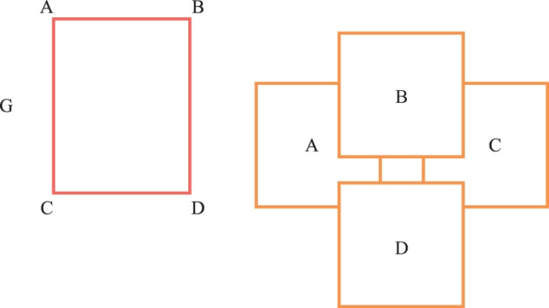
Notes:
FIGURE 2.9 A two-dimensional box representation of graph G that is a square.

Slide 10
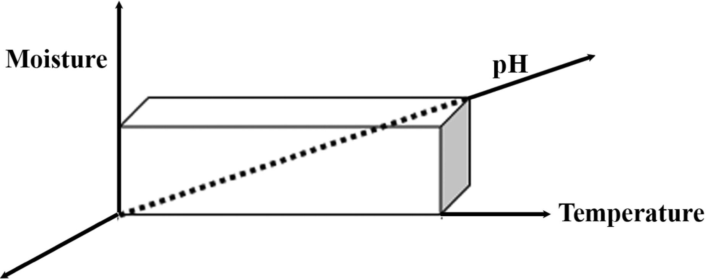
Notes:
FIGURE 2.10 A three-dimensional species habitat niche represented by temperature, moisture, and pH.

Slide 11
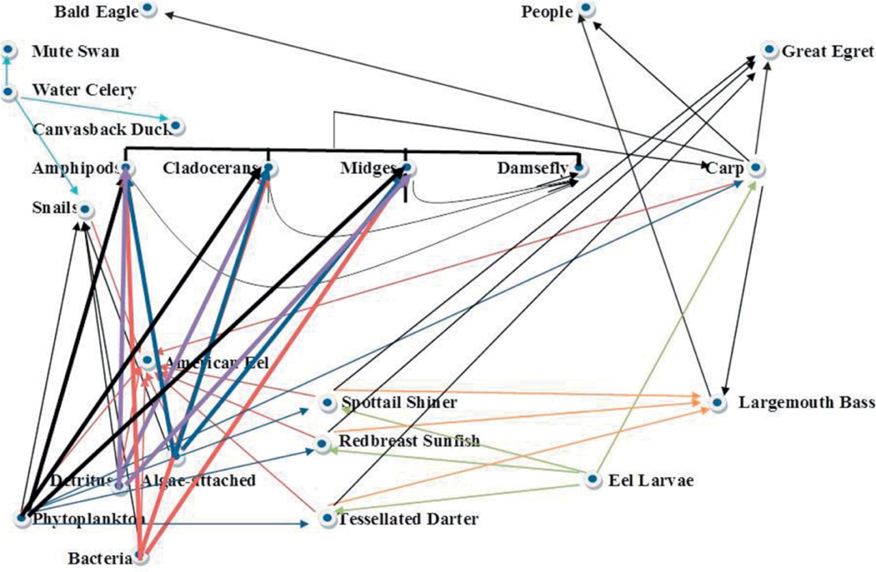
Notes:
FIGURE 2.11 Partial food web of the shallow water Hudson River food web. Reference [12] with permission.

Slide 12
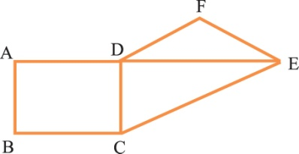
Notes:
FIGURE 2.12 A graph.

Slide 13
Notes:
FIGURE 2.13 Food web related to Figure 2.12.

Slide 14
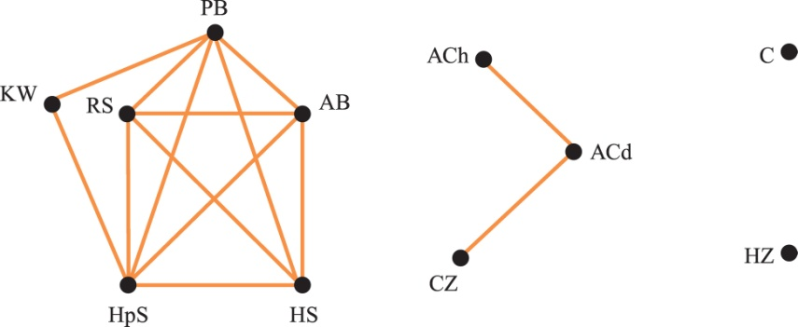
Notes:
FIGURE 2.14 PP projection graph for food web in Figure 2.6 with weights given in the matrix shown in Table 2.7.

Slide 15
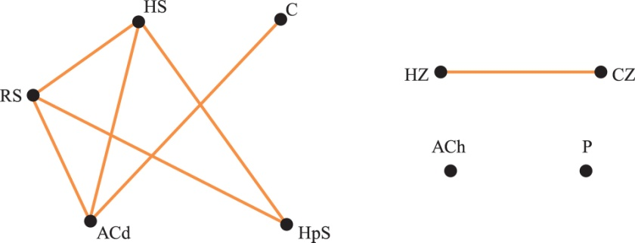
Notes:
FIGURE 2.15 EP Projection graph for food web in Figure 2.6 with weights given in the matrix shown in Table 2.8.

