Slide 1
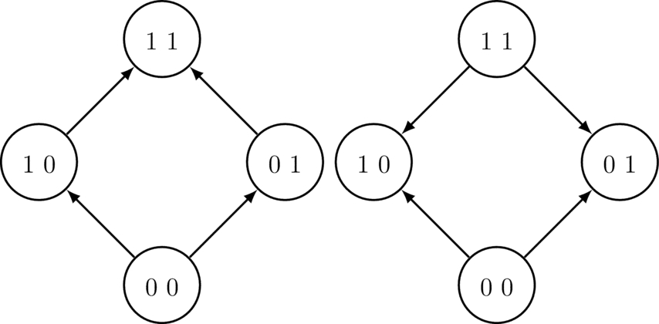
Notes:
FIGURE 3.1 Example fitness graphs for a two-locus system.

Slide 2
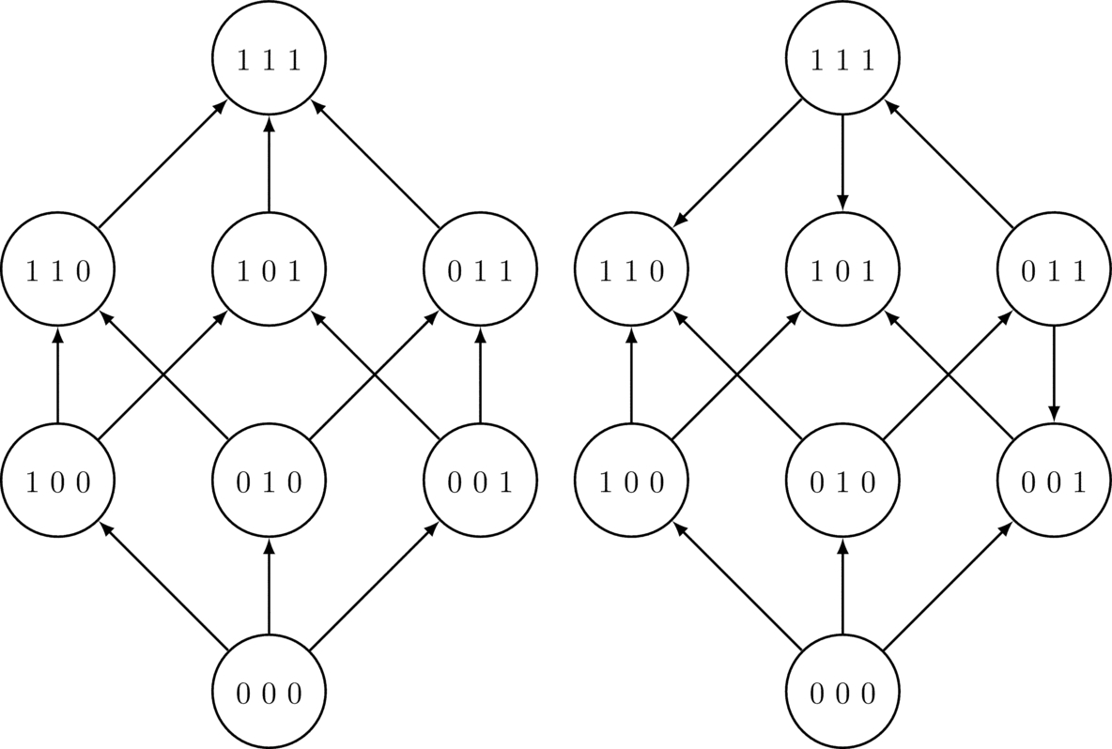
Notes:
FIGURE 3.2 Example fitness graphs for a three-locus system.

Slide 3
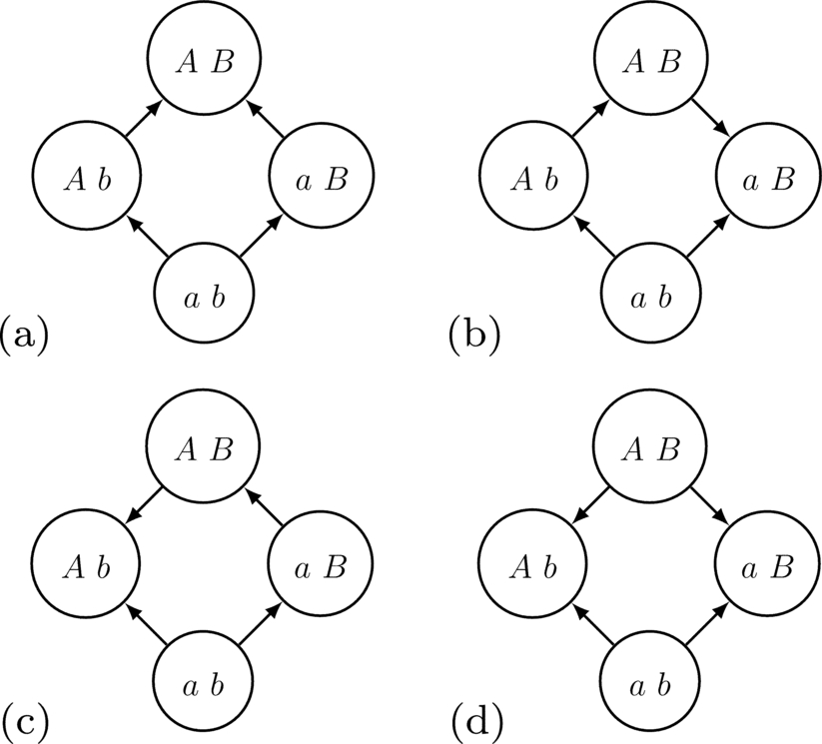
Notes:
FIGURE 3.3 Two-locus systems.

Slide 4
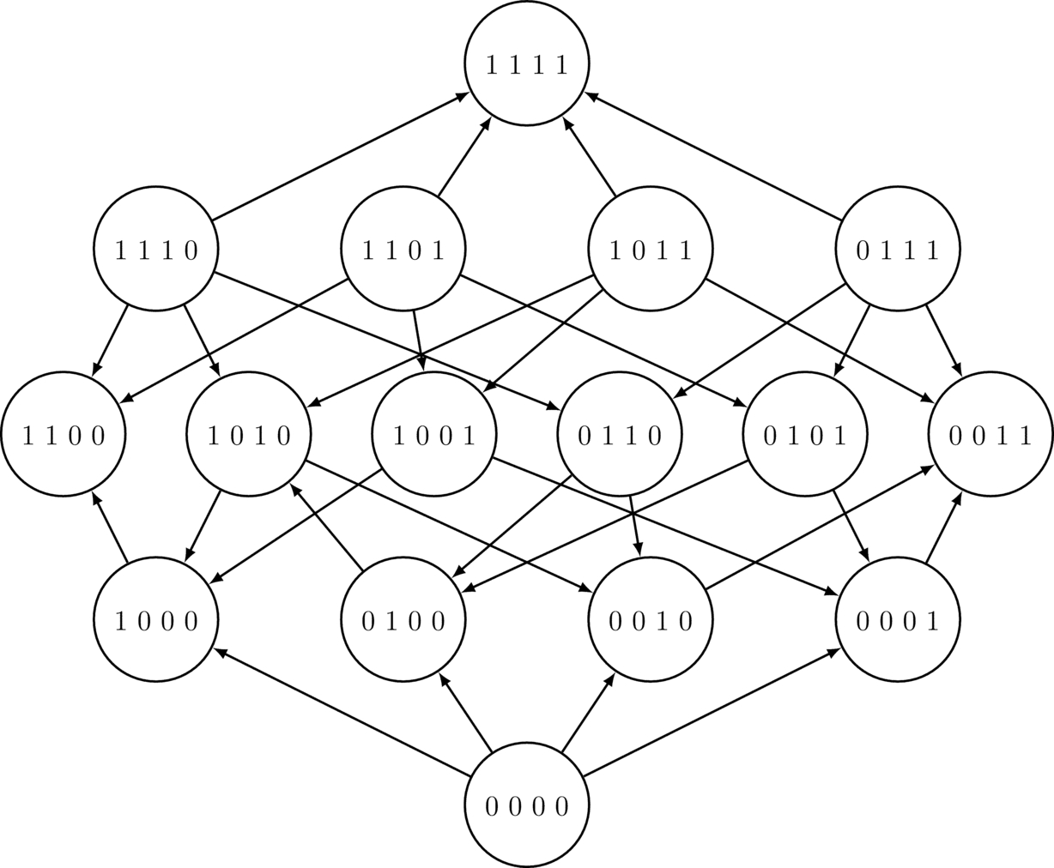
Notes:
FIGURE 3.4 A four-locus system.

