Slide 1
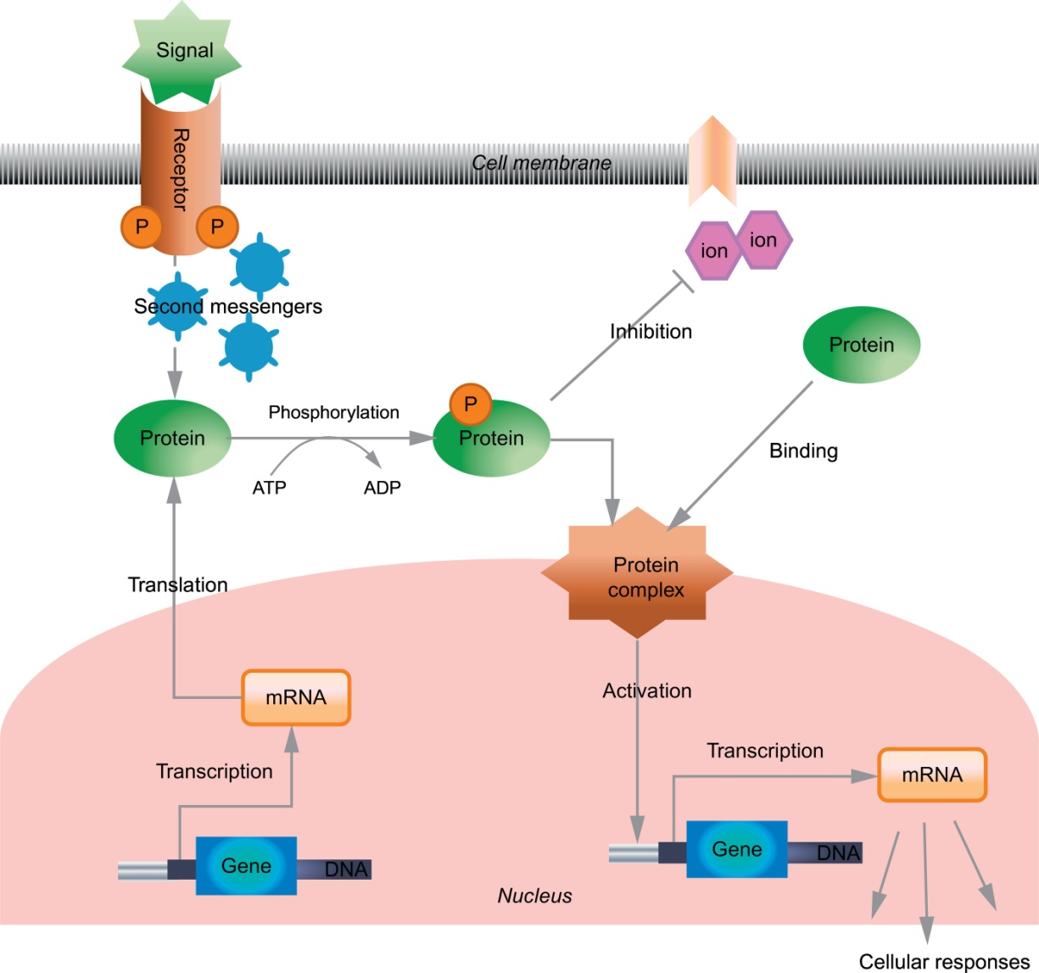
Notes:
FIGURE 4.1 Scheme of a hypothetical signal transduction process involving diverse interactions of cellular components. Figure
reproduced from Ref. [4].

Slide 2
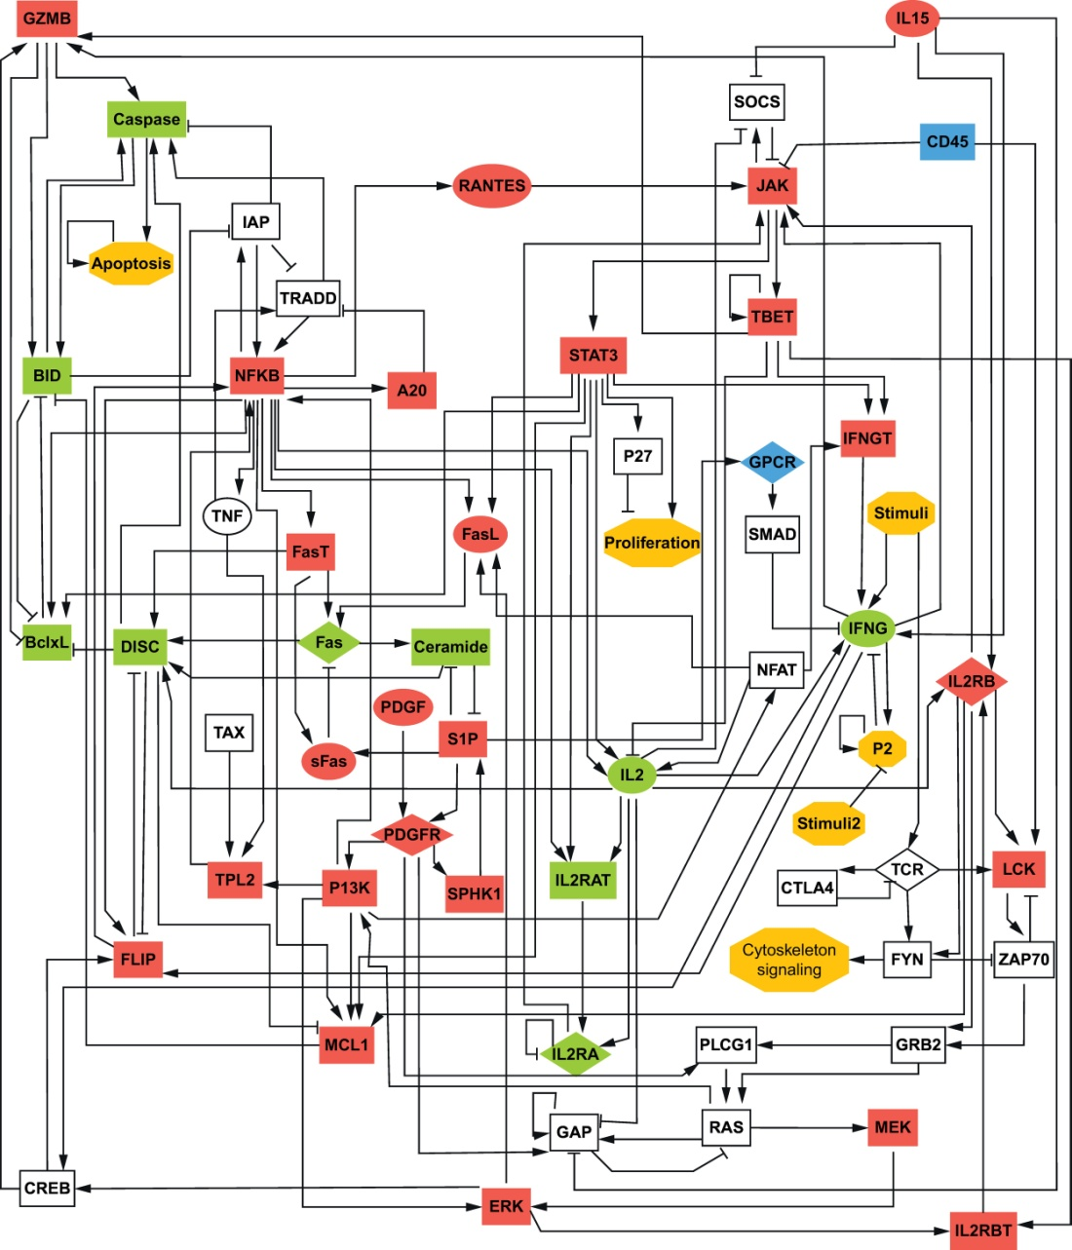
Notes:
FIGURE 4.2 A signal transduction network involved in activation-induced cell death of white blood cells called cytotoxic T cells. The
key signals are Stimuli (representing stimulus of the cell by the presence of pathogens) together with the external molecules interleukin
15 (IL15) and platelet-derived growth factor (PDGF).These signals are identified as nodes with only outgoing links (nodes with this
property are called sources). The key output node of the network is Apoptosis, expressing programmed cell death. Note that this node has
no outgoing links (a node with this property is called a sink). The nodes of the network include proteins, mRNAs, and concepts. The shape
of the nodes indicates the cellular location: rectangles indicate intracellular components, ellipses indicate extracellular components, and
diamonds indicate receptors. Conceptual nodes are represented by hexagons. The background of the non-conceptual nodes corresponds
to the known status of these nodes in abnormally surviving T-LGL cells as compared to normal T cells: red (dark) indicates abnormally
high expression or activity, green (lighter) means abnormally low expression or activity. The full names of the nodes can be found in
[5, 6]. An arrowhead or a short perpendicular bar at the end of an edge indicates activation or inhibition, respectively. Figure reproduced
from Ref. [6].

Slide 3
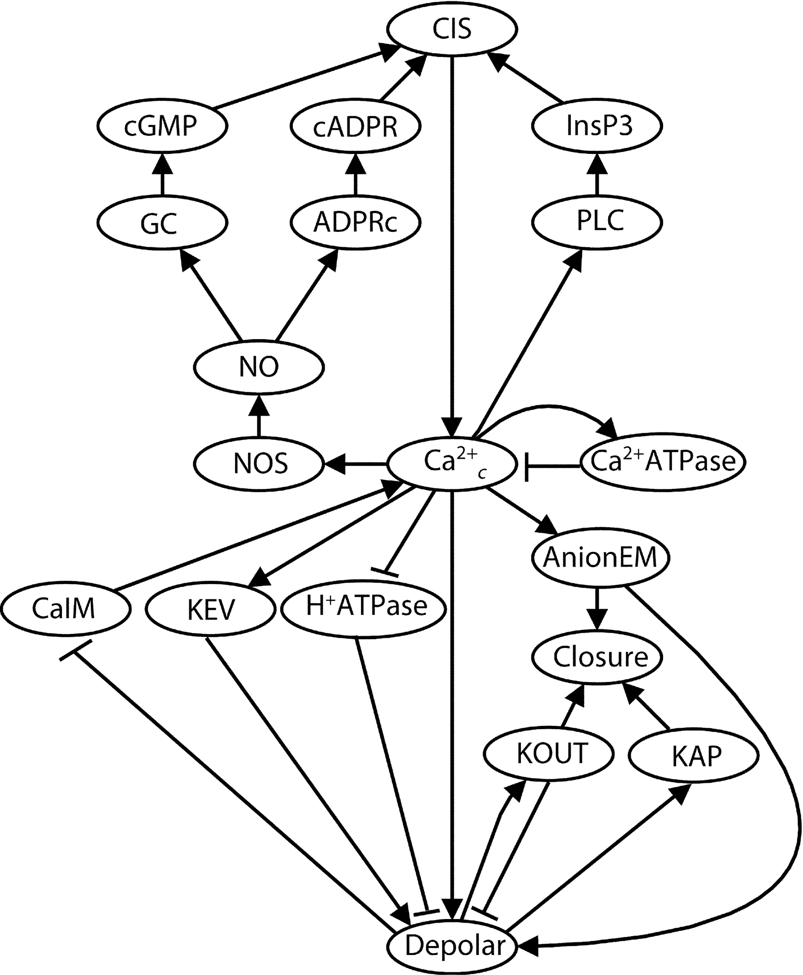
Notes:
FIGURE 4.3 Figure for Exercise 4.1. The network is a part of a plant signal transduction network whose signal is the drought hormone
abscisic acid and whose outcome is the closure of the stomata (microscopic pores on the leaves) [15, 16]. An arrowhead or a short
perpendicular bar at the end of an edge indicates activation or inhibition, respectively. The full names of the nodes can be found in
[15, 16]. Figure reprinted from Ref. [17] with permission from Elsevier.

Slide 4
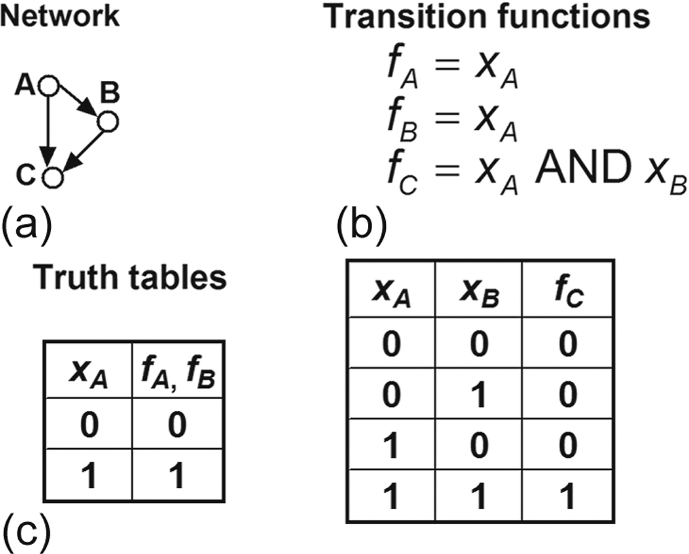
Notes:
FIGURE 4.4 A Boolean model of a simple signal transduction network. (a) The signal transduction network. The edges with arrows
represent positive effects. Note that the network does not uniquely determine the Boolean updating function for node C. (b) The Boolean
transition functions in the model. The first transition function indicates that the state variable of node A does not change. The second
transition function indicates that the state variable of node B follows the state of node A with a delay. The third transition function indicates
that the condition for the ON state of node C is that both A and B are on. (c) The truth tables of the Boolean updating functions given in (b).

Slide 5
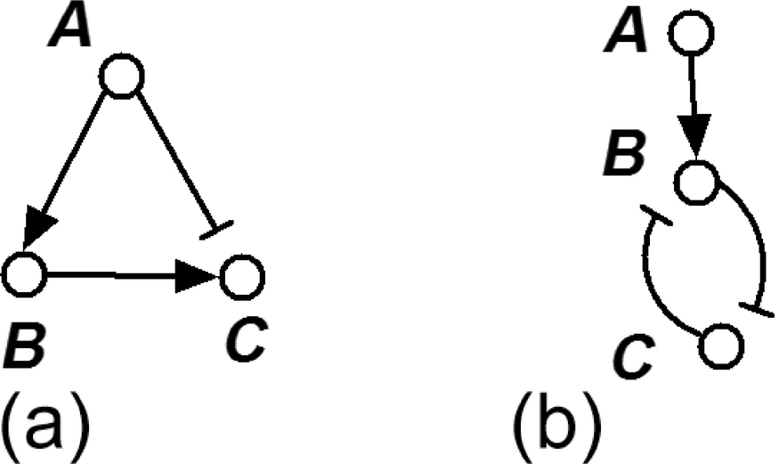
Notes:
FIGURE 4.5 Figure for Exercise 4.2 and several of the follow-up exercises. Two simple signal transduction networks. For both networks,
A is the source node (signal).

Slide 6
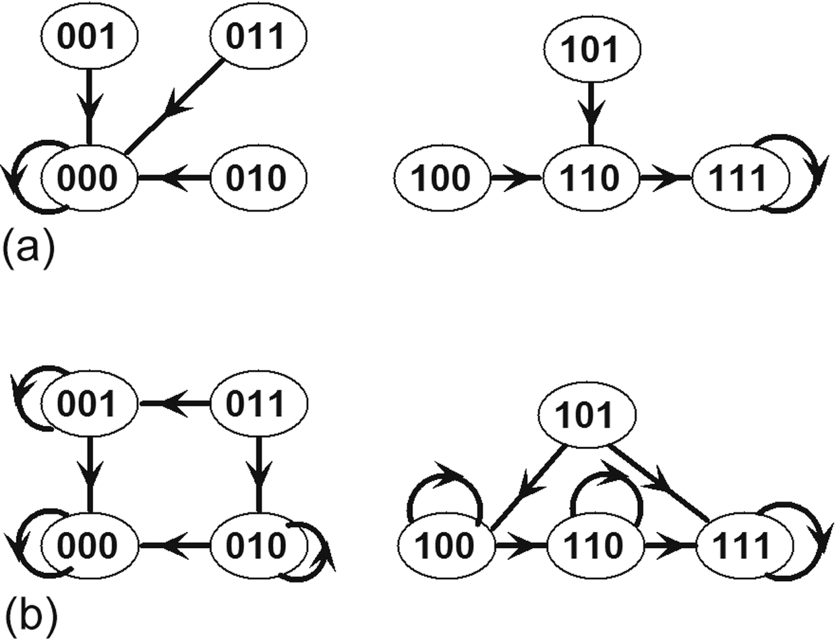
Notes:
FIGURE 4.6 State transition graphs corresponding to the Boolean model presented in Figure 4.4. The symbols correspond to the states
of the system, indicated in the order A, B, C; thus 000 represents xA = 0, xB = 0, xC = 0. A directed edge between two states indicates
the possibility of transition from the first state to the second by updating the nodes in the manner specified by the updating scheme. An
edge that starts and ends at the same state (a loop) indicates that the state does not change during update. (a) The state transition graph
corresponding to synchronous update, when all nodes are updated simultaneously. The two states that have loops are the fixed points of
the system. (b) The state transition graph corresponding to updating one node at a time (general asynchronous update). While several
states have loops, indicating that at least one of the nodes does not change state during update, only the two states that have no outgoing
edges are fixed points of the system.

Slide 7
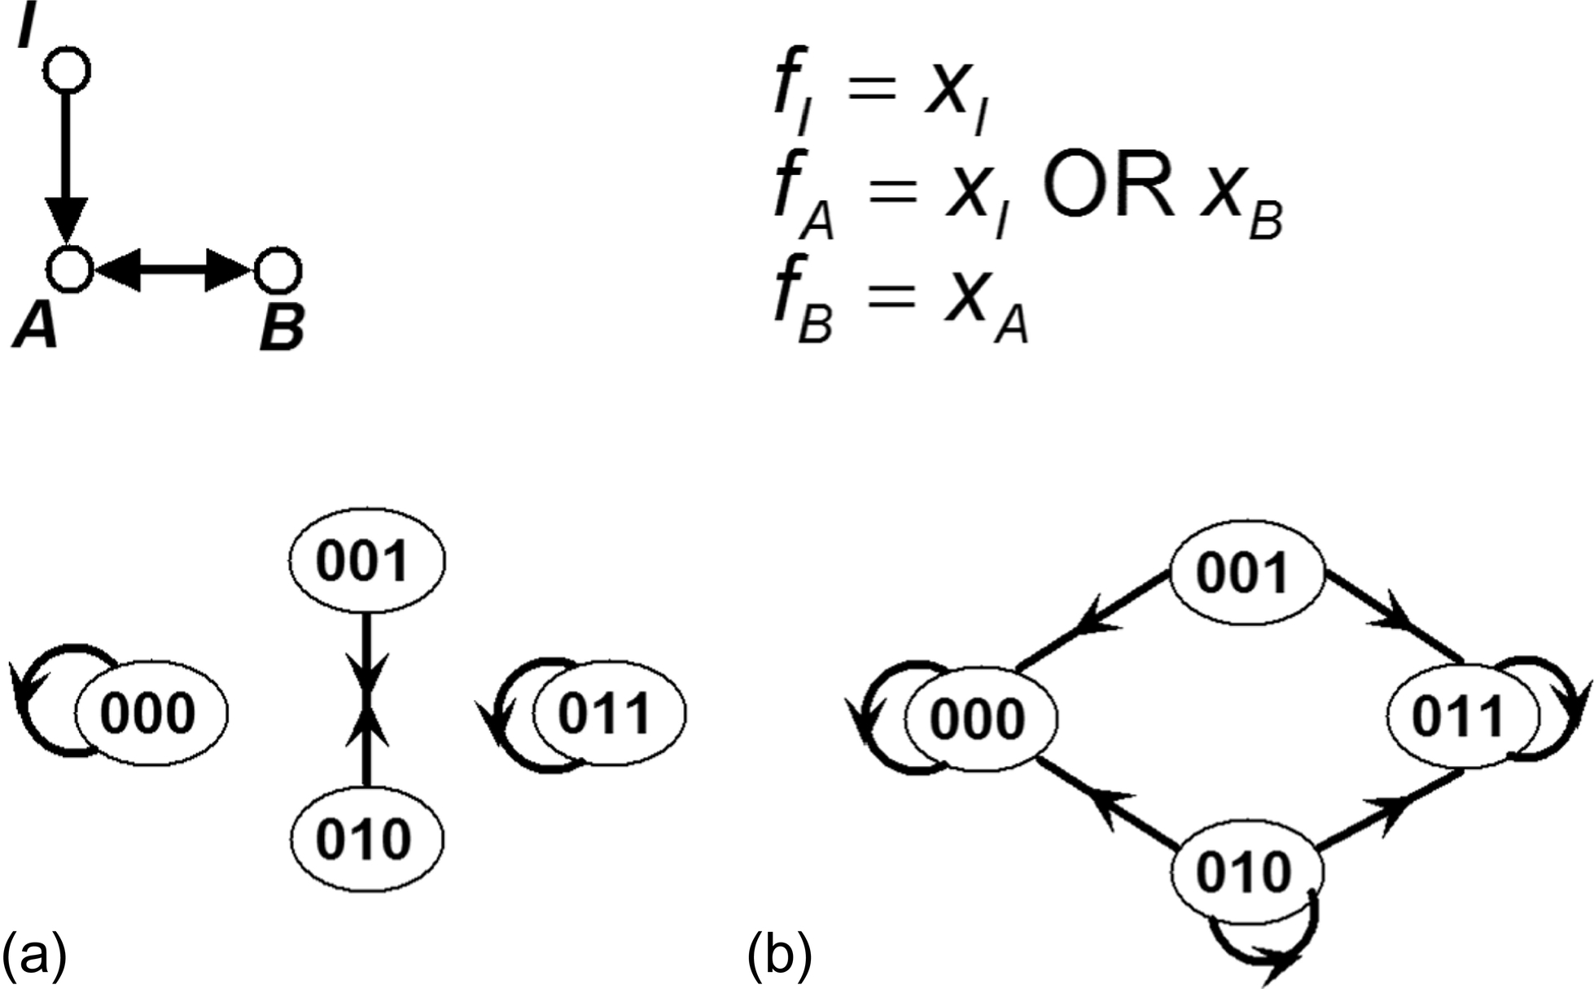
Notes:
FIGURE 4.7 A simple signal transduction network composed of a source node I and two nodes, A and B, which form a mutual activation
loop. It is assumed that the positive inputs from I and B are independently sufficient to activate node A. (a) The network’s state transition
graph corresponding to synchronous update, when the signal is OFF (xI = 0). The states are specified in the node order I, A, B. (b) The
state transition graph corresponding to general asynchronous update, when the signal is OFF (xI = 0).

Slide 8
Notes:
FIGURE 4.8 A simple three-node network for Exercise 4.13.

Slide 9
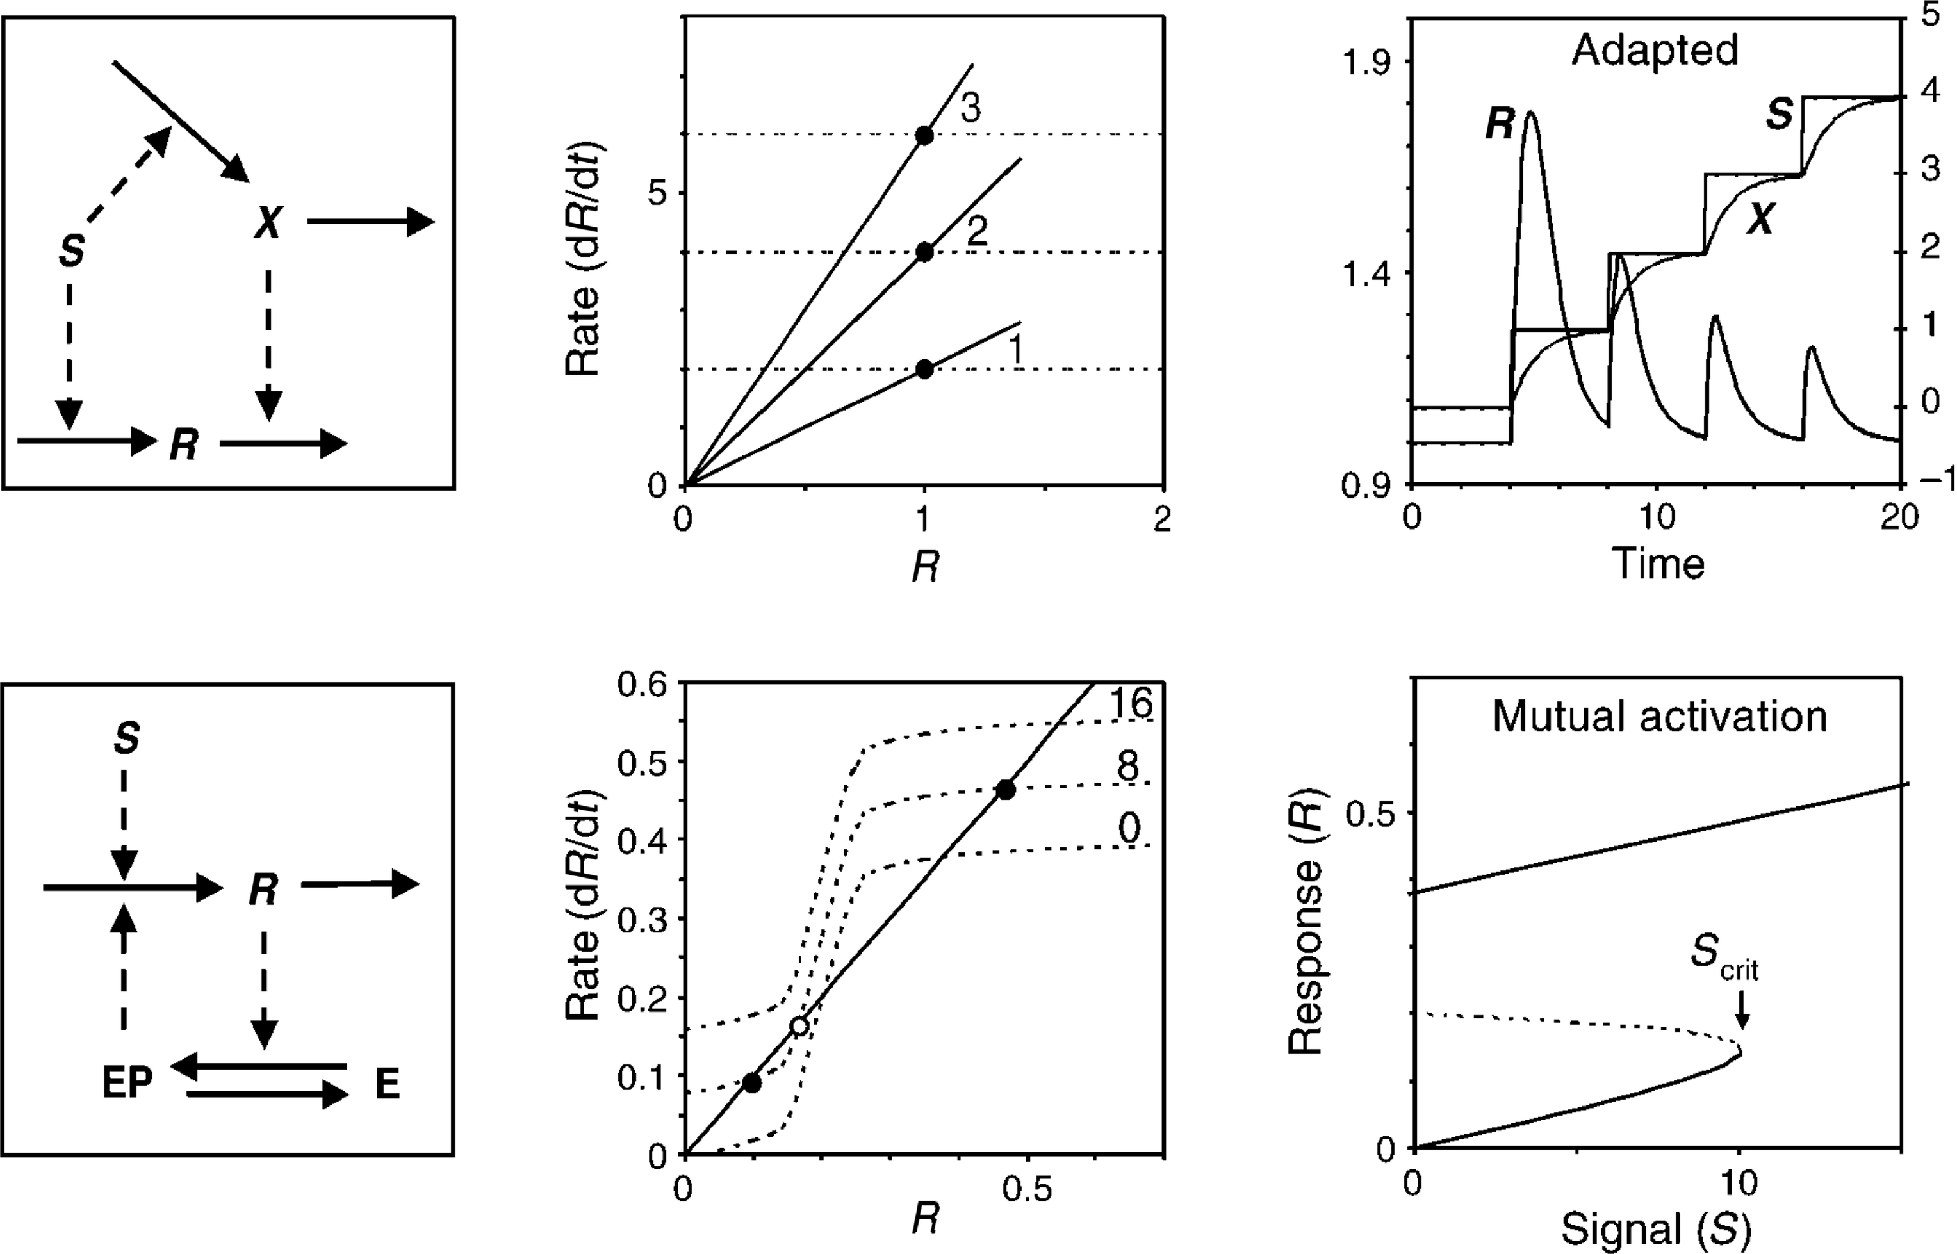
Notes:
FIGURE 4.9 In the networks (left column), solid edges represent mass flow, such as synthesis or degradation of a protein, and dashed
edges represent regulation of synthesis or of degradation. The source node of the networks represents the signal, and one node is designated
as the response. The top row represents an example of feed-forward loop-based excitation-adaptation behavior, with S denoting the
strength of the signal and X and R denoting the concentrations of two proteins. In the bottom network, the cycle between the EP and E
nodes represents a phosphorylation-dephosphorylation cycle in which the total protein concentration is constant. This cycle is described
by Michaelis-Menten kinetics, while the rest of the processes are assumed to follow mass action kinetics. The diagrams in the middle
column indicate the absolute value of the rate of the synthesis and degradation of protein R as a function of the concentration of R.
The diagram in the top right indicates the time course of the concentration of protein R when the value of the signal is increasing in
a step-wise manner. The diagram in the bottom right indicates the steady state concentration of protein R as a function of the value of
the signal. Figure reprinted from Ref. [26] with permission from Elsevier.

Slide 10
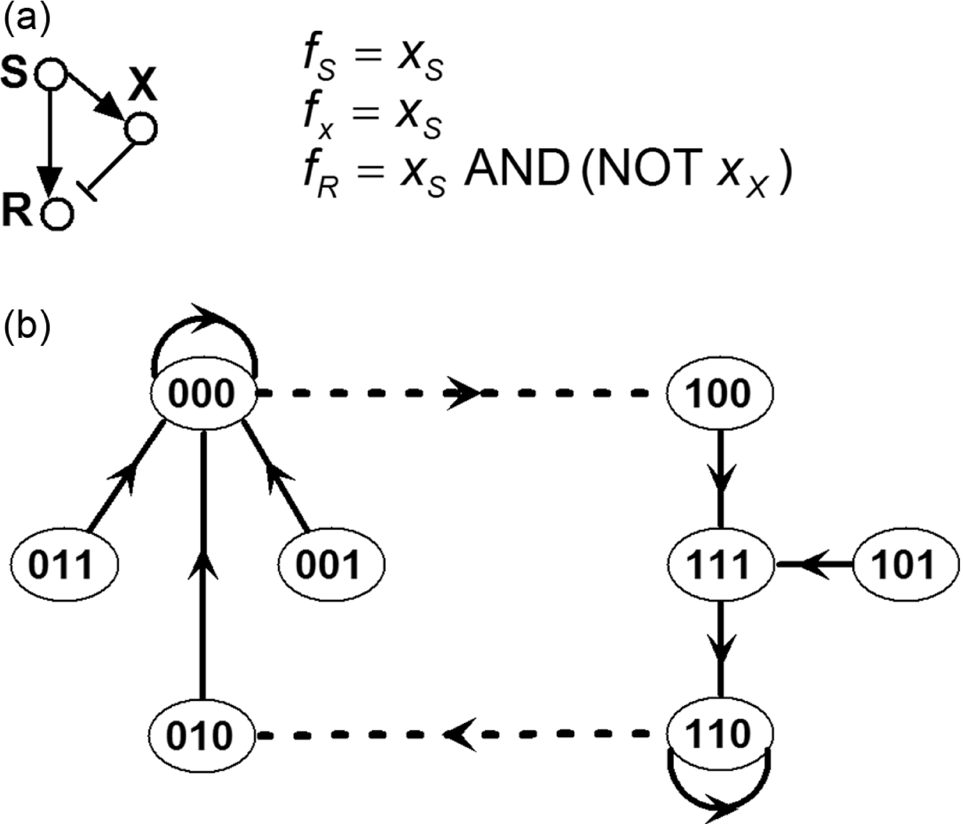
Notes:
FIGURE 4.10 The Boolean correspondent of themodel in the top row of Figure 4.9. (a) The network and Boolean transition functions. (b)
The state transition graph of the model. The node states are shown in the order S, X, R. The transitions shown as dashed lines correspond
to an externally set change in the value of the signal variable xS. The path that starts from the 000 steady state and ends in the 110 steady
state qualitatively reproduces the excitation-adaptation behavior of xR seen in the continuous model.

Slide 11
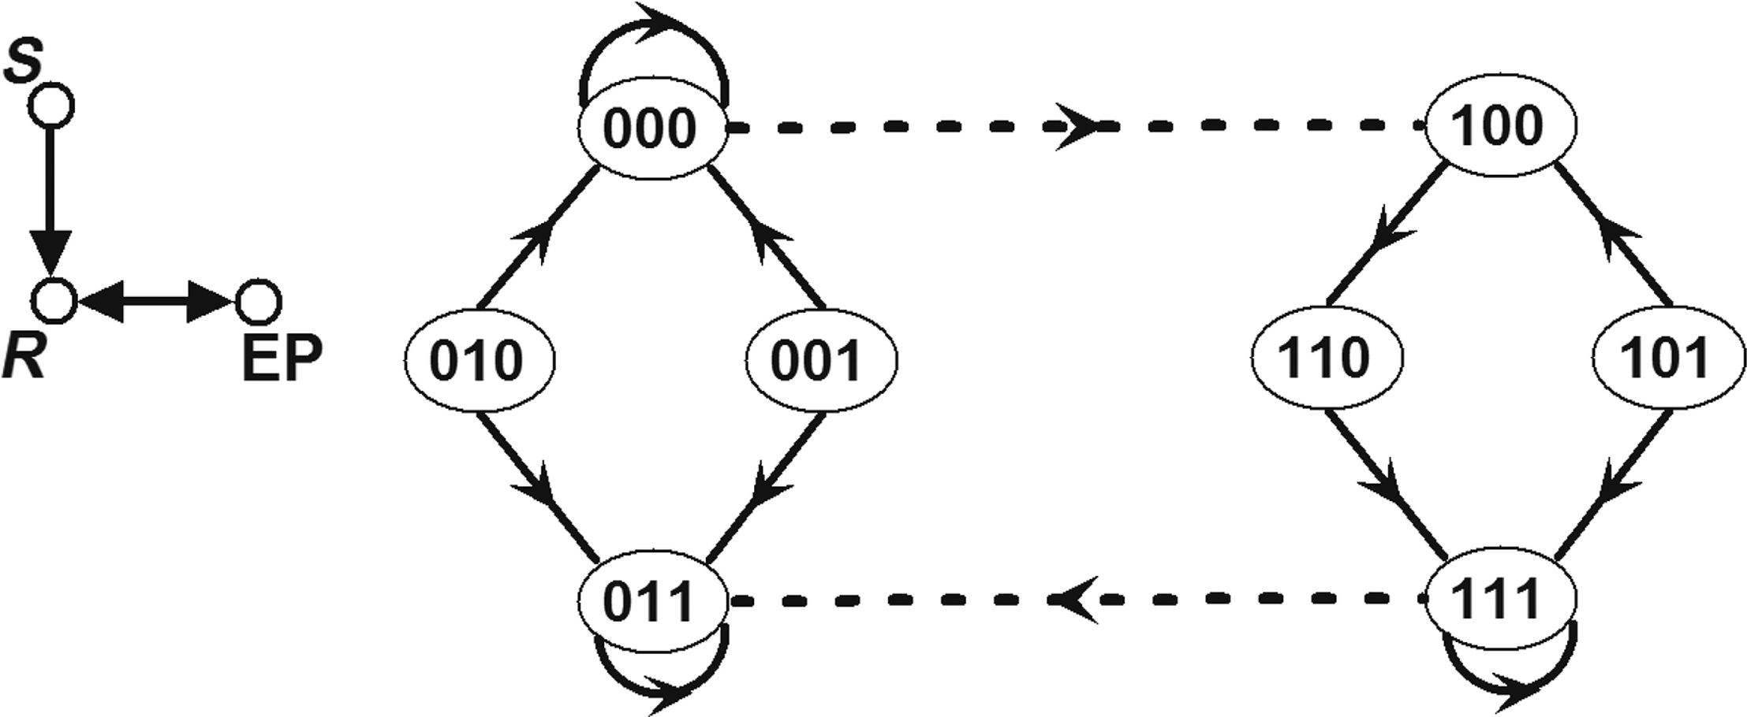
Notes:
FIGURE 4.11 The Boolean correspondent of the model in the bottom row of Figure 4.9. The transitions shown as dashed lines correspond
to an externally set change in the value of the signal variable xS. For simplicity the loops that correspond to single node updates that do
not change the node’s state are not shown in the state transition graph, only loops that correspond to fixed points. The trajectory from
the state 000 through 100, 110, 111, and 011 qualitatively reproduces the hysteresis of the continuous model. The order of variables is
S, R, EP.

Slide 12
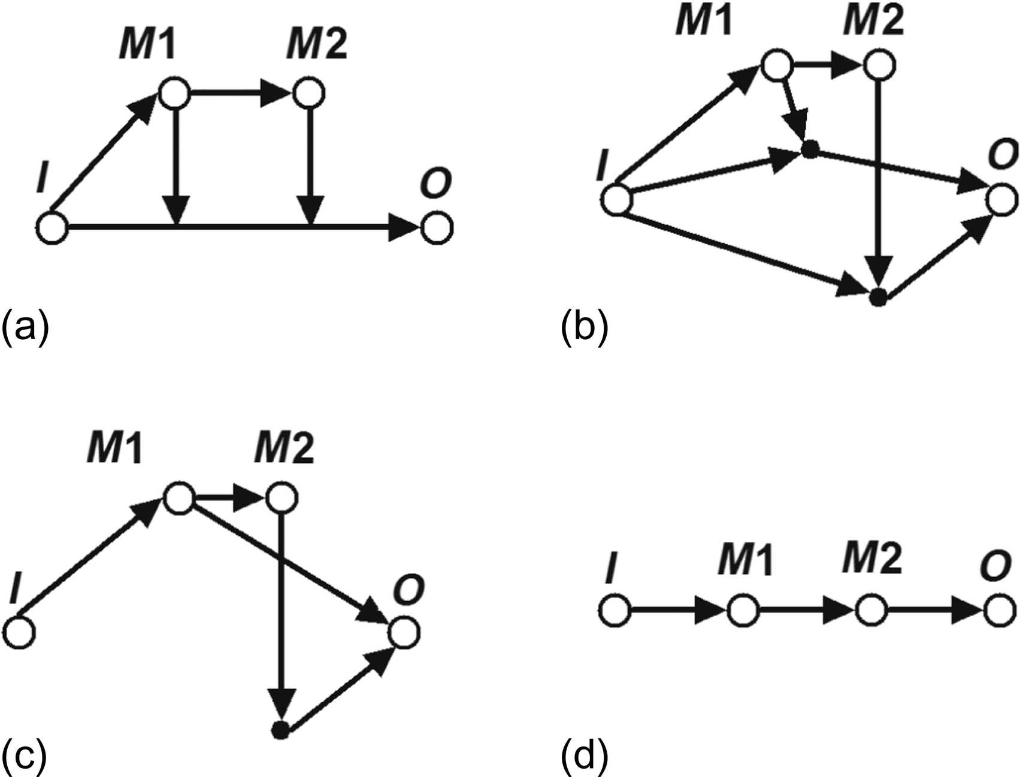
Notes:
FIGURE 4.12 Illustration of the interpretation and simplification of causal information in order to find the most parsimonious signal
transduction network. The interpretation involves the addition of unknown mediators, here shown as black dots. The simplification steps
include transitive reduction and the collapsing of unknown mediator nodes.

Slide 13
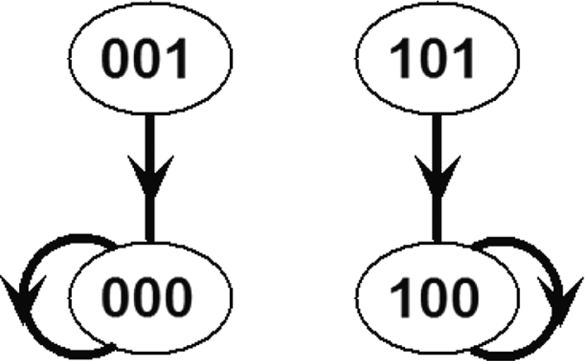
Notes:
FIGURE 4.13 State transition graph for Example 4.1 (the network in Figure 4.4) when node B is knocked out. Because nodes A and B
are not updated (A is a sustained signal and B is knocked out), synchronous and general asynchronous update are equivalent in this case.

Slide 14
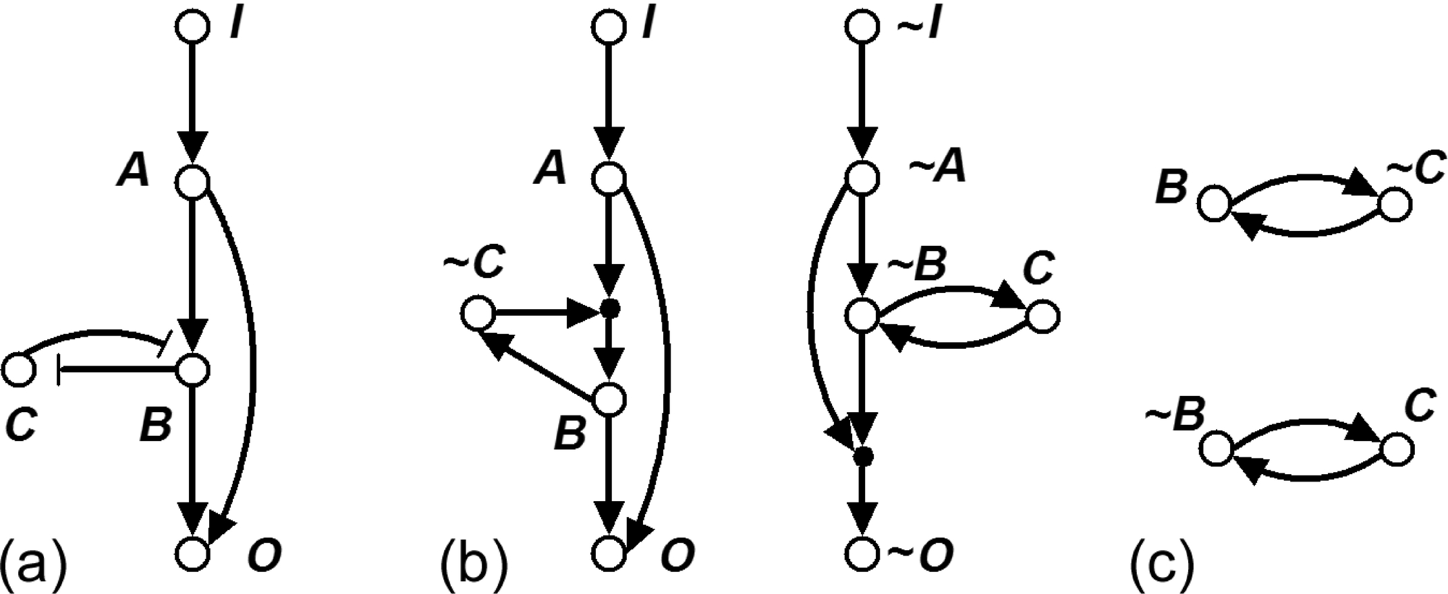
Notes:
FIGURE 4.14 Illustration of methods that integrate the structure and logic of regulatory interactions. (a) A hypothetical signal
transduction network. (b) The expanded representation of the network which integrates the Boolean transition functions fB = xA AND
NOT xC, and fO = xA OR xB. The expanded network includes five complementary nodes, indicated by preceding the node name by ∼,
and two composite nodes, indicated by small black filled circles. (c) The stable motifs of the expanded network in the case of a sustained
input signal (xI = 1). The first stable motif corresponds to the state 11101 (in the order I, A, B, C, O), while the second stable motif
corresponds to the state 11011.

Slide 15
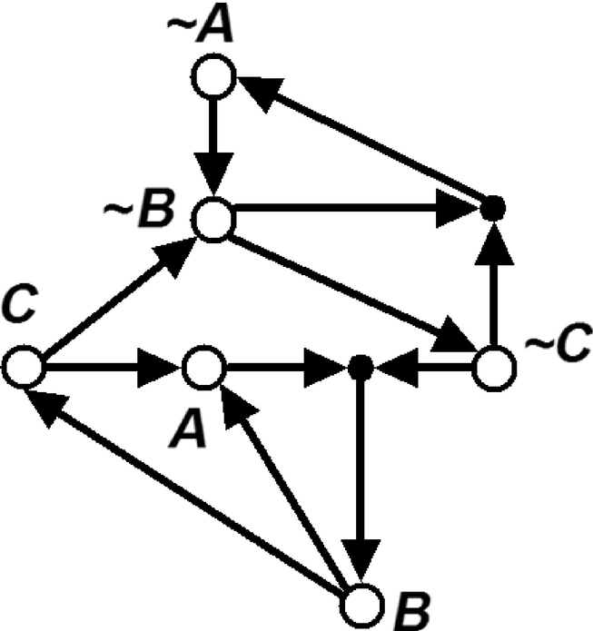
Notes:
FIGURE 4.15 An expanded network for Exercise 4.29.

Slide 16
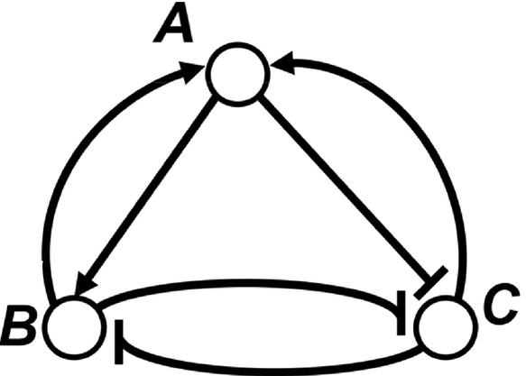
Notes:
FIGURE 4.16 A simple three-node network for Exercise 4.34.

